Slide 1
TOGAF 9 Fundamental: 5. UML Overview
Romi Satria Wahono romi@romisatriawahono.net http://romisatriawahono.net/tfu WA/SMS: +6281586220090

Slide 2
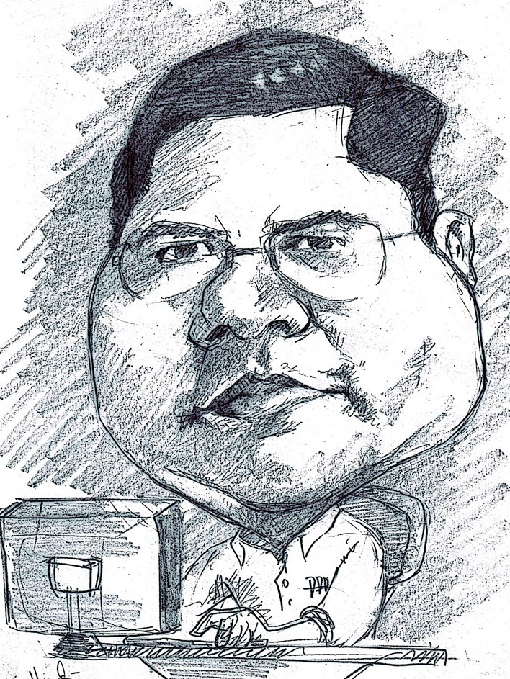
Romi Satria Wahono
SD Sompok Semarang (1987)
SMPN 8 Semarang (1990)
SMA Taruna Nusantara Magelang (1993)
B.Eng, M.Eng and Ph.D in Software Engineering from Saitama University Japan (1994-2004) Universiti Teknikal Malaysia Melaka (2014)
Research Interests: Software Engineering, Machine Learning
Founder IlmuKomputer.Com
PNS di PDII LIPI (1994-2007)
Founder dan CEO PT Brainmatics Cipta Informatika

Slide 3
Course Outline
Introduction
TOGAF Concepts
TOGAF ADM
BPMN Overview
UML Overview
TOGAF Case Study

Slide 4
5. UML Overview
5.1 The Nature of Software Development
5.2 Identifying Business Value (System Request)
5.3 Feasibility Analysis
5.4 Systems Analysis and Design with UML
5.5 Estimating Project Size with Use Case Points

Slide 5
5.1 The Nature of Software Development

Slide 6
Systems Development Projects Fail
More than half of all systems development projects Fail (42% - Standish Group, 53% - General Accounting Office)
Canceled before completion
System is never used once finished
Doesn't provide the expected benefits
Most of the ones that don't fail:
Are delivered late
Are over budget
Don't provide the features promised

Slide 7
Recent Significant IT Failures
Company | Year | Outcome
Hudson Bay (Canada) | 2005 | Inventory system problems lead to $33.3 million loss
UK Inland Revenue | 2004/5 | $3.45 billion tax-credit overpayment caused by software errors
Avis Europe PLC (UK) | 2004 | Enterprise resource planning (ERP) system cancelled after $54.5 million spent
Ford Motor Co. | 2004 | Purchasing system abandoned after deployment costing approximately $400 M
Hewlett-Packard Co. | 2004 | ERP system problems contribute to $160 million loss
AT&T Wireless | 2004 | Customer relations management (CRM) system upgrade problems lead to $100M loss

Slide 8
Keunikan dari Software
Karakteristik | Software | Hardware
Kompleksitas | Tingkat kompleksitas dari produk software tinggi, dengan kemungkinan perubahan parameter dan fungsi yang sangat beragam | Tingkat kompleksitas produk lain rendah, dengan kemungkinan perubahan parameter dan fungsi tidak beragam
Visibilitas Produk | Produk tidak terlihat dengan kasat mata, termasuk bila ada cacat (defect) dari produk | Produk terlihat dengan kasat mata, termasuk bila ada cacat (defect) dari produk

Slide 9
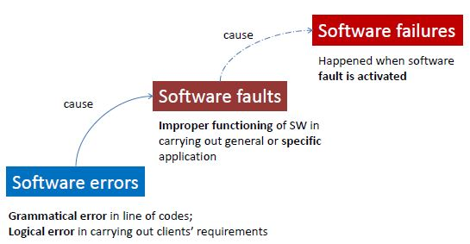
Software Errors, Faults, Failures

Slide 10
Analisis Kasus
Suatu perusahaan PT ABC memproduksi software yang akan ditanam ke dalam suatu device
Salah satu fungsi yang terdapat pada software adalah akan mematikan device secara otomatis apabila suhu ruangan lebih besar daripada 30º celcius
Programmer salah menuliskan logika menjadi:
…
if (suhu > 3) shutdownDevice();
…
Error ini tidak pernah menyebabkan failure pada software, dan perusahaan PT ABC sampai saat ini terkenal sebagai perusahaan yang memproduksi software tanpa bug
Jelaskan mengapa bisa terjadi demikian!

Slide 11
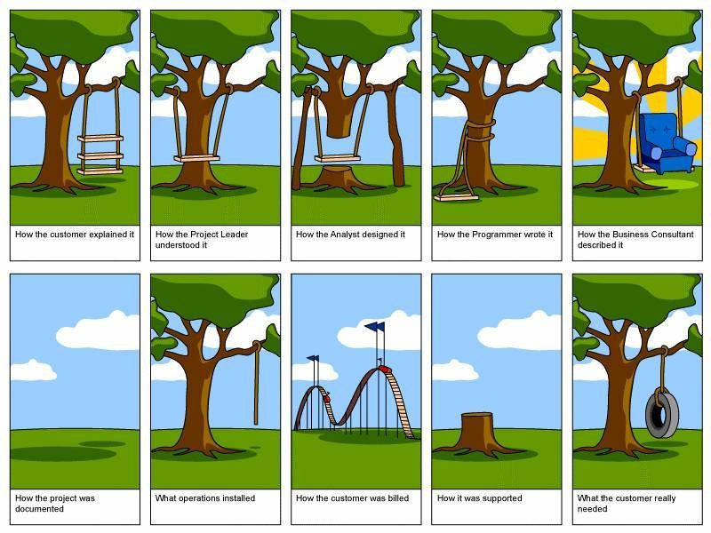

Slide 12
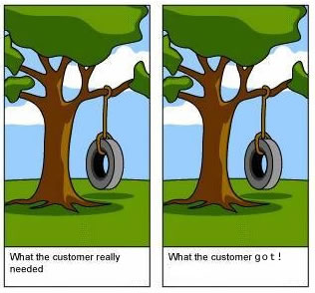
Is it Possible?

Slide 13
5.2 Identifying Business Value (System Request)

Slide 14
When Do Projects Begin?
When someone sees an opportunity to create business value from using information technology
Then he or she creates a system request
Feasibility analysis is used to aid in the decision of whether or not to proceed with the project
Project estimation is important activity which aims to estimating the size of software project

Slide 15
Elements of a System Request
Project Name
The name of project
Project sponsor
Primary point of contact for the project
Business need
Reason prompting the project
Business requirements
Business capabilities the system will need to have
Business value
Benefits the organization can expect from the project
Special issues
Anything else that should be considered
Budget constraints, deadline, Legal requirements

Slide 16
Business Need
Describes why the system should be built
Why the project should be funded
Should be clear and concise
Probably not completely defined

Slide 17
Business Requirements
What the system will do
High level explanation to the approval committee
Tell about the features and capabilities
Can be replaced by Use Case Diagram

Slide 18
Business Value
Tangible value
A quantifiable value
E.g.: 2 % reduction in operating cost
Intangible value
Intuitive believe why the system will help the company
E.g.: improved customer service, a better competitive position

Slide 19
Sofware Quality
Software quality is (IEEE, 1991):
The degree to which a system, component, or process meets specified requirements
The degree to which a system, component, or process meets customer or user needs or expectations
Software quality measures how well software is designed (quality of design), and how well the software conforms to that design (quality of conformance) (Pressman, 2014)
Quality means conformance to requirements (Crosby, 1979)

Slide 20
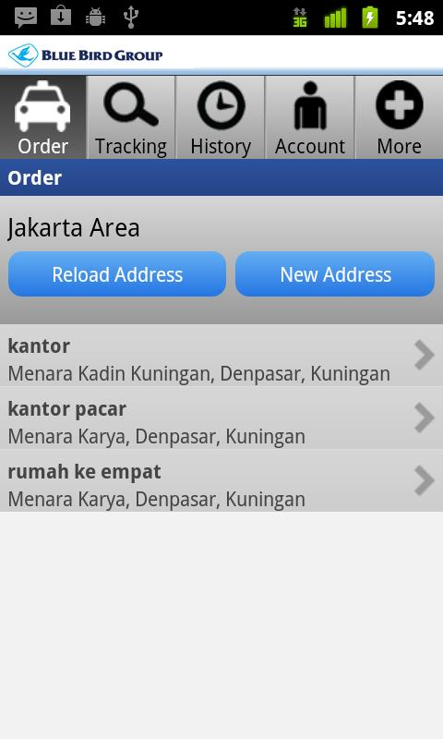
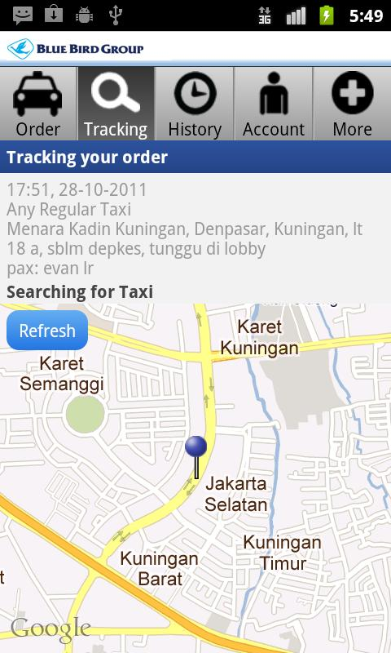
Software untuk Pesan Taxi

Slide 21
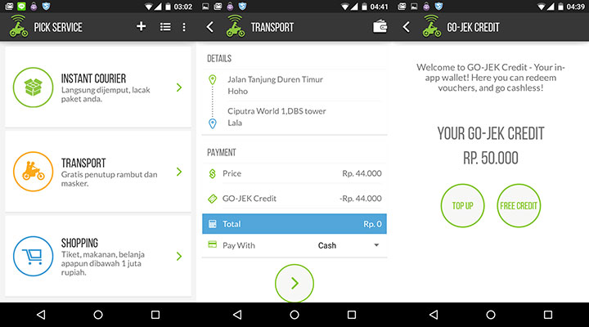
Software untuk Pesan Ojek (Go-Jek)

Slide 22

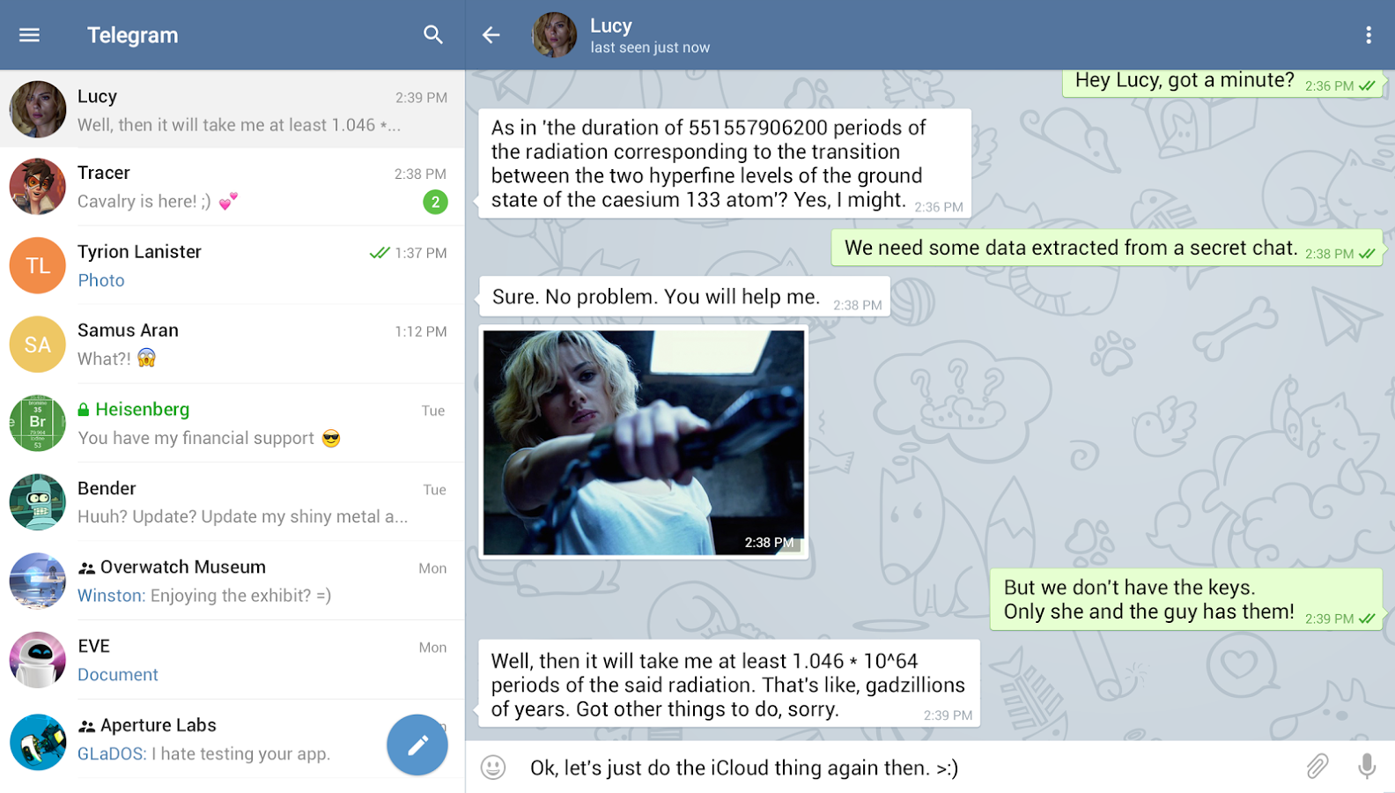

Slide 23
System Request
Elemen | Deskripsi | Contoh
Business Need | The business-related reason for initiating the software development project | Increase sales Improve market share Improve access to information Improve customer service Decrease product defects Streamline supply acquisition processes
Business Requirements | The business capabilities that software will provide | Provide onIine access to information Capture customer demographic information Include product search capabilities Produce management reports Include online user support
Business Value | The benefits that the software will create for the organization | 3% increase in sales % increase in market share 10% operational cost reduction $200,000 cost savings from decreased supply costs $150,000 savings from removal of existing system

Slide 24
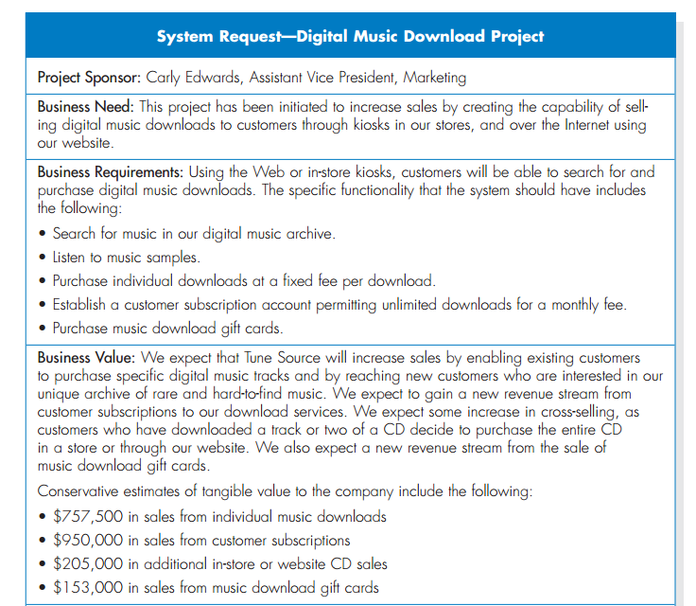

Slide 25
System Request—Internet order project
Project sponsor: | Margaret Mooney, Vice President of Marketing
Business Need: | This project has been initiated to reach new Internet customers and to better serve existing customers using Internet sales support.
Business Requirements:
Using the Web, customers should be able to search for products and identify the brick-and-mortar stores that have them in stock. They should be able to put items on hold at a store location or place an order for items that are not carried or not in stock. The functionality that the system should have is listed below: Search through the CD Selections’ inventory of products Identify the retail stores that have the product in stock Put a product on hold at a retail store and schedule a time to pick up the product Place an order for products not currently in stock or not carried by CD Selections Receive confirmation that an order can be placed and when it will be in stock
Business Value:
We expect that CD Selections will increase sales by reducing lost sales due to out-of-stock or nonstocked items and by reaching out to new customers through its Internet presence. We expect the improved services will reduce customer complaints, primarily because 50 percent of all customer complaints stem from out of stocks or nonstocked items. Also, CD Selections should benefit from improved customer satisfaction and increased brand recognition due to its Internet presence. Conservative estimates of tangible value to the company includes: $750,000 in sales from new customers $1,875,000 in sales from existing customers $50,000 yearly reduction in customer service calls
Special Issues or Constraints:
The Marketing Department views this as a strategic system. This Internet system will add value to our current business model, and it also will serve as a proof of concept for future Internet endeavors. For example, in the future, CD Selections may want to sell products directly over the Internet.
The system should be in place for the holiday shopping season next year.

Slide 26
Exercise: Membuat System Request
Lihat contoh System Request untuk Internet Order Project
Pikirkan suatu sistem* yang saat ini dibutuhkan oleh perusahaan atau organisasi anda
Buat System Request dari sistem tersebut

Slide 27
5.3 Feasibility Analysis

Slide 28
Feasibility Analysis
Technical feasibility: Can we build it?
Economic feasibility: Should we build it?
Organizational feasibility: If we build it, will they come?

Slide 29
Feasibility Analysis
1 | Technical Feasibility | Familiarity with application: Less familiarity generates more risk Familiarity with technology: Less familiarity generates more risk Project size: Large projects have more risk Compatibility: The harder it is to integrate the system with the company’s existing technology, the higher the risk will be
2 | Economic Feasibility | Return on Investment (ROI) Break Even Point (BEP) Intangible Benefit
3 | Organizational Feasibility | Is the software project strategically aligned with the business?

Slide 30
Technical Feasibility
Familiarity with application | Knowledge of business domain Need to understand improvements Need to recognize pitfalls and bad ideas
Familiarity with technology | Is technology new to this organization? Is this a brand new technology? Extension of existing firm technologies
Project size | Number of people, time, and features
Compatibility | Systems are not built in a vacuum Needs to integrate with current systems and data

Slide 31
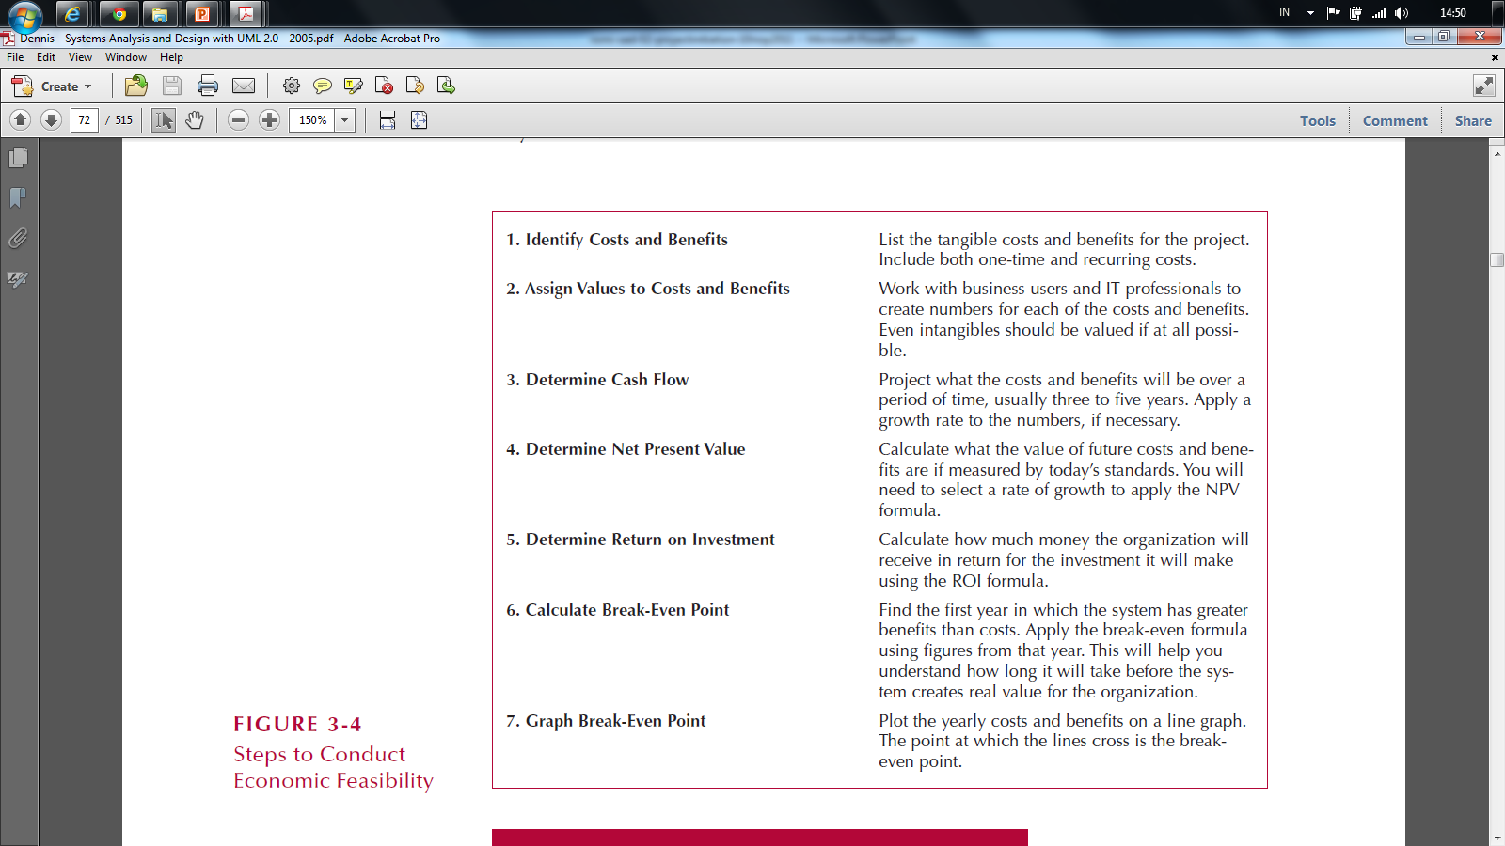
Economic Feasibility: Should We Build It?

Slide 32
Cost-Benefit Analysis - Cash Flow
Project costs and benefits over several years (3–5)
Use normal growth rates for sales etc.
Total added to determine
Overall Benefits = Total Benefits – Total Costs
Higher number is better

Slide 33
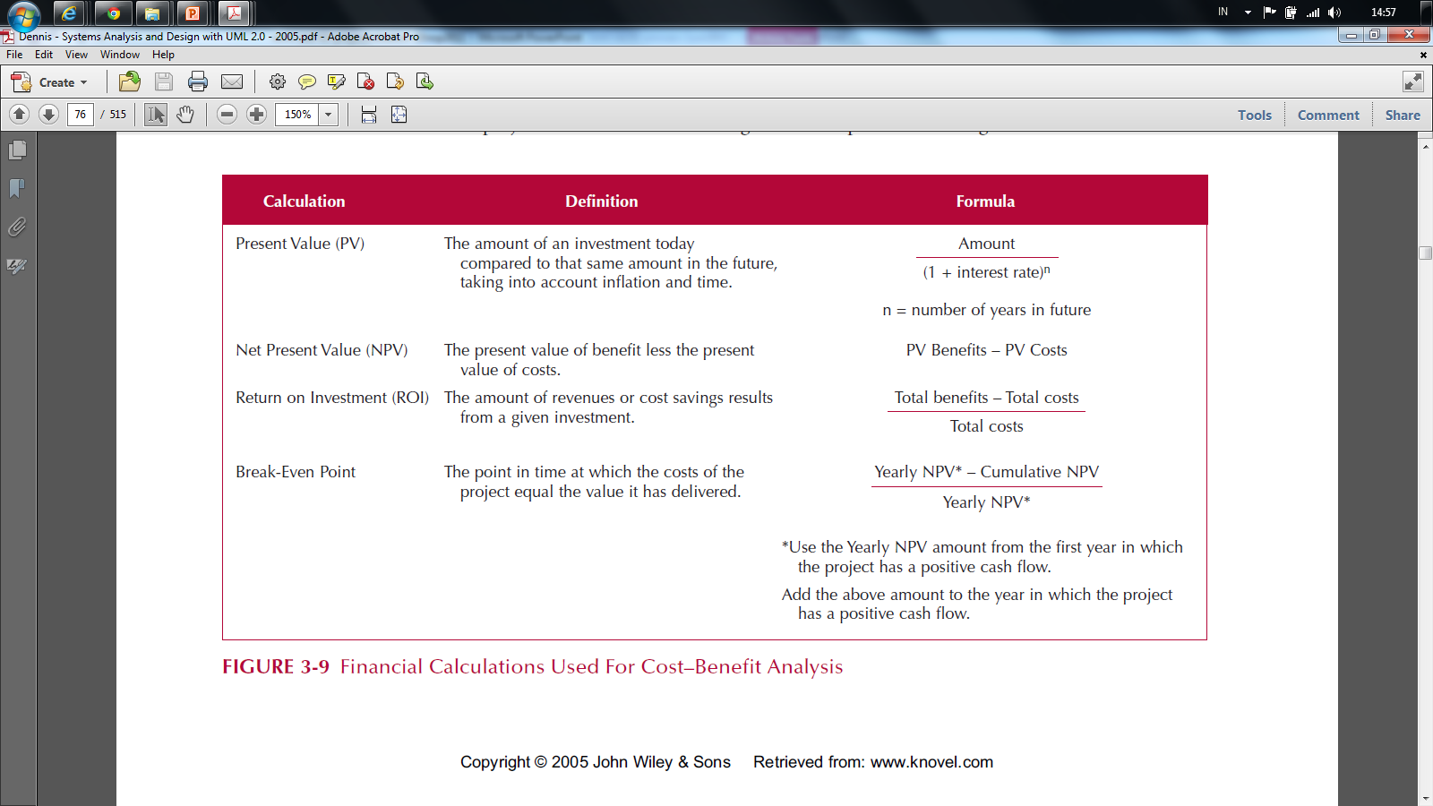
Cost-Benefit Analysis - Cash Flow

Slide 34
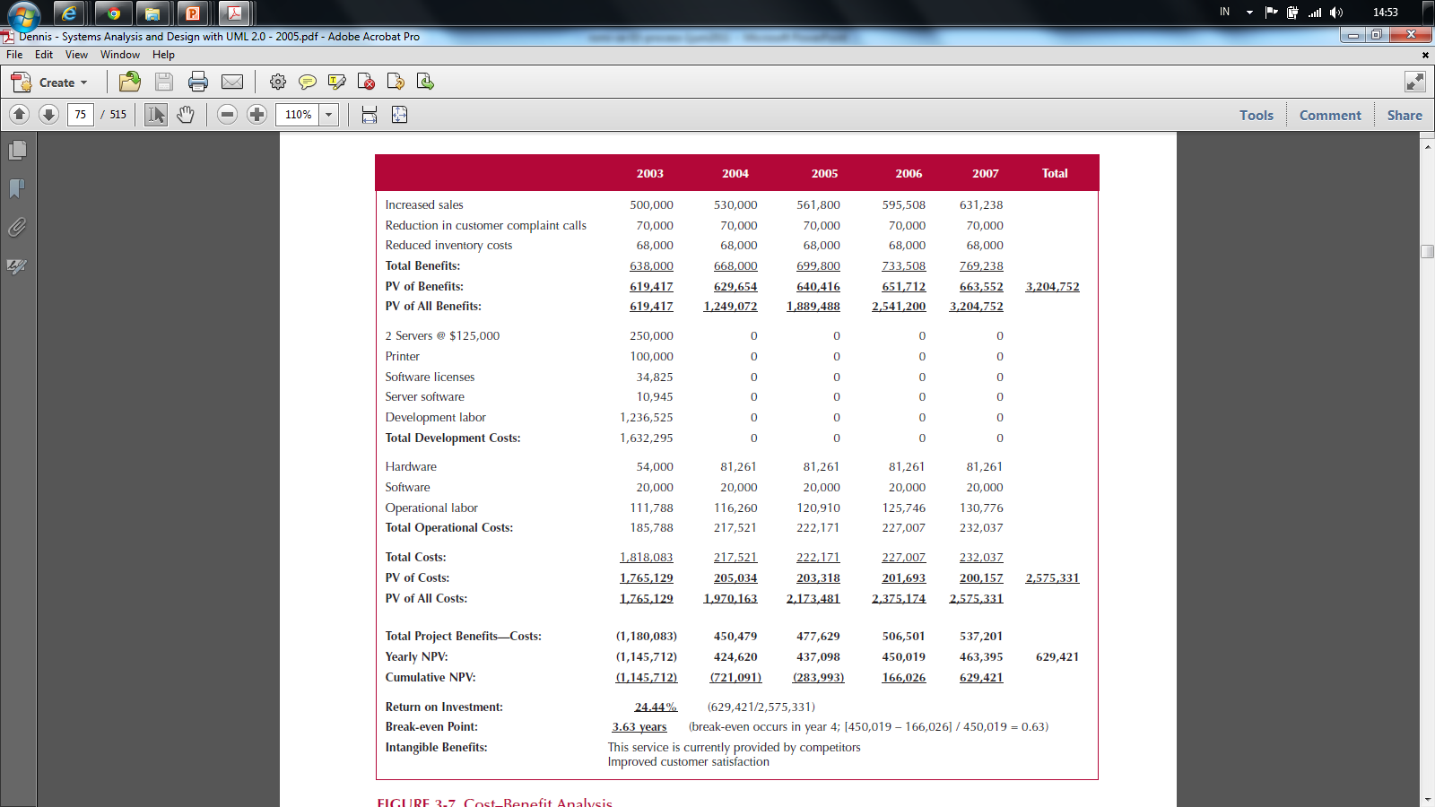
Cash Flow Plan

Slide 35
Present Value (PV)
The amount of an investment today compared to the same amount n years in the future
Taking into account inflation and time
PV =
Amount
(1 + Interest Rate)^{n}

Slide 36
Net Present Value

Slide 37
Net Present Value (NPV)
The present value of benefit less the present value of cost
NPV = PV Benefits – PV Costs

Slide 38
NPV Calculation

Slide 39
Return on Investment (ROI)
The Amount of revenue or cost savings results from a given investment
ROI =
Total Benefits – Total Costs
Total Costs

Slide 40
ROI Calculation

Slide 41
Break Even Point (BEP)
The point in time when the costs of the project equal the value it has delivered
BEP =
* Use the yearly NPV amount from the first year in which project has positive cash flow
Yearly NPV* – Cumulative NPV
Yearly* NPV

Slide 42
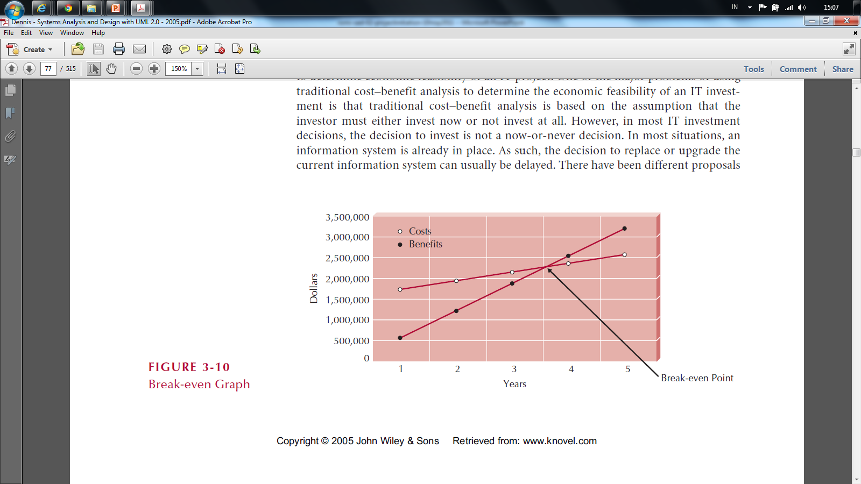
Break Even Point (BEP)

Slide 43
Organizational Feasibility
Strategic Alignment
How well does the project match up with the business strategy?
Stakeholder analysis considers
Project champion (Product Owner)
Organizational management
System users
Anybody affected by the change

Slide 44
Stakeholder Analysis Considers
Project champion(s)
High-level non-IS executive
Shepherds project to completion
It's good to have more than one
Organizational management
Need this support to sell system to organization
System users
In the loop so end system meets needs

Slide 45
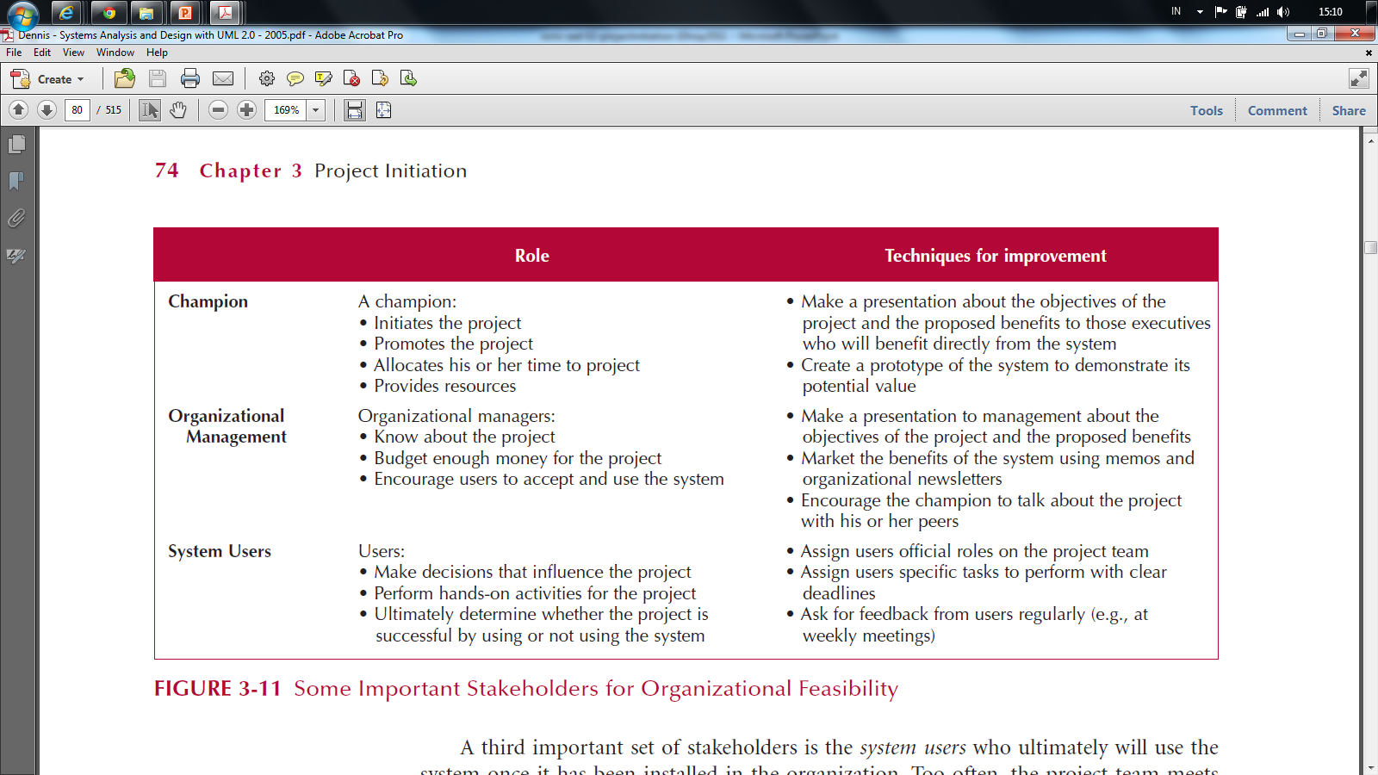
Stakeholder Analysis Considers

Slide 46
Feasibility Analysis Template
Technical Feasibility: Can We Build It?
Familiarity with Application: Less familiarity generates more risk Familiarity with Technology: Less familiarity generates more risk Project Size: Large projects have more risk Compatibility: The harder it is to integrate the system with the company’s existing technology, the higher the risk
Economic Feasibility: Should We Build It?
Return on Investment (ROI) over 3 years Break-even Point (BEP) Total benefit after 3 years
Organizational Feasibility: If We Build It, Will They Come?
Project champion(s) Senior management Users Other stakeholders Is the project strategically aligned with the business?

Slide 47
CD Selection Internet Order Feasibility Analysis Executive Summary
Margaret Mooney and Alec Adams created the following feasibility analysis for the CD Selections Internet Order System Project. The System Proposal is attached, along with the detailed feasibility study
Technical Feasibility The Internet Order System is feasible technically, although there is some risk. CD Selections’ risk regarding familiarity with the application is high The Marketing Department has little experience with Internet-based marketing and sales The IT Department has strong knowledge of the company’s existing order systems; however, it has not worked with Web-enabled order systems CD Selections’ risk regarding familiarity with the technology is medium The IT Department has relied on external consultants and an Information Service Provider to develop its existing Web environment The IT Department has learned about Web technology by maintaining the corporate site Development tools and products for commercial Web application development are available in the marketplace, although the IT department has little experience with them The project size is considered medium risk The project team likely will include less than ten people Business user involvement will be required The project timeframe cannot exceed a year because of the Christmas holiday season implementation deadline, and it should be much shorter The compatibility with CD Selections’ existing technical infrastructure should be good The current Order System is a client-server system built using open standards. An interface with the Web should be possible Retail stores already place and maintain orders electronically An Internet infrastructure already is in place at retail stores and at the corporate headquarters

Slide 48
Economic Feasibility
A cost–benefit analysis was performed; see attached spreadsheet for details. A conservative approach shows that the Internet Order System has a good chance of adding to the bottom line of the company significantly. Return on Investment (ROI) over 3 years: 229 percent Break-even point (BEP): after 1.7 years Total benefit after three years: $3.5 million (adjusted for present value) Intangible Costs and Benefits Improved customer satisfaction Greater brand recognition
Organizational Feasibility
From an organizational perspective, this project has low risk. The objective of the system, which is to increase sales, is aligned well with the senior management’s goal of increasing sales for the company. The move to the Internet also aligns with Marketing’s goal to become more savvy in Internet marketing and sales. The project has a project champion, Margaret Mooney, Vice President of Marketing. Margaret is well positioned to sponsor this project and to educate the rest of the senior management team when necessary. To date, much of senior management is aware of and supports the initiative. The users of the system, Internet consumers, are expected to appreciate the benefits of CD Selections’ Web presence. And, management in the retail stores should be willing to accept the system, given the possibility of increased sales at the store level.

Slide 49
 | 2003 | 2004 | 2005 | Total
Increased sales from new customers | 0 | 750,000 | 772,500
Increased sales from existing customers | 0 | 1,875,000 | 1,931,250
Reduction in customer complaint calls | 0 | 50,000 | 50,000
Total Benefits: | 0 | 2,675,000 | 2,753,750
PV of Benefits: | 0 | 2,521,444 | 2,520,071 | 5,041,515
PV of All Benefits: | 0 | 2,521,444 | 5,041,515
Labor: Analysis, Design and Implementation | 162,000 | 0 | 0
Consultant Fees | 50,000 | 0 | 0
Office Space and Equipment | 7,000 | 0 | 0
Software and Hardware | 35,000 | 0 | 0
Total Development Costs: | 254,000 | 0 | 0
Labor: Webmaster | 85,000 | 87,550 | 90,177
Labor: Network Technician | 60,000 | 61,800 | 63,654
Labor: Computer Operations | 50,000 | 51,500 | 53,045
Labor: Business Manager | 60,000 | 61,800 | 63,654
Labor: Assistant Manager | 45,000 | 46,350 | 47,741
Labor: 3 Staff | 90,000 | 92,700 | 95,481
Software upgrades and licenses | 4,000 | 1,000 | 1,000
Hardware upgrades | 5,000 | 3,000 | 3,000
User training | 2,000 | 1,000 | 1,000
Communications charges | 20,000 | 20,000 | 20,000
Marketing expenses | 25,000 | 25,000 | 25,000
Total Operational Costs: | 446,000 | 452,700 | 464,751
Total Costs: | 700,000 | 452,700 | 464,751
PV of Costs: | 679,612 | 426,713 | 425,313 | 1,531,638
PV of all Costs: | 679,612 | 1,106,325 | 1,531,638
Total Project Costs Less Benefits: | (700,000) | 2,222,300 | 2,288,999
Yearly NPV: | (679,612) | 2,094,731 | 2,094,758 | 3,509,878
Cumulative NPV: | (679,612) | 1,415,119 | 3,509,878
Return on Investment (ROI): | 229.16% | (3,509,878/1,531,638)
Break-even Point (BEP): | 1.32 years | (BEP in Year 2 = [2,094,731 – 1,415,119] / 2,094,731 = 0.32)

Slide 50
Exercise: Membuat Feasibility Analysis
Lihat contoh Feasibility Analysis untuk Internet Order Project
Perhatikan kembali System Request yang sebelumnya sudah kita buat
Buat Feasibility Analysis dari system yang akan kita buat tersebut

Slide 51
5.4 Systems Analysis and Design with UML

Slide 52
System Analysis and Design with UML
System Analysis
Business Process Identification
Use Case Diagram
Business Process Modeling
Activity Diagram or Business Process Modeling Notation (BPMN)
Business Process Realization
Sequence Diagram (Buat untuk setiap use case dengan menggunakan pola Boundary-Control-Entity)
System Design
Program Design
Class Diagram (Gabungkan Boundary-Control-Entity Class dan susun story dari sistem yang dibangun)
Package Diagram (Gabungan class yang sesuai, boleh menggunakan pola B-C-E)
Deployment Diagram (arsitektur software dari sistem yang dibangun)
User Interface Design (Buat UI design dari Boundary Class)
Entity-Relationship Model (Buat ER diagram dari Entity Class)

Slide 53
5.4.1 Business Process Identification: Use Case Diagram

Slide 54
Use Case Diagrams
Summarized into a single picture
All of the use cases for the part of the system being modeled
Use case represents the discrete activities performed by the user
Use Case Diagram tells what the system will do
Good for communicating with users

Slide 55
Use Case Diagram Syntax
Actor
person or system that derives benefit from and is external to the subject
Use Case
Represents a major piece of system functionality
Association Relationship
Include Relationship
Extend Relationship
Generalization Relationship
<<includes>>
<<extends>>

Slide 56
Use Case
A major piece of system functionality
Can extend other Use Cases
Placed inside system boundary
Labeled with descriptive verb - noun phrase
Use Case

Slide 57
System Boundary
Boundary
Includes the name of the system inside or on top
Represents the scope of the system
Actors are outside the scope of the system

Slide 58
Actor
A person or another system that interacts with the current system
A role, not a specific user
Provides input, receives output, or both
⟨⟨actor⟩⟩
Actor/Role

Slide 59
Association Relationship
Links actor and the Use Case
Shows two-way communication
If one-way, arrows are used
* is for "multiplicity of the Association"
*
*

Slide 60
Extends Relationship
Extends Use Case to include Optional behavior
Arrow points from the extension Use Case to the base Use Case
⟨⟨extend⟩⟩
Make Payment
Arrangement
⟨⟨extend⟩⟩
Make Appointment

Slide 61
Include Relationship
Include one Use Case from within another
Arrow points from base Use Case to the included Use Case
⟨⟨include⟩⟩
Make New
Patient Appointment
⟨⟨include⟩⟩
Create New Patient

Slide 62
Generalization Relationship
A specialized Use Case to a more generalized Use Case
Arrow points from specialized to general Use Case
Make Old Appointment
Make Appointment

Slide 63
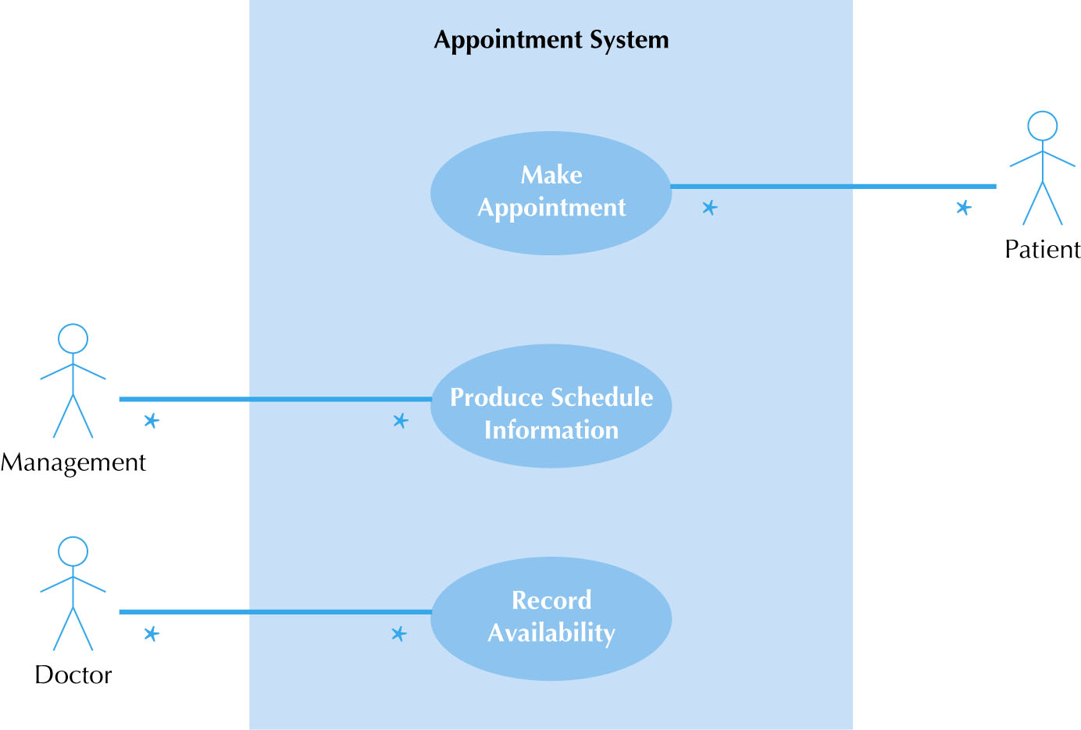
Use Case Diagram for Appointment System

Slide 64
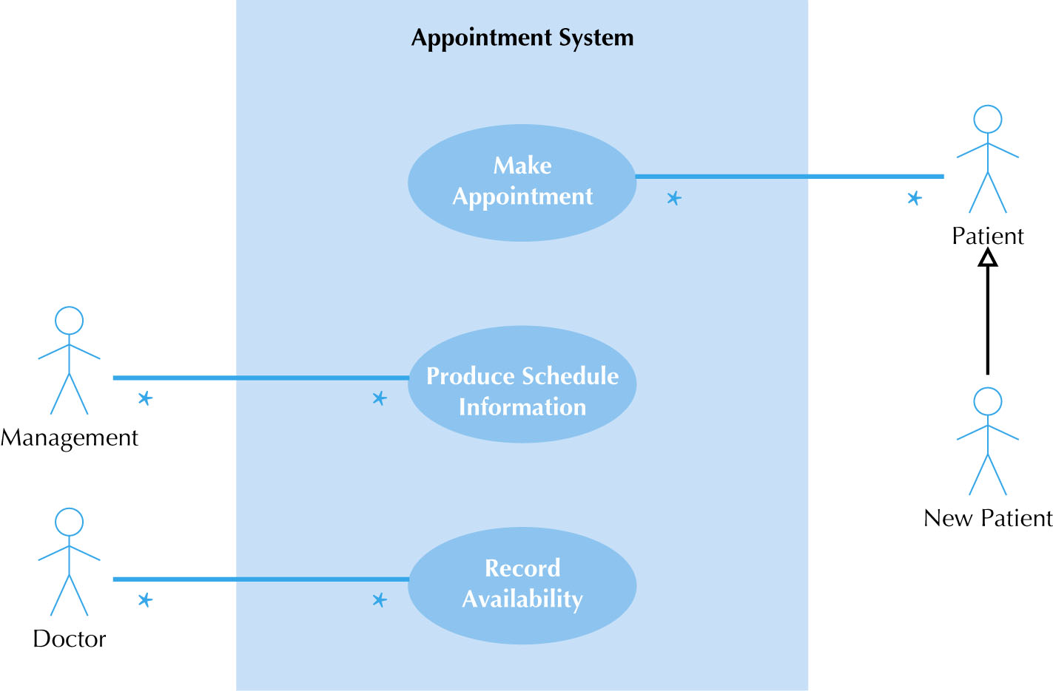
Use Case Diagram with Specialized Actor

Slide 65
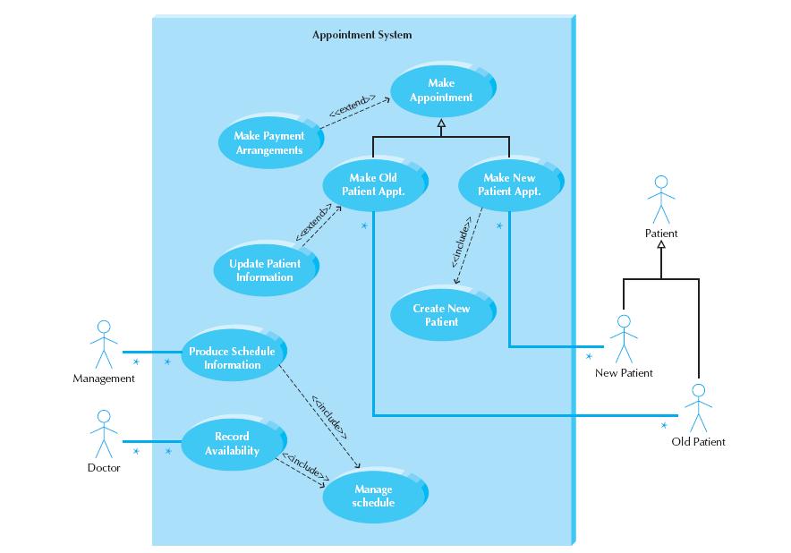
Extend and Include Relationships

Slide 66
Studi Kasus: ATM System

Slide 67
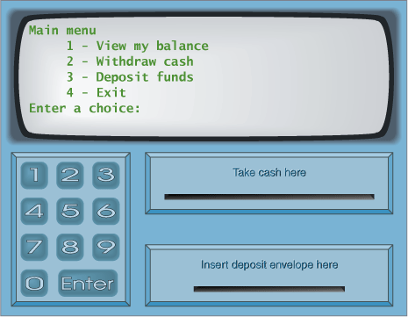
ATM System

Slide 68
ATM System
Layar
Kotak Uang
Kotak Kartu
Kotak Kuitansi

Slide 69
Masukkan PIN:
Kotak Uang
Kotak Kartu
Kotak Kuitansi

Slide 70
Menu Utama
Melihat Saldo
Mentransfer Uang
Mengambil Uang
Logout
Kotak Uang
Kotak Kartu
Kotak Kuitansi

Slide 71
Menu Melihat Saldo
Saldo anda adalah ….
Kotak Uang
Kotak Kartu
Kotak Kuitansi

Slide 72
Menu Mentransfer Uang
No Account Penerima:
Kotak Uang
Kotak Kartu
Kotak Kuitansi

Slide 73
Menu Mentransfer Uang
Jumlah uang yang dikirim:
Kotak Uang
Kotak Kartu
Kotak Kuitansi

Slide 74
Menu Mentransfer Uang
Uang berhasil terkirim
Kotak Uang
Kotak Kartu
Kotak Kuitansi

Slide 75
Menu Mengambil Uang
Jumlah uang yang diambil:
Kotak Uang
Kotak Kartu
Kotak Kuitansi

Slide 76
Menu Mengambil Uang
Uang berhasil diambil
Kotak Uang
Kotak Kartu
Kotak Kuitansi

Slide 77
Use Case Diagram

Slide 78
Use Case Diagram (Alternatif)

Slide 79
5.4.2 Business Process Modeling

Slide 80
System Analysis and Design with UML
System Analysis
Business Process Identification
Use Case Diagram
Business Process Modeling
Activity Diagram or Business Process Modeling Notation (BPMN)
Business Process Realization
Sequence Diagram (Buat untuk setiap use case dengan menggunakan pola Boundary-Control-Entity)
System Design
Program Design
Class Diagram (Gabungkan Boundary-Control-Entity Class dan susun story dari sistem yang dibangun)
Package Diagram (Gabungan class yang sesuai, boleh menggunakan pola B-C-E)
Deployment Diagram (arsitektur software dari sistem yang dibangun)
User Interface Design (Buat UI design dari Boundary Class)
Entity-Relationship Model (Buat ER diagram dari Entity Class)

Slide 81
Business Process Modeling: Activity Diagram

Slide 82
BPM With Activity Diagrams
A number of activities support a business process across several departments
Activity diagrams model the behavior in a business process

Slide 83
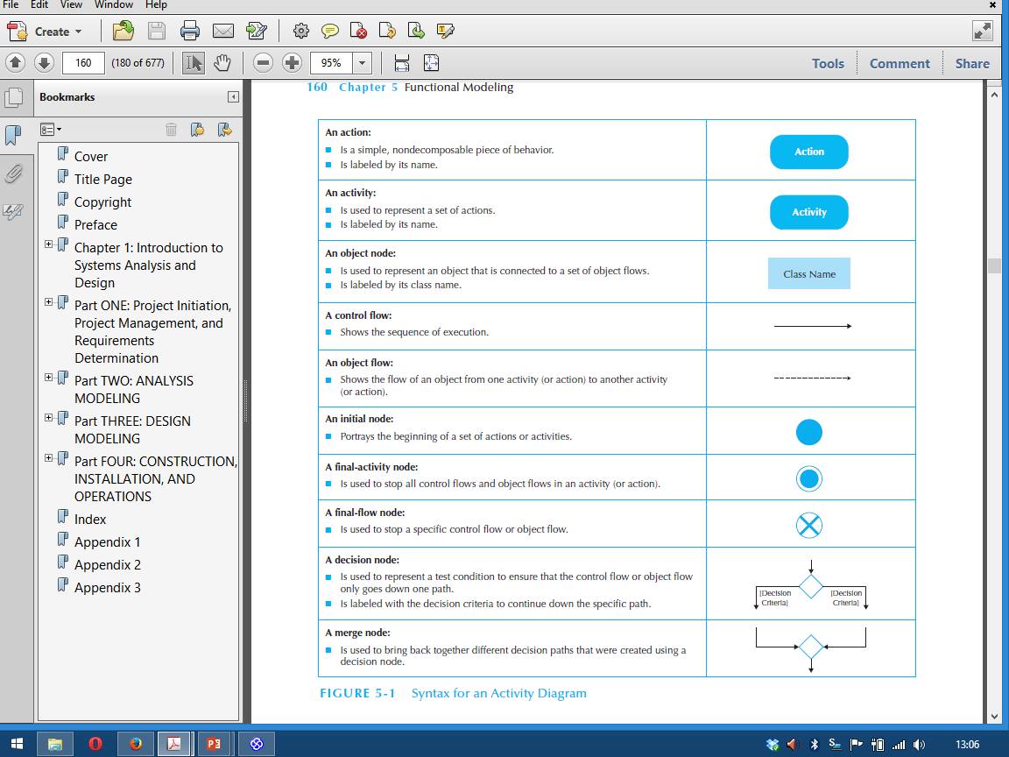
Syntax for an Activity Diagram

Slide 84
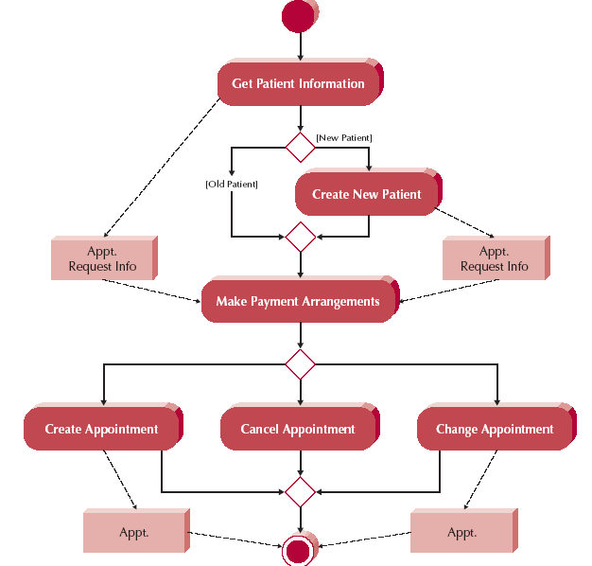
Activity Diagram Example

Slide 85
Creating Activity Diagrams
Set the context or scope of the activity being modeled
Identify the activities and control/object flows between activities
Identify any decisions made
Look for opportunities for parallelism
Draw the diagram

Slide 86
Business Process Modeling: BPMN

Slide 87
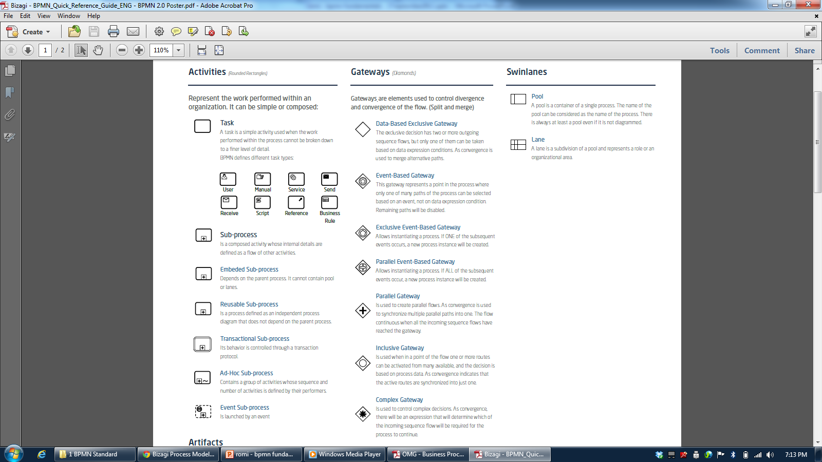
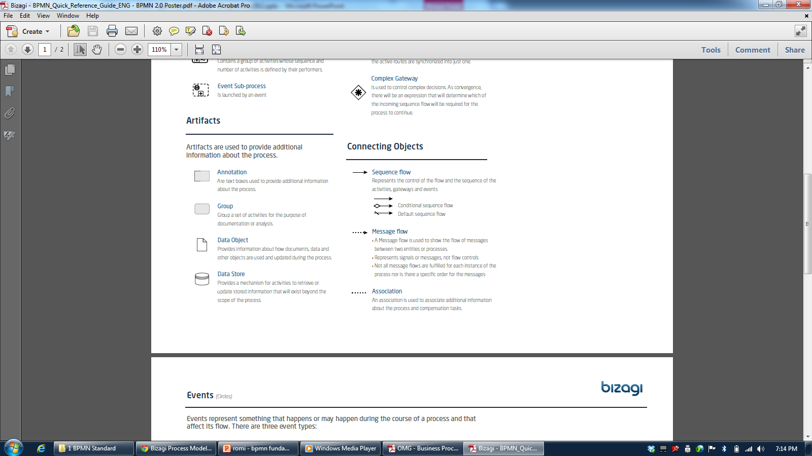

Slide 88
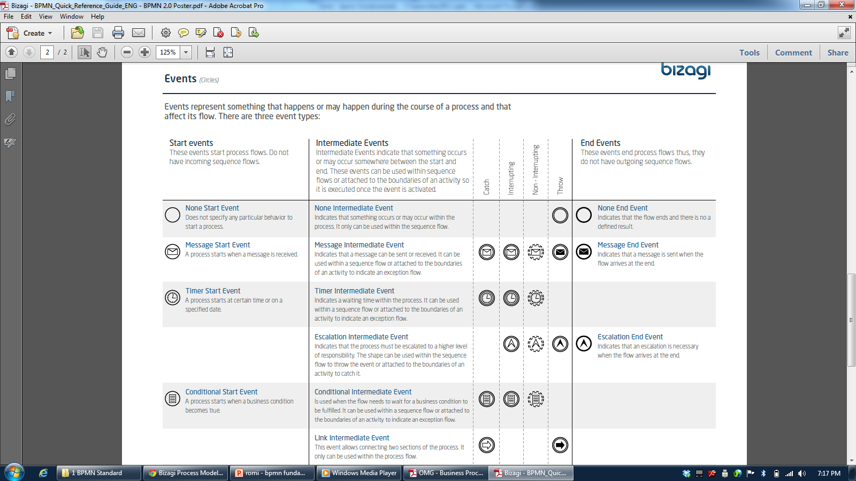

Slide 89
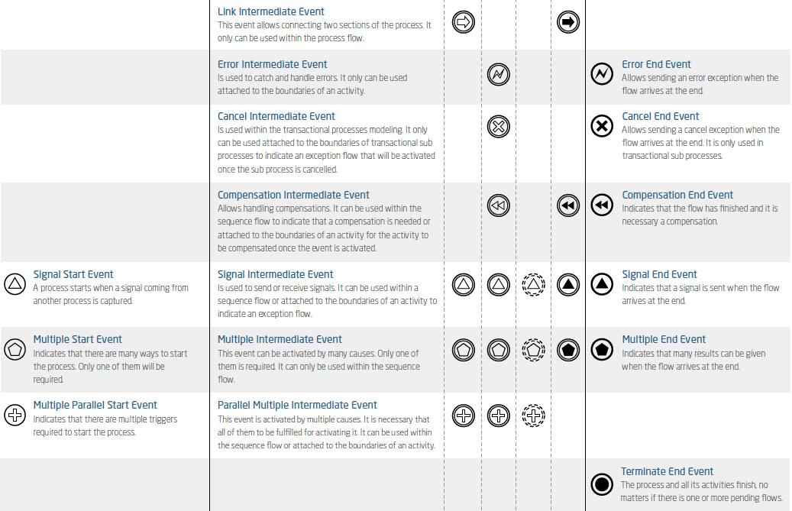

Slide 90
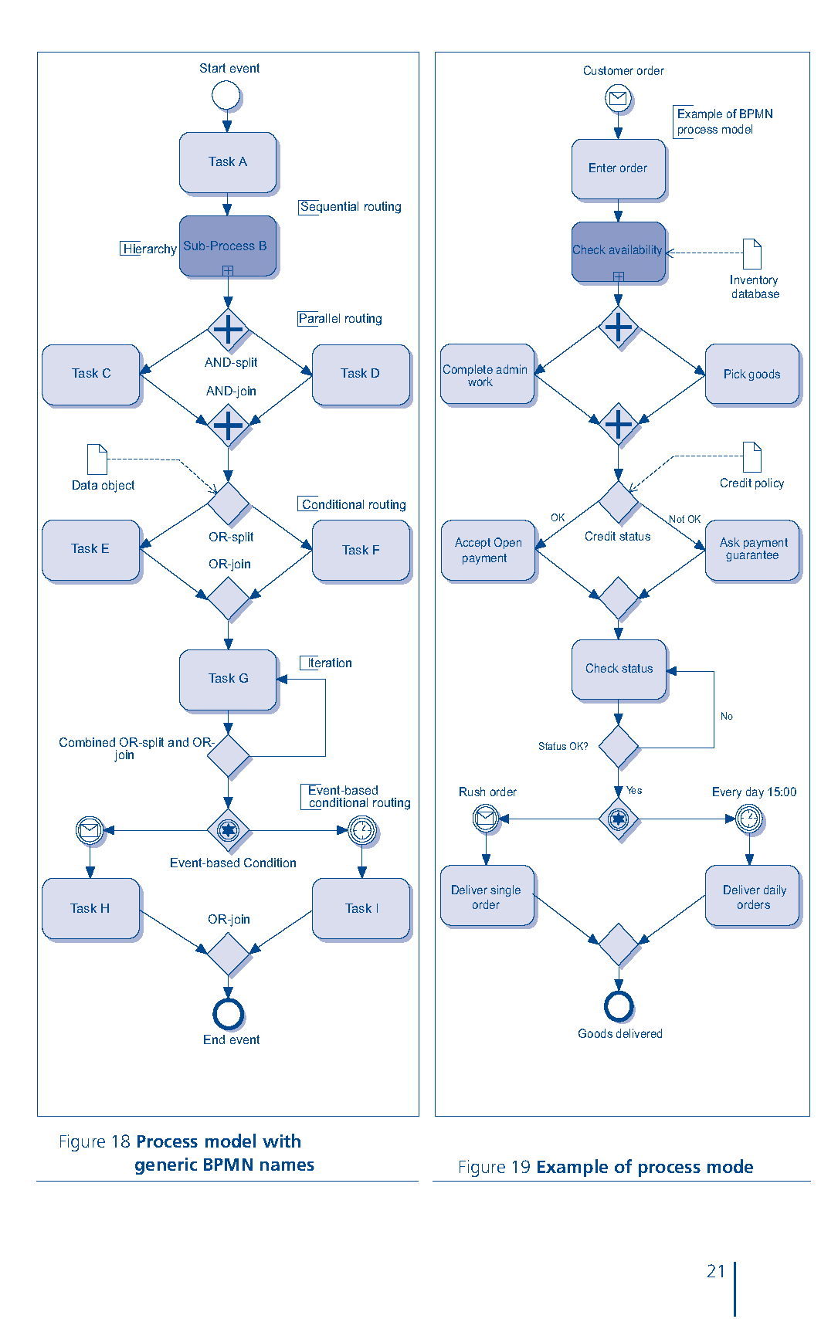

Slide 91
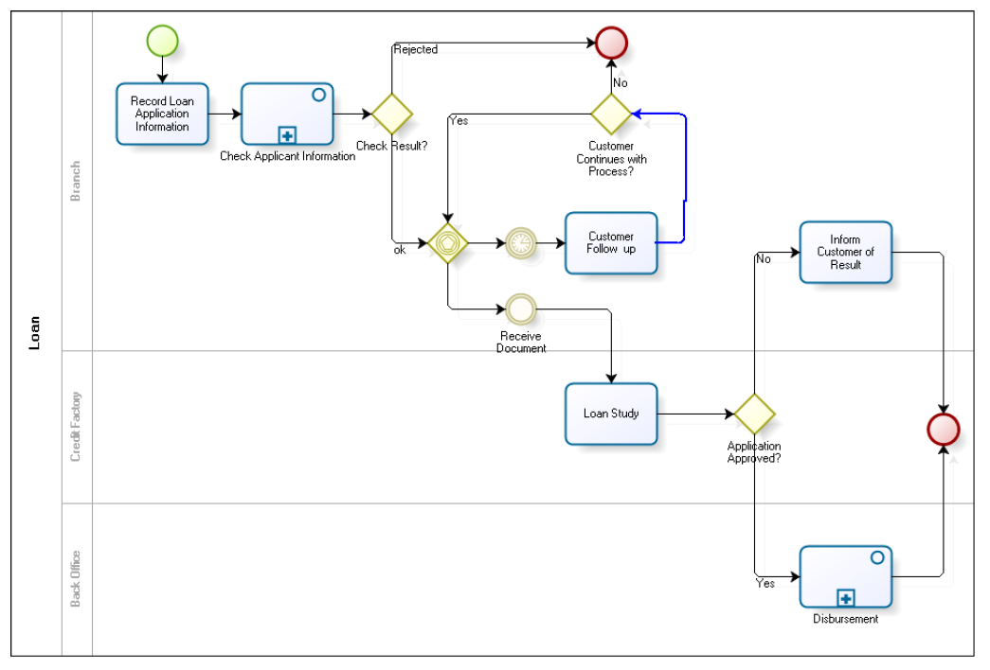
Credit Application

Slide 92
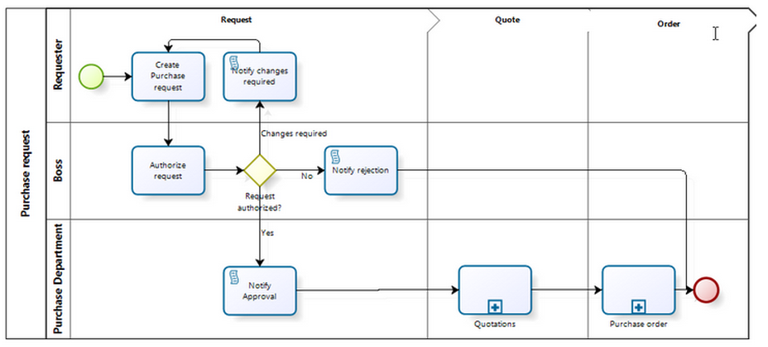
Purchase Request

Slide 93
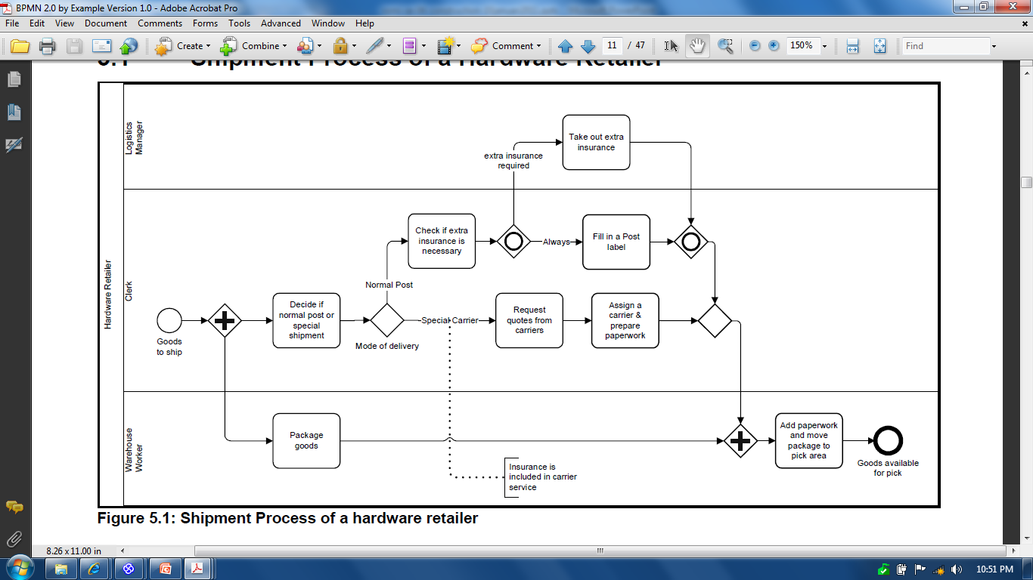
Shipment Process of a Hardware Retailer

Slide 94
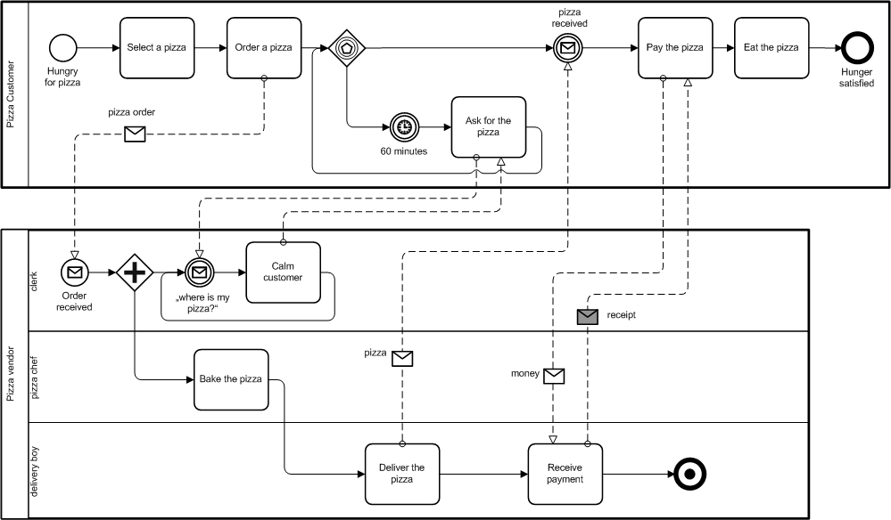
The Pizza Collaboration

Slide 95
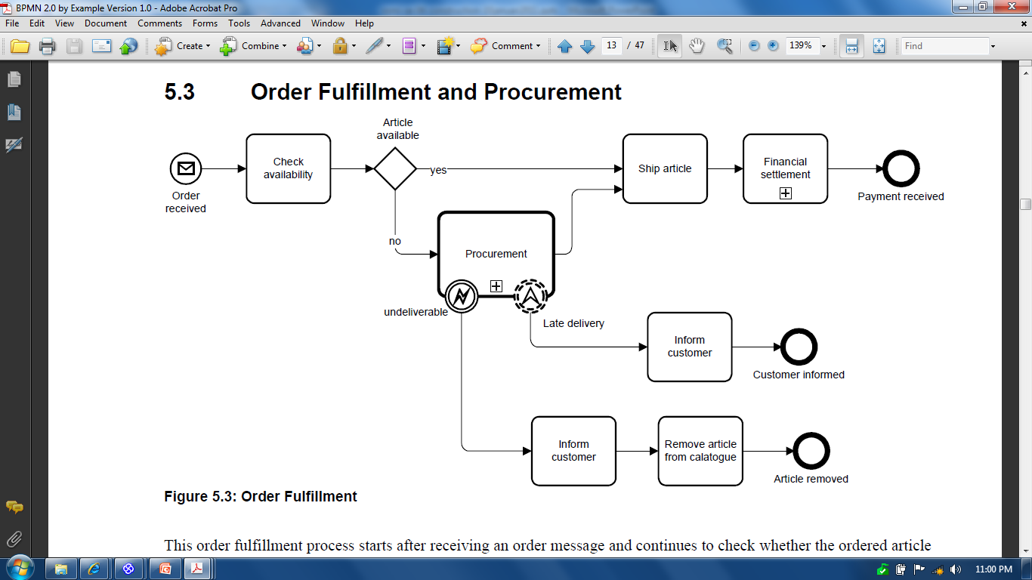
Order Fulfillment and Procurement

Slide 96
Studi Kasus: ATM System

Slide 97
Activity Diagram: Memasukkan Kartu

Slide 98
Activity Diagram: Memasukkan PIN

Slide 99
Activity Diagram: Mengecek Saldo

Slide 100
Activity Diagram: Mentransfer Uang

Slide 101
Activity Diagram: Mengambil Uang

Slide 102
Activity Diagram: Melakukan Logout

Slide 103
5.4.3 Business Process Realization: Sequence Diagram

Slide 104
System Analysis and Design with UML
System Analysis
Business Process Identification
Use Case Diagram
Business Process Modeling
Activity Diagram or Business Process Modeling Notation (BPMN)
Business Process Realization
Sequence Diagram (Buat untuk setiap use case dengan menggunakan pola Boundary-Control-Entity)
System Design
Program Design
Class Diagram (Gabungkan Boundary-Control-Entity Class dan susun story dari sistem yang dibangun)
Package Diagram (Gabungan class yang sesuai, boleh menggunakan pola B-C-E)
Deployment Diagram (arsitektur software dari sistem yang dibangun)
User Interface Design (Buat UI design dari Boundary Class)
Entity-Relationship Model (Buat ER diagram dari Entity Class)

Slide 105
Sequence Diagrams
Illustrate the objects that participate in a use case
Show the messages that pass between objects for a particular use-case over time

Slide 106
Sequence Diagram Syntax
AN ACTOR
AN OBJECT
A LIFELINE
A FOCUS OF CONTROL
A MESSAGE
OBJECT DESTRUCTION
anObject:aClass
aMessage()
x

Slide 107
Sequence Diagram
Susun Sequence Diagram untuk setiap Use Case yang dibuat
Mulai dari menarik Actor yang ada di Use Case Diagram, lanjutkan dengan membuat sequence detail dari berjalannya Use Case
Catatan: Objek dari Lifeline di Sequence Diagram akan menjadi kandidat Class

Slide 108
Jenis Class
Boundary Class:
Class yang berinteraksi dengan aktor langsung (user interface)
Form, input, UI ini masuk di sini
Control Class:
Class yang berhubungan dengan pemrosesan, penghitungan, kalkulasi, komputasi, query, dst
Entity Class:
Class yang berhubungan dengan data, penyimpanan data/file

Slide 109
Studi Kasus: ATM System

Slide 110
Sequence Diagram: Memasukkan Kartu

Slide 111
Sequence Diagram: Memasukkan PIN

Slide 112
Sequence Diagram: Mengecek Saldo

Slide 113
Sequence Diagram: Mentransfer Uang

Slide 114
Sequence Diagram: Mengambil Uang

Slide 115
Sequence Diagram: Melakukan Logout

Slide 116
5.4.4 Class Diagram

Slide 117
System Analysis and Design with UML
System Analysis
Business Process Identification
Use Case Diagram
Business Process Modeling
Activity Diagram or Business Process Modeling Notation (BPMN)
Business Process Realization
Sequence Diagram (Buat untuk setiap use case dengan menggunakan pola Boundary-Control-Entity)
System Design
Program Design
Class Diagram (Gabungkan Boundary-Control-Entity Class dan susun story dari sistem yang dibangun)
Package Diagram (Gabungan class yang sesuai, boleh menggunakan pola B-C-E)
Deployment Diagram (arsitektur software dari sistem yang dibangun)
User Interface Design (Buat UI design dari Boundary Class)
Entity-Relationship Model (Buat ER diagram dari Entity Class)

Slide 118
Class Diagram Elements
Classes
Attributes
Operations
Relationships

Slide 119
Classes
Templates for creating instances or objects
All objects of a class have same structure and behavior, but contain different attributes
Concrete: used to create actual objects
Abstract: extended to create other classes

Slide 120
Attributes
Units of information relevant to the description of the class
Only attributes important to the task should be included
Attributes should be primitive types (integers, strings, doubles, date, time, Boolean, etc.)

Slide 121
Operations (Methods)
Defines the behavior of the class
Action that instances/objects can take
Focus on relevant problem-specific operations (at this point)

Slide 122
Relationships
Generalization
“Is-A” relationship
Enables inheritance of attributes & oper's
Subclasses and superclasses
Principle of substitutability
Subclass be substituted for superclass
Aggregation
“Has-A” relationship
Relates parts to wholes
Uses decomposition
Association
Relationships that don't fit “Is-A” or “Has-A”
Often a weaker form of “Has-A”
Miscellaneous relationships between classes
Example:
Patient schedules an appointment
So the appointment has a patient
This is weak

Slide 123
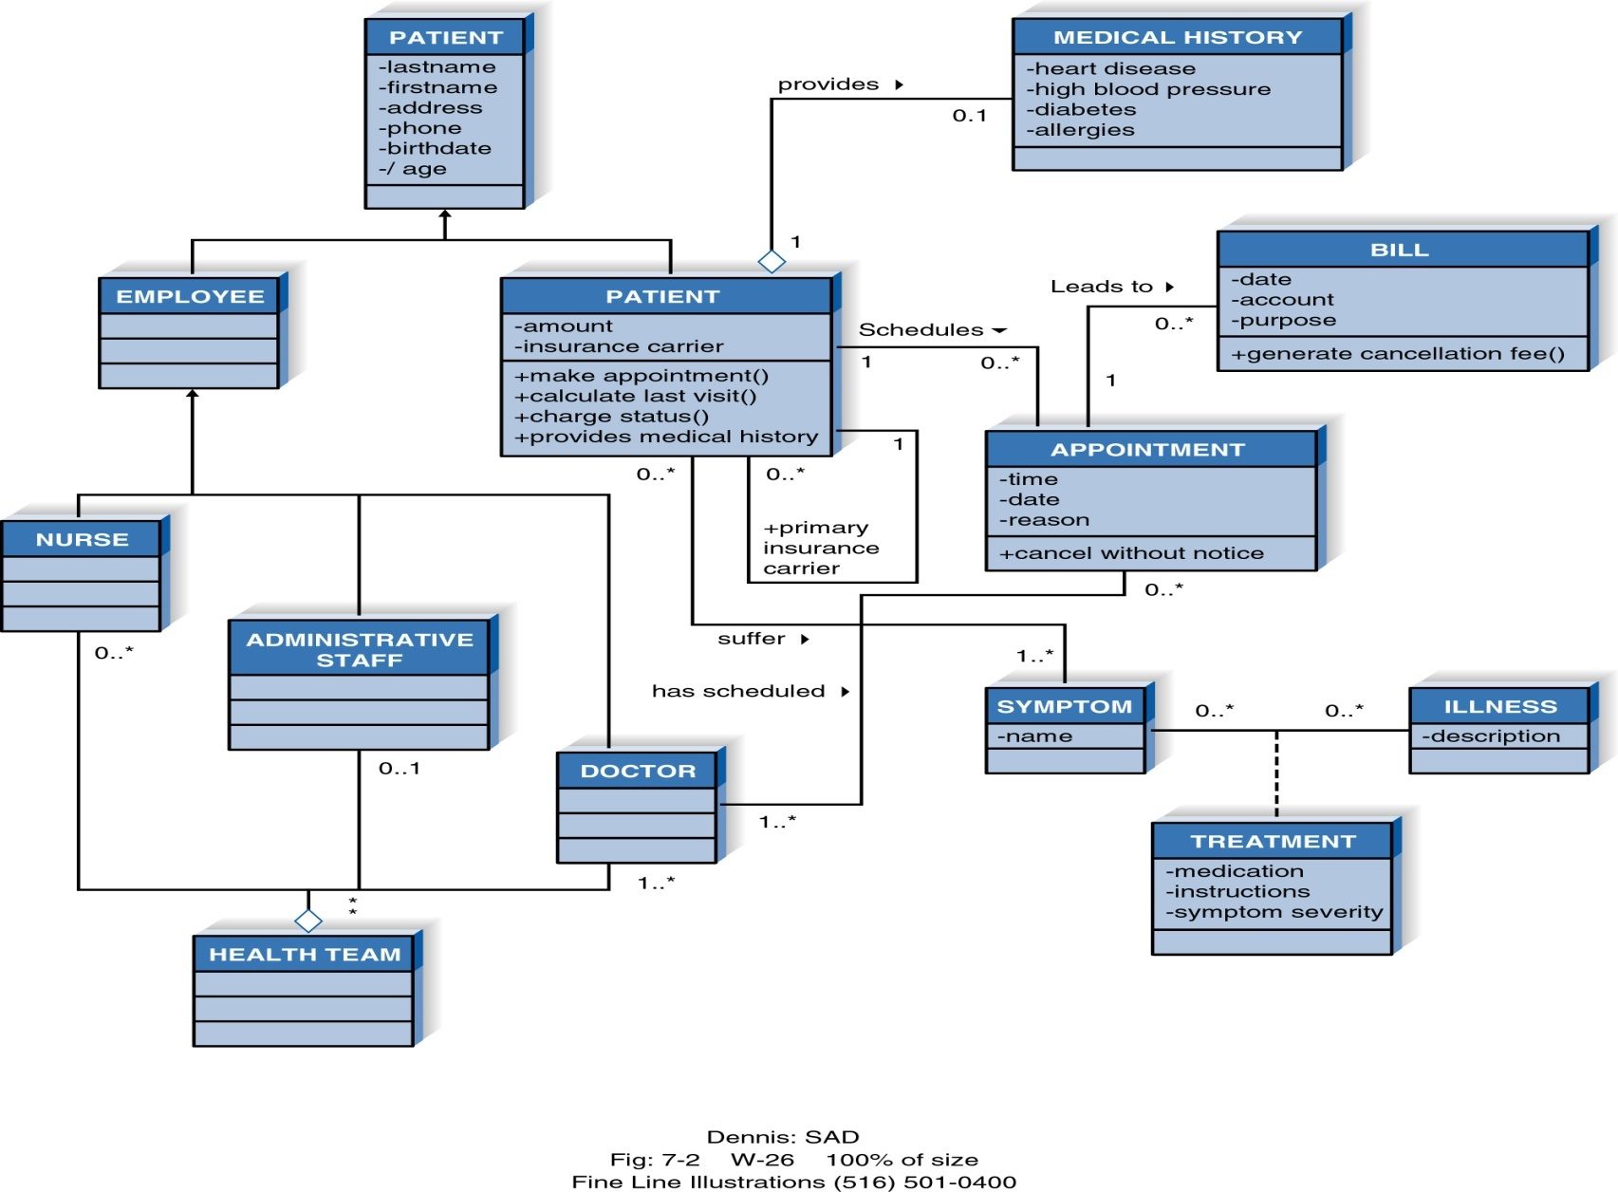
Example Class Diagram

Slide 124
More on Attributes
Derived attributes
/age, for example can be calculated from birth date and current date
Visibility of attributes
+Public: not hidden from any object
#Protected: hidden from all but immediate subclasses
–Private: hidden from all other classes
Default is private

Slide 125
More on Operations
Constructor: creates object
Query: see class state
Update: change attribute values
Operations can also be public, protected, or private
Default for operations is public

Slide 126
More on Relationships
A primary purpose of class diagrams is to show relationships, or associations, between classes
Class can be related to itself (role)
Use a "+" sign to show it's a role and not the name of a relationship

Slide 127
Relationship Multiplicity
Exactly one
Zero or more
One or more
Zero or one
Specified range
Disjoint ranges
Dept
1
Boss
Employee
0..*
Child
Boss
1..*
Employee
Employee
0..1
Spouse
Employee
2..4
Vacation
Employee
1..3, 5
Committee

Slide 128
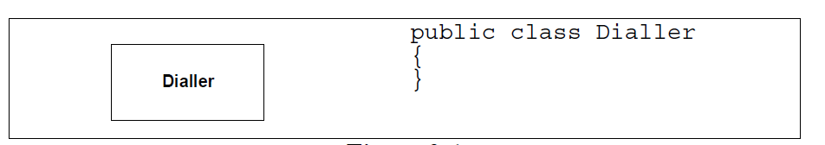
Class

Slide 129
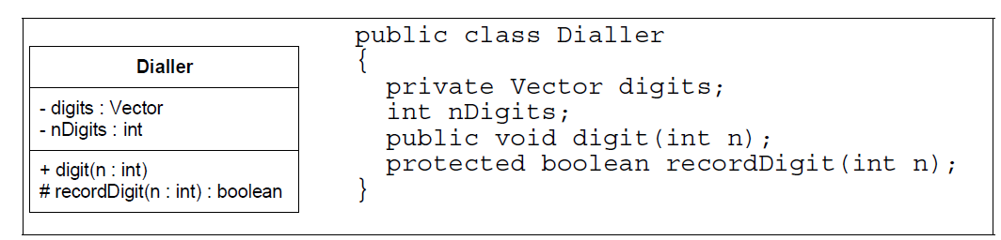
Class with Attribute and Method

Slide 130
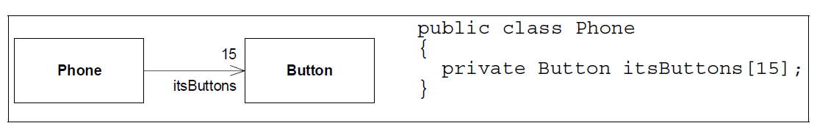
Class Association

Slide 131
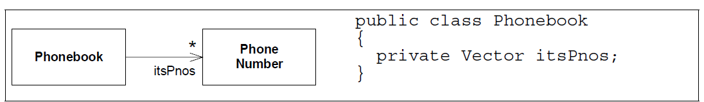
Multiplicity

Slide 132
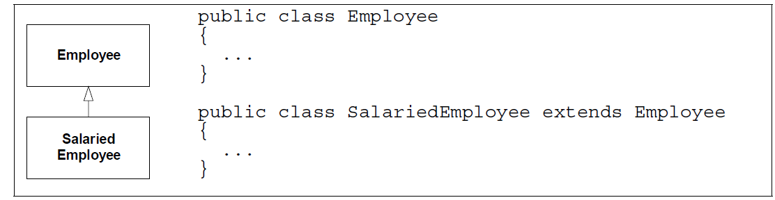
Inheritance

Slide 133
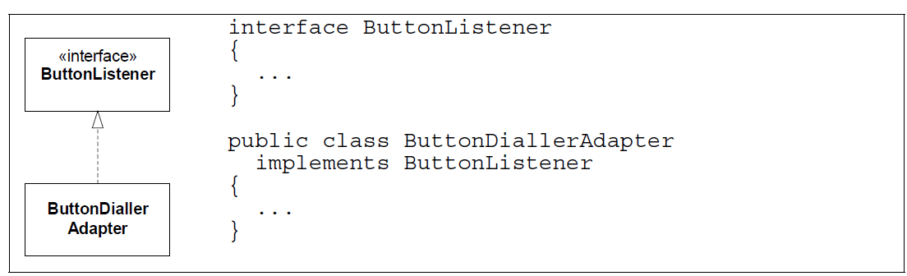
Interface

Slide 134
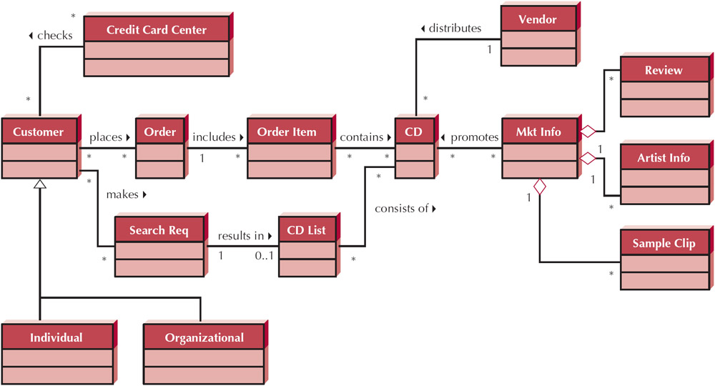
Class Diagram: Internet Order Project

Slide 135
Class Diagram: Sistem ATM

Slide 136
5.4.5 Deployment Diagram

Slide 137
System Analysis and Design with UML
System Analysis
Business Process Identification
Use Case Diagram
Business Process Modeling
Activity Diagram or Business Process Modeling Notation (BPMN)
Business Process Realization
Sequence Diagram (Buat untuk setiap use case dengan menggunakan pola Boundary-Control-Entity)
System Design
Program Design
Class Diagram (Gabungkan Boundary-Control-Entity Class dan susun story dari sistem yang dibangun)
Package Diagram (Gabungan class yang sesuai, boleh menggunakan pola B-C-E)
Deployment Diagram (arsitektur software dari sistem yang dibangun)
User Interface Design (Buat UI design dari Boundary Class)
Entity-Relationship Model (Buat ER diagram dari Entity Class)

Slide 138


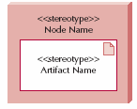
Deployment Diagram
Node
Servers
Mainframes, Minis, Micros
Clients
Input/Output HW used by users
Terminals, PCs, special purpose HW
Network
HW and SW to connect clients to servers
Nodes
Any piece of hardware in the model
A computational resource
Labeled by its name
Stereotype to label the type of node
Artifacts
Piece of the information system, such as software or a database table
Node with Deployed Artifact
Shows artifact placed on a physical node
Good for showing distribution data or software
Communication paths
Links between nodes of the network
Artifact
Node with Deployment Artifact
Communication Path

Slide 139
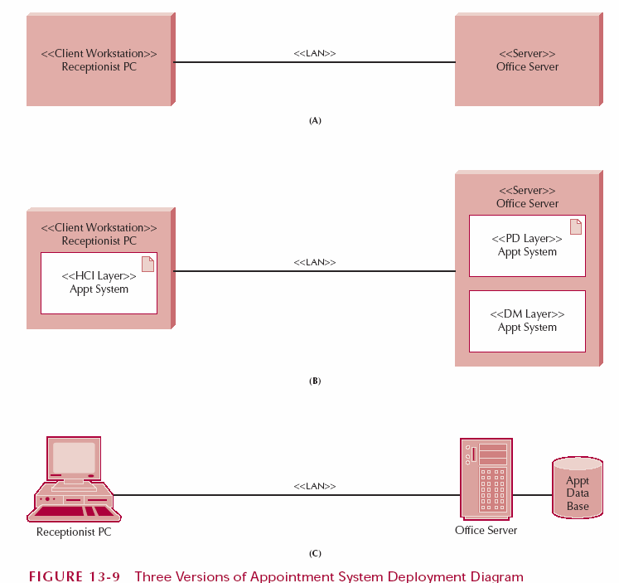
Diagram Examples

Slide 140
Deployment Diagram (3 Tier)

Slide 141
5.4.6 Data Model

Slide 142
System Analysis and Design with UML
System Analysis
Business Process Identification
Use Case Diagram
Business Process Modeling
Activity Diagram or Business Process Modeling Notation (BPMN)
Business Process Realization
Sequence Diagram (Buat untuk setiap use case dengan menggunakan pola Boundary-Control-Entity)
System Design
Program Design
Class Diagram (Gabungkan Boundary-Control-Entity Class dan susun story dari sistem yang dibangun)
Package Diagram (Gabungan class yang sesuai, boleh menggunakan pola B-C-E)
Deployment Diagram (arsitektur software dari sistem yang dibangun)
User Interface Design (Buat UI design dari Boundary Class)
Entity-Relationship Model (Buat ER diagram dari Entity Class)

Slide 143
Data Model

Slide 144
5.5 Estimating Project Size with Use Case Points

Slide 145
Use Case Points
Unadjusted Actor Weighting (UAW)
Actor Type | Description | Weighting Factor
Simple | External System with well-defined API | 1
Average | External System using a protocol-based interface, e.g., HTTP, TCT/IP, SQL | 2
Complex | Human | 3
Unadjusted Use Case Weighting (UUCW)
Use-Case Type | Description | Weighting Factor
Simple | 1-3 transactions | 5
Average | 4-7 transactions | 10
Complex | More than 7 transactions | 15
Unadjusted Use Case Points (UUCP) = UAW + UUCW

Slide 146
Sistem ATM – Use Case Diagram
Human = 3
Transaction = ?

Slide 147
Sequence Diagram - Mentransfer Uang
Transaction = 3

Slide 148
Technical Complexity Factors (TCF)
Factor Number | Description | Weight
T1 | Distributed system | 2.0
T2 | Response time or throughput performance objectives | 1.0
T3 | End-user online efficiency | 1.0
T4 | Complex internal processing | 1.0
T5 | Reusability of code | 1.0
T6 | Easy to install | 0.5
T7 | Ease of use | 0.5
T8 | Portability | 2.0
T9 | Ease of change | 1.0
TCF = 0.6 + (0.01 * TFactor)

Slide 149
Environmental Complexity Factors (ECF)
Factor Number | Description | Weight
E1 | Familiarity with system development process in use | 1.5
E2 | Application experience | 0.5
E3 | Object-oriented experience | 1.0
E4 | Lead analyst capability | 0.5
E5 | Motivation | 1.0
E6 | Requirements stability | 2.0
E7 | Part time staff | -1.0
E8 | Difficulty of programming language | -1.0
ECF = 1.4 + (-0.03 * EFactor)

Slide 150
Computing Use Case Points
Adjusted Use Case Points (UCP) = UUCP * TCF * ECF
Effort in Person Hours = UCP * PHM

Slide 151
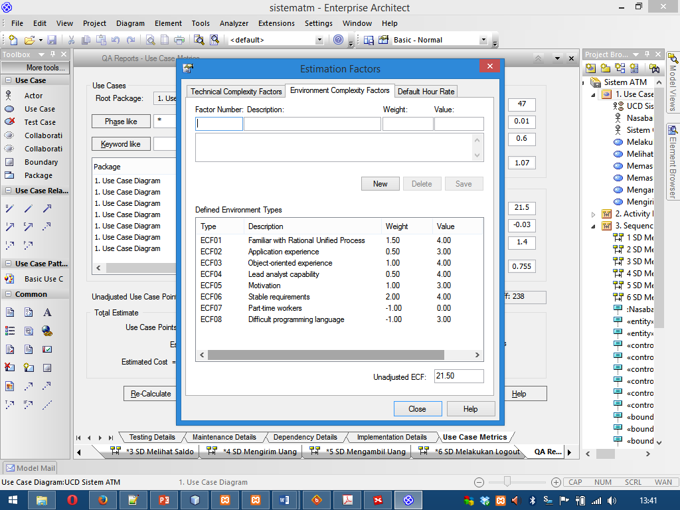
Person Hour Multiplier (PHM)
Let F1 = Number of ECF1 to ECF6 that are < 3
Let F2 = Number of ECF7 and ECF8 that are > 3
If F1 + F2 <= 2 PHM = 20 Else if F1 + F2 = 3 or 4 PHM = 28 Else Scrap the project

Slide 152
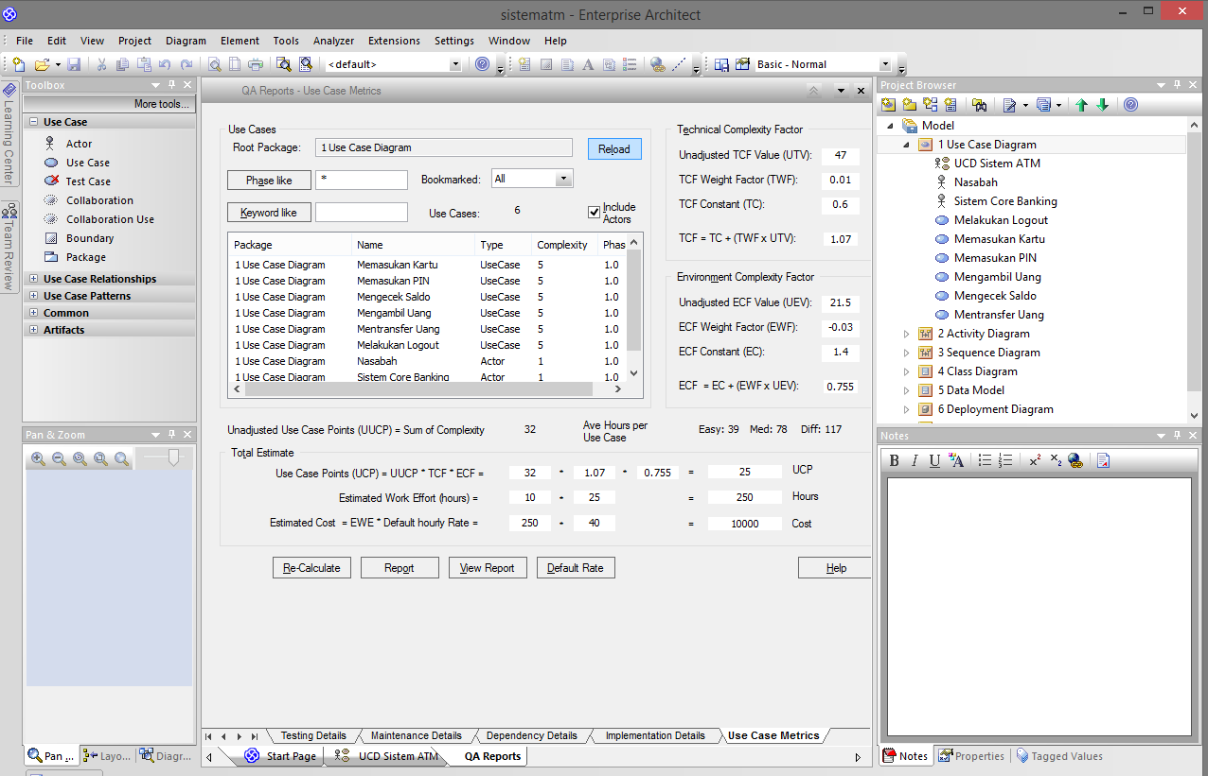
Use Case Points in Sparx EA

Slide 153
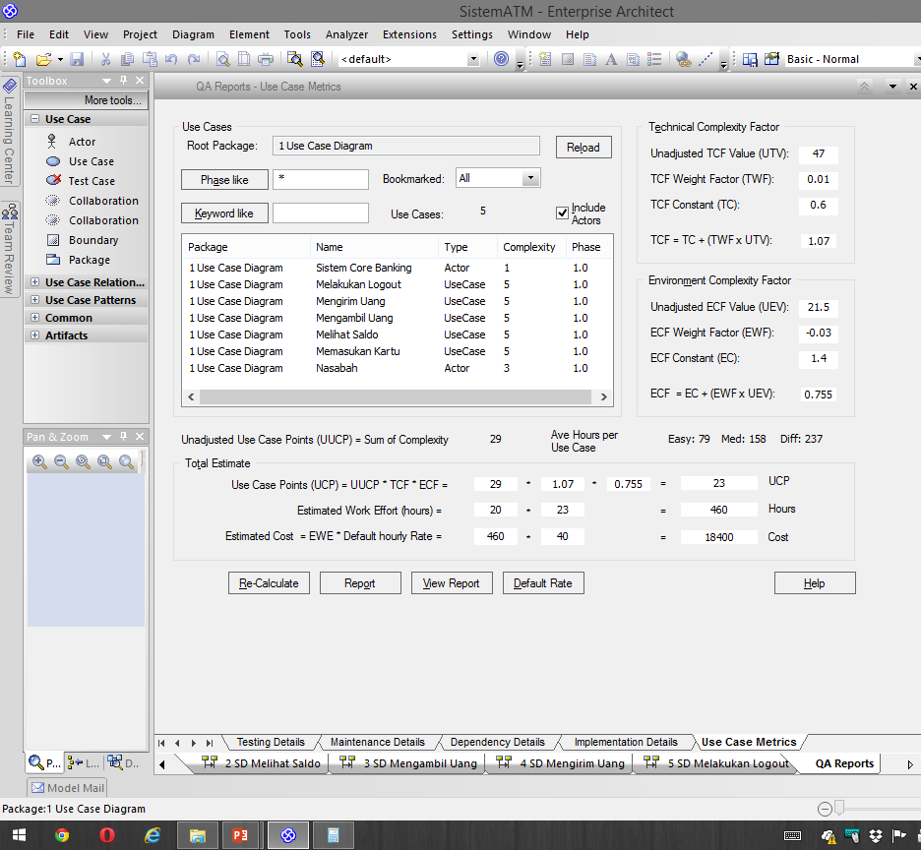

Slide 154
Example: Sistem ATM
UCP = 27
PHM = 20
PH = 20*27 = 540
PM = 540/8/22 = 3.06
PM = 540/10/25 = 2.16
TIME (M) = 3.0 * PM ^{1/3}
TIME (M) = 3.0 * 3.06 ^{1/3} = 4.36
TIME (M) = 3.0 * 2.16 ^{1/3} = 3.8

Slide 155
Example: Schedule
 | Fase | PM | M | Cost
1 | Planning | 1 | 1 | 10
2 | Analysis | 2 | 2 | 40
3 | Design | 2 | 1 | 20
4 | Implementation | 6 | 3 | 90
 |  |  | 5 | 160jt

Slide 156
Example: Sistem ERP
UCP = 662
PHM = 20
PH = 20*662 = 13240
PM = 13240/8/22 = 75
PM = 13240/10/26 = 50
TIME (M) = 3.0 * PM ^{1/3}
TIME (M) = 3.0 * 75 ^{1/3} = 12.65
TIME (M) = 3.0 * 50 ^{1/3} = 11.05

Slide 157
Budget (Custom Software)
Pekerjaan | Man-Month | Month | Budget | Total
Planning | 1 | 1 | 5000.000 | 10.000.000
Analysis | 2 | 1 | 10.000.000 | 20.000.000
Design | 2 | 1 | 4000.000 | 32.000.000
Implementation | 4 | 2 | 3000.000 | 24.000.000
Training | 2 | 1 | 4000.000 | 8000.000
 |  |  |  | 94.000.000

Slide 158
Budget (Generic Software)
Product |  |  |  | Total
LMS |  |  |  | 10.000.000
Teleconference |  |  |  | 2.000.000
Chatting |  |  |  | 4.000.000
eLibrary |  |  |  | 20.000.000

Slide 159
References
Rachel Harrison, Study Guide TOGAF® 9 Foundation 2nd Edition, The Open Group, 2011
Rachel Harrison, Study Guide TOGAF® 9 Certified 2nd Edition, The Open Group, 2011
Open Group Standard, TOGAF® Version 9.1 (G116), The Open Group, 2011
Open Group Standard, TOGAF® Version 9.1 – A Pocket Guide (G117), The Open Group, 2011
Daniel Minoli, Enterprise Architecture A to Z: Frameworks, Business Process Modeling, SOA, and Infrastructure Technology, Taylor & Francis, 2008
Jon Holt and Simon Perry, Modelling Enterprise Architectures, The Institution of Engineering and Technology, 2010
Alan Dennis et al, Systems Analysis and Design with UML 4th Edition, John Wiley and Sons, 2013

