Slide 1
TOGAF 9.1 Fundamental
Romi Satria Wahono romi@romisatriawahono.net http://romisatriawahono.net/tfu WA/SMS: +6281586220090

Slide 2
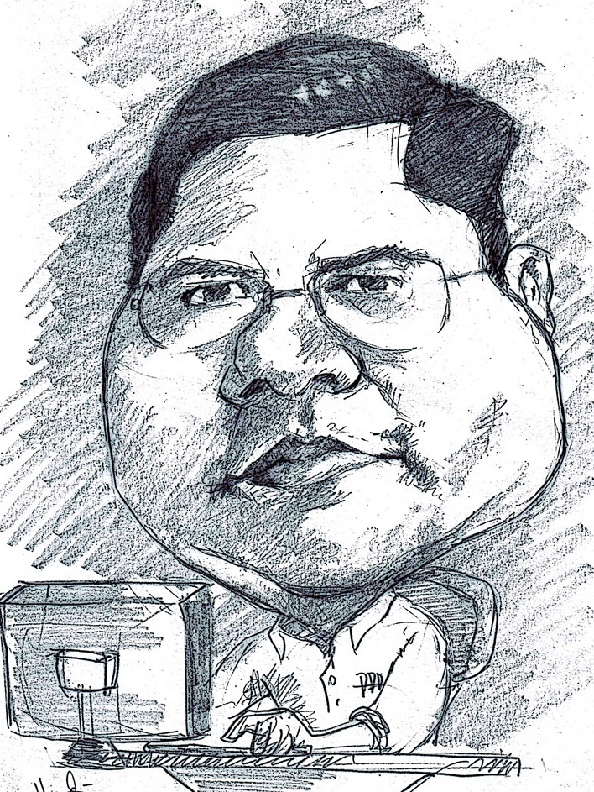
Romi Satria Wahono
SD Sompok Semarang (1987)
SMPN 8 Semarang (1990)
SMA Taruna Nusantara Magelang (1993)
B.Eng, M.Eng and Ph.D in Software Engineering from Saitama University Japan (1994-2004) Universiti Teknikal Malaysia Melaka (2014)
Research Interests: Software Engineering, Machine Learning
Founder IlmuKomputer.Com
PNS di PDII LIPI (1994-2007)
Founder dan CEO PT Brainmatics Cipta Informatika

Slide 3



Textbooks

Slide 4
Course Outline
Introduction
TOGAF Concepts
TOGAF ADM
BPMN Overview
UML Overview
TOGAF Case Study

Slide 5
PreTest
Apa tugas atau pekerjaan utama anda saat ini?
Apa itu enterprise architecture dan mengapa kita harus menggunakannya?
Apa itu enterprise architecture framework dan mengapa kita harus menggunakannya?
Modelkan business process dari requirement di bawah dengan diagram yang anda pahami!
PROSES PEMINJAMAN UANG DI BANK
Peminjam mengisi form pengajuan pinjaman
Bank memproses dengan pengecekan dokumen dan analisis kelayakan
Peminjaman akan dicairkan apabila peminjam dinyatakan layak mendapatkan pinjaman

Slide 6
1. Introduction
1.1 What and Why Enterprise Architecture
1.2 What and Why Enterprise Architecture Framework
1.3 Major Enterprise Architecture Framework
1.4 Enterprise Architecture Tools
1.5 Enterprise Architecture Competency

Slide 7
1.1 What and Why Enterprise Architecture

Slide 8

Rumah Saya
Total penghuni 13 orang
1 istri, 7 anak, 3 prt, 1 supir
10 kamar tidur
1 ruang perpustakaan
2 ruang keluarga
6 kamar mandi
1 kolam renang
1 kolam ikan dengan puluhan jenis ikan
Taman dengan puluhan pohon dan hewan

Slide 9
Kondisi Rumah Saya
Saya tidak tahu secara detail:
Kegiatan sehari-hari dan kebiasaan masing-masing penghuni rumah
Seluruh aset rumah dan di mana posisinya
Dokumen yang diproduksi seluruh penghuni
Saya tidak tahu tahapan detail:
Bagaimana menguras kolam renang
Bagaimana membersihkan kamar tidur, kamar mandi, ruang tengah

Slide 10
Masalah di Rumah Saya
Ketika membeli kursi baru untuk dapur
→ ternyata ada kursi tidak terpakai di ruang tengah
Masing-masing penghuni rumah mendownload film
→ internet jadi lambat dan laptop kekurangan space hdd
Ketika membeli printer baru
→ Spesifikasi printer tidak didukung oleh semua laptop
Ketika ada acara keluarga
→ jadwal bentrok dengan kegiatan beberapa anggota keluarga
Ketika pendaftaran sekolah dimulai dan perlu dokumen
→ dokumen sulit dikumpulkan karena tersebar
Ketika membeli buku baru
→ Ternyata buku sudah ada ruang perpustakaan

Slide 11
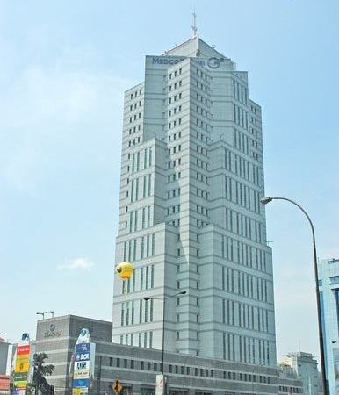
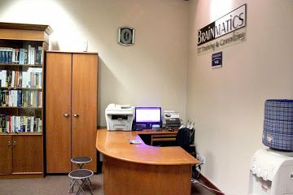
Organisasi
Rumah
=

Slide 12

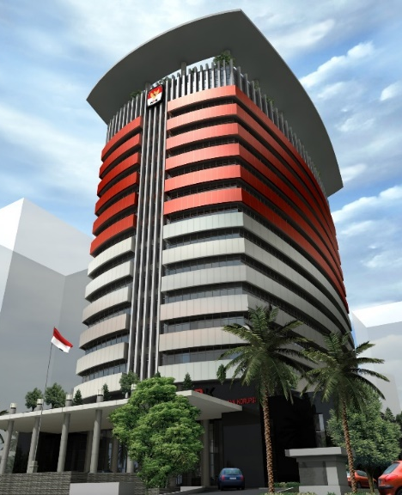





Kondisi Suatu Organisasi
Ribuan pegawai dan puluhan unit kerja yang sering tidak termonitor dengan baik
Proses bisnis kompleks
Infrastruktur dan aset tidak terkendali
Staff dan pimpinan baru perlu waktu untuk memahami kondisi organisasi

Slide 13
Masalah di Organisasi
Ketika suatu unit kerja membeli laptop dan printer
Ternyata ada laptop dan printer tidak terpakai di unit kerja lain
Prediksi berapa kebutuhan laptop dan printer tiap tahun?
Ketika ada staff mengajukan cuti
→Dasar apa yang digunakan atasan untuk mengizinkan cuti?
→Prediksi jumlah staff yang mengajukan cuti tiap bulan
Ketika KPK sedang mengusut suatu kasus
→ Prediksi seseorang bisa menjadi tersangka atau tidak?
→ Dimana dan apa dokumen yang dibutuhkan?
Ketika suatu unit kerja ingin pengadaan barang
→ Ternyata barang yang sama berlebih di unit kerja lain
Ketika ingin membuat kebijakan tentang keuangan
Banyak meleset karena tidak diolah dari data dan informasi
Estimasi kebutuhan budget tahunan?
Ketika kepala organisasi berganti
→ Bagaimana kepala organisasi baru bisa belajar cepat tentang organisasi?

Slide 14
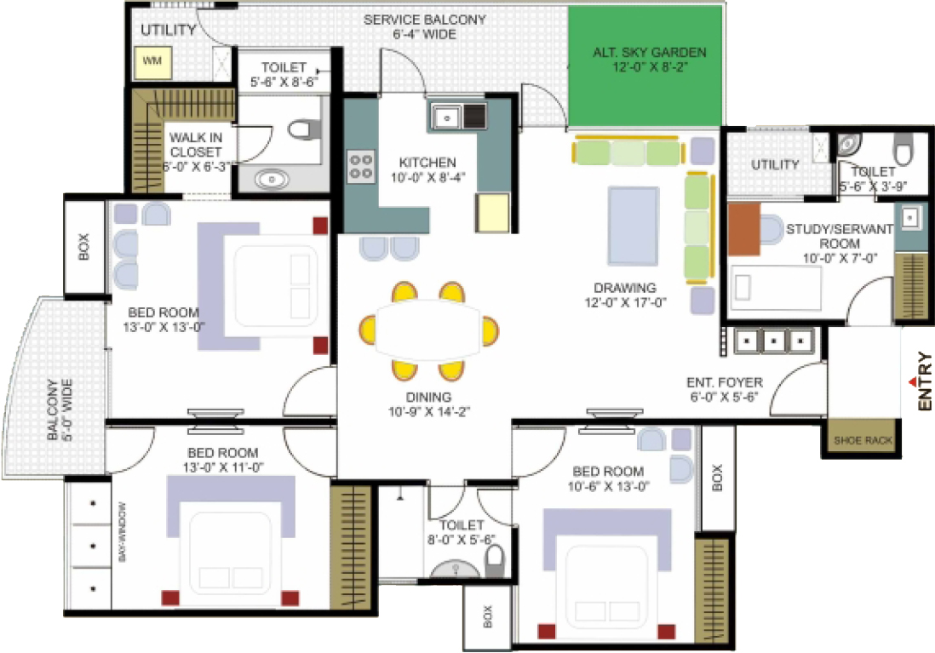
Saya Perlu Cetak Biru Arsitektur
Struktur Organisasi
Tujuan Organisasi
Business Process
Struktur Data
Software Sistem
Infrastruktur IT
Kebijakan Keamanan
dsb …
Business Architecture
Data Architecture
Application Architecture
Technology Architecture
Enterprise Architecture

Slide 15
What is an Enterprise?
A collection of organizations that share a common set of goals, such as a government agency, part of a corporation, or a corporation in its entirety
Large corporations may comprise multiple enterprises
An “extended enterprise” can include partners, suppliers, and customers

Slide 16
What is Architecture?
The organizational structure of a system or component (IEEE Standard 610, Standard Computer Dictionary: A Compilation of IEEE Standard Computer Glossaries)
The fundamental organization of a system embodied in its components, their relationships to each other, and to the environment, and the principles guiding its design and evolution (IEEE Standard 1471, IEEE Recommended Practice for Architectural Description of Software-Intensive Systems)

Slide 17
What is Architecture?
A formal description of a system, or a detailed plan of the system at a component level to guide its implementation
The structure of components, their inter-relationships, and the principles and guidelines governing their design and evolution over time

Slide 18
What is Enterprise Architecture?
The organizing logic for business processes and IT infrastructure reflecting the integration and standardization requirements of the firm’s operating model (MIT Center for Information Systems Research)
A conceptual blueprint that defines the structure and operation of an organization. The intent of an enterprise architecture is to determine how an organization can most effectively achieve its current and future objectives (SearchCIO.com)

Slide 19
Apa Itu Enterprise Architecture?
Cetak biru organisasi yang berisi proses bisnis, data, aplikasi dan infrastruktur IT, yang dirancang dan diterapkan secara terpadu untuk membantu berjalannya kegiatan organisasi dengan lebih efektif dan efisien
Proses BISNIS dan aktifitas organisasi menggunakan …
DATA, yang harus dikumpulkan, dikelola, diamankan dan didistribusikan menggunakan …
APLIKASI, baik itu aplikasi custom atau generic, yang berjalan di atas …
TEKNOLOGI, seperti infrastruktur, sistem dan jaringan komputer

Slide 20
Enterprise Architecture Layer
Architecture Type | Description
Business Architecture | The business strategy, governance, organization, and key business processes
Data Architecture | The structure of an organization's logical and physical data assets and data management resources
Application Architecture | A blueprint for the individual applications to be deployed, their interactions, and their relationships to the core business processes of the organization
Technology Architecture | The logical software and hardware capabilities that are required to support the deployment of business, data, and application services. This includes IT infrastructure, middleware, networks, communications, processing, and standards

Slide 21
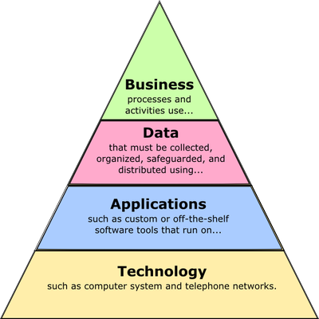

Slide 22
Mengapa Enterprise Architecture?
Banyak Proses Bisnis di Dalam Organisasi yang Terpecah-Pecah dan Tidak Sinkron
Lingkungan Terintegrasi
Yang responsif terhadap perubahan, sehingga proses bisnis di organisasi bisa berjalan dengan efektif dan efisien

Slide 23
Keuntungan Enterprise Architecture (EA)
Keuntungan | Deskripsi
Efisiensi Proses Bisnis | Mengurangi biaya operasional Organisasi lebih lincah bergerak Meningkatkan produktifitas organisasi
Efisiensi Operasional IT | Mengurangi biaya pengembangan dan maintenance software Meningkatkan interoperabilitas serta pengelolaan sistem dan jaringan yang lebih mudah Meningkatkan efisiensi dalam melakukan upgrade dan pengembangan sistem atau komponen baru
Meningkatkan ROI dan Mengurangi Resiko | Mengurangi kompleksitas dari bisnis dan IT Maksimum ROI pada bisnis dan infrastruktur IT Fleksibilitas dalam membuat dan membeli solusi IT Mengurangi resiko pada investasi dan TCO

Slide 24
Keuntungan Enterprise Architecture
Institute for Enterprise Architecture Development, 2005

Slide 25
1.2 What and Why Enterprise Architecture Framework?

Slide 26
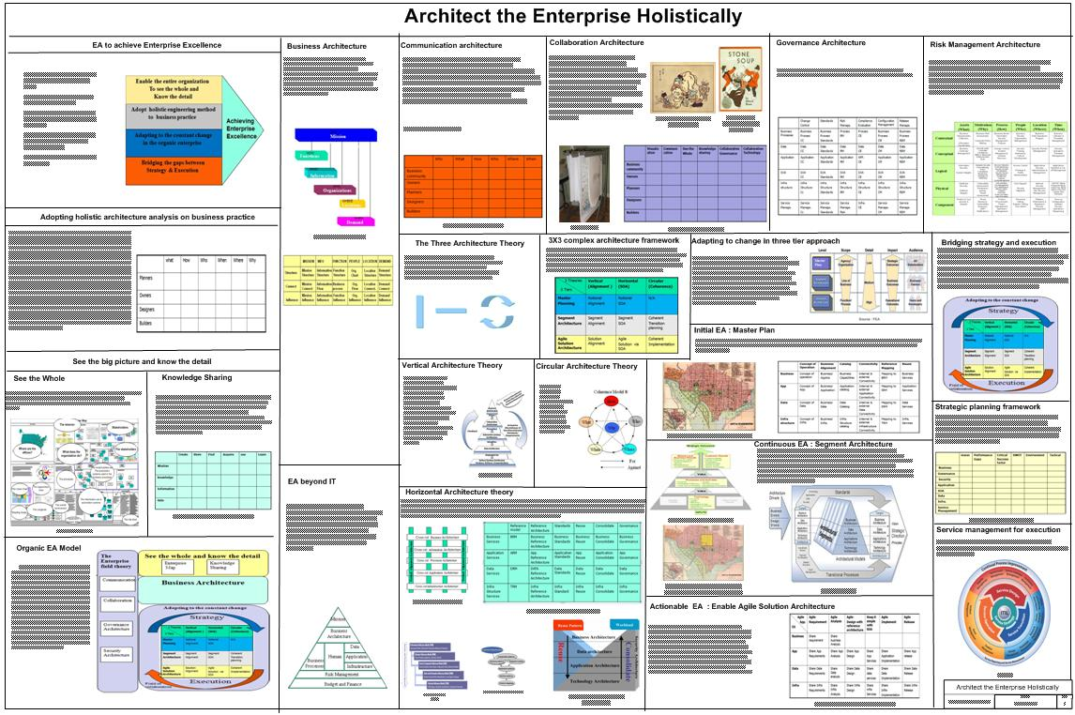

Slide 27
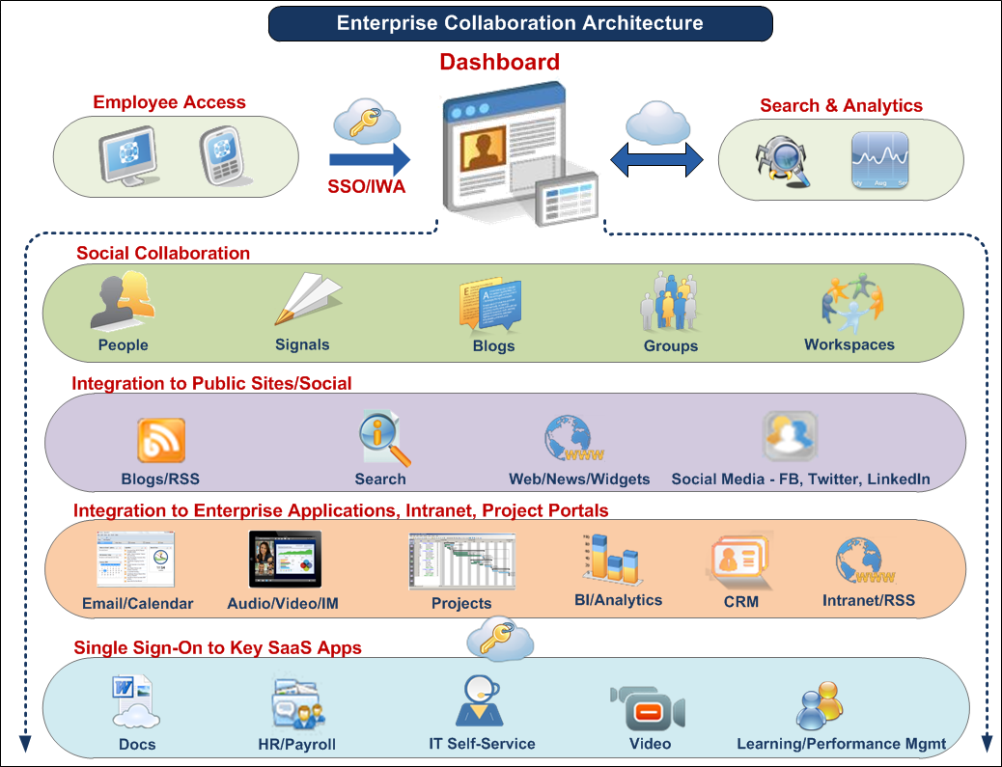

Slide 28
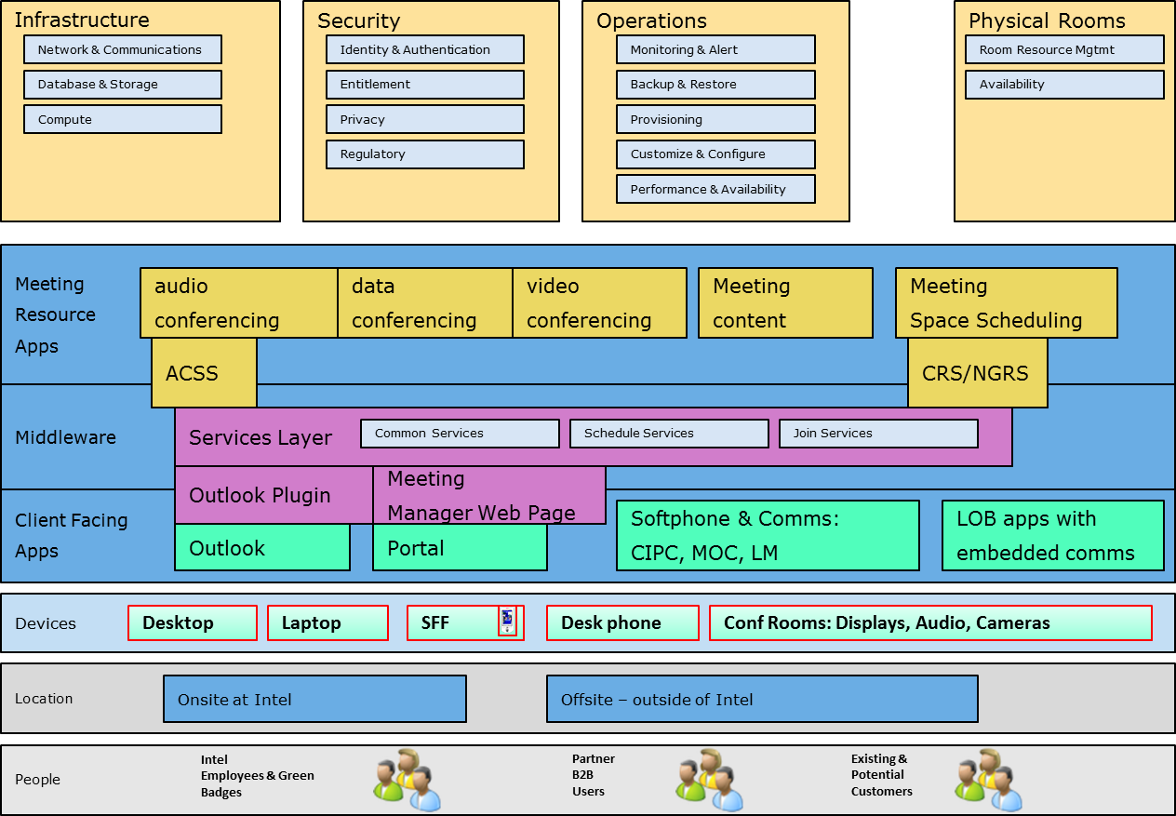

Slide 29
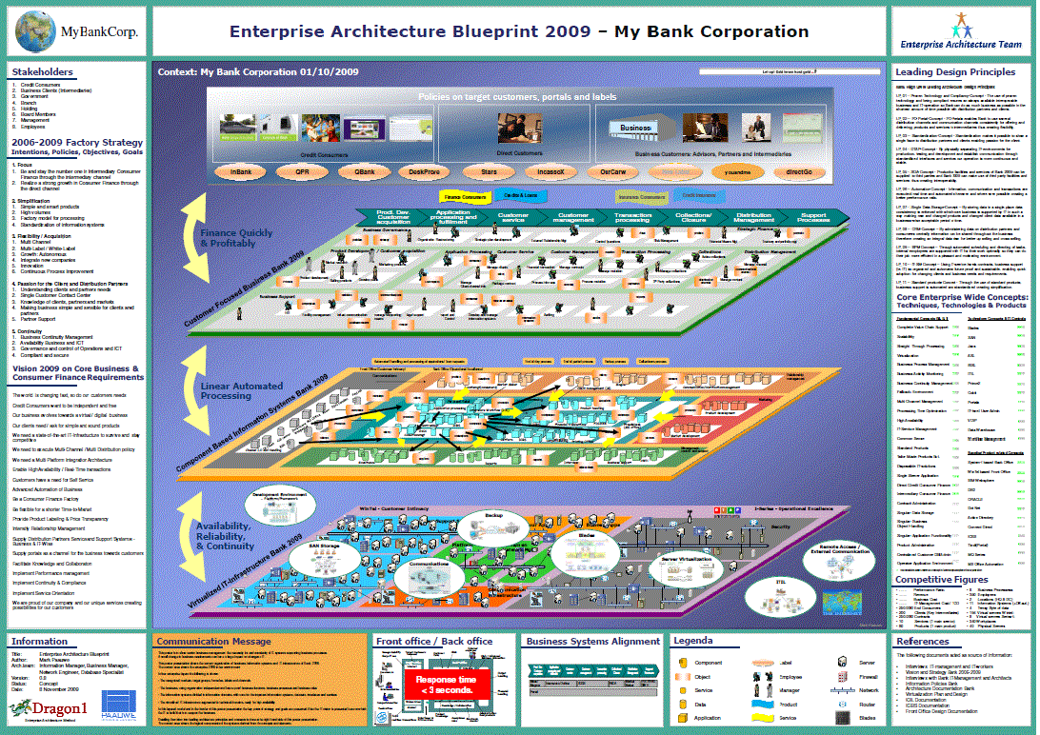

Slide 30
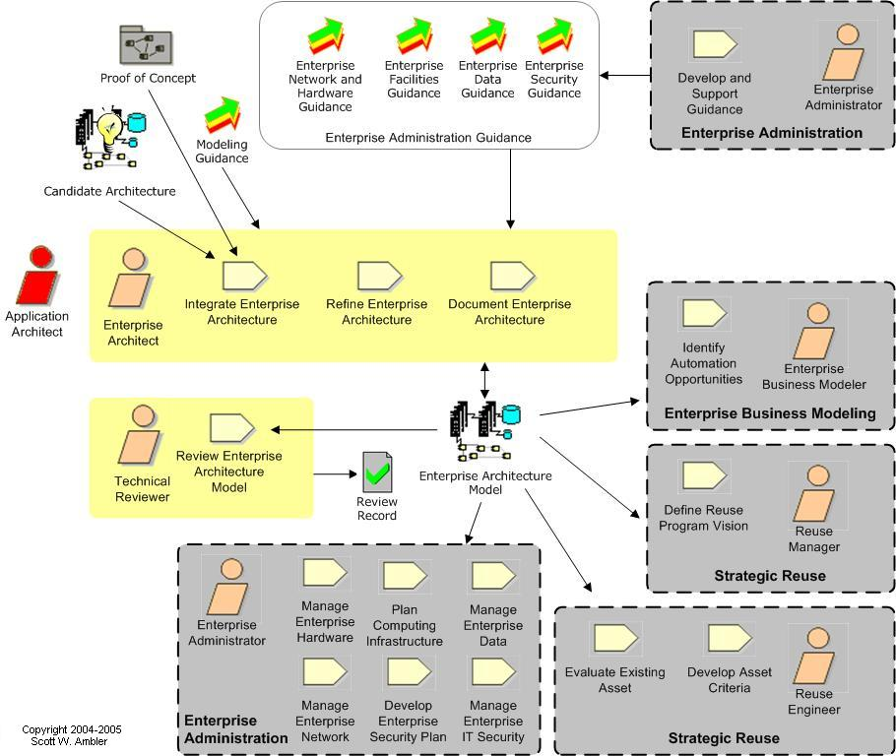

Slide 31
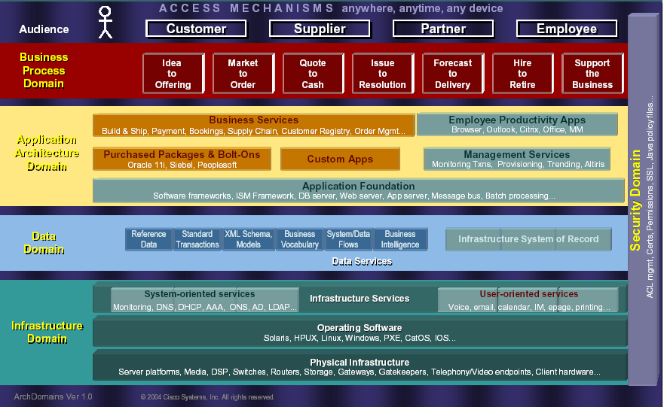

Slide 32
Bagaimana Cara Membuat EA?
Harus mulai dari mana?
Siapa saja yang terlibat?
Apa yang harus dibuat?
Bagaimana tahapan pembuatannya?
Bagaimana standardisasi untuk desainnya?
☹
Pusing? Perlu contoh dan template?
☺
Enterprise Architecture Framework

Slide 33
What is an Architecture Framework?
A foundational structure, or set of structures, which can be used for developing a broad range of different architectures:
Describe a method for designing a target state of the enterprise in terms of a set of building blocks, and for showing how the building blocks fit together
Contain a set of tools and provide a common vocabulary
Include a list of recommended standards and compliant products that can be used to implement the building blocks

Slide 34
Why do We Need a Framework for Enterprise Architecture?
Using an architecture framework will speed up and simplify architecture development
Ensure more complete coverage of the designed solution
Make certain that the architecture selected allows for future growth in response to the needs of the business

Slide 35
1.3 Major Enterprise Architecture Framework

Slide 36
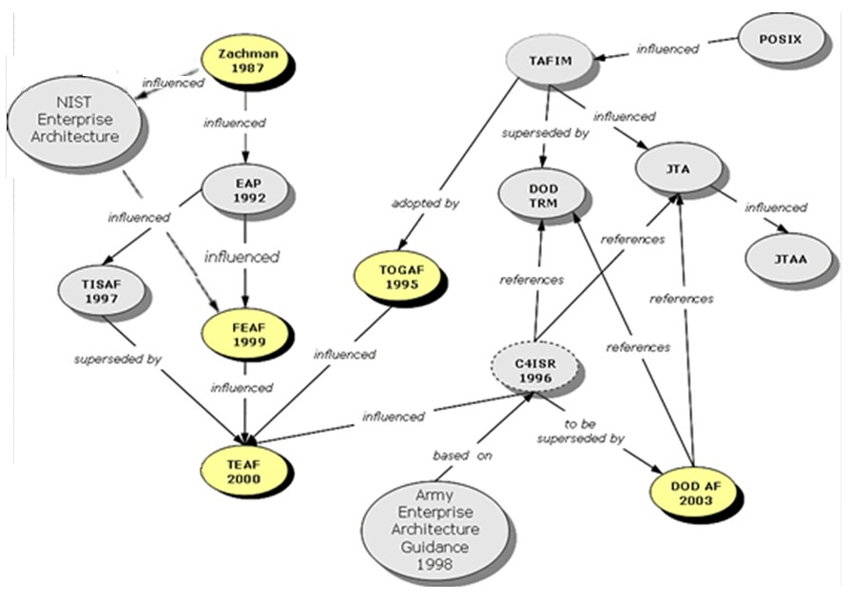
History of EA Framework

Slide 37
Jenis EA Framework
Jenis | EA Framework
Consortia-Developed Frameworks | ARCON, GERAM, RM-ODP, IDEAS Group, ISO 19439, TOGAF
Defense Industry Frameworks | AGATE, DNDAF, DoDAF, MODAF, NAF
Government Frameworks | ESAAF, GEA, FDIC, FEAF, NORA, NIST, TEAF
Open Source Frameworks | LEAD, MEGAF, Praxeme, TRAK, SABSA
Proprietary Frameworks | ASSIMPLER, AM, IAF, OBASHI, IFW, SAM, SAP EAF, Zachman Framework, SOMF
In 2013, TOGAF is the most popular Enterprise Architecture framework (judged by published certification numbers)

Slide 38
Major EA Framework
The Zachman Framework for Enterprise Architectures
Although self-described as a framework, is actually more accurately defined as a taxonomy
The Open Group Architectural Framework (TOGAF)
Although called a framework, is actually more accurately defined as a process
The Federal Enterprise Architecture(FEA)
Can be viewed as either an implemented enterprise architecture or a proscriptive methodology for creating an enterprise architecture
The Gartner Methodology
Can be best described as an enterprise architectural practice

Slide 39
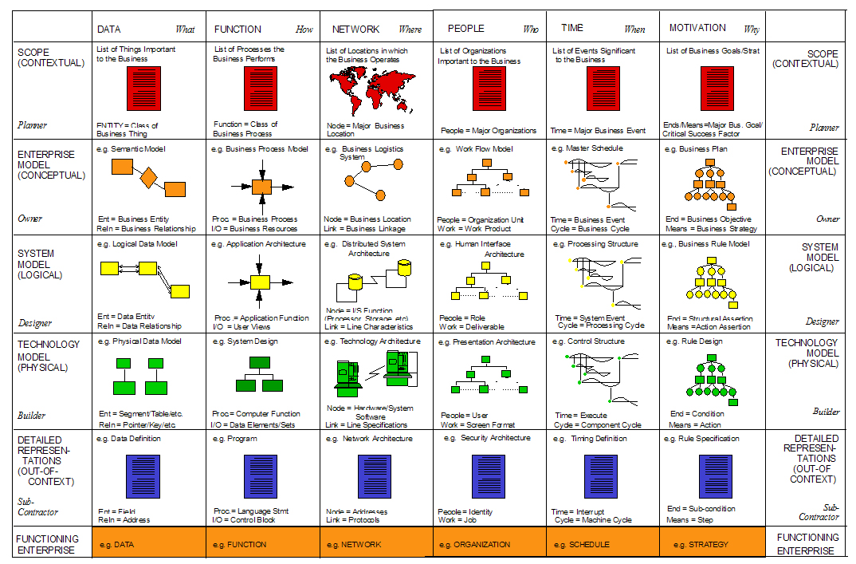
Zachman Framework

Slide 40
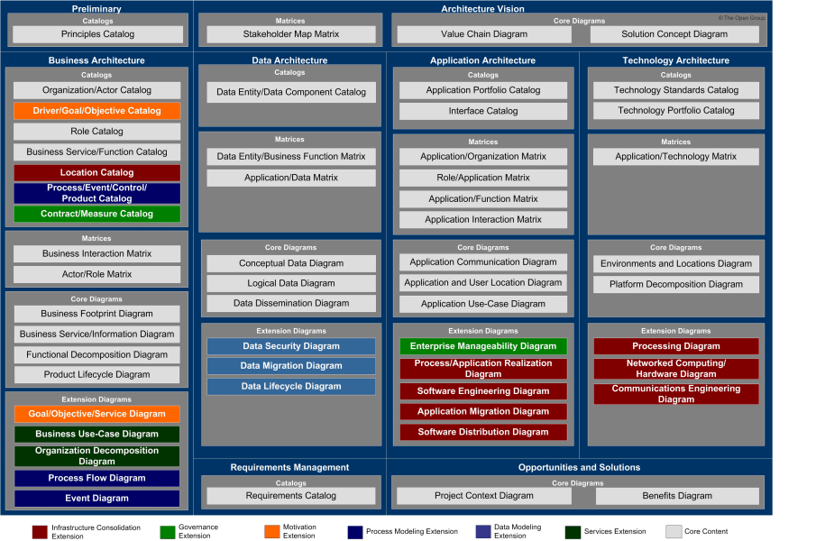
TOGAF

Slide 41
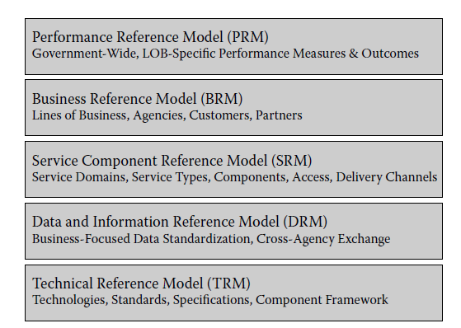
FEA

Slide 42
EA Framework Comparison
Taxonomy completeness: how well you can use the methodology to classify the various architectural artifacts (Zachman)
Process completeness: how fully the methodology guides you through a step-by-step process for creating an enterprise architecture (TOGAF)
Reference-model guidance: how useful the methodology is in helping you build a relevant set of reference models (FEA)
Practice guidance: how much the methodology helps you assimilate the mindset of enterprise architecture into your organization (Gartner)
Maturity model: how much guidance the methodology gives you in assessing the effectiveness and maturity of different organizations within your enterprise in using enterprise architecture
(Sessions - A Comparison of the Top Four EA Methodologies - 2007)

Slide 43
EA Framework Comparison
Business focus: whether the methodology will focus on using technology to drive business value, in which business value is specifically defined as either reduced expenses and/or increased income
Governance guidance: how much help the methodology will be in understanding and creating an effective governance model for enterprise architecture
Partitioning guidance: how well the methodology will guide you into effective autonomous partitions of the enterprise, which is an important approach to managing complexity
Prescriptive catalog: how well the methodology guides you in setting up a catalogue of architectural assets that can be reused in future activities
Vendor neutrality: how likely you are to get locked-in to a specific consulting organization by adopting this methodology. A high rating here indicates low vendor lock-in
Information availability: the amount and quality of free or inexpensive information about this methodology
Time to value: the length of time you will likely be using this methodology before you start using it to build solutions that deliver high business value

Slide 44
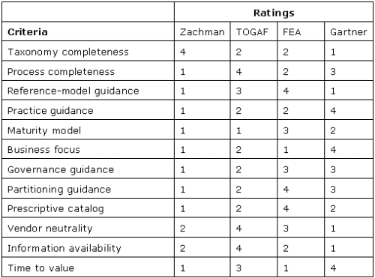
EA Framework Comparison
(Roger Sessions, A Comparison of the Top Four EA Methodologies, 2007)

Slide 45
1.4 Enterprise Architecture Tools

Slide 46
EA Tools (Short and Wilson, 2011)
planningIT (alphabet.com)
SAMU (altollgroup.eu)
Abacus (avolution.com.au)
Architect (bizzdesign.com)
Corporate Modeler (casewise.com)
Envision VIP (future-tech.com)
Rational System Architect (ibm.com)
Mega Suite (mega.com)
ProVision (metastorm.com)
MooD (tsorg.com)
ARIS (softwareag.com)
Enterprise Architect (sparxsystems.com)
(Julie Short and Chriss Wilson, Gartner Assessment of EA Tool Capabilities, Gartner Research, 2011)

Slide 47
Comparison Parameters
Repository or Metamodel
Modeling
Decision Analysis
Presentation
Administration
Configurability
Frameworks and Standards
Usability
(Julie Short and Chriss Wilson, Gartner Assessment of EA Tool Capabilities, Gartner Research, 2011)

Slide 48
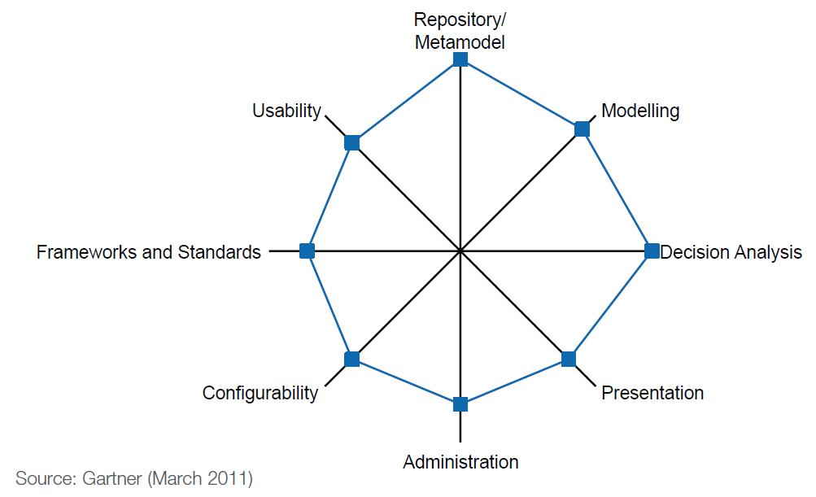
planningIT (alphabet.com)

Slide 49
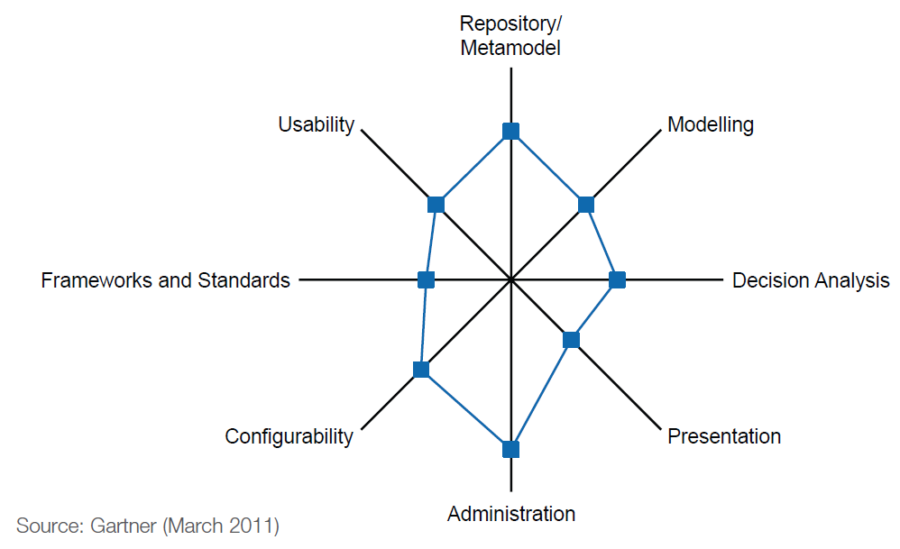
SAMU (altollgroup.eu)

Slide 50
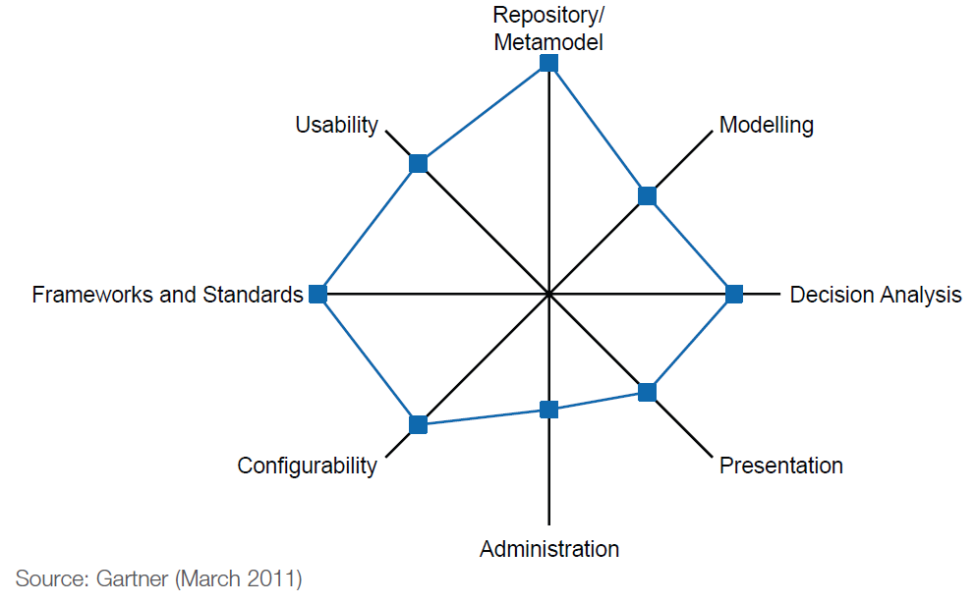
Abacus (avolution.com.au)

Slide 51
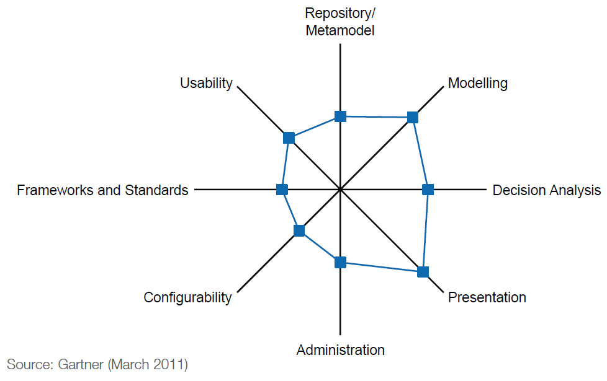
Architect (bizzdesign.com)

Slide 52
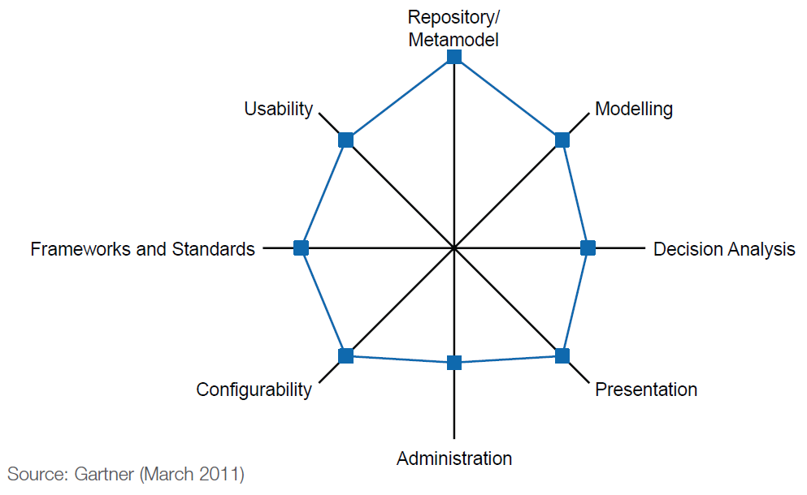
Corporate Modeler (casewise.com)

Slide 53

Envision VIP (future-tech.com)

Slide 54
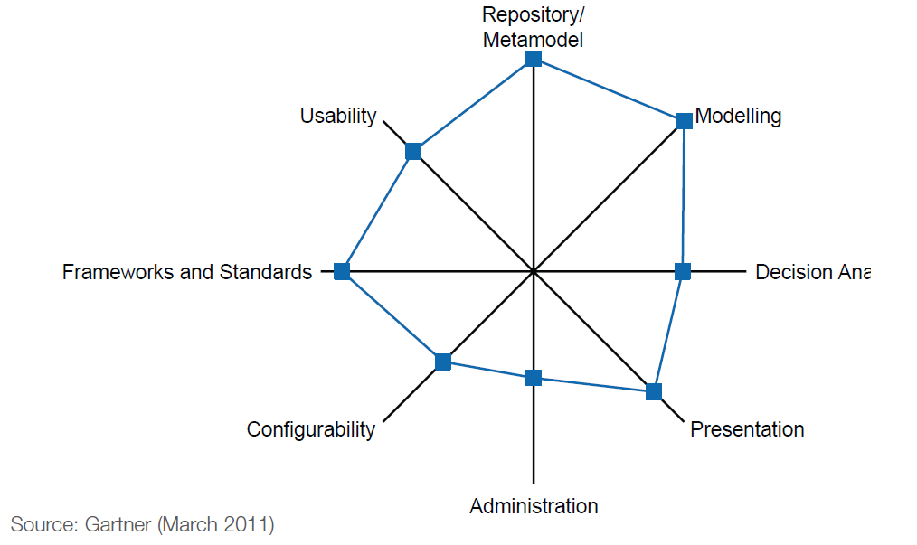
Rational System Architect (ibm.com)

Slide 55
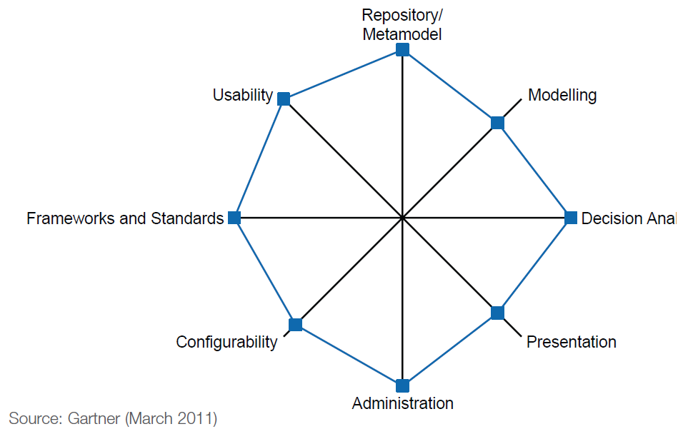
Mega Suite (mega.com)

Slide 56
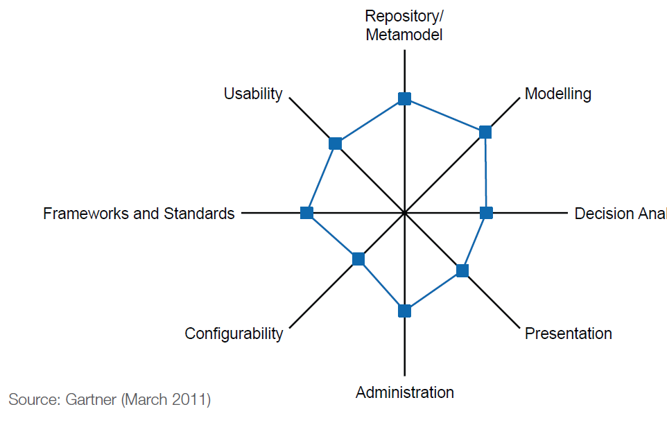
ProVision (metastorm.com)

Slide 57
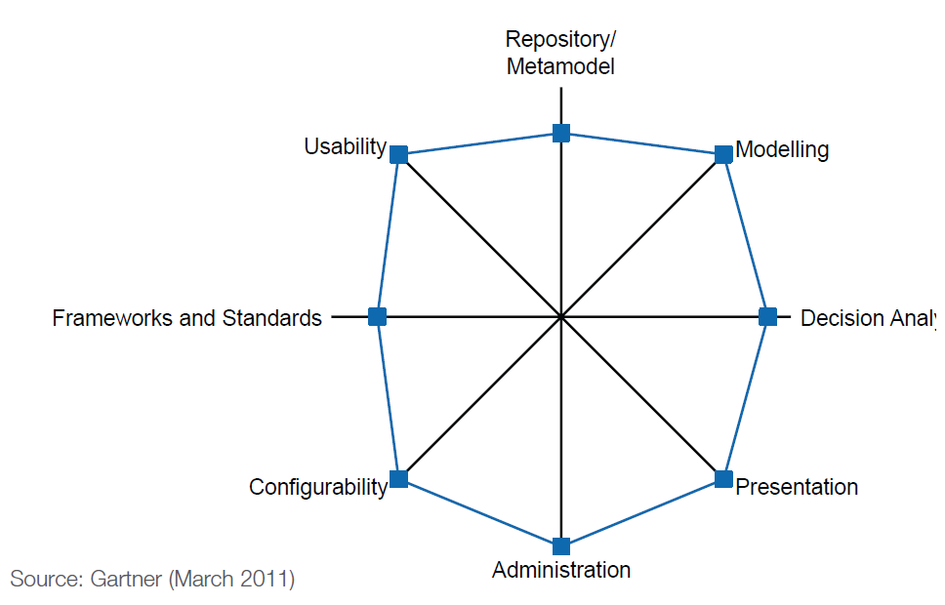
MooD (tsorg.com)

Slide 58
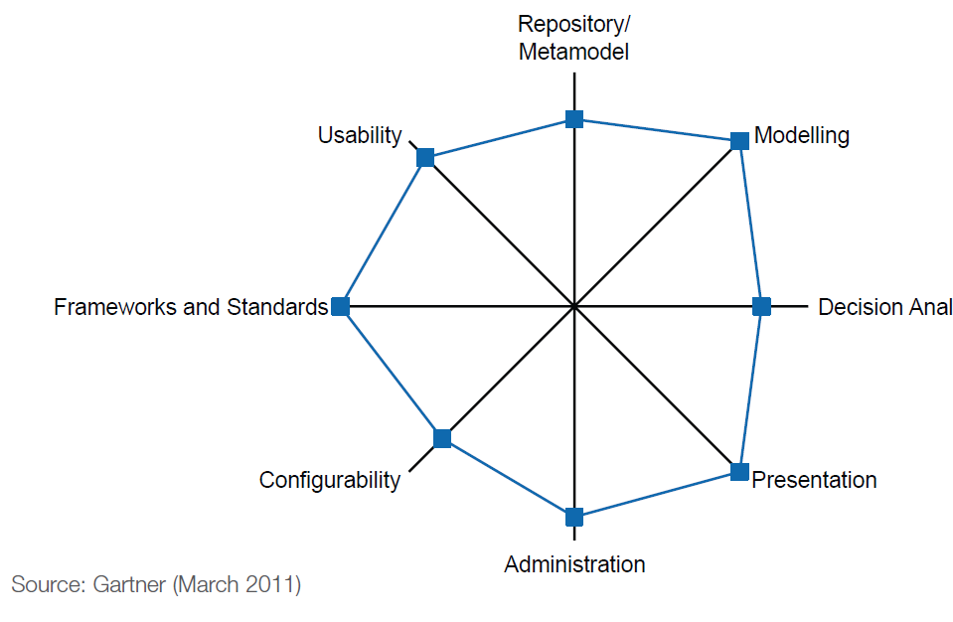
ARIS (softwareag.com)

Slide 59
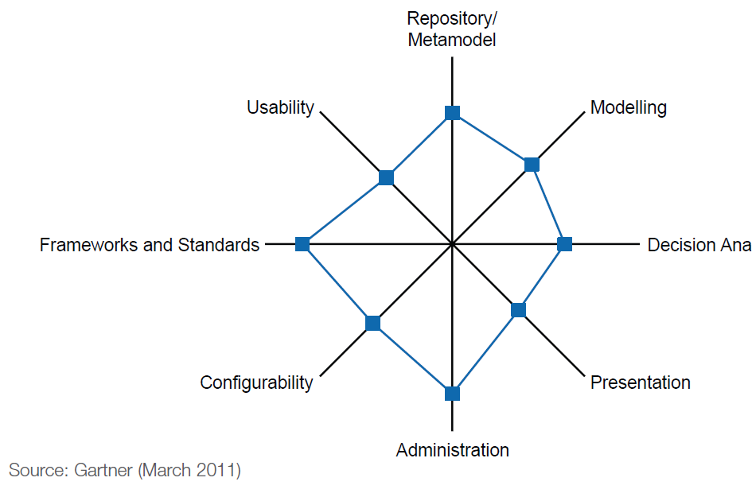
Enterprise Architect (sparxsystems.com)

Slide 60
EA Tools (Schekkerman, 2011)
(Schekkerman, Enterprise Architecture Tool Selection Guide, Institute For Enterprise Architecture Developments, 2011)
Application | Company | Category
PlanningIT Abacus Rational System Architect Mega Suite Meta Strom Enterprise Qualiware Product Suite ARIS Business Performance Troux Tranformation | Alphabet Avolution IBM Mega International Open Text Qualiware Software AG Troux | Leaders
MooD Platform | Salamader | Visionaries
BizzDesign Architect Corporate Modeler | BizzDesign Casewise | Challenger
SAMU Data Traction Envision VIP Eva Netmodeler Enterprise Architect | Atol Technologies Enterprise Elements Future Tech System Promis Sparx System | Niche Player

Slide 61
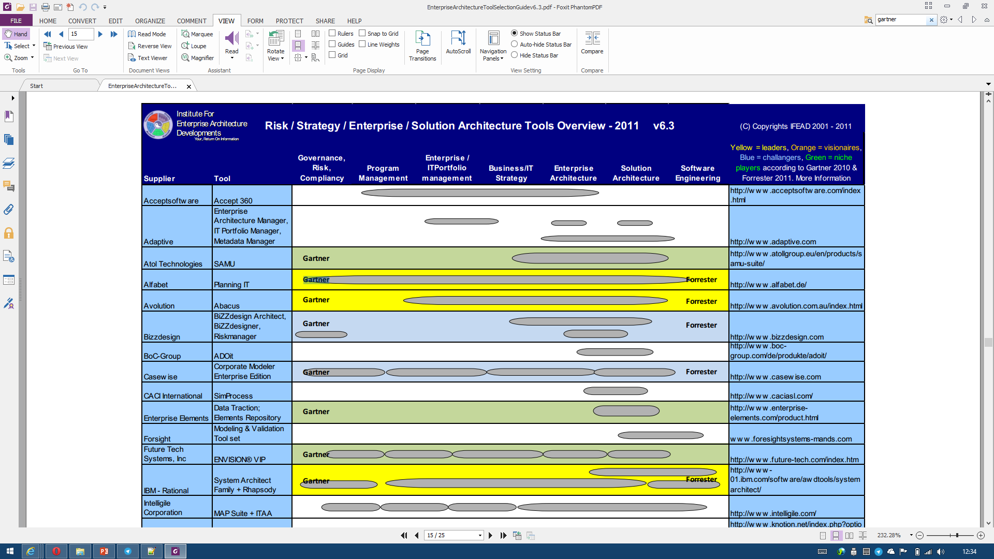

Slide 62
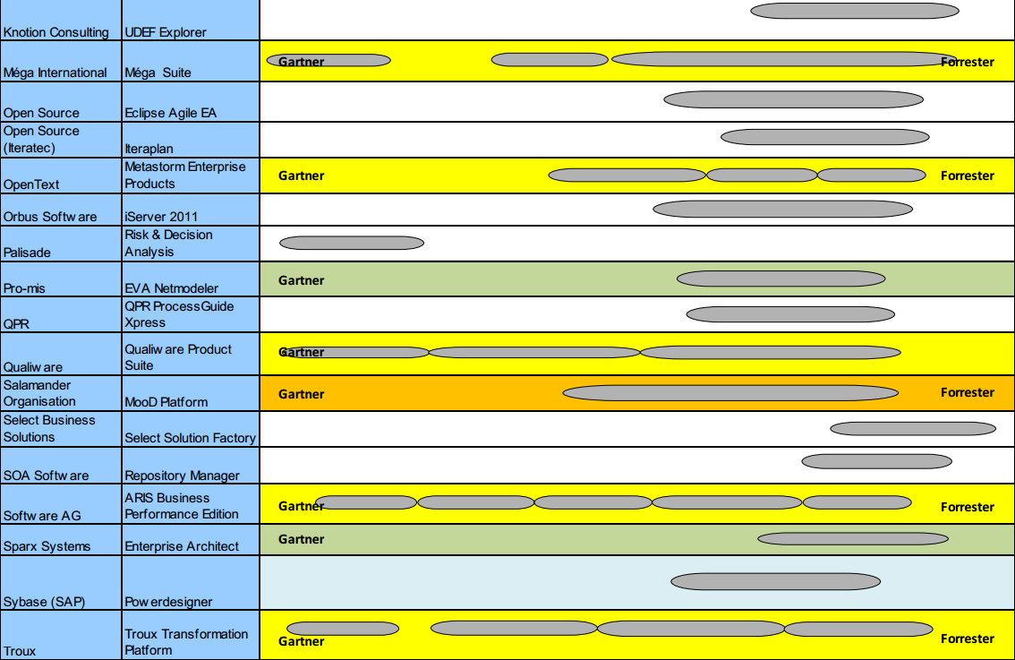

Slide 63
1.5 Enterprise Architecture Competency

Slide 64
Key Competencies to Create an Enterprise Architecture
Enterprise Architecture Framework
Enterprise Architecture Tools
Business Strategy and Organization Analysis → Business Model Canvas
Business Process Model and Notation (BPMN)
Data Modeling
Unified Modeling Language (UML)
Infrastructure and Network Design

Slide 65
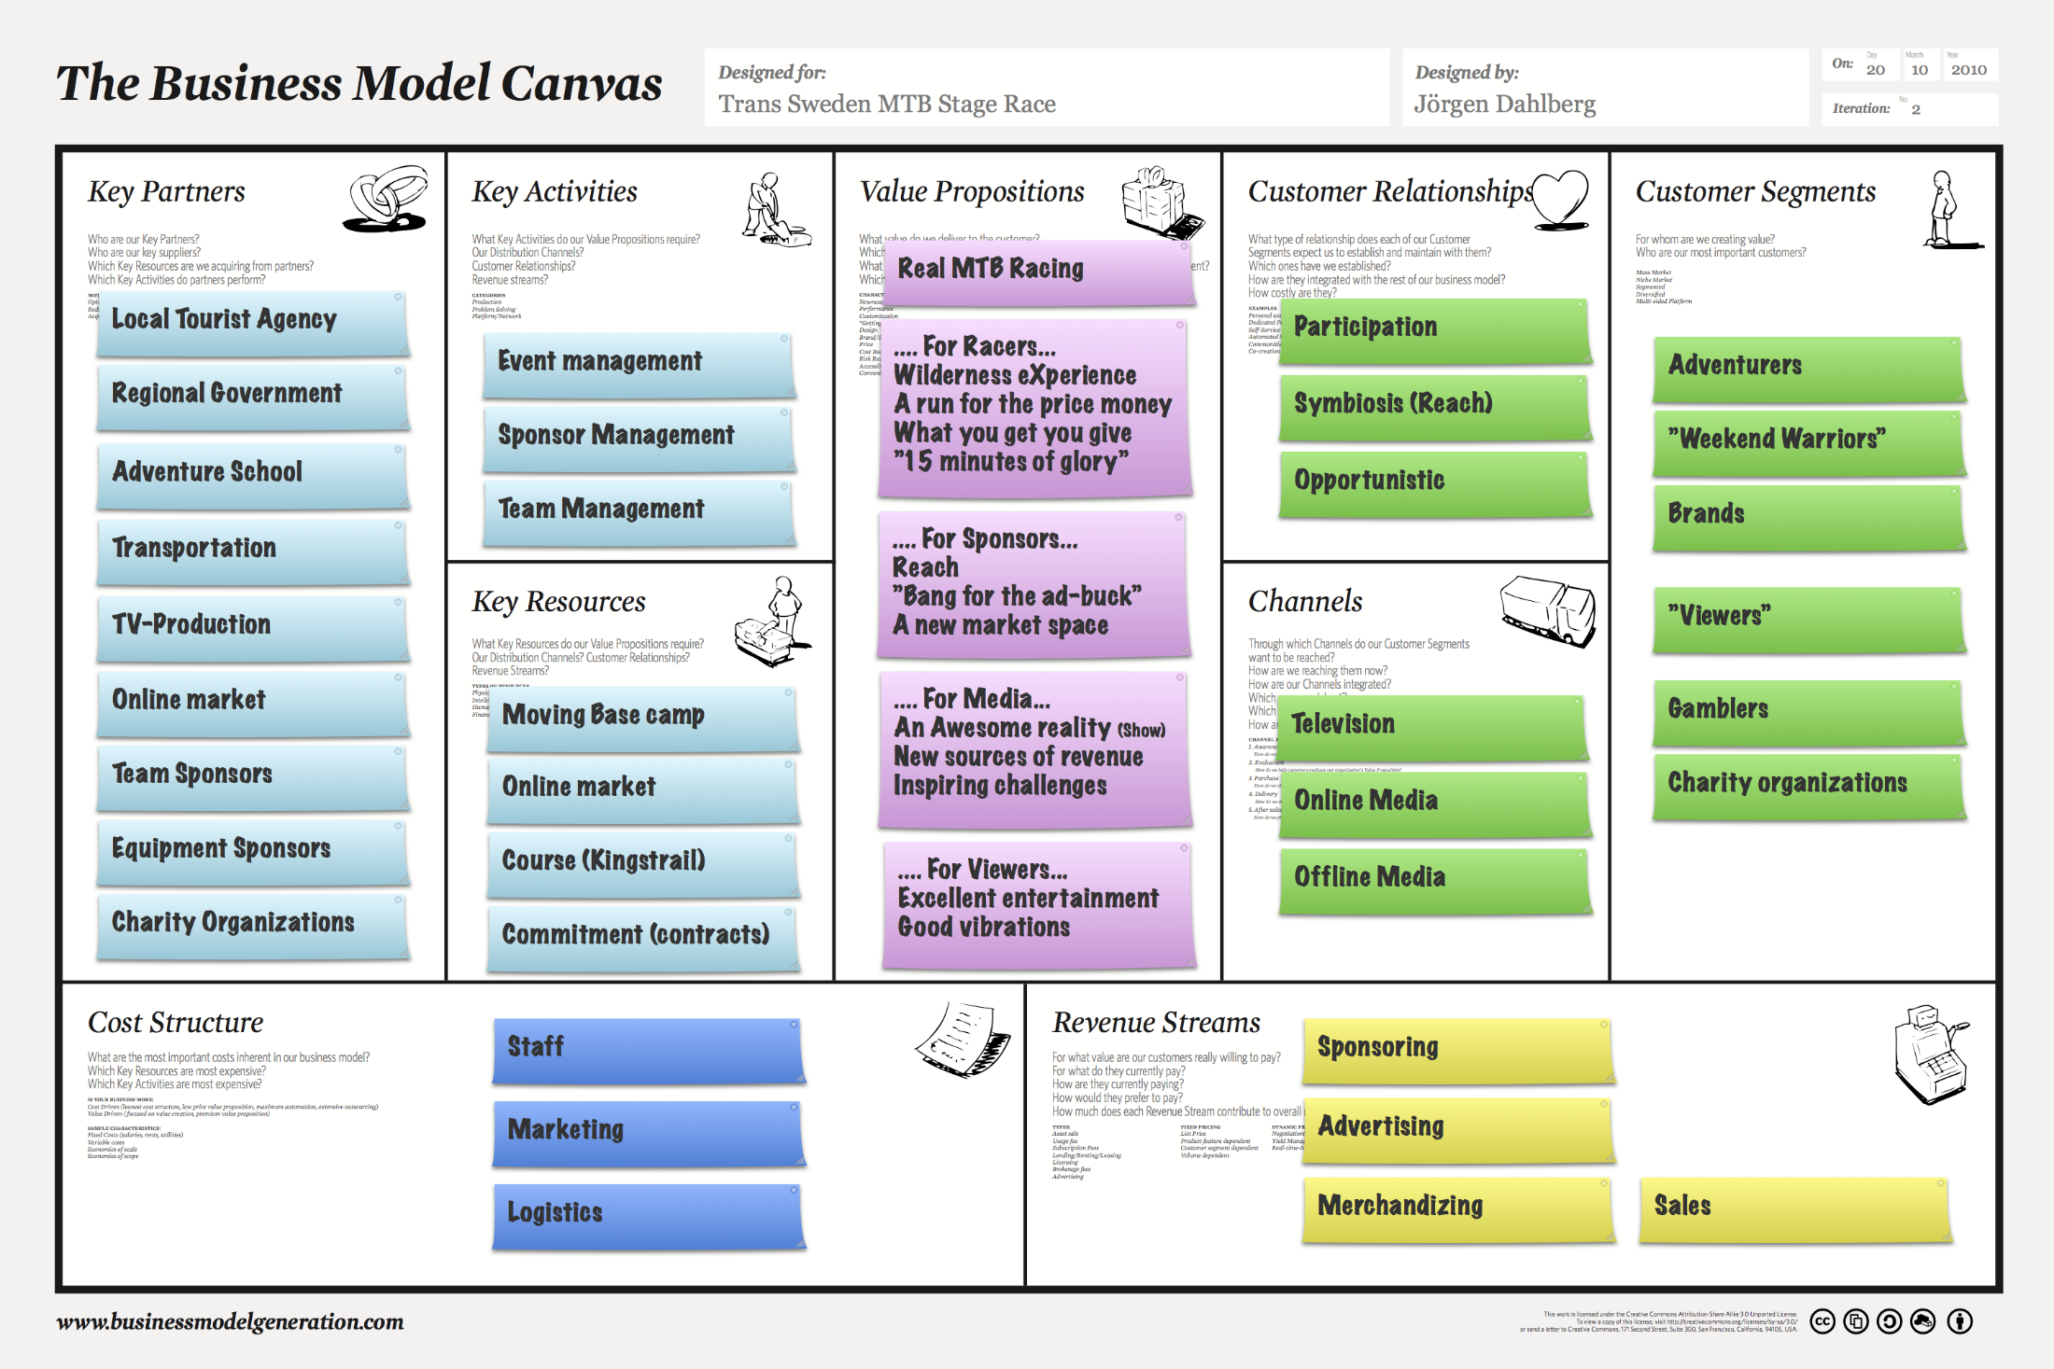

Slide 66
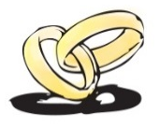
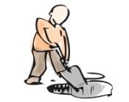
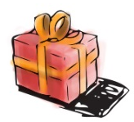





















Business Model Canvas
PT Brainmatics Cipta Informatika
Key Partners
Key Activities
Value Propositions
Customer Relationships
Customer Segments
Pearson
Vue
Software
Development
Kurikulum Internasional dan Customizable dengan Kebutuhan
Offline: Kegiatan Workshop dan Training
Staff IT
Training
Center
Dosen
Kryterion Online
Pengajar dengan Kompetensi Terpadu Akademisi dan Industri
Online: Social Media Participation, Situs Brainmatics.Com
Certification Examination
Mahasiswa
Prometrics
Key Resources
Peserta Ujian
Sertifikasi
Ruang Kelas Nyaman dan Posisi di Tengah Kota Jakarta
Channels
Percetakan
Kurikulum
Email
Pegawai
International Authorized Training and Testing Center
Telepon
Lembaga Pendidikan
Penerbit dan Distributor Buku
Brand Romi Satria Wahono
Brainmatics.Com
Lembaga
Pemerintahan
Online Market
Pengembangan Software dengan Metodologi Standard Internasional
Instant Messaging (YM, WA, Line, BBM)
Food Court
Perusahaan Swasta
Brand IlmuKomputer.Com
Social Media (Kaskus, Facebook, Twitter)
Cost Structure
Revenue Streams
Honor Pengajar
Biaya Operasional
Penjualan
Jasa Training
Penjualan Produk Software
Gaji Pegawai
Biaya Infrastruktur
Biaya Marketing

Slide 67
Business Model Canvas
Organisasi Anda
Key Partners
Key Activities
Value Propositions
Customer Relationships
Customer Segments
Key Resources
Channels
Cost Structure
Revenue Streams

Slide 68
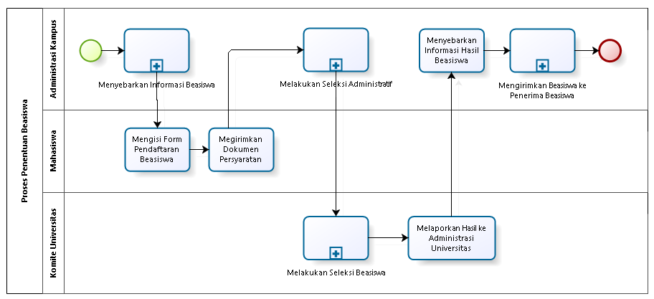
Business Process Model and Notation (BPMN)
Notasi standard untuk pemodelan proses bisnis
Object Management Group (OMG))
Permenpan No 12 Tahun 2011 tentang Pedoman Penataan Tata Laksana (Business Process)

Slide 69
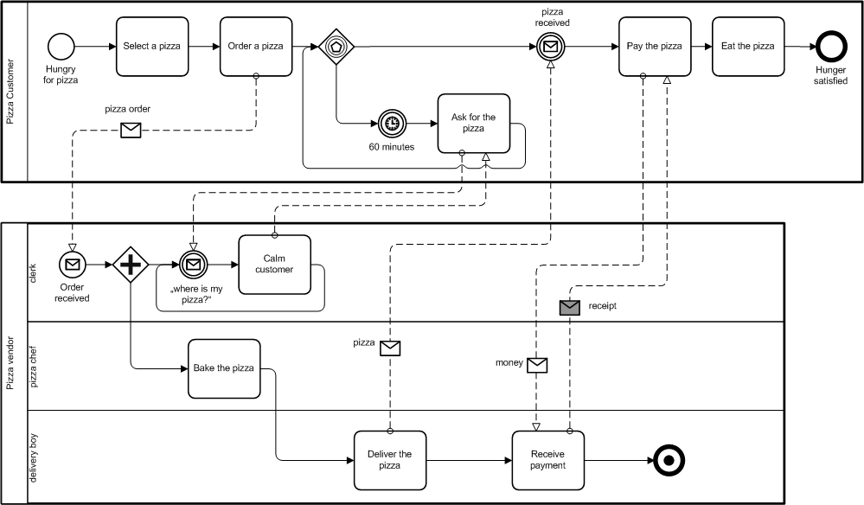
BPMN

Slide 70
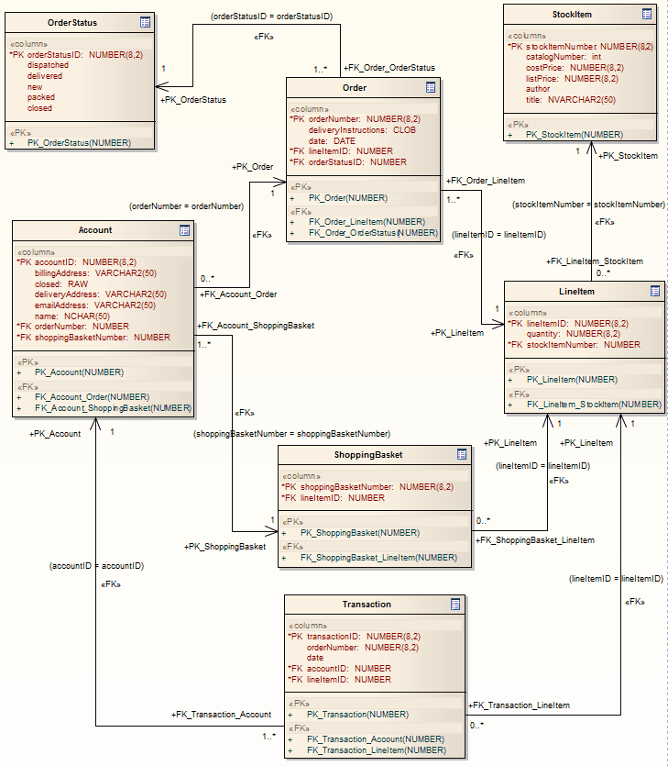
Data Modeling

Slide 71
UML
Use-Case Diagram
Statechart Diagram
Class Diagram
Actor A
Use Case 1
FileMgr
add( )
DocumentList
Document
Actor B
fetchDoc( )
delete( )
name : int
sortByName( )
docid : int
numField : int
get( )
read() fill the
Use Case 2
open( )
code..
close( )
FileList
read( )
fList
sortFileList( )
create( )
add( )
fillDocument( )
delete( )
1
Use Case 3
1
rep
File
Deployment Diagram
Repository
(from Persistence)
read( )
GrpFile
name : char * = 0
read( )
readDoc( )
open( )
Collaboration Diagram
readFile( )
create( )
fillFile( )
9: sortByName ( )
Repository
DocumentList
1: Doc view request ( )
mainWnd : MainWnd
FileManager
Window95
Windows95
Windows95
L
2: fetchDoc( )
Document
¹®¼­°ü¸®
4: create ( )
gFile : GrpFile
Å¬¶óÀÌ¾ðÆ®.EXE
¹®¼­°ü¸® ¾ÖÇÃ¸´
8: fillFile ( )
Windows
user : Clerk
fileMgr : FileMgr
NT
Solaris
3: create ( )
GraphicFile
¹®¼­°ü¸® ¿£Áø.EXE
Alpha
6: fillDocument ( )
File
FileList
Windows
ÀÀ¿ë¼­¹ö.EXE
UNIX
7: readFile ( )
NT
IBM
repository : Repository
5: readDoc ( )
document : Document
Mainframe
Component Diagram
µ¥ÀÌÅ¸º£ÀÌ½º¼­¹ö
mainWnd
fileMgr :
document :
gFile
repository
user
FileMgr
Document
Target
System
Æ¯Á¤¹®¼­¿¡ ´ëÇÑ º¸±â¸¦
1: Doc view request ( )
»ç¿ëÀÚ°¡ ¿äÃ»ÇÑ´Ù.
2: fetchDoc( )
3: create ( )
4: create ( )
5: readDoc ( )
È­ÀÏ°ü¸®ÀÚ´Â ÀÐ¾î¿Â
6: fillDocument ( )
¹®¼­ÀÇ Á¤º¸¸¦ ÇØ´ç ¹®¼­
°´Ã¼¿¡ ¼³Á¤À» ¿äÃ»ÇÑ´Ù.
7: readFile ( )
Forward and Reverse Engineering
È­¸é °´Ã¼´Â ÀÐ¾îµéÀÎ
9: sortByName ( )
8: fillFile ( )
°´Ã¼µé¿¡ ´ëÇØ ÀÌ¸§º°·Î
Á¤·ÄÀ» ½ÃÄÑ È­¸é¿¡
º¸¿©ÁØ´Ù.
Sequence Diagram

Slide 72
Test Yourself Questions
Which one of the following best describes why you need a framework for enterprise architecture?
Architecture design is complex
Using a framework can speed up the process
Using a framework ensures more complete coverage
A framework provides a set of tools and a common vocabulary
All of these

Slide 73
Test Yourself Questions
Which of the following are the architecture domains that are commonly accepted subsets of an overall enterprise architecture?
Application, Business, Data, Technology
Capability, Segment, Strategic
Context, Definition, Governance, Transformation
Definition, Realization, Transition, Vision

Slide 74
Test Yourself Questions
Which one of the following best describes an enterprise architecture?
An architecture of a commercial organization
An architecture that consists of more than one subsidiary company
An architecture that crosses multiple systems, and multiple functional groups within the enterprise
The highest level of architecture that can be achieved in a given organization

Slide 75
References
Rachel Harrison, Study Guide TOGAF® 9 Foundation 2nd Edition, The Open Group, 2011
Rachel Harrison, Study Guide TOGAF® 9 Certified 2nd Edition, The Open Group, 2011
Open Group Standard, TOGAF® Version 9.1 (G116), The Open Group, 2011
Open Group Standard, TOGAF® Version 9.1 – A Pocket Guide (G117), The Open Group, 2011
Daniel Minoli, Enterprise Architecture A to Z: Frameworks, Business Process Modeling, SOA, and Infrastructure Technology, Taylor & Francis, 2008
Jon Holt and Simon Perry, Modelling Enterprise Architectures, The Institution of Engineering and Technology, 2010
Alan Dennis et al, Systems Analysis and Design with UML 4th Edition, John Wiley and Sons, 2013

