Slide 1
Theory of Computation
5. Pushdown Automata
Romi Satria Wahono
romi@romisatriawahono.net
http://romisatriawahono.net/tc
Mobile: +6281586220090

Slide 2
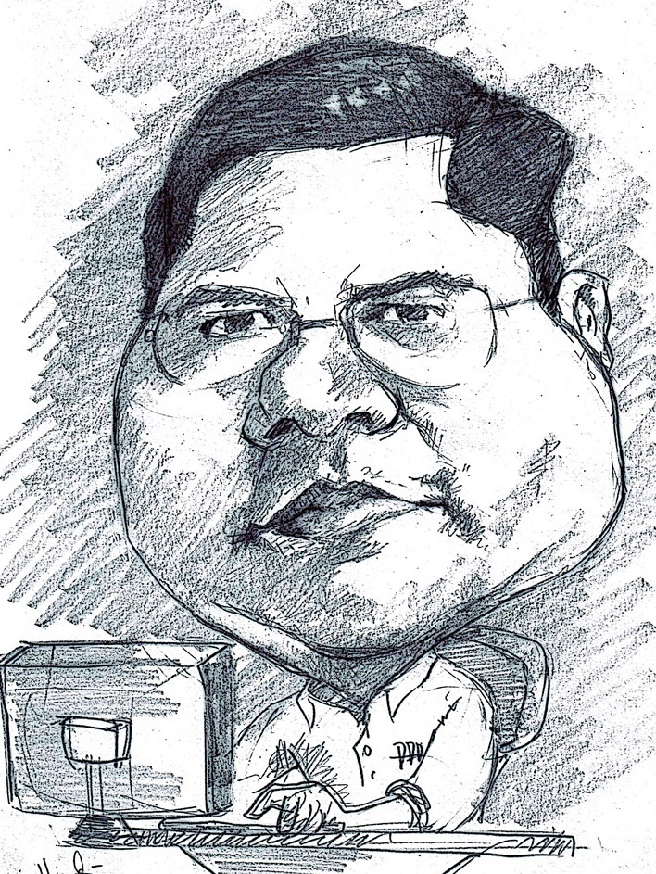
Romi Satria Wahono
SD Sompok Semarang (1987)
SMPN 8 Semarang (1990)
SMA Taruna Nusantara Magelang (1993)
B.Eng, M.Eng and Ph.D in Software Engineering from
Saitama University Japan (1994-2004)
Universiti Teknikal Malaysia Melaka (2014)
Research Interests: Software Engineering,
Machine Learning
Founder dan Koordinator IlmuKomputer.Com
Peneliti LIPI (2004-2007)
Founder dan CEO PT Brainmatics Cipta Informatika

Slide 3
Course Outline
Introduction
Math Fundamental 1: Set, Sequence, Function
Math Fundamental 2: Graph, String, Logic
Finite Automata
Pushdown Automata
Turing Machines

Slide 4
5. Context-Free Languages
5.1 Context-Free Grammars
5.2 Push Down Automata

Slide 5
5.1 Context-Free Grammars

Slide 6
Recap: Models of Computation
Model | Language Recognition | Memory Management | Implementation
Finite Automata | Regular Languages | No temporary memory | Elevators, Vending Machines, Traffic Light, Neural Network (small computing power)
Pushdown Automata | Context-free Languages | Stack | Compilers for Programming Languages (medium computing power)
Turing machine | Unrestricted Grammar, Lambda Calculus (Computable Languages) | Random access memory | Any Algorithm (highest computing power)

Slide 7
Introduction and Motivation
A Context Free Grammar is a “machine” that creates a language
A language created by a CF grammar is called A Context Free Language (CFL)
The class of Context Free Languages Properly Contains the class of Regular Languages

Slide 8
Context Free Grammar - Example
Consider grammar :
A CFL consists of substitution rules called Productions
The capital letters (I) are the Variables
The string consists of variables and other symbols called the Terminals

Slide 9
Context Free Grammar - Example
Consider grammar :
The grammar generates the language
called the language of
, denoted by

Slide 10
Context Free Grammar - Example
Consider grammar :
This is a Derivation of the word by :
On each step, a single rule is activated
This mechanism is nondeterministic

Slide 11
Context Free Grammar - Example
This is A Parse Tree of the word by :

Slide 12
Context Free Grammar - Example
Each internal node of the tree is associated with a single production

Slide 13
Context Free Grammar (CFG) - Example
Example of a context-free grammar, which we call G₃
A → 0A1
A → B
B → #
For example, grammar G₃ generates the string 000#111
The sequence of substitutions to obtain a string is called a derivation. A derivation of string 000#111 in grammar G₃ is
A ⇒ 0A1 ⇒ 00A11 ⇒ 000A111 ⇒ 000B111 ⇒ 000#111
We abbreviate several rules with the same left-hand variable, using the symbol “ | ” as an “or”
  A → 0A1 and A → B
  A → 0A1 | B
We may also represent the same information pictorially with a parse tree

Slide 14
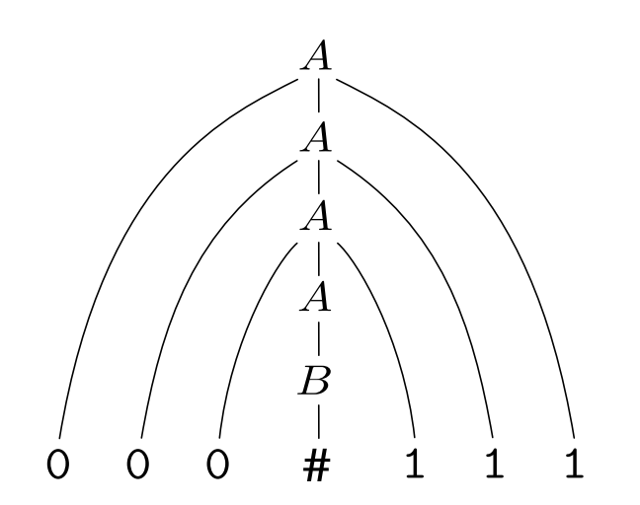
Parse Tree for 000#111 in Grammar G₃

Slide 15
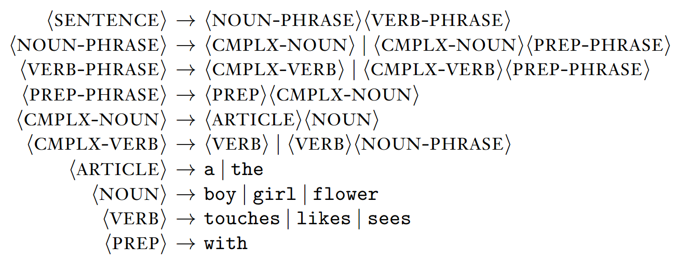
CFG – Example of English Language
Grammar G₂ has:
  10 variables (the capitalized grammatical terms written inside brackets)
  27 terminals (the standard English alphabet plus a space character)
  18 rules
Strings in L(G₂) include:
  a boy sees
  the boy sees a flower
  a girl with a flower likes the boy
Each of these strings has a derivation in grammar G₂

Slide 16
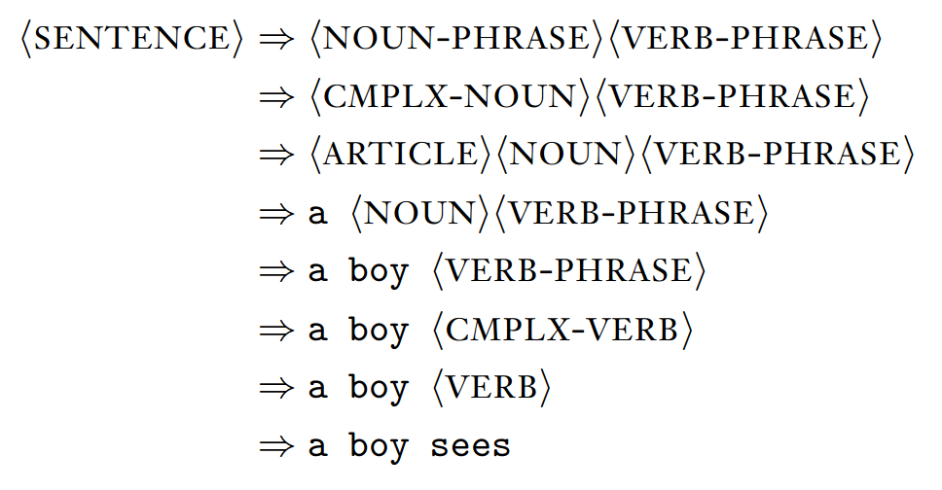
Derivation of the First String

Slide 17
CF Grammar – A Formal Definition
A Context Free Grammar is a 4-tupple
where:
is a finite set called the variables
is a finite set, disjoint from V called the terminals
is a set of rules, where a rule is a variable and a string of variables and terminals, and
is the start variable

Slide 18
A Derivation – A Formal Definition
A word is a string of terminals
A derivation of a word w from a context Free Grammar
is a sequence of strings
over , where:
is the start variable of G
For each , is obtained by activating a single production (rule) of G on one of the variables of

Slide 19
CF Grammar – A Formal Definition
A word w is in the Language of grammar G, denoted by , if there exists a derivation whose rightmost string is w
Thus,

Slide 20
Example2: Arithmetical EXPS
Grammar :
Rules:
1.
2.
3.

Slide 21
Example2: Arithmetical EXPS
Derivation of by Grammar :
input

Slide 22
Example2: Arithmetical EXPS
Derivation of by Grammar :
input
rule

Slide 23
Example2: Arithmetical EXPS
Derivation of by Grammar :
input output
rule

Slide 24
Example2: Arithmetical EXPS
Derivation of by Grammar :
input

Slide 25
Example2: Arithmetical EXPS
Derivation of by Grammar :
input
rule

Slide 26
Example2: Arithmetical EXPS
Derivation of by Grammar :
input output
rule

Slide 27
Example2: Arithmetical EXPS
Derivation of by Grammar :
input

Slide 28
Example2: Arithmetical EXPS
Derivation of by Grammar :
input
rule

Slide 29
Example2: Arithmetical EXPS
Derivation of by Grammar :
input
output
rule

Slide 30
Example2: Arithmetical EXPS
Derivation of by Grammar :
input

Slide 31
Example2: Arithmetical EXPS
Derivation of by Grammar :
input
rule

Slide 32
Example2: Arithmetical EXPS
Derivation of by Grammar :
input output
rule

Slide 33
Example2: Arithmetical EXPS
Derivation of by Grammar :
input

Slide 34
Example2: Arithmetical EXPS
Derivation of by Grammar :
input
rule

Slide 35
Example2: Arithmetical EXPS
Derivation of by Grammar :
input
output rule

Slide 36
Example2: Arithmetical EXPS
Derivation of by Grammar :
input

Slide 37
Example2: Arithmetical EXPS
Derivation of by Grammar :
input
rule

Slide 38
Example2: Arithmetical EXPS
Derivation of by Grammar :
input output
rule

Slide 39
Example2: Arithmetical EXPS
Derivation of by Grammar :
input

Slide 40
Example2: Arithmetical EXPS
Derivation of by Grammar :
input
input

Slide 41
Example2: Arithmetical EXPS
Derivation of by Grammar :
input
output rule

Slide 42
Example2: Arithmetical EXPS
Derivation of by Grammar :
input

Slide 43
Example2: Arithmetical EXPS
Derivation of by Grammar :
input
rule

Slide 44
Example2: Arithmetical EXPS
Derivation of by Grammar :
output rule

Slide 45
Example2: Arithmetical EXPS
Derivation of by Grammar :
input

Slide 46
Example2: Arithmetical EXPS
Derivation of by Grammar :
input
rule

Slide 47
Example2: Arithmetical EXPS
Derivation of by Grammar :
output rule

Slide 48
Example2: Arithmetical EXPS
Derivation of by Grammar :
input

Slide 49
Example2: Arithmetical EXPS
Derivation of by Grammar :
input rule

Slide 50
Example2: Arithmetical EXPS
Derivation of by Grammar :

Slide 51
Example2: Arithmetical EXPS
Derivation of by Grammar :
Note: There is more than one derivation

Slide 52
Ambiguity
We already saw that a word may have more then a single derivation from the same grammar
A Leftmost Derivation is a derivation in which rules are applied in order left to right
A grammar is ambiguous if it has Two parse trees
Reminder: Two parse trees are equal if they are equal as trees and if all productions corresponding to inner nodes are also equal

Slide 53
Example4: Similar to Arith. EXPS
Grammar :
Rules:

Slide 54
Example4: 1st Parse Tree for______

Slide 55
Example4: 2nd Parse Tree for_____

Slide 56
Ambiguity
Note: Some ambiguous grammars may have an unambiguous equivalent grammar
But: There exist Inherently Ambiguous Grammars, i.e. an ambiguous grammar that does not have an equivalent unambiguous one

Slide 57
Discussion
Q: From a computational point of view, how strong are context free languages?
A: Since the language is not regular and it is CF, we conclude that
Q: Can one prove ?
A: Yes

Slide 58
Discussion
Q: A language is regular if it is recognized by a DFA (or NFA). Does there exist a type of machine that characterizes CFL?
A: Yes, those are the Push-Down Automata (Next Lecture)
Q: Can one prove a language not to be CFL ?
A: Yes, by the Pumping Lemma for CFL-s . For example: is not CFL

Slide 59
5.2 Push Down Automata

Slide 60
Introduction and Motivation
In this lecture we introduce Pushdown Automata, a computational model equivalent to context free languages
A pushdown automata is an NFA augmented with an infinitely large stack
The additional memory enables recognition of some non regular languages

Slide 61
Schematic of a Finite Automaton
Finite control
a
a
b
a
c
input

Slide 62
Schematic of a Pushdown Automaton
Finite control
b
c
c
a
a
input
x
y
z
stack

Slide 63
Informal Description
A Pushdown Automata (PDA) can write an unbounded number of Stack Symbols on the stack and read these symbols later.
Writing a symbol onto the stack is called pushing and it pushes all symbols on the stack one stack cell down.

Slide 64
Informal Description
Removing a symbol off the stack is called popping and every symbol on the stack moves one stack cell up.
Note: A PDA can access only the stack’s topmost symbol (LIFO).

Slide 65
A PDA Recognizing_________
This PDA reads symbols from the input.
As each 0 is read, it is pushed onto the stack.
As each 1 is read, a 0 is popped from the stack.
If the stack becomes empty exactly when the
last 1 is read – accept.
Otherwise – reject.

Slide 66
Checking Stack Emptiness
The definition of a PDA does not give a special way to check emptiness.
One way to do it is to augment the stack alphabet with a special “emptiness” marker, the symbol $. (Note: There is nothing special about $ any other symbol not in the original can do.)

Slide 67
Checking Stack Emptiness
The computation is started by an transition in which $ is pushed on the stack.
If the end marker $ is found on the stack at the end of the computation, it is popped by a single additional transition after which the automaton “knows” that the stack is empty.

Slide 68
A PDA Recognizing_________
The label of each transition represents the input (left of arrow) and pushed stack symbol (right of the arrow).

Slide 69
A PDA Recognizing_________
The $ symbol, pushed onto the stack at the beginning of the computation, is used as an “empty” marker.

Slide 70
A PDA Recognizing_________
The PDA accepts either if the input is empty, or if scanning the input is completed and the PDA is at

Slide 71
Nondeterministic PDAs
A Nondeterministic PDA allows nondeterministic transitions.
Nondeterministic PDA-s are strictly stronger then deterministic PDA-s
In this respect, the situation is not similar to the situation of DFA-s and NFA-s.
Nondeterministic PDA-s are equivalent to CFL-s.

Slide 72
PDA – A Formal Definition
A pushdown automaton is a 6-tupple
where:
is a finite set called the states.
is the input alphabet.
is the stack alphabet.
is the transition function.
is the start state, and
is the set of accepting states.

Slide 73
PDA - The Transition Function
Consider the expression :
Recall that , and that .
Assume that the PDA is in state , the next input symbol is , and the top stack symbol is

Slide 74
PDA - The Transition Function
The next transition may either depend on the input symbol and the stack symbol , or only on the input symbol , or only on the stack symbol , or on none of them.
This choice is formally expressed by the argument of the transition function as detailed in the next slides.

Slide 75
Transition Function Sub-steps
Each step of the automaton is atomic, meaning it is executed in a single indivisible time unit.
For descriptive purposes only, each step is divided into two separate sub-steps:
  Sub-step1: A symbol may be read from the input, a symbol may be read and popped off the stack.
  Sub-step2: A state transition is carried out and a stack symbol may be pushed on the stack.

Slide 76
Transition Function – 1st Sub-step
If the transition depends both on and we write
. In this case is consumed and is removed from the stack.
If the transition depends only on we write
, is consumed and the stack does not change.

Slide 77
Transition Function – 1st Sub-step
If the transition depends only on , we write
. In this case is not consumed and
is removed from the stack.
Finally, If the transition depends neither on , nor on , we write . In this case is not consumed and the stack is not changed.

Slide 78
PDA - The Transition Function
The range of the transition function is :
The power set of the Cartesian product of the set of PDA states and the stack alphabet.
Using pairs means that determines:
  The new state to which the PDA moves.
  The new stack symbol pushed on the stack.

Slide 79
PDA - The Transition Function
Using the power set means that the PDA is nondeterministic: At any given situation, it may make a nondeterministic transition.
Finally, the use of means that at each transition the PDA may either push a stack symbol onto the stack or not (if the value is ).

Slide 80
CFLG-s and PDA-s are Equivalent
Theorem:
A language is CFL if and only if there exists a PDA accepting it.
Lemma->
For any CFL L, there exists a PDA P such that
.

Slide 81
Proof Idea
Since L is a CFL there exists a CFG G such that
. We will present a PDA P, that recognizes L.
The PDA P starts with a word on its input.
In order to decide whether , P simulates the derivation of w.

Slide 82
Proof Idea (cont.)
Recall that a derivation is a sequence of strings, where each string contains variables and terminals. The first string is always the start symbol of G and each string is obtained from the previous one by a single activation of some rule.

Slide 83
Proof Idea (cont.)
A string may allow activation of several rules and the PDA P non deterministically guesses the next rule to be activated.
The initial idea for the simulation is to store each intermediate string on the stack. Upon each production, the string on the stack before production is transformed to the string after production.

Slide 84
Proof Idea (cont.)
Unfortunately, this idea does not quite work since at any given moment, P can only access the top symbol on the stack.
To overcome this problem, the stack holds only a suffix of each intermediate string where the top symbol is the variable to be substituted during the next production.

Slide 85
The Intermediate String aaSbb
Finite control
S
a
a
a
b
b
b
b
b
input
$
stack

Slide 86
Informal Description of P
Push the marker $ and the start symbol S on the stack.
Repeat
If the top symbol is a variable V – Replace V by the right hand side of some non deterministically chosen rule whose left hand side is V .
…..

Slide 87
Informal Description of P
Push the marker $ and the start symbol S on the stack.
Repeat
…..
If the top symbol is a terminal compare it with the next symbol on the input. If equal – advance the input and pop the variable else – reject.

Slide 88
Informal Description of P
Push the marker $ and the start symbol S on the stack.
Repeat
…..
…..
If the top symbol is $ and the input is finished – accept else – reject

Slide 89
The Proof
We start by defining Extended Transitions:
Assume that PDA P is in state q , it reads from the input and pops from the stack and then moves to state r while pushing
onto the stack.
This is denoted by .
Next, extended transitions are implemented.

Slide 90
Implementing Extended Trans.
Add states .
Set the transition function as follows:
Add to .
Set ,
,
……
(see next slide)

Slide 91
Implementing Extended Trans.
This extended transition
Is implemented by this
transition sequence

Slide 92
The Proof
Let G be an arbitrary CFG. Now we are ready to construct the PDA, P such that that
The states of P are a
where E contains all states needed to implement the extended transitions presented in the previous slide.
The PDA P is presented on the next slide:

Slide 93
The Result PDA
This completes the Proof

Slide 94
Example
Consider the following CFG:
The Schematic NFA
Implementing First Transition
Implementing 1st Rule with Variables
Implementing 2nd Rule with Variables
Implementing 3rd Rule with Variables
Implementing Rules with Constants
Implementing 4th Rule with Variables
That’s All Folks!!!

Slide 95
Referensi
Michael Sipser, Introduction to the Theory of Computation Third Edition, Cengage Learning, 2012
George Tourlakis, Theory of Computation, Wiley, 2012
John Martin, Introduction to Languages and the Theory of Computation, McGraw-Hill , 2010
Robert Sedgewick and Kevin Wayne, Introduction to Computer Science, Addison-Wesley, 2015 (http://introcs.cs.princeton.edu/java)
Albert Endres dan Dieter Rombach, A Handbook of Software and Systems Engineering, Pearson Education Limited, 2003

