Slide 1
Software Engineering: 2. Process
Romi Satria Wahono romi@romisatriawahono.net http://romisatriawahono.net/se WA/SMS: +6281586220090

Slide 2
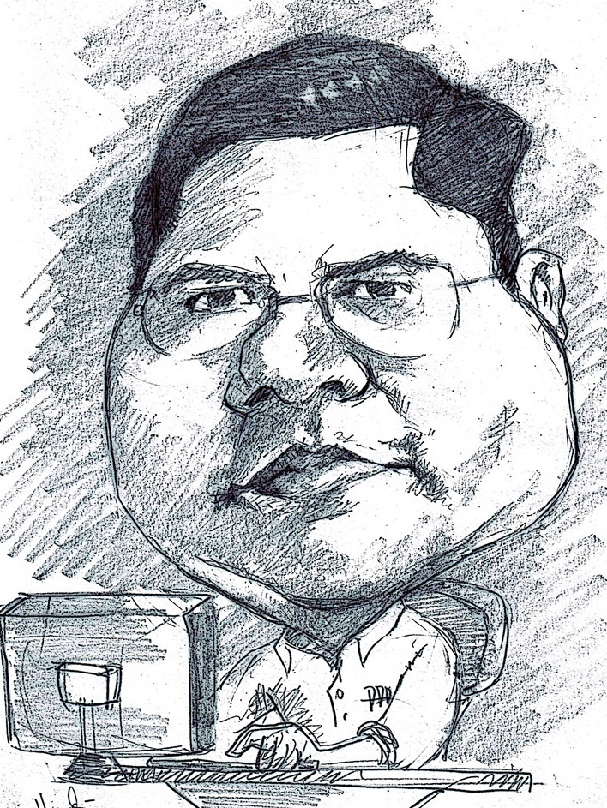
Romi Satria Wahono
SD Sompok Semarang (1987)
SMPN 8 Semarang (1990)
SMA Taruna Nusantara Magelang (1993)
B.Eng, M.Eng and Ph.D in Software Engineering from Saitama University Japan (1994-2004) Universiti Teknikal Malaysia Melaka (2014)
Research Interests: Software Engineering, Machine Learning
Founder dan Koordinator IlmuKomputer.Com
Peneliti LIPI (2004-2007)
Founder dan CEO PT Brainmatics Cipta Informatika

Slide 3
Course Outline
1. Introduction
2. Process
4. Quality
5. Research
3. Methodology

Slide 4
2. Process
2.1 Software Development Life Cycle
2.2 Software Effort Estimation

Slide 5
2.1 Software Development Life Cycle

Slide 6
2.1.1 Planning

Slide 7
When Do Software Projects Begin?
When someone sees an opportunity to create business value from using information technology
Then he or she creates a system request
Feasibility analysis is used to aid in the decision of whether or not to proceed with the project

Slide 8
Software Development Life Cycle (SDLC)
Implementation
Design
Analysis
Planning
(Dennis, 2012)

Slide 9
Software Development Life Cycle (SDLC)
Planning: Why build the system?
System request, feasibility analysis
Analysis: Who, what, when, where will the system be?
Requirement gathering, business process modeling
Design: How will the system work?
Program design, user interface design, data design
Implementation: System construction and delivery
System construction, testing, documentation and installation

Slide 10
1. Planning – System Request
Elemen | Deskripsi | Contoh
Business Need | The business-related reason for initiating the software development project | Increase sales Improve market share Improve access to information Improve customer service Decrease product defects Streamline supply acquisition processes
Business Requirements | The business capabilities that software will provide | Provide onIine access to information Capture customer demographic information Include product search capabilities Produce management reports Include online user support
Business Value | The benefits that the software will create for the organization | 3% increase in sales % increase in market share 10% operational cost reduction $200,000 cost savings from decreased supply costs $150,000 savings from removal of existing system

Slide 11
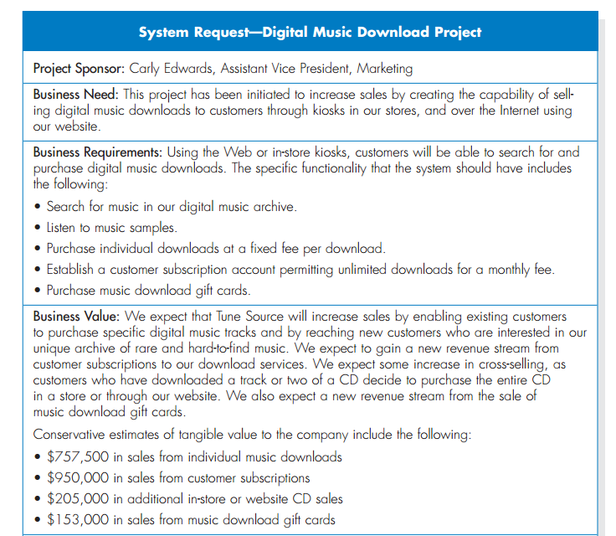

Slide 12
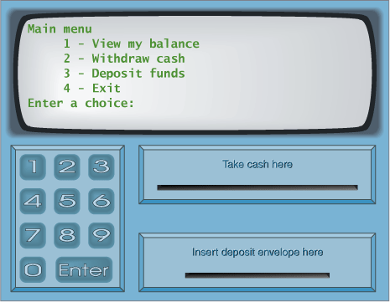
System Request – Case Study
Menu Utama
Melihat Saldo
Mentransfer Uang
Mengambil Uang
Logout
Kotak Uang
Kotak Kartu
Kotak Kuitansi

Slide 13
System Request – Online ATM System
Project Sponsor: | Margaret Mooney, Vice President of Marketing
Business Need: | Project ini dibuat dengan tujuan untuk mendapatkan pelanggan baru yang menggunakan Internet dam memberikan layanan yang lebih baik ke pelanggan yang ada melalui layanan berbasis Internet
Business Requirements:
Dengan menggunakan Online ATM System, pelanggan dapat melakukan seluruh transaksi perbankan. Fitur utama yang ada pada sistem ini adalah: Pengecekan Saldo Pengiriman Uang Transaksi Pembayaran Tagihan
Business Value:
Keuntungan Intangible: - Meningkatkan layanan ke pelanggan - Mengurangi komplen dari pelanggan Keuntungan Tangible: - $750,000 transaksi keuangan dari pelangan baru - $1,875,000 transaksi keuangan dari pelanggan lama - $50,000 pengurangan biaya telepon untuk melayani pelanggan

Slide 14
Latihan Studi Kasus
Buat System Request untuk aplikasi yang dibutuhan oleh suatu organisasi
Pikirkan baik-baik, keuntungan yang didapat (business value) dari penerapan system tersebut di organisasi

Slide 15
2. Planning - Feasibility Analysis
Technical feasibility: Can we build it?
Economic feasibility: Should we build it?
Organizational feasibility: If we build it, will they come?

Slide 16
2. Planning - Feasibility Analysis
1 | Technical Feasibility | Familiarity with application: Less familiarity generates more risk Familiarity with technology: Less familiarity generates more risk Project size: Large projects have more risk Compatibility: The harder it is to integrate the system with the company’s existing technology, the higher the risk will be
2 | Economic Feasibility | Return on Investment (ROI) Break Even Point (BEP) Intangible Benefit
3 | Organizational Feasibility | Is the software project strategically aligned with the business?

Slide 17
Feasibility Analysis - Technical Feasibility
Familiarity with application | Knowledge of business domain Need to understand improvements Need to recognize pitfalls and bad ideas
Familiarity with technology | Is technology new to this organization? Is this a brand new technology? Extension of existing firm technologies
Project size | Number of people, time, and features
Compatibility | Systems are not built in a vacuum Needs to integrate with current systems and data

Slide 18
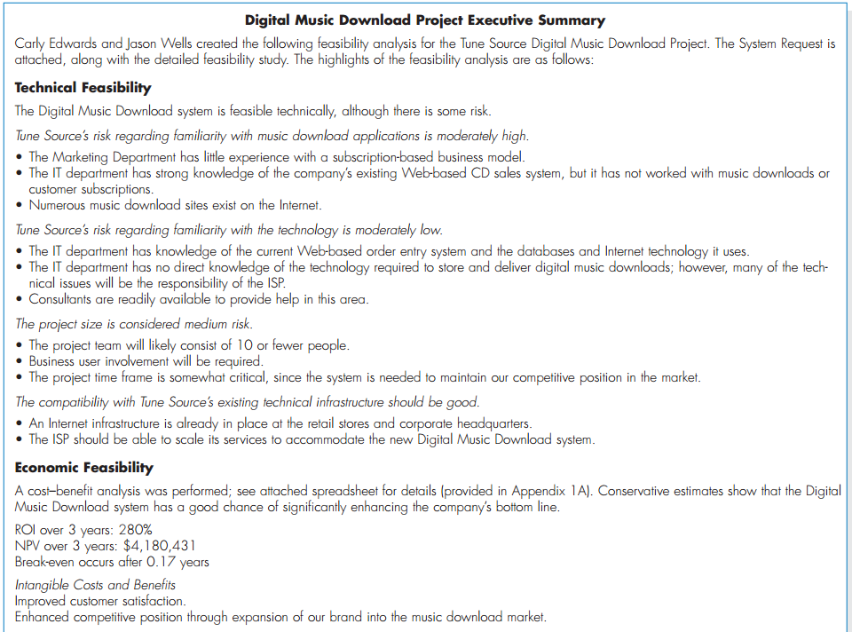

Slide 19
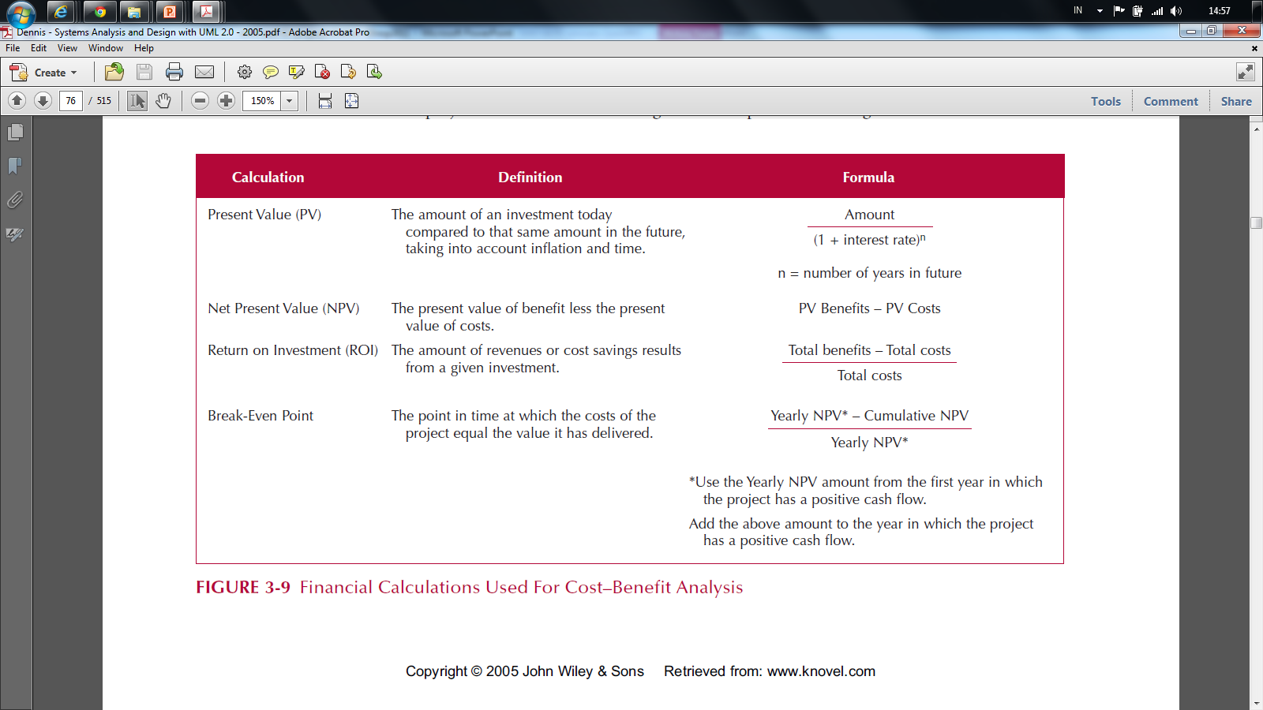
Feasibility Analysis - Economic Feasibility

Slide 20
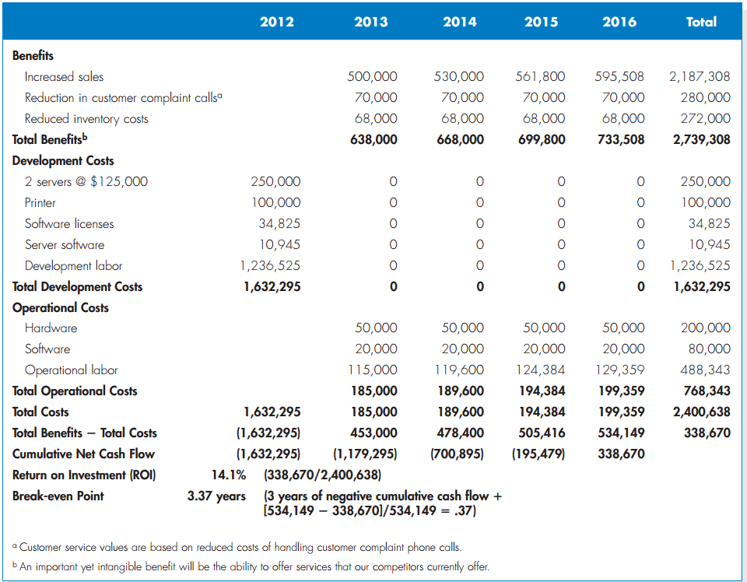

Slide 21
Present Value (PV)
The amount of an investment today compared to the same amount n years in the future
Taking into account inflation and time
PV =
Amount
(1 + Interest Rate)^{n}

Slide 22
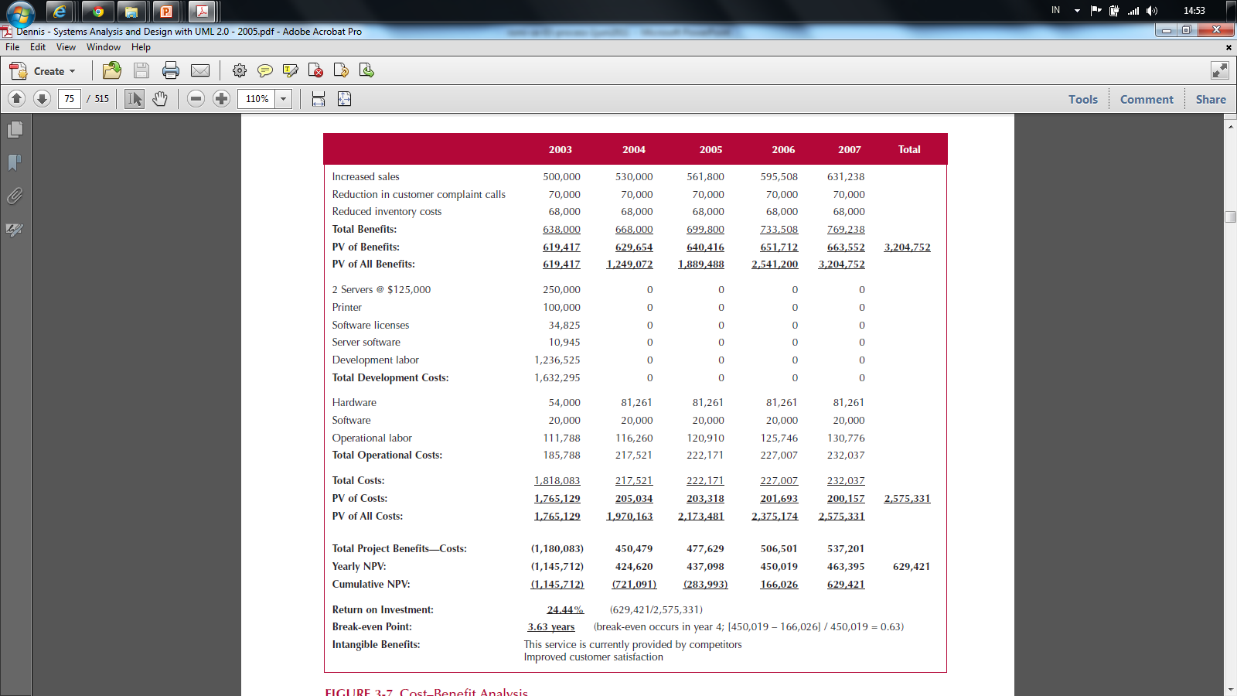
Net Present Value

Slide 23
Net Present Value (NPV)
The present value of benefit less the present value of cost
NPV = PV Benefits – PV Costs

Slide 24
NPV Calculation

Slide 25
Return on Investment (ROI)
The Amount of revenue or cost savings results from a given investment
ROI =
Total Benefits – Total Costs
Total Costs

Slide 26
ROI Calculation

Slide 27
Break Even Point (BEP)
The point in time when the costs of the project equal the value it has delivered
BEP =
* Use the yearly NPV amount from the first year in which project has positive cash flow
Yearly NPV* – Cumulative NPV
Yearly* NPV

Slide 28
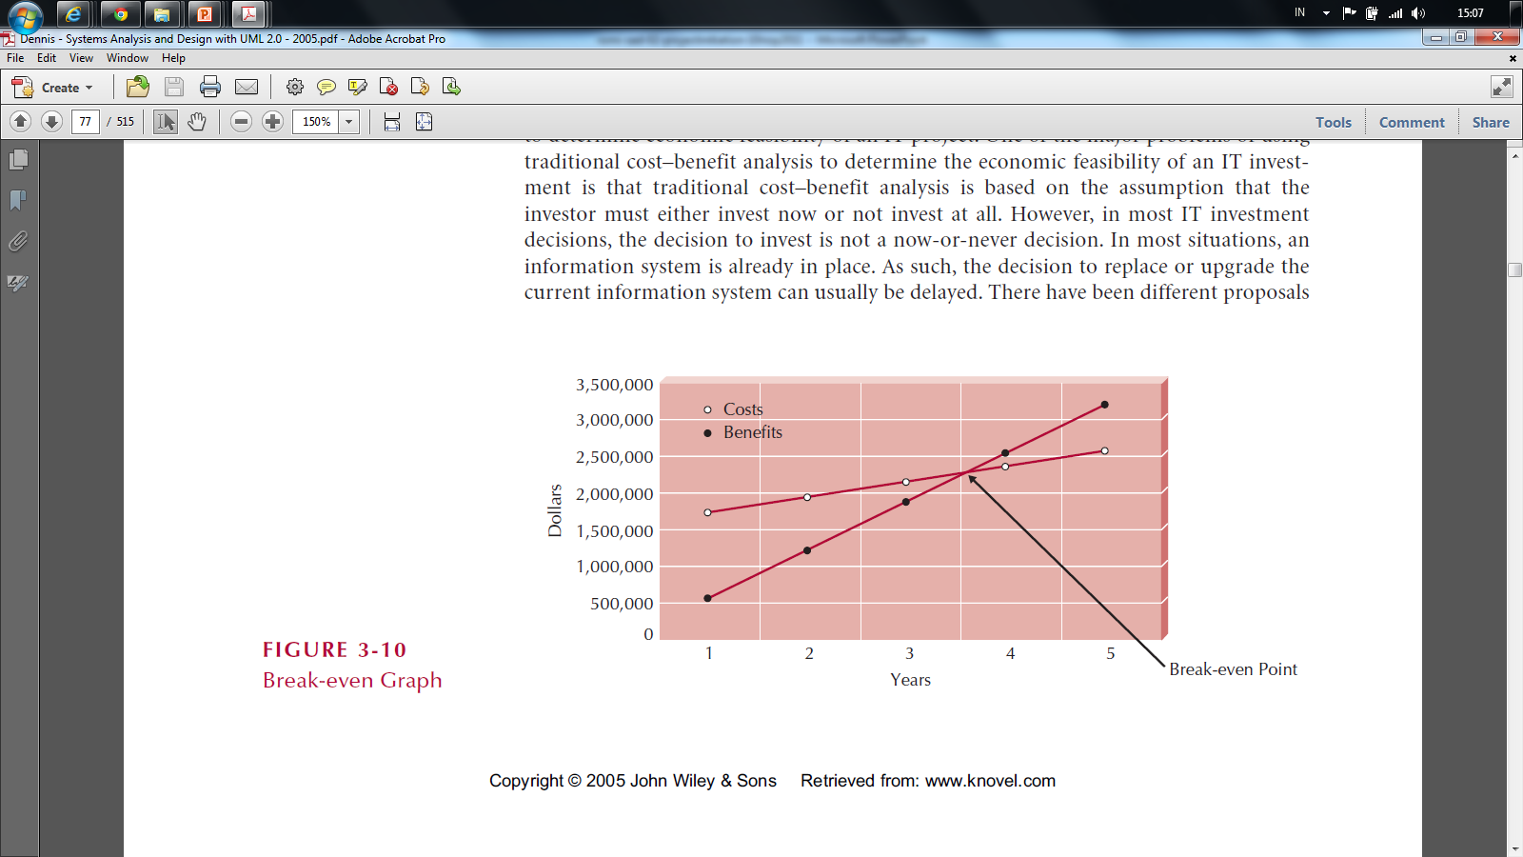
Break Even Point (BEP)

Slide 29
Cash Flow Plan

Slide 30
Feasibility Analysis - Organizational Feasibility
Strategic Alignment
How well does the project match up with the business strategy?
Stakeholder analysis considers
Project champion(s)
Organizational management
System users
Anybody affected by the change

Slide 31
Stakeholder Analysis Considers
Project champion(s)
High-level non-IS executive
Shepherds project to completion
It's good to have more than one
Organizational management
Need this support to sell system to organization
System users
In the loop so end system meets needs

Slide 32
Feasibility Analysis – Case Study
Technical feasibility
Economic feasibility
Organizational feasibility

Slide 33
Feasibility Analysis - Online ATM System
Margaret Mooney and Alec Adams created the following feasibility analysis for the Online ATM System Project.
1. Technical Feasibility The Online ATM System is feasible technically, although there is some risk. 1.1 Online ATM System’s risk regarding familiarity with the application is high The Marketing Department has little experience with Internet-based marketing and sales The IT Department has strong knowledge of the company’s existing ATM systems, however, it has not worked with Web-enabled ATM systems. 1.2 Online ATM System’s risk regarding familiarity with the technology is medium The IT Department has relied on external consultants to develop its existing Web env. The IT Department has learned about Web technology by maintaining the corporate site 1.3 The project size is considered medium risk The project team likely will include less than ten people Business user involvement will be required The project timeframe cannot exceed a year and it should be much shorter 1.4 The compatibility with existing technical infrastructure should be good The current ATM System is a client-server system built using open standards. An interface with the Web should be possible Retail bank already place and maintain orders electronically An Internet infrastructure already is in place at retail bank and at the corporate headquarters

Slide 34
2. Economic Feasibility
A cost–benefit analysis was performed. A conservative approach shows that the Online ATM System has a good chance of adding to the bottom line of the company significantly. Return on Investment (ROI) over 3 years: 229 percent Break-even point (BEP) occurs: after 1.7 years Total benefit after three years: $3.5 million Intangible Costs and Benefits Improved customer satisfaction Greater brand recognition
3. Organizational Feasibility
From an organizational perspective, this project has low risk. The objective of the system, which is to increase sales, is aligned well with the senior management’s goal of increasing sales for the company. The move to the Internet also aligns with Marketing’s goal to become more savvy in Internet marketing and sales. The project has a project champion, Margaret Mooney, Vice President of Marketing. Margaret is well positioned to sponsor this project and to educate the rest of the senior management team when necessary. Much of senior management is aware of and supports the initiative.

Slide 35
 | 2003 | 2004 | 2005 | Total
Increased sales from new customers | 0 | 750,000 | 772,500
Increased sales from existing customers | 0 | 1,875,000 | 1,931,250
Reduction in customer complaint calls | 0 | 50,000 | 50,000
Total Benefits: | 0 | 2,675,000 | 2,753,750
PV of Benefits: | 0 | 2,521,444 | 2,520,071 | 5,041,515
PV of All Benefits: | 0 | 2,521,444 | 5,041,515
Labor: Analysis, Design and Implementation | 162,000 | 0 | 0
Consultant Fees | 50,000 | 0 | 0
Office Space and Equipment | 7,000 | 0 | 0
Software and Hardware | 35,000 | 0 | 0
Total Development Costs: | 254,000 | 0 | 0
Labor: Webmaster | 85,000 | 87,550 | 90,177
Labor: Network Technician | 60,000 | 61,800 | 63,654
Labor: Computer Operations | 50,000 | 51,500 | 53,045
Labor: Business Manager | 60,000 | 61,800 | 63,654
Labor: Assistant Manager | 45,000 | 46,350 | 47,741
Labor: 3 Staff | 90,000 | 92,700 | 95,481
Software upgrades and licenses | 4,000 | 1,000 | 1,000
Hardware upgrades | 5,000 | 3,000 | 3,000
User training | 2,000 | 1,000 | 1,000
Communications charges | 20,000 | 20,000 | 20,000
Marketing expenses | 25,000 | 25,000 | 25,000
Total Operational Costs: | 446,000 | 452,700 | 464,751
Total Costs: | 700,000 | 452,700 | 464,751
PV of Costs: | 679,612 | 426,713 | 425,313 | 1,531,638
PV of all Costs: | 679,612 | 1,106,325 | 1,531,638
Total Project Costs Less Benefits: | (700,000) | 2,222,300 | 2,288,999
Yearly NPV: | (679,612) | 2,094,731 | 2,094,758 | 3,509,878
Cumulative NPV: | (679,612) | 1,415,119 | 3,509,878
Return on Investment (ROI): | 229.16% | (3,509,878/1,531,638)
Break-even Point (BEP): | 1.32 years | (BEP in Year 2 = [2,094,731 – 1,415,119] / 2,094,731 = 0.32)

Slide 36
Latihan Studi Kasus
Lakukan Feasibility Analysis untuk System Request yang dibuat

Slide 37
2.1.2 Analysis and Design

Slide 38
Analysis Design Paradigm and Diagrams
 | Paradigm | Diagrams
1 | Data-oriented | DFD
2 | Process-oriented | Flowchart
3 | Object-oriented (data + process) | UML

Slide 39
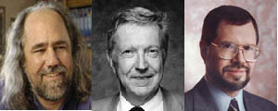
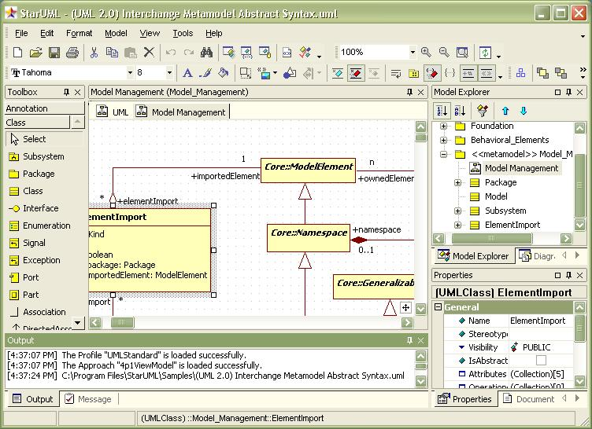
Sejarah UML
Booch, Jacobson, Rumbaugh
In the 90s many people creating OO diagramming languages
Three different ones created by Grady Booch, Ivar Jacobson, James Rumbaugh
Joined forces with
Rational (company) to
create Unified Modeling
Langauge (UML)

Slide 40
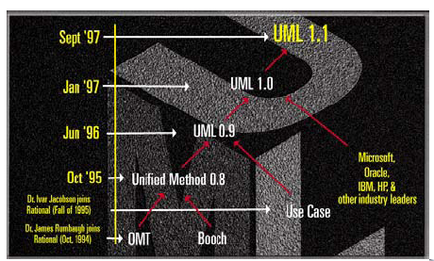
Sejarah UML
2011 → UML 2.4
2003 → UML 2.0

Slide 41
What is the UML?
UML: Unified Modeling Language
UML can be used for modeling all processes in the development life cycle and across different implementation technologies (technology and language independent)
UML is the standard language for visualizing, specifying, constructing, and documenting the artifacts of a software-intensive system
UML is a communication tool – for the team, and other stakeholders

Slide 42
The Triangle of Success in Software Dev.
Notation: Standard
Tools: Support Standard and Process
Process: Customer-Oriented Methodology

Slide 43
UML Tools
Rational Rose
Visual Paradigm
Enterprise Architect
Microsoft Visio
Star UML
Netbeans UML Plugin

Slide 44
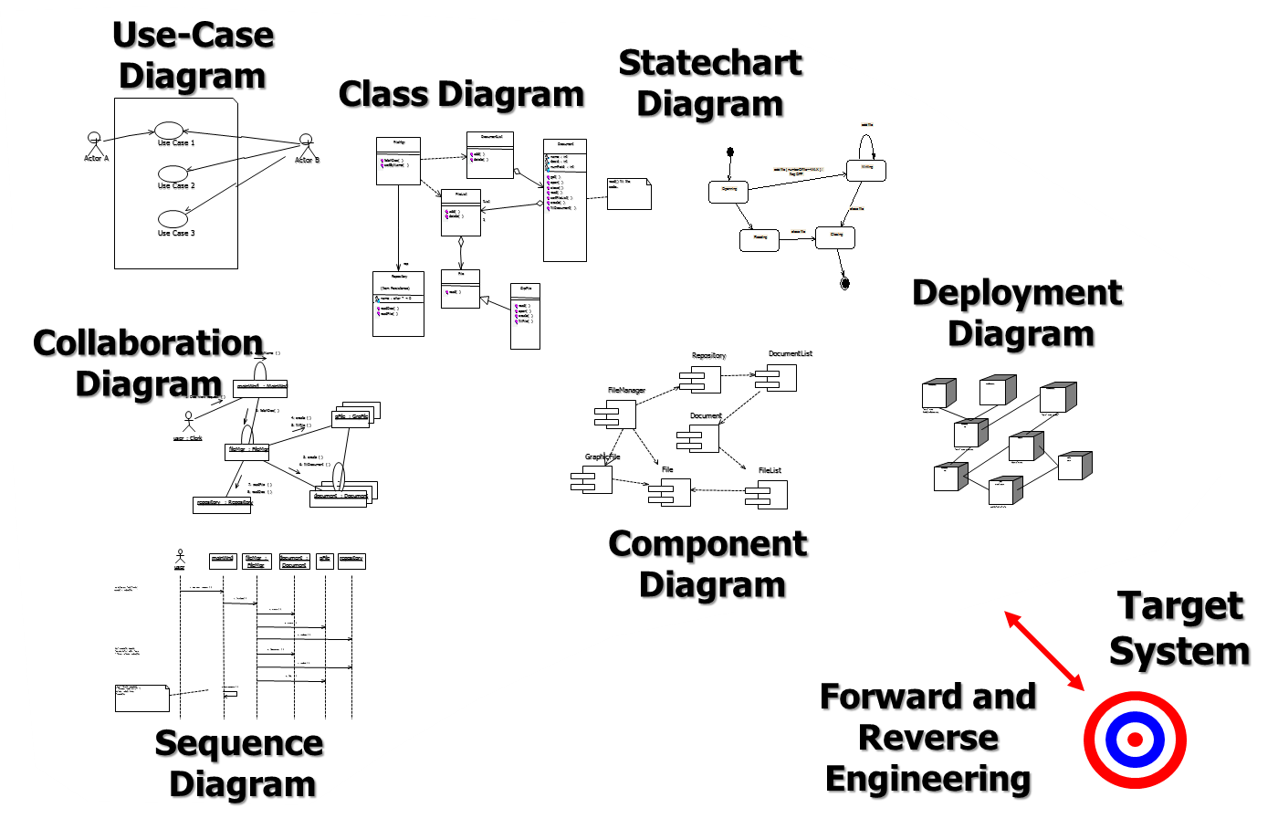
UML 2.0 Diagrams
UML version 2.0 has 14 diagrams in 2 major groups:
Structure Diagrams
Behavior Diagrams

Slide 45
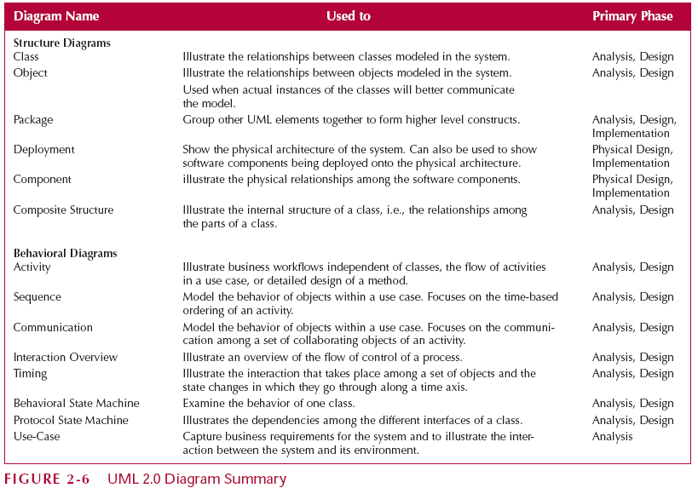
UML 2.0 Diagram

Slide 46
UML Structure Diagrams
Represent the data and static relationships in an information system
Class Diagram
Object Diagram
Package Diagram
Deployment Diagram
Component Diagram
Composite Structure Diagram

Slide 47
Structure Diagrams
Class Diagrams
Common vocabulary used by analyst and users
Represent things (employee, paycheck,…)
Shows the relationships between classes
Object Diagrams
Similar to class diagrams
Instantiation of a class diagram
Relationships between objects
Package Diagrams
Group UML elements together to form higher level constructs

Slide 48
Structure Diagrams
Deployment Diagrams
Shows the physical architecture and software components of system
For example, network nodes
Component Diagrams
Physical relationships among software components
Example – Client/Server (Which machines run which software)
Composite Structure
Illustrates internal structure of a complex class

Slide 49
UML Behavior Diagrams
Depict the dynamic relationships among the instances or objects that represent the business information system
Activity Diagram
Sequence Diagram
Communication Diagram
Interaction Diagram
Timing Diagram
Behavior State Machine
Protocol State Machine
Use Case Diagrams

Slide 50
Behavior Diagrams
Activity Diagrams
Model processes in an information system
Example: Business workflows, business logic
Interaction Diagrams
Shows interaction among objects
Sequence Diagrams
Time-based ordering of the interaction
Communication Diagrams
Communication among a set of collaborating objects of an activity

Slide 51
Behavior Diagrams
Interaction Diagrams
Overview of flow of control of a process
Timing Diagrams
Show how an object changes over time
State Machines
Examines behavior of one class
Models the different states and state transitions an object can experience
Use-Case Diagrams
Shows interaction between the system and environment
Captures business requirements

Slide 52
UML Problems
UML is modeling notation, it is not a development process or a methodology
UML driven development process?
UML is too complex, difficult to understand quickly
Should we use all UML diagrams?

Slide 53
UML Process (EA Sparx)
Display the boundary of a system and its major functions using use cases and actors
Model the organization’s business process with activity diagram
Illustrate use case realizations with sequence diagrams
Represent a static structure of a system using class diagrams
Reveal the physical implementation architecture with deployment diagrams

Slide 54
UML Process (EA Sparx)
Use Cases Diagram
Activity Diagram
Sequence Diagram
Class Diagram
Deployment Diagrams

Slide 55
UML Process (Kendal, 2011)
A use case diagram, describing how the system is used. Analysts start with a use case diagram
An activity diagram, illustrating the overall flow of activities. Each use case may create one activity diagram
Sequence diagrams, showing the sequence of activities and class relationships. Each use case may create one or more sequence diagrams
Class diagrams, showing the classes and relationships. Sequence diagrams are used to determine classes
Statechart diagrams, showing the state transitions. Each class may create a statechart diagram, which is useful for determining class methods

Slide 56
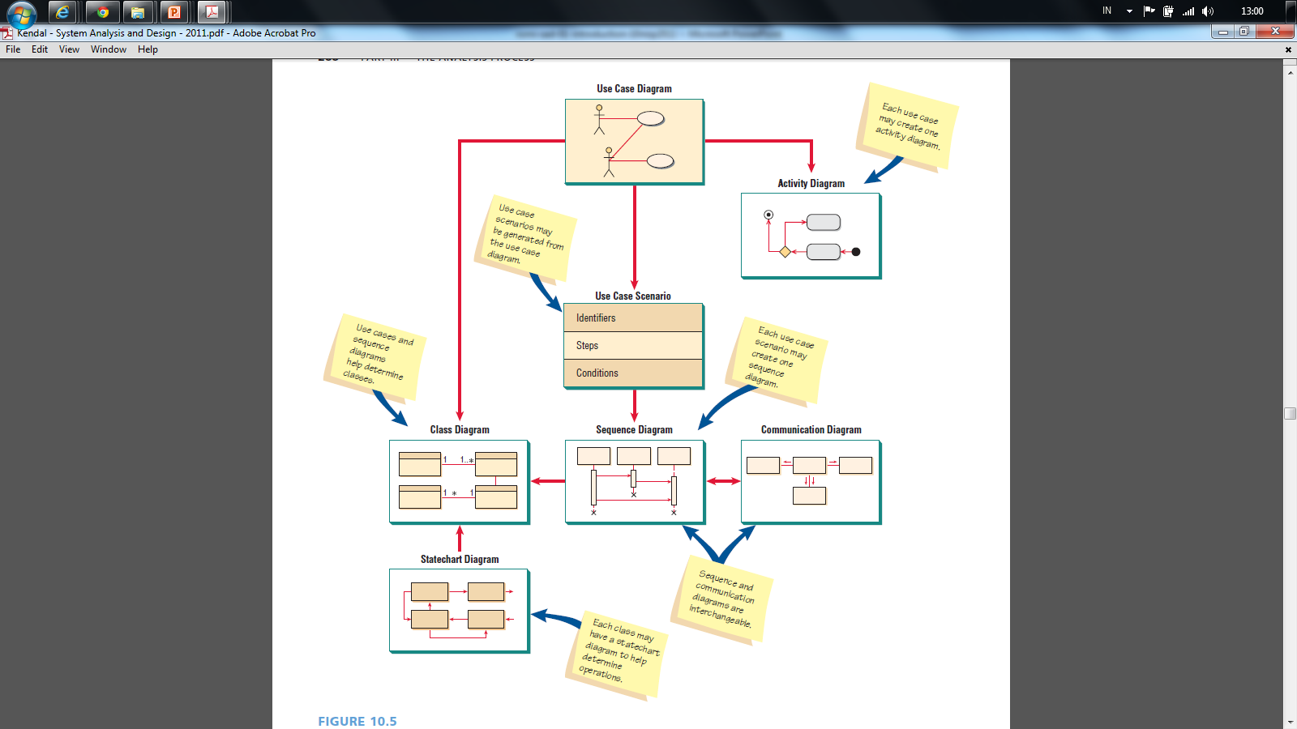
(Kendall and Kendall, 2011)

Slide 57
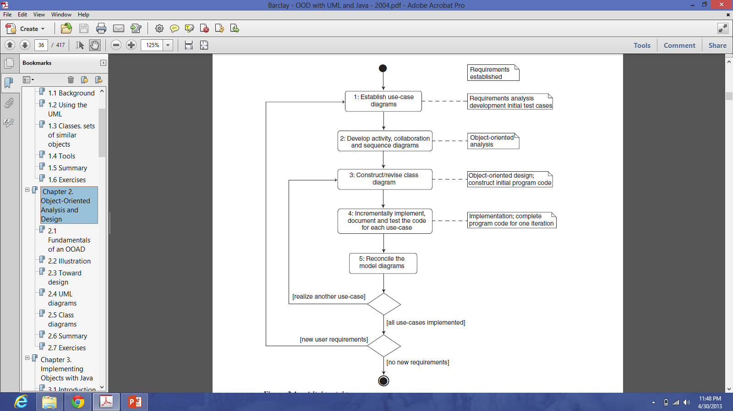
UML Process (Barclay, 2004)

Slide 58
System Analysis and Design with UML
System Analysis
Business Process Identification
Use Case Diagram
Business Process Modeling
Activity Diagram or Business Process Modeling Notation (BPMN)
Business Process Realization
Sequence Diagram (Buat untuk setiap use case dengan menggunakan pola Boundary-Control-Entity)
System Design
Program Design
Class Diagram (Gabungkan Boundary-Control-Entity Class dan susun story dari sistem yang dibangun)
Package Diagram (Gabungan class yang sesuai, boleh menggunakan pola B-C-E)
Deployment Diagram (arsitektur software dari sistem yang dibangun)
User Interface Design (Buat UI design dari Boundary Class)
Entity-Relationship Model (Buat ER diagram dari Entity Class)

Slide 59
SDLC and Artifacts
Planning
1.1 System Request
1.2 Feasibility Analysis
Analysis
2.1 Use Case Diagram
2.2 Activity Diagram
2.3 Sequence Diagram
Design
3.1 Class Diagram
3.2 Deployment Diagram
3.3 User Interface Design
3.4 Data Model
Implementation 4.1 Program Code 4.2 Testing Plan 4.3 Documentation
System
Proposal
System
Specification
New
Software

Slide 60
Use Case Diagram

Slide 61
Use Case Diagrams
Summarized into a single picture
All of the use cases for the part of the system being modeled
Use case represents the discrete activities performed by the user
Use Case Diagram tells what the system will do
Good for communicating with users

Slide 62
Syntax for an Use Case Diagram
Actor
person or system that derives benefit from and is external to the subject
Use Case
Represents a major piece of system functionality
Association Relationship
Include Relationship
Extend Relationship
Generalization Relationship
<<includes>>
<<extends>>

Slide 63
Use Case
A major piece of system functionality
Can extend other Use Cases
Placed inside system boundary
Labeled with descriptive verb - noun phrase
Use Case

Slide 64
System Boundary
Boundary
Includes the name of the system inside or on top
Represents the scope of the system
Actors are outside the scope of the system

Slide 65
Actor
A person or another system that interacts with the current system
A role, not a specific user
Provides input, receives output, or both
⟨⟨actor⟩⟩
Actor/Role

Slide 66
Association Relationship
Links actor and the Use Case
Shows two-way communication
If one-way, arrows are used
* is for "multiplicity of the Association"
*
*

Slide 67
Extends Relationship
Extends Use Case to include Optional behavior
Arrow points from the extension Use Case to the base Use Case
⟨⟨extend⟩⟩
Make Payment
Arrangement
⟨⟨extend⟩⟩
Make Appointment

Slide 68
Include Relationship
Include one Use Case from within another
Arrow points from base Use Case to the included Use Case
⟨⟨include⟩⟩
Make New
Patient Appointment
⟨⟨include⟩⟩
Create New Patient

Slide 69
Generalization Relationship
A specialized Use Case to a more generalized Use Case
Arrow points from specialized to general Use Case
Make Old Appointment
Make Appointment

Slide 70
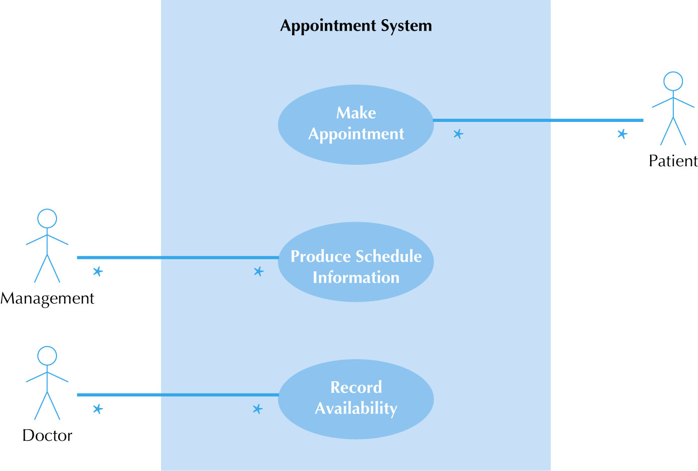
Use Case Diagram for Appointment System

Slide 71
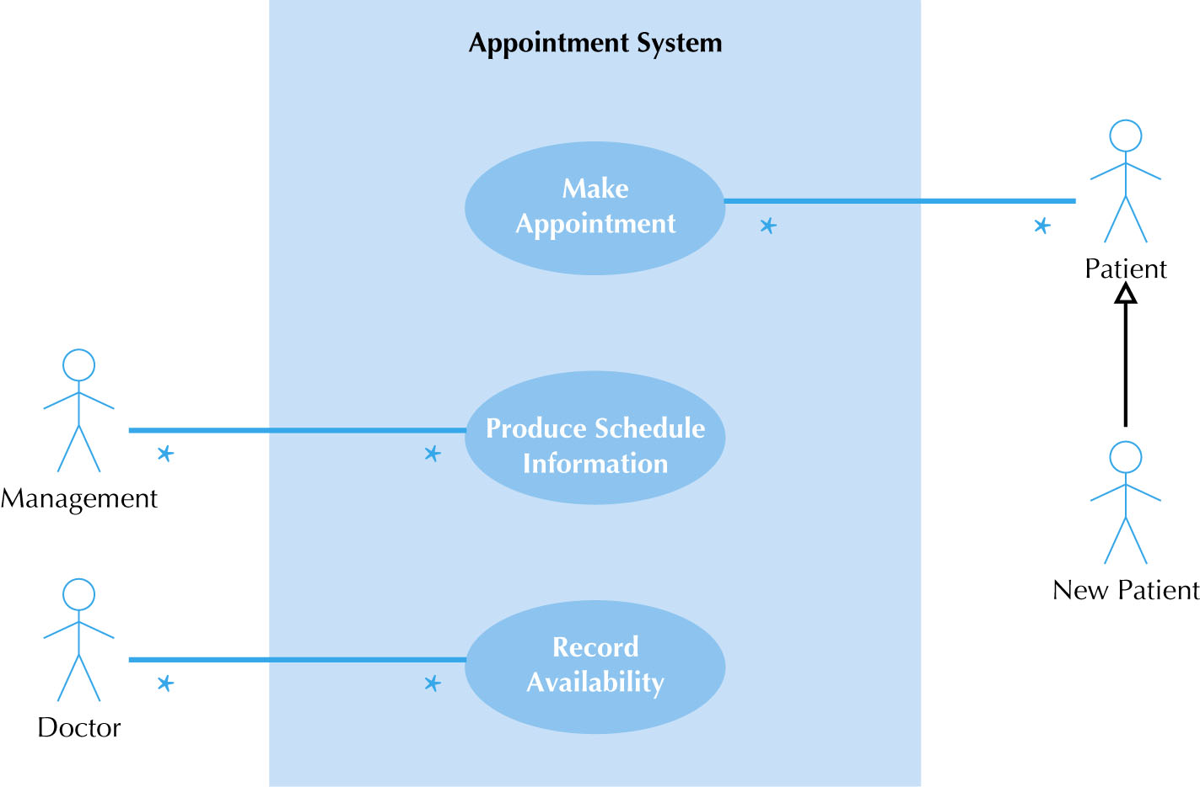
Use Case Diagram with Specialized Actor

Slide 72
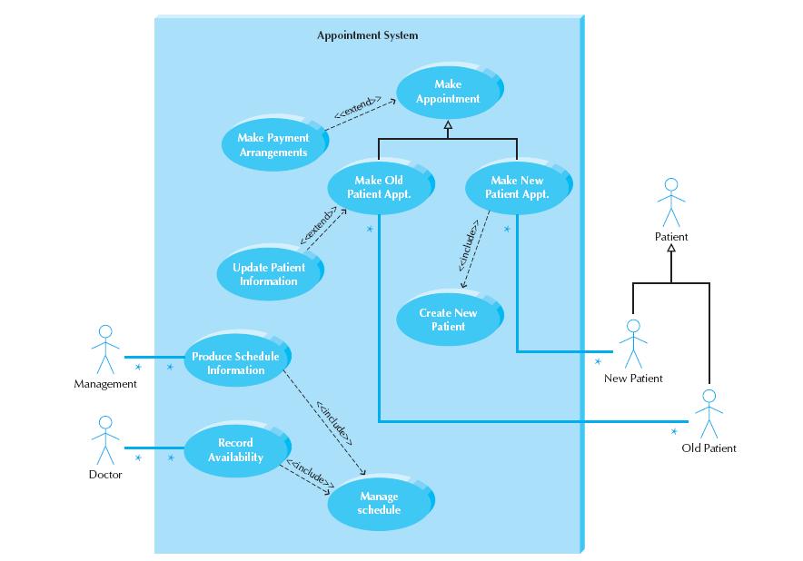
Extend and Include Relationships

Slide 73
Use Case Diagram – Case Study

Slide 74
Latihan Studi Kasus
Pahami kembali System Request yang sudah dibuat
Lanjutkan dengan membuat Use Case Diagram dari System Request yang dibuat

Slide 75
Activity Diagram

Slide 76
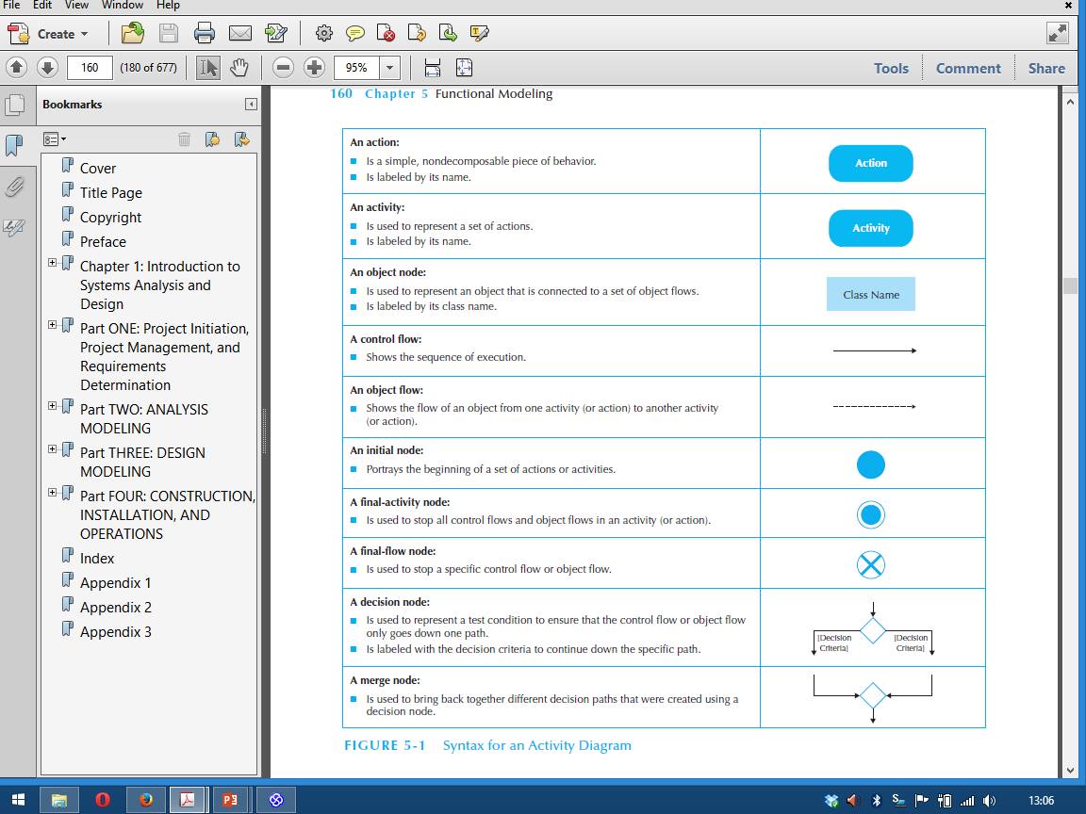
Syntax for an Activity Diagram

Slide 77
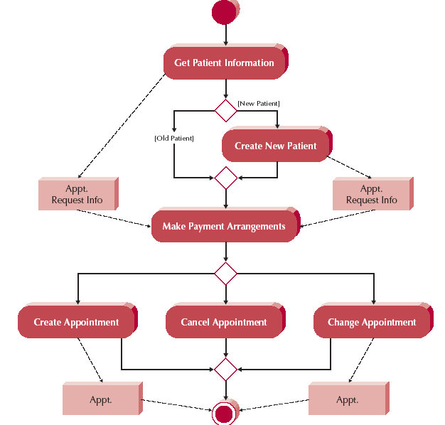
Activity Diagram Example

Slide 78
Syntax for an Activity Diagram

Slide 79
2. Activity Diagram: Memasukkan PIN

Slide 80
2. Activity Diagram: Mengecek Saldo

Slide 81
2. Activity Diagram: Mentransfer Uang

Slide 82
2. Activity Diagram: Melakukan Logout

Slide 83
Latihan Studi Kasus
Pahami kembali System Request yang sudah dibuat
Lanjutkan dengan membuat Activity Diagram dari System Request yang dibuat

Slide 84
Sequence Diagram

Slide 85
Sequence Diagrams
Illustrate the objects that participate in a use case
Show the messages that pass between objects for a particular use-case over time

Slide 86
Sequence Diagram Syntax
AN ACTOR
AN OBJECT
A LIFELINE
A FOCUS OF CONTROL
A MESSAGE
OBJECT DESTRUCTION
anObject:aClass
aMessage()
x

Slide 87
3. Sequence Diagram: Memasukkan PIN

Slide 88
Type of Class
Boundary Class
Class yang berhubungan dengan actor (user interface)
Control Class
Class yang berhubungan dengan pemrosesan, komputasi, penghitungan, dsb
Entity Class
Class yang berhubungan dengan data (flat file or database)

Slide 89
3. Sequence Diagram: Mengecek Saldo

Slide 90
3. Sequence Diagram: Mentransfer Uang

Slide 91
3. Sequence Diagram: Melakukan Logout

Slide 92
Latihan Studi Kasus
Pahami kembali System Request yang sudah dibuat
Lanjutkan dengan membuat Sequence Diagram dari System Request yang dibuat

Slide 93
Class Diagram

Slide 94
Class Diagram Elements
Classes
Attributes
Operations
Relationships

Slide 95
Classes
Templates for creating instances or objects
All objects of a class have same structure and behavior, but contain different attributes
Concrete: used to create actual objects
Abstract: extended to create other classes

Slide 96
Attributes
Units of information relevant to the description of the class
Only attributes important to the task should be included
Attributes should be primitive types (integers, strings, doubles, date, time, Boolean, etc.)

Slide 97
Operations (Methods)
Defines the behavior of the class
Action that instances/objects can take
Focus on relevant problem-specific operations (at this point)

Slide 98
Relationships
Generalization
“Is-A” relationship
Enables inheritance of attributes & oper's
Subclasses and superclasses
Principle of substitutability
Subclass be substituted for superclass
Aggregation
“Has-A” relationship
Relates parts to wholes
Uses decomposition
Association
Relationships that don't fit “Is-A” or “Has-A”
Often a weaker form of “Has-A”
Miscellaneous relationships between classes
Example:
Patient schedules an appointment
So the appointment has a patient
This is weak

Slide 99
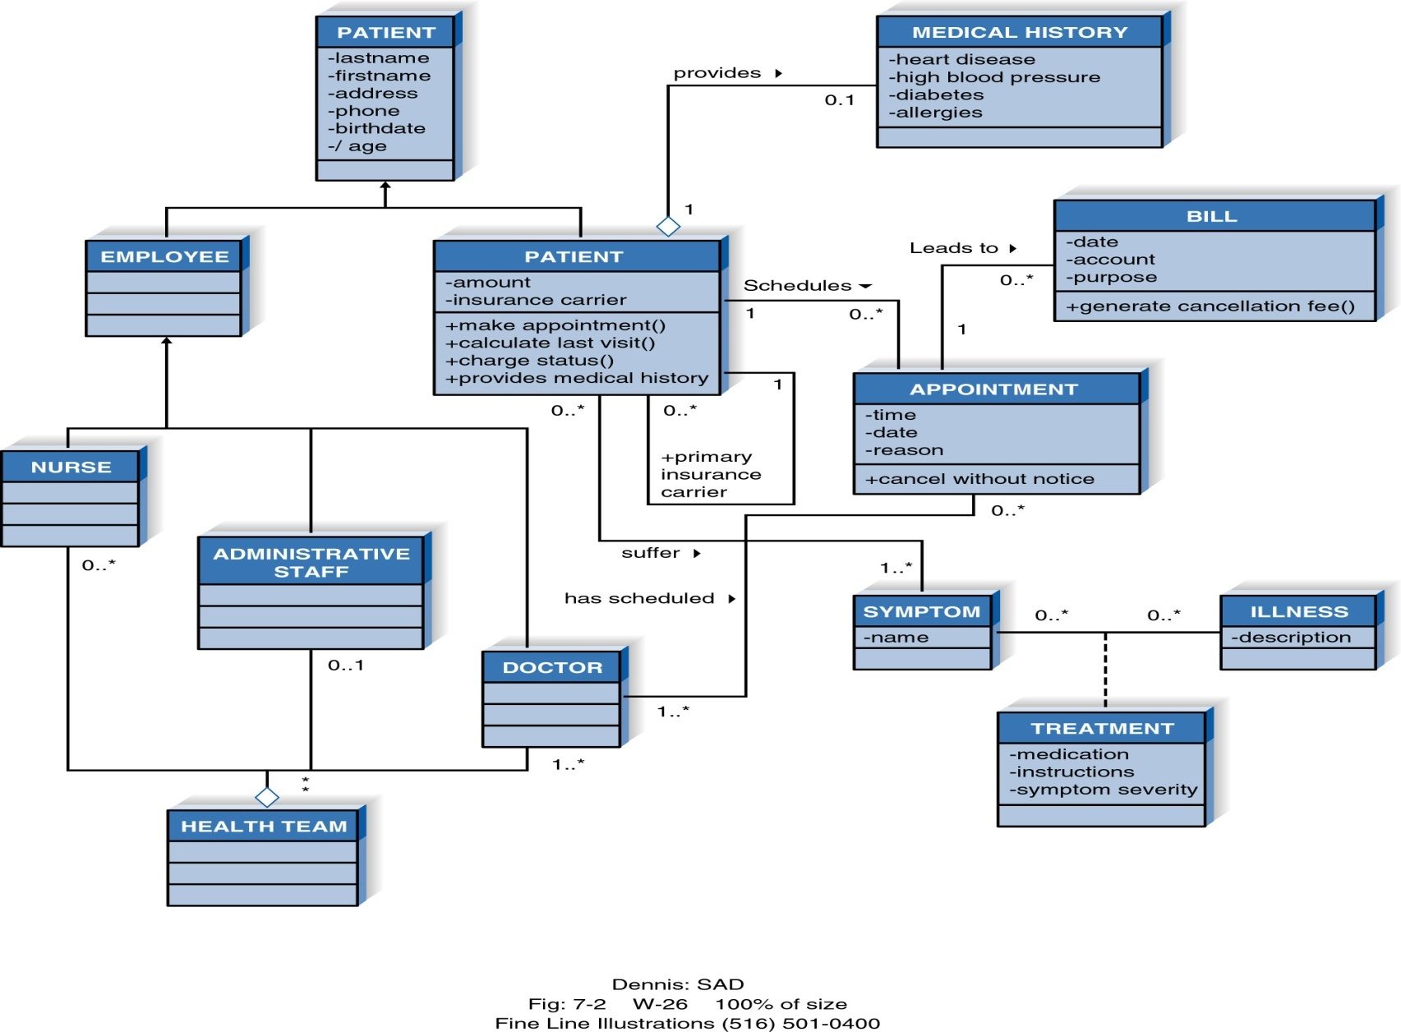
Example Class Diagram

Slide 100
More on Attributes
Derived attributes
/age, for example can be calculated from birth date and current date
Visibility of attributes
+Public: not hidden from any object
#Protected: hidden from all but immediate subclasses
–Private: hidden from all other classes
Default is private

Slide 101
Relationship Multiplicity
Exactly one
Zero or more
One or more
Zero or one
Specified range
Disjoint ranges
Dept
1
Boss
Employee
0..*
Child
Boss
1..*
Employee
Employee
0..1
Spouse
Employee
2..4
Vacation
Employee
1..3, 5
Committee

Slide 102
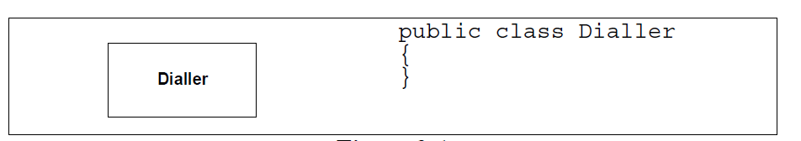
Class

Slide 103
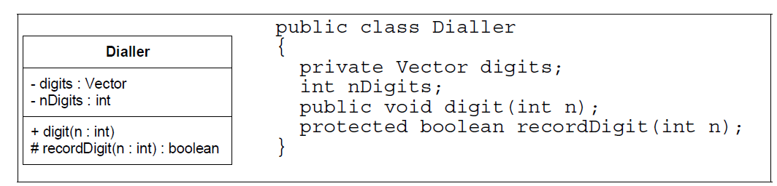
Class with Attribute and Method

Slide 104
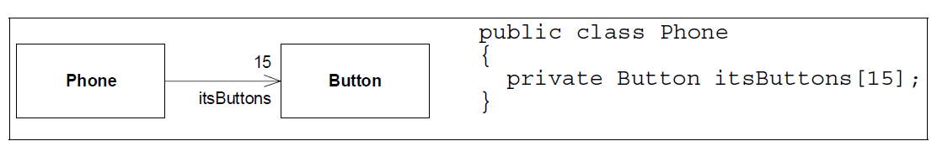
Class Association

Slide 105
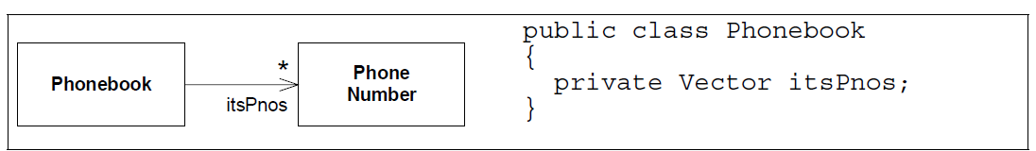
Multiplicity

Slide 106
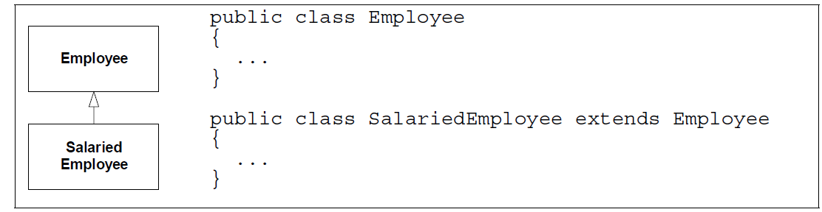
Inheritance

Slide 107
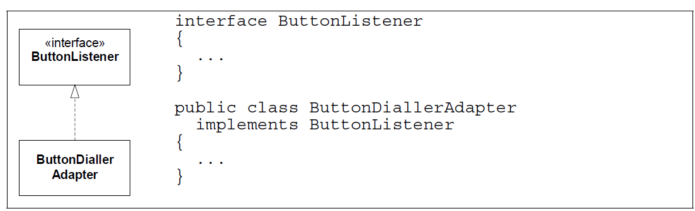
Interface

Slide 108
Class Diagram – Case Study

Slide 109
Latihan Studi Kasus
Pahami kembali System Request yang sudah dibuat
Lanjutkan dengan membuat Class Diagram dari System Request yang dibuat

Slide 110
Deployment Diagram – Case Study

Slide 111
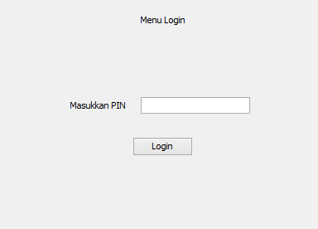
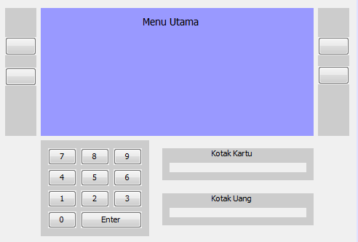
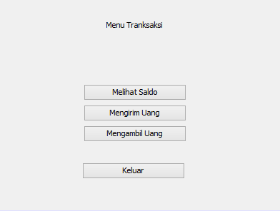
User Interface Design – Case Study

Slide 112
Data Model – Case Study

Slide 113
Latihan Studi Kasus
Pahami kembali System Request yang sudah dibuat
Lanjutkan dengan membuat Deployment Diagram, User Interface Design dan Data Model dari System Request yang dibuat

Slide 114
2.1.3 Implementation
Construction
Testing
Documentation
Installation

Slide 115
1. Construction
Assigning the programmers
Coordinating the activities
Managing the schedule

Slide 116
Assigning Programmers
Start by looking at the package diagrams
Assign similar modules to the same programmer
Remember the "programmer paradox"
Can't just add more people
Fewer programmers is normally better
Adding manpower to a late project makes it later (Brook, 1975)
“Just because a woman can make a baby in nine months, it does not follow that nine women can make a baby in one month”

Slide 117
Coordinating Activities
Hold weekly project meetings
discuss changes to the system
discuss other issues of the past week
Create and follow standards
Set up separate workspace for
development, testing, production
as a minimum, separate files
Use change control
program log, sign-in/-out
Use CASE tools

Slide 118
Managing the Schedule
Use initial time estimates as a baseline
Revise time estimates as construction proceeds
Fight against scope creep
Monitor “minor” slippage
Create risk assessment and track changing risks
Risks change as deadline approaches
Fight the temptation to lower quality to meet unreasonable schedule demands

Slide 119
Anekdot di Pengembangan Software
Project Manager is a Person who thinks nine women can deliver a baby in One month
Developer is a Person who thinks it will take 18 months to deliver a Baby
Client is the one who doesn't know why he wants a baby
Marketing Manager is a person who thinks he can deliver a baby even if no man and woman are available
Tester is a person who always tells his wife that this is not the Right baby
Human Resource is a person who thinks that a donkey can deliver a human baby if given 9 months

Slide 120
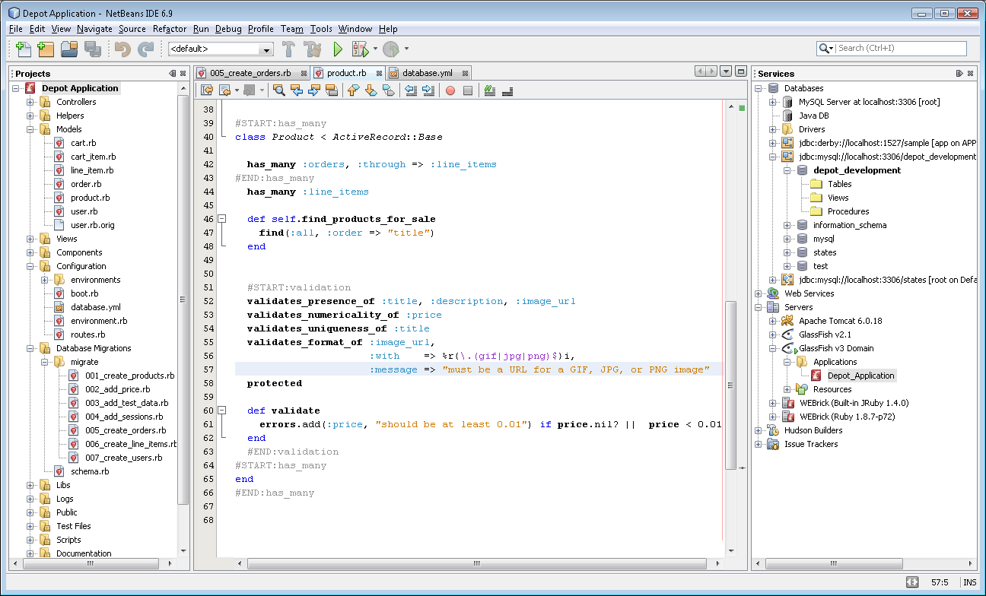
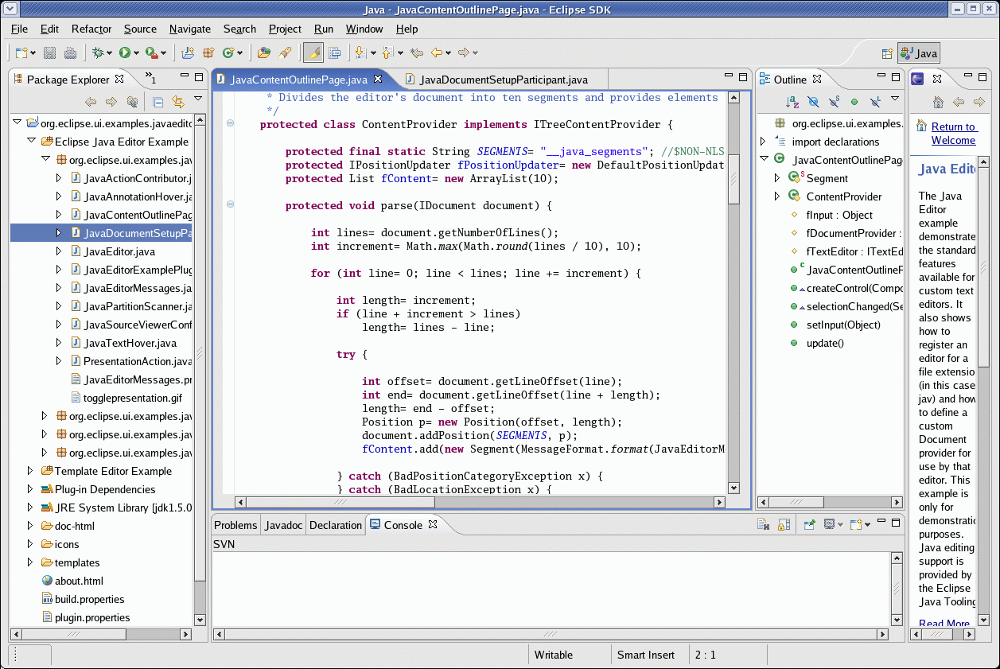
Program Code – Case Study

Slide 121
2. Testing
Testing can never prove there are no errors
The purpose is not to demonstrate that the system is free of errors
The purpose is to detect as many errors as possible
It is dangerous to test early modules without an overall testing plan
It may be difficult to reproduce sequence of events causing an error
Testing must be done systematically and results documented carefully

Slide 122
Stage of Testing
Unit testing
Tests each module to assure that it performs its function
Integration testing
Tests the interaction of modules to assure that they work together
System testing
Tests to assure that the software works well as part of the overall system
Acceptance testing
Tests to assure that the system serves organizational needs

Slide 123
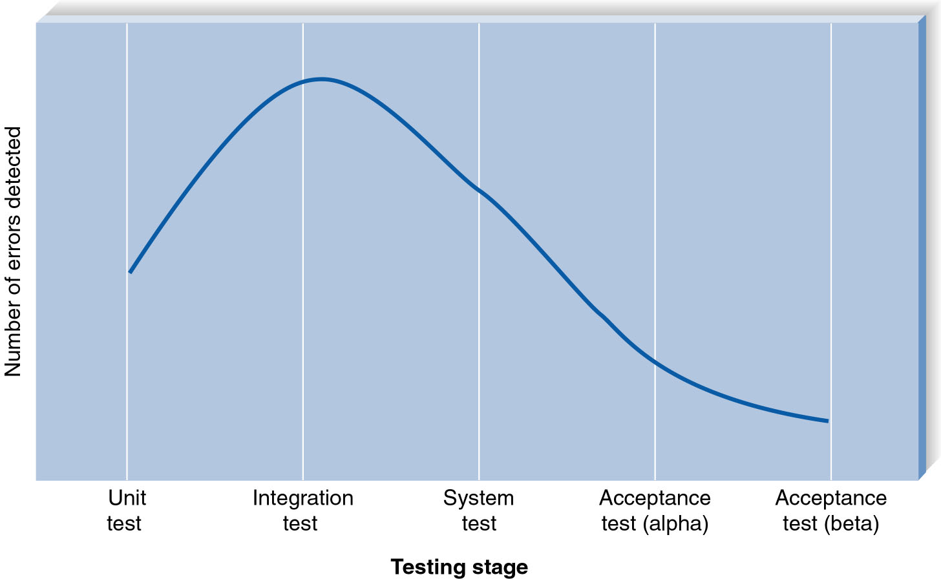
Error Discover Rates

Slide 124
3. Documentation
System Documentation
User Documentation

Slide 125
System Documentation
Compiled and refined System Specification
Helps programmers and analysts understand the application
Used for development and maintenance
Largely a by product of the SDLC phases
Often can be automated (JavaDoc)

Slide 126
User Documentation
Help users operate the system
High quality documentation takes about 3 hours per page to produce
Should not be left to the end of the project
User Documentation Type:
Reference documents (help system)
User needs to learn a specific task
Procedures manuals
How to perform a business function
May require several tasks
Tutorials
How to use major function of system

Slide 127
4. Installation
Transitioning to new systems involves managing change from pre-existing norms and habits
Change management involves:
Unfreezing -- loosening up peoples’ habits and norms
Moving – conversion from old to new systems
Refreezing -- institutionalize and make efficient the new way of doing things

Slide 128
Unfreezing
Activities to date facilitate unfreezing
Users:
Already know of the new system
Helped in the analysis phase
Helped in the design
This probably has already unfreezed current habits and norms

Slide 129
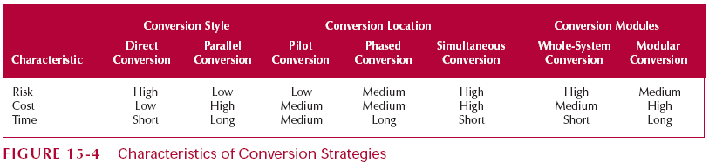
Conversion Strategy

Slide 130
Types of System Adopters
Ready Adopters (20% - 30%)
Recognize the benefits
Quickly adopt the system
Become proponents of the system
Resistant adopters (20% - 30%)
Refuse to accept the change
Fight against the system
Reluctant Adopters (40% - 60%)
Apathetic & blow with the wind

Slide 131
SDLC and Artifacts
Planning
1.1 System Request
1.2 Feasibility Analysis
Analysis
2.1 Use Case Diagram
2.2 Activity Diagram
2.3 Sequence Diagram
Design
3.1 Class Diagram
3.2 Deployment Diagram
3.3 User Interface Design
3.4 Data Model
Implementation 4.1 Program Code 4.2 Testing Plan 4.3 Documentation
System
Proposal
System
Specification
New
Software

Slide 132
2.2 Software Effort Estimation

Slide 133
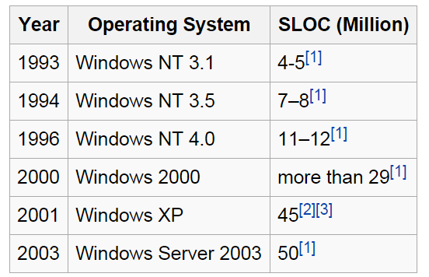

“Size” of Software Systems
Source: Wikipedia

Slide 134
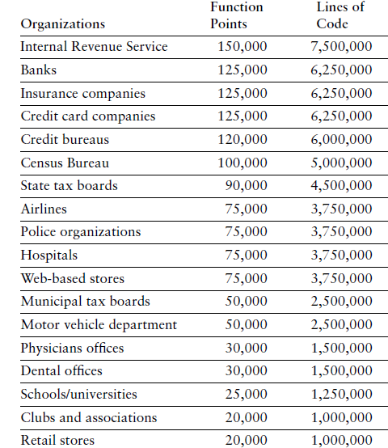
“Size” of Software Systems
Caper Jones, The Economic of Software Quality (2012)

Slide 135
Software Effort Estimation Methods
1. Simply Method
(Industry Std Percentages)
Use the time spent for planning
Estimate System Size (Function Point)
3. Use Case Point
(Gustav Karner, 1993)
Estimate System Size (Use Case Points)
Along with industry standard percentages
Estimate the overall time for the project
2. Function Point
(Allen Albrecht, 1979)
Estimate Effort Required (Person-Month)
Estimate Time Required (Month)
Estimate Effort Required (Person-Month)
Estimate Time Required (Month)

Slide 136
1. Simply Method

Slide 137
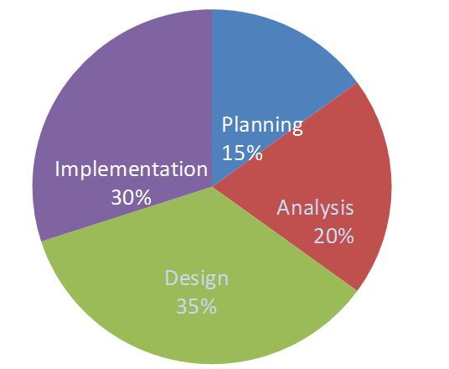
Simply Method

Slide 138
Time Spent for Each Phase
We are given that so

Slide 139
Estimate the Overall Time
Planning Analysis Design Implementation
Industry
Standard
For Web 15% 20% 35% 30%
Applications
Effort
Required 4 5.33 9.33 8
in Time (month)
Example: Analysis month

Slide 140
2. Function Point

Slide 141
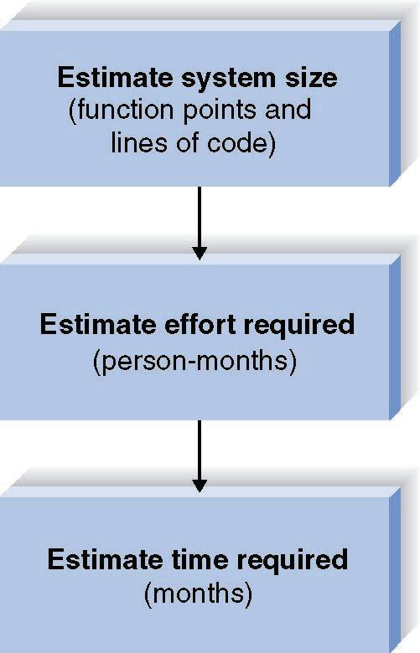
Function Point Approach
(Allen Albrecht, 1979)

Slide 142
A. Function Points Estimation -- Step One (TUFP)
Complexity
Description Low Medium High Total
Inputs __x 3 __x 4 __x 6 ____
Outputs __x 4 __x 5 __x 7 ____
Queries __x 3 __x 4 __x 6 ____
Files __x 7 __x 10 __x 15 ____
Program __x 5 __x 7 __x 10 ____
Interfaces
TOTAL UNADJUSTED FUNCTION POINTS ____

Slide 143
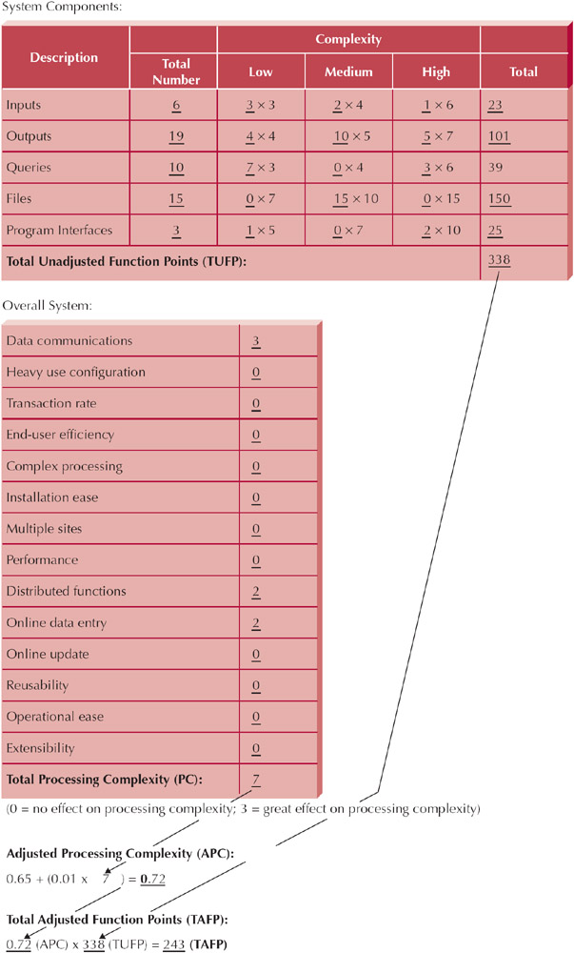
Example: Sistem ATM

Slide 144
Function Points Estimation -- Step Two (Processing Complexity)
Scale of 0 to 3
Data Communications _____
Heavy Use Configuration _____
Transaction Rate _____
End-User efficiency _____
Complex Processing _____
Installation Ease _____
Multiple sites _____
Performance _____
Distributed functions _____
On-line data entry _____
On-line update _____
Reusability _____
Operational Ease _____
Extensibility _____
Processing Complexity (PC) _____

Slide 145
Example: Sistem ATM

Slide 146
Function Point Estimation -- Step Three (TAFP)
Processing Complexity (PC) = 7
(From Step Two)
Adjusted Processing
Complexity (PCA) = 0.65 + (0.01 * 7 ) = 0.72
Total Adjusted
Function Points (TAFP): 338 * 0.72 = 243
(From Step One)

Slide 147
Adjusted Processing Complexity
Choose standard Adjusted Project Complexity (PCA) from the range:
0.65 Simple systems
1.0 "Normal" systems
1.35 Complex systems

Slide 148
Converting Function Points to Lines of Code
Language
LOC/Function Code Point
C
COBOL
JAVA
C++
Turbo Pascal
Visual Basic
PowerBuilder
HTML
Packages
(e.g., Access, Excel)
130
110
55
50
50
30
15
15
10-40
Source: Capers Jones, Software Productivity Research

Slide 149
Lines of Codes (LOC)
Line of Codes (LOC) = TAFP * LOC/TAFP
Example:
If TAFP = 243 Then we build the software using Java
LOC = (243 * 55) = 13365 line of codes

Slide 150
Contoh Jenis Aplikasi dan FP
Caper Jones, The Economic of Software Quality (2012)

Slide 151
B. Estimating Effort
Effort = 1.4 * thousands-of- lines-of-code
(in Person- Months)
Example:
If LOC = 13365 Then...
Effort = (1.4 * 13.365) = 18.711 Person Months

Slide 152
C. Estimating Time
Time = 3.0 * person-months^{1/3}
(in Months)
Example:
If LOC = 13365 Then...
Effort = (1.4 * 13.365) = 18.711 person-months
Time = 3.0 * 18.711 ^{1/3} = 7.9 month

Slide 153
Calculate System Size
Imagine that job hunting has been going so well that you need to develop a system to support your efforts. The system should allow you to input information about the companies with which you interview, the interviews and office visits that you have scheduled, and the offers that you receive. It should be able to produce reports, such as a company contact list, an interview schedule, and an office visit schedule, as well as produce thank-you letters to be brought into a word processor to customize. You also need the system to answer queries, such as the number of interviews by city and your average offer amount. The system will be developed using Java.

Slide 154
Hitung Size dari Sistem dengan Function Point
Sebuah perusahaan membutuhkan sistem job seeker untuk pencari kerja dan perusahaan pembuka lowongan pekerjaan
Sistem memungkinkan pencari kerja untuk menginput data curriculum vitae. Di sisi lain, perusahan pembuka lowongan kerja bisa menginput data perusahaan dan lowongan pekerjaan yang disediakan
Pencari kerja dapat melakukan pencarian (query) tentang lowongan pekerjaan apa saja yang tersedia, sedangkan pembuka lowongan kerja mencari tentang siapa saja yang sudah mendaftar di suatu lowongan pekerjaan
Sistem mampu memproduksi laporan dan statistik lengkap tentang pencari kerja, perusahaan, jenis lowongan pekerjaan dan tren lowongan kerja yang sedang populer
Laporan statistik akan disajikan dalam bentuk infografik dan juga tersedia dalam bentuk file pdf yang bisa didownload
Sistem akan dikembangkan dengan menggunakan bahasa pemrograman Java

Slide 155
TUFP
 | Fungsi | Bobot | Total
Input | 4 | 3 | 12
Output | 3 | 4 | 12
Queries | 2 | 3 | 6
File | 1 | 7 | 7
Program Interface | 5 | 5 | 25
TUFP |  |  | 62

Slide 156
TAFP
Processing Complexity (PC) = 6
(From Step Two)
Adjusted Processing
Complexity (PCA) = 0.65 + (0.01 * 6 ) = 0.71
Total Adjusted
Function Points (TAFP): 62 * 0.71 = 44.02
(From Step One)

Slide 157
LOC → Effort (ManMonth)→ Time (Month)
LOC = 55*44.02 = 2421
Effort = 1.4*2.421 = 3.39 MM
Time = 3.0 * 3.39 ^{(1/3)} = 4.5 M

Slide 158
3. Use Case Point

Slide 159
Use Case Points
Unadjusted Actor Weighting (UAW)
Actor Type | Description | Weighting Factor
Simple | External System with well-defined API | 1
Average | External System using a protocol-based interface, e.g., HTTP, TCT/IP, SQL | 2
Complex | Human | 3
Unadjusted Use Case Weighting (UUCW)
Use-Case Type | Description | Weighting Factor
Simple | 1-3 transactions | 5
Average | 4-7 transactions | 10
Complex | More than 7 transactions | 15
Unadjusted Use Case Points (UUCP) = UAW + UUCW

Slide 160
Sistem ATM – Use Case Diagram
Human = 3
Transaction = ?

Slide 161
Sequence Diagram - Mentransfer Uang
Transaction = 3

Slide 162
Technical Complexity Factors (TCF)
Factor Number | Description | Weight
T1 | Distributed system | 2.0
T2 | Response time or throughput performance objectives | 1.0
T3 | End-user online efficiency | 1.0
T4 | Complex internal processing | 1.0
T5 | Reusability of code | 1.0
T6 | Easy to install | 0.5
T7 | Ease of use | 0.5
T8 | Portability | 2.0
T9 | Ease of change | 1.0
TCF = 0.6 + (0.01 * TFactor)

Slide 163
Environmental Complexity Factors (ECF)
Factor Number | Description | Weight
E1 | Familiarity with system development process in use | 1.5
E2 | Application experience | 0.5
E3 | Object-oriented experience | 1.0
E4 | Lead analyst capability | 0.5
E5 | Motivation | 1.0
E6 | Requirements stability | 2.0
E7 | Part time staff | -1.0
E8 | Difficulty of programming language | -1.0
ECF = 1.4 + (-0.03 * EFactor)

Slide 164
Computing Use Case Points
Adjusted Use Case Points (UCP) = UUCP * TCF * ECF
Effort in Person Hours = UCP * PHM

Slide 165
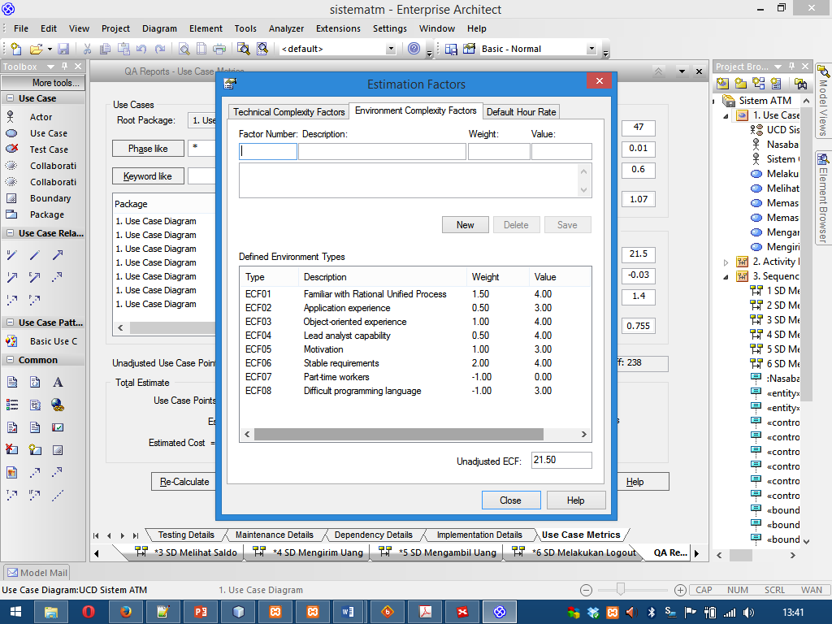
Person Hour Multiplier (PHM)
Let F1 = Number of ECF1 to ECF6 that are < 3
Let F2 = Number of ECF7 and ECF8 that are > 3
If F1 + F2 <= 2 PHM = 20 Else if F1 + F2 = 3 or 4 PHM = 28 Else Scrap the project

Slide 166
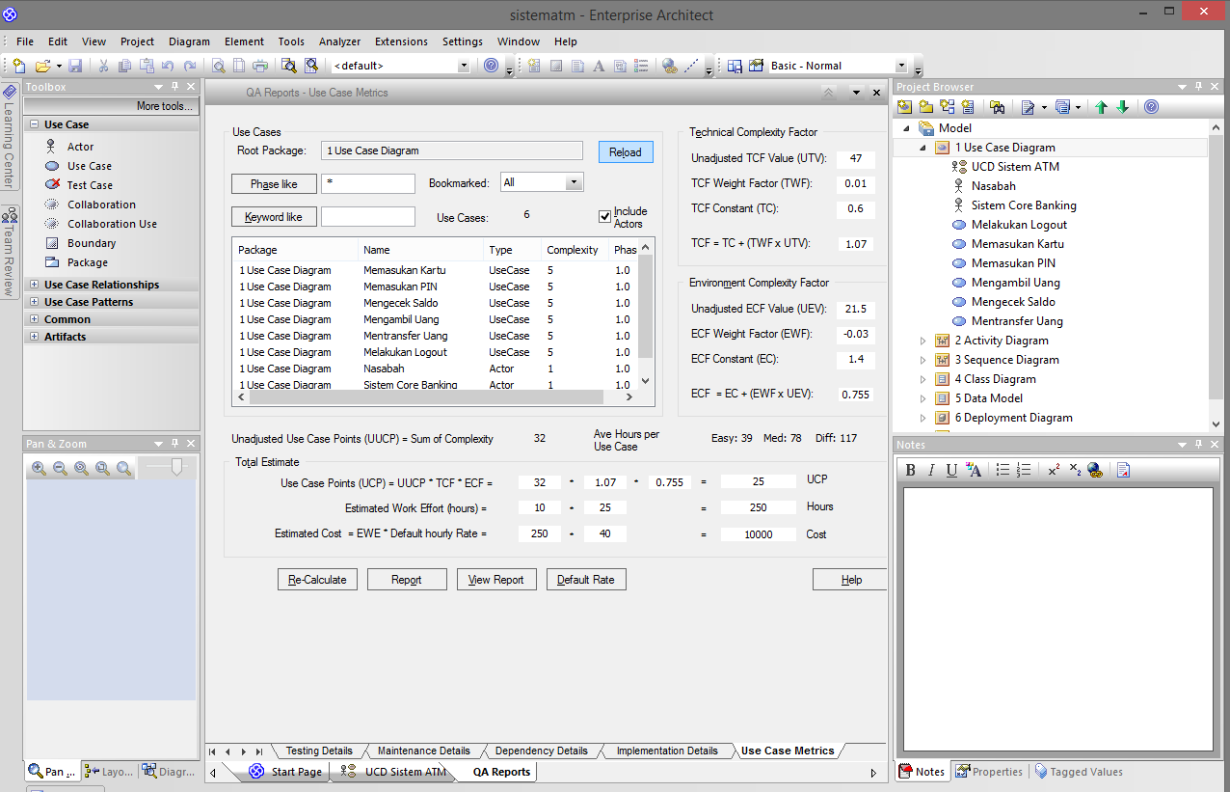
Use Case Points in Sparx EA

Slide 167
Example: Sistem ATM
UCP = 19
PHM = 20
PH = 20*19 = 360
PM = 360/8/22 = 2.05
TIME (M) = 3.0 * PM ^{1/3}
TIME (M) = 3.0 * 2.05 ^{1/3}
TIME (M) = 3 * 1.27 = 3.81

Slide 168
Example: Sistem ATM
UCP = 23
PHM = 20
PH = 20*23 = 460
PM = 460/8/22 = 2.61
TIME (M) = 3.0 * PM ^{1/3}
TIME (M) = 3.0 * 2.61 ^{1/3}
TIME (M) = 4.13

Slide 169
Reference (Foundation)
Ian Sommerville, Software Engineering 10th Edition, Addison-Wesley, 2015
Roger S. Pressman, Software Engineering: A Practitioner’s Approach 8th Edition, McGraw-Hill, 2014
P. Bourque and R.E. Fairley, eds., Guide to the Software Engineering Body of Knowledge Version 3.0, IEEE Computer Society, 2014
Albert Endres dan Dieter Rombach, A Handbook of Software and Systems Engineering, Pearson Education Limited, 2003
Yingxu Wang, Software Engineering Foundations: A Software Science Perspective, Auerbach Publications, Taylor & Francis Group, 2008

Slide 170
Reference (Process)
Alan Dennis et al, Systems Analysis and Design with UML – 4th Edition, John Wiley and Sons, 2012
Dan Pilone and Russ Miles, Head First Software Development, O’Reilly Media, 2008
Barclay and Savage, Object-Oriented Design with UML and Java, Elsevier, 2004
Kenneth E. Kendall and Julie E Kendall, Systems Analysis and Design 8th Edition, Prentice Hall, 2010
Hassan Gomaa, Software Modeling and Design: UML, Use Cases, Patterns, and Software Architectures, Cambridge University Press, 2011
Layna Fischer (edt.), BPMN 2.0 Handbook Second Edition, Future Strategies, 2012

Slide 171
Reference (Quality)
Daniel Galin, Software Quality Assurance, Addison-Wesley, 2004
Kshirasagar Naik and Priyadarshi Tripathy, Software Testing and Quality Assurance, John Wiley & Sons, Inc., 2008
Jeff Tian, Software Quality Engineering, John Wiley & Sons, Inc., 2005
G. Gordon Schulmeyer, Handbook of Software Quality Assurance Fourth Edition, Artech House, 2008

Slide 172
Reference (Research)
Christian W. Dawson, Project in Computing and Information System a Student Guide 2nd Edition, Addison-Wesley, 2009
Mikael Berndtsson, Jörgen Hansson, Björn Olsson, Björn Lundell, Thesis Projects - A Guide for Students in Computer Science and Information System 2nd Edition, Springer-Verlag London Limited, 2008
Mary Shaw, Writing Good Software Engineering Research Papers, Proceedings of the 25th International Conference on Software Engineering, 2003
C. Wohlin, P. Runeson, M. Host, M. C. Ohlsson, B. Regnell, and A. Wesslen, Experimentation in Software Engineering, Springer, 2012
P. Runeson, M. Host, A. Rainer, and B. Regnell, Case Study Research in Software Engineering: Guiidelines and Examples, John Wiley & Sons, Inc., 2012

