Slide 1
Software Engineering
Romi Satria Wahono romi@romisatriawahono.net http://romisatriawahono.net/se WA/SMS: +6281586220090

Slide 2
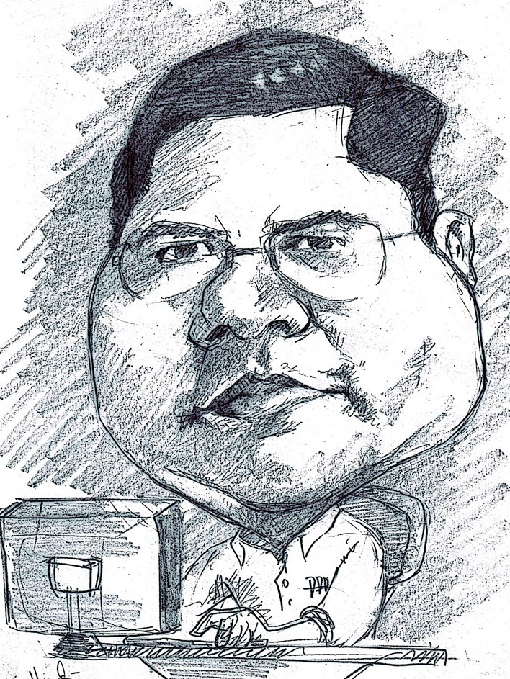
Romi Satria Wahono
SD Sompok Semarang (1987)
SMPN 8 Semarang (1990)
SMA Taruna Nusantara Magelang (1993)
B.Eng, M.Eng and Ph.D in Software Engineering from Saitama University Japan (1994-2004) Universiti Teknikal Malaysia Melaka (2014)
Research Interests: Software Engineering and Machine Learning
Founder dan Koordinator IlmuKomputer.Com
Peneliti LIPI (2004-2007)
Founder dan CEO PT Brainmatics Cipta Informatika

Slide 3
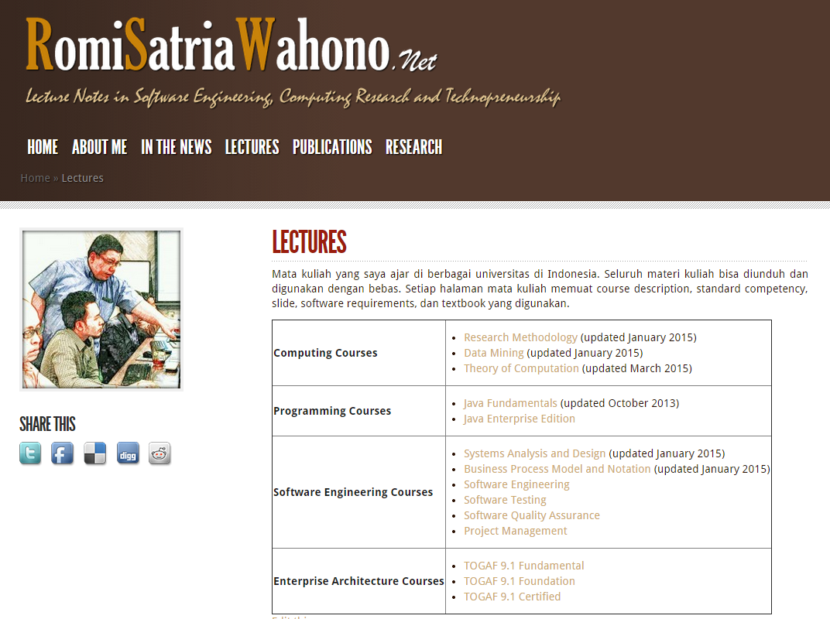

Slide 4
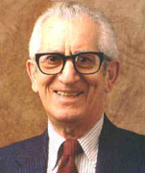
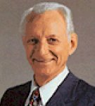
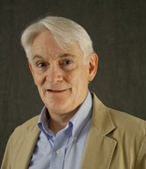
Learning Design
Educational Objectives (Benjamin Bloom)
Cognitive
Criterion Referenced Instruction (Robert Mager)
Competencies
Evaluation
Minimalism (John Carroll)
Start Immediately
Affective
Psychomotor
Minimize the Reading
Error Recognition
Self-Contained
Performance

Slide 5
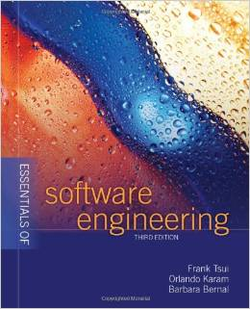
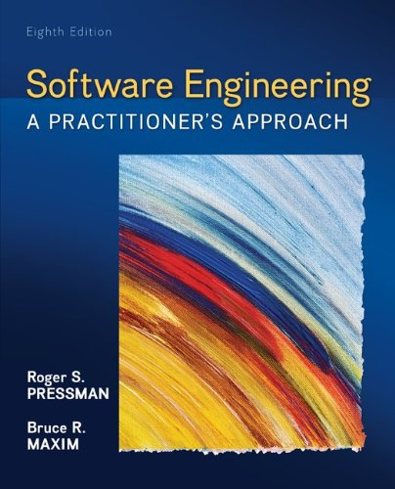
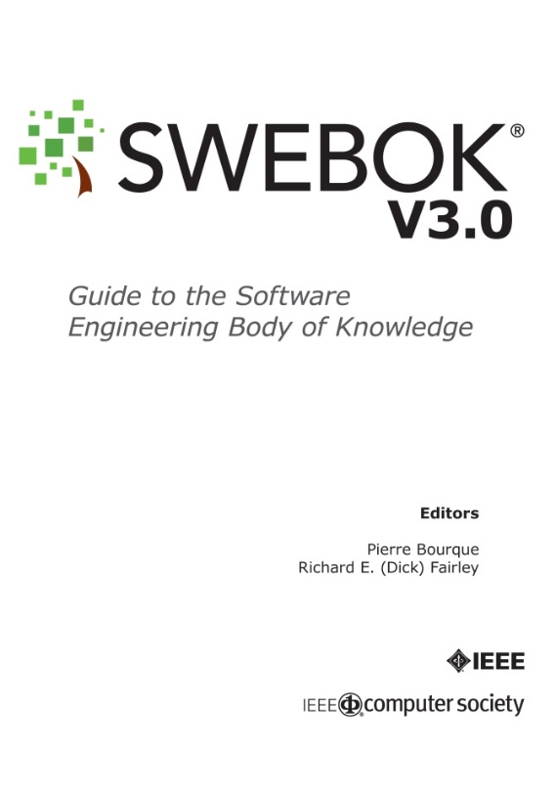

Textbooks

Slide 6
Course Outline
1. Introduction
2. Process
4. Quality
5. Research
3. Methodology

Slide 7
1. Introduction
1.1 What is Software
1.2 What is Software Engineering
1.3 Software Myths
1.4 Software Engineering Discipline

Slide 8
1.1 What is Software

Slide 9
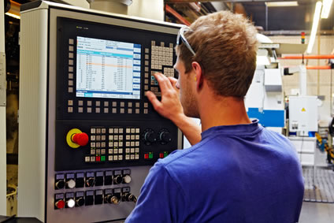
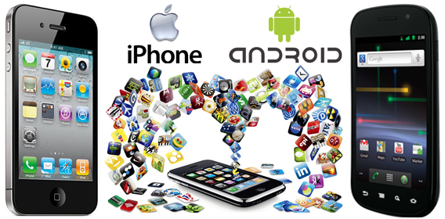
Software Di Sekitar Kita
Hampir semua peralatan elektronik digerakkan oleh software!
Mobil, pesawat terbang, kapal laut, …
Telepon, bangunan, kota, …
Semua disiplin ilmu menggunakan software!
Teknik dan sains (teknik sipil, teknik mesin, teknik geologi, …)
Kedokteran, farmasi, …
Hardware tidak berfungsi tanpa software di dalamnya

Slide 10
The Definition of Software
Computer programs, procedures, and possibly associated documentation and data pertaining to the operation of a computer system (IEEE, 1991) (ISO, 1997) (ISO/IEC 9000-3)
(1) Instructions (computer programs) that when executed provide desired features, function, and performance (2) Data structures that enable the programs to adequately manipulate information, and (3) Descriptive information in both hard copy and virtual forms that describes the operation and use of the programs (Pressman, 2014)
Computer programs and associated documentation (Sommerville, 2015)

Slide 11
Jenis Software
Market
Domain
Lisensi

Slide 12
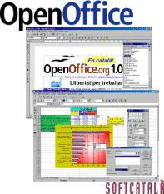
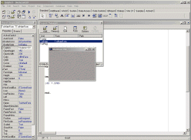
Jenis Software (Market)
Software Generik
Perangkat lunak standar yang diproduksi oleh perusahaan pengembang dan dijual pada pasar terbuka ke siapapun yang bisa membelinya (Shrink-wrapped)
Software Pesanan
Perangkat lunak yang dikembangkan khusus dan disesuaikan dengan kebutuhan pelanggan
(Sommerville, 2015)

Slide 13
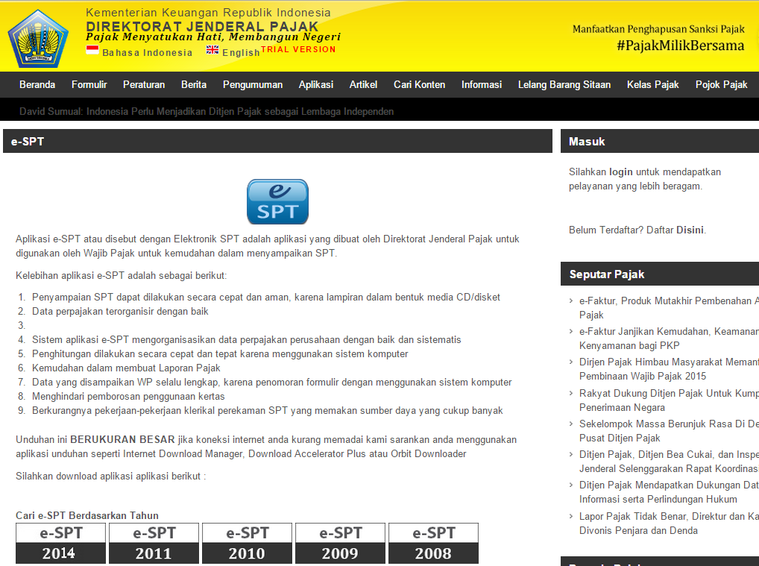

Slide 14
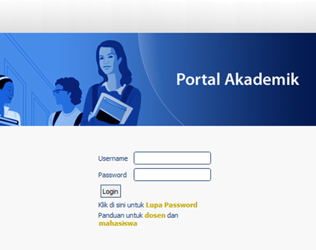
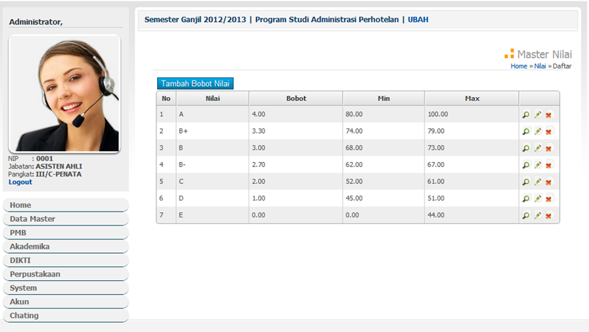
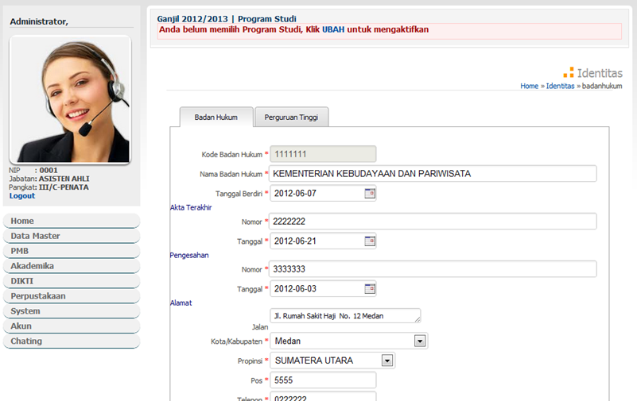

Slide 15
Jenis Software (Domain)
System software
Application software
Engineering/scientific software
Embedded software
Product line software
Web applications
Artificial intelligence software
(Pressman, 2014)

Slide 16
System Software
System software is a collection of programs written to service other programs
It is characterized by heavy interaction with computer hardware; heavy usage by multiple users; concurrent operation that requires scheduling, resource sharing, and sophisticated process management; complex data structures; and multiple external interfaces
Ex. Compilers, operating system, drivers etc.

Slide 17
Application Software
Application software consists of standalone programs that solve a specific business need
Application software is used to control the business function in real-time.

Slide 18
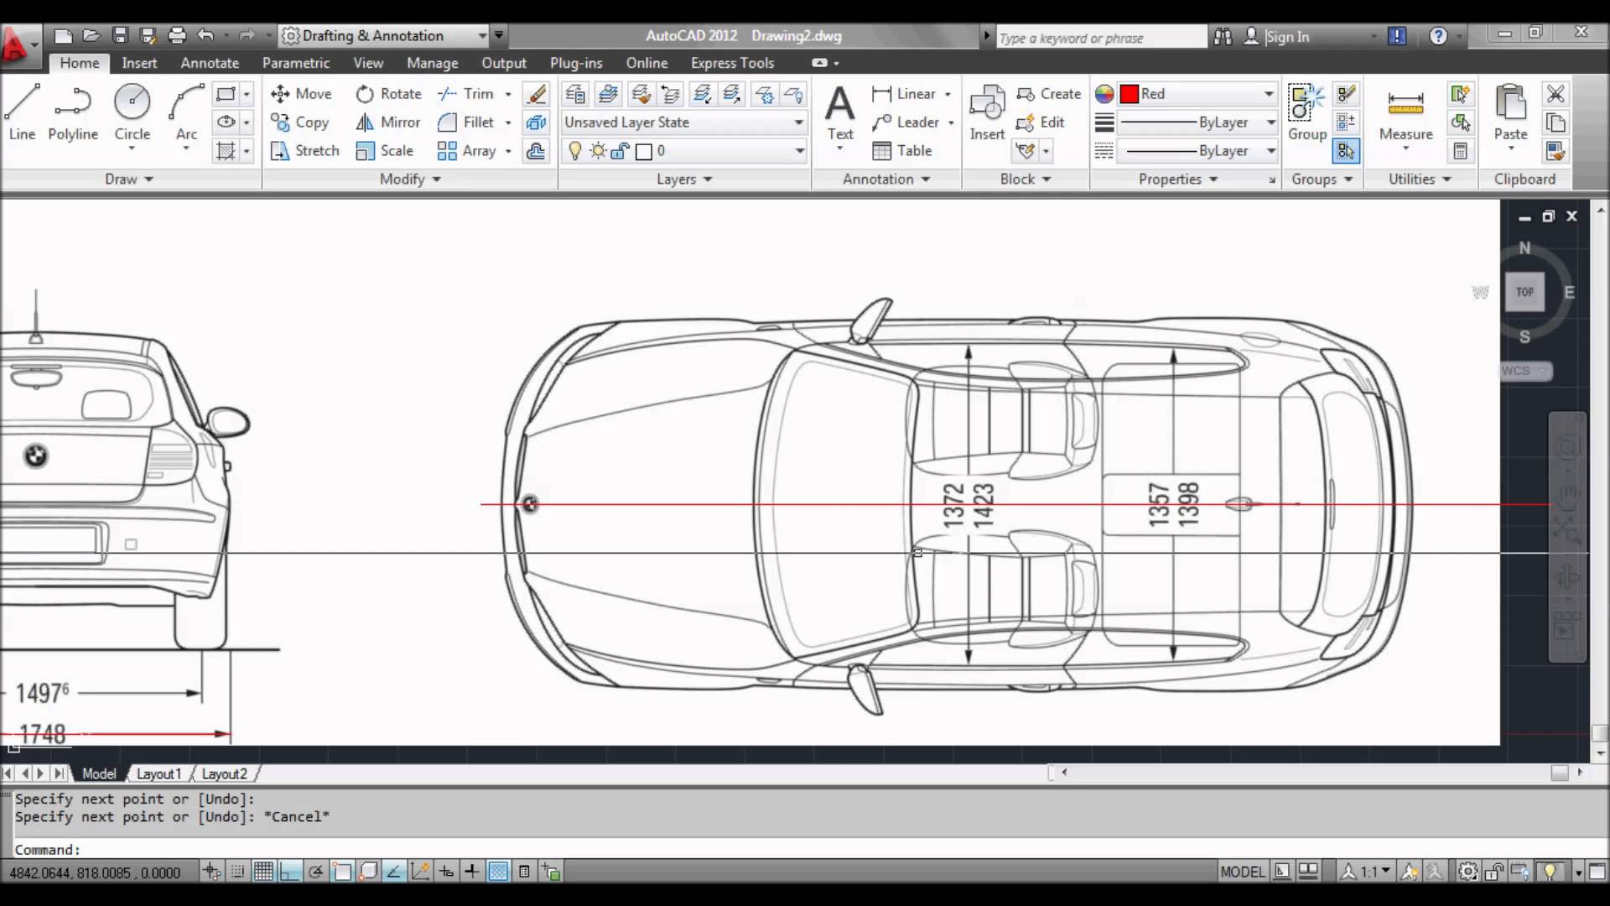
Engineering /Scientific software
Characterized by "number crunching" algorithms
Applications range from astronomy to volcano logy, from automotive stress analysis to space shuttle orbital dynamics, and from molecular biology to automated manufacturing
Ex. Computer Aided Design (CAD), system stimulation etc.

Slide 19
Embedded Software
It resides in read-only memory and is used to control products and systems
Embedded software can perform limited and esoteric functions
Ex. Elevator, Air Conditioner, keypad control for a microwave oven

Slide 20
Product Line Software
Designed to provide a specific capability for use by many different customers, product line software can focus on a limited and esoteric marketplace
Ex. Word processing, spreadsheet, CG, multimedia, etc.

Slide 21
Web Applications
Web apps can be little more than a set of linked hypertext files
It evolving into sophisticated computing environments that not only provide standalone features, functions but also integrated with corporate database and business applications

Slide 22
Artificial Intelligence Software
AI software makes use of non-numerical algorithms to solve complex problems that are not amenable to computation or straightforward analysis
Ex. Robotics, expert system, game playing, etc.

Slide 23
Jenis Software (Lisensi)
Open Source Software | Proprietary Software
Linux, OpenOffice, GIMP | MS Windows, MS Office 2013, Adobe Photoshop
Purchased with its source code | Purchased without its source code
Users can get for free of charge | Users must pay to get
Users can modify the software | Users cannot modify the software
Users can install software freely into any computer | Users must have a license from vendor before install into computer
No one is responsible to the software | Fully support from vendor if anything happened to the software

Slide 24
Open Source Software
Software yang source codenya terbuka dan didistribusikan dalam suatu format lisensi yang memungkinkan pihak lain secara bebas memperbanyak dan memodifikasi source code didalamnya
Hak cipta tetap ada, tapi lisensi memungkinkan orang lain bebas untuk menggunakan dan memodifikasi software tersebut
Jenis lisensi open source software:
GNU General Public License (GPL)
Apache License
BSD license
MIT License
Mozilla Public License

Slide 25
Proprietary Software
Software yang source codenya tertutup dan didistribusikan dengan suatu format lisensi yang membatasi pihak lain untuk menggunakan, memperbanyak dan memodifikasi
Lisensi proprietary software memungkinkan orang lain menggunakan software yang kita buat dengan diikuti penyerahan royalti (uang) ke pemilik hak ciptanya
Shareware dan Freeware adalah proprietary software. Free for use belum tentu free for (redistribute) atau free for modify!

Slide 26
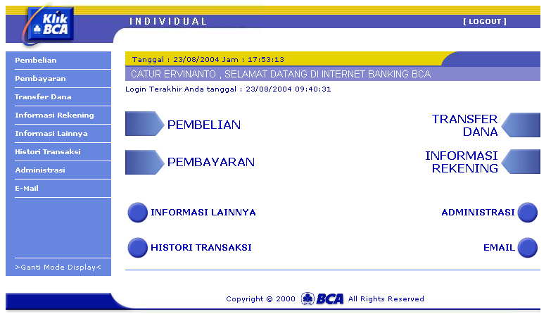
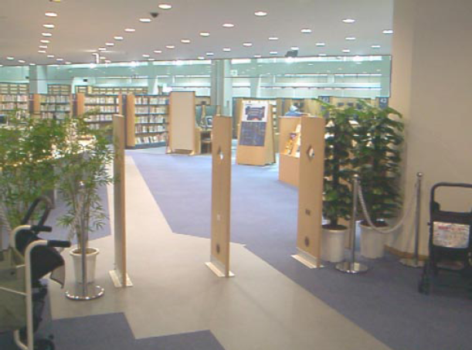
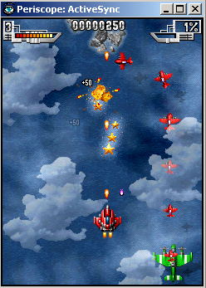
Peranan Software
Menggantikan peran manusia: Dengan otomasi terhadap suatu tugas atau proses
Memperkuat peran manusia: Dengan membantu manusia mengerjakan suatu tugas atau proses dengan lebih baik dan tertata
Restrukturisasi Peran Manusia: Dengan melakukan perubahan-perubahan thd sekumpulan tugas atau proses
Hiburan dan Permainan: Dengan menyajikan aplikasi interaktif hiburan yang semakin dekat dengan kenyataan

Slide 27
Hardware vs. Software
Hardware | Software
Manufactured | Developed/Engineered
Wear out | Deteriorate
Built using components | Custom built
Relatively simple | Complex
Visible Defect | Invisible Defect

Slide 28
Manufacturing vs. Development
Once a hardware product has been manufactured, it is difficult or impossible to modify
In contrast, software products are routinely modified and upgraded.
In hardware, hiring more people allows you to accomplish more work,
but the same does not necessarily hold true in software engineering
Unlike hardware, software costs are concentrated in design rather than production

Slide 29
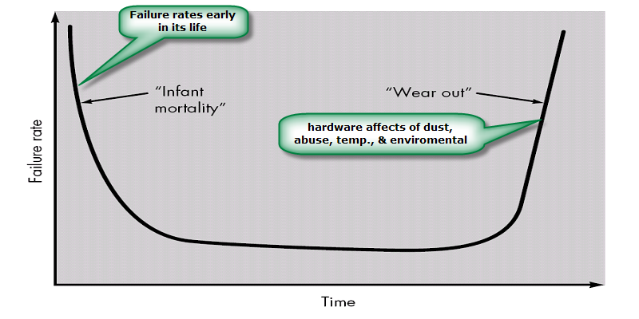
Failure Curve for Hardware

Slide 30
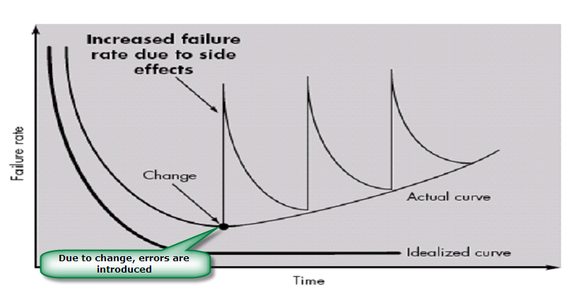
Failure Curve for Software
When a hardware component wears out, it is replaced by a spare part
There are no software spare parts. Every software failure indicates an error in design or in the process through which design was translated into machine executable code
Therefore, software maintenance involves considerably more complexity

Slide 31
Component Based vs. Custom Built
Hardware products typically employ many standardized design components
Most software continues to be custom built
The software industry does seem to be moving (slowly) toward component-based construction

Slide 32
Visibility of Product
Produk software tidak terlihat dengan kasat mata, termasuk bila ada cacat (defect) dari produk
Produk hardware terlihat dengan kasat mata, termasuk bila ada cacat (defect) dari produk

Slide 33
Warranty Lawsuits
Mortenson vs. Timeberline Software (TS) (≈1993)
Mortenson menggunakan software yang diproduksi TS untuk membuka tender pembangunan rumah sakit
Software memiliki bug sehingga memenangkan perusahaan yang mengajukan proposal paling mahal (kerugian 2 miliar USD)
TS tahu tentang bug itu, tapi tidak mengirimkan update ke Mortenson
Pengadilan di Amerika Serikat memenangkan perusahaan TS
Uniform Computer Information Transaction Act (UCITA) allows software manufacturers to:
disclaim all liability for defects
prevent the transfer of software from person to person

Slide 34
Disclaimer of Warranties
DISCLAIMER OF WARRANTIES. TO THE MAXIMUM EXTENT PERMITTED BY APPLICABLE LAW, MICROSOFT AND ITS SUPPLIERS PROVIDE TO YOU THE SOFTWARE COMPONENT, AND ANY (IF ANY) SUPPORT SERVICES RELATED TO THE SOFTWARE COMPONENT ("SUPPORT SERVICES") AS IS AND WITH ALL FAULTS; AND MICROSOFT AND ITS SUPPLIERS HEREBY DISCLAIM WITH RESPECT TO THE SOFTWARE COMPONENT AND SUPPORT SERVICES ALL WARRANTIES AND CONDITIONS, WHETHER EXPRESS, IMPLIED OR STATUTORY, INCLUDING, BUT NOT LIMITED TO, ANY (IF ANY) WARRANTIES OR CONDITIONS OF OR RELATED TO: TITLE, NON-INFRINGEMENT, MERCHANTABILITY, FITNESS FOR A PARTICULAR PURPOSE, LACK OF VIRUSES, ACCURACY OR COMPLETENESS OF RESPONSES, RESULTS, LACK OF NEGLIGENCE OR LACK OF WORKMANLIKE EFFORT, QUIET ENJOYMENT, QUIET POSSESSION, AND CORRESPONDENCE TO DESCRIPTION. THE ENTIRE RISK ARISING OUT OF USE OR PERFORMANCE OF THE SOFTWARE COMPONENT AND ANY SUPPORT SERVICES REMAINS WITH YOU.

Slide 35
1.2 What is Software Engineering?

Slide 36
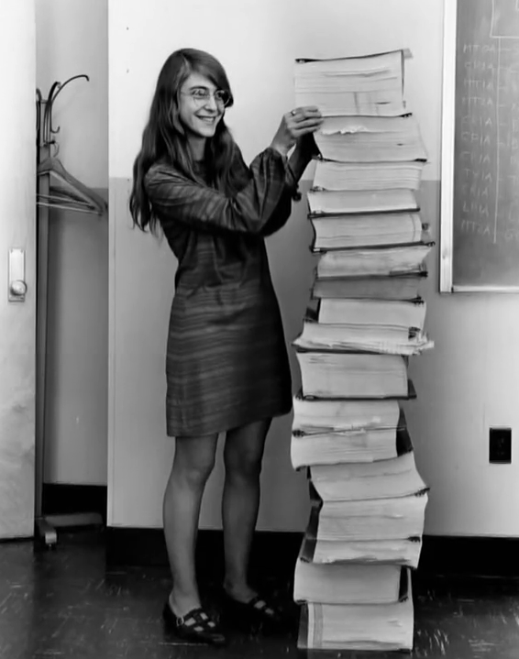
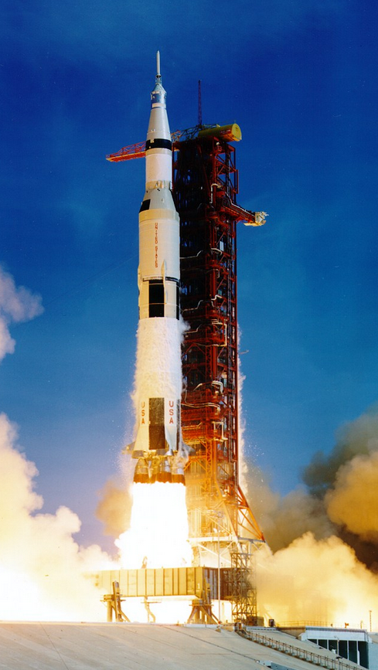
The Term “Software Engineering”
Margaret Hamilton (NASA engineer), coined the term “software engineering” in 1960’s
Standing with the “code” (on punch cards) she developed for the Apollo 11

Slide 37
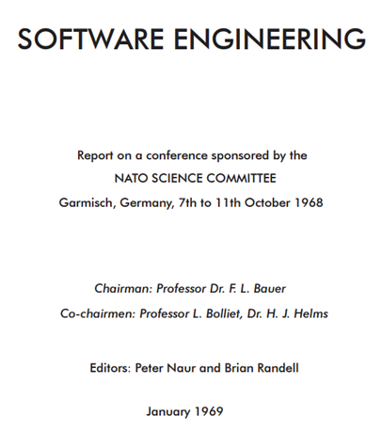
Mengapa Software Engineering?
Terminologi software engineering secara resmi pertama kali digunakan pada conference tentang software crisis tahun 1968
Krisis perangkat lunak merupakan akibat langsung dari lahirnya komputer generasi ke 3 yang canggih pada waktu itu
Perangkat lunak yang dihasilkan menjadi menjadi beberapa kali lebih besar dan kompleks
Pendekatan informal tidak cukup efektif (cost, waktu dan kualitas) dalam pengembangan perangkat lunak
Biaya hardware jatuh dan biaya perangkat lunak naik cepat

Slide 38
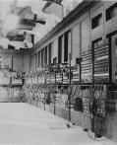
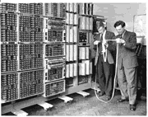
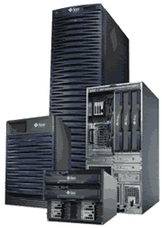
Generasi Komputer
Generasi I (1946-1959)
Menggunakan tabung hampa
ENIAC, EDSAC
Generasi II (1959-1964)
Menggunakan transistor
PDP-1, PDP-8, UNIVAC, IBM 70xx
Generasi III (1964-1979)
Menggunakan IC
IBM S360, NOVA, UNIVAC 1108
Generasi IV (1980-sekarang)
Menggunakan VLSI

Slide 39
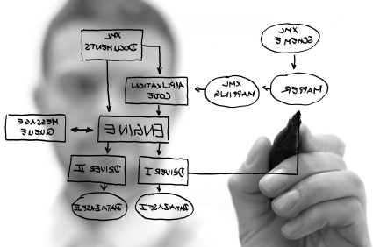
What is Software Engineering?
Disiplin ilmu yang membahas semua aspek produksi perangkat lunak, mulai dari tahap awal spesifikasi, desain, konstruksi, testing sampai pemeliharaan setelah digunakan
(Sommerville, 2009)

Slide 40
What is Software Engineering?
Definition (IEEE, 1993):
(1) The application of systematic, disciplined, quantifiable approach to the development, operation, and maintenance of software; that is, the application of engineering to software.(2) The study of approaches as in (1) above
Its a discipline that is concerned with all aspects of software production
Software engineers should adopt:
Systematic and organized approach to their work
Use appropriate tools and techniques depending on the problem to be solved
The development constraints and the resources available

Slide 41
What is Software Engineering?

Slide 42
What is Software Engineering?
Software engineering is NOT (just) programming
But, of course, to be a good software engineer, one should be good at programming
Software engineering is the study and application of engineering to the design, development, testing, and maintenance of software systems
Software engineering deal with issues such as:
How can we develop a software in shortest time, lowest cost and with highest quality?
How can we test a software in shortest time, lowest cost and with highest quality?
When we have a large team of programmers, how can we assign the best people to development and testing tasks?
How can we ensure we have inquired the software requirements from the client in the most efficient and effective way?

Slide 43
Software Engineering Problem
Building software will always be hard. There is inherently no silver bullet (Brooks, 1987)

Slide 44
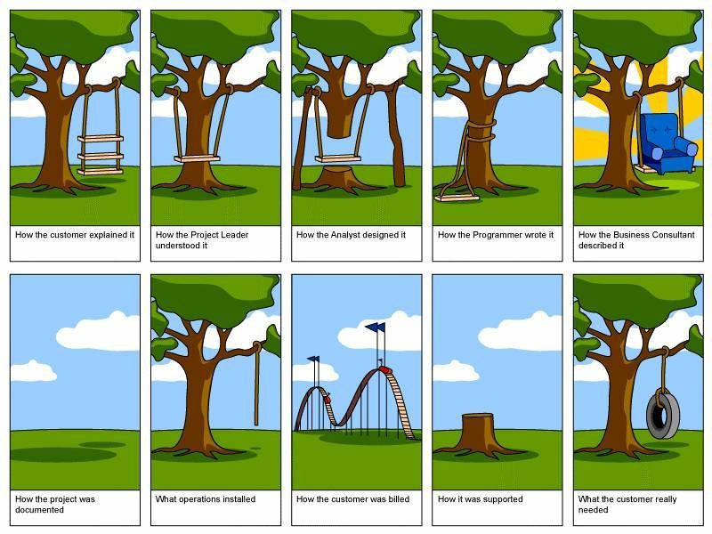

Slide 45
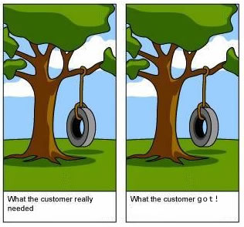
The Challenges in Software Engineering
Good software:
Should deliver the functionality and performance that the software users need
Should be maintainable, dependable and usable
(Sommerville, 2012)

Slide 46
Software Quality Metrics
Software
Quality
Product (mengukur software dari kualitas produk jadinya)
McCall
ISO 9126
Process (mengukur software dari kematangan proses pengembangannya)
CMMI
ISO 9001
SPICE

Slide 47
Latihan Kognitif
Jelaskan latar belakang munculnya disiplin software engineering!
Jelaskan definisi dari software engineering!
Apa yang disebut dengan software yang berkualitas?
Jelaskan bagaimana cara mengukur kualitas software!

Slide 48
1.3 Software Myths

Slide 49
Software Myths
Definition:
Beliefs about software and the process used to build it. Myths have number of attributes that have made them insidious (i.e. dangerous).
Misleading Attitudes - caused serious problem for managers and technical people
Software Myths:
Management myths: Managers in most disciplines, are often under pressure to maintain budgets, keep schedules on time, and improve quality
Customer Myths: Customer may be a person from inside or outside the company that has requested software under contract
Practitioner's myths

Slide 50
Management Myths
Myth1:
We already have a book that's full of standards and procedures for building software, won't that provide my people with everything they need to know?
Reality:
Are software practitioners aware of existence standards?
Does it reflect modern software engineering practice?
Is it complete? Is it streamlined to improve time to delivery while still maintaining a focus on quality?

Slide 51
Management Myths
Myth2:
If we get behind schedule, we can add more programmers and catch up
Reality:
Software development is not a mechanistic process like manufacturing. Adding people to a late software project makes it later (Brook, 1975)
People can be added but only in a planned and well-coordinated manner
Myth3:
If I decide to outsource the software project to a third party, I can just relax and let that firm build it
Reality:
If an organization does not understand how to manage and control software projects internally, it will invariably struggle when it outsource software projects

Slide 52
Customer Myths
Myth1:
A general statement of objectives is sufficient to begin writing programs— we can fill in the details later
Reality:
A poor up-front definition is the major cause of failed software efforts. A formal and detailed description of the information domain, function, behavior, performance, interfaces, design constraints, and validation criteria is essential. These characteristics can be determined only after thorough communication between customer and developer.
Myth2:
Project requirements continually change, but change can be easily accommodated because software is flexible
Reality:
Customer can review requirements and recommend modifications with relatively little impact on cost. When changes are requested during software design, the cost impact grows rapidly. Below mentioned figure for reference.

Slide 54
Practitioner's myths
Myth1:
Once we write the program and get it to work, our job is done
Reality:
Someone once said that "the sooner you begin 'writing code', the longer it'll take you to get done." Industry data indicate that between 60 and 80 percent of all effort expended on software will be expended after it is delivered to the customer for the first time
Myth2:
Until I get the program "running" I have no way of assessing its quality
Reality:
One of the most effective software quality assurance mechanisms can be applied from the inception of a project—the formal technical review

Slide 55
Practitioner's myths
Myth3:
The only deliverable work product for a successful project is the working program
Reality:
A working program is only one part of a software configuration that includes many elements. Documentation provides a foundation for successful engineering and, more important, guidance for software support
Myth4:
Software engineering will make us create voluminous and unnecessary documentation and will invariably slow us down
Reality:
Software engineering is not about creating documents. It is about creating quality. Better quality leads to reduced rework. And reduced rework results in faster delivery times

Slide 56
Latihan Kognitif
Jelaskan dengan bahasa sendiri apa yang dimaksud dengan software!
Jelaskan jenis-jenis software!
Jelaskan karakteristik dari software yang membuat berbeda dengan produk hardware!

Slide 57
Latihan Analisis Kasus
PT ABC meminta jasa anda untuk membangun sebuah situs portal untuk perusahaan PT ABC tersebut
Anda menggunakan CMS opensource bernama Wordpress untuk engine dari situs portal yang dibuat
Kemudian anda mengembangkan beberapa plugin yang sesuai dengan business process yang diinginkan oleh perusahaan tersebut. Sehingga akhirnya berhasil dibangun sebuah situs portal perusahaan yang lengkap dan sesuai dengan keinginan perusahan tersebut
Anda mengirimkan invoice tagihan untuk perusahaan PT ABC sebesar Rp. 100 juta untuk biaya pembangunan situs portal tersebut
Apakah yang saya lakukan ini sah dan diperbolehkan?

Slide 58
1.4 Software Engineering Discipline

Slide 59
Disiplin Ilmu Software Engineering
Peter J Dennings yang memimpin task force disiplin ilmu computing memasukkan software engineering sebagai satu disiplin ilmu (Dennings, 1999)
IEEE Computer Society membentuk tim khusus untuk menyusun pohon ilmu Software Engineering (Software Engineering Body of Knowledge, SWEBOK) http://swebok.org
Software Engineering termasuk nama jurusan atau fakultas yang diakui menurut IEEE Computing Curricula 2005

Slide 60
Matriks Dennings 1999
Algoritma dan Struktur Data
Bahasa Pemrograman
Arsitektur Komputer
Sistem Operasi dan Jaringan
Software Engineering
Database dan Sistim Retrieval Informasi
Artificial Intelligence dan Robotik
Grafik
Human Computer Interaction
Ilmu Komputasi
Organizational Informatics
BioInformatik
( Peter J. Dennings, 1999 )

Slide 61
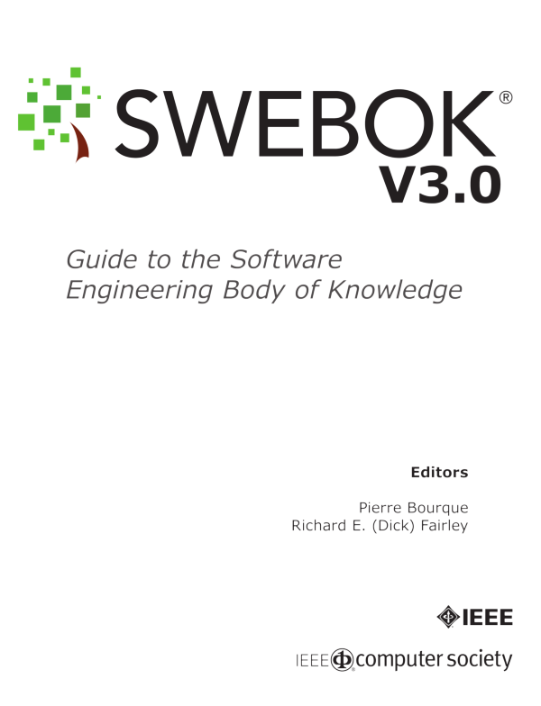
Software Engineering Body of Knowledge (SWEBOK)
Software Requirements
Software Design
Software Construction
Software Testing
Software Maintenance
Software Configuration Management
Software Engineering Management
Software Engineering Process
Software Engineering Models and Methods
Software Quality
Software Engineering Professional Practice
Software Engineering Economics
Computing Foundations
Mathematical Foundations
Engineering Foundations

Slide 62
IEEE/ACM Computing Curricula 2005
Computer Engineering (CE)
pengembangan sistem terintegrasi(software dan hardware)
Computer Engineer
Information
System (IS)
analisa kebutuhan dan proses bisnis serta desain sistem
System Analyst
Computer Science (CS)
konsep computing dan
pengembangan software
Computer Scientist
Information
Technology (IT)
pengembangan dan maintenance infrastruktur IT
IT Engineer
Software Engineering (SE)
pengembangan software
dan pengelolaan tahapan
SDLC
Software Engineer

Slide 63
Why Become a Software Engineer?
5 Best Jobs in the World:
Software Engineer:
$80,500 Average Pay and 46% 10 Year Growth
College Professor:
$81,500 Average Pay and 31% 10 Year Growth
Financial Adviser:
$122,500 Average Pay and 26% 10 Year Growth
Human Resources Manager:
$73,500 Average Pay and 23% 10 Year Growth
Physician Assistant:
$75,000 Average Pay and 50% 10 Year Growth

Slide 64
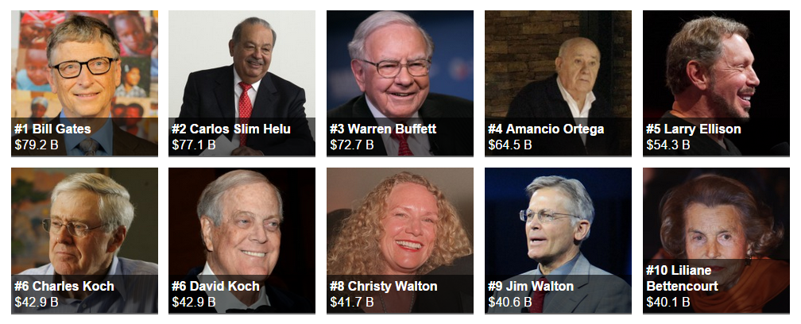

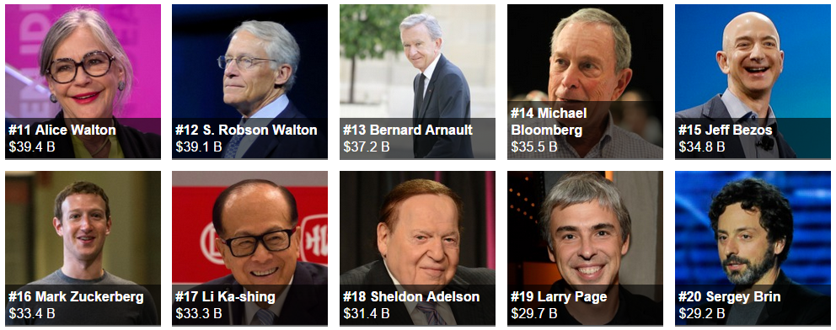
The World's Billionaires

Slide 65
Reference (Foundation)
Ian Sommerville, Software Engineering 10th Edition, Addison-Wesley, 2015
Roger S. Pressman, Software Engineering: A Practitioner’s Approach 8th Edition, McGraw-Hill, 2014
P. Bourque and R.E. Fairley, eds., Guide to the Software Engineering Body of Knowledge Version 3.0, IEEE Computer Society, 2014
Albert Endres dan Dieter Rombach, A Handbook of Software and Systems Engineering, Pearson Education Limited, 2003
Yingxu Wang, Software Engineering Foundations: A Software Science Perspective, Auerbach Publications, Taylor & Francis Group, 2008

Slide 66
Reference (Process)
Alan Dennis et al, Systems Analysis and Design with UML – 4th Edition, John Wiley and Sons, 2012
Dan Pilone and Russ Miles, Head First Software Development, O’Reilly Media, 2008
Barclay and Savage, Object-Oriented Design with UML and Java, Elsevier, 2004
Kenneth E. Kendall and Julie E Kendall, Systems Analysis and Design 8th Edition, Prentice Hall, 2010
Hassan Gomaa, Software Modeling and Design: UML, Use Cases, Patterns, and Software Architectures, Cambridge University Press, 2011
Layna Fischer (edt.), BPMN 2.0 Handbook Second Edition, Future Strategies, 2012

Slide 67
Reference (Quality)
Daniel Galin, Software Quality Assurance, Addison-Wesley, 2004
Kshirasagar Naik and Priyadarshi Tripathy, Software Testing and Quality Assurance, John Wiley & Sons, Inc., 2008
Jeff Tian, Software Quality Engineering, John Wiley & Sons, Inc., 2005
G. Gordon Schulmeyer, Handbook of Software Quality Assurance Fourth Edition, Artech House, 2008

Slide 68
Reference (Research)
Christian W. Dawson, Project in Computing and Information System a Student Guide 2nd Edition, Addison-Wesley, 2009
Mikael Berndtsson, Jörgen Hansson, Björn Olsson, Björn Lundell, Thesis Projects - A Guide for Students in Computer Science and Information System 2nd Edition, Springer-Verlag London Limited, 2008
Mary Shaw, Writing Good Software Engineering Research Papers, Proceedings of the 25th International Conference on Software Engineering, 2003
C. Wohlin, P. Runeson, M. Host, M. C. Ohlsson, B. Regnell, and A. Wesslen, Experimentation in Software Engineering, Springer, 2012
P. Runeson, M. Host, A. Rainer, and B. Regnell, Case Study Research in Software Engineering: Guiidelines and Examples, John Wiley & Sons, Inc., 2012

