Slide 1
Project Management
12. Project Procurement Management
Romi Satria Wahono
romi@romisatriawahono.net
http://romisatriawahono.net

Slide 2
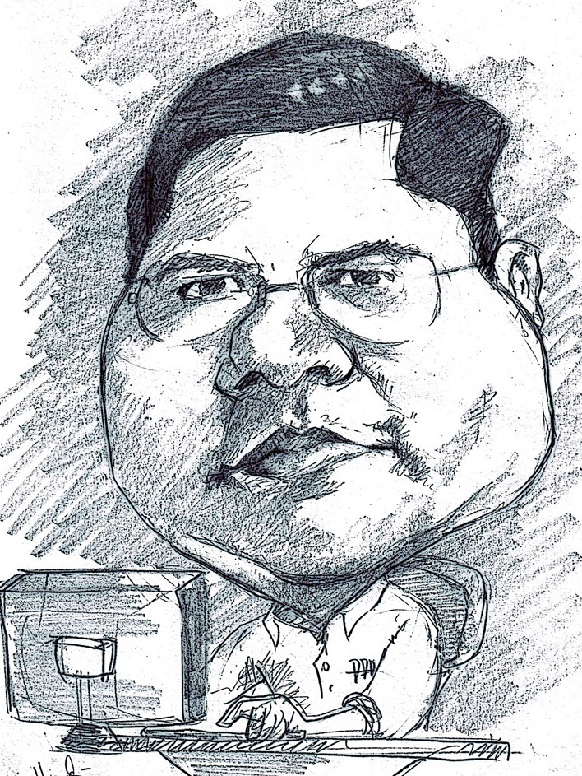
Romi Satria Wahono
SD Sompok Semarang (1987)
SMPN 8 Semarang (1990)
SMA Taruna Nusantara, Magelang (1993)
B.Eng, M.Eng and Dr.Eng (on-leave)
Department of Computer Science
Saitama University, Japan (1994-2004)
Research Interests: Software Engineering and
Intelligent Systems
Founder IlmuKomputer.Com
LIPI Researcher (2004-2007)
Founder and CEO PT Brainmatics Cipta Informatika

Slide 3
Project Management Course Outline
Introduction to Project Management
The Project Management and Information Technology Context
The Project Management Process Groups: A Case Study
Project Integration Management
Project Scope Management
Project Time Management
Project Cost Management
Project Quality Management
Project Human Resource Management
Project Communication Management
Project Risk Management
Project Procurement Management

Slide 4
12. Project Procurement Management

Slide 5
Learning Objectives
Understand the importance of project procurement management and the increasing use of outsourcing for information technology projects
Describe the work involved in planning procurements for projects, including determining the proper type of contract to use and preparing a procurement management plan, statement of work, source selection criteria, and make-or-buy analysis
Discuss what is involved in conducting procurements and strategies for obtaining seller responses, selecting sellers, and awarding contracts
Understand the process of administering procurements by managing procurement relationships and monitoring contract performance
Describe the process of closing procurements
Discuss types of software available to assist in project procurement management

Slide 6
Importance of Project Procurement Management
Procurement means acquiring goods and/or services from an outside source
Other terms include purchasing and outsourcing
Experts predict that global spending on computer software and services will continue to grow
People continue to debate whether offshore outsourcing helps their own country or not

Slide 7
Debates on Outsourcing
Some companies, such as Wal-Mart, prefer to do no outsourcing at all, while others do a lot of outsourcing
Most organizations do some form of outsourcing to meet their IT needs and spend most money within their own country
The U.S. temporary workforce continues to grow as people work for temporary job agencies so they can more easily move from company to company

Slide 8
IT Outsourcing Survey Results
Application development is the most popular form of IT outsourcing and was used by 53 percent of organizations surveyed
The IT function with the largest percentage of work outsourced is disaster recovery services, accounting for 50 percent of total IT outsourcing
Even though application development and maintenance are frequently outsourced, they are a low percentage of the amount of total IT work outsourced

Slide 9
Why Outsource?
To reduce both fixed and recurrent costs
To allow the client organization to focus on its core business
To access skills and technologies
To provide flexibility
To increase accountability

Slide 10
Contracts
A contract is a mutually binding agreement that obligates the seller to provide the specified products or services and obligates the buyer to pay for them
Contracts can clarify responsibilities and sharpen focus on key deliverables of a project
Because contracts are legally binding, there is more accountability for delivering the work as stated in the contract
A recent trend in outsourcing is the increasing size of contracts

Slide 11
What Went Wrong?
Companies often change their minds about procurement; for example, JPMorgan Chase announced a seven-year, $5 billion deal to outsource much of its data processing to IBM, but they revoked the contract less than two years into its existence because the procurement plan no longer fit their business strategy
The Australian Computer Society says sending work offshore may lower the number of students entering IT courses, deplete the number of skilled IT professionals, and diminish the nation’s strategic technology capability
Procurement can also cause security problems, including the protection of intellectual property, integrity of data, and the reliability of infrastructure in offshore locations

Slide 12
Project Procurement Management Processes
Project procurement management: acquiring goods and services for a project from outside the performing organization
Processes include:
  Planning procurements: determining what to procure, when, and how
  Conducting procurements: obtaining seller responses, selecting sellers, and awarding contracts
  Administering procurements: managing relationships with sellers, monitoring contract performance, and making changes as needed
  Closing procurements: completing and settling each contract, including resolving of any open items

Slide 13
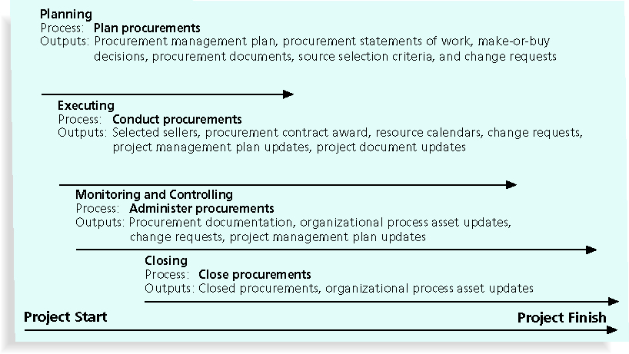
Project Procurement Management Summary

Slide 14
Planning Procurements
Identifying which project needs can best be met by using products or services outside the organization
If there is no need to buy any products or services from outside the organization, then there is no need to perform any of the other procurement management processes

Slide 15
What Went Right?
Several organizations, such as The Boots Company PLC in England, outsource their IT services to save money compared with the cost of running the systems themselves
Carefully planning procurement can also save millions of dollars, as the U.S. Air Force did by using a unit pricing strategy for a large office automation project

Slide 16
Tools and Techniques for Planning Purchases and Acquisitions
Make-or-buy analysis: general management technique used to determine whether an organization should make or perform a particular product or service inside the organization or buy from someone else
Often involves financial analysis
Experts, both internal and external, can provide valuable inputs in procurement decisions

Slide 17
Make-or-Buy Example
Assume you can lease an item you need for a project for $800/day; to purchase the item, the cost is $12,000 plus a daily operational cost of $400/day
How long will it take for the purchase cost to be the same as the lease cost?

Slide 18
Make-or Buy Solution
Set up an equation so both options, purchase and lease, are equal
In this example, use the following equation; let d be the number of days to use the item:
  $12,000 + $400d = $800d
  Subtracting $400d from both sides, you get:
  $12,000 = $400d
  Dividing both sides by $400, you get:
  d = 30
If you need the item for more than 30 days, it is more economical to purchase it

Slide 19
Types of Contracts
Different types of contracts can be used in different situations:
  Fixed price or lump sum contracts: involve a fixed total price for a well-defined product or service
  Cost reimbursable contracts: involve payment to the seller for direct and indirect costs
  Time and material contracts: hybrid of both fixed price and cost reimbursable contracts, often used by consultants
  Unit price contracts: require the buyer to pay the seller a predetermined amount per unit of service
A single contract can actually include all four of these categories if it makes sense for that particular procurement

Slide 20
Point of Total Assumption
The Point of Total Assumption (PTA) is the cost at which the contractor assumes total responsibility for each additional dollar of contract cost
Contractors do not want to reach the point of total assumption because it hurts them financially, so they have an incentive to prevent cost overruns
The PTA is calculated with the following formula:
PTA = (ceiling price – target price)/government share + target cost

Slide 21
Cost Reimbursable Contracts
Cost plus incentive fee (CPIF): the buyer pays the supplier for allowable performance costs plus a predetermined fee and an incentive bonus
Cost plus fixed fee (CPFF): the buyer pays the supplier for allowable performance costs plus a fixed fee payment usually based on a percentage of estimated costs
Cost plus percentage of costs (CPPC): the buyer pays the supplier for allowable performance costs plus a predetermined percentage based on total costs

Slide 22
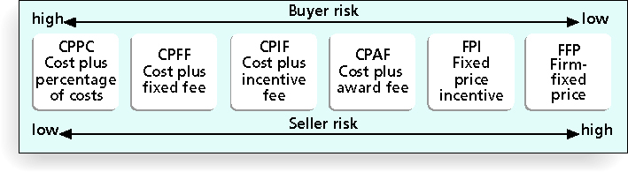
Contract Types versus Risk

Slide 23
Media Snapshot
Contract incentives can be extremely effective; on August 1, 2007, tragedy struck Minneapolis, Minnesota, when a bridge on I-35W collapsed, killing 13 motorists, injuring 150 people, and leaving a mass of concrete and steel in the river and on its banks
Peter Sanderson, project manager for the joint venture of Flatiron-Manson led his team in completing the project; the contractors earned $25 million in incentive fees on top of their $234 million contract for completing the bridge three months ahead of schedule
MnDOT justified the incentive payment by saying that each day the bridge was closed, it cost road users more than $400,000

Slide 24
Contract Clauses
Contracts should include specific clauses that take into account issues that are unique to the project
Can require various educational or work experience for different pay rights
A termination clause is a contract clause that allows the buyer or supplier to end the contract

Slide 25
Procurement Management Plan
Describes how the procurement processes will be managed, from developing documentation for making outside purchases or acquisitions to contract closure
Contents vary based on project needs

Slide 26
Contract Statement of Work (SOW)
A statement of work is a description of the work required for the procurement
If a SOW is used as part of a contract to describe only the work required for that particular contract, it is called a contract statement of work
A SOW is a type of scope statement
A good SOW gives bidders a better understanding of the buyer’s expectations

Slide 27
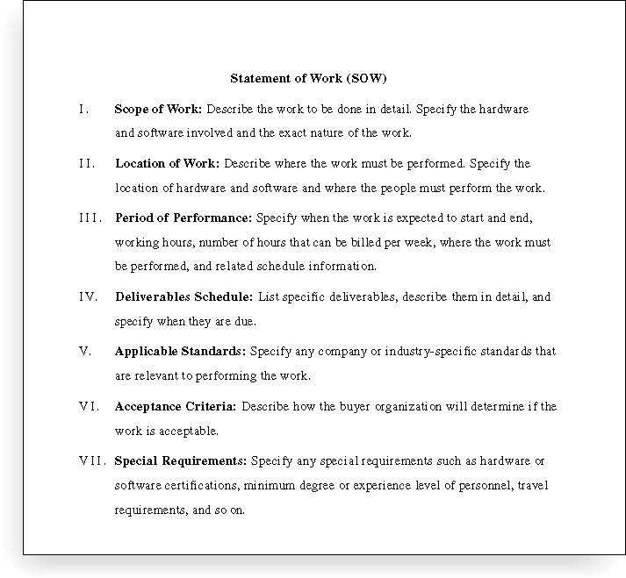
Statement of Work (SOW) Template

Slide 28
Procurement Documents
Request for Proposals: used to solicit proposals from prospective sellers
  A proposal is a document prepared by a seller when there are different approaches for meeting buyer needs
Requests for Quotes: used to solicit quotes or bids from prospective suppliers
  A bid, also called a tender or quote (short for quotation), is a document prepared by sellers providing pricing for standard items that have been clearly defined by the buyer

Slide 29
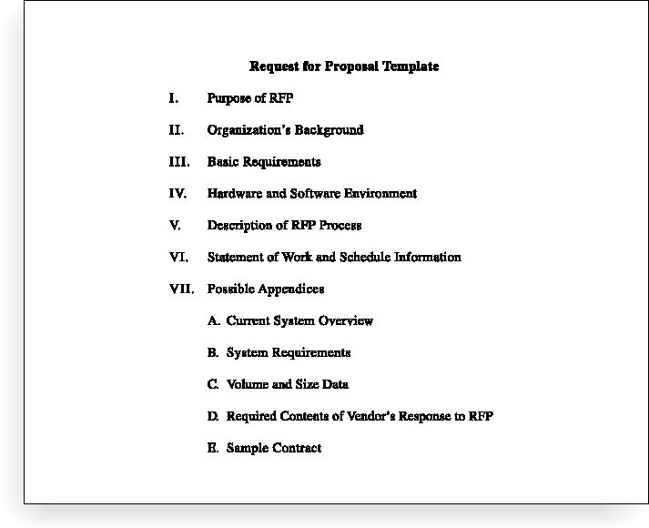
Request for Proposal (RFP) Template

Slide 30
Evaluation Criteria
It’s important to prepare some form of evaluation criteria, preferably before issuing a formal RFP or RFQ
Beware of proposals that look good on paper; be sure to evaluate factors, such as past performance and management approach
Can require a technical presentation as part of a proposal

Slide 31
Conducting Procurements
Deciding whom to ask to do the work
Sending appropriate documentation to potential sellers
Obtaining proposals or bids
Selecting a seller
Awarding a contract

Slide 32
Approaches for Procurement
Organizations can advertise to procure goods and services in several ways:
  Approaching the preferred vendor
  Approaching several potential vendors
  Advertising to anyone interested
A bidders’ conference can help clarify the buyer’s expectations

Slide 33
Source Selection
Evaluating proposals or bids from sellers
Choosing the best one
Negotiating the contract
Awarding the contract

Slide 34
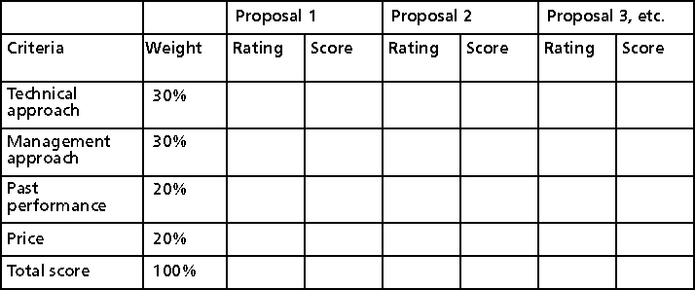
Sample Proposal Evaluation Sheet

Slide 35
Seller Selection
Organizations often do an initial evaluation of all proposals and bids and then develop a short list of potential sellers for further evaluation
Sellers on the short list often prepare a best and final offer (BAFO)
Final output is a contract signed by the buyer and the selected seller

Slide 36
Administering Procurements
Ensures that the seller’s performance meets contractual requirements
Contracts are legal relationships, so it is important that legal and contracting professionals be involved in writing and administering contracts
It is critical that project managers and team members watch for constructive change orders, which are oral or written acts or omissions by someone with actual or apparent authority that can be construed to have the same effect as a written change order

Slide 37
Suggestions for Change Control in Contracts
Changes to any part of the project need to be reviewed, approved, and documented by the same people in the same way that the original part of the plan was approved
Evaluation of any change should include an impact analysis; how will the change affect the scope, time, cost, and quality of the goods or services being provided?
Changes must be documented in writing; project team members should also document all important meetings and telephone phone calls

Slide 38
Suggestions for Change Control in Contracts (continued)
Project managers and teams should stay closely involved to make sure the new system will meet business needs and work in an operational environment
Have backup plans
Use tools and techniques, such as a contract change control system, buyer-conducted performance reviews, inspections and audits, and so on

Slide 39
Best Practice
Accenture developed a list of best practices from experienced outsourcers throughout the world:
  Build in Broad Business Outcomes Early and Often
  Hire a Partner, Not Just a Provider
  It’s More Than a Contract, It’s a Business Relationship
  Leverage Gain-Sharing
  Use Active Governance
  Assign a Dedicated Executive
  Focus Relentlessly on Primary Objectives

Slide 40
Closing Procurements
Involves completing and settling contracts and resolving any open items
The project team should:
  Determine if all work was completed correctly and satisfactorily
  Update records to reflect final results
  Archive information for future use
The contract itself should include requirements for formal acceptance and closure

Slide 41
Tools to Assist in Contract Closure
Procurement audits identify lessons learned in the procurement process
Negotiated settlements help close contracts more smoothly
A records management system provides the ability to easily organize, find, and archive procurement-related documents

Slide 42
Using Software to Assist in Project Procurement Management
Word processing software helps write proposals and contracts, spreadsheets help evaluate suppliers, databases help track suppliers, and presentation software helps present procurement-related information
E-procurement software does many procurement functions electronically
Organizations also use other Internet tools to find information on suppliers or auction goods and services

Slide 43
Summary
Project procurement management involves acquiring goods and services for a project from outside the performing organization
Processes include:
  Plan procurements
  Conduct procurements
  Administer procurements
  Close procurements

Slide 44
References
Kathy Schwalbe, Managing Information Technology Projects 6th Edition, Course Technology, Cengage Learning, 2010
A Guide to the Project Management Body of Knowledge: PMBOK Guide 4th Edition, Project Management Institute, 2008

