Slide 1
Project Management
9. Project Human Resource Management
Romi Satria Wahono romi@romisatriawahono.net http://romisatriawahono.net

Slide 2
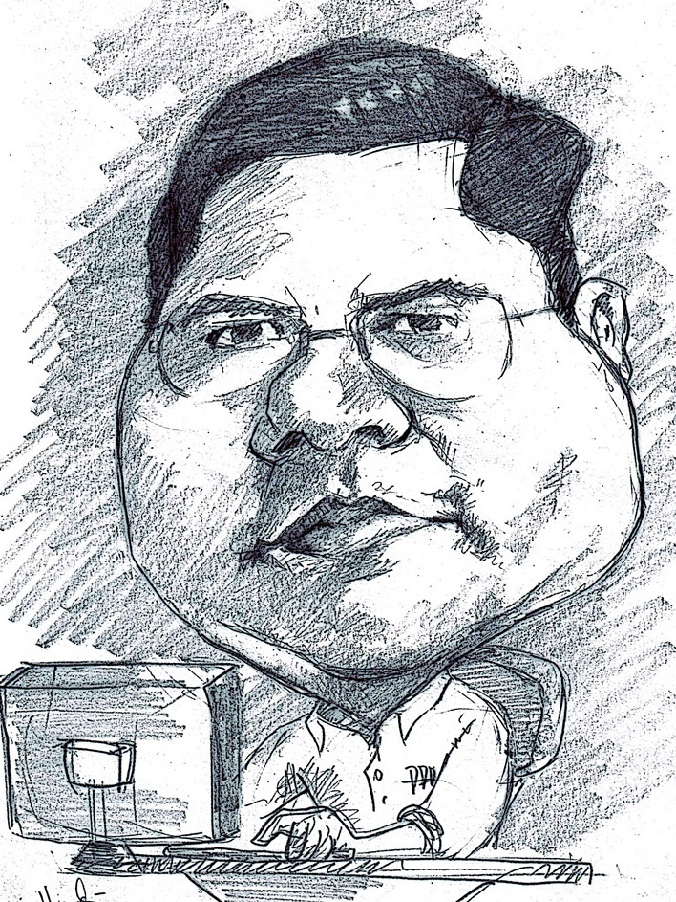
Romi Satria Wahono
SD Sompok Semarang (1987)
SMPN 8 Semarang (1990)
SMA Taruna Nusantara, Magelang (1993)
B.Eng, M.Eng and Dr.Eng (on-leave) Department of Computer Science Saitama University, Japan (1994-2004)
Research Interests: Software Engineering and Intelligent Systems
Founder IlmuKomputer.Com
LIPI Researcher (2004-2007)
Founder and CEO PT Brainmatics Cipta Informatika

Slide 3
Project Management Course Outline
Introduction to Project Management
The Project Management and Information Technology Context
The Project Management Process Groups: A Case Study
Project Integration Management
Project Scope Management
Project Time Management
Project Cost Management
Project Quality Management
Project Human Resource Management
Project Communication Management
Project Risk Management
Project Procurement Management

Slide 4
9. Project Human Resource Management

Slide 5
Learning Objectives
Explain the importance of good human resource management on projects, including the current state and future implications of the global IT workforce
Define project human resource management and understand its processes
Summarize key concepts for managing people by understanding the theories of Abraham Maslow, Frederick Herzberg, David McClelland, and Douglas McGregor on motivation, H. J. Thamhain and D. L. Wilemon on influencing workers, and Stephen Covey on how people and teams can become more effective

Slide 6
Learning Objectives
Discuss human resource planning and be able to create a human resource plan, project organizational chart, responsibility assignment matrix, and resource histogram
Understand important issues involved in project staff acquisition and explain the concepts of resource assignments, resource loading, and resource leveling
Assist in team development with training, team-building activities, and reward systems
Explain and apply several tools and techniques to help manage a project team and summarize general advice on managing teams
Describe how project management software can assist in project human resource management

Slide 7
The Importance of Human Resource Management
Many corporate executives have said, “People are our most important asset”
People determine the success and failure of organizations and projects

Slide 8
The Global IT Workforce
Although there have been ups and downs in the IT labor market, there will always be a need for good IT workers
The Digital Planet 2008 study estimated that the global marketplace for information and communications technology (ICT) would top $3.7 trillion in 2008 and reach almost $4 trillion by 2011

Slide 9
More Digital Planet Report Findings
Communications products and services represented the largest single category of ICT spending (57 percent) in 2007 with $1.9 trillion; consumers spent 29 percent of ICT dollars worldwide, while spending by business and government accounted for 71 percent
The top ten ICT spending countries are, in descending order: the U.S., Japan, China, Germany, U.K., France, Italy, Brazil, Canada, and Spain; in 2008, China jumped ahead of Germany, the United Kingdom, and France
The Americas’ growth in ICT spending will be the slowest of the three broad regions at 4 percent between 2007 and 2011; the Asia-Pacific region and the Europe, Africa, and Middle East regions will grow annually at 10.5 percent and 5 percent, respectively

Slide 10
U.S. IT Workforce
U.S. IT employment topped 4 million for the first time in 2008
Several IT-related occupations will be among the top 30 fastest-growing occupations in the U.S. between now and 2016, with network systems/data communications analysts and computer software engineers listed as numbers one and four
IT staff struggle to transition to project management, CIOs argue, and complain that educational institutions are not putting adequate focus on these skills through coursework

Slide 11
Implications for the Future of IT Human Resource Management
Proactive organizations are addressing workforce needs by:
Improving benefits
Redefining work hours and incentives
Finding future workers

Slide 12
Media Snapshot
Here’s the dirty little secret: U.S. productivity is No. 1 in the world when productivity is measured as gross domestic product per worker, but our lead vanishes when productivity is measured as GDP per hour worked…Europeans take an average of six to seven weeks of paid annual leave, compared with just 12 days in the United States; twice as many American as European workers put in more than 48 hours per week
Sociologists have shown that many Americans, especially men, would like to have more family or leisure time; recent surveys show that many Americans are willing to sacrifice up to a quarter of their salaries in return for more time off

Slide 13
What Went Wrong?
A 2006 report by The Conference Board, Corporate Voices for Working Families, Partnership for 21st Century Skills, and the Society for Human Resource Management suggests that entry level workers in the U.S. are ill-prepared for the workplace
Four-year college graduates were listed as deficient in the following three skills:
Written communications - 27.8%
Writing in English - 26.2%
Leadership - 23.8%

Slide 14
What is Project Human Resource Management?
Making the most effective use of the people involved with a project
Processes include:
Developing the human resource plan: identifying and documenting project roles, responsibilities, and reporting relationships
Acquiring the project team: getting the needed personnel assigned to and working on the project
Developing the project team: building individual and group skills to enhance project performance
Managing the project team: tracking team member performance, motivating team members, providing timely feedback, resolving issues and conflicts, and coordinating changes to help enhance project performance

Slide 15
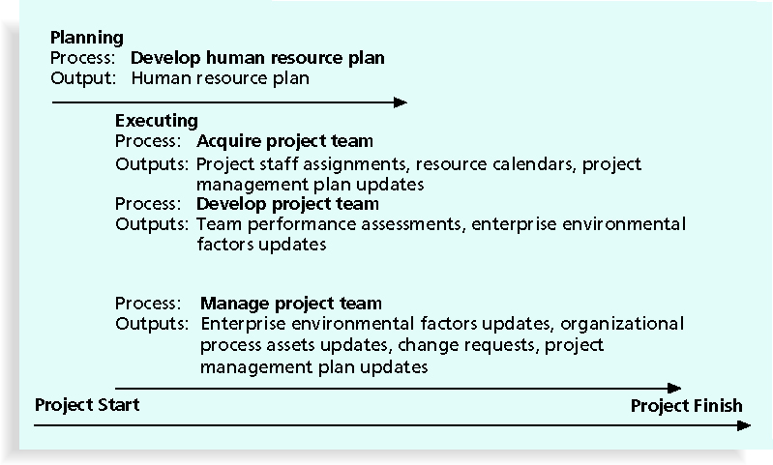
Project Human Resource Management Summary

Slide 16
Keys to Managing People
Psychologists and management theorists have devoted much research and thought to the field of managing people at work
Important areas related to project management include:
Motivation theories
Influence and power
Effectiveness

Slide 17
Intrinsic and Extrinsic Motivation
Intrinsic motivation causes people to participate in an activity for their own enjoyment
Extrinsic motivation causes people to do something for a reward or to avoid a penalty
For example:
some children take piano lessons for intrinsic motivation (they enjoy it)
while others take them for extrinsic motivation (to get a reward or avoid punishment)

Slide 18
Maslow’s Hierarchy of Needs
Abraham Maslow argued that humans possess unique qualities that enable them to make independent choices, thus giving them control of their destiny
Maslow developed a hierarchy of needs which states that people’s behaviors are guided or motivated by a sequence of needs

Slide 19
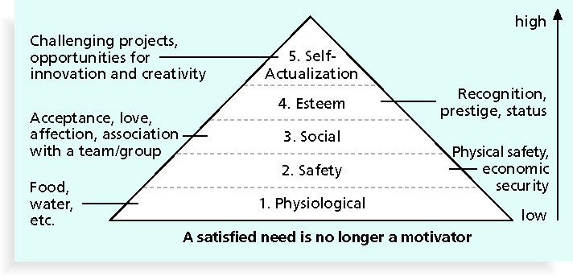
Maslow’s Hierarchy of Needs

Slide 20
Herzberg’s Motivational and Hygiene Factors
Frederick Herzberg wrote several famous books and articles about worker motivation; he distinguished between:
Motivational factors: achievement, recognition, the work itself, responsibility, advancement, and growth, which produce job satisfaction
Hygiene factors: cause dissatisfaction if not present, but do not motivate workers to do more; examples include larger salaries, more supervision, and a more attractive work environment

Slide 21
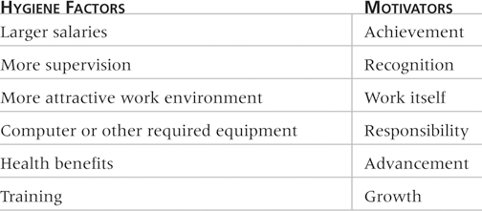
Examples of Herzberg’s Hygiene Factors and Motivators

Slide 22
McClelland’s Acquired-Needs Theory
Specific needs are acquired or learned over time and shaped by life experiences, including:
Achievement (nAch): achievers like challenging projects with achievable goals and lots of feedback
Affiliation (nAff): people with high nAff desire harmonious relationships and need to feel accepted by others, so managers should try to create a cooperative work environment for them
Power (nPow): people with a need for power desire either personal power (not good) or institutional power (good for the organization); provide institutional power seekers with management opportunities

Slide 23
McGregor’s Theory X and Y
Douglas McGregor popularized the human relations approach to management in the 1960s
Theory X: assumes workers dislike and avoid work, so managers must use coercion, threats, and various control schemes to get workers to meet objectives
Theory Y: assumes individuals consider work as natural as play or rest and enjoy the satisfaction of esteem and self-actualization needs
Theory Z: introduced in 1981 by William Ouchi and is based on the Japanese approach to motivating workers, emphasizing trust, quality, collective decision making, and cultural values

Slide 24
Thamhain and Wilemon’s Ways to Have Influence on Projects
Authority: the legitimate hierarchical right to issue orders
Assignment: the project manager's perceived ability to influence a worker's later work assignments
Budget: the project manager's perceived ability to authorize others' use of discretionary funds
Promotion: the ability to improve a worker's position
Money: the ability to increase a worker's pay and benefits

Slide 25
Thamhain and Wilemon’s Ways to Have Influence on Projects (continued)
Penalty: the project manager's ability to cause punishment
Work challenge: the ability to assign work that capitalizes on a worker's enjoyment of doing a particular task
Expertise: the project manager's perceived special knowledge that others deem important
Friendship: the ability to establish friendly personal relationships between the project manager and others

Slide 26
Ways to Influence that Help and Hurt Projects
Projects are more likely to succeed when project managers influence with:
Expertise
Work challenge
Projects are more likely to fail when project managers rely too heavily on:
Authority
Money
Penalty

Slide 27
Power
Power is the potential ability to influence behavior to get people to do things they would not otherwise do
Types of power include:
Coercive
Legitimate
Expert
Reward
Referent

Slide 28
Covey and Improving Effectiveness
Project managers can apply Covey’s 7 habits to improve effectiveness on projects
Be proactive
Begin with the end in mind
Put first things first
Think win/win
Seek first to understand, then to be understood
Synergize
Sharpen the saw

Slide 29
Empathic Listening and Rapport
Good project managers are empathic listeners; they listen with the intent to understand
Before you can communicate with others, you have to have rapport, a relation of harmony, conformity, accord, or affinity
Mirroring is the matching of certain behaviors of the other person, a technique to help establish rapport
IT professionals need to develop empathic listening and other people skills to improve relationships with users and other stakeholders

Slide 30
1. Developing the Human Resource Plan
Involves identifying and documenting project roles, responsibilities, and reporting relationships
Contents include:
Project organizational charts
Staffing management plan
Responsibility assignment matrixes
Resource histograms

Slide 31
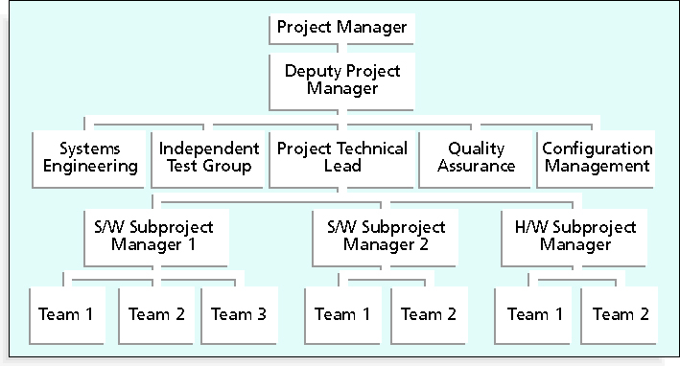
Sample Organizational Chart for a Large IT Project

Slide 32
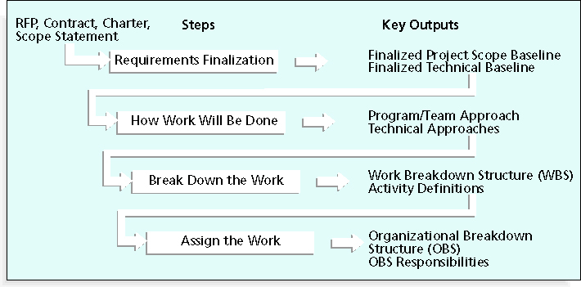
Work Definition and Assignment Process

Slide 33
Responsibility Assignment Matrices
A responsibility assignment matrix (RAM) is a matrix that maps the work of the project as described in the WBS to the people responsible for performing the work as described in the OBS
Can be created in different ways to meet unique project needs

Slide 34
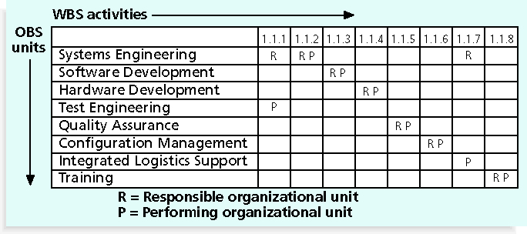
Sample Responsibility Assignment Matrix (RAM)

Slide 35
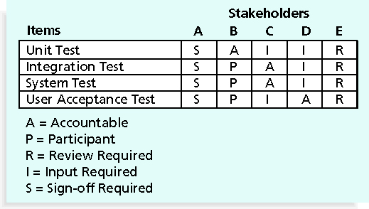
RAM Showing Stakeholder Roles

Slide 36
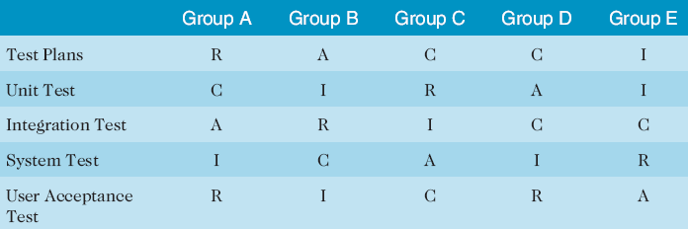
Sample RACI Chart
R = responsibility
A = accountability, only one A per task
C = consultation
I = informed
Note that some people reverse the definitions of responsible and accountable

Slide 37
Staffing Management Plans and Resource Histograms
A staffing management plan describes when and how people will be added to and taken off the project team
A resource histogram is a column chart that shows the number of resources assigned to a project over time

Slide 38
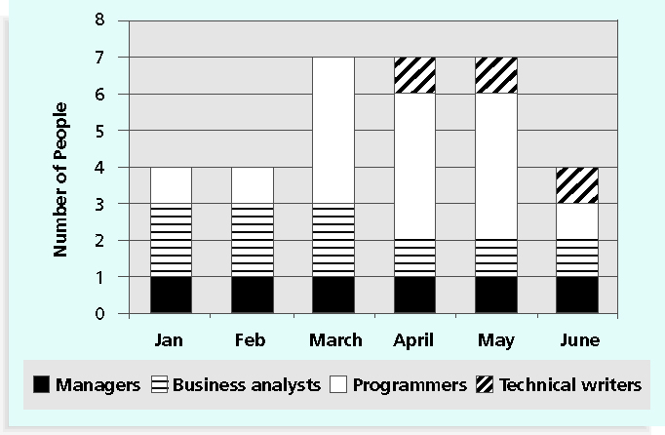
Sample Resource Histogram

Slide 39
What Went Right?
In addition to providing technical training for IT personnel, several companies have made significant investments in project management training to provide career paths for project managers
Hewlett Packard employed only six registered PMPs in 1997, but by August 2004, it employed more than 1,500 PMPs and was adding 500 more per year
While most consulting firms offer a single path to a leadership position, IBM has four to allow their people to succeed by focusing on their strengths and interests in one or more disciplines

Slide 40
2. Acquiring the Project Team
Acquiring qualified people for teams is crucial
The project manager who is the smartest person on the team has done a poor job of recruiting!
It’s important to assign the appropriate type and number of people to work on projects at the appropriate times

Slide 41
Resource Assignment
Staffing plans and good hiring procedures are important, as are incentives for recruiting and retention
Some companies give their employees one dollar for every hour a new person they helped hire works
Some organizations allow people to work from home as an incentive
Enrollment in U.S. computer science and engineering programs has dropped almost in half since 2000, and one-third of U.S. workers will be over the age of 50 by 2010
CIO’s researchers suggest that organizations rethink hiring practices and incentives to hire and retain IT talent

Slide 42
Best Practice
Best practices can be applied to include the best places for people to work
For example, Fortune Magazine lists the “100 Best Companies to Work For” in the United States every year, with Google taking the honors in 2007 and 2008
Working Mothers Magazine lists the best companies in the U.S. for women based on benefits for working families
The Timesonline (www.timesonline.co.uk) provides the Sunday Times list of the 100 Best Companies to Work For, a key benchmark against which UK companies can judge their Best Practice performance as employers

Slide 43
Resource Loading
Resource loading refers to the amount of individual resources an existing schedule requires during specific time periods
Helps project managers develop a general understanding of the demands a project will make on the organization’s resources and individual people’s schedules
Overallocation means that more resources than are available are assigned to perform work at a given time

Slide 44
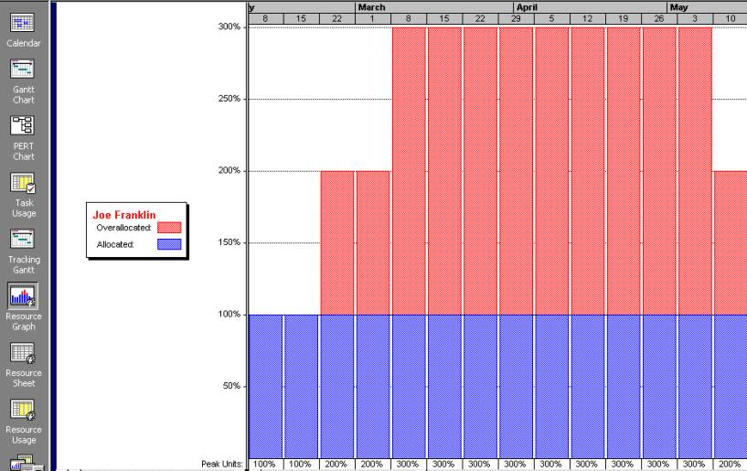
Sample Histogram Showing an Overallocated Individual

Slide 45
Resource Leveling
Resource leveling is a technique for resolving resource conflicts by delaying tasks
The main purpose of resource leveling is to create a smoother distribution of resource usage and reduce overallocation

Slide 46
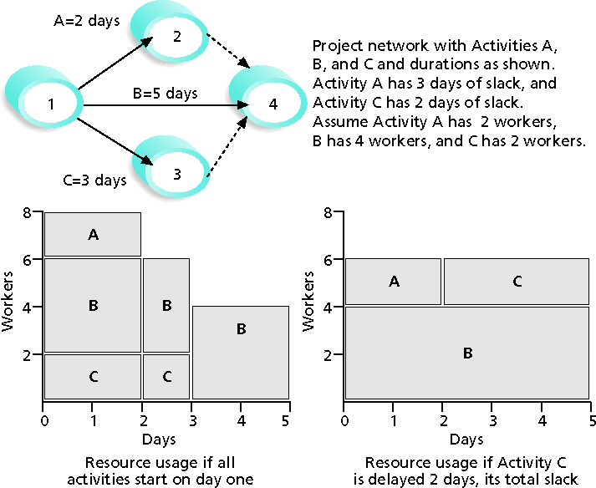
Resource Leveling Example

Slide 47
Benefits of Resource Leveling
When resources are used on a more constant basis, they require less management
It may enable project managers to use a just-in-time inventory type of policy for using subcontractors or other expensive resources
It results in fewer problems for project personnel and accounting department
It often improves morale

Slide 48
3. Developing the Project Team
The main goal of team development is to help people work together more effectively to improve project performance
It takes teamwork to successfully complete most projects

Slide 49
Tuckman Model of Team Development
Forming
Storming
Norming
Performing
Adjourning

Slide 50
Training
Training can help people understand themselves, each other, and how to work better in teams
Team building activities include:
Physical challenges
Psychological preference indicator tools

Slide 51
Meyers-Briggs Type Indicator (MBTI)
MBTI is a popular tool for determining personality preferences and helping teammates understand each other
Four dimensions include:
Extrovert/Introvert (E/I)
Sensation/Intuition (S/N)
Thinking/Feeling (T/F)
Judgment/Perception (J/P)
NTs or rationals are attracted to technology fields
IT people vary most from the general population in not being extroverted or sensing

Slide 52
Social Styles Profile
People are perceived as behaving primarily in one of four zones, based on their assertiveness and responsiveness:
Drivers
Expressives
Analyticals
Amiables
People on opposite corners (drivers and amiables, analyticals and expressives) may have difficulties getting along

Slide 53
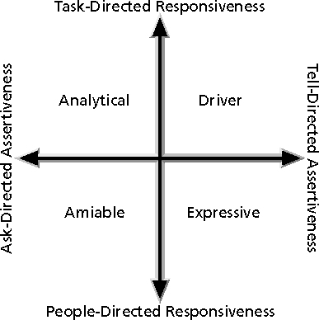
Social Styles

Slide 54
DISC Profiles
Also uses a four-dimensional model of normal behavior
Dominance
Influence
Steadiness
Compliance
People in opposite quadrants can have problems understanding each other

Slide 55
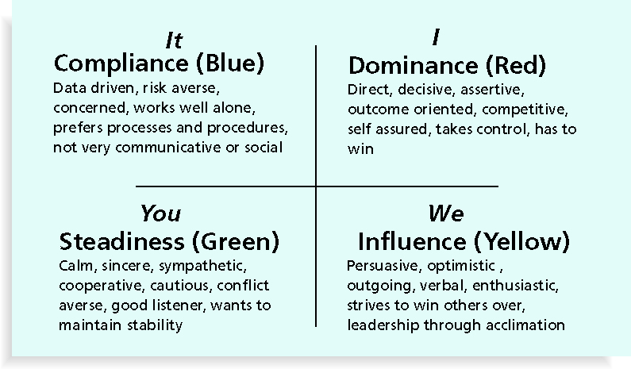
The DISC Profile

Slide 56
Reward and Recognition Systems
Team-based reward and recognition systems can promote teamwork
Focus on rewarding teams for achieving specific goals
Allow time for team members to mentor and help each other to meet project goals and develop human resources

Slide 57
4. Managing the Project Team
Project managers must lead their teams in performing various project activities
After assessing team performance and related information, the project manager must decide:
If changes should be requested to the project
If corrective or preventive actions should be recommended
If updates are needed to the project management plan or organizational process assets

Slide 58
Tools and Techniques for Managing Project Teams
Observation and conversation
Project performance appraisals
Conflict management
Issue logs
Interpersonal skills

Slide 59
General Advice on Teams
Be patient and kind with your team
Fix the problem instead of blaming people
Establish regular, effective meetings
Allow time for teams to go through the basic team-building stages
Limit the size of work teams to three to seven members

Slide 60
General Advice on Teams (continued)
Plan some social activities to help project team members and other stakeholders get to know each other better
Stress team identity
Nurture team members and encourage them to help each other
Take additional actions to work with virtual team members

Slide 61
Five Dysfunctions of a Team
Patrick Lencioni, author of several books on teams, says that “Teamwork remains the one sustainable competitive advantage that has been largely untapped”*
The five dysfunctions of teams are:
Absence of trust
Fear of conflict
Lack of commitment
Avoidance of accountability
Inattention to results
*Lencioni, Patrick, “Overcoming the Five Dysfunctions of a Team,” Jossey-Bass: San Francisco, CA (2005), p. 3.

Slide 62
Using Software to Assist in Human Resource Management
Software can help in producing RAMS and resource histograms
Project management software includes several features related to human resource management such as:
Assigning resources
Identifying potential resource shortages or underutilization
Leveling resources

Slide 63
Project Resource Management Involves Much More Than Using Software
Project managers must:
Treat people with consideration and respect
Understand what motivates them
Communicate carefully with them
Focus on your goal of enabling project team members to deliver their best work

Slide 64
Summary
Project human resource management includes the processes required to make the most effective use of the people involved with a project
Main processes include:
Develop human resource plan
Acquire project team
Develop project team
Manage project team

Slide 65
References
Kathy Schwalbe, Managing Information Technology Projects 6th Edition, Course Technology, Cengage Learning, 2010
A Guide to the Project Management Body of Knowledge: PMBOK Guide 4th Edition, Project Management Institute, 2008

