Slide 1
Project Management
5. Project Scope Management
Romi Satria Wahono
romi@romisatriawahono.net
http://romisatriawahono.net

Slide 2
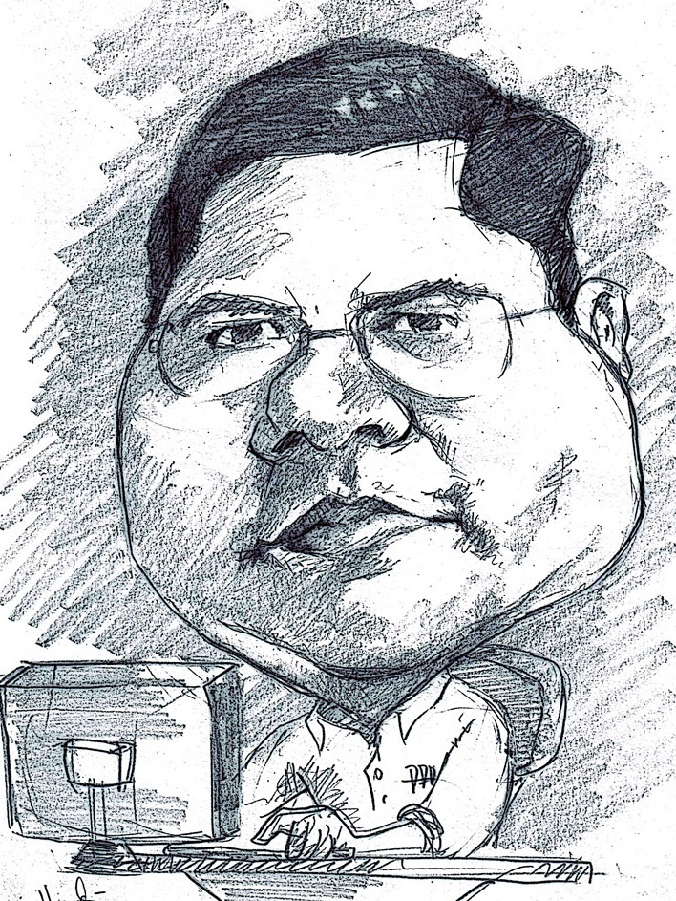
Romi Satria Wahono
SD Sompok Semarang (1987)
SMPN 8 Semarang (1990)
SMA Taruna Nusantara, Magelang (1993)
B.Eng, M.Eng and Dr.Eng (on-leave)
Department of Computer Science
Saitama University, Japan (1994-2004)
Research Interests: Software Engineering and
Intelligent Systems
Founder IlmuKomputer.Com
LIPI Researcher (2004-2007)
Founder and CEO PT Brainmatics Cipta Informatika

Slide 3
Project Management Course Outline
Introduction to Project Management
The Project Management and Information Technology Context
The Project Management Process Groups: A Case Study
Project Integration Management
Project Scope Management
Project Time Management
Project Cost Management
Project Quality Management
Project Human Resource Management
Project Communication Management
Project Risk Management
Project Procurement Management

Slide 4
5. Project Scope Management

Slide 5
Learning Objectives
Understand the importance of good project scope management
Discuss methods for collecting and documenting requirements in order to meet stakeholder needs and expectations
Explain the scope definition process and describe the contents of a project scope statement
Discuss the process for creating a work breakdown structure using the analogy, top-down, bottom-up, and mind-mapping approaches
Explain the importance of verifying scope and how it relates to defining and controlling scope
Understand the importance of controlling scope and approaches for preventing scope-related problems on information technology projects
Describe how software can assist in project scope management

Slide 6
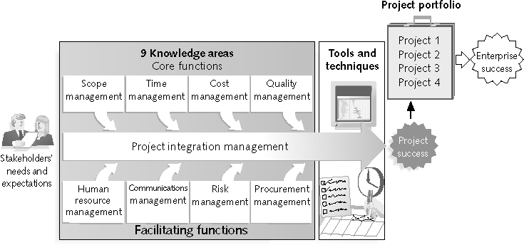
Project Management Framework

Slide 7
What is Project Scope Management?
Scope refers to all the work involved in creating the products of the project and the processes used to create them
A deliverable is a product produced as part of a project, such as hardware or software, planning documents, or meeting minutes
Project scope management includes the processes involved in defining and controlling what is or is not included in a project

Slide 8
Project Scope Management Processes
Collecting requirements: defining and documenting the features and functions of the products produced during the project as well as the processes used for creating them
Defining scope: reviewing the project charter, requirements documents, and organizational process assets to create a scope statement
Creating the WBS: subdividing the major project deliverables into smaller, more manageable components
Verifying scope: formalizing acceptance of the project deliverables
Controlling scope: controlling changes to project scope throughout the life of the project

Slide 9
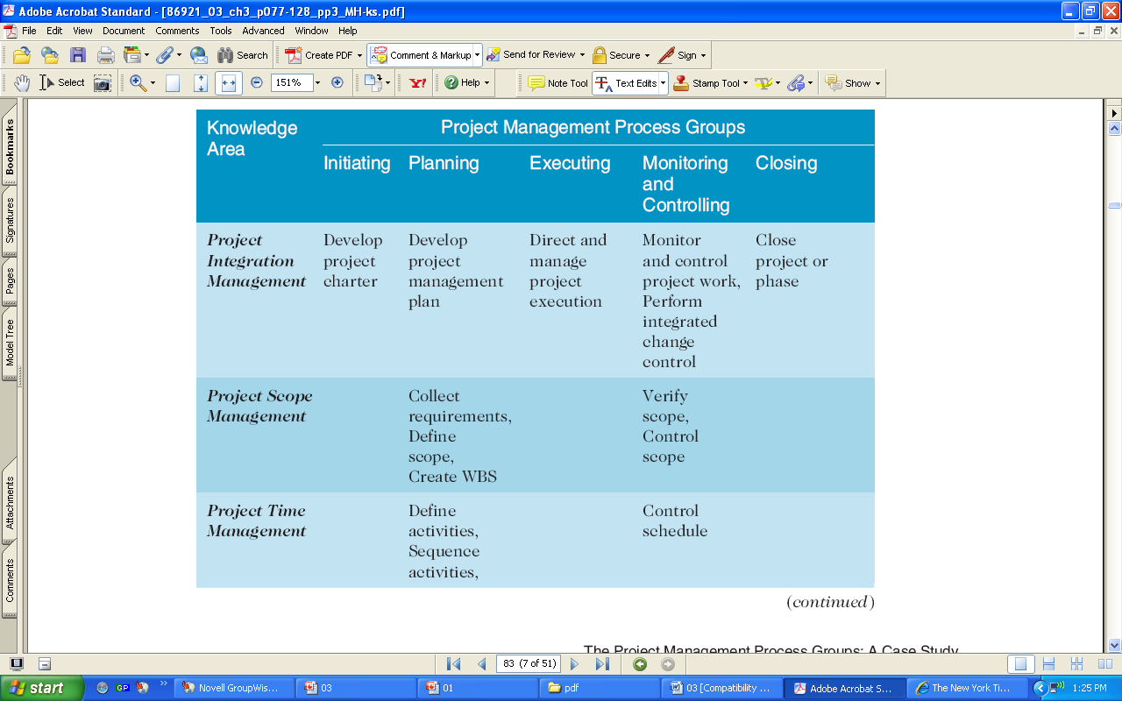
Project Management Process Groups and Knowledge Area Mapping
Source: PMBOK® Guide, Fourth Edition, 2008

Slide 10
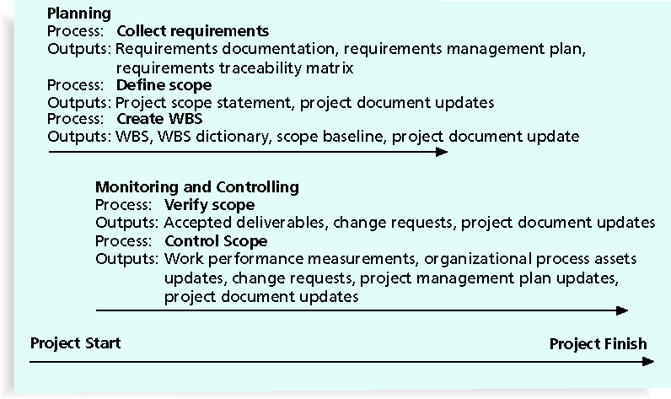
Project Scope Management Summary

Slide 11
1. Collecting Requirements
A requirement is “a condition or capability that must be met or possessed by a system, product, service, result, or component to satisfy a contract, standard, specification, or other formal document” (PMBOK® Guide, 2008)
For some IT projects, it is helpful to divide requirements development into categories called elicitation, analysis, specification, and validation
It is important to use an iterative approach to defining requirements since they are often unclear early in a project

Slide 12
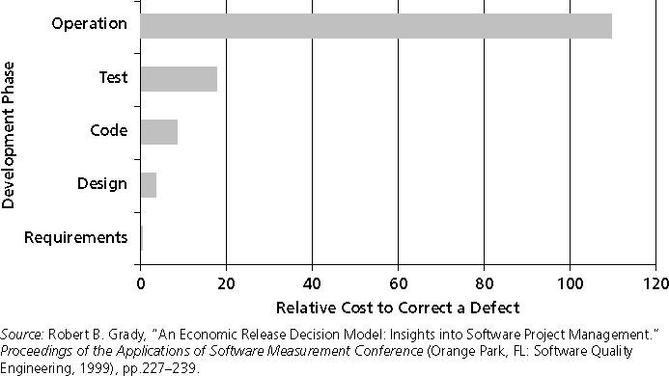
Relative Cost to Correct a Software Requirement Defect

Slide 13
Methods for Collecting Requirements
Interviewing
Focus groups and facilitated workshops
Using group creativity and decision-making techniques
Questionnaires and surveys
Observation
Prototyping
Software tools

Slide 14
What Went Right?
Genesys Telecommunications Laboratories uses Accept software, a product planning and innovation management application and winner of the Excellence in Product Management Award from 2006–2008
Accept helps them instill a consistent, repeatable, and predictable process for new product definition and development
They can define what information comprises a requirement and enforce discipline around that process

Slide 15
Documenting Requirements
Requirements documents are often generated by software and include text, images, diagrams, videos, and other media; they are often broken down into different categories such as functional, service, performance, quality, training requirements, and so on
A requirements management plan describes how project requirements will be analyzed, documented, and managed
A requirements traceability matrix (RTM) is a table that lists requirements, various attributes of each requirement, and the status of the requirements to ensure that all requirements are addressed

Slide 16
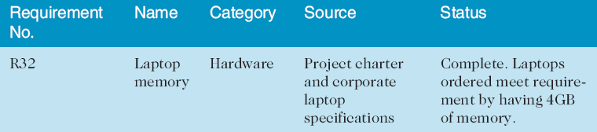
Sample Requirements Traceability Matrix

Slide 17
2. Defining Scope
Key inputs for preparing the project scope statement include the project charter, requirements documentation, and organizational process assets such as policies and procedures related to scope statements as well as project files and lessons learned from previous, similar projects
As time progresses, the scope of a project should become more clear and specific

Slide 18
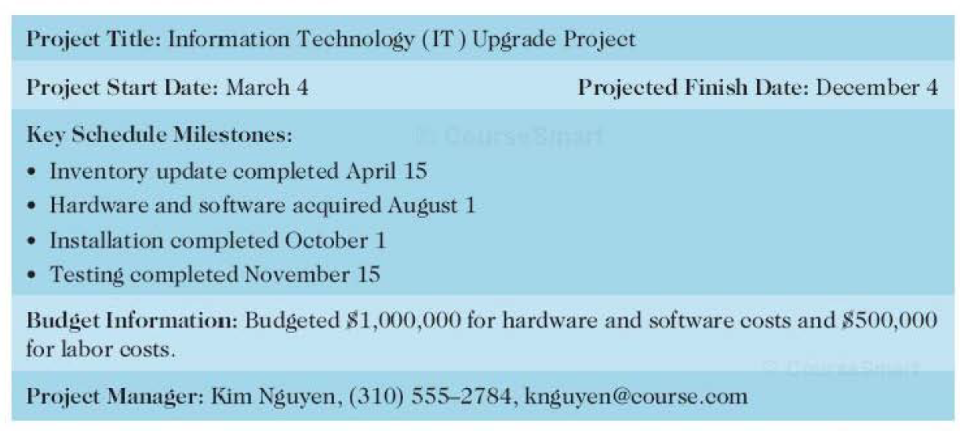
Sample Project Charter

Slide 19
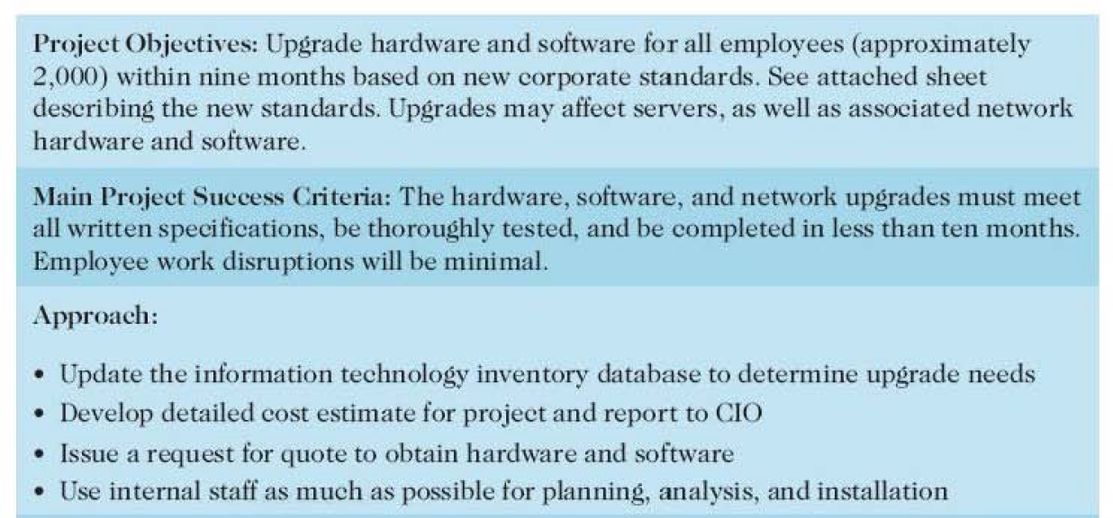

Slide 20
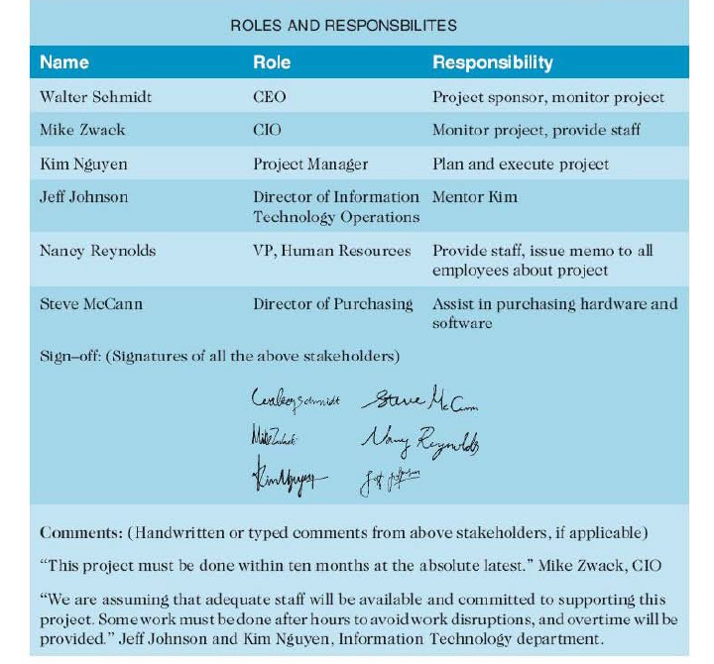

Slide 21
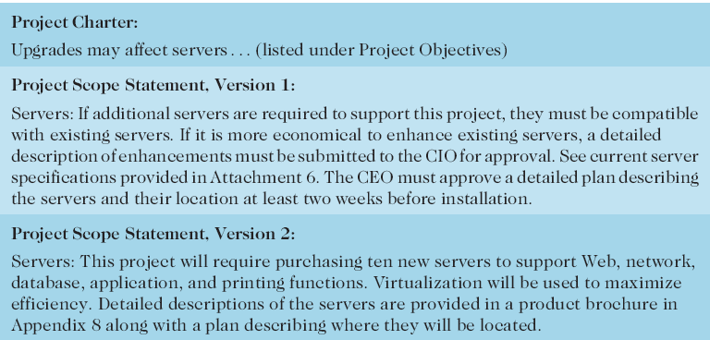
Further Defining Project Scope

Slide 22
Media Snapshot
Many people enjoy watching television shows like Trading Spaces, where participants have two days and $1,000 to update a room in their neighbor’s house; since the time and cost are set, it’s the scope that has the most flexibility
Although most homeowners are very happy with work done on the show, some are obviously disappointed; part of agreeing to be on the show includes signing a release statement acknowledging that you will accept whatever work has been done
Too bad you can’t get sponsors for most projects to sign a similar release form; it would make project scope management much easier!

Slide 23
3. Creating the Work Breakdown Structure (WBS)
A WBS is a deliverable-oriented grouping of the work involved in a project that defines the total scope of the project
WBS is a foundation document that provides the basis for planning and managing project schedules, costs, resources, and changes
Decomposition is subdividing project deliverables into smaller pieces
A work package is a task at the lowest level of the WBS

Slide 24
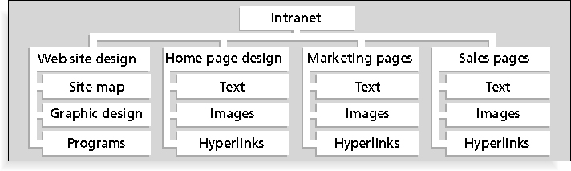
Sample Intranet WBS Organized by Product

Slide 25
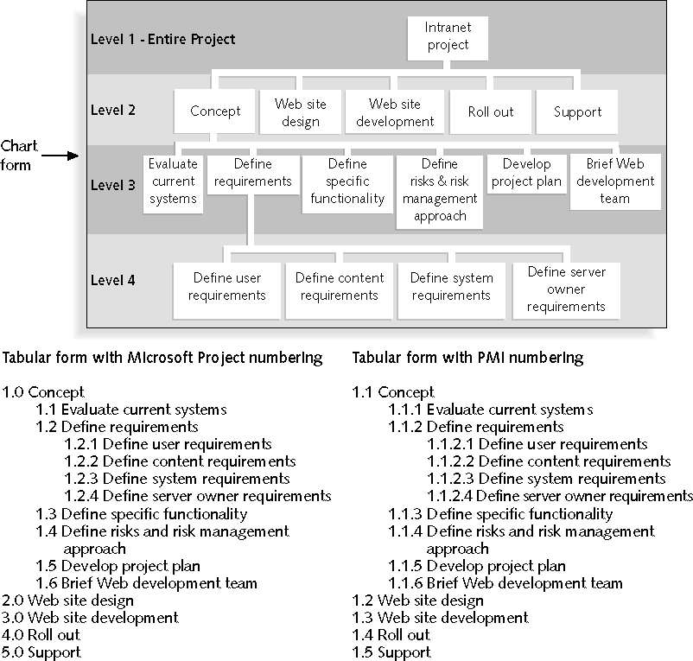
Sample Intranet WBS Organized by Phase

Slide 26
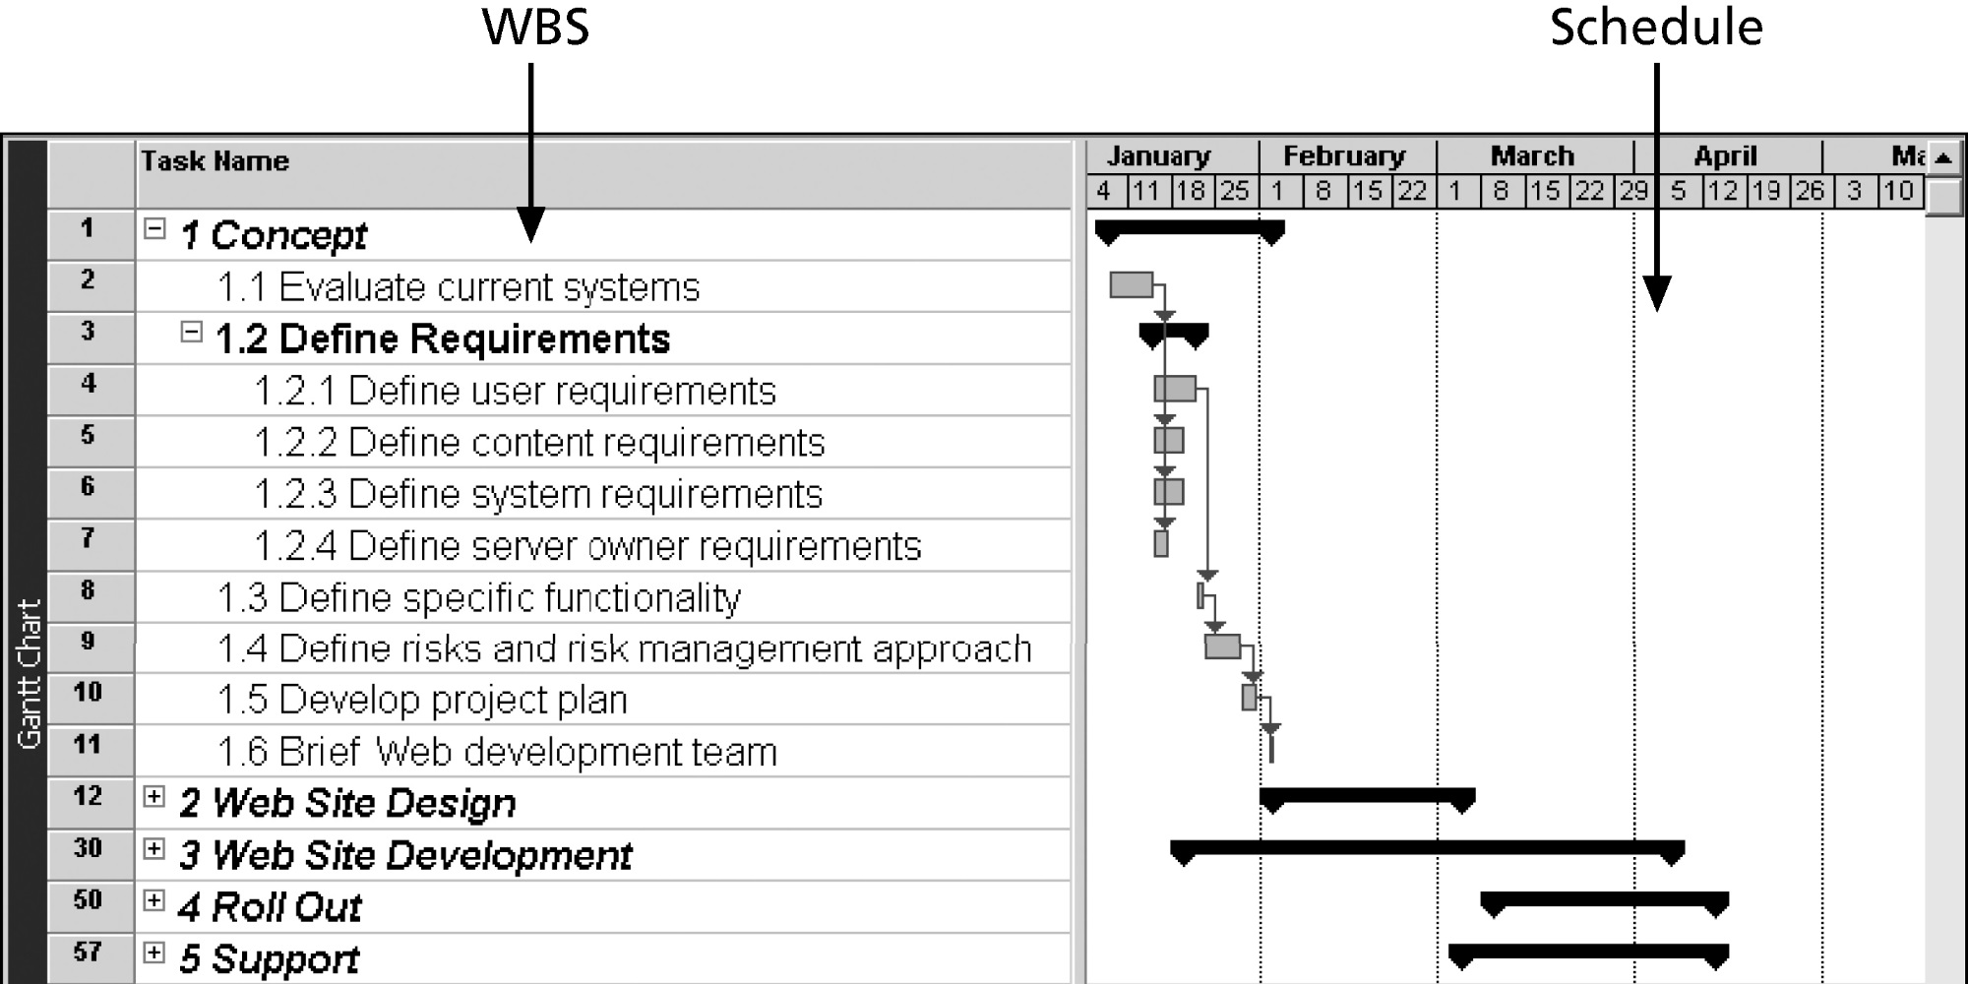
Intranet WBS and Gantt Chart in Microsoft Project

Slide 27
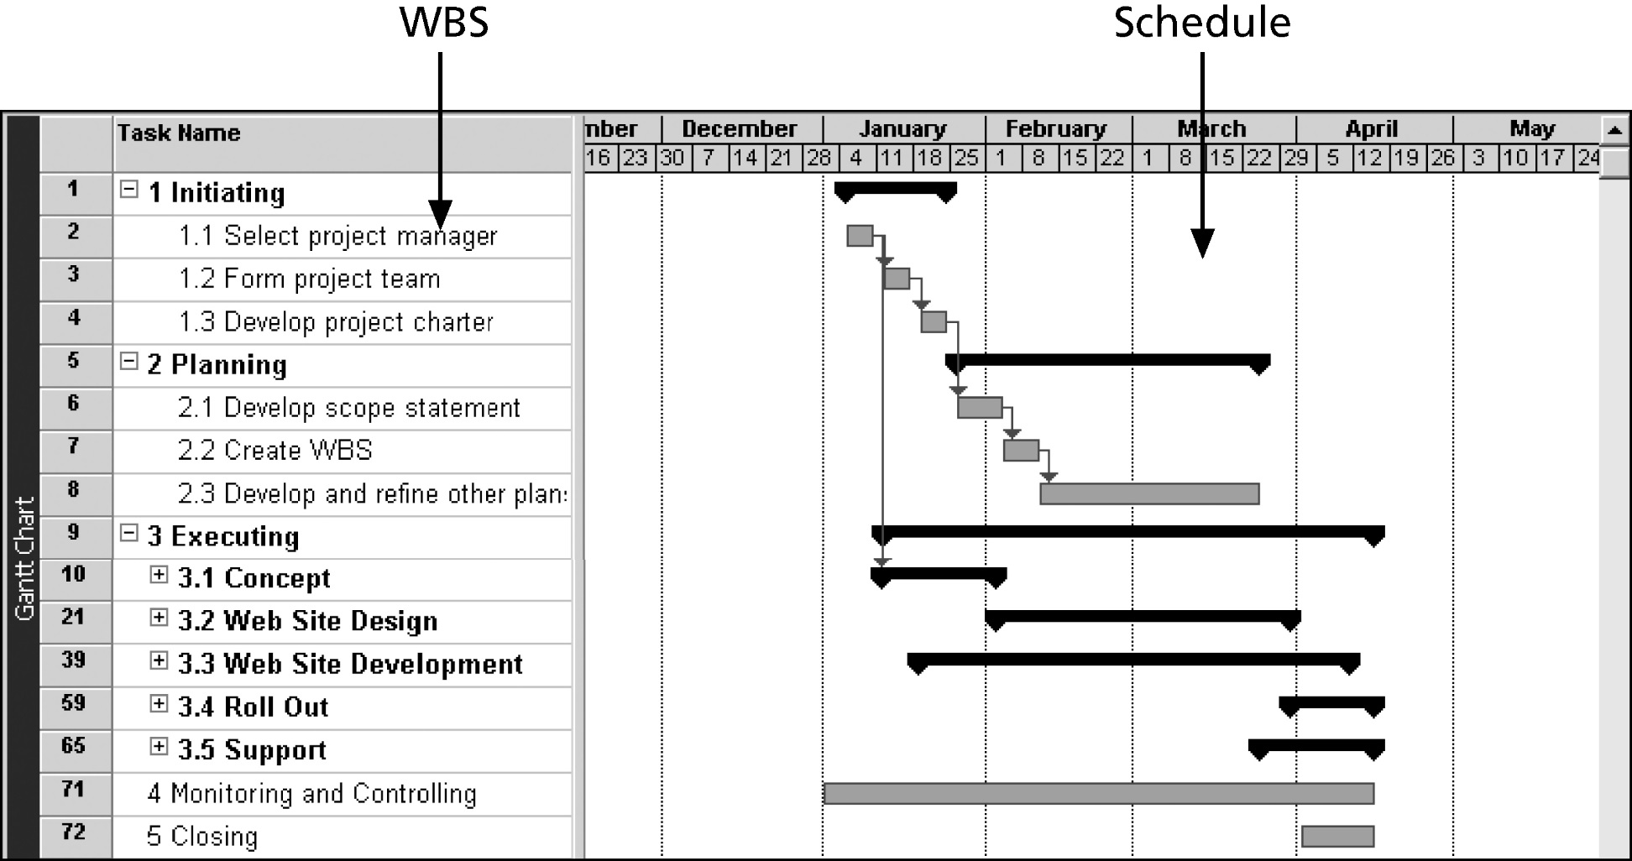
Intranet Gantt Chart Organized by Project Management Process Groups

Slide 28
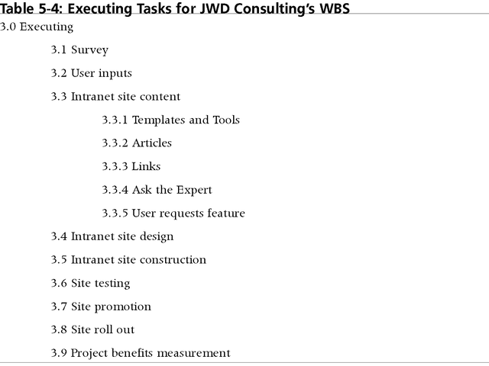
Executing Tasks for JWD Consulting’s WBS

Slide 29
Approaches to Developing WBSs
Using guidelines: some organizations, like the DOD, provide guidelines for preparing WBSs
The analogy approach: review WBSs of similar projects and tailor to your project
The top-down approach: start with the largest items of the project and break them down
The bottom-up approach: start with the specific tasks and roll them up
Mind-mapping approach: mind mapping is a technique that uses branches radiating out from a core idea to structure thoughts and ideas

Slide 30
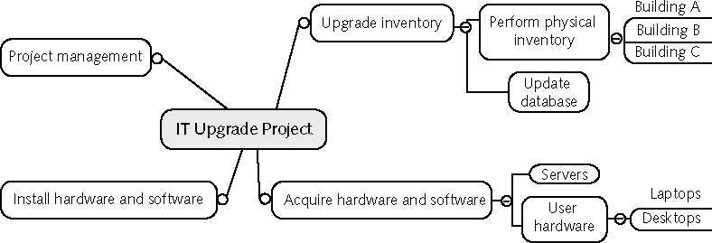
Sample Mind-Mapping Approach for Creating a WBS

Slide 31
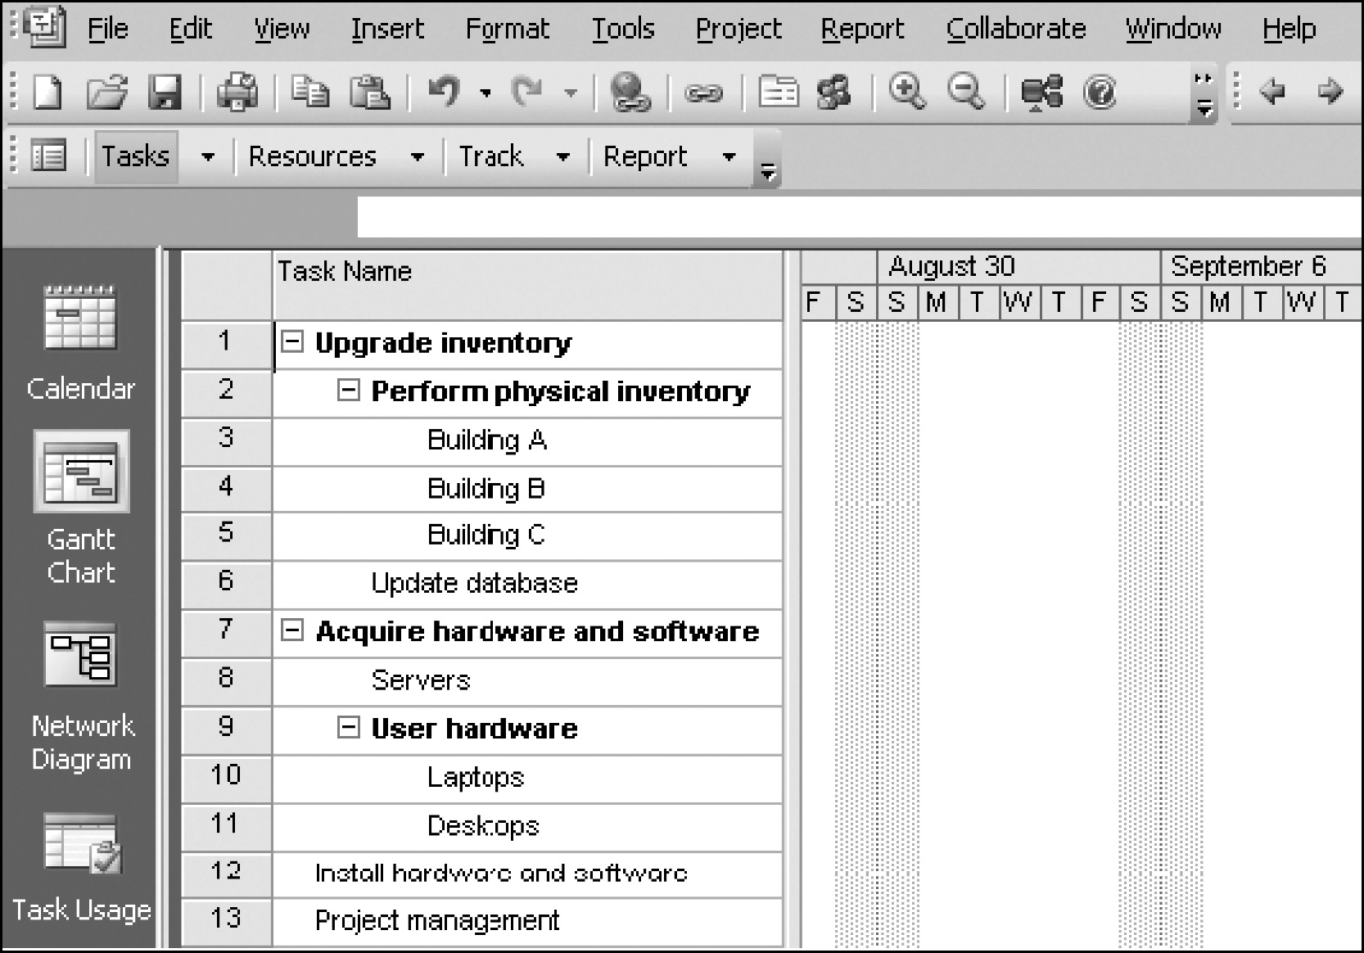
Project 2007 File with WBS Generated from a Mind Map

Slide 32
The WBS Dictionary and Scope Baseline
Many WBS tasks are vague and must be explained more so people know what to do and can estimate how long it will take and what it will cost to do the work
A WBS dictionary is a document that describes detailed information about each WBS item
The approved project scope statement and its WBS and WBS dictionary form the scope baseline, which is used to measure performance in meeting project scope goals

Slide 33
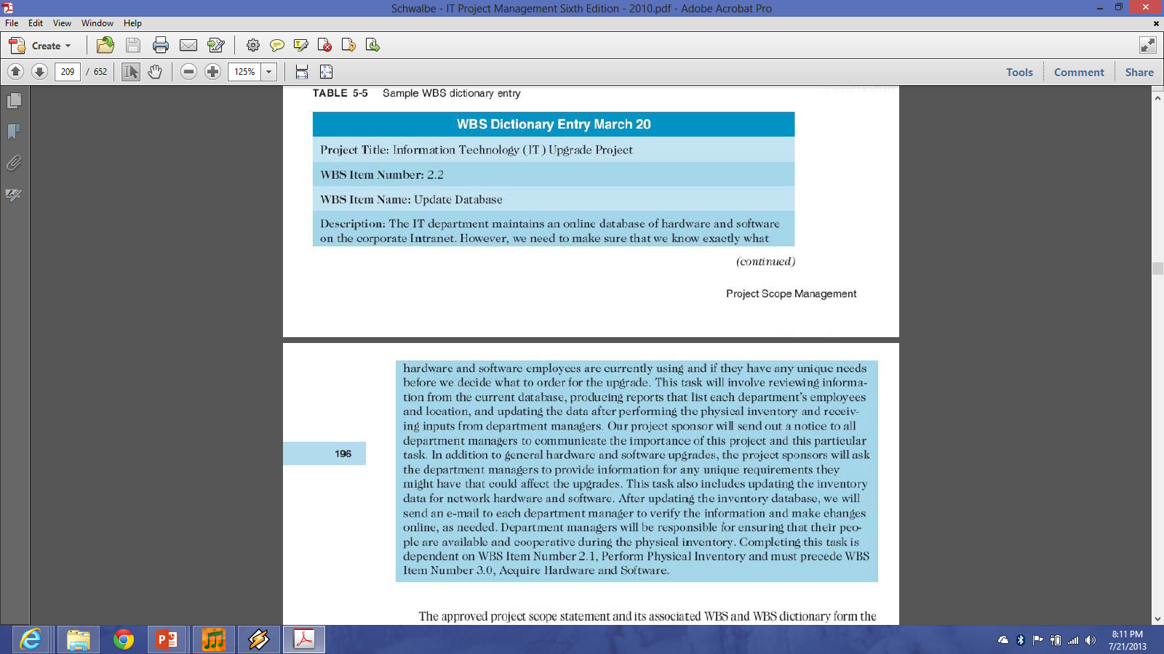

Slide 34
Advice for Creating a WBS and WBS Dictionary
A unit of work should appear at only one place in the WBS
The work content of a WBS item is the sum of the WBS items below it
A WBS item is the responsibility of only one individual, even though many people may be working on it
The WBS must be consistent with the way in which work is actually going to be performed; it should serve the project team first and other purposes only if practical

Slide 35
Advice for Creating a WBS and WBS Dictionary (continued)
Project team members should be involved in developing the WBS to ensure consistency and buy-in
Each WBS item must be documented in a WBS dictionary to ensure accurate understanding of the scope of work included and not included in that item
The WBS must be a flexible tool to accommodate inevitable changes while properly maintaining control of the work content in the project according to the scope statement

Slide 36
What Went Wrong?
A project scope that is too broad and grandiose can cause severe problems
  Scope creep and an overemphasis on technology for technology’s sake resulted in the bankruptcy of a large pharmaceutical firm, Texas-based FoxMeyer Drug
  In 2001, McDonald’s fast-food chain initiated a project to create an intranet that would connect its headquarters with all of its restaurants to provide detailed operational information in real time; after spending $170 million on consultants and initial implementation planning, McDonald’s realized that the project was too much to handle and terminated it

Slide 37
4. Verifying Scope
It is very difficult to create a good scope statement and WBS for a project
It is even more difficult to verify project scope and minimize scope changes
Scope verification involves formal acceptance of the completed project scope by the stakeholders
Acceptance is often achieved by a customer inspection and then sign-off on key deliverables

Slide 38
5. Controlling Scope
Scope control involves controlling changes to the project scope
Goals of scope control are to:
  Influence the factors that cause scope changes
  Assure changes are processed according to procedures developed as part of integrated change control
  Manage changes when they occur
Variance is the difference between planned and actual performance

Slide 39
Best Practices for Avoiding Scope Problems
Keep the scope realistic. Don’t make projects so large that they can’t be completed. Break large projects down into a series of smaller ones.
Involve users in project scope management. Assign key users to the project team and give them ownership of requirements definition and scope verification.
Use off-the-shelf hardware and software whenever possible. Many IT people enjoy using the latest and greatest technology, but business needs, not technology trends, must take priority.
Follow good project management processes. As described in this chapter and others, there are well-defined processes for managing project scope and others aspects of projects.

Slide 40
Suggestions for Improving User Input
Develop a good project selection process and insist that sponsors are from the user organization
Have users on the project team in important roles
Have regular meetings with defined agendas, and have users sign off on key deliverables presented at meetings
Deliver something to users and sponsors on a regular basis
Don’t promise to deliver when you know you can’t
Co-locate users with developers

Slide 41
Suggestions for Reducing Incomplete and Changing Requirements
Develop and follow a requirements management process
Use techniques such as prototyping, use case modeling, and JAD to get more user involvement
Put requirements in writing and keep them current
Create a requirements management database for documenting and controlling requirements

Slide 42
Suggestions for Reducing Incomplete and Changing Requirements (cont.)
Provide adequate testing and conduct testing throughout the project life cycle
Review changes from a systems perspective
Emphasize completion dates to help focus on what’s most important
Allocate resources specifically for handling change requests/enhancements like NWA did with ResNet

Slide 43
Using Software to Assist in Project Scope Management
Word-processing software helps create several scope-related documents
Spreadsheets help to perform financial calculations and weighted scoring models and to develop charts and graphs
Communication software like e-mail and the Web help clarify and communicate scope information
Project management software helps in creating a WBS, the basis for tasks on a Gantt chart
Specialized software is available to assist in project scope management

Slide 44
Summary
Project scope management includes the processes required to ensure that the project addresses all the work required, and only the work required, to complete the project successfully
Main processes include:
  Collect requirements
  Define scope
  Create WBS
  Verify scope
  Control scope

Slide 45
References
Kathy Schwalbe, Managing Information Technology Projects 6th Edition, Course Technology, Cengage Learning, 2010
A Guide to the Project Management Body of Knowledge: PMBOK Guide 4th Edition, Project Management Institute, 2008

