Slide 1
Project Management
4. Project Integration Management
Romi Satria Wahono romi@romisatriawahono.net http://romisatriawahono.net

Slide 2
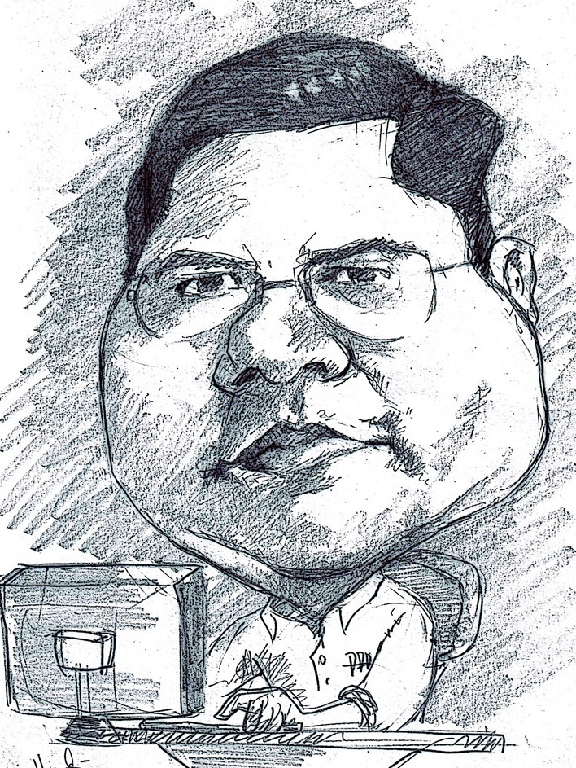
Romi Satria Wahono
SD Sompok Semarang (1987)
SMPN 8 Semarang (1990)
SMA Taruna Nusantara, Magelang (1993)
B.Eng, M.Eng and Dr.Eng (on-leave) Department of Computer Science Saitama University, Japan (1994-2004)
Research Interests: Software Engineering and Intelligent Systems
Founder IlmuKomputer.Com
LIPI Researcher (2004-2007)
Founder and CEO PT Brainmatics Cipta Informatika

Slide 3
Project Management Course Outline
Introduction to Project Management
The Project Management and Information Technology Context
The Project Management Process Groups: A Case Study
Project Integration Management
Project Scope Management
Project Time Management
Project Cost Management
Project Quality Management
Project Human Resource Management
Project Communication Management
Project Risk Management
Project Procurement Management

Slide 4
4. Project Integration Management

Slide 5
Learning Objectives
Describe an overall framework for project integration management as it relates to the other PM knowledge areas and the project life cycle
Explain the strategic planning process and apply different project selection methods
Explain the importance of creating a project charter to formally initiate projects
Describe project management plan development, understand the content of these plans, and review approaches for creating them
Explain project execution, its relationship to project planning, the factors related to successful results, and tools and techniques to assist in project execution

Slide 6
Learning Objectives
Describe the process of monitoring and controlling project work
Understand the integrated change control process, planning for and managing changes on information technology projects, and developing and using a change control system
Explain the importance of developing and following good procedures for closing projects
Describe how software can assist in project integration management

Slide 7
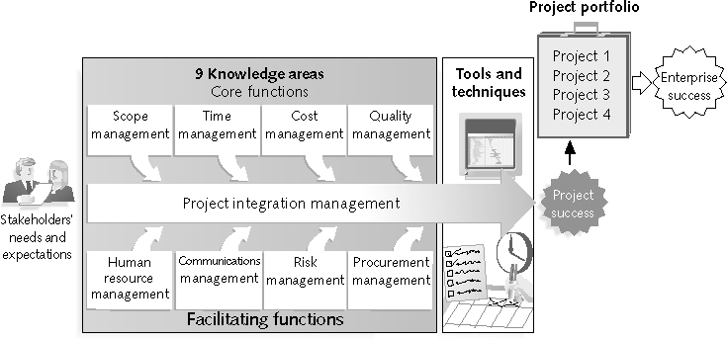
Project Management Framework

Slide 8
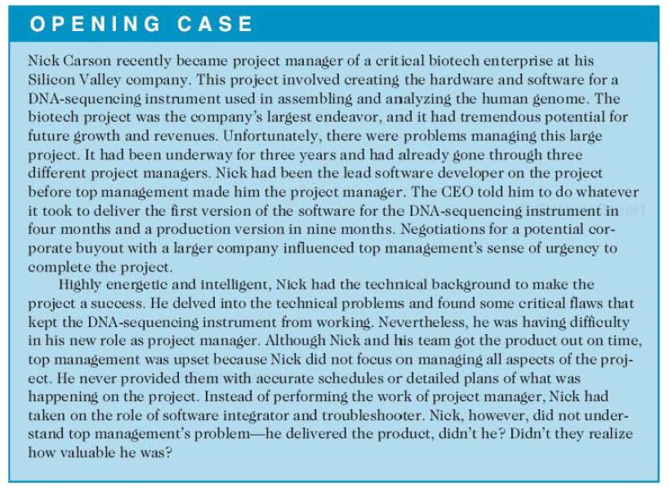

Slide 9
The Key to Project Success: Good Project Integration Management
Project managers must coordinate all of the other knowledge areas throughout a project’s life cycle
Many new project managers have trouble looking at the “big picture” and want to focus on too many details (see opening case for a real example)
Project integration management is not the same thing as software integration

Slide 10
Project Integration Management Processes
Develop the project charter: working with stakeholders to create the document that formally authorizes a project
Develop the project management plan: coordinating all planning efforts to create a consistent, coherent document
Direct and manage project execution: carrying out the project management plan by performing the activities included in it
Monitor and control the project work: overseeing project work to meet the performance objectives of the project
Perform integrated change control: coordinating changes that affect the project’s deliverables and organizational process assets
Close the project or phase: finalizing all project activities to formally close the project or phase

Slide 11
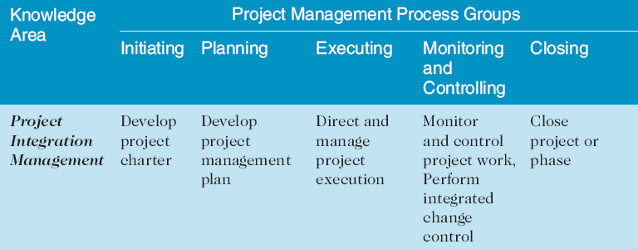
Project Management Process Groups and Knowledge Area Mapping
Source: PMBOK® Guide, Fourth Edition, 2008

Slide 12
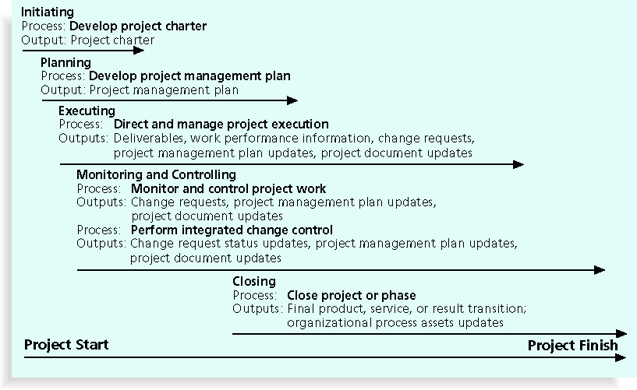
Project Integration Management Summary

Slide 13
What Went Wrong?
The Airbus A380 megajet project was two years behind schedule in Oct. 2006, causing Airbus’ parent company to face an expected loss of $6.1 billion over the next four years
The project suffered from severe integration management problems, or integration disintegration...
“Early this year, when pre-assembled bundles containing hundreds of miles of cabin wiring were delivered from a German factory to the assembly line in France, workers discovered that the bundles, called harnesses, didn't fit properly into the plane. Assembly slowed to a near-standstill, as workers tried to pull the bundles apart and re-thread them through the fuselage. Now Airbus will have to go back to the drawing board and redesign the wiring system.”
Matlack, Carol. “First, Blame the Software,” BusinessWeek Online (October 5, 2006)

Slide 14
Strategic Planning and Project Selection
Strategic planning involves determining long-term objectives, predicting future trends, and projecting the need for new products and services
Organizations often perform a SWOT analysis
Analyzing Strengths, Weaknesses, Opportunities, and Threats
As part of strategic planning, organizations:
Identify potential projects
Use realistic methods to select which projects to work on
Formalize project initiation by issuing a project charter

Slide 15
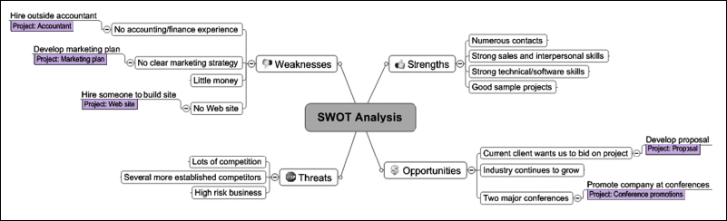
Mind Map of a SWOT Analysis to Help Identify Potential Projects

Slide 16
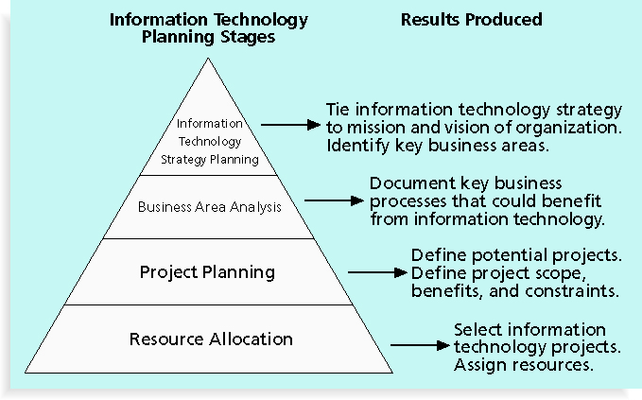
Information Technology Planning Process

Slide 17
Best Practice
Only one in seven product concepts comes to fruition; why is it that some companies like Proctor & Gamble, Johnson and Johnson, Hewlett Packard, and Sony are consistently successful in new product dev (NPD)?
Because they use a disciplined, systematic approach to NPD projects based on best practices
Four important forces behind NPD success include the following:
A product innovation and technology strategy for the business
Resource commitment and focusing on the right projects, or solid portfolio management
An effective, flexible, and streamlined idea-to-launch process
The right climate and culture for innovation, true cross-functional teams, and senior management commitment to NPD

Slide 18
Methods for Selecting Projects
There are usually more projects than available time and resources to implement them
Methods for selecting projects include:
Focusing on broad organizational needs
Categorizing information technology projects
Performing net present value or other financial analyses
Using a weighted scoring model
Implementing a balanced scorecard

Slide 19
1. Focusing on Broad Organizational Needs
It is often difficult to provide strong justification for many IT projects, but everyone agrees they have a high value
“It is better to measure gold roughly than to count pennies precisely”
Three important criteria for projects:
There is a need for the project
There are funds available
There’s a strong will to make the project succeed

Slide 20
2. Categorizing IT Projects
One categorization is whether the project addresses:
A problem
An opportunity, or
A directive
Another categorization is how long it will take to do and when it is needed
Another is the overall priority of the project

Slide 21
3. Financial Analysis of Projects
Financial considerations are often an important consideration in selecting projects
Three primary methods for determining the projected financial value of projects:
Net present value (NPV) analysis
Return on investment (ROI)
Payback analysis

Slide 22
4. Net Present Value Analysis
Net present value (NPV) analysis is a method of calculating the expected net monetary gain or loss from a project by discounting all expected future cash inflows and outflows to the present point in time
Projects with a positive NPV should be considered if financial value is a key criterion
The higher the NPV, the better

Slide 23
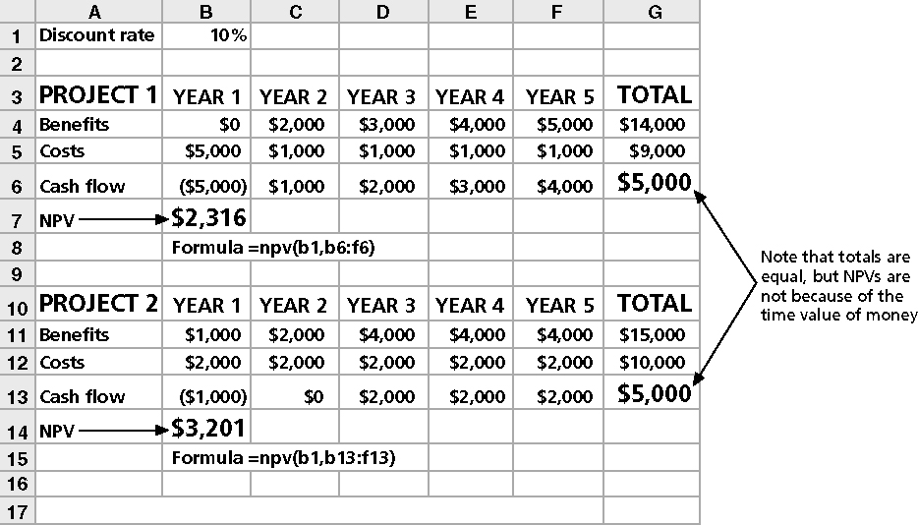
Net Present Value Example

Slide 24
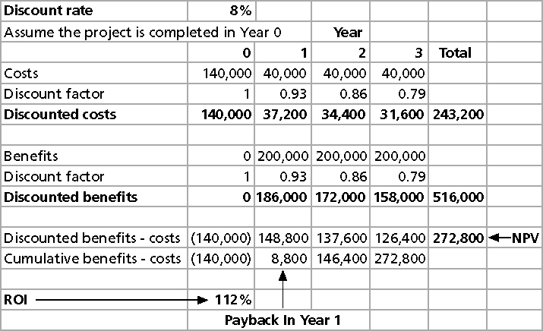
JWD Consulting NPV Example
Note: See the template called business_case_financials.xls

Slide 25
NPV Calculations
Determine estimated costs and benefits for the life of the project and the products it produces
Determine the discount rate (check with your organization on what to use)
Calculate the NPV (see text for details)
Notes: Some organizations consider the investment year as year 0, while others start in year 1; some people enter costs as negative numbers, while others do not
Check with your organization for their preferences

Slide 26
Return on Investment
Return on investment (ROI) is calculated by subtracting the project costs from the benefits and then dividing by the costs ROI = (total discounted benefits - total discounted costs)/discounted costs
The higher the ROI, the better
Many organizations have a required rate of return or minimum acceptable rate of return on investment for projects
Internal rate of return (IRR) can be calculated by finding the discount rate that makes the NPV equal to zero

Slide 27
Payback Analysis
Another important financial consideration is payback analysis
The payback period is the amount of time it will take to recoup, in the form of net cash inflows, the total dollars invested in a project
Payback occurs when the net cumulative discounted benefits equals the costs
Many organizations want IT projects to have a fairly short payback period

Slide 28
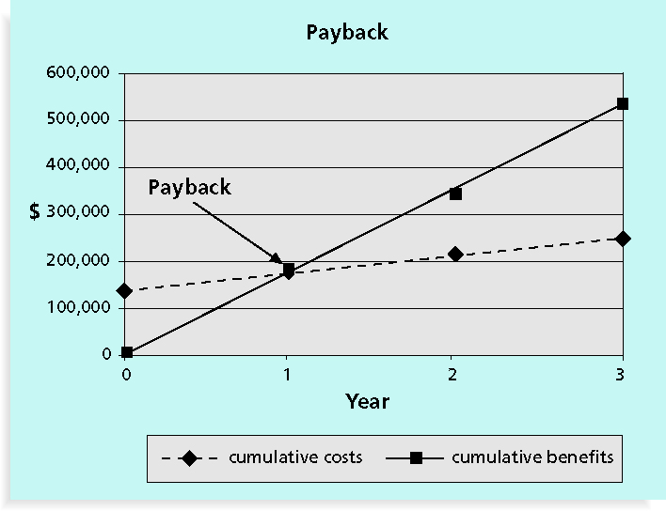
Charting the Payback Period

Slide 29
4. Weighted Scoring Model
A weighted scoring model is a tool that provides a systematic process for selecting projects based on many criteria
Identify criteria important to the project selection process
Assign weights (percentages) to each criterion so they add up to 100%
Assign scores to each criterion for each project
Multiply the scores by the weights and get the total weighted scores
The higher the weighted score, the better

Slide 30
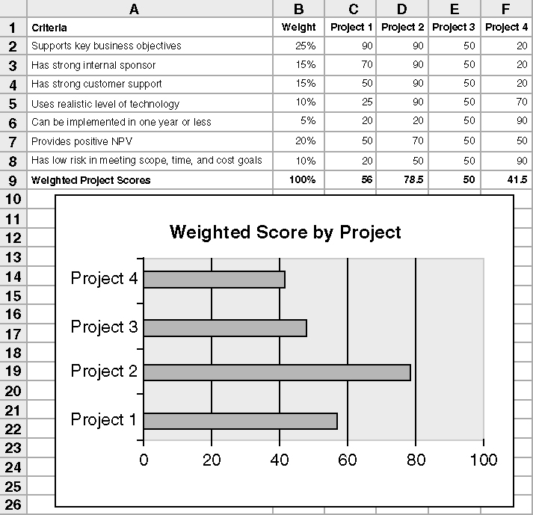
Sample Weighted Scoring Model for Project Selection

Slide 31
5. Implementing a Balanced Scorecard
Drs. Robert Kaplan and David Norton developed this approach to help select and manage projects that align with business strategy
A balanced scorecard:
Is a methodology that converts an organization’s value drivers, such as customer service, innovation, operational efficiency, and financial performance, to a series of defined metrics
See www.balancedscorecard.org for more information

Slide 32
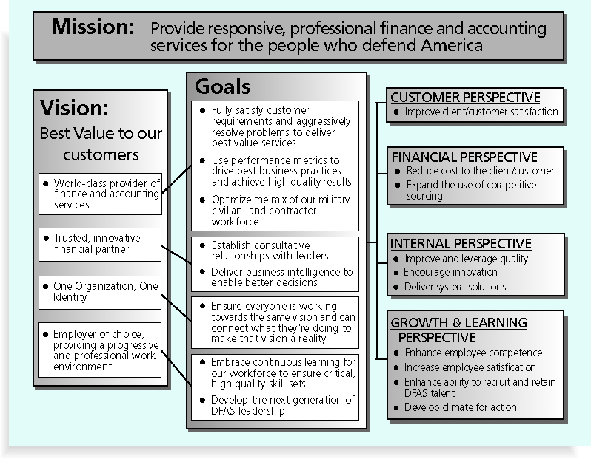
Balanced Scorecard Example

Slide 33
Project Charters
After deciding what project to work on, it is important to let the rest of the organization know
A project charter is a document that formally recognizes the existence of a project and provides direction on the project’s objectives and management
Key project stakeholders should sign a project charter to acknowledge agreement on the need and intent of the project
a signed charter is a key output of project integration management

Slide 34
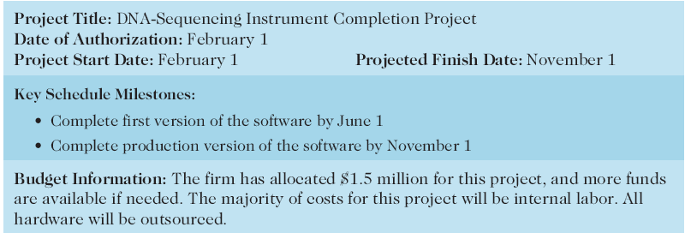
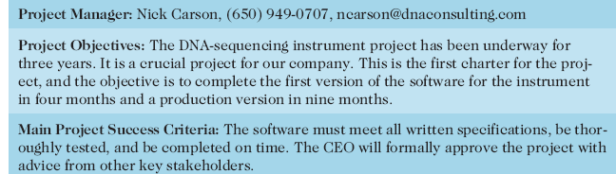
Project Charter for the DNA-Sequencing Instrument Completion Project

Slide 35
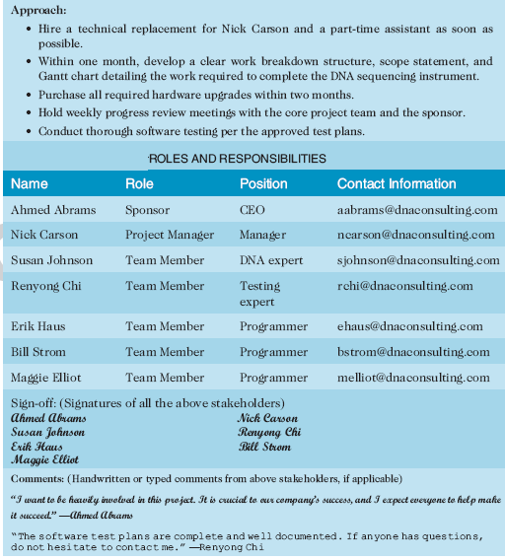

Slide 36
Project Management Plans
A project management plan is a document used to coordinate all project planning documents and help guide a project’s execution and control
Plans created in the other knowledge areas are subsidiary parts of the overall project management plan

Slide 37
Common Elements of a Project Management Plan
Introduction or overview of the project
Description of how the project is organized
Management and technical processes used on the project
Work to be done, schedule, and budget information

Slide 38
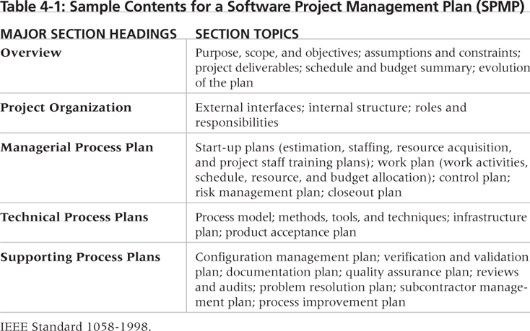
Sample Contents for a Software Project Management Plan (SPMP)

Slide 39
What the Winners Do
"The winners clearly spell out what needs to be done in a project, by whom, when, and how. For this they use an integrated toolbox, including PM tools, methods, and techniques…
If a scheduling template is developed and used over and over, it becomes a repeatable action that leads to higher productivity and lower uncertainty. Sure, using scheduling templates is neither a breakthrough nor a feat. But laggards exhibited almost no use of the templates. Rather, in constructing schedules their project managers started with a clean sheet, a clear waste of time.”*
*Milosevic, Dragan and And Ozbay. “Delivering Projects: What the Winners Do.” Proceedings of the Project Management Institute Annual Seminars & Symposium (November 2001).

Slide 40
Project Execution
Project execution involves managing and performing the work described in the project management plan
The majority of time and money is usually spent on execution
The application area of the project directly affects project execution because the products of the project are produced during execution

Slide 41
Coordinating Planning and Execution
Project planning and execution are intertwined and inseparable activities
Those who will do the work should help to plan the work
Project managers must solicit input from the team to develop realistic plans

Slide 42
Providing Leadership and a Supportive Culture
Project managers must lead by example to demonstrate the importance of creating and then following good project plans
Organizational culture can help project execution by:
Providing guidelines and templates
Tracking performance based on plans
Project managers may still need to break the rules to meet project goals, and senior managers must support those actions

Slide 43
Important Skills for Project Execution
General management skills like leadership, communication, and political skills
Product, business, and application area skills and knowledge
Use of specialized tools and techniques

Slide 44
Project Execution Tools and Techniques
Expert judgment: experts can help project managers and their teams make many decisions related to project execution
Project management information systems: there are hundreds of project management software products available on the market today, and many organizations are moving toward powerful enterprise project management systems that are accessible via the Internet
See the What Went Right? example of Kuala Lumpur’s Integrated Transport Information System on p. 159

Slide 45
Monitoring and Controlling Project Work
Changes are inevitable on most projects, so it’s important to develop and follow a process to monitor and control changes
Monitoring project work includes collecting, measuring, and disseminating performance information
A baseline is the approved project management plan plus approved changes

Slide 46
Media Snapshot
The 2002 Olympic Winter Games and Paralympics took five years to plan and cost more than $1.9 billion. PMI awarded the Salt Lake Organizing Committee (SLOC) the Project of the Year award for delivering world-class games.
Four years before the Games began, the SLOC used a Primavera software-based system with a cascading color-coded WBS to integrate planning
The SLOC also used an Executive Roadmap, a one-page list of the top 100 Games-wide activities, to keep executives apprised of progress. Activities were tied to detailed project information within each department’s schedule. A 90-day highlighter showed which managers were accountable for each integrated activity.
Fraser Bullock, SLOC Chief Operating Officer and Chief, said, “We knew when we were on and off schedule and where we had to apply additional resources. The interrelation of the functions meant they could not run in isolation—it was a smoothly running machine.”*
*Foti, Ross, “The Best Winter Olympics, Period,” PM Network (January 2004) 23.

Slide 47
Integrated Change Control
Three main objectives are:
Influencing the factors that create changes to ensure that changes are beneficial
Determining that a change has occurred
Managing actual changes as they occur

Slide 48
Change Control on Information Technology Projects
Former view: the project team should strive to do exactly what was planned on time and within budget
Problem: stakeholders rarely agreed up-front on the project scope, and time and cost estimates were inaccurate
Modern view: project management is a process of constant communication and negotiation
Solution: changes are often beneficial, and the project team should plan for them

Slide 49
Change Control System
A formal, documented process that describes when and how official project documents and work may be changed
Describes who is authorized to make changes and how to make them

Slide 50
Change Control Board (CCB)
A formal group of people responsible for approving or rejecting changes on a project
CCBs provide guidelines for preparing change requests, evaluate change requests, and manage the implementation of approved changes
Includes stakeholders from the entire organization

Slide 51
Making Timely Changes
Some CCBs only meet occasionally, so it may take too long for changes to occur
Some organizations have policies in place for time-sensitive changes
“48-hour policy” allows project team members to make decisions; then they have 48 hours to reverse the decision pending senior management approval
Delegate changes to the lowest level possible, but keep everyone informed of changes

Slide 52
Configuration Management
Ensures that the descriptions of the project’s products are correct and complete
Involves identifying and controlling the functional and physical design characteristics of products and their support documentation
Configuration management specialists identify and document configuration requirements, control changes, record and report changes, and audit the products to verify conformance to requirements
See www.icmhq.com for more information

Slide 53
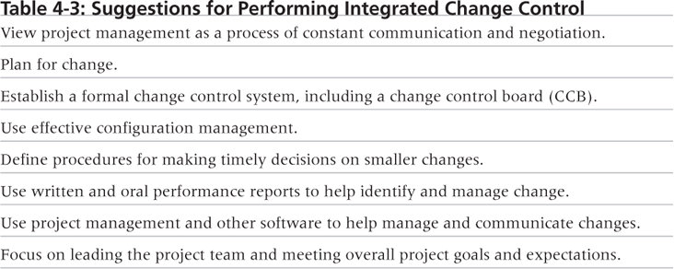
Suggestions for Performing Integrated Change Control

Slide 54
Closing Projects and Phases
To close a project or phase, you must finalize all activities and transfer the completed or cancelled work to the appropriate people
Main outputs include:
Final product, service, or result transition
Organizational process asset updates

Slide 55
Using Software to Assist in Project Integration Management
Several types of software can be used to assist in project integration management
Documents can be created with word processing software
Presentations are created with presentation software
Tracking can be done with spreadsheets or databases
Communication software like e-mail and Web authoring tools facilitate communications
Project management software can pull everything together and show detailed and summarized information
Business Service Management (BSM) tools track the execution of business process flows

Slide 56
Summary
Project integration management involves coordinating all of the other knowledge areas throughout a project’s life cycle
Main processes include:
Develop project charter
Develop project management plan
Direct and manage project execution
Monitor and control project work
Perform integrated change control
Close the project or phase

Slide 57
References
Kathy Schwalbe, Managing Information Technology Projects 6th Edition, Course Technology, Cengage Learning, 2010
A Guide to the Project Management Body of Knowledge: PMBOK Guide 4th Edition, Project Management Institute, 2008

