Slide 1
Project Management
3. The Project Management Process Groups: A Case Study
Romi Satria Wahono romi@romisatriawahono.net http://romisatriawahono.net

Slide 2

Romi Satria Wahono
SD Sompok Semarang (1987)
SMPN 8 Semarang (1990)
SMA Taruna Nusantara, Magelang (1993)
B.Eng, M.Eng and Dr.Eng (on-leave) Department of Computer Science Saitama University, Japan (1994-2004)
Research Interests: Software Engineering and Intelligent Systems
Founder IlmuKomputer.Com
LIPI Researcher (2004-2007)
Founder and CEO PT Brainmatics Cipta Informatika

Slide 3
Project Management Course Outline
Introduction to Project Management
The Project Management and Information Technology Context
The Project Management Process Groups: A Case Study
Project Integration Management
Project Scope Management
Project Time Management
Project Cost Management
Project Quality Management
Project Human Resource Management
Project Communication Management
Project Risk Management
Project Procurement Management

Slide 4
3. The Project Management Process Groups: A Case Study

Slide 5
Learning Objectives
Describe the five project management (PM) process groups, the typical level of activity for each, and the interactions among them
Understand how the PM process groups relate to the PM knowledge areas
Discuss how organizations develop information technology PM methodologies to meet their needs
Review a case study of an organization applying the project management process groups to manage an information technology project; describe outputs of each process group; and understand the contribution that effective project initiating, planning, executing, monitoring and controlling, and closing make to project success

Slide 6
Project Management Process Groups
A process is a series of actions directed toward a particular result
Project management can be viewed as a number of interlinked processes
The project management process groups include:
Initiating processes
Planning processes
Executing processes
Monitoring and controlling processes
Closing processes

Slide 7
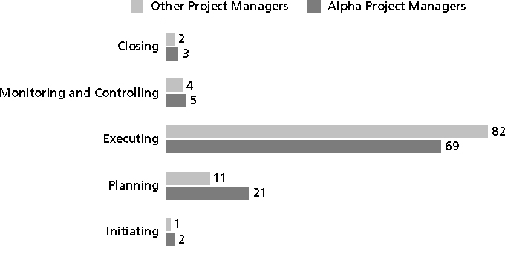
Percentage of Time Spent on Each Process Group

Slide 8
What Went Wrong?
Philip A. Pell, PMP, commented on how the U.S. Internal Revenue Service (IRS) needed to improve its project management process. “Pure and simple, good, methodology-centric, predictable, and repeatable project management is the SINGLE greatest factor in the success (or in this case failure) of any project… The project manager is ultimately responsible for the success or failure of the project.”*
In 2006, the IRS lost more than $320 million due to a botched fraud-detection system project
A 2008 U.S. Government Accountability Office (GAO) report stated that IRS had fixed just 29 of 98 information security weaknesses identified the previous year
Comments posted on CIO Magazine Web site on article “For the IRS, There’s No EZ Fix,” (April 1, 2004)

Slide 9
Media Snapshot
Just as information technology projects need to follow the project management process groups, so do other projects, such as the production of a movie
Processes involved in making movies might include screenwriting (initiating), producing (planning), acting and directing (executing), editing (monitoring and controlling), and releasing the movie to theaters (closing)
Many people enjoy watching the extra features on a DVD that describe how these processes lead to the creation of a movie… This acted “…not as promotional filler but as a serious and meticulously detailed examination of the entire filmmaking process.”*
Project managers in any field know how important it is to follow a good process
Jacks, Brian, “Lord of the Rings: The Two Towers Extended Edition (New Line)”, Underground Online (accessed from www.ugo.com August 4, 2004)

Slide 10
Discussion
Jelaskan tentang project management process group dan tahapannya!

Slide 11
Mapping the Process Groups to the Knowledge Areas
You can map the main activities of each PM process group into the nine knowledge areas using the PMBOK® Guide 2008
Note that there are activities from each knowledge area under the planning and monitoring and controlling process groups
Two new processes were added in 2008: identify stakeholders and collect requirements

Slide 12
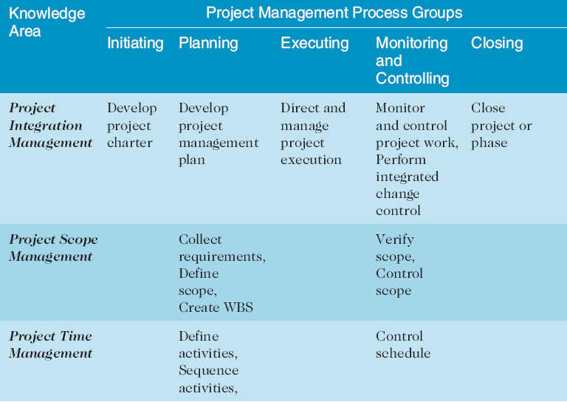
Project Management Process Groups and Knowledge Area Mapping
Source: PMBOK® Guide, Fourth Edition, 2008

Slide 13
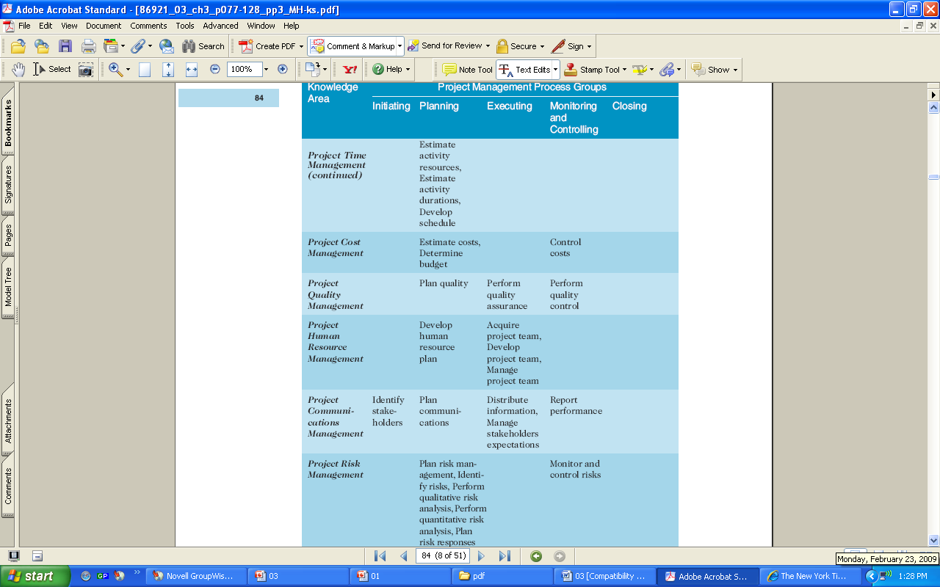

Slide 14
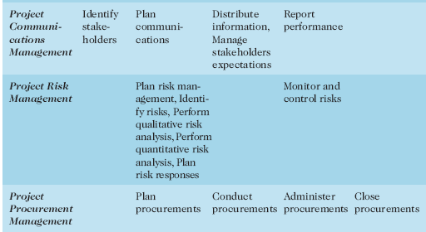

Slide 15
Developing an IT Project Management Methodology
Many organizations develop their own project management methodologies, especially for IT projects
A methodology describes how things should be done; a standard describes what should be done
PRINCE2, Agile, RUP, and Six Sigma provide different project management methodologies

Slide 16
What Went Right?
AgênciaClick, an interactive advertising and online communications company based in São Paulo, Brazil, made PMI’s list of outstanding organizations in project management in 2007
Since 2002, the company saw revenues jump 132 percent, primarily due to their five-year emphasis on practicing good project management across the entire company

Slide 17
Discussion
Lakukan mapping antara project management process group dan knowledge areas!

Slide 18
Case Study: JWD Consulting’s Project Management Intranet Site
This case study provides an example of what’s involved in initiating, planning, executing, controlling, and closing an IT project
Note: This case study provides a big picture view of managing a project; later chapters provide detailed information on each knowledge area

Slide 19
Project Pre-initiation
It is good practice to lay the groundwork for a project before it officially starts
Senior managers often perform several pre-initiation tasks, including the following:
Determine the scope, time, and cost constraints for the project
Identify the project sponsor
Select the project manager
Develop a business case for a project (see Table 3-2 for an example)
Meet with the project manager to review the process and expectations for managing the project
Determine if the project should be divided into two or more smaller projects

Slide 20
Project Pre-initiation: Business Case
Introduction/Background
Business Objective
Current Situation and Problem/Opportunity Statement
Critical Assumption and Constraints
Analysis of Option and Recommendation
Preliminary Project Requirements
Budget Estimate and Financial Analysis
Schedule Estimate
Potential Risks
Exhibits
Business Case ≈ Feasibility Analysis

Slide 21
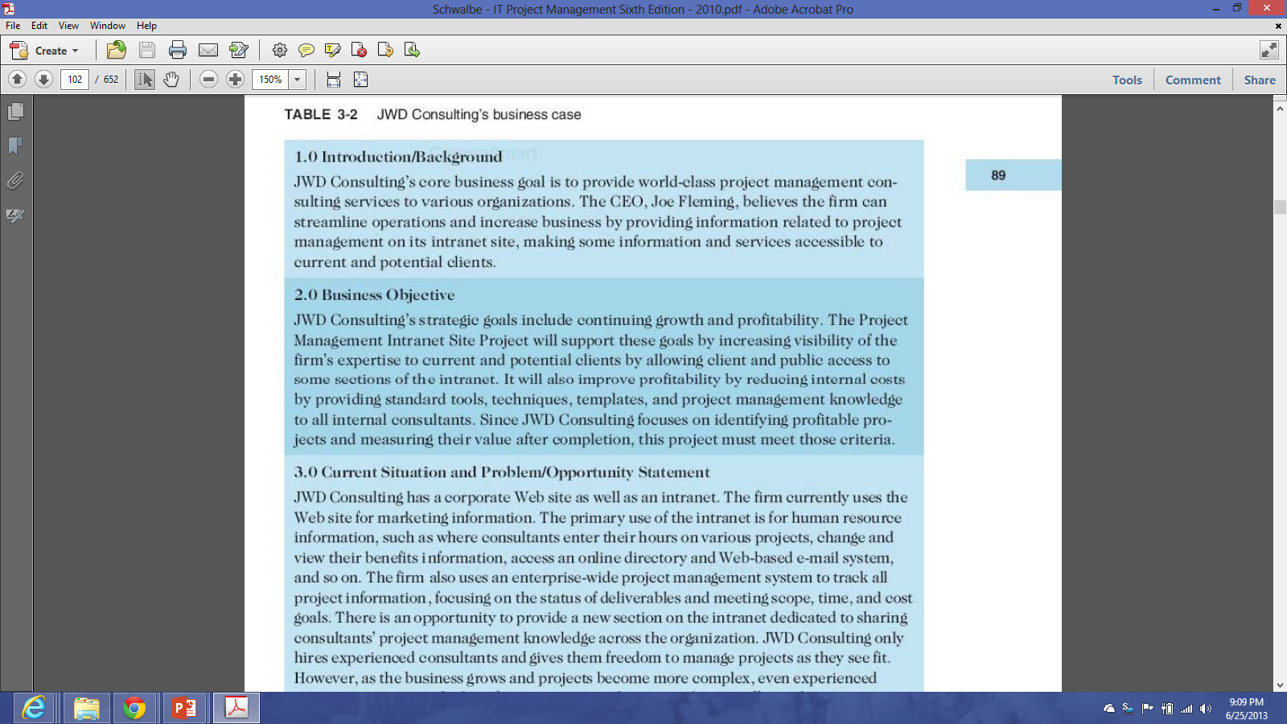

Slide 22
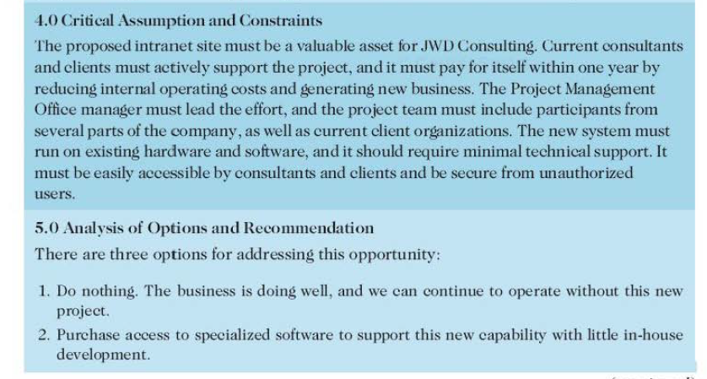

Slide 23
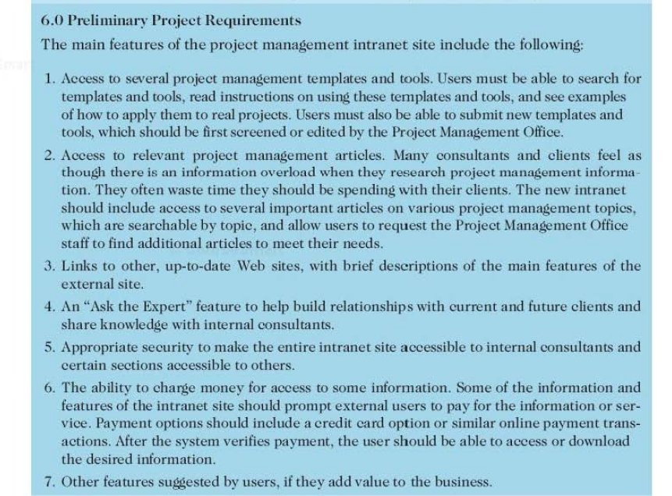

Slide 24
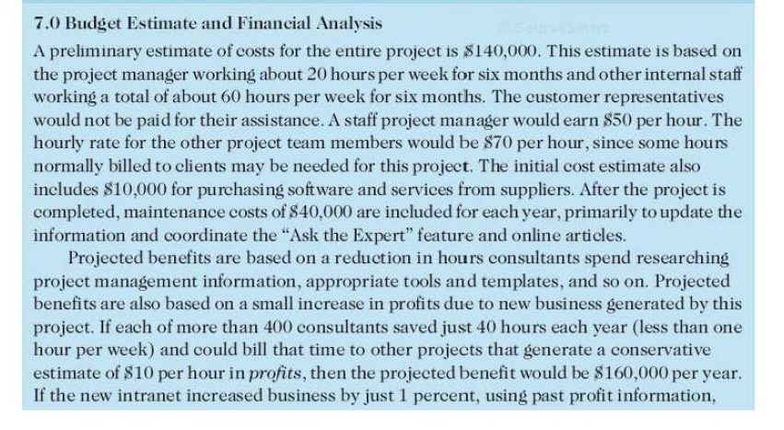

Slide 25
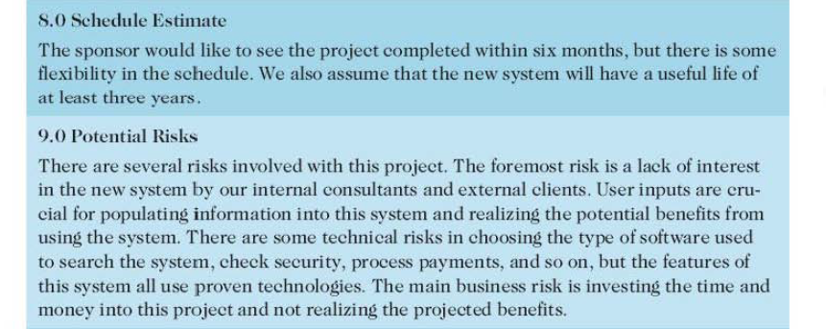

Slide 26
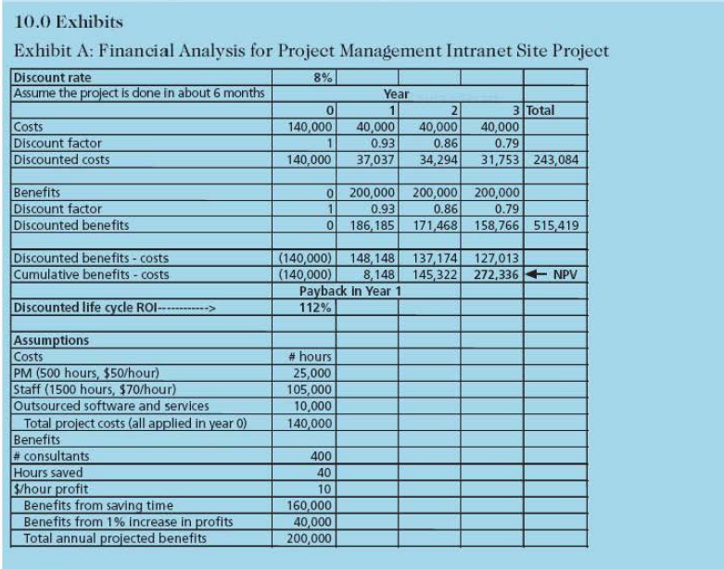

Slide 27
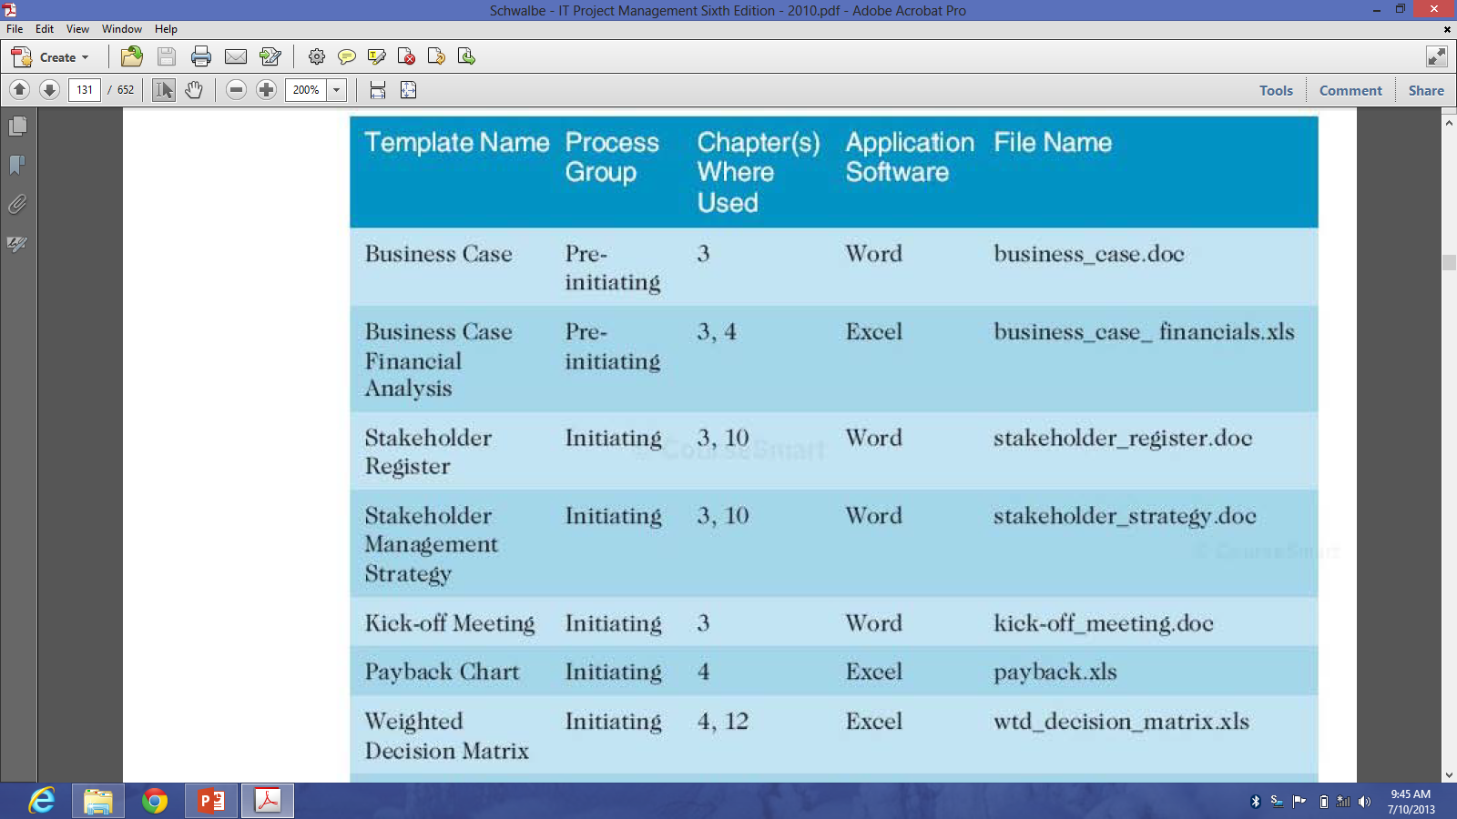
Project Pre-Initiating Template

Slide 28
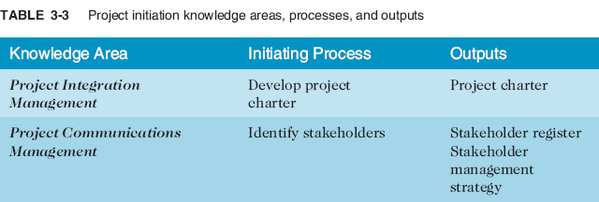
Project Initiation
Initiating a project includes recognizing and starting a new project or project phase
The main goal is to formally select and start off projects

Slide 29
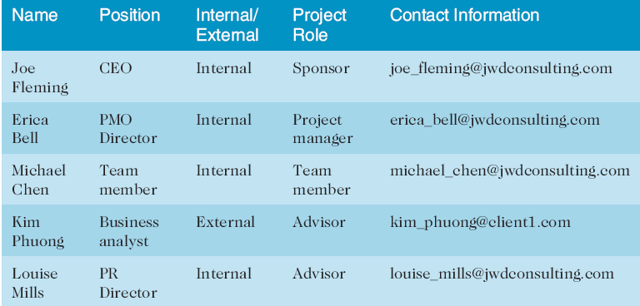
Stakeholder Register

Slide 30
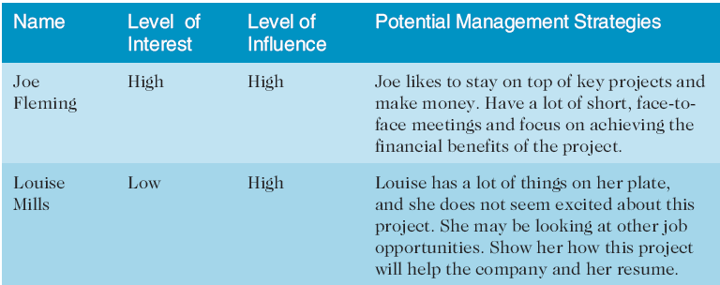
Stakeholder Management Strategy

Slide 31
Project Charters and Kick-off Meetings
See Table 3-6 for an example of a charter
Charters are normally short and include key project information and stakeholder signatures
It’s good practice to hold a kick-off meeting at the beginning of a project so that stakeholders can meet each other, review the goals of the project, and discuss future plans

Slide 32
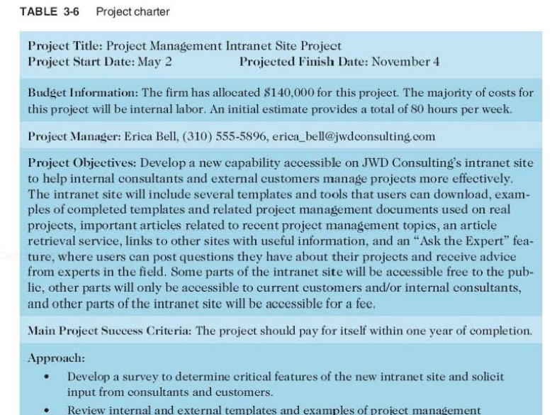

Slide 33
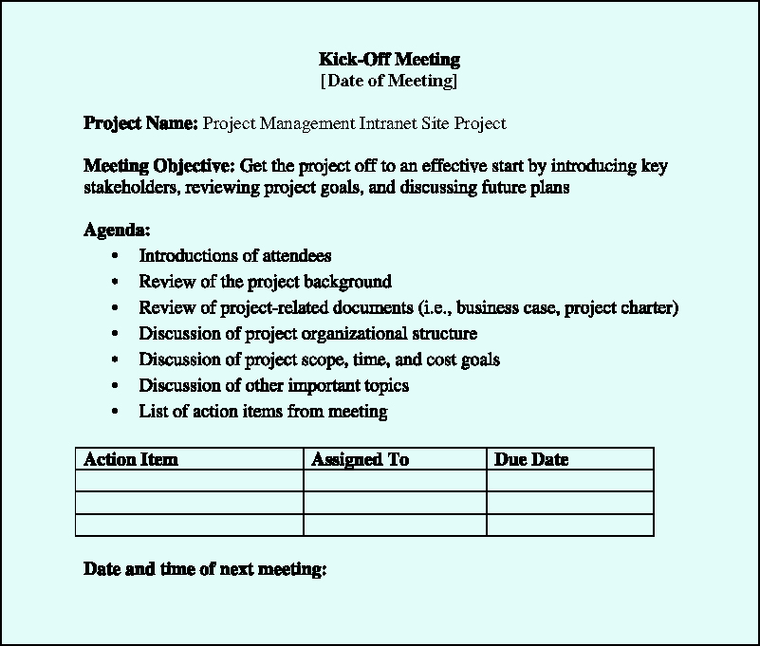

Slide 34
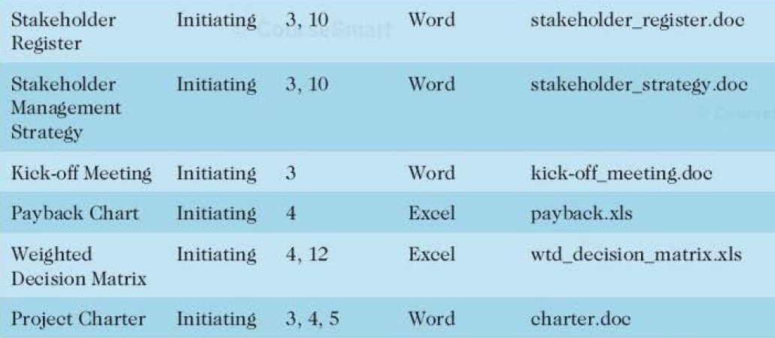
Project Initiation Template

Slide 35
Project Planning
The main purpose of project planning is to guide execution
Every knowledge area includes planning information (see Table 3-7)
Key outputs included in the JWD project include:
A team contract
A project scope statement
A work breakdown structure (WBS)
A project schedule, in the form of a Gantt chart with all dependencies and resources entered
A list of prioritized risks (part of a risk register)
See sample documents on pages 100-107

Slide 36
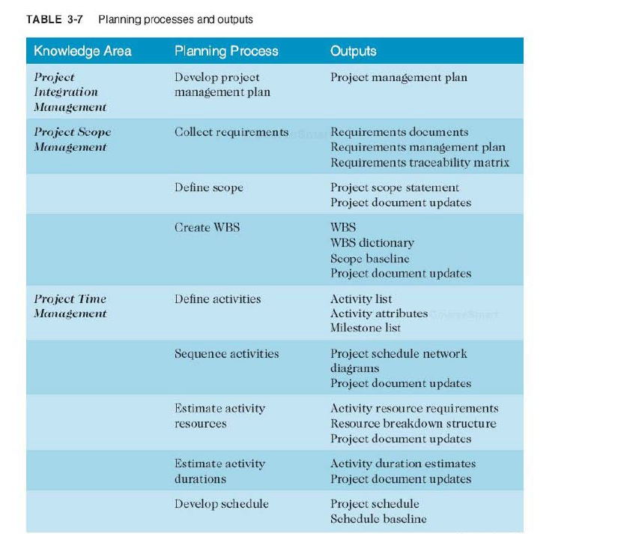

Slide 37
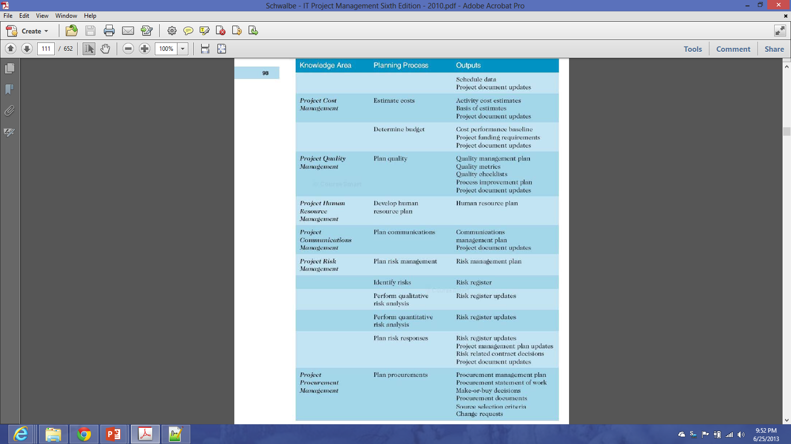

Slide 39
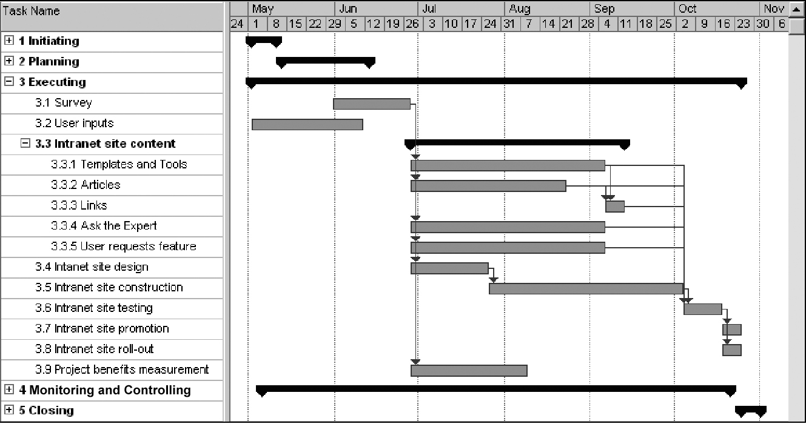
JWD Consulting Intranet Site Project Baseline Gantt Chart

Slide 40
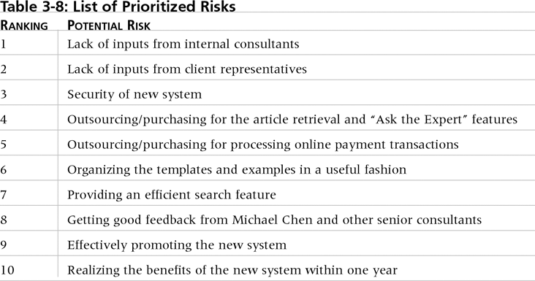
List of Prioritized Risks

Slide 41
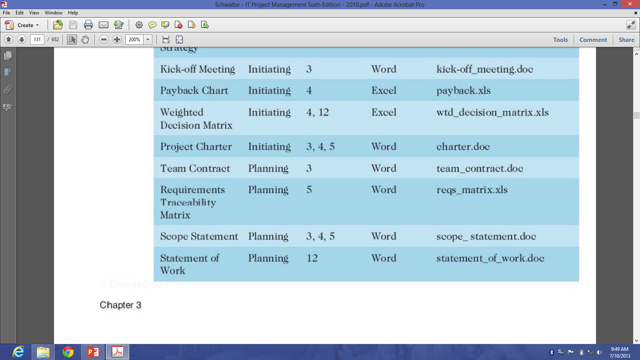
Project Planning Template

Slide 42
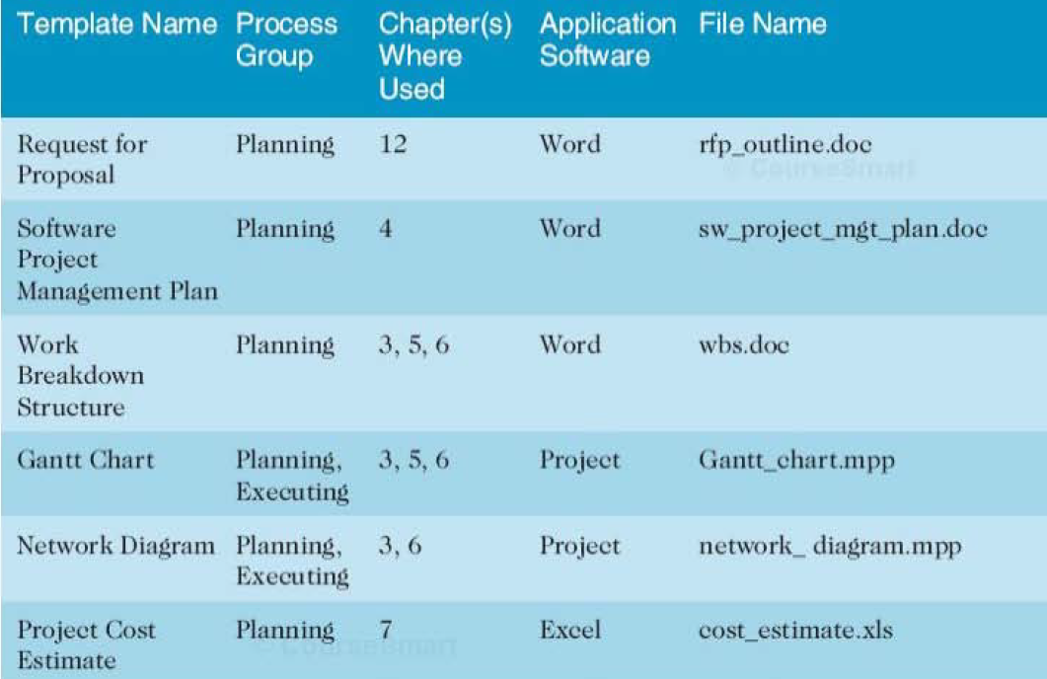
Project Planning Template

Slide 43
Project Executing
Usually takes the most time and resources to perform project execution
Project managers must use their leadership skills to handle the many challenges that occur during project execution
Table 3-11 on p. 108 lists the executing processes and outputs; many project sponsors and customers focus on deliverables related to providing the products, services, or results desired from the project
A milestone report (example on pp. 109-110) can help focus on completing major milestones

Slide 44
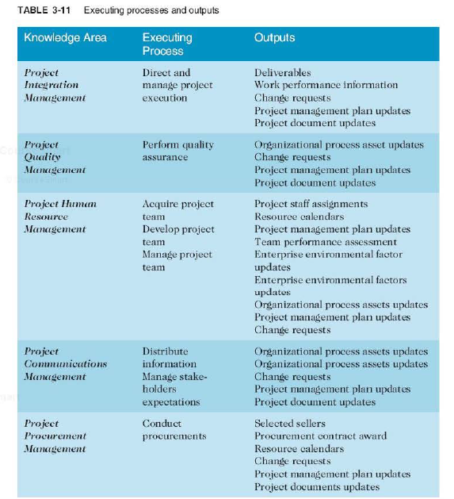

Slide 45
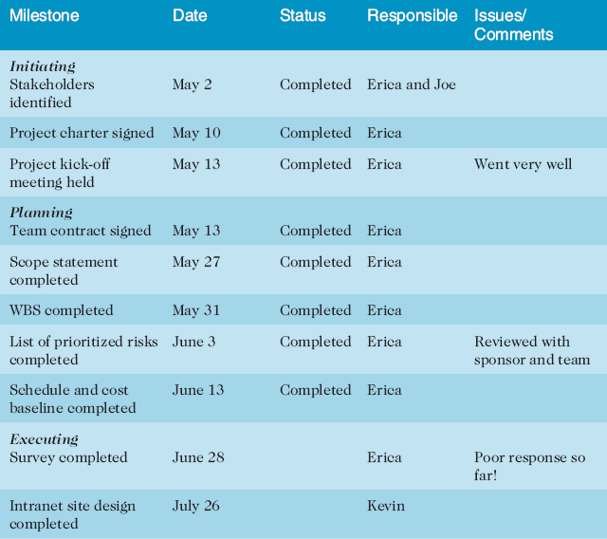
Part of Milestone Report

Slide 46
Best Practice
One way to learn about best practices in project management is by studying recipients of PMI’s Project of the Year award
The Quartier international de Montreal (QIM), Montreal’s international district, was a 66-acre urban revitalization project in the heart of downtown Montreal
This $90 million, five-year project turned a once unpopular area into a thriving section of the city with a booming real estate market and has generated $770 million in related construction

Slide 47
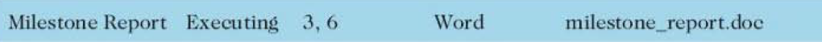
Project Planning Template

Slide 48
Project Monitoring and Controlling
Involves measuring progress toward project objectives, monitoring deviation from the plan, and taking correction actions
Affects all other process groups and occurs during all phases of the project life cycle
Outputs include performance reports, change requests, and updates to various plans
See Table 3-13

Slide 49
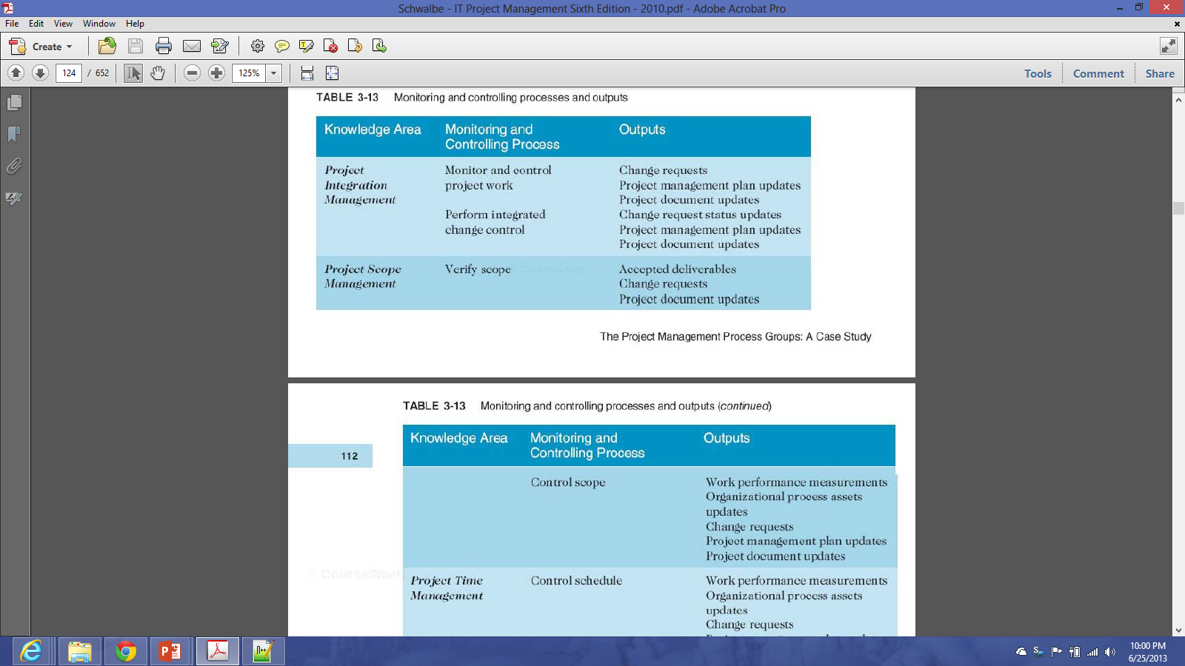

Slide 50
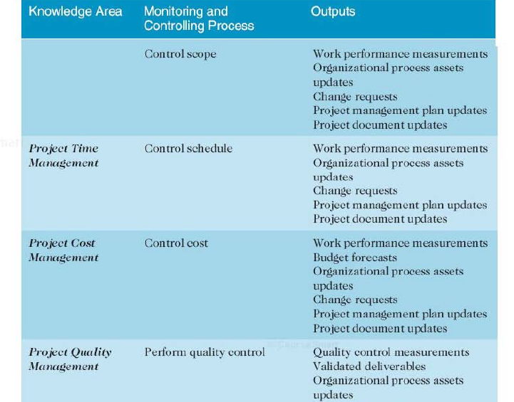
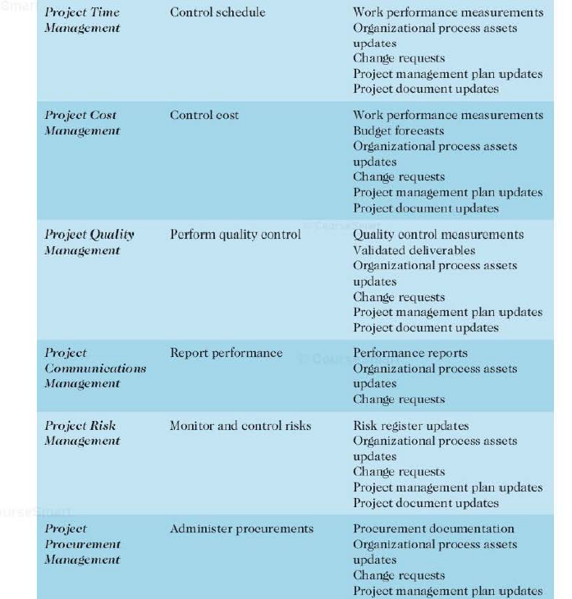

Slide 51
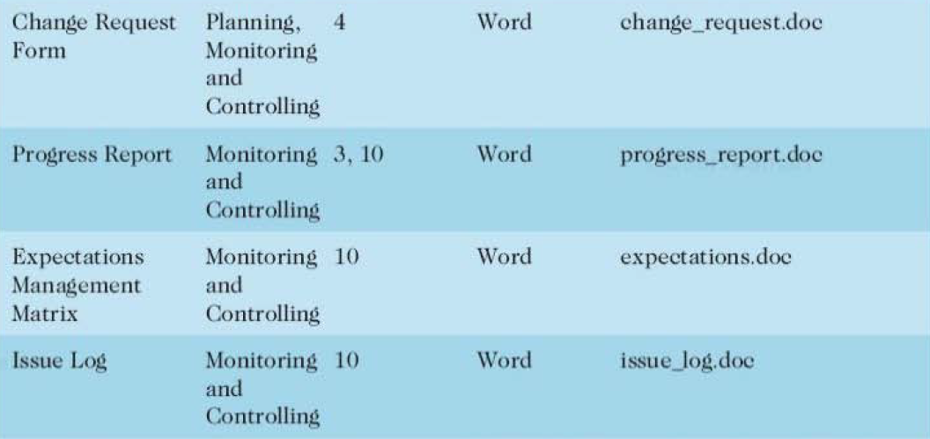
Project Monitoring and Controling Template

Slide 52
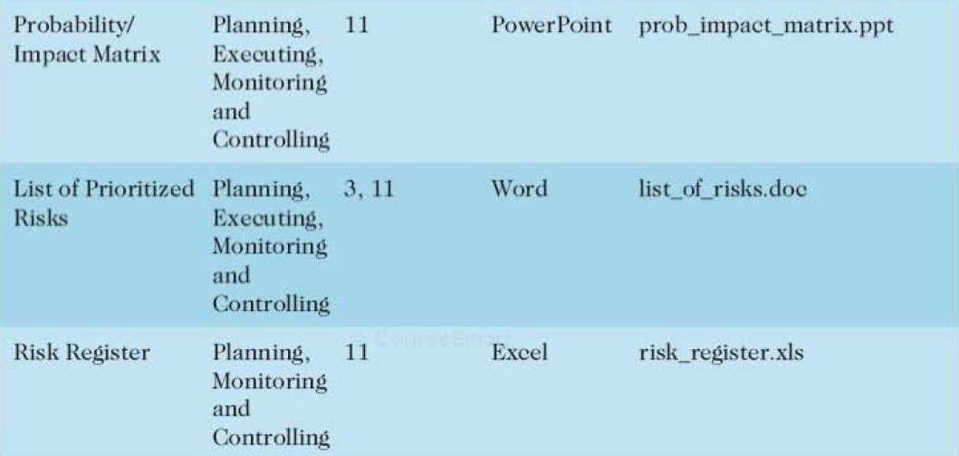
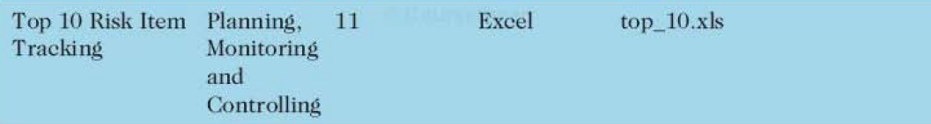
Project Monitoring and Controling Template

Slide 53
Project Closing
Involves gaining stakeholder and customer acceptance of the final products and services
Even if projects are not completed, they should be closed out to learn from the past
Outputs include project archives and lessons learned, part of organizational process assets
Most projects also include a final report and presentation to the sponsor/senior management

Slide 54
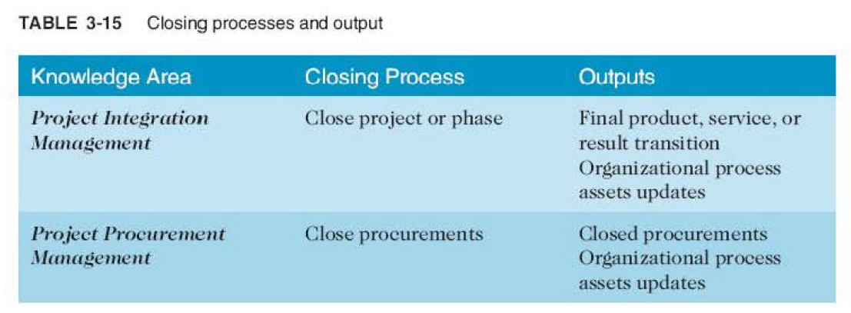

Slide 55
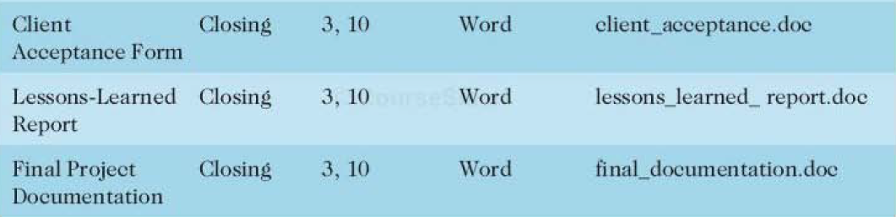
Project Closing Template

Slide 56
Templates
Table 3-18 on pp. 118-121 lists the templates available on:
http://www.kathyschwalbe.com
http://pmtexts.com/my-books/it-pm-book/

Slide 57
Discussion
Pahami dengan baik project management case study dimana JWD consulting mengelola project “intranet site project”!
Berdasarkan case study di atas dan template yang telah disediakan, lakukan simulasi project management untuk project yang sedang/telah anda kerjakan!
Gunakan template yang telah disediakan

Slide 58
Summary
The five project management process groups are initiating, planning, executing, monitoring and controlling, and closing
You can map the main activities of each process group to the nine knowledge areas
Some organizations develop their own information technology project management methodologies
The JWD Consulting case study provides an example of using the process groups and shows several important project documents

Slide 59
References
Kathy Schwalbe, Managing Information Technology Projects 6th Edition, Course Technology, Cengage Learning, 2010
A Guide to the Project Management Body of Knowledge: PMBOK Guide 4th Edition, Project Management Institute, 2008

