Slide 1
Project Management
Romi Satria Wahono romi@romisatriawahono.net http://romisatriawahono.net

Slide 2
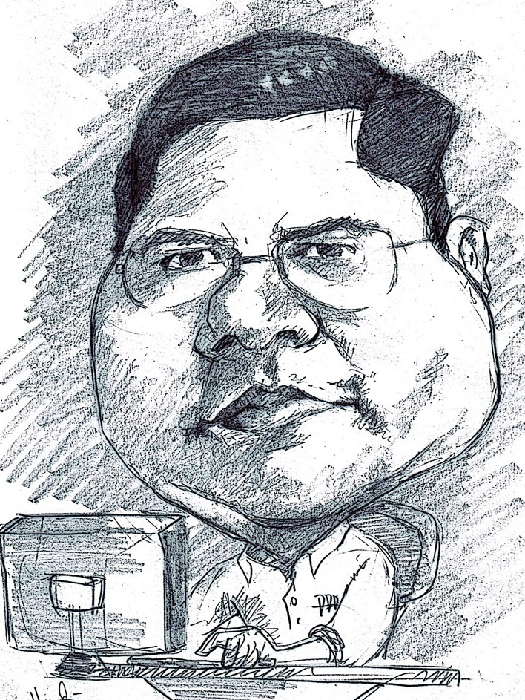
Romi Satria Wahono
SD Sompok Semarang (1987)
SMPN 8 Semarang (1990)
SMA Taruna Nusantara Magelang (1993)
B.Eng, M.Eng and Dr.Eng (on-leave) Department of Computer Science Saitama University, Japan (1994-2004)
Research Interests: Software Engineering and Intelligent Systems
Founder IlmuKomputer.Com
LIPI Researcher (2004-2007)
Founder and CEO PT Brainmatics Cipta Informatika

Slide 3

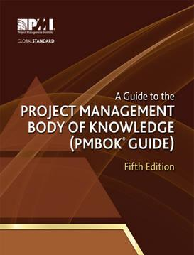
Textbooks

Slide 4
Course Outline
Introduction to Project Management
The Project Management and Information Technology Context
The Project Management Process Groups: A Case Study
Project Integration Management
Project Scope Management
Project Time Management
Project Cost Management
Project Quality Management
Project Human Resource Management
Project Communication Management
Project Risk Management
Project Procurement Management

Slide 5
1. Introduction to Project Management

Slide 6
Learning Objectives
Understand the growing need for better project management, especially for information technology projects
Explain what a project is, provide examples of projects, attributes of projects, and describe the triple constraint of projects
Describe key elements of the project management, including project stakeholders, the knowledge areas, tools and techniques
Discuss the relationship between project, program, and portfolio management and the contributions to enterprise success
Understand the role of the project manager by describing what project managers do, what skills they need, and what the career field is like
Describe the project management profession, including the role of organizations like the Project Management Institute (PMI) and the importance of certification and ethics

Slide 7
Introduction
Many organizations today have a new or renewed interest in project management
Computer hardware, software, networks, and the use of interdisciplinary and global work teams have radically changed the work environment
The world as a whole spends nearly $10 trillion of its $40.7 trillion gross product on projects of all kinds
More than 16 million people regard project management as their profession

Slide 8
Project Management Statistics
The overall information and communications technology (ICT) market grew by 6 percent to almost $3 trillion in 2010
In the U.S. the size of the IT workforce topped 4 million workers for the first time in 2008
In 2007 the total compensation for the average senior project manager in U.S. dollars was $104,776 per year in the United States, $111,412 in Australia, and $120,364 in the United Kingdom
The number of people earning their Project Management Professional (PMP) certification continues to increase

Slide 9
Motivation for Studying Information Technology (IT) Project Management
IT Projects have a terrible track record, as described in the What Went Wrong?
A 1995 Standish Group study (CHAOS) found that only 16.2% of IT projects were successful in meeting scope, time, and cost goals; over 31% of IT projects were canceled before completion
A PricewaterhouseCoopers study found that overall, half of all projects fail and only 2.5% of corporations consistently meet their targets for scope, time, and cost goals for all types of project

Slide 10
Advantages of Using Formal Project Management
Better control of financial, physical, and human resources
Improved customer relations
Shorter development times
Lower costs
Higher quality and increased reliability
Higher profit margins
Improved productivity
Better internal coordination
Higher worker morale

Slide 11
What Is a Project?
A project is “a temporary endeavor undertaken to create a unique product, service, or result” (PMBOK® Guide, Fourth Edition, 2008, p. 5)
On the other hand, operations is work done to sustain the business
Projects end when their objectives have been reached or the project has been terminated
Projects can be large or small and take a short or long time to complete

Slide 12
Examples of IT Projects
A technician replaces ten laptops for a small department
A small software development team adds a new feature to an internal software application for the finance department
A college campus upgrades its technology infrastructure to provide wireless Internet access across the whole campus
A cross-functional task force in a company decides what Voice-over-Internet-Protocol (VoIP) system to purchase and how it will be implemented
A government group develops a system to track child immunizations

Slide 13
Top Strategic Technologies for 2008 (Gartner)
Green IT
Unified communications
Business process modeling
Virtualization 2.0
Social software

Slide 14
Top Strategic Technologies for 2012 (Gartner)
Media tablets and beyond: no single platform will dominate the market, but that tablet sales will soon surpass laptop sales
Mobile-centric applications and interfaces: User interfaces will be mobile-centric, emphasizing touch, gesture, search, voice, and video
Contextual and social user experience: A contextually aware interface anticipates a user’s needs and provides the most appropriate content, product, or service
Internet of things: Internet usage will expand as sensors are added to physical items, ex: NFC allows users to make payments, board airplanes, etc
Cloud computing: Enterprises will move from trying to understand the cloud to making decisions on when to implement cloud services

Slide 15
Media Snapshot: Where IT Matters
In 2006, Baseline Magazine published “Where I.T. Matters: How 10 Technologies Transformed 10 Industries” as a retort to Nicholas Carr’s ideas (author of “IT Doesn’t Matter”)
VoIP has transformed the telecommunications industry and broadband Internet access
Global Positioning Systems (GPS) has changed the farming industry
Digital supply chain has changed the entertainment industry’s distribution system

Slide 16
Project Attributes
A project:
Has a unique purpose
Is temporary
Is developed using progressive elaboration
Requires resources, often from various areas
Should have a primary customer or sponsor
The project sponsor usually provides the direction and funding for the project
Involves uncertainty

Slide 17
Discussion
Ceritakan tentang salah satu project yang pernah anda tangani
Mengapa pekerjaan itu anda sebut sebuah project?
Apa bedanya pekerjaan biasa dengan project?

Slide 18
Project and Program Managers
Project managers work with project sponsors, the project team, and other people involved in a project to meet project goals
Program: group of related projects managed in a coordinated way to obtain benefits and control not available from managing them individually (PMBOK® Guide, Fourth Edition, 2008, p. 9)
Program managers oversee programs; often act as bosses for project managers

Slide 19
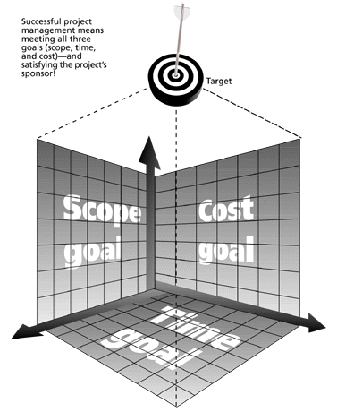
Triple Constraint of Project Management
Successful project management means meeting all three goals (scope, time, and cost) – and satisfying the project’s sponsor!

Slide 20
Discussion
Ceritakan salah satu project yang pernah anda tangani dan ternyata dinyatakan bahwa project itu gagal
Mengapa project tersebut dikatakan gagal?

Slide 21
What is Project Management?
Project management is “the application of knowledge, skills, tools and techniques to project activities to meet project requirements” (PMBOK® Guide, Fourth Edition, 2008, p. 6)
Project managers strive to meet the triple constraint by balancing project scope, time, and cost goals

Slide 22
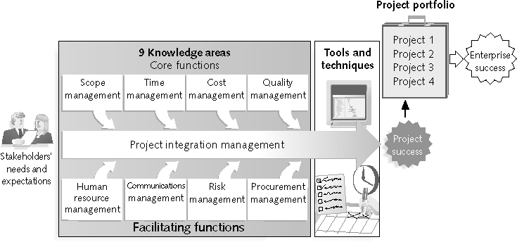
Project Management Framework

Slide 23
Project Stakeholders
Stakeholders are the people involved in or affected by project activities
Stakeholders include:
The project sponsor
The project manager
The project team
Support staff
Customers
Users
Suppliers
Opponents to the project

Slide 24
9 Project Management Knowledge Areas
Knowledge areas describe the key competencies that project managers must develop
4 core knowledge areas lead to specific project objectives (scope, time, cost, and quality)
4 facilitating knowledge areas are the means through which the project objectives are achieved (human resources, communication, risk, and procurement management)
1 knowledge area (project integration management) affects and is affected by all of the other knowledge areas
All knowledge areas are important!

Slide 25
Project Management Tools and Techniques
Project management tools and techniques assist project managers and their teams in various aspects of project management
Some specific ones include:
Project charter, scope statement, and WBS (scope)
Gantt charts, network diagrams, critical path analysis, critical chain scheduling (time)
Cost estimates and earned value management (cost)
See Table on the next slide for many more

Slide 26
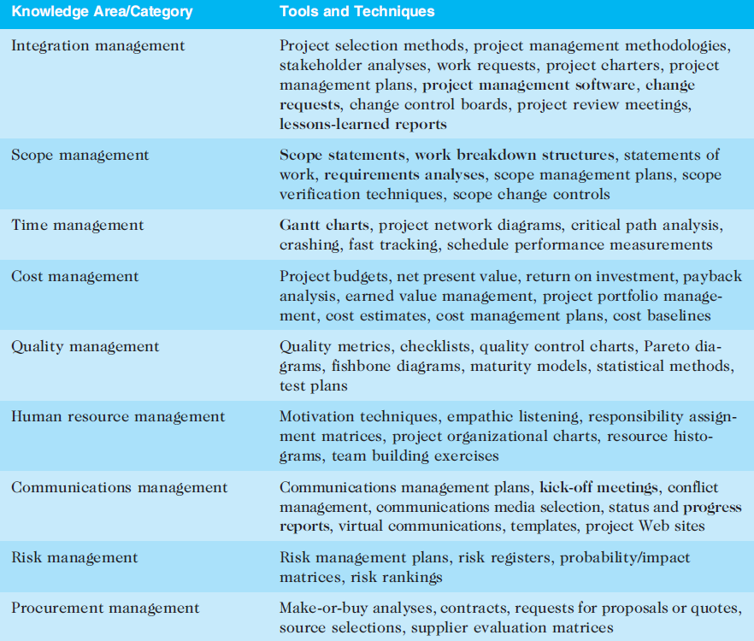

Slide 27
Super Tools
“Super tools” are those tools that have high use and high potential for improving project success, such as:
Software for task scheduling (such as project management software)
Scope statements
Requirements analyses
Lessons-learned reports
Tools already extensively used that have been found to improve project importance include:
Progress reports
Kick-off meetings
Gantt charts
Change requests

Slide 28
What Went Right? Improved Project Performance
The Standish Group’s CHAOS studies show improvements in IT projects in the past decade:
The number of successful IT projects has more than doubled, from 16 percent in 1994 to 35 percent in 2006
The number of failed projects decreased from 31 percent in 1994 to 19 percent in 2006
The United States spent more money on IT projects in 2006 than 1994 ($346 billion and $250 billion, respectively), but the amount of money wasted on challenged and failed projects was down to $53 billion in 2006 compared to $140 billion in 1994

Slide 29
Why the Improvements?
"The reasons for the increase in successful projects vary. First, the average cost of a project has been more than cut in half. Better tools have been created to monitor and control progress and better skilled project managers with better management processes are being used. The fact that there are processes is significant in itself.”
Standish Group, "CHAOS 2001: A Recipe for Success" (2001)

Slide 30
Project Success
There are several ways to define project success:
The project met scope, time, and cost goals
The project satisfied the customer/sponsor
The results of the project met its main objective, such as making or saving a certain amount of money, providing a good return on investment, or simply making the sponsors happy

Slide 31
What Helps Projects Succeed?
Executive support
User involvement
Experienced project manager
Clear business objectives
Minimized scope
Standard software infrastructure
Firm basic requirements
Formal methodology
Reliable estimates
Other criteria, such as small milestones, proper planning, competent staff, and ownership
The Standish Group, “Extreme CHAOS,” (2001)

Slide 32
What the Winners Do…
Recent research findings show that companies that excel in project delivery capability:
Use an integrated project management toolbox (use standard/advanced PM tools, lots of templates)
Grow project leaders, emphasizing business and soft skills
Develop a streamlined project delivery process
Measure project health using metrics, like customer satisfaction or return on investment

Slide 33
Discussion
Mengapa kita perlu memahami project management?
Bagaimana cara termudah untuk memahami tentang project management?

Slide 34
Program and Project Portfolio Management
A program is “a group of related projects managed in a coordinated way to obtain benefits and control not available from managing them individually” (PMBOK® Guide, Fourth Edition, 2008, p. 9)
A program manager provides leadership and direction for the project managers heading the projects within the program
Examples of common programs in the IT field include infrastructure, applications development, and user support

Slide 35
Project Portfolio Management
As part of project portfolio management, organizations group and manage projects and programs as a portfolio of investments that contribute to the entire enterprise’s success
Portfolio managers help their organizations make wise investment decisions by helping to select and analyze projects from a strategic perspective

Slide 36
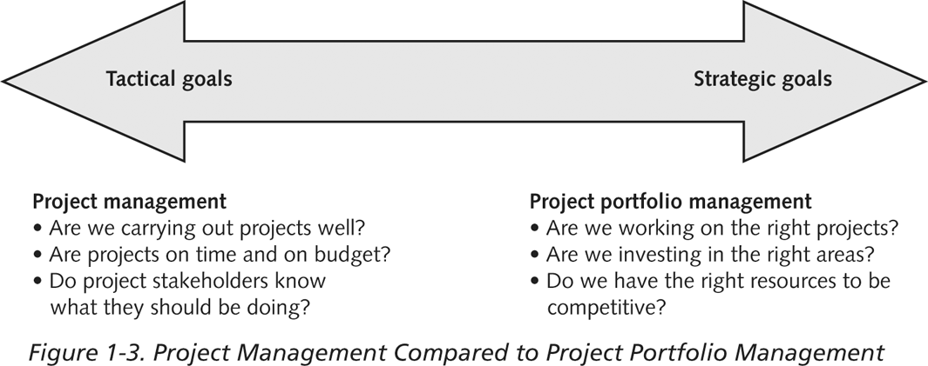
Project Management Compared to Project Portfolio Management

Slide 37
Best Practice
A best practice is “an optimal way recognized by industry to achieve a stated goal or objective”*
Robert Butrick suggests that organizations need to follow basic principles of project management, including these two mentioned earlier:
Make sure your projects are driven by your strategy; be able to demonstrate how each project you undertake fits your business strategy, and screen out unwanted projects as soon as possible
Engage your stakeholders; ignoring stakeholders often leads to project failure; be sure to engage stakeholders at all stages of a project, and encourage teamwork and commitment at all times
*Project Management Institute, Organizational Project Management Maturity Model
(OPM3) Knowledge Foundation (2003), p. 13.

Slide 38
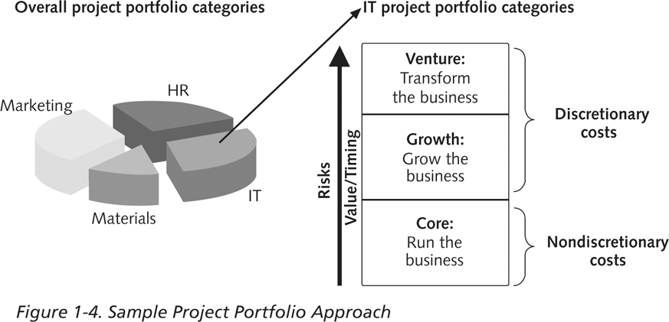
Sample Project Portfolio Approach

Slide 39
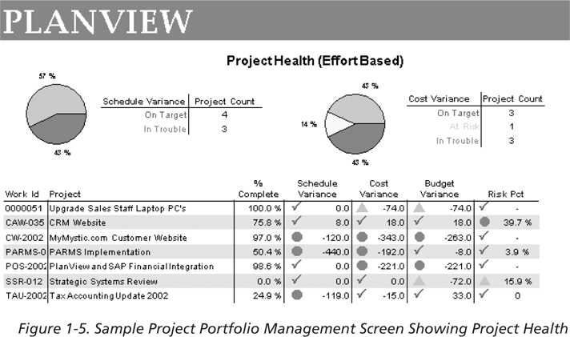
Sample Project Portfolio Management: Project Health

Slide 40
Discussion
Apakah yang dimaksud dengan program?
Jelaskan perbedaan project management dan project portfolio management

Slide 41
The Role of the Project Manager
Job descriptions vary, but most include responsibilities like planning, scheduling, coordinating, and working with people to achieve project goals
Remember that 97% of successful projects were led by experienced project managers, who can often help influence success factors

Slide 42
Suggested Skills for Project Managers
Project managers need a wide variety of skills
They should:
Be comfortable with change
Understand the organizations they work in and with
Be able to lead teams to accomplish project goals

Slide 43
Suggested Skills for Project Managers
The Project Management Body of Knowledge
Application area knowledge, standards, and regulations
Project environment knowledge
General management knowledge and skills
Soft skills or human relations skills

Slide 44
Ten Most Important Skills and Competencies for Project Managers
People skills
Leadership
Listening
Integrity, ethical behavior, consistent
Strong at building trust
Verbal communication
Strong at building teams
Conflict resolution, conflict management
Critical thinking, problem solving
Understands, balances priorities

Slide 45
Different Skills Needed in Different Situations
Large projects: leadership, relevant prior experience, planning, people skills, verbal communication, and team-building skills were most important
High uncertainty projects: risk management, expectation management, leadership, people skills, and planning skills were most important
Very novel projects: leadership, people skills, having vision and goals, self confidence, expectations management, and listening skills were most important

Slide 46
Importance of Leadership Skills
Effective project managers provide leadership by example
A leader focuses on long-term goals and big-picture objectives while inspiring people to reach those goals
A manager deals with the day-to-day details of meeting specific goals
Project managers often take on the role of both leader and manager

Slide 47
Careers for IT Project Managers
In a 2006 survey by CIO.com, IT executives ranked the skills that would be the most in demand in the next two to five years
Project/program management topped the list!

Slide 48
Top IT Skills (Johnson, 2011)
SKILL PERCENTAGE OF RESPONDENTS
Project/program management 60%
Business process management 55%
Business analysis 53%
Application development 52%
Database management 49%
Security 42%
Enterprise architect 41%
Strategist/internal consultant 40%
System analyst 39%
Carolyn Johnson, 2006 Midyear Staffing Updates, CIO Research Reports, October 2006

Slide 49
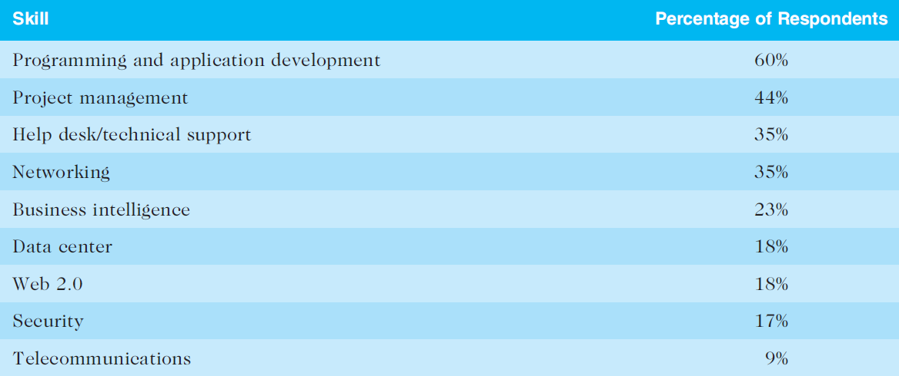
Top IT Skills (Saia, 2011)
Rick Saia, 9 Hot IT Skills for 2012, Computerworld, September 26, 2011

Slide 50
Discussion
Jelaskan peran dari project manager!
Jelaskan seberapa penting skill project management di dunia kerja saat ini!

Slide 51
The Project Management Profession
The profession of project management is growing at a very rapid pace
It is helpful to understand the history of the field, the role of professional societies like the Project Management Institute, and the growth in project management software

Slide 52
History of Project Management
Some people argue that building the Egyptian pyramids was a project, as was building the Great Wall of China
In 1946, most people consider the Manhattan Project to be the first project to use “modern” project management. About three-year and cost almost $2 billion (in 1946). The project had a separate project manager and a technical manager
In 1917, Henry Gantt developed the famous Gantt Chart
In 1950-1960, US military continued to be key in refining several project management techniques
In 1958, members of US navy polaris missile project first used network diagrams

Slide 53
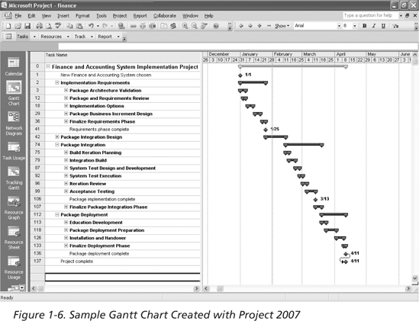
Sample Gantt Chart Created with Project 2007

Slide 54
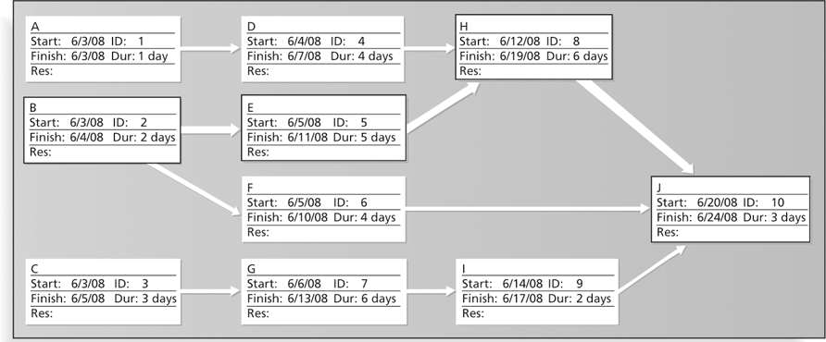
Sample Network Diagram in Microsoft Project

Slide 55
The Project Management Institute
The Project Management Institute (PMI) is an international professional society for project managers founded in 1969
PMI has continued to attract and retain members. In 1993, there were about 1,000 certified project management professionals. By December 31, 2011, there were 467,390 active PMPs.
There are specific interest groups in many areas, like engineering, financial services, health care, IT, etc.
Project management research and certification programs continue to grow

Slide 56
Project Management Certification
PMI provides certification as a Project Management Professional (PMP)
A PMP has documented sufficient project experience, agreed to follow a code of ethics, and passed the PMP exam
The number of people earning PMP certification is increasing quickly
PMI and other organizations offer additional certification programs

Slide 57
Growth in PMP Certification, 1993-2008

Slide 58
Ethics in Project Management
Ethics, loosely defined, is a set of principles that guide our decision making based on personal values of what is “right” and “wrong”
Project managers often face ethical dilemmas
In order to earn PMP certification, applicants must agree to PMI’s Code of Ethics and Professional Conduct
Several questions on the PMP exam are related to professional responsibility, including ethics

Slide 59
Project Management Software
There are hundreds of different products to assist in performing project management
Three main categories of tools:
Low-end tools: handle single or smaller projects well, cost under $200 per user
Midrange tools: handle multiple projects and users, cost $200-600 per user, Microsoft Project most popular
High-end tools: also called enterprise project management software, often licensed on a per-user basis, like VPMi Enterprise Online (www.vcsonline.com)
See the Project Management Center Web site (http://www.infogoal.com/pmc/pmcswr.htm) that provide project management software

Slide 60
Discussion
Jelaskan tentang profesi dan asosiasi project management!
Jelaskan tentang software project management tools yang pernah anda gunakan!

Slide 61
Summary
A project is a temporary endeavor undertaken to create a unique product, service, or result
Project management is the application of knowledge, skills, tools, and techniques to project activities to meet project requirements
A program is a group of related projects managed in a coordinated way
Project portfolio management involves organizing and managing projects and programs as a portfolio of investments
Project managers play a key role in helping projects and organizations succeed
The project management profession continues to grow and mature

Slide 62
References
Kathy Schwalbe, Managing Information Technology Projects 6th Edition, Course Technology, Cengage Learning, 2010
A Guide to the Project Management Body of Knowledge: PMBOK Guide 4th Edition, Project Management Institute, 2008

