Slide 1
Knowledge Management:
5. Assessment
Romi Satria Wahono
romi@romisatriawahono.net
http://romisatriawahono.net/km
WA/SMS: +6281586220090

Slide 2

Romi Satria Wahono
SD Sompok Semarang (1987)
SMPN 8 Semarang (1990)
SMA Taruna Nusantara Magelang (1993)
B.Eng, M.Eng and Ph.D in Software Engineering from
Saitama University Japan (1994-2004)
Universiti Teknikal Malaysia Melaka (2014)
Research Interests: Software Engineering and
Machine Learning
Founder dan Koordinator IlmuKomputer.Com
Peneliti LIPI (2004-2007)
Founder dan CEO PT Brainmatics Cipta Informatika

Slide 3
Contents
1. Introduction | 1.1 What and Why Knowledge Management 1.2 Types of Knowledge 1.3 Knowledge Transformation
2. Foundations | 2.1 Knowledge Management Infrastructure 2.2 Knowledge Management Mechanism 2.3 Knowledge Management Technologies
3. Solutions | 3.1 Knowledge Management Processes 3.2 Knowledge Management Systems
4. Systems | 4.1 Knowledge Application Systems 4.2 Knowledge Capture Systems 4.3 Knowledge Sharing Systems 4.4 Knowledge Discovery Systems
5. Assessment | 5.1 Organizational Impacts of Knowledge Management 5.2 Type of Knowledge Management Assessment

Slide 4
5. Assessment
5.1 Organizational Impacts of Knowledge Management
5.2 Type of Assessment of Knowledge Management

Slide 5
5.1 Organizational Impacts of Knowledge Management

Slide 6
Organization Impact Levels
People
Processes
Products
Organizational Performance
Knowledge Management

Slide 7
Impact on People
KM can facilitate employee learning
KM also causes employees to become more flexible, and enhances their job satisfaction
Consists of:
  Impact on Employee Learning
  Impact on Employee Adaptability
  Impact on Employee Job Satisfaction

Slide 8
1. Impact on Employee Learning
This can be accomplished through
  Externalization
  Internalization
  Socialization
  Communities of practice

Slide 9
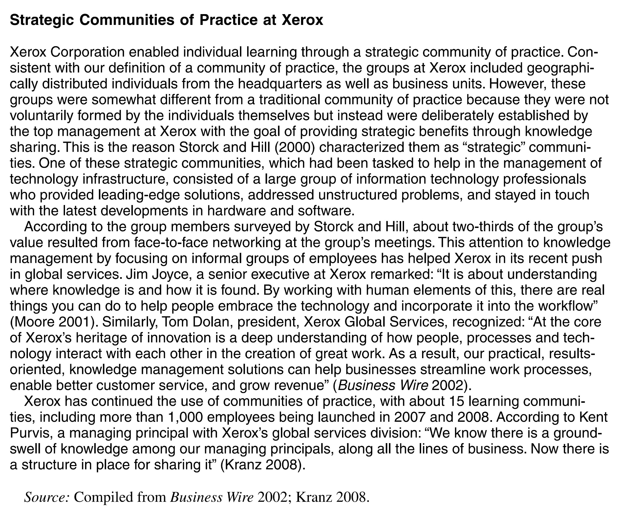

Slide 10
2. Impact on Employee Adaptability
Employees are likely to adapt when they interact with each other
They are more likely to accept change
They are more prepared to respond to change

Slide 11
3. Impact on Employee Job Satisfaction
Recent study found that in organizations having more employees sharing knowledge with one another, turnover rates were reduced, thereby positively affecting revenue and profit
KM also provides employees with solutions to problems they face in case those same problems have been encountered earlier, and effectively addressed

Slide 12
How KM Impacts People
Knowledge
Employee Learning
Knowledge Management
Employee Adaptability
Employee
Job Satisfaction

Slide 13
Impact on Processes
KM enables improvements in organizational processes such as marketing, manufacturing, accounting, engineering, and public relations
These impacts can be seen along three major dimensions:
  Effectiveness
  Efficiency
  Degree of innovation of the processes

Slide 14
Effectiveness, Efficiency and Innovation
Effectiveness is performing the most suitable processes and making the best possible decisions
Efficiency is performing the processes quickly and in a low-cost fashion
Innovation is performing the processes in a creative and novel fashion, that improves effectiveness and efficiency or at least marketability

Slide 15
Impact on Processes
Impact on Process Effectiveness
  KM can enable organizations to become more effective by helping them to select and perform the most appropriate processes
  KM enables organizations to quickly adapt their processes according to the current circumstances, thereby maintaining process effectiveness in changing times
Impact on Process Efficiency
  Managing knowledge effectively can also enable organizations to be more productive and efficient
Impact on Process Innovation
  Organizations can increasingly rely on knowledge shared across individuals to produce innovative solutions to problems as well as to develop more innovative organizational processes

Slide 16
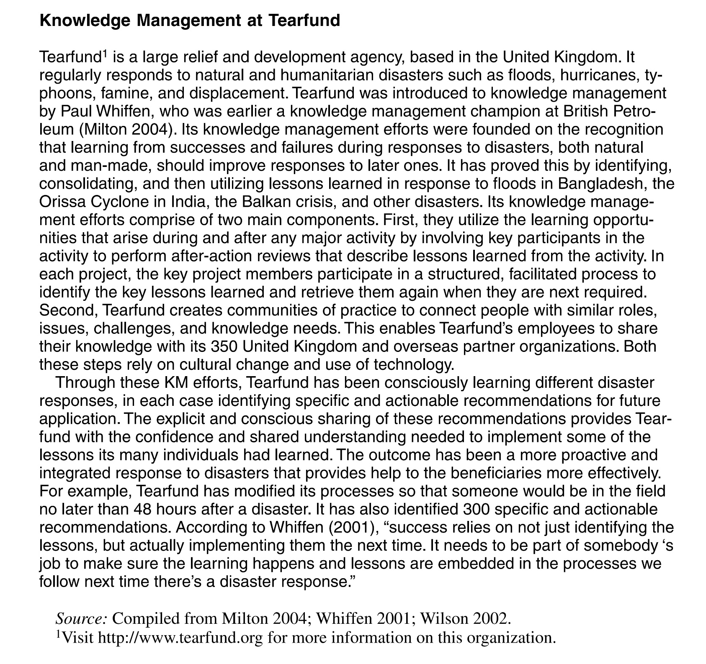

Slide 17
How KM Impacts Organizational Processes?
Process Effectiveness
Fewer mistakes
Adaptation to changed circumstances
Knowledge Management
Knowledge
Process Efficiency
Productivity improvement
Cost savings
Process Innovation
Improved brainstorming
Better exploitation of new ideas

Slide 18
Impact on Products
Impact on products can be
  Value added products
  Knowledge based products
Knowledge
Value-added Products
Knowledge-based products
Knowledge Management

Slide 19
1. Impact on Value-Added Products
KM processes can help organizations offer new products or improved products that provide a significant additional value as compared with earlier products
Value-added products also benefit from KM due to the effect the latter has on organizational process innovation

Slide 20
2. Impact on Knowledge-Based Products
KM can have a significant impact on product that are knowledge based like those in consulting or software development etc.
Knowledge based products can sometimes play a significant role in traditional manufacturing firms

Slide 21
Impacts on Organizational Performance
Direct Impacts
  Knowledge is used to create innovative products that generate revenue and profit
Indirect Impacts
  Use of KM to demonstrate intellectual leadership within the industry, which, in turn, might enhance customer loyalty
  Use of knowledge to gain an advantageous negotiating position with respect to competitors or partner organizations

Slide 22
Economy of Scale and Scope
A company’s output is said to exhibit economy of scale if the average cost of production per unit decreases with increase in output
A company’s output is said to exhibit economy of scope when the total cost of that same company producing two or more different products is less than the sum of the costs that would be incurred if each product had been produced separately by a different company

Slide 23
How Knowledge Management Impacts Organizational Performance
Organizational Performance
Scale economies
Scope economies
Sustainable competitive advantage
Knowledge
Vision
Strategy
Revenues
Costs
Knowledge Management

Slide 24
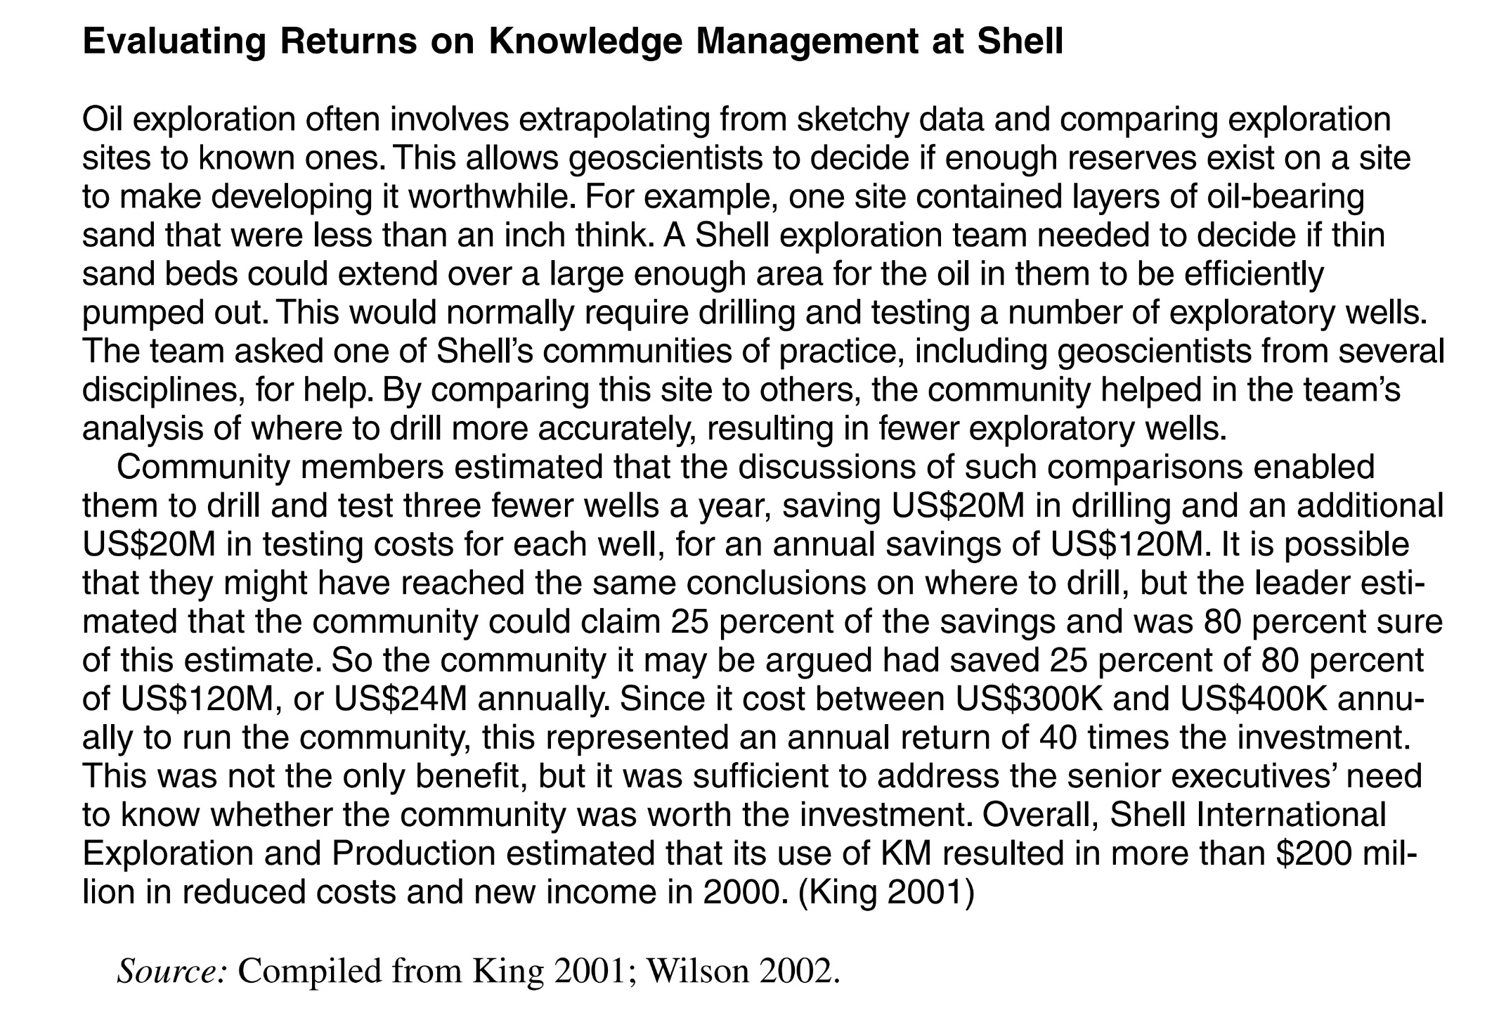

Slide 25
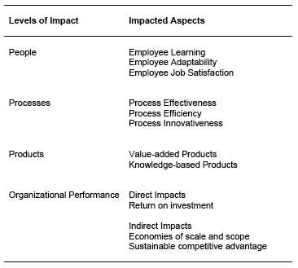
A Summary of Organizational Impacts of Knowledge Management

Slide 26
5.2 Type of Knowledge Management Assessment

Slide 27
Why Assess Knowledge Management?
It would not be possible to determine where improvements are needed
Helps establishing a baseline for implementing KM solutions
Helps understand whether costs of KM efforts are justified
Helps identify the gap in KM efforts
Help make a case for more investment into KM

Slide 28
The Timing of KM
Periodically for an entire organization or subunit
At the start of a KM project
At the end of a KM project

Slide 29
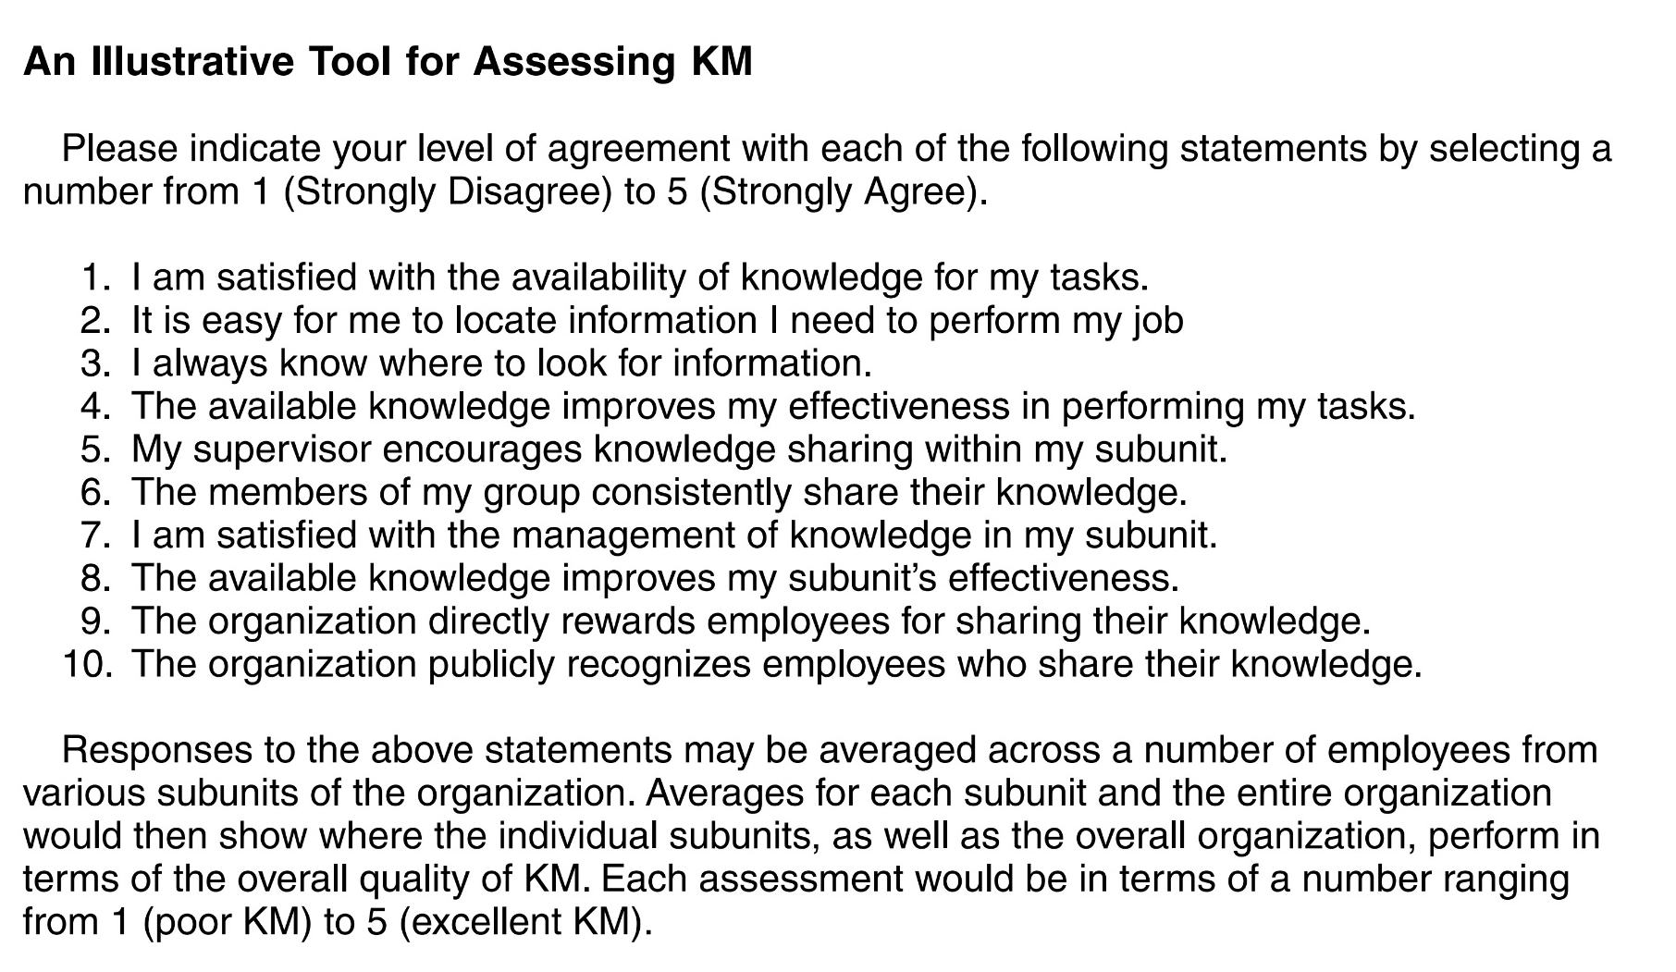
The Timing of KM

Slide 30
The Nature of KM
Qualitative KM assessments aim to develop a basic understanding of whether the KM efforts are working
Quantitative assessments of KM produce specific numerical scores indicating how well an organization, an organizational subunit, or an individual is performing with respect to KM

Slide 31
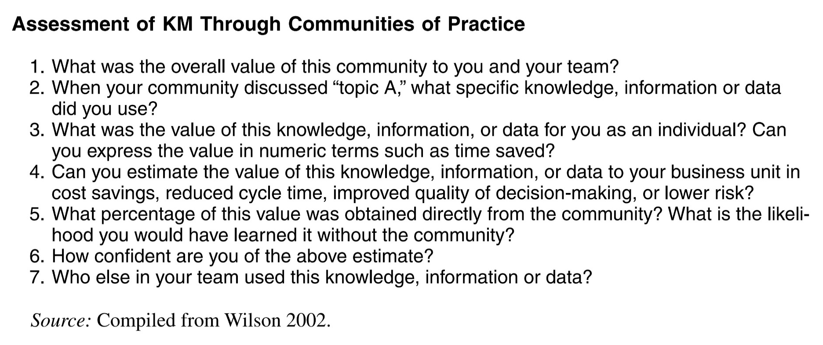
The Nature of KM

Slide 32
Assessment of KM Solutions
Involves evaluating the extent to which knowledge discovery, capture, sharing, and application processes are utilized, and how well they are supported by KM technologies and systems

Slide 33
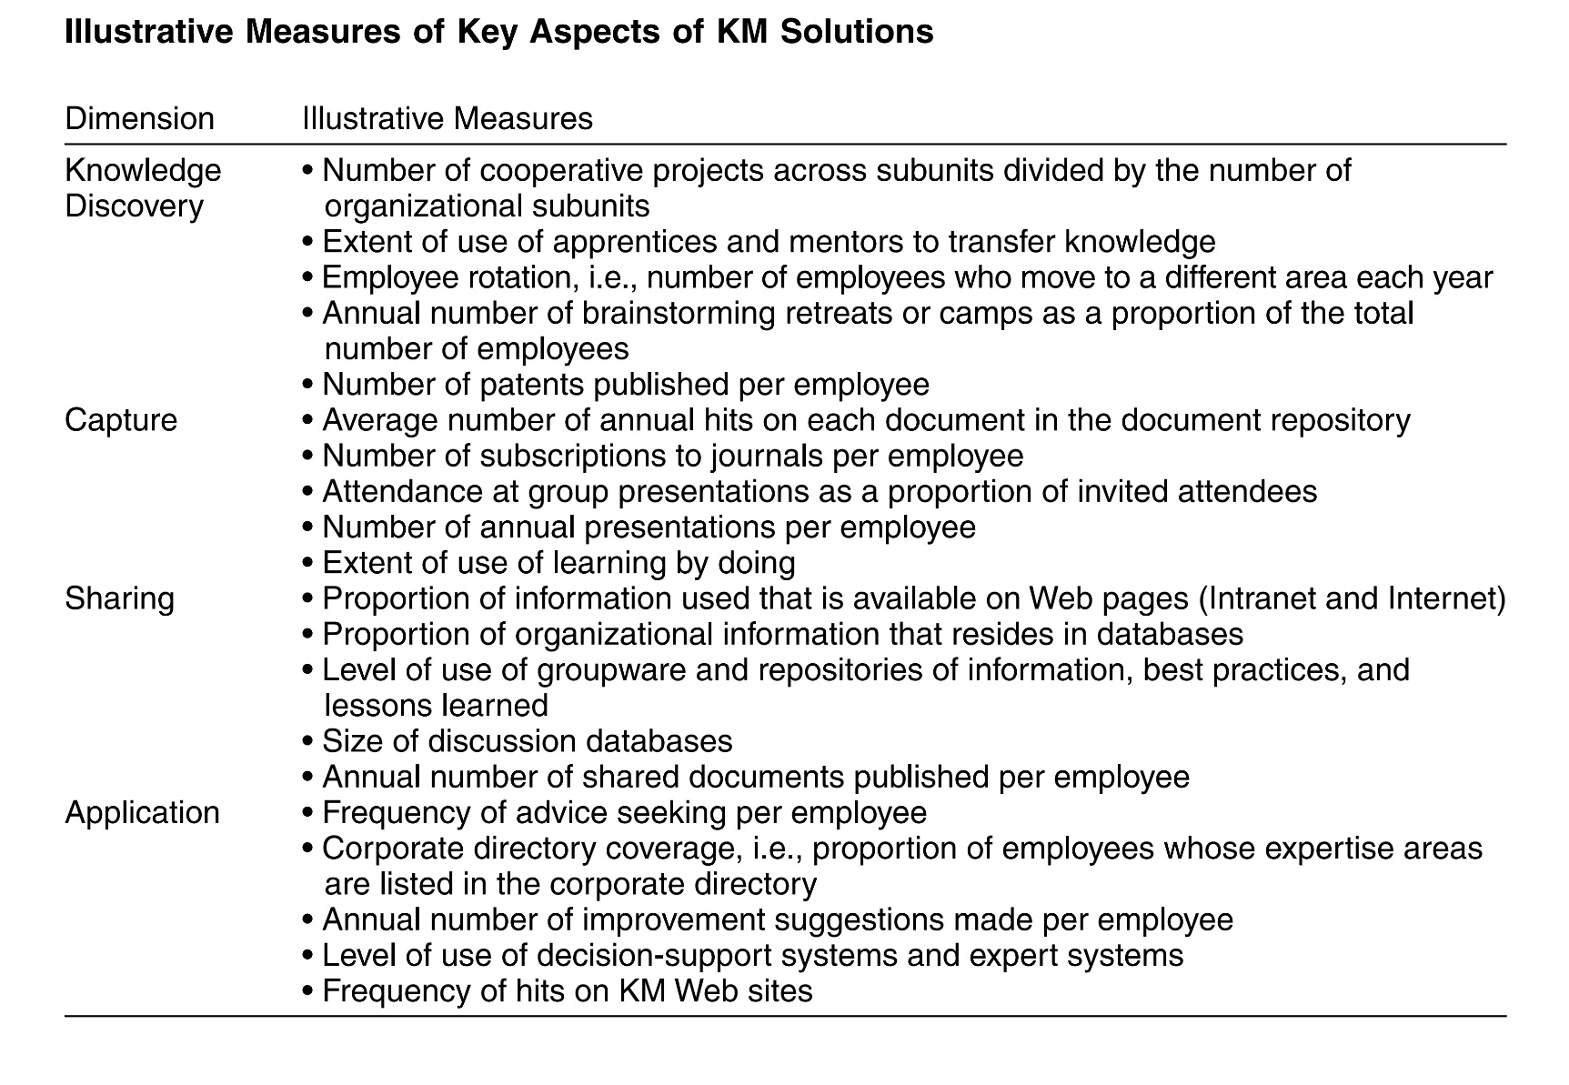

Slide 34
Assessment of Knowledge
Identification of the relevant areas of knowledge
Evaluation of the extent to which knowledge in each of these areas is available
Value each area of knowledge contributed to the organization

Slide 35
Assessment of Impacts
KM solutions and knowledge can impact the organization performance and therefore it is essential to assess the impacts
Impact on employees
Impact on processes
Impact on products
Impact on organizational performance

Slide 36
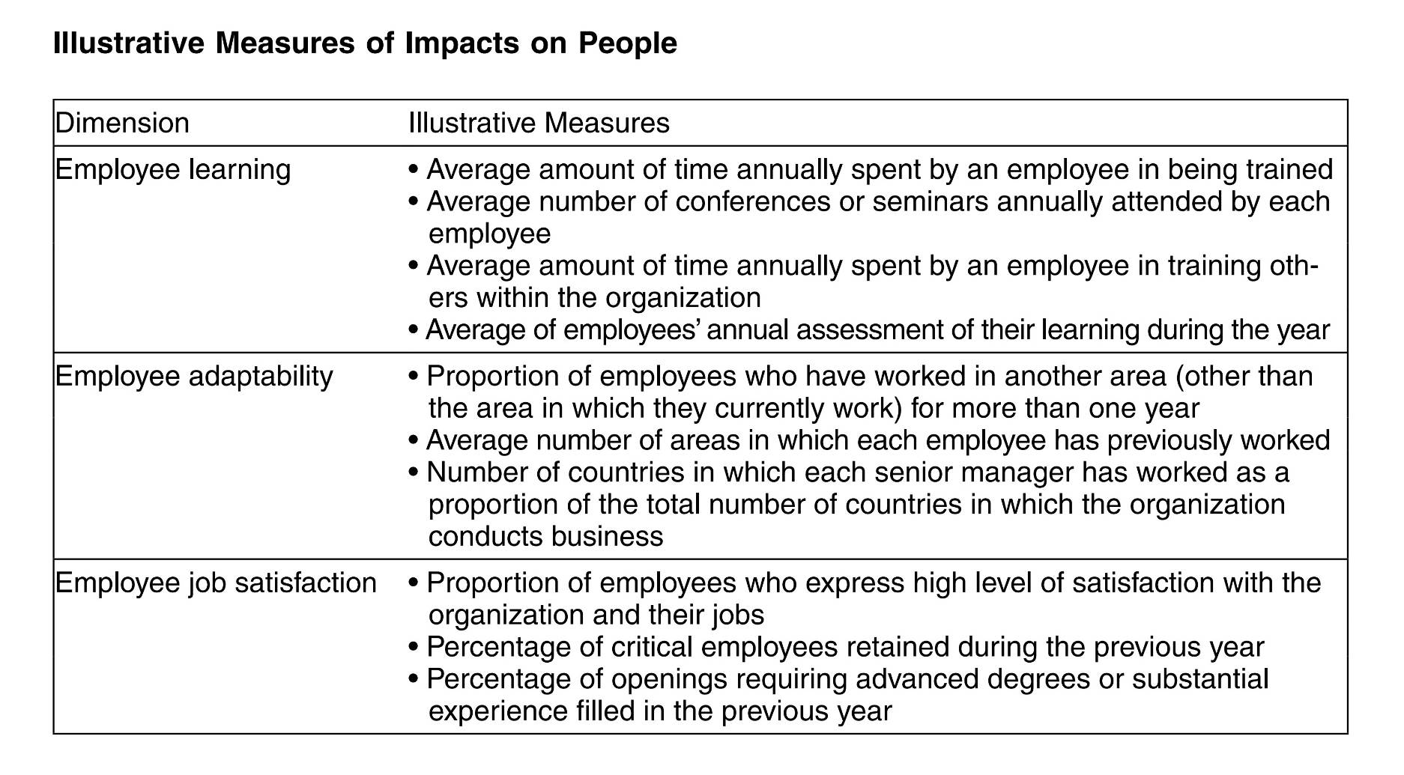

Slide 37


Slide 38
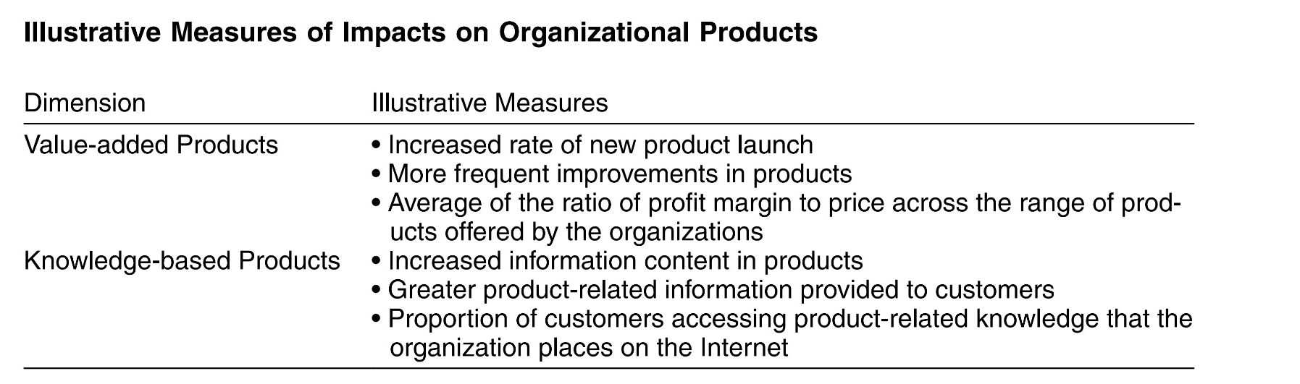

Slide 39
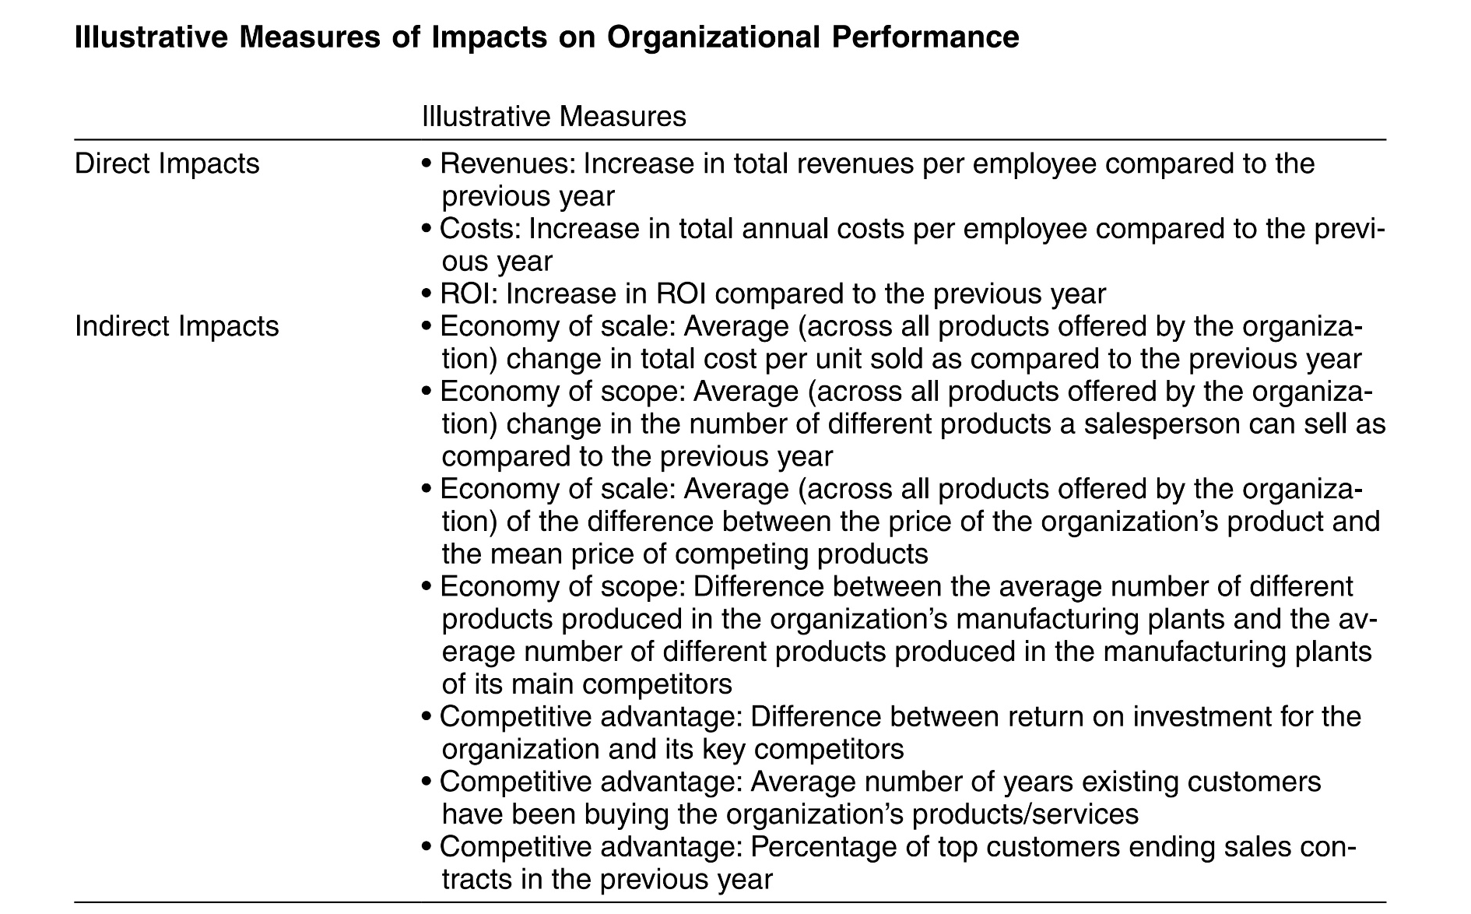

Slide 40
Approaches for KM Assessment
Benchmarking
Balanced Scorecard method
Intangible assets monitor framework
Skandia Method
Real options approach

Slide 41
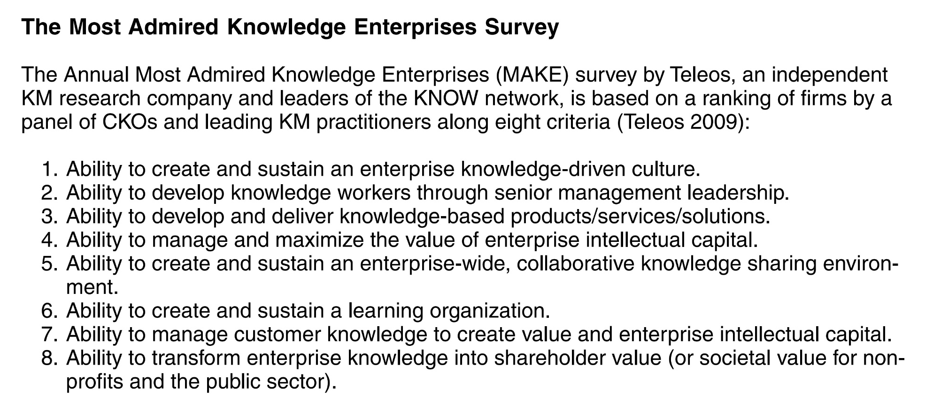

Slide 42
Recommendations for KM Assessment
Why do KM?
Establish a baseline
Qualitative methods
Simple
Avoid KM metrics that are hard to control
Measure at the appropriate level
Rewards
Be conservative

Slide 43
Referensi
Peter Drucker, The age of social transformation, The Atlantic Monthly, 274(5), 1994
Ikujiro Nonaka and Hirotaka Takeuchi, The Knowledge Creating Company, Oxford University Press, 1995
Kimiz Dalkir and Jay Liebowitz, Knowledge Management in Theory and Practice, The MIT Press, 2011
Irma Becerra-Fernandez and Rajiv Sabherwal, Knowledge Management: Systems and Processes, M.E. Sharpe, Inc., 2010
Romi Satria Wahono, Menghidupkan Pengetahuan Sudahkah Kita Lakukan?, Jurnal Dokumentasi dan Informasi - Baca, LIPI, 2005

