Slide 1
Knowledge Management:
4. Systems
Romi Satria Wahono
romi@romisatriawahono.net
http://romisatriawahono.net/km
WA/SMS: +6281586220090

Slide 2
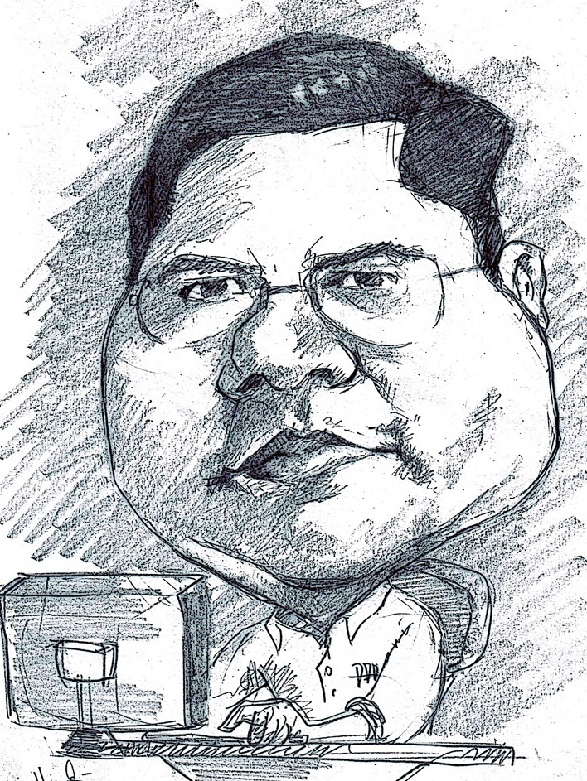
Romi Satria Wahono
SD Sompok Semarang (1987)
SMPN 8 Semarang (1990)
SMA Taruna Nusantara Magelang (1993)
B.Eng, M.Eng and Ph.D in Software Engineering from
Saitama University Japan (1994-2004)
Universiti Teknikal Malaysia Melaka (2014)
Research Interests: Software Engineering and
Machine Learning
Founder dan Koordinator IlmuKomputer.Com
Peneliti LIPI (2004-2007)
Founder dan CEO PT Brainmatics Cipta Informatika

Slide 3
Contents
1. Introduction | 1.1 What and Why Knowledge Management 1.2 Types of Knowledge 1.3 Knowledge Transformation
2. Foundations | 2.1 Knowledge Management Infrastructure 2.2 Knowledge Management Mechanism 2.3 Knowledge Management Technologies
3. Solutions | 3.1 Knowledge Management Processes 3.2 Knowledge Management Systems
4. Systems | 4.1 Knowledge Application Systems 4.2 Knowledge Capture Systems 4.3 Knowledge Sharing Systems 4.4 Knowledge Discovery Systems
5. Assessment | 5.1 Organizational Impacts of Knowledge Management 5.2 Type of Knowledge Management Assessment

Slide 4
4. Systems
4.1 Knowledge Application Systems
4.2 Knowledge Capture Systems
4.3 Knowledge Sharing Systems
4.4 Knowledge Discovery Systems

Slide 5
4.1 Knowledge Application Systems
Systems that Utilized Knowledge

Slide 6
Systems that Utilized Knowledge
Knowledge application systems support the process through which individuals utilize the knowledge possessed by other individuals without actually acquiring, or learning, that knowledge
Both mechanisms and technologies can support knowledge application systems by facilitating the knowledge management processes of routines and direction
Knowledge application systems are typically enabled by intelligent technologies

Slide 7
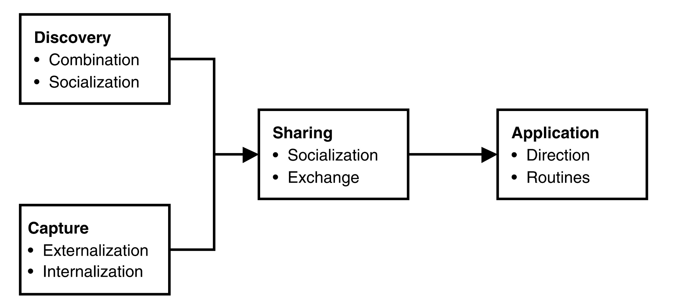
KM Processes

Slide 8
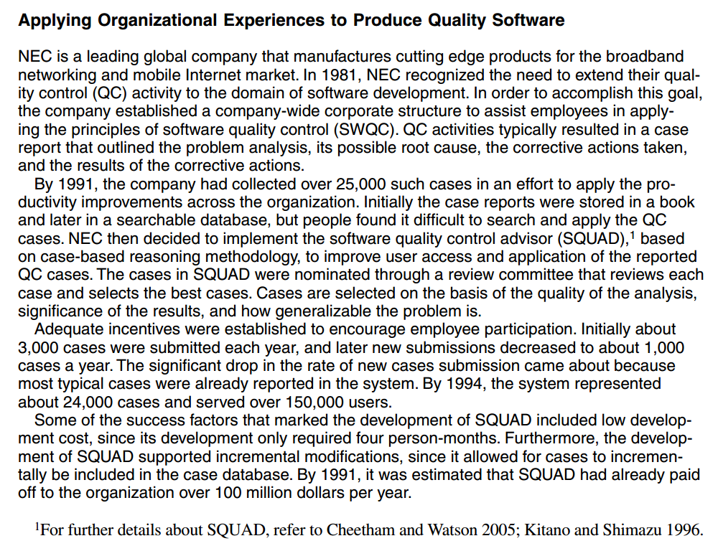

Slide 9
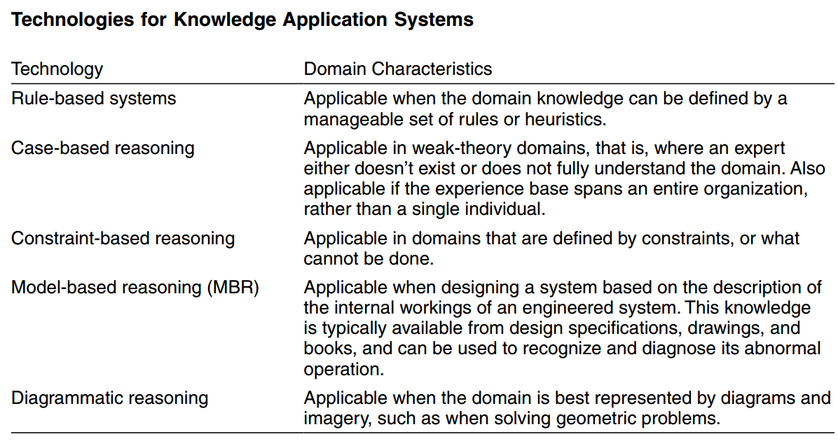

Slide 10
4.2 Knowledge Capture Systems
Systems that Preserve and Formalize Knowledge

Slide 11
Systems that Preserve and Formalize Knowledge
Knowledge capture systems are designed to help elicit and store knowledge, both tacit and explicit
Knowledge can be captured using mechanisms or technologies so that the captured knowledge can then be shared and used by others
Storytelling is the mechanism by which early civilizations passed on their values and their wisdom from one generation to the next
One type of knowledge capture system that we describe in this chapter is based on the use of mind map as a knowledge modeling/visualization tool

Slide 12
KM Processes

Slide 13
4.3 Knowledge Sharing Systems
Systems that Organize and Distribute Knowledge

Slide 14
Knowledge Sharing Systems
Knowledge sharing systems can be described as systems that enable members of an organization to acquire tacit and explicit knowledge from each other
In a knowledge sharing system, knowledge owners will:
  Want to share their knowledge with a controllable and trusted group
  Decide when to share and the conditions for sharing
  Seek a fair exchange, or reward, for sharing their knowledge

Slide 15
Type of Knowledge Sharing Systems
Incident report databases
Alert systems
Best practices databases
Lessons learned systems
Expertise locator systems

Slide 16
KM Processes

Slide 17
4.4 Knowledge Discovery Systems
Systems that Create Knowledge

Slide 18
Knowledge Discovery Systems
The technologies that enable the discovery of new knowledge uncover the relationships from explicit information
Knowledge discovery technologies can be very powerful for organizations wishing to obtain an advantage over their competition
Recall that knowledge discovery in databases (KDD) or Data Mining is the process of finding and interpreting patterns from data, involving the application of algorithms to interpret the patterns generated by these algorithms (Fayyad et al. 1996)

Slide 19
Data Mining
Data mining systems have made a significant contribution in scientific fields for years, for example in breast cancer diagnosis (Kovalerchuk et al. 2000)
Perhaps the recent proliferation of e-commerce applications providing reams of hard data ready for analysis presents us with an excellent opportunity to make profitable use of these techniques.

Slide 20
KM Processes

Slide 21
Peran Utama Data Mining
1. Estimasi
2. Prediksi
3. Klasifikasi
4. Klastering
5. Asosiasi

Slide 22
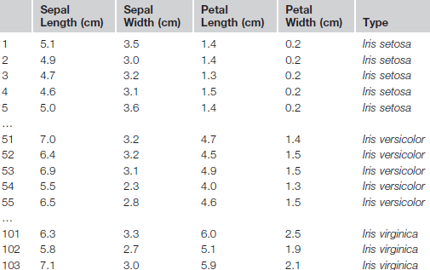
Dataset (Himpunan Data)
Attribute/Feature
Class/Label/Target
Record/
Object/
Sample/
Tuple
Nominal
Numerik

Slide 23
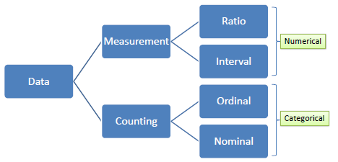
Jenis Atribut

Slide 24
Tipe Data
Jenis Atribut | Deskripsi | Contoh | Operasi
Ratio (Mutlak) | Data yang diperoleh dengan cara pengukuran, dimana jarak dua titik pada skala sudah diketahui Mempunyai titik nol yang absolut (*, /) | Umur Berat badan Tinggi badan Jumlah uang | geometric mean, harmonic mean, percent variation
Interval (Jarak) | Data yang diperoleh dengan cara pengukuran, dimana jarak dua titik pada skala sudah diketahui Tidak mempunyai titik nol yang absolut (+, - ) | Suhu 0°c-100°c, Umur 20-30 tahun | mean, standard deviation, Pearson's correlation, t and F tests
Ordinal (Peringkat) | Data yang diperoleh dengan cara kategorisasi atau klasifikasi Tetapi diantara data tersebut terdapat hubungan atau berurutan (<, >) | Tingkat kepuasan pelanggan (puas, sedang, tidak puas) | median, percentiles, rank correlation, run tests, sign tests
Nominal (Label) | Data yang diperoleh dengan cara kategorisasi atau klasifikasi Menunjukkan beberapa object yang berbeda (=, ≠) | Kode pos Jenis kelamin Nomer id karyawan Nama kota | mode, entropy, contingency correlation, χ² test

Slide 25
1. Estimasi Waktu Pengiriman Pizza
Customer | Jumlah Pesanan (P) | Jumlah Traffic Light (TL) | Jarak (J) | Waktu Tempuh (T)
1 | 3 | 3 | 3 | 16
2 | 1 | 7 | 4 | 20
3 | 2 | 4 | 6 | 18
4 | 4 | 6 | 8 | 36
...
1000 | 2 | 4 | 2 | 12
Label
Pembelajaran dengan
Metode Estimasi (Regresi Linier)
Waktu Tempuh (T) = 0.48P + 0.23TL + 0.5J
Pengetahuan

Slide 26
Contoh: Estimasi Performansi CPU
Example: 209 different computer configurations
Linear regression function
    PRP = -55.9 + 0.0489 MYCT + 0.0153 MMIN + 0.0056 MMAX
    + 0.6410 CACH - 0.2700 CHMIN + 1.480 CHMAX
Cycle time (ns)
Main memory (Kb)
Cache (Kb)
Channels
Performance
MYCT
MMIN
MMAX
CACH
CHMIN
CHMAX
PRP
1
125
256
6000
256
16
128
198
2
29
8000
32000
32
8
32
269
…
208
480
512
8000
32
0
0
67
209
480
1000
4000
0
0
0
45

Slide 27
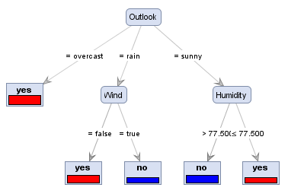
Output/Pola/Model/Knowledge
Formula/Function (Rumus atau Fungsi Regresi)
  WAKTU TEMPUH = 0.48 + 0.6 JARAK + 0.34 LAMPU + 0.2 PESANAN
Decision Tree (Pohon Keputusan)
Rule (Aturan)
  IF ips3=2.8 THEN lulustepatwaktu
Cluster (Klaster)

Slide 28
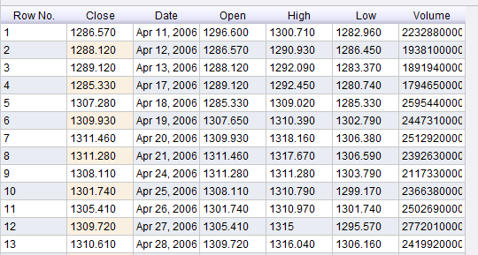
2. Prediksi Harga Saham
Label
Dataset harga saham dalam bentuk time series (rentet waktu)
Pembelajaran dengan
Metode Prediksi (Neural Network)

Slide 29
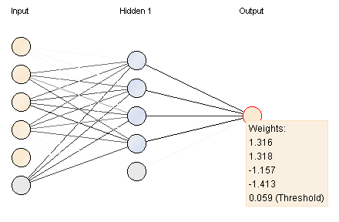
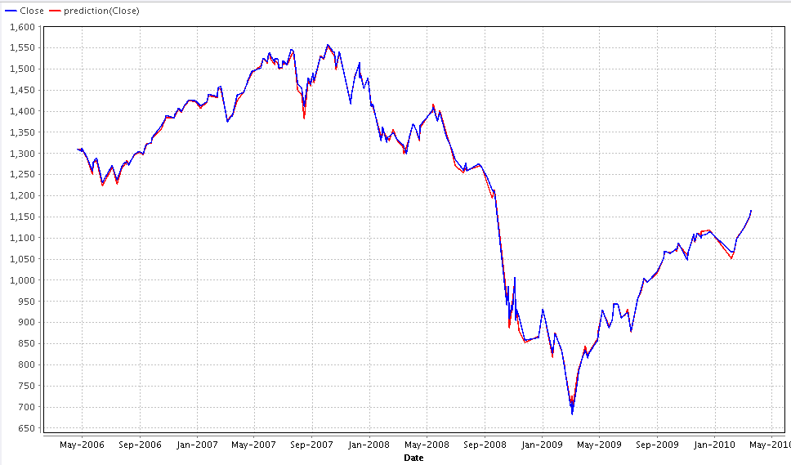
Pengetahuan berupa Rumus Neural Network
Prediction Plot

Slide 30
3. Klasifikasi Kelulusan Mahasiswa
Label
NIM | Gender | Nilai UN | Asal Sekolah | IPS1 | IPS2 | IPS3 | IPS 4 | ... | Lulus Tepat Waktu
10001 | L | 28 | SMAN 2 | 3.3 | 3.6 | 2.89 | 2.9 |  | Ya
10002 | P | 27 | SMA DK | 4.0 | 3.2 | 3.8 | 3.7 |  | Tidak
10003 | P | 24 | SMAN 1 | 2.7 | 3.4 | 4.0 | 3.5 |  | Tidak
10004 | L | 26.4 | SMAN 3 | 3.2 | 2.7 | 3.6 | 3.4 |  | Ya
...
...
11000 | L | 23.4 | SMAN 5 | 3.3 | 2.8 | 3.1 | 3.2 |  | Ya
Pembelajaran dengan
Metode Klasifikasi (C4.5)

Slide 31
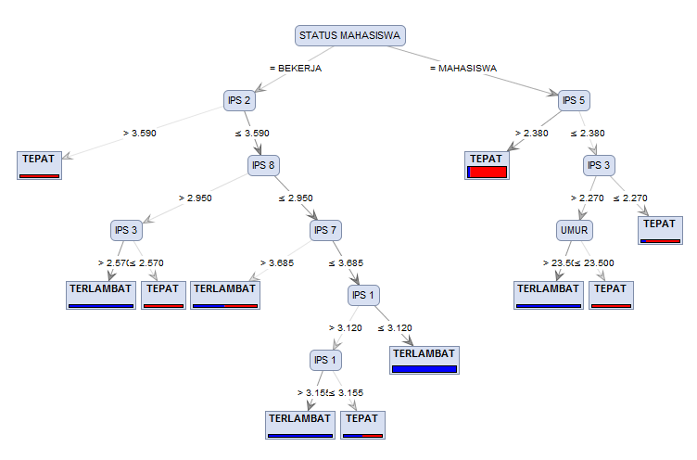
Pengetahuan Berupa Pohon Keputusan

Slide 32
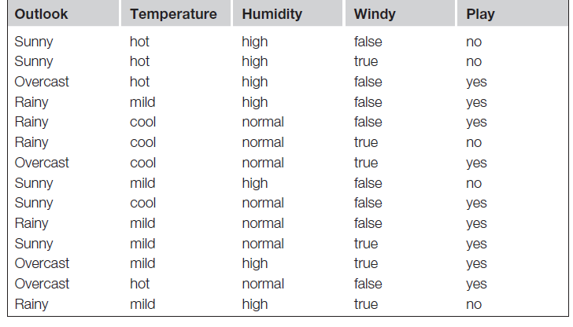
Contoh: Rekomendasi Main Golf
Input:
Output (Rules):
      If outlook = sunny and humidity = high then play = no
      If outlook = rainy and windy = true then play = no
      If outlook = overcast then play = yes
      If humidity = normal then play = yes
      If none of the above then play = yes

Slide 33
Contoh: Rekomendasi Main Golf
Output (Tree):

Slide 34
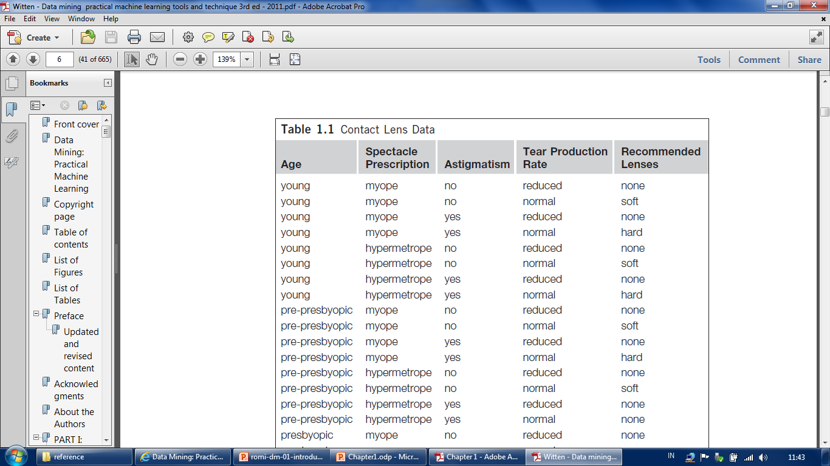
Contoh: Rekomendasi Contact Lens
Input:

Slide 35
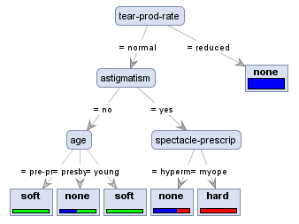
Contoh: Rekomendasi Contact Lens
Output/Model (Tree):

Slide 36
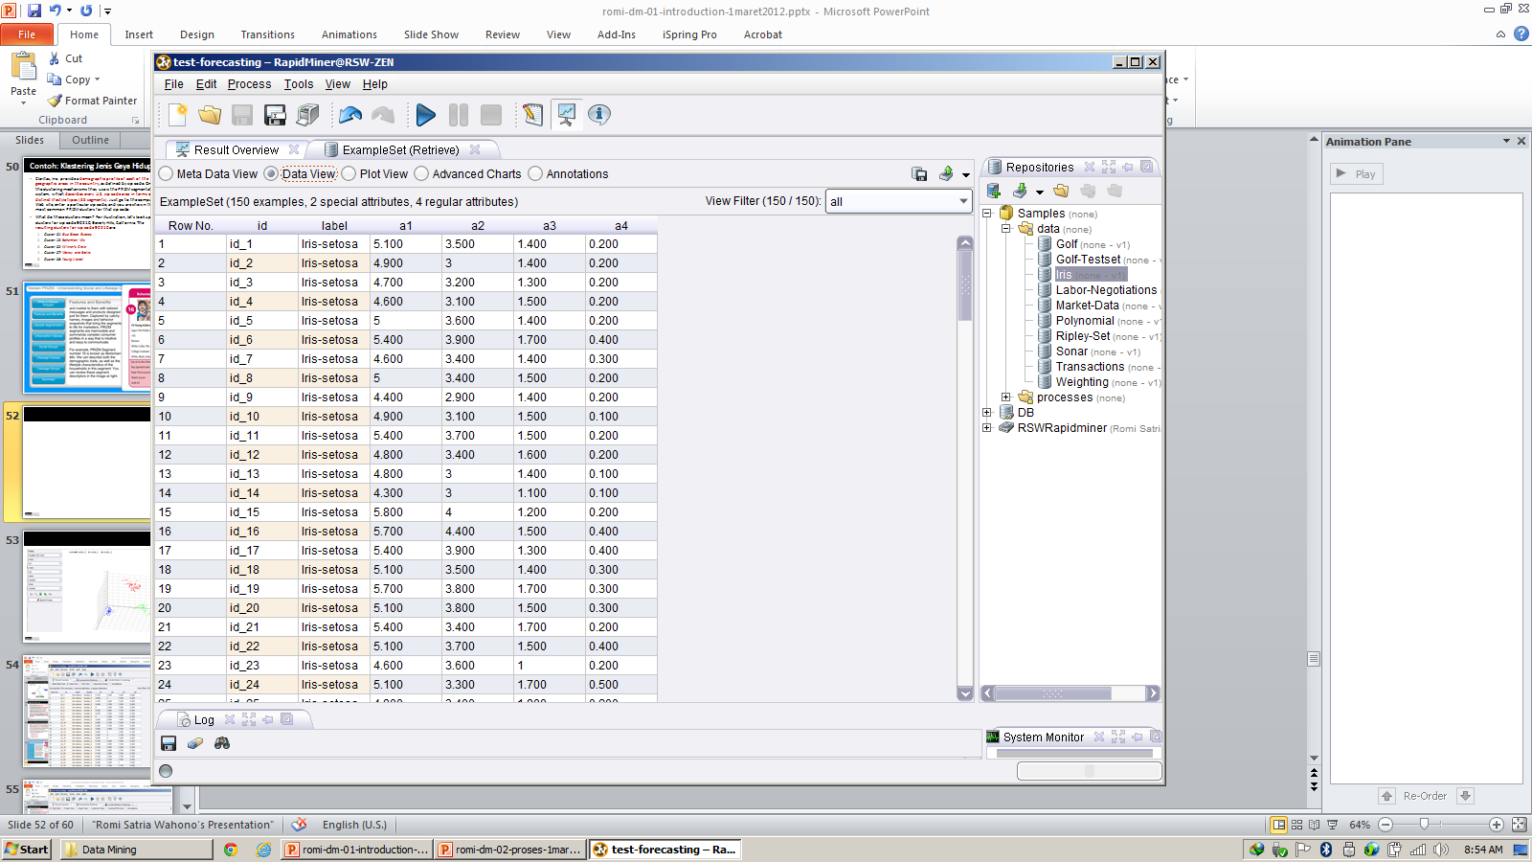
4. Klastering Bunga Iris
Dataset Tanpa Label
Pembelajaran dengan
Metode Klastering (K-Means)

Slide 37
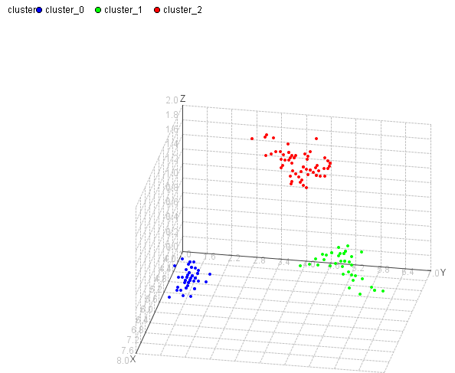
Pengetahuan Berupa Klaster

Slide 38
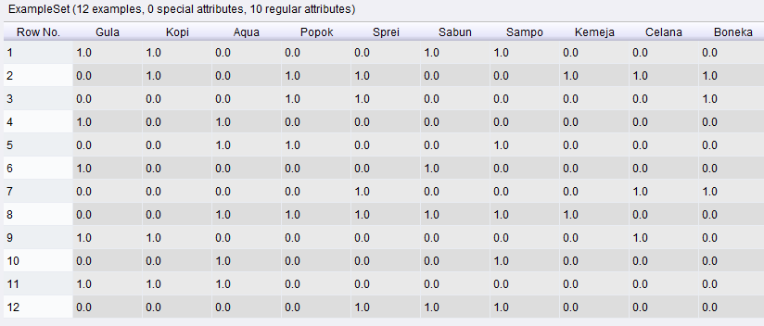
5. Aturan Asosiasi Pembelian Barang
Pembelajaran dengan
Metode Asosiasi (FP-Growth)

Slide 39
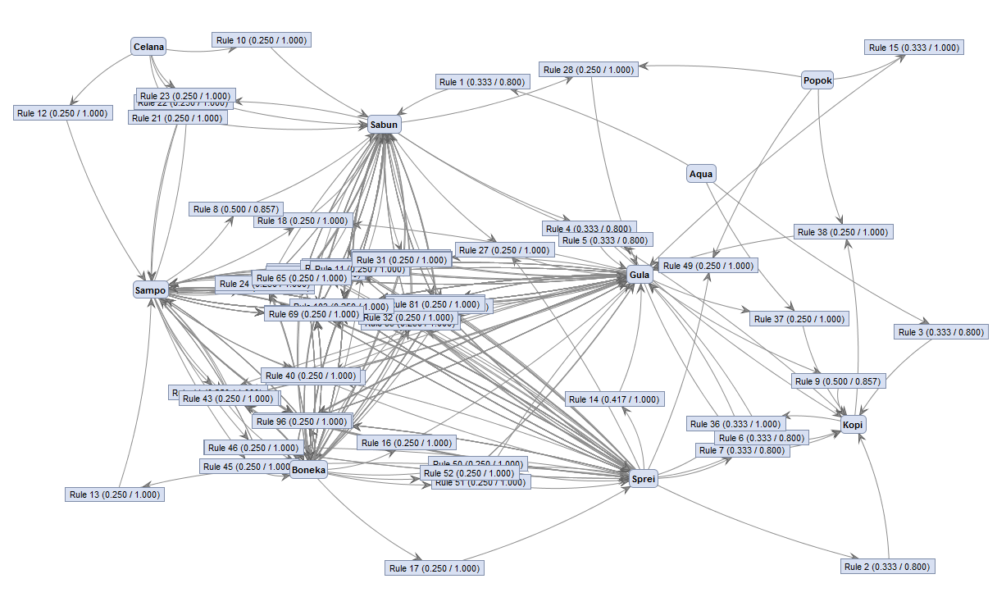
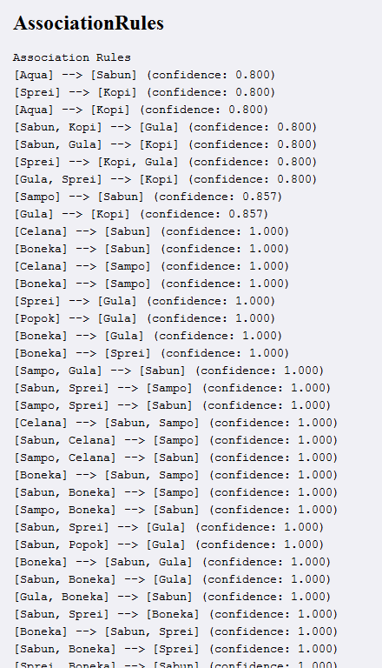
Pengetahuan Berupa Aturan Asosiasi

Slide 40
Algoritma Data Mining (DM)
Estimation (Estimasi):
  Linear Regression, Neural Network, Support Vector Machine, etc
Prediction/Forecasting (Prediksi/Peramalan):
  Linear Regression, Neural Network, Support Vector Machine, etc
Classification (Klasifikasi):
  Naive Bayes, K-Nearest Neighbor, Decision Tree (C4.5, ID3, CART), Linear Discriminant Analysis, Logistic Regression, etc
Clustering (Klastering):
  K-Means, K-Medoids, Self-Organizing Map (SOM), Fuzzy C-Means, etc
Association (Asosiasi):
  FP-Growth, A Priori, Coefficient of Correlation, Chi Square, etc

Slide 41
Referensi
Peter Drucker, The age of social transformation, The Atlantic Monthly, 274(5), 1994
Ikujiro Nonaka and Hirotaka Takeuchi, The Knowledge Creating Company, Oxford University Press, 1995
Kimiz Dalkir and Jay Liebowitz, Knowledge Management in Theory and Practice, The MIT Press, 2011
Irma Becerra-Fernandez and Rajiv Sabherwal, Knowledge Management: Systems and Processes, M.E. Sharpe, Inc., 2010
Romi Satria Wahono, Menghidupkan Pengetahuan Sudahkah Kita Lakukan?, Jurnal Dokumentasi dan Informasi - Baca, LIPI, 2005

