Slide 1
Knowledge Management: 3. Solutions
Romi Satria Wahono romi@romisatriawahono.net http://romisatriawahono.net/km WA/SMS: +6281586220090

Slide 2
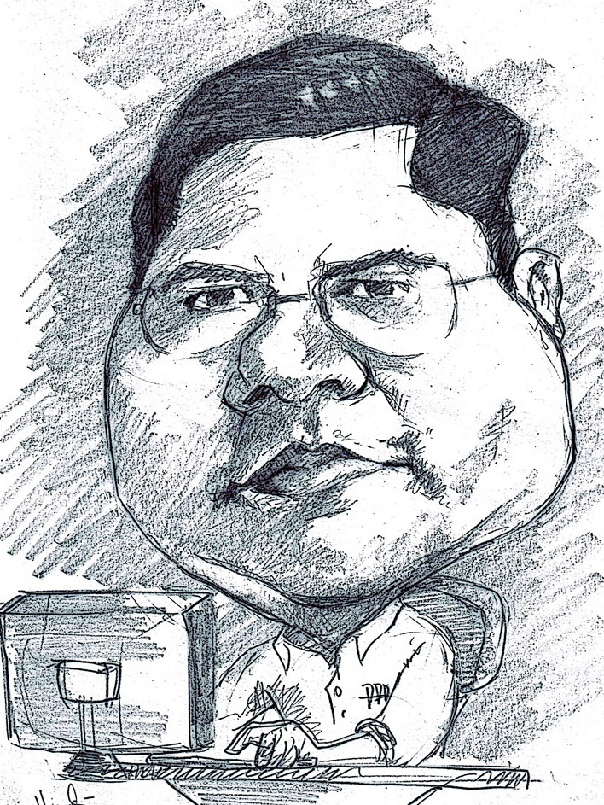
Romi Satria Wahono
SD Sompok Semarang (1987)
SMPN 8 Semarang (1990)
SMA Taruna Nusantara Magelang (1993)
B.Eng, M.Eng and Ph.D in Software Engineering from Saitama University Japan (1994-2004) Universiti Teknikal Malaysia Melaka (2014)
Research Interests: Software Engineering and Machine Learning
Founder dan Koordinator IlmuKomputer.Com
Peneliti LIPI (2004-2007)
Founder dan CEO PT Brainmatics Cipta Informatika

Slide 3
Contents
1. Introduction | 1.1 What and Why Knowledge Management 1.2 Types of Knowledge 1.3 Knowledge Transformation
2. Foundations | 2.1 Knowledge Management Infrastructure 2.2 Knowledge Management Mechanism 2.3 Knowledge Management Technologies
3. Solutions | 3.1 Knowledge Management Processes 3.2 Knowledge Management Systems
4. Systems | 4.1 Knowledge Application Systems 4.2 Knowledge Capture Systems 4.3 Knowledge Sharing Systems 4.4 Knowledge Discovery Systems
5. Assessment | 5.1 Organizational Impacts of Knowledge Management 5.2 Type of Knowledge Management Assessment

Slide 4
3. Solutions
3.1 Knowledge Management Processes
3.2 Knowledge Management Systems

Slide 5
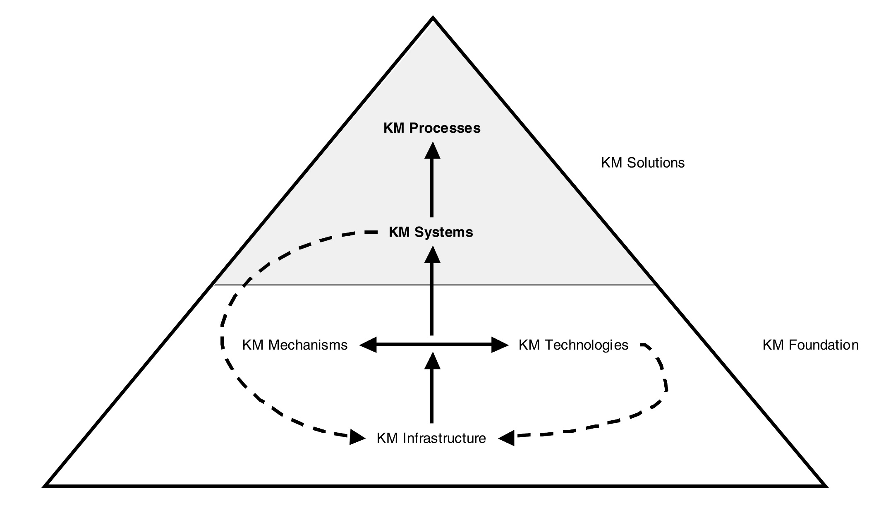
KM Foundations and Solutions

Slide 6
KM Foundations and Solutions
Knowledge Discovery
Knowledge Capture
Knowledge Sharing
Knowledge Application
KM Processes
Combination
Socialization
Internalization
Externalization
Exchange
Direction
Routines
Knowledge Discovery Systems
Knowledge Capture Systems
Knowledge Sharing Systems
Knowledge Application Systems
KM Systems
KM Mechanisms
Analogies and metaphors
Brainstorming retreats
On-the-job training
Face-to-face meetings
Apprenticeships
Employee rotation
Learning by observation
….
Decision support systems
Web-based discussion groups
Repositories of best practices
Artificial intelligence systems
Case-based reasoning
Groupware
Web pages
…
KM Technologies
KM Infrastructure
Organization Culture
Organization
Structure
IT
Infrastructure
Common Knowledge
Physical Environment

Slide 7
3.1 Knowledge Management Processes

Slide 8
Knowledge Management
Knowledge management can be defined as performing the activities involved in discovering, capturing, sharing, and applying knowledge so as to enhance, in a cost-effective fashion, the impact of knowledge on the unit’s goal achievement
(Becerra-Fernandez, 2010)

Slide 9
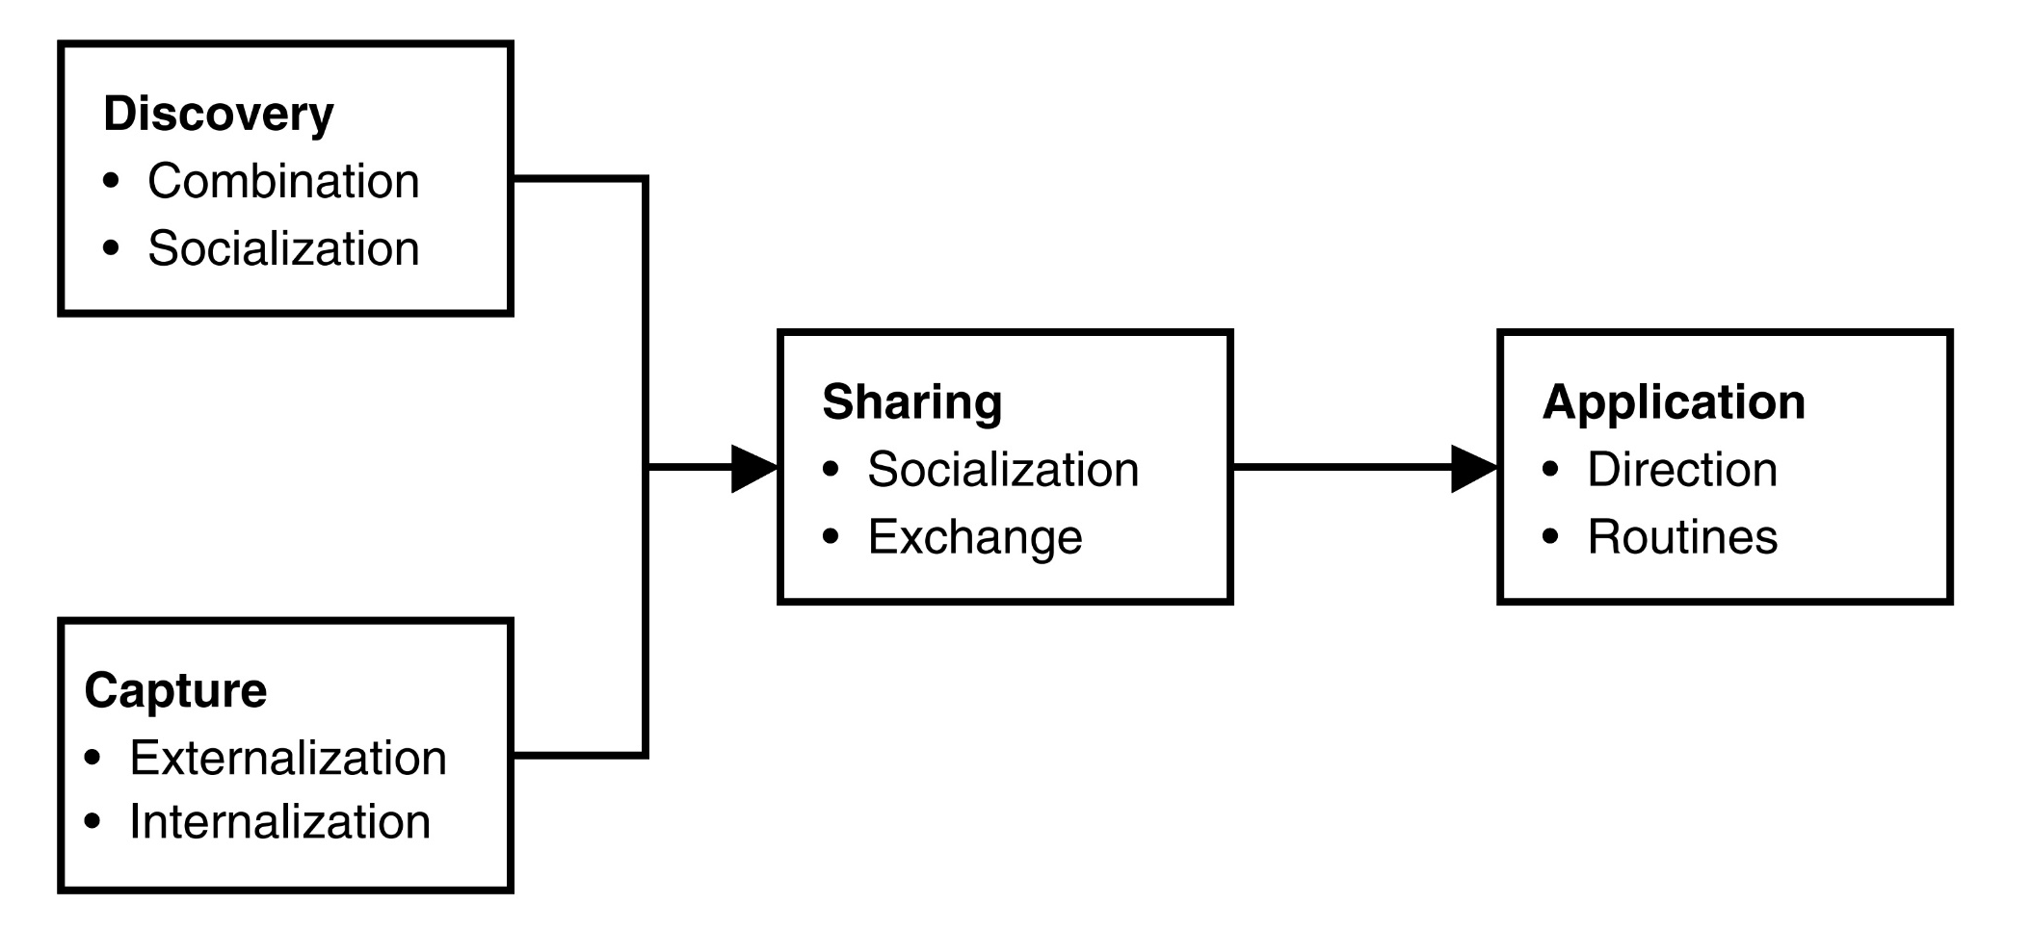
KM Processes

Slide 10
KM Processes
Thus, knowledge management relies on four main kinds of KM processes:
The processes through which knowledge is discovered or captured then shared and applied
These four KM processes are supported by a set of seven KM subprocesses:
One subprocess (socialization) supporting two KM processes (discovery and sharing)
Four subprocesses focusing on the ways in which knowledge is converted through the interaction between tacit and explicit knowledge (socialization, externalization, internalization, and combination) (Nonaka, 1994)
Three KM subprocesses (exchange, direction, and routines) based on (Grant, 1996) and (Nahapiet & Ghoshal, 1998)

Slide 11
Knowledge Discovery
Knowledge discovery may be defined as the development of new tacit or explicit knowledge from data and information or from the synthesis of prior knowledge
The discovery of new explicit knowledge relies most directly on combination
The discovery of new tacit knowledge relies most directly on socialization

Slide 12
Knowledge Spiral

Slide 13
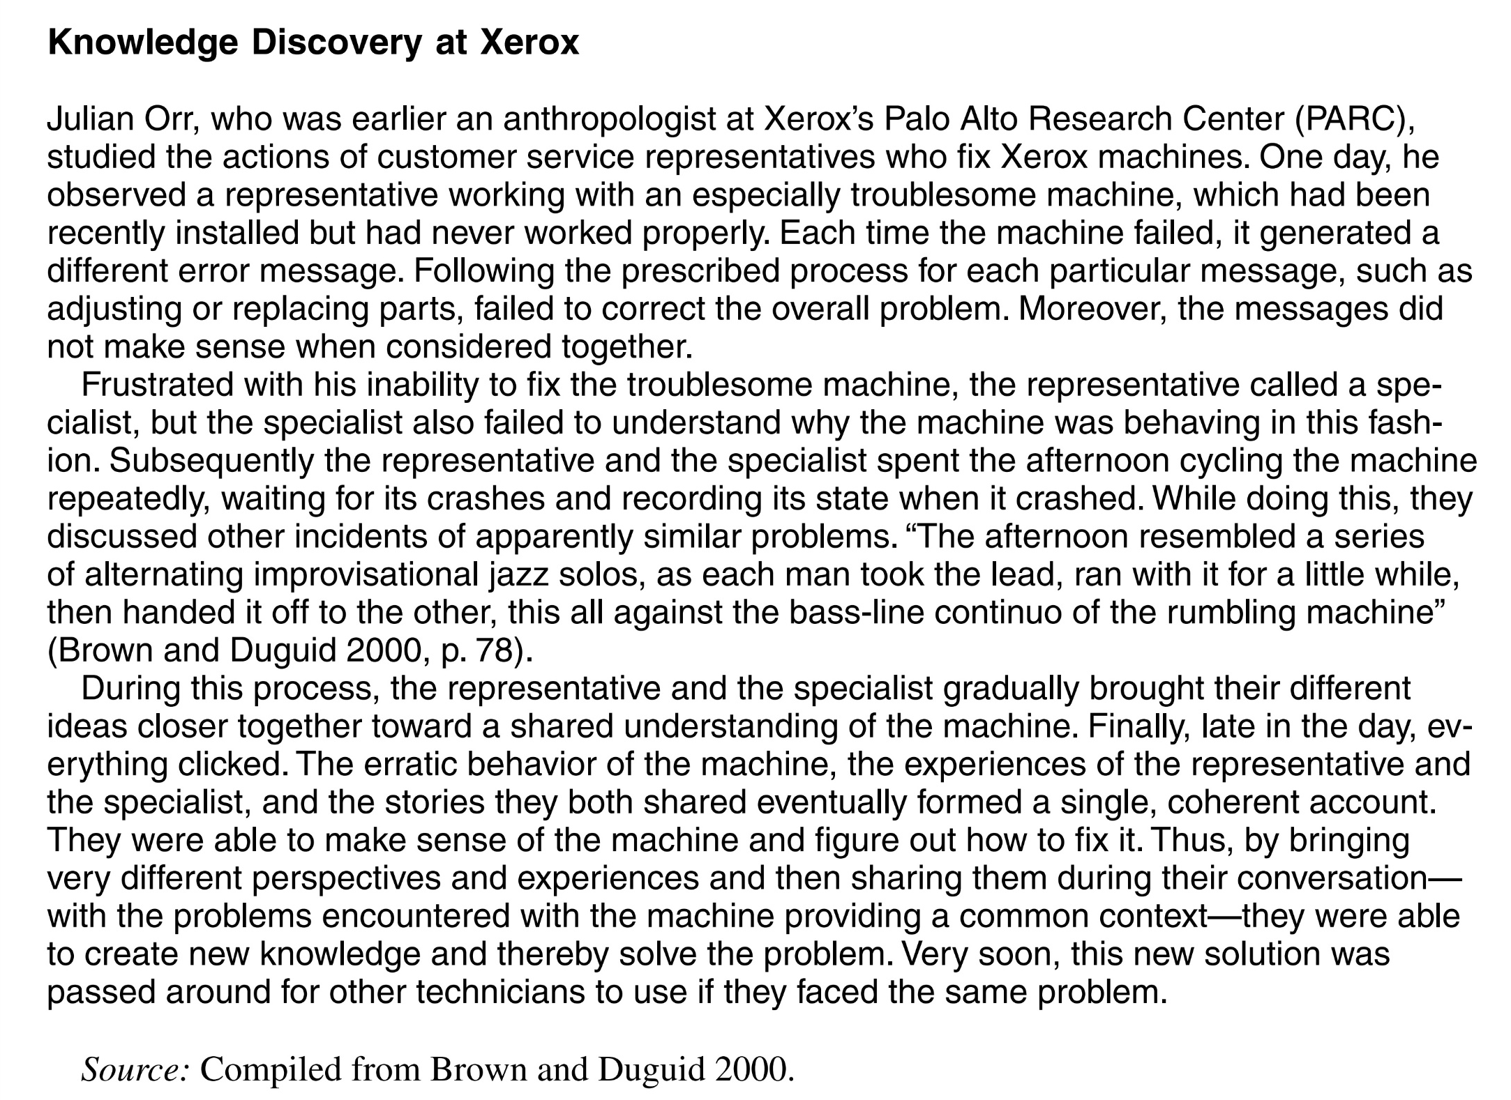

Slide 14
Latihan
Deskripsikan knowledge discovery yang anda pernah lakukan di perusahaan tempat anda bekerja saat ini, baik itu combination maupun socialization
Tambahkan pada Mindmap yang sebelumnya sudah dibuat

Slide 15
Knowledge Capture
Knowledge can exist within people (individuals or groups), artifacts (practices, technologies, or repositories) and organizational entities (organizational units, organizations, interorganizational networks)
Moreover, knowledge could be either explicit or tacit. It might sometimes reside within an individual’s mind without that individual being able to recognize it and share it with others
Knowledge capture is the process of retrieving either explicit or tacit knowledge that resides within people, artifacts, organizational entities or outside the organizational boundaries (consultants, competitors, customers, suppliers, etc)
The knowledge capture process benefits most directly from two KM subprocesses: externalization and internalization

Slide 16
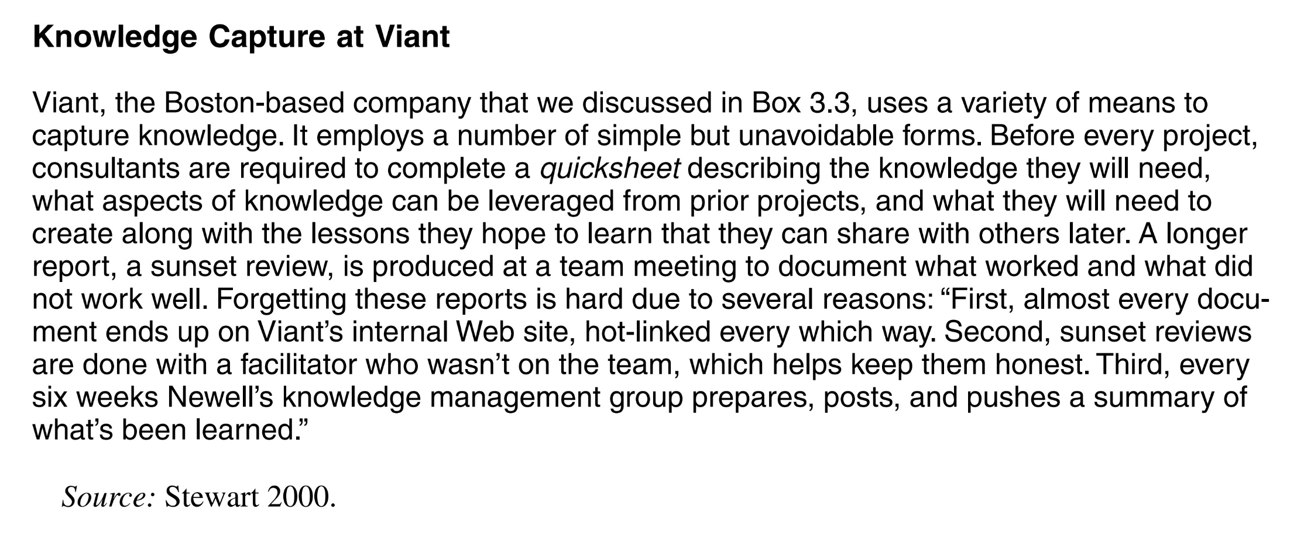

Slide 17
Latihan
Deskripsikan knowledge capture yang anda pernah lakukan di perusahaan tempat anda bekerja saat ini, baik itu externalization maupun internalization
Tambahkan pada Mindmap yang sebelumnya sudah dibuat

Slide 18
Knowledge Sharing
Knowledge sharing is the process through which explicit or tacit knowledge is communicated to other individuals
Depending on whether explicit or tacit knowledge is being shared, exchange or socialization processes are used
Socialization facilitates the sharing of tacit knowledge in cases in which new tacit knowledge is being created as well as when new tacit knowledge is not being created
Exchange, in contrast to socialization, focuses on the sharing of explicit knowledge. It is used to communicate or transfer explicit knowledge among individuals, groups, and organizations (Grant 1996)

Slide 19
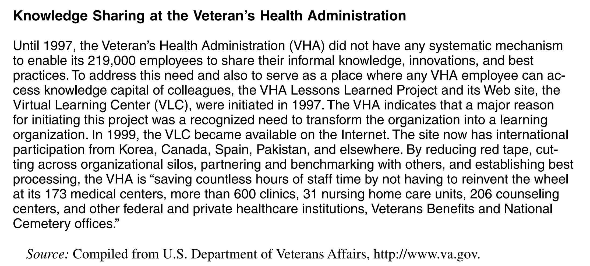

Slide 20
Latihan
Deskripsikan knowledge sharing yang anda pernah lakukan di perusahaan tempat anda bekerja saat ini, baik itu socialization maupun internalization
Tambahkan pada Mindmap yang sebelumnya sudah dibuat

Slide 21
Knowledge Application
Knowledge contributes most directly to organizational performance when it is used to make decisions and perform tasks
Of course, the process of knowledge application depends on the available knowledge, and knowledge itself depends on the processes of knowledge discovery, capture, and sharing
Therefore, knowledge utilization benefits from two processes: routines and direction
Direction refers to the process through which the individual possessing the knowledge directs the action of another individual without transferring to that individual the knowledge underlying the direction
Routines involve the utilization of knowledge embedded in procedures, rules, and norms that guide future behavior. Routines economize on communication more than directions as they are embedded in procedures or technologies. However, they take time to develop (Grant, 1996)

Slide 22
Direction
Direction is the process used when a production worker calls an expert to ask her how to solve a particular problem with a machine and then proceeds to solve the problem based on the instructions given by the expert
A student taking a test who asks his fellow classmate for the answer to a question gets a direction (which of course could be wrong), and no knowledge is effectively shared between the two, which means the next time the student faces that question, posed perhaps in a slightly different form, he will not be able to discern the right answer

Slide 23
Routines
Routines could be automated through the use of IT, such as in systems that provide help desk agents, field engineers, consultants, and customer end users with specific and automated answers from a knowledge base (Sabherwal and Sabherwal, 2007)
An inventory management system utilizes considerable knowledge about the relationship between demand and supply, but neither the knowledge nor the directions are communicated through individuals. Also, enterprise systems are coded with routines that describe business process within industry segments

Slide 24
Latihan
Deskripsikan knowledge application yang anda pernah lakukan di perusahaan tempat anda bekerja saat ini, baik itu direction maupun routines
Tambahkan pada Mindmap yang sebelumnya sudah dibuat

Slide 25
3.2 Knowledge Management Systems

Slide 26
Knowledge Management Systems
Knowledge management systems are the integration of technologies and mechanisms that are developed to support the four KM processes
Depending on the KM process most directly supported, KM systems can be classified into four kinds:
Knowledge capture systems
Knowledge discovery systems
Knowledge sharing systems
Knowledge application systems

Slide 27
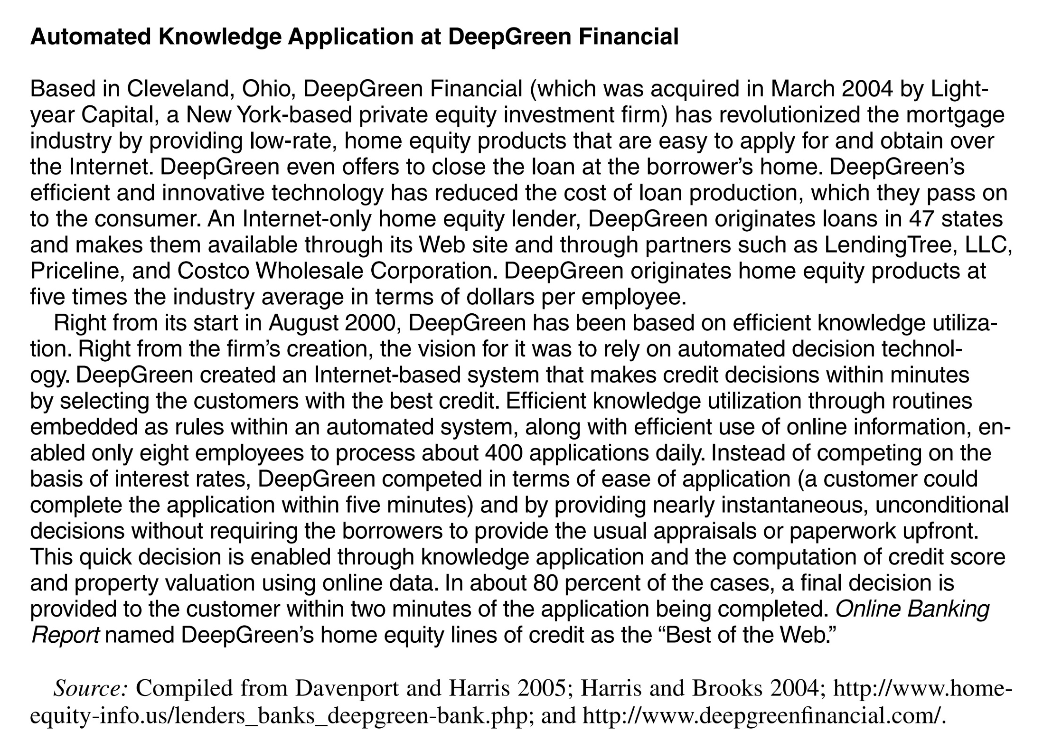

Slide 28
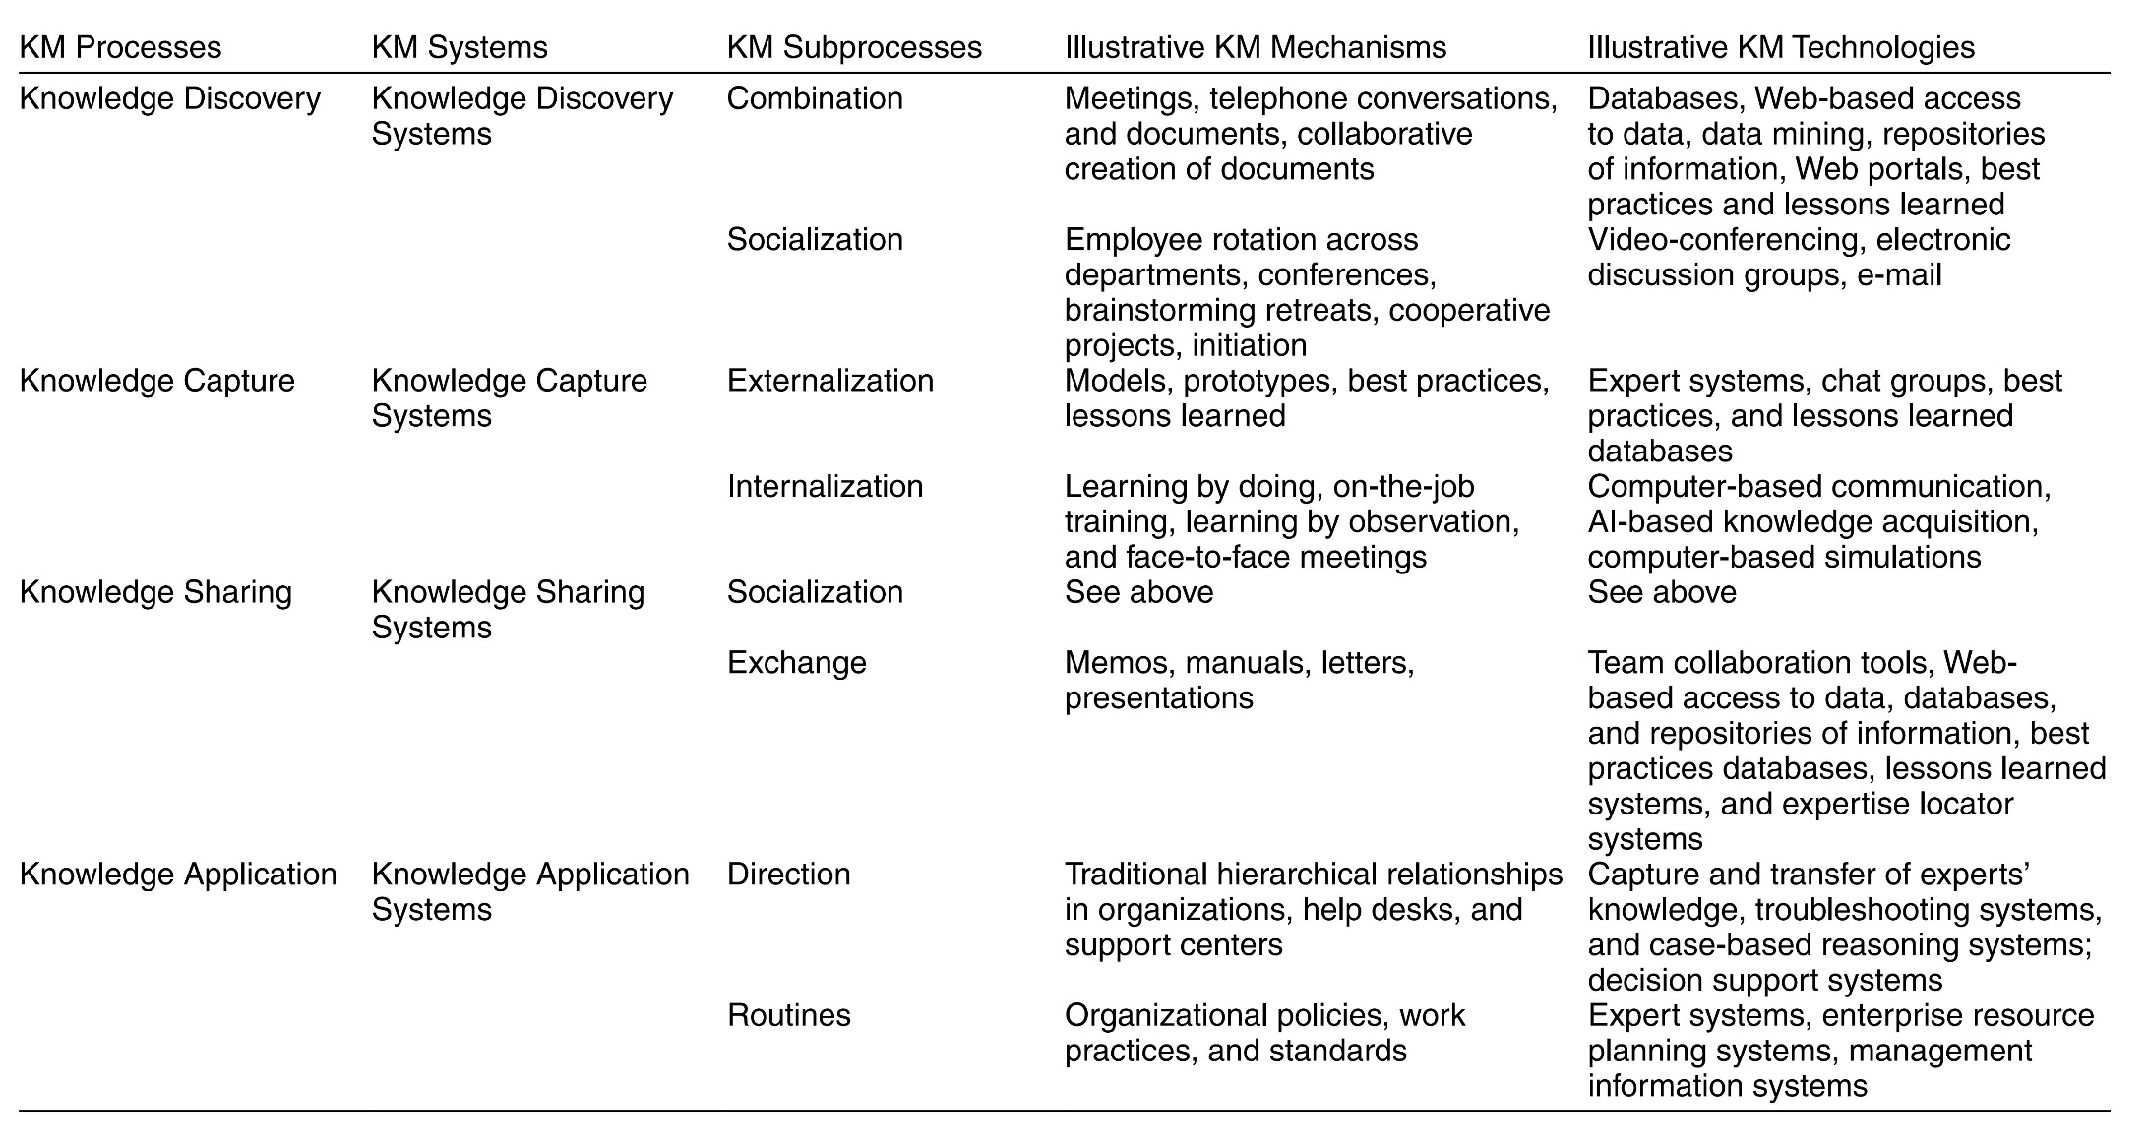
KM Processes and Systems and Associated Mechanism and Technologies

Slide 29
Combination of Four Types of KM Processes and Systems
Knowledge application enables efficiency
However, too much emphasis on knowledge application could reduce knowledge creation, which often benefits from individuals viewing the same problem from multiple different perspectives and thereby leads to reduced effectiveness and innovation
Knowledge capture enables knowledge to be converted from tacit form to explicit, or from explicit form to tacit, and thereby facilitates knowledge sharing
However, it might lead to reduced attention to knowledge creation. Knowledge capture could lead to some knowledge being lost in the conversion process
Knowledge sharing enables efficiency by reducing redundancy
However, too much knowledge sharing could lead to knowledge leaking from the organization and becoming available to competitors, and consequently reduce the benefits to the focal organization.
Knowledge discovery enables innovation
However, too much emphasis on knowledge discovery could lead to reduced efficiency. It is not always suitable to create new knowledge, just as it may not always be appropriate to reuse existing knowledge.

Slide 30
KM Foundations and Solutions
Knowledge Discovery
Knowledge Capture
Knowledge Sharing
Knowledge Application
KM Processes
Combination
Socialization
Internalization
Externalization
Exchange
Direction
Routines
Knowledge Discovery Systems
Knowledge Capture Systems
Knowledge Sharing Systems
Knowledge Application Systems
KM Systems
KM Mechanisms
Analogies and metaphors
Brainstorming retreats
On-the-job training
Face-to-face meetings
Apprenticeships
Employee rotation
Learning by observation
….
Decision support systems
Web-based discussion groups
Repositories of best practices
Artificial intelligence systems
Case-based reasoning
Groupware
Web pages
…
KM Technologies
KM Infrastructure
Organization Culture
Organization
Structure
IT
Infrastructure
Common Knowledge
Physical Environment

Slide 31
Referensi
Peter Drucker, The age of social transformation, The Atlantic Monthly, 274(5), 1994
Ikujiro Nonaka and Hirotaka Takeuchi, The Knowledge Creating Company, Oxford University Press, 1995
Kimiz Dalkir and Jay Liebowitz, Knowledge Management in Theory and Practice, The MIT Press, 2011
Irma Becerra-Fernandez and Rajiv Sabherwal, Knowledge Management: Systems and Processes, M.E. Sharpe, Inc., 2010
Romi Satria Wahono, Menghidupkan Pengetahuan Sudahkah Kita Lakukan?, Jurnal Dokumentasi dan Informasi - Baca, LIPI, 2005

