Slide 1
Knowledge Management:
2. Foundations
Romi Satria Wahono
romi@romisatriawahono.net
http://romisatriawahono.net/km
WA/SMS: +6281586220090

Slide 2
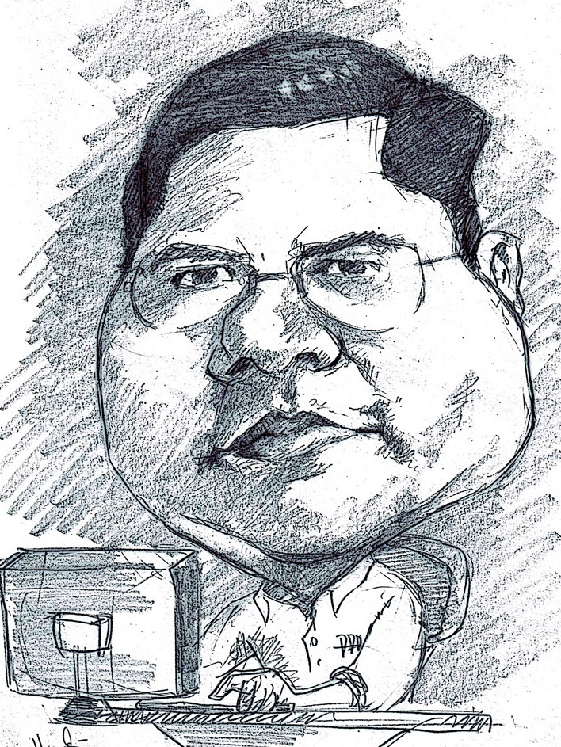
Romi Satria Wahono
SD Sompok Semarang (1987)
SMPN 8 Semarang (1990)
SMA Taruna Nusantara Magelang (1993)
B.Eng, M.Eng and Ph.D in Software Engineering from
Saitama University Japan (1994-2004)
Universiti Teknikal Malaysia Melaka (2014)
Research Interests: Software Engineering and
Machine Learning
Founder dan Koordinator IlmuKomputer.Com
Peneliti LIPI (2004-2007)
Founder dan CEO PT Brainmatics Cipta Informatika

Slide 3
Contents
1. Introduction | 1.1 What and Why Knowledge Management 1.2 Types of Knowledge 1.3 Knowledge Transformation
2. Foundations | 2.1 Knowledge Management Infrastructure 2.2 Knowledge Management Mechanism 2.3 Knowledge Management Technologies
3. Solutions | 3.1 Knowledge Management Processes 3.2 Knowledge Management Systems
4. Systems | 4.1 Knowledge Application Systems 4.2 Knowledge Capture Systems 4.3 Knowledge Sharing Systems 4.4 Knowledge Discovery Systems
5. Assessment | 5.1 Organizational Impacts of Knowledge Management 5.2 Type of Knowledge Management Assessment

Slide 4
2. Foundations
2.1 Knowledge Management Infrastructure
2.2 Knowledge Management Mechanism
2.3 Knowledge Management Technology

Slide 5
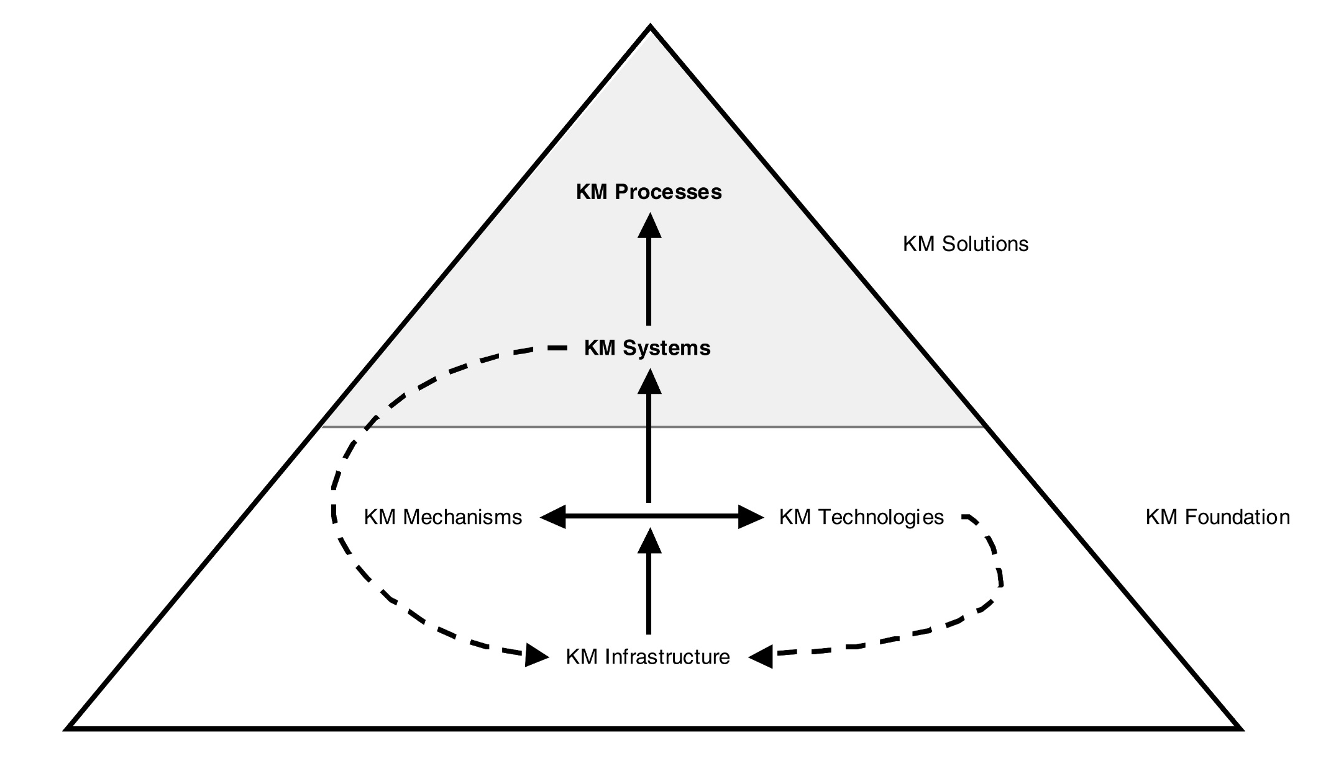
KM Foundations and Solutions

Slide 6
KM Foundations and Solutions
Knowledge Discovery
Knowledge Capture
Knowledge Sharing
Knowledge Application
KM Processes
Combination
Socialization
Internalization
Externalization
Exchange
Direction
Routines
Knowledge Discovery Systems
Knowledge Capture Systems
Knowledge Sharing Systems
Knowledge Application Systems
KM Systems
KM Mechanisms
Analogies and metaphors
Brainstorming retreats
On-the-job training
Face-to-face meetings
Apprenticeships
Employee rotation
Learning by observation
….
Decision support systems
Web-based discussion groups
Repositories of best practices
Artificial intelligence systems
Case-based reasoning
Groupware
Web pages
…
KM Technologies
KM Infrastructure
Organization Culture
Organization
Structure
IT
Infrastructure
Common Knowledge
Physical Environment

Slide 7
2.1 Knowledge Management Infrastructure

Slide 8
KM Infrastructure
KM mechanisms and technologies rely on the KM infrastructure, which reflects the long-term foundation for knowledge management
In an organizational context, KM infrastructure includes five major components:
  Organization culture
  Organization structure
  Information technology infrastructure
  Common knowledge
  Physical environment

Slide 9
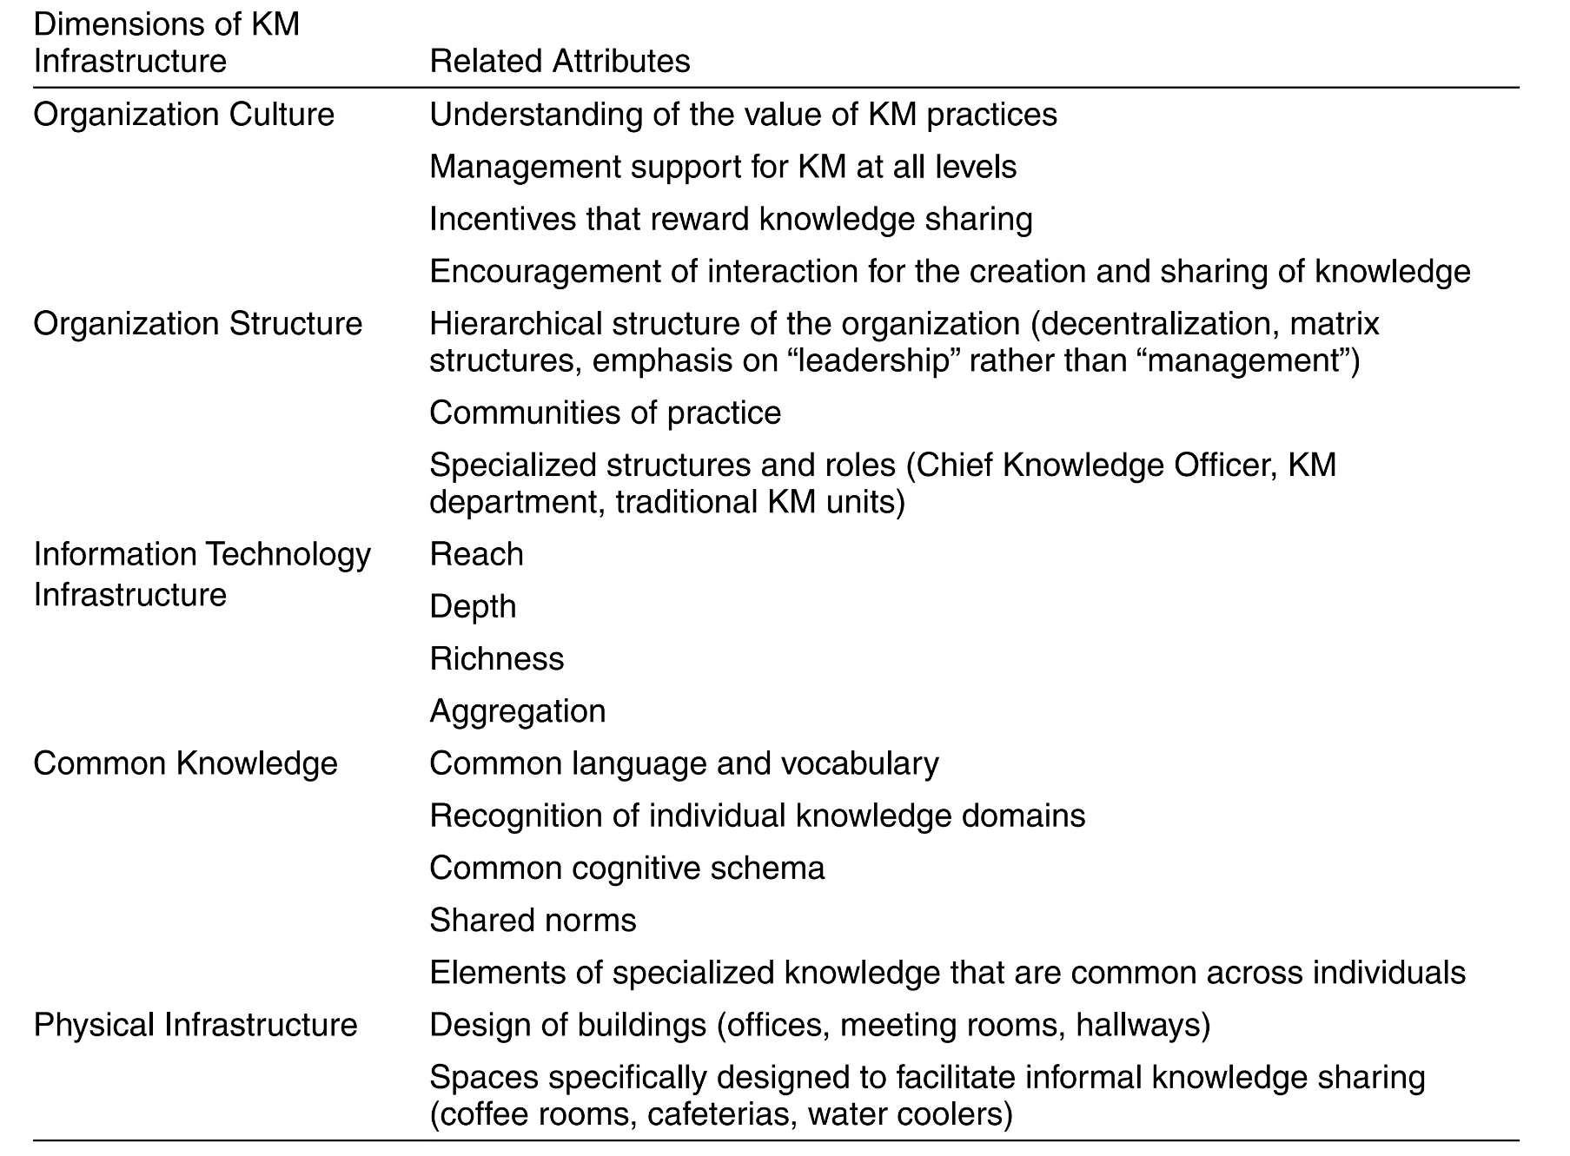
KM Infrastructure

Slide 10
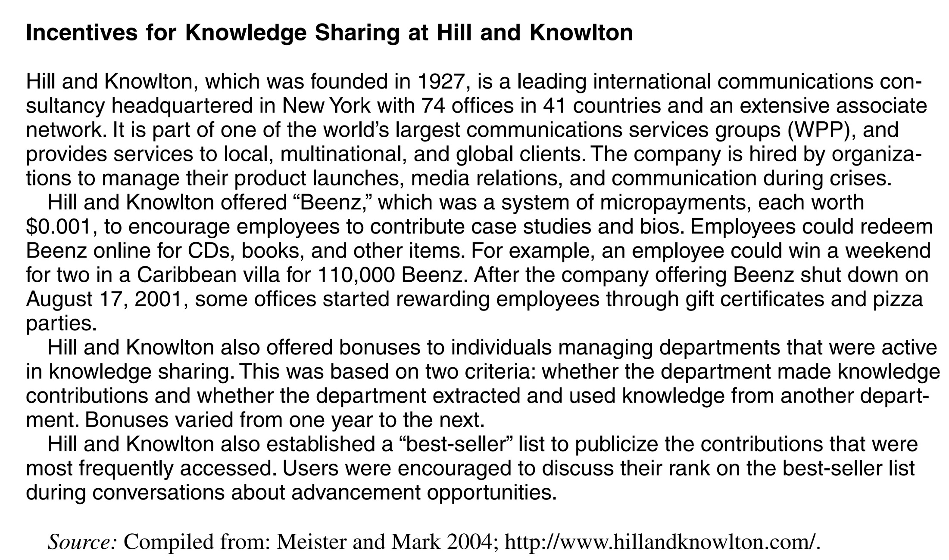

Slide 11
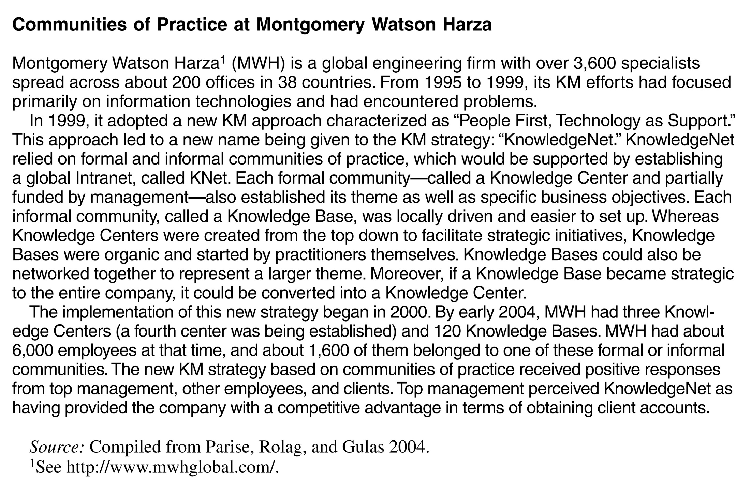

Slide 12
Latihan
Lakukan pendataan KM infrastructure yang kita miliki di perusahaan tempat kita bekerja
Gambarkan dengan menggunakan mindmap

Slide 13
2.2 Knowledge Management Mechanism

Slide 14
Knowledge Management Mechanism
Knowledge management mechanisms are organizational or structural means used to promote knowledge management
They enable KM systems, and they are themselves supported by the KM infrastructure
KM mechanisms may (or may not) utilize technology, but they do involve some kind of organizational arrangement or social or structural means of facilitating KM
  Examples of KM mechanisms include learning by doing, on-the-job training, learning by observation, and face-to-face meetings
  More long-term KM mechanisms include the hiring of a Chief Knowledge Officer, cooperative projects across departments, traditional hierarchical relationships, organizational policies, standards, initiation process for new employees, and employee rotation across departments

Slide 15
KM Foundations and Solutions
Knowledge Discovery
Knowledge Capture
Knowledge Sharing
Knowledge Application
KM Processes
Combination
Socialization
Internalization
Externalization
Exchange
Direction
Routines
Knowledge Discovery Systems
Knowledge Capture Systems
Knowledge Sharing Systems
Knowledge Application Systems
KM Systems
KM Mechanisms
Analogies and metaphors
Brainstorming retreats
On-the-job training
Face-to-face meetings
Apprenticeships
Employee rotation
Learning by observation
….
Decision support systems
Web-based discussion groups
Repositories of best practices
Artificial intelligence systems
Case-based reasoning
Groupware
Web pages
…
KM Technologies
KM Infrastructure
Organization Culture
Organization
Structure
IT
Infrastructure
Common Knowledge
Physical Environment

Slide 16
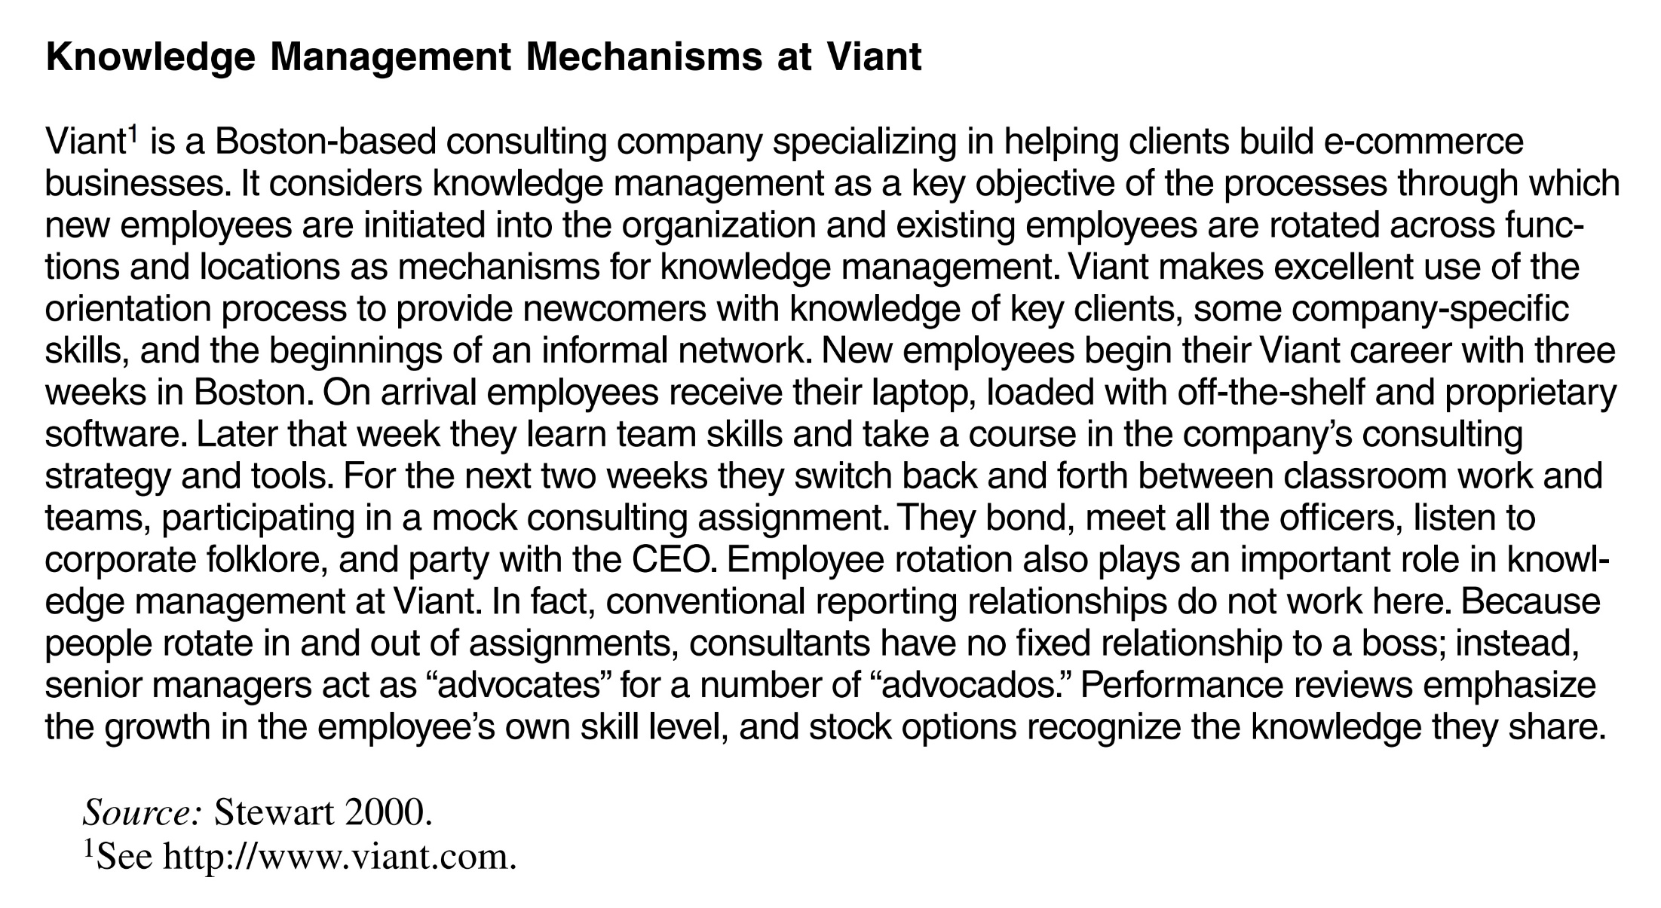

Slide 17


Slide 18
Latihan
Sebutkan KM mechanism yang ada di perusahaan termpat kita bekerja
Gambarkan dengan menggunakan MindMap

Slide 19
2.3 Knowledge Management Technology

Slide 20
Knowledge Management Technology
KM technologies are information technologies that can be used to facilitate knowledge management
Thus KM technologies are intrinsically no different from information technologies, but they focus on knowledge management rather than information processing
KM technologies also support KM systems and benefit from the KM infrastructure, especially the information technology infrastructure
KM technologies constitute a key component of KM systems

Slide 21
Knowledge Management Technology
Artificial intelligence (AI) technologies including those used for knowledge acquisition and case-based reasoning systems, electronic discussion groups, computer-based simulations, databases, decision support systems
Information repositories including best practices databases and lessons learned systems
Web 2.0 technologies, such as wikis and blogs

Slide 22
KM Technology Examples
World Bank’s use of a combination of video interviews and hyperlinks to documents and reports to systematically record the knowledge of employees that are close to retirement (Lesser and Prusak 2001)
At BP plc, desktop videoconferencing has improved communication and enabled many problems at offshore oil fields to be solved without extensive traveling (Skyrme 2000)

Slide 23
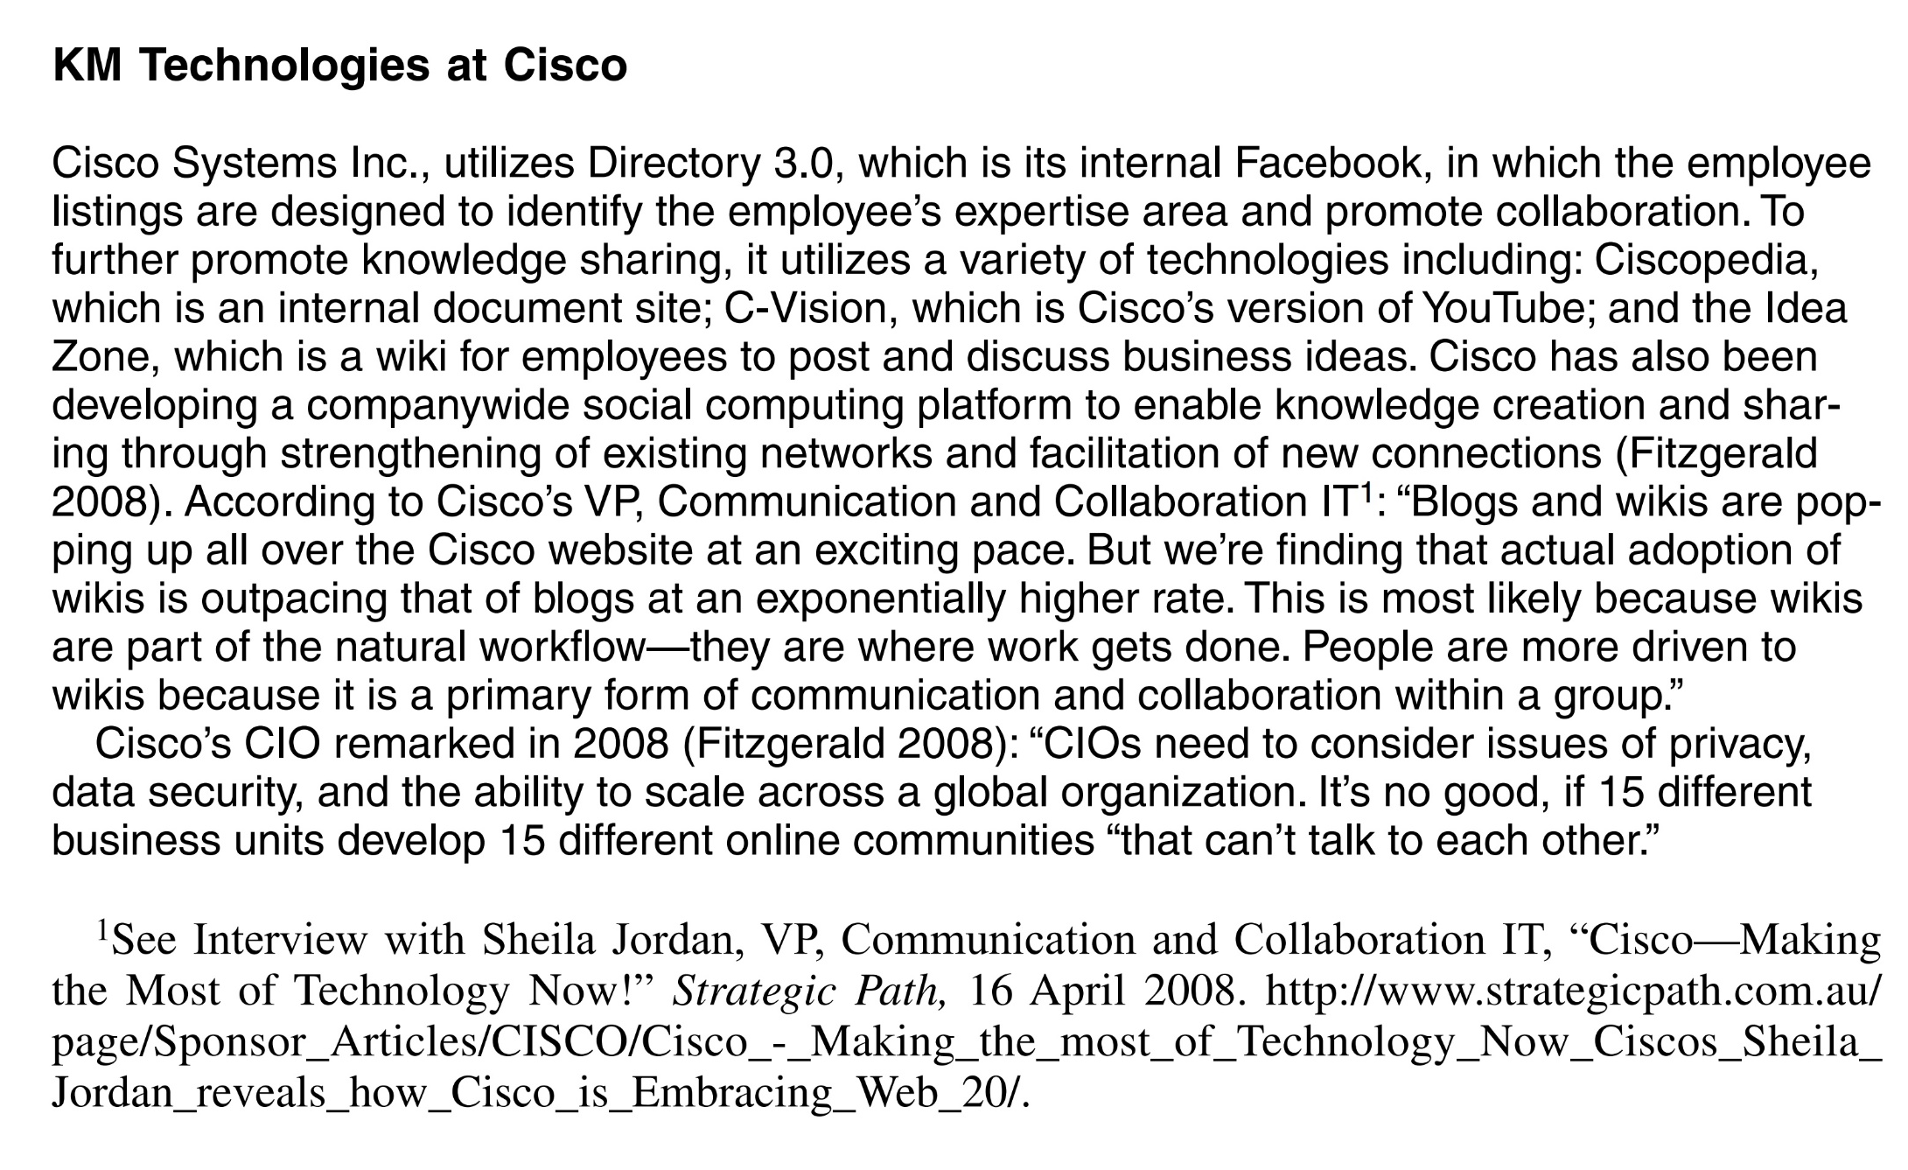

Slide 24
Latihan
Sebutkan KM technology yang ada di perusahaan termpat kita bekerja
Gambarkan dengan menggunakan MindMap

Slide 25
Referensi
Peter Drucker, The age of social transformation, The Atlantic Monthly, 274(5), 1994
Ikujiro Nonaka and Hirotaka Takeuchi, The Knowledge Creating Company, Oxford University Press, 1995
Kimiz Dalkir and Jay Liebowitz, Knowledge Management in Theory and Practice, The MIT Press, 2011
Irma Becerra-Fernandez and Rajiv Sabherwal, Knowledge Management: Systems and Processes, M.E. Sharpe, Inc., 2010
Romi Satria Wahono, Menghidupkan Pengetahuan Sudahkah Kita Lakukan?, Jurnal Dokumentasi dan Informasi - Baca, LIPI, 2005

