Slide 1
Tata Kelola
Teknologi Informasi
Romi Satria Wahono
romi@romisatriawahono.net
http://romisatriawahono.net
081586220090

Slide 2
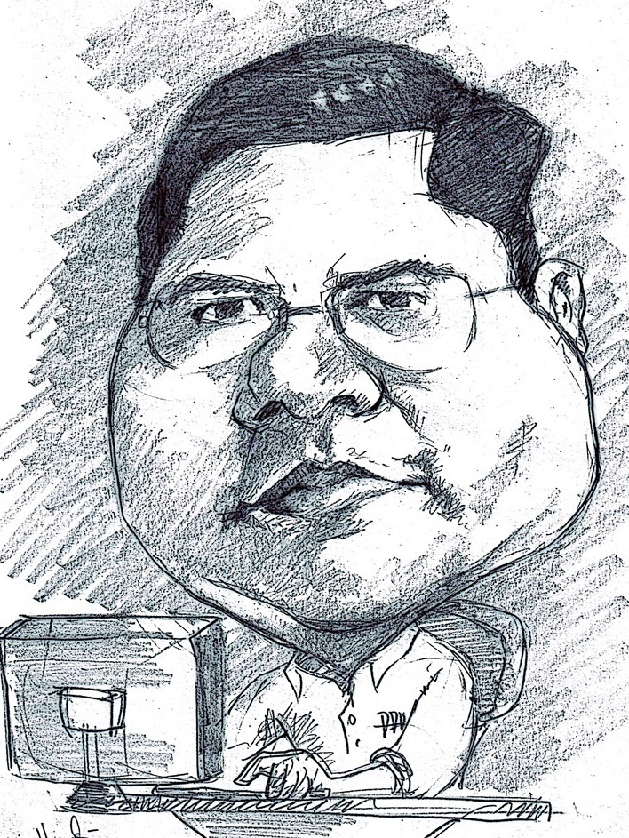
Romi Satria Wahono
SMA Taruna Nusantara Magelang (1993)
B.Eng, M.Eng and Ph.D in Software Engineering
Saitama University Japan (1994-2004)
Universiti Teknikal Malaysia Melaka (2014)
Research Interests in Software Engineering and
Machine Learning
LIPI Researcher (2004-2007)
Professional Member of IEEE, ACM and PMI
IT Award Winners from WSIS (United Nations), Kemdikbud, LIPI, etc
Industrial IT Certifications: TOGAF, ITIL, CCNA, etc
IT Enterprise Architect: KPK, UNSRI, LIPI, Ristek Dikti, DJPK Kemenkeu, etc
Founder and CEO:
  PT IlmuKomputerCom Braindevs Sistema
  PT Brainmatics Cipta Informatika

Slide 3
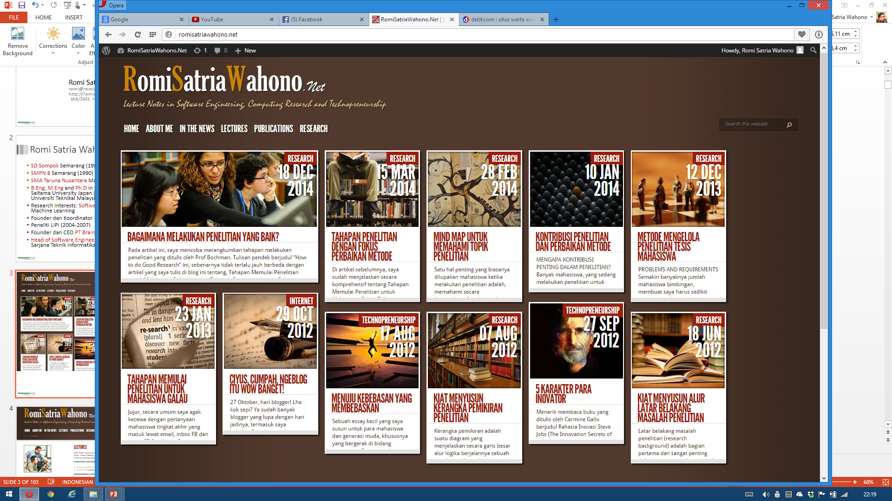

Slide 4
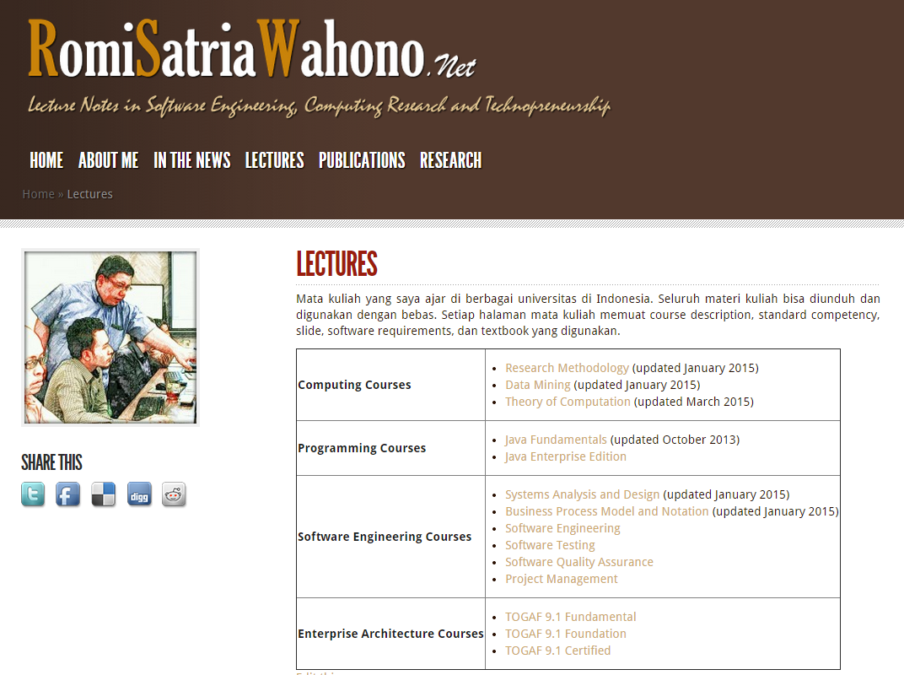

Slide 5
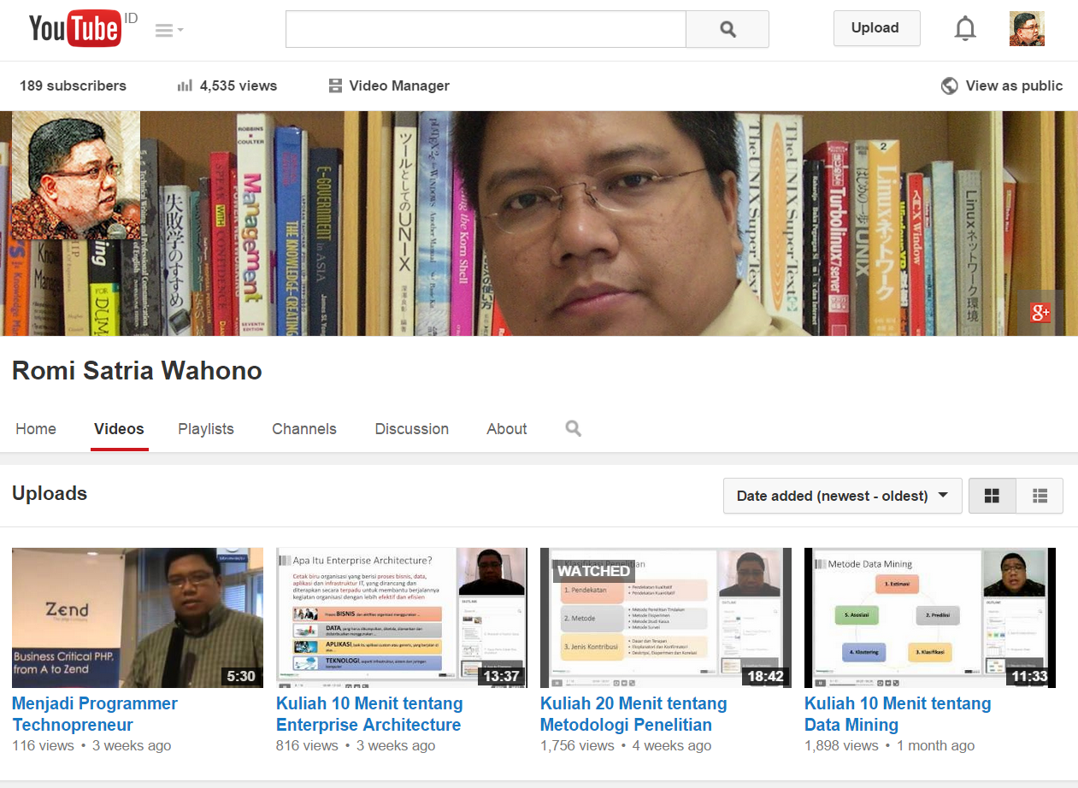

Slide 6

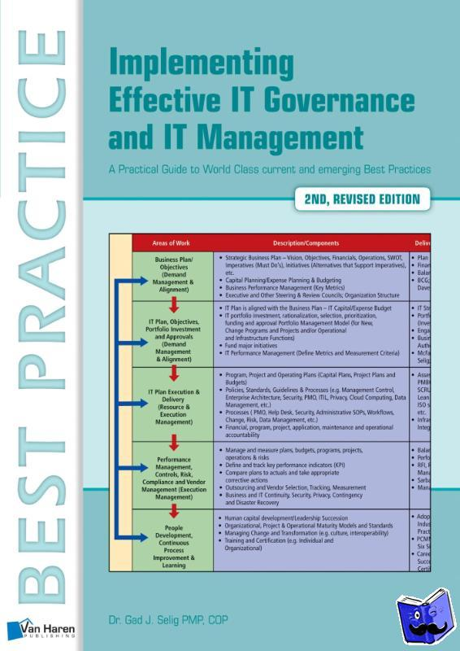



Textbooks

Slide 7
Pre-Test (Jawab dengan Jujur)
Menurut anda, apakah teknologi informasi itu benar-benar sesuai dengan yang digembar gemborkan orang-orang? Atau menurut anda hanya omong kosong, membuang-buang uang dan tidak ada manfaatnya? Atau malah keberadaannya hanya mengganggu pekerjaan saja?
Sebutkan beberapa aplikasi teknologi informasi yang telah sukses diterapkan di organisasi anda!
Apakah aplikasi tersebut anda sebut sukses karena membuat pekerjaan menjadi lebih cepat atau efisien? Atau bisa karena faktor lain? Menurut anda, apa saja kriteria aplikasi teknologi informasi itu disebut sukses diterapkan?
Apa yang anda harapkan dari workshop tata kelola ini? Pengetahuan apa yang anda inginkan? Atau karena hanya penugasan dan anda tidak paham atau malah anda sebenarnya tidak tertarik dengan workshop ini?

Slide 8
Course Outline
1. Pengantar Teknologi Informasi
3. Framework dan Studi Kasus Tata Kelola Teknologi Informasi
2. Pengantar Tata Kelola Teknologi Informasi

Slide 9
1. Pengantar Teknologi Informasi
1.1 Peluang dan Tantangan Penerapan Teknologi Informasi
1.2 5 Mitos Kesalahan Penerapan Teknologi Informasi

Slide 10
1.1 Peluang dan Tantangan Penerapan Teknologi Informasi

Slide 11
Peluang
Low Cost Outsourcing
Tantangan
Science and Technology Development
Human Resource, Innovation and Creativity
Industrial Performance
Large ICT Investment
Big Market
Technopreneurship

Slide 12
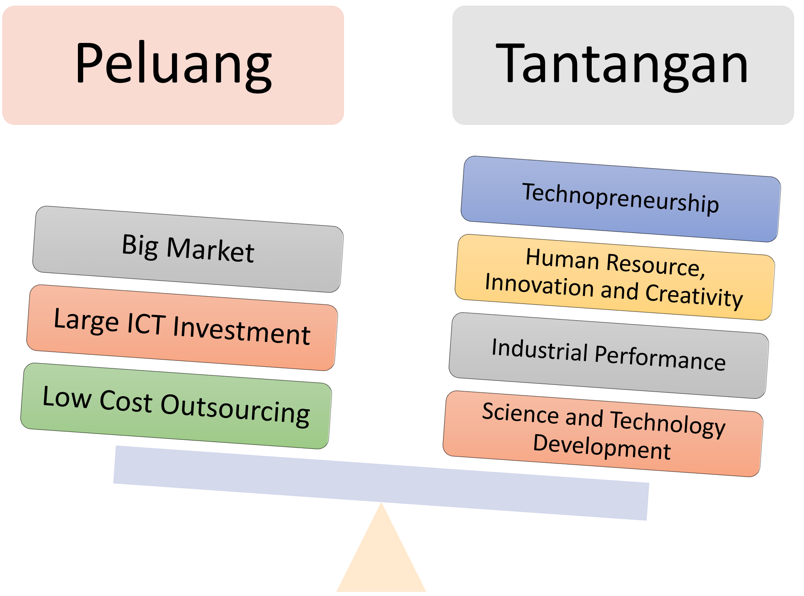
Large ICT Investment
Total ICT investment in Indonesia per year:
  US$33 billion (Global Connectivity Index 2016)
  US$15.8 billion (IDC Report 2016)
90% of this investment will go on hardware
  Domestic and international companies continue to setup and expand into the eastern region of the archipelago nation (6,000 islands)
(Global Connectivity Index 2016)

Slide 13
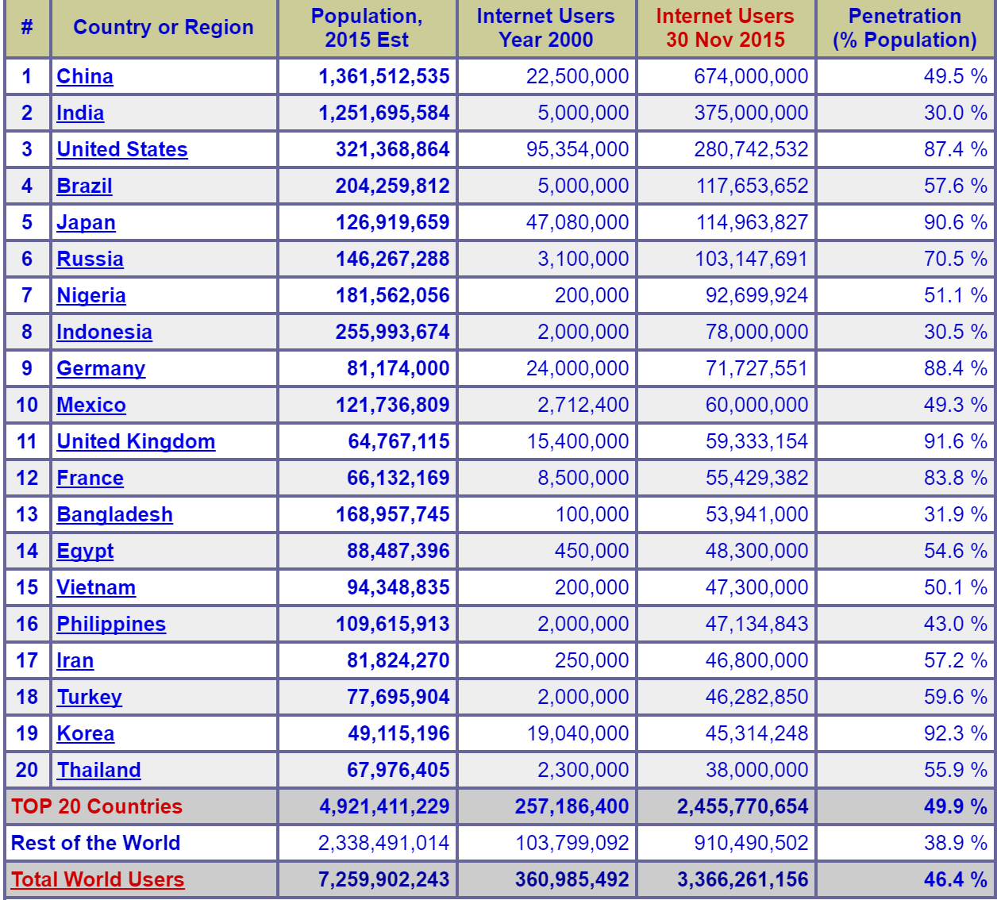
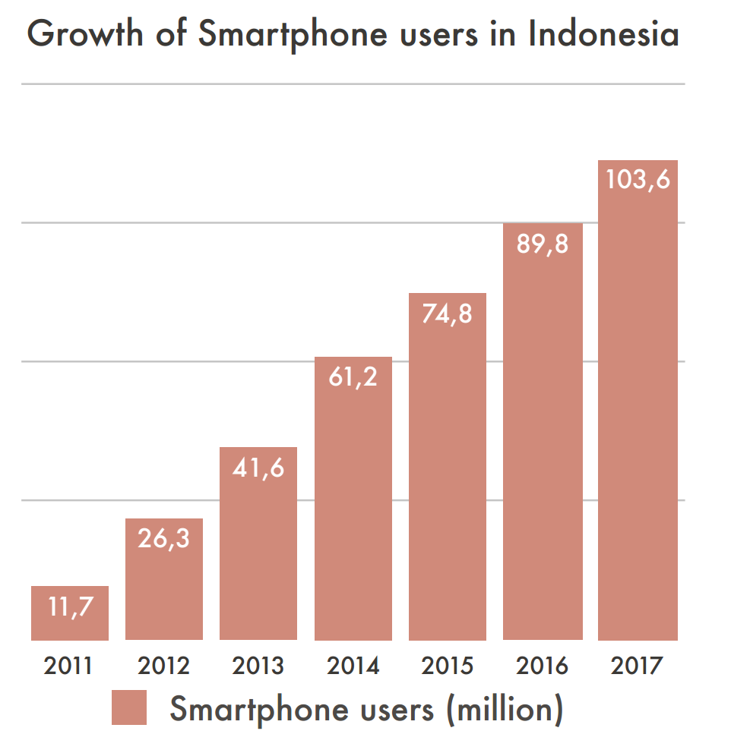
Big Market (Internet Penetration)
(Source: Internet World Stats, 2015)
(Source: Thomas Klaffke, Top Trends in Indonesia, 2014)

Slide 14
Outsourcing Index
Overall rank | Country | Overall outsourcing index | Cost competitiveness index | Resources & skills index | Business & economic environment index
1 | India | 7.1 | 8.3 | 6 | 4.2
2 | Indonesia | 6.7 | 8.6 | 4.3 | 4.4
3 | Estonia | 6.6 | 7.5 | 5.2 | 6.9
4 | Singapore | 6.5 | 6.4 | 5.7 | 9.4
5 | Bulgaria | 6.4 | 8.8 | 2.9 | 5.2
6 | China | 6.4 | 7 | 5.6 | 5.6
7 | Philippines | 6.3 | 9 | 2.8 | 3.9
8 | Lithuania | 5.9 | 7 | 3.9 | 6.5
9 | Thailand | 5.9 | 8.2 | 2.3 | 5.9
10 | Malaysia | 5.8 | 7.9 | 2.2 | 6.9
(Source: Clutch Research Report on Outsourcing Index 2014)

Slide 15
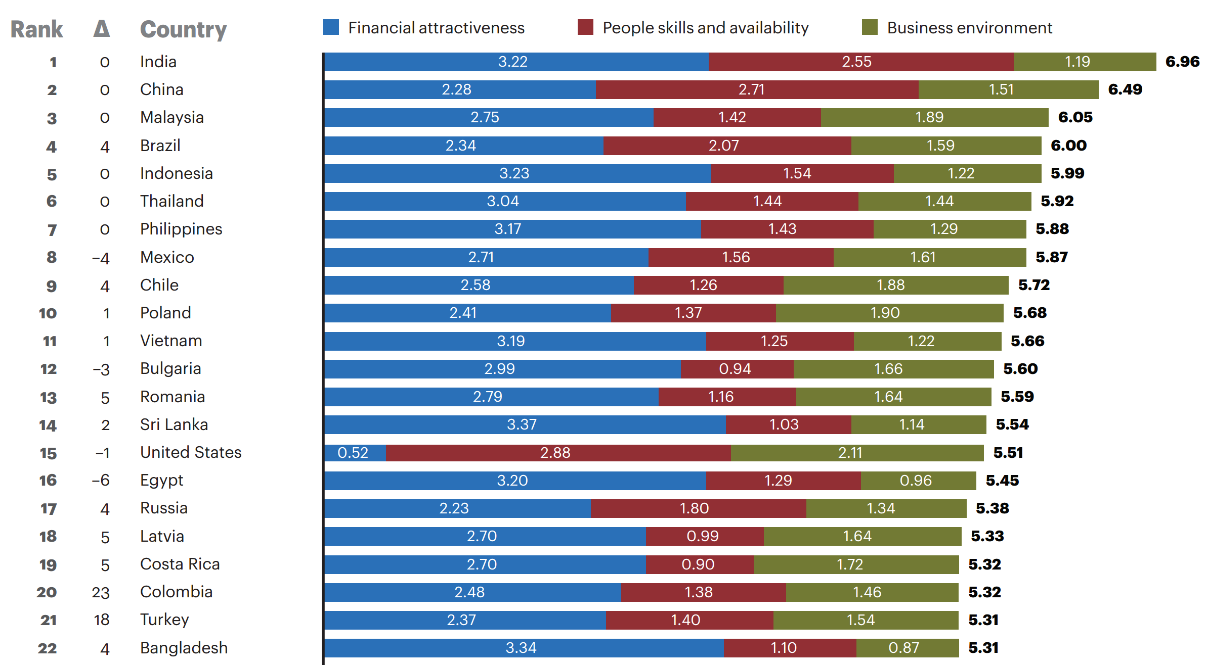
Global Service Location Index
(A.T. Kearney Global Service Location Index 2016)

Slide 16
Technopreneurship Ratio

Slide 17
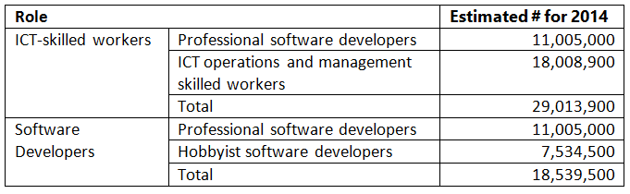
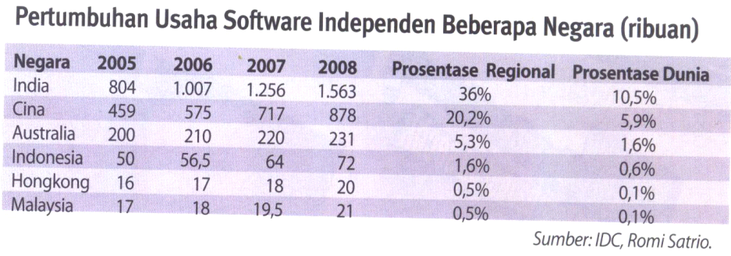
Developers and ICT Workers
(Source: IDC 2014 Worldwide Software Developer and ICT-Skilled Worker Estimates)
(Source: IDC Professional Developer Index)

Slide 18
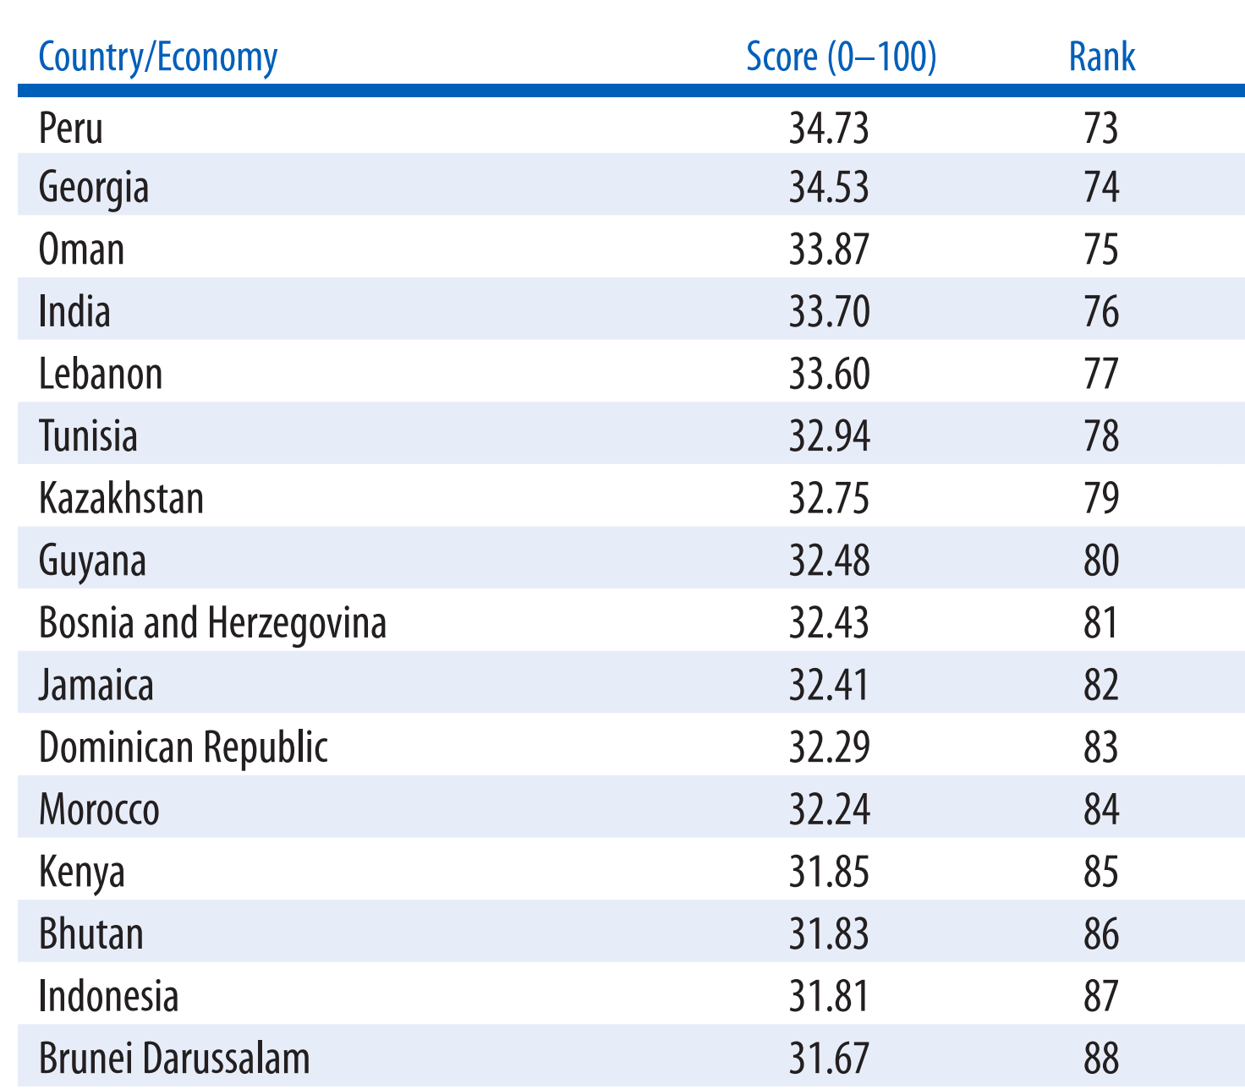
Global Innovation Index
(Source: Global Innovation Index 2014, WIPO, Cornell University)

Slide 19
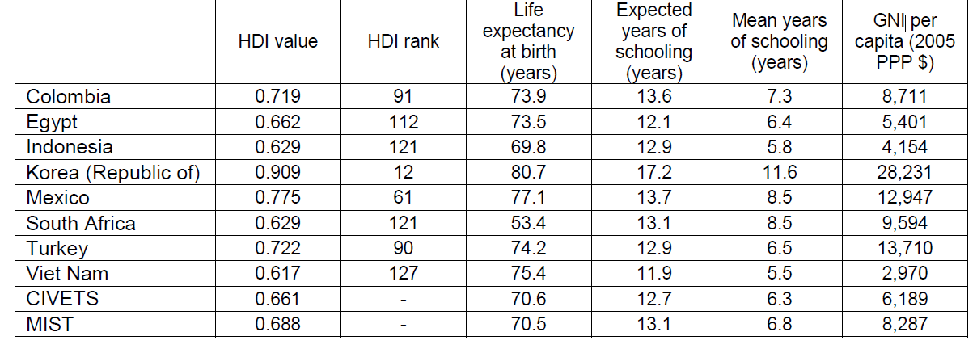
Human Development Index
Indonesia performs worse than the average MIST country
Its HDI is higher than Vietnam’s only
(Source: Human Development Report 2013)

Slide 20
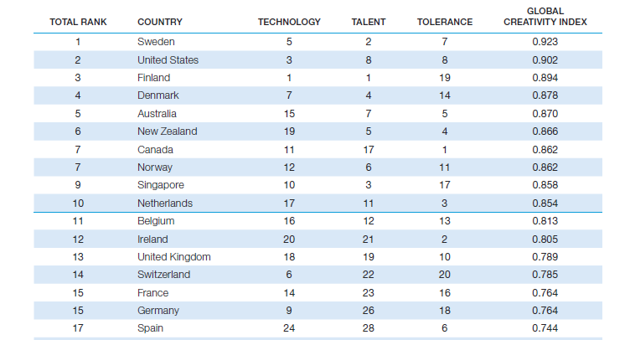
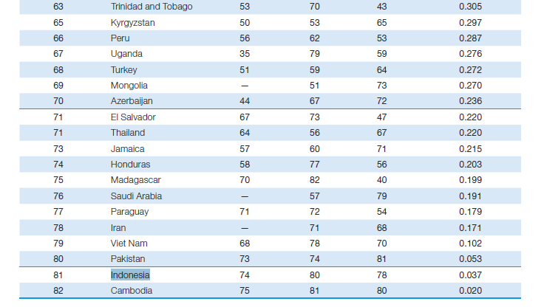
Global Creativity Index
(Source: Martin Prosperity Institute, Global Creativity Index 2011)

Slide 21
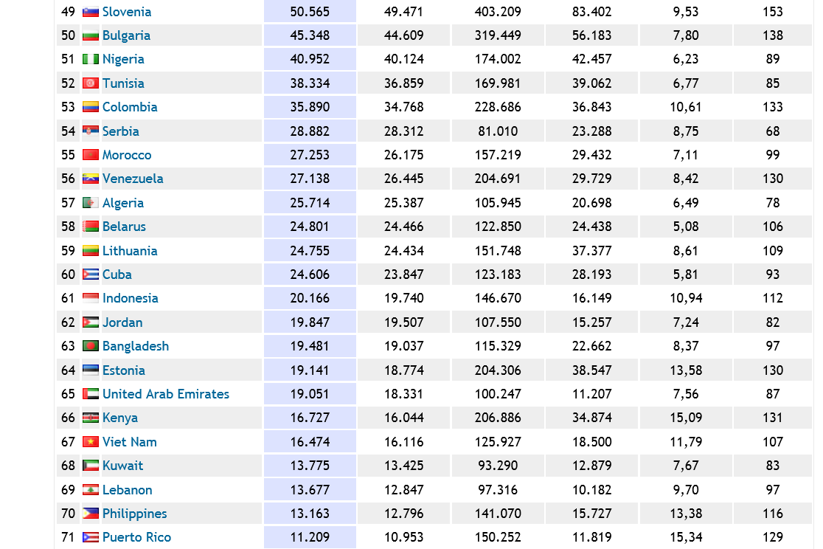
Science and Technology Development (ScimagoJR.Com)

Slide 22
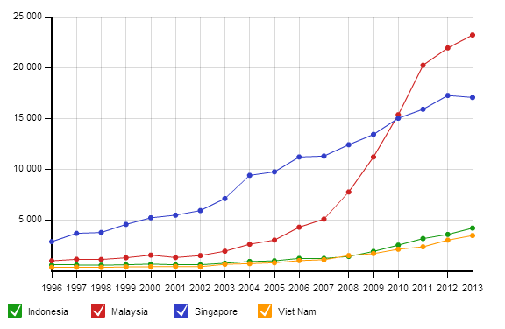
Science and Technology Development (ScimagoJR.Com)

Slide 23
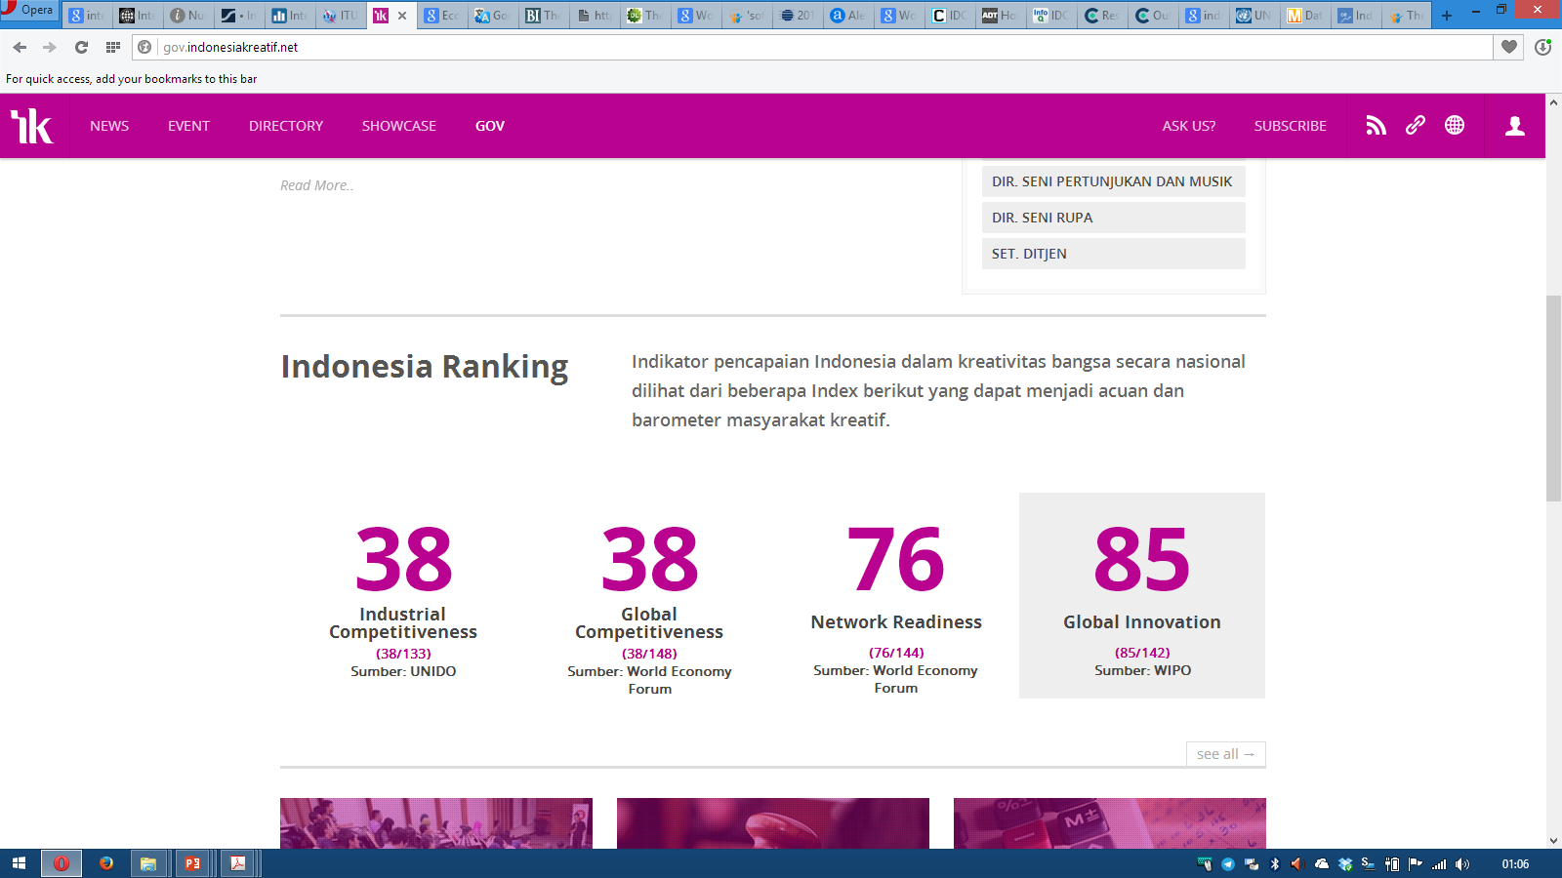
Indeks Kreatifitas Lain

Slide 24
1.2 5 Mitos Kesalahan Penerapan Teknologi Informasi

Slide 25

MITOS 1
Cara Sekarang Masih Manual, Saya akan Terapkan Teknologi Informasi

Slide 26
Kegagalan Project Teknologi Informasi
50% lebih project teknologi informasi gagal
(42% - Standish Group, 53% - General Accounting Office)
  Dibatalkan sebelum selesai
  Selesai tapi tidak pernah dipakai
  Tidak bermanfaat bagi pengguna
  Tidak sesuai dengan keinginan pengguna

Slide 27
Size Berbanding Lurus dengan Kegagalan
Company | Year | Outcome
Hudson Bay (Canada) | 2005 | Inventory system problems lead to $33.3 million loss
UK Inland Revenue | 2004/5 | $3.45 billion tax-credit overpayment caused by software errors
Avis Europe PLC (UK) | 2004 | Enterprise resource planning (ERP) system cancelled after $54.5 million spent
Ford Motor Co. | 2004 | Purchasing system abandoned after deployment costing approximately $400 M
Hewlett-Packard Co. | 2004 | ERP system problems contribute to $160 million loss
AT&T Wireless | 2004 | Customer relations management (CRM) system upgrade problems lead to $100M loss

Slide 28
Keunikan dari Software
Karakteristik | Software | Hardware
Kompleksitas | Tingkat kompleksitas dari produk software tinggi, dengan kemungkinan perubahan parameter dan fungsi yang sangat beragam | Tingkat kompleksitas produk lain rendah, dengan kemungkinan perubahan parameter dan fungsi tidak beragam
Visibilitas Produk | Produk tidak terlihat dengan kasat mata, termasuk bila ada cacat (defect) dari produk | Produk terlihat dengan kasat mata, termasuk bila ada cacat (defect) dari produk

Slide 29
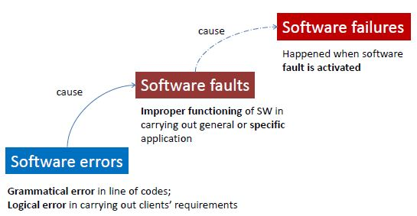
Software Errors, Faults, Failures

Slide 30
Software Errors != Failures
Suatu perusahaan PT ABC memproduksi software yang akan ditanam ke dalam suatu device
Salah satu fungsi yang terdapat pada software adalah akan mematikan device secara otomatis apabila suhu ruangan lebih besar daripada 30º celcius
Programmer salah menuliskan logika menjadi:
…
if (suhu > 3) shutdownDevice();
…
Error ini tidak pernah menyebabkan failure pada software, dan perusahaan PT ABC sampai saat ini terkenal sebagai perusahaan yang memproduksi software tanpa bug
Jelaskan mengapa bisa terjadi demikian!

Slide 31
Warranty Lawsuits
Mortenson vs. Timeberline Software (TS) (≈1993)
  Mortenson menggunakan software yang diproduksi TS untuk membuka tender pembangunan rumah sakit
  Software memiliki bug sehingga memenangkan perusahaan yang mengajukan proposal paling mahal (kerugian 2 miliar USD)
  TS tahu tentang bug itu, tapi tidak mengirimkan update ke Mortenson
  Pengadilan di Amerika Serikat memenangkan perusahaan TS
Uniform Computer Information Transaction Act (UCITA) allows software manufacturers to:
  disclaim all liability for defects
  prevent the transfer of software from person to person

Slide 32
Disclaimer of Warranties
DISCLAIMER OF WARRANTIES. TO THE MAXIMUM EXTENT PERMITTED BY APPLICABLE LAW, MICROSOFT AND ITS SUPPLIERS PROVIDE TO YOU THE SOFTWARE COMPONENT, AND ANY (IF ANY) SUPPORT SERVICES RELATED TO THE SOFTWARE COMPONENT ("SUPPORT SERVICES") AS IS AND WITH ALL FAULTS; AND MICROSOFT AND ITS SUPPLIERS HEREBY DISCLAIM WITH RESPECT TO THE SOFTWARE COMPONENT AND SUPPORT SERVICES ALL WARRANTIES AND CONDITIONS, WHETHER EXPRESS, IMPLIED OR STATUTORY, INCLUDING, BUT NOT LIMITED TO, ANY (IF ANY) WARRANTIES OR CONDITIONS OF OR RELATED TO: TITLE, NON-INFRINGEMENT, MERCHANTABILITY, FITNESS FOR A PARTICULAR PURPOSE, LACK OF VIRUSES, ACCURACY OR COMPLETENESS OF RESPONSES, RESULTS, LACK OF NEGLIGENCE OR LACK OF WORKMANLIKE EFFORT, QUIET ENJOYMENT, QUIET POSSESSION, AND CORRESPONDENCE TO DESCRIPTION. THE ENTIRE RISK ARISING OUT OF USE OR PERFORMANCE OF THE SOFTWARE COMPONENT AND ANY SUPPORT SERVICES REMAINS WITH YOU.

Slide 33
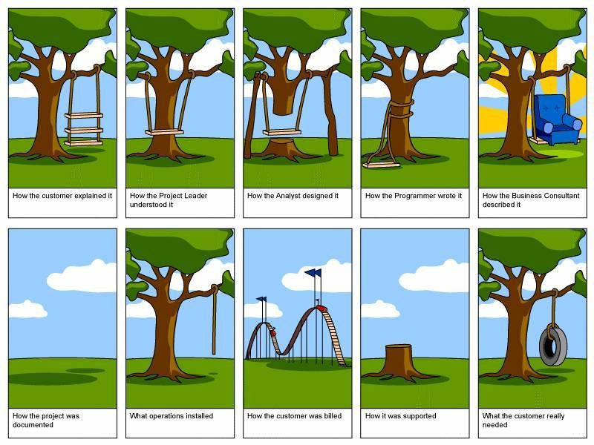

Slide 34
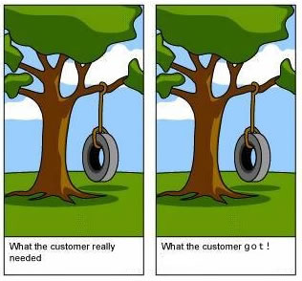
Tantangan Pengembangan Teknologi Informasi

Slide 35
Software Tidak Dibutuhkan?
Analisis lagi software mahal yang kita miliki:
  Sistem Komputerisasi KTP
  Sistem e-KTP
  Sistem Pencatatan Pembersihan Toilet
  Sistem e-Learning di Universitas
Software datang untuk memberi manfaat dan mempercepat pekerjaan manusia
  Software datang bukan hanya karena ingin mengubah cara sekarang yang masih manual

Slide 36
Divisi IT = Cost Center?
Divisi IT bukanlah tempat menghabiskan anggaran
Divisi IT dibentuk supaya seluruh proses bisnis organisasi bisa berjalan lebih efektif dan efisien

Slide 37

MITOS 2
Kualitas Software Dinilai dari Teknologi
yang Digunakan

Slide 38
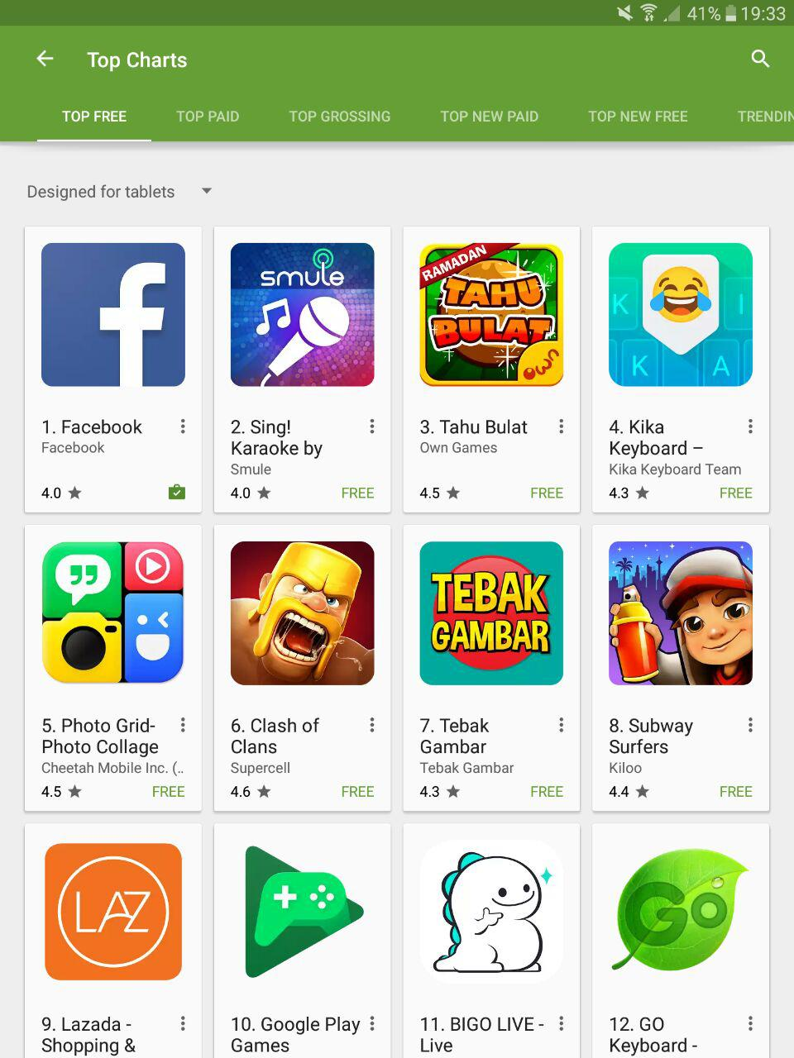
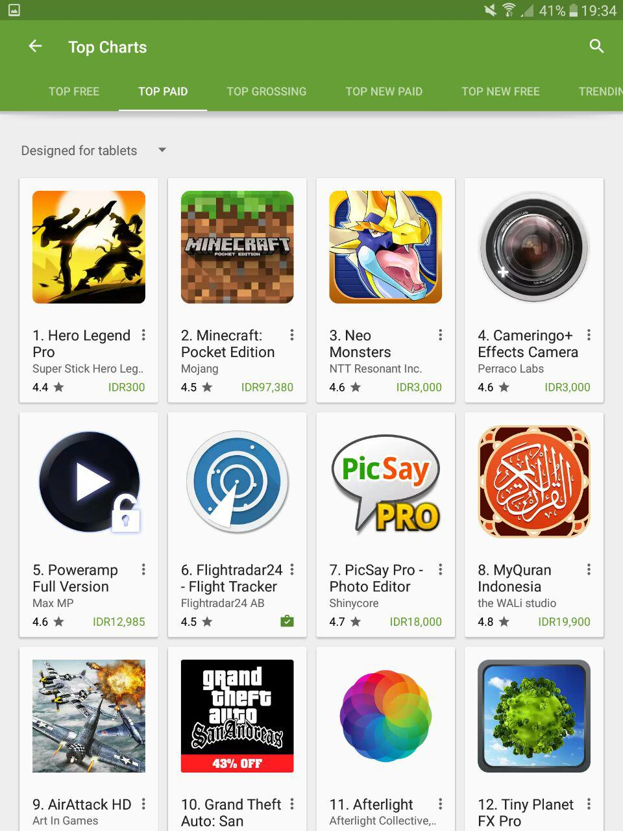

Teknologi Dibalik Software yang Sukses?

Slide 39
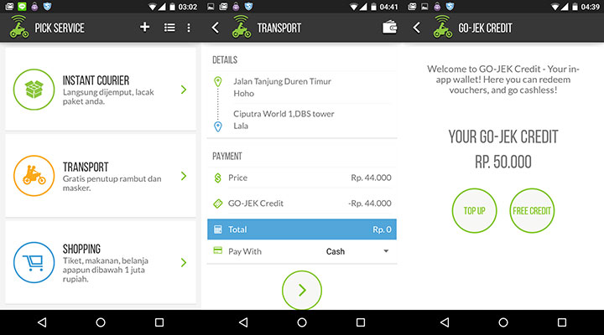
Berapa Harga Aplikasi Gojek?

Slide 40
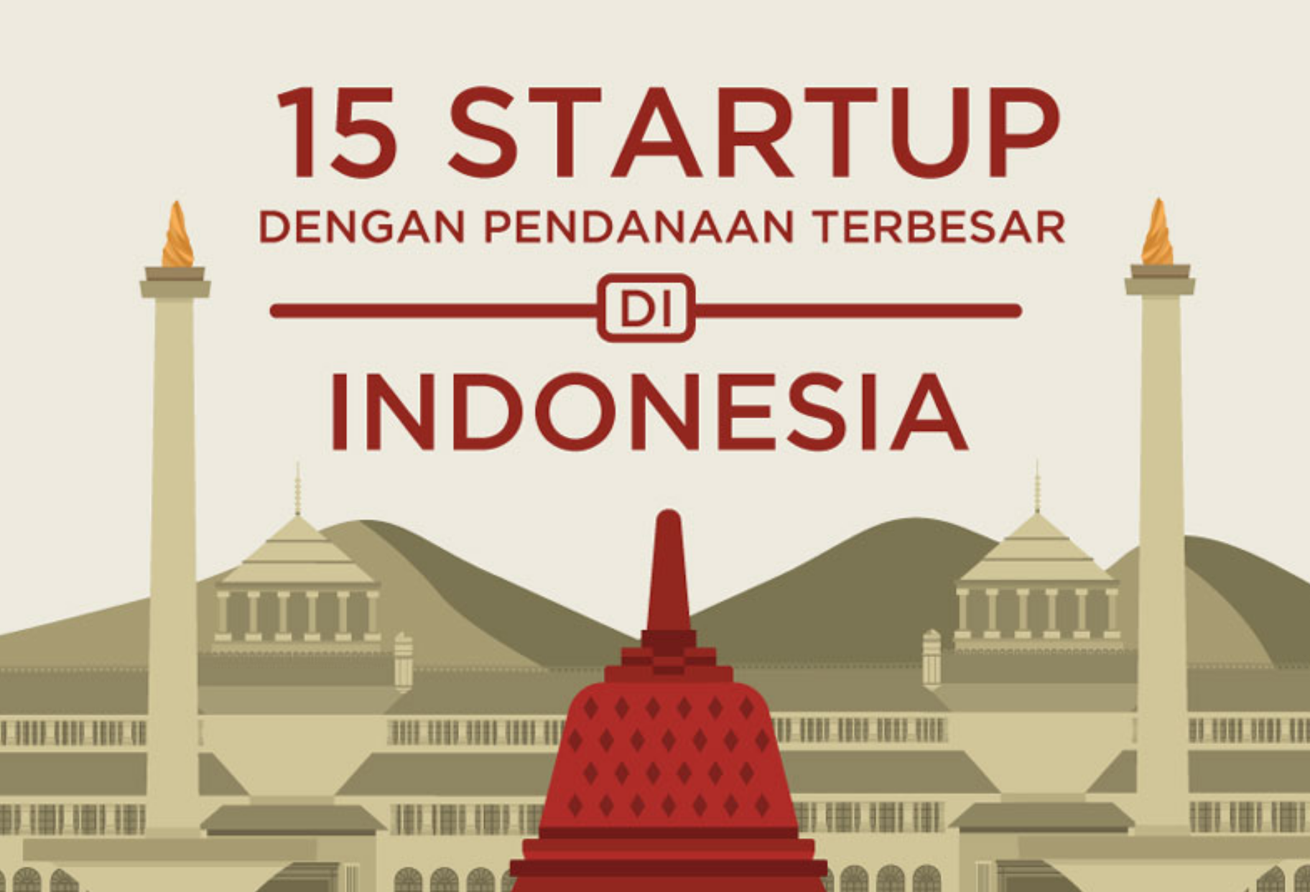
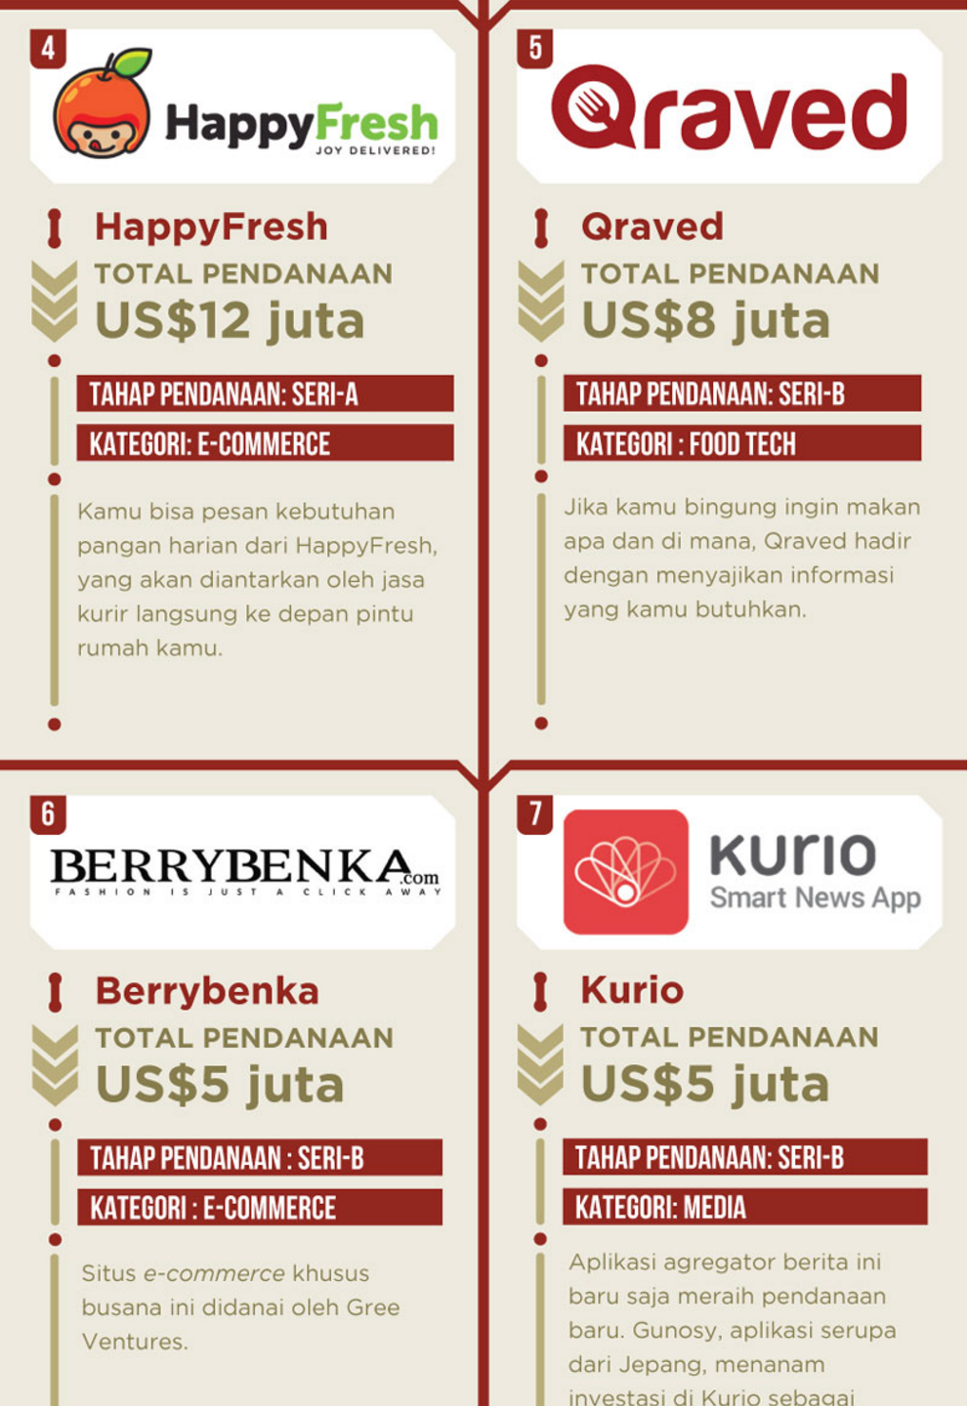
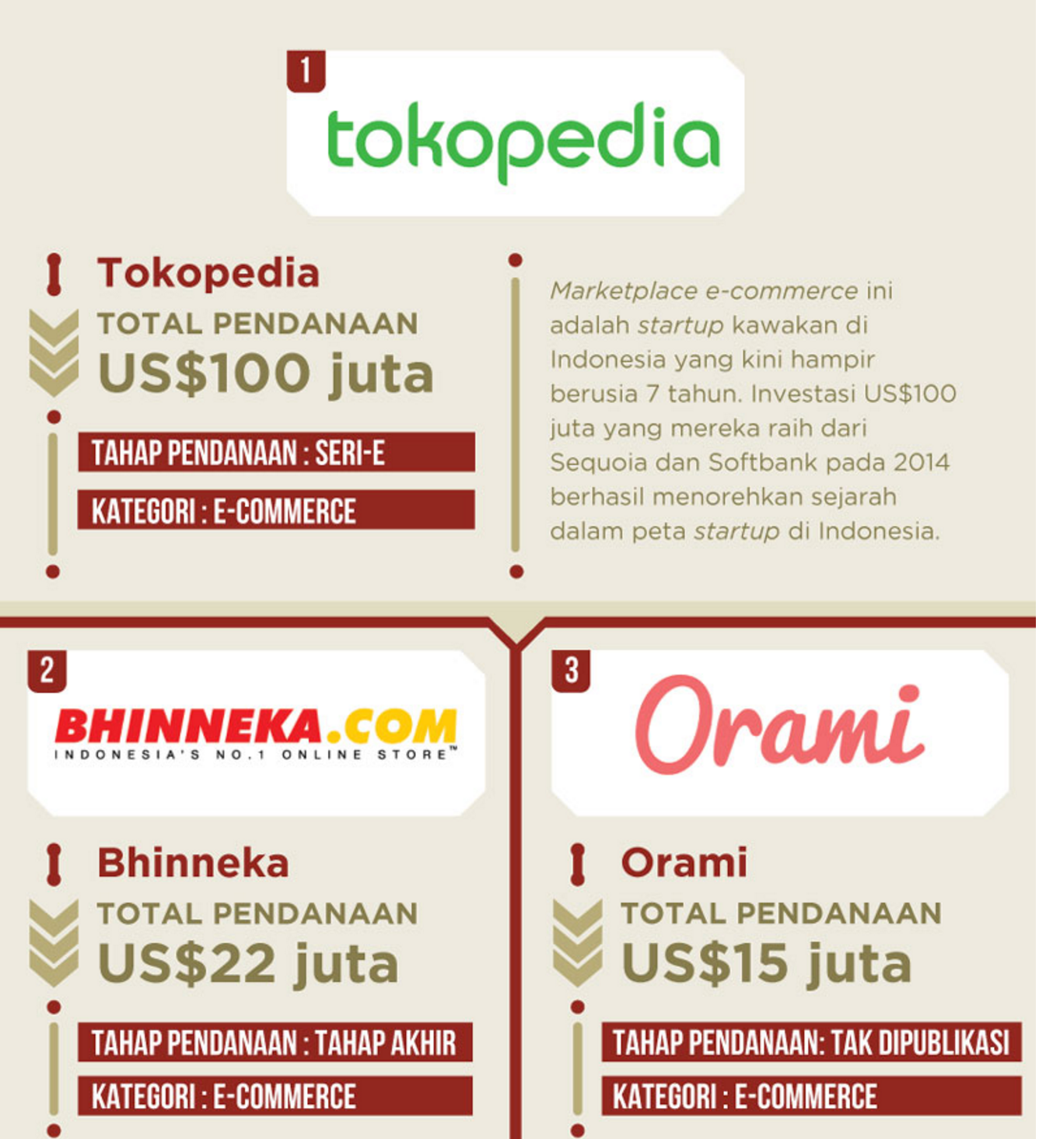
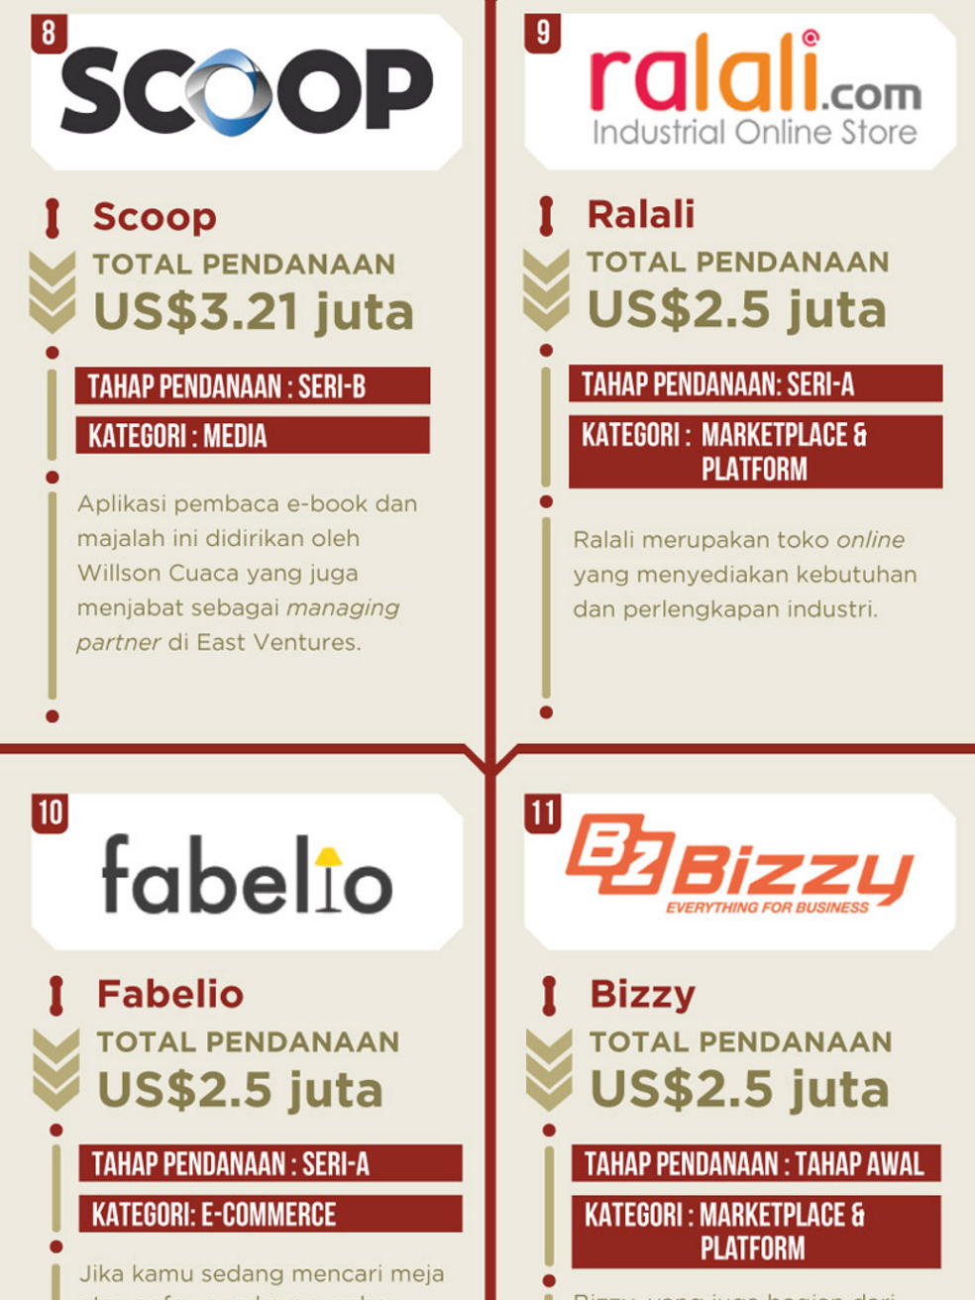

Slide 41
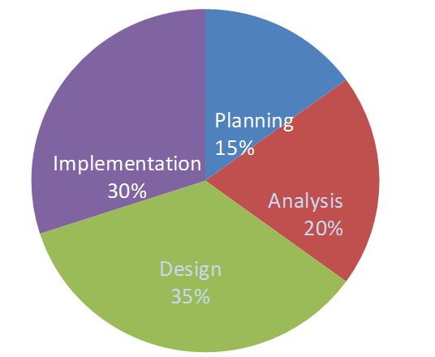
Distribusi Effort Pengembangan Software
(Dennis et al., 2013)

Slide 42
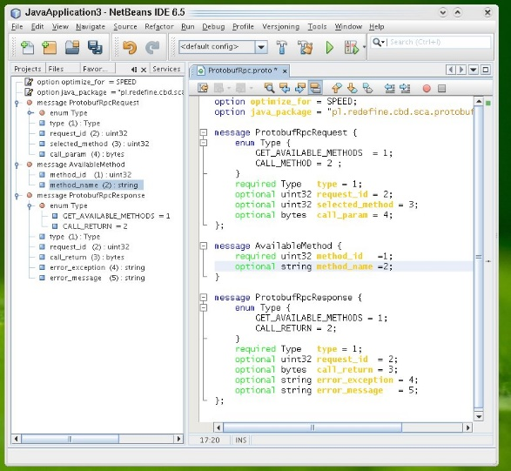
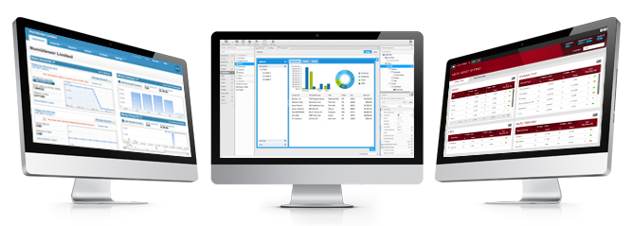
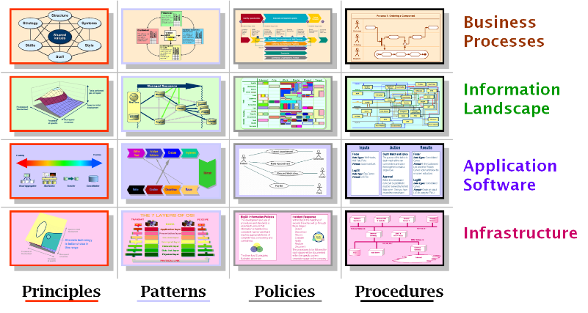
Software Development Evolution
How to Write a Code
(Coder or Programmer)
How to Develop a Software
(Software Engineer)
How to Manage Software
(Enterprise Architect)

Slide 43
Software Engineering Law
Architecture wins over technology
(Morris-Ferguson Law)
Hierarchical structures reduce complexity
(Simon Law)

Slide 44


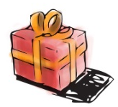


















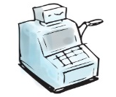
Business Model Canvas
Fasilkom UNSRI
Key Partners
Key Activities
Value
Propositions
Customer
Relationships
Customer
Segments
Pengajaran dan Pendidikan
Universitas dan Unit Kerja Dibawahnya
Promosi ke Stakeholders
Penelitian
Kurikulum Internasional Standar ACM
Penunjang
Tracer Study Alumni
Siswa SMA/SMK
Alumni
Pengabdian kepada Masyarakat
Integrasi Kurikulum dengan Sertifikasi Internasional
Seminar, Workshop dan Pelatihan
Industry
DIKTI
Key Resources
Mahasiswa Terseleksi dengan Ketat
Channels
Mahasiswa S1
Kurikulum
BAN-PT
Email
Guru Sekolah Menengah
ISP
Dosen
Pegawai
Memiliki Jurnal Internasional Terakreditasi DIKTI
Telepon
Mahasiswa
Laboratorium Riset dan Lab Praktikum
Website
Fax
Universitas Lainya
Prodi
Kerjasama Program dengan Universitas Luar Negeri
Surat Kabar
Pemda
Social Media
(Facebook, Twitter)
Sarana dan Prasarana
Cost Structure
Revenue Streams
Honor Pegawai kontrak
Honor Penelitian dan Pengabdian Dosen
Biaya Promosi
Hibah Penelitian dan Pengabdian
Proyek Kerjasama
BOPTN
Pembangunan Infrastruktur
Biaya Operasional
Biaya Pengembangan SDM
Pembiayaan Hibah Penelitian dan Pengabdian
Hibah (CSR)
SPP (PNBP)
APBN

Slide 45
Arsitektur Aplikasi Organisasi
FUNGSI ORGANISASI
Pengelolaan Umum dan Perlengkapan
Pengelolaan Keuangan dan Kepegawaian
Pengelolaan
Tata Usaha
Pengembangan dan Pengelolaan ICT
Pengembangan Bisnis dan Kerjasama
Pengelolaan Kemahasiswaan dan Alumni
Pendidikan dan Pengajaran
Penelitian
Pengabdian kepada Masyarakat
PROSES BISNIS
Penyusunan RKAKL
Pengelolaan Keuangan
Pengendalian Dokumen Internal
Pengembangan Layanan
Pengelolaan Kerjasama
Pengelolaan Beasiswa
Penerimaan Mahasiswa Baru Fakultas
Pengajuan Proposal Penelitian
Pengajuan Proposal Pengabdian Masyarakat
Pelaksanaan Pengadaan
Pengelolaan Usulan Pegawai dan Dosen
Pengendalian Dokumen Eksternal
Pengelolaan Layanan
Evaluasi Kerjasama
Pengelolaan Mahasiswa
Pengisian KRS
Pelaksanaan Perkuliahan
Pelaksanaan Penelitian
Pelaksanaan Pengabdian Masyarakat
Pengelolaan Aset
Pengelolaan Usulan Pangkat dan Jabatan Dosen
Identifikasi dan Pemenuhan Sumber Daya
Monitoring Jaringan
Pengelolaan Pelatihan & Sertifikasi Dosen
Pengelolaan Alumni
Penyelesaian Kerja Praktik
PenyelesaiaanT ugas Akhir
Evaluasi Kinerja Pegawai
Pengelolaan Pelatihan, Sertifikasi Mahasiswa & Pihak Exkternal
Pendaftaran Yudisium
Monitoring dan Evaluasi Mutu Akademik
Pengelolaan Kurikulum
APLIKASI
ERP FASILKOM UNSRI
OPERATIONAL INFORMATION SYSTEMS
Modul Permintaan Barang
Modul E-Budgeting
Modul Pengelolaan Dokumen
Modul Monitoring
Modul Layanan Kerjasama
Modul Layanan Mahasiswa dan Alumni
Modul Elearning
Modul Monitoring PPM
Modul Pengelolaan Pegawai & Dosen
Modul Layanan Informasi Pelatihan dan Sertifikasi
Modul Manajemen Lab.
Modul Monitoring TA
Modul Monitoring dan Evaluasi Mutu Akademik
Modul E-Library
STRATEGIC INFORMATION SYSTEMS
M o d u l D a s h b o a r d K i n e r j a F a k u l t a s
PUBLIC INFORMATION SYSTEMS
Situs Blog Dosen dan Mahasiswa
E-Journal
SISTEM EKSTERNAL
LPSE
SIMKEU
SIMAK BMN
SIRENA
SIMAK
KEY PERFORMANCE INDICATOR
- Akurasi Jumlah Aset
- Kelancaran Pengadaan Barang
- Tingkat Serapan Anggaran
- Akuntabilitas Penggunaan Anggaran
- Kelancaran Pangkat dan Jabatan
- Tingkat Rasio Dosen Mahasiswa
- Jumlah Dosen Studi Lanjut
- Jumlah Insentif Dosen Tetap
- Akurasi Dokumen
- Peningkatan Paperless Dokumen
- Jumlah Tiket Masalah Terselesaikan
- Tingkat Kehandalan Layanan
- Jumlah Kerjasama
- Jumlah Realisasi Kerjasama
- Jumlah Pelatihan dan Sertifikasi (Nasional dan Internasional)
- Jumlah Penerima Beasiswa
- Jumlah Keterserapan Alumni
- Jumlah Kegiatan Mahasiswa (Prestasi)
- Rata-rata IPK
- Rata-rata Masa Studi
- Tingkat Kehadiran Dosen
- Tingkat Kehadiran Mahasiswa
- Akreditasi Program Studi
- Lama Penyusunan TA
- Kesesuaian Jenis Pekerjaan Alumni
- Tingkat DO
- Jumlah Proposal Masuk dan Diterima
- Jumlah Publikasi Per Dosen
- Jumlah Dana Penelitian
- Jumlah Sumber Dana Penelitian
- Jumlah Proposal Masuk dan Diterima
- Jumlah Dana Pengabdian
- Jumlah Sumber Dana Pengabdian

Slide 46
Kualitas Software
Software quality is (IEEE, 1991):
The degree to which a system, component, or process meets specified requirements
The degree to which a system, component, or process meets customer expectation or user needs (benefits)

Slide 47

MITOS 3
Divisi IT Harus Memikirkan Semua Ide dan Kebutuhan Perusahaan

Slide 48
Tahapan Pengembangan Software
Implementation
Design
Analysis
Planning

Slide 49
Distribusi Effort Pengembangan Software
(Dennis et al., 2013)

Slide 50
Planning
Business Value Identification
Lower Cost
Increase Profit
Feasibility Analysis
Technical (Capabilities)
Economic
(ROI, BEP)
Organizational
(Goals, Core Business)

Slide 51
System Request – Online ATM System
Project Sponsor: | Margaret Mooney, Vice President of Marketing
Business Need: | Project ini dibuat dengan tujuan untuk mendapatkan pelanggan baru yang menggunakan Internet dam memberikan layanan yang lebih baik ke pelanggan yang ada melalui layanan berbasis Internet
Business Requirements:
Dengan menggunakan Online ATM System, pelanggan dapat melakukan seluruh transaksi perbankan. Fitur utama yang ada pada sistem ini adalah: Pengecekan Saldo Pengiriman Uang Transaksi Pembayaran Tagihan
Business Value:
Keuntungan Intangible: - Meningkatkan layanan ke pelanggan - Mengurangi komplen dari pelanggan Keuntungan Tangible: - $750,000 transaksi keuangan dari pelangan baru - $1,875,000 transaksi keuangan dari pelanggan lama - $50,000 pengurangan biaya telepon untuk melayani pelanggan

Slide 52
Feasibility Analysis - Online ATM System
Margaret Mooney and Alec Adams created the following feasibility analysis for the Online ATM System Project.
1. Technical Feasibility The Online ATM System is feasible technically, although there is some risk. 1.1 Online ATM System’s risk regarding familiarity with the application is high The Marketing Department has little experience with Internet-based marketing and sales The IT Department has strong knowledge of the company’s existing ATM systems, however, it has not worked with Web-enabled ATM systems. 1.2 Online ATM System’s risk regarding familiarity with the technology is medium The IT Department has relied on external consultants to develop its existing Web env. The IT Department has learned about Web technology by maintaining the corporate site 1.3 The project size is considered medium risk The project team likely will include less than ten people Business user involvement will be required The project timeframe cannot exceed a year and it should be much shorter 1.4 The compatibility with existing technical infrastructure should be good The current ATM System is a client-server system built using open standards. An interface with the Web should be possible Retail bank already place and maintain orders electronically An Internet infrastructure already is in place at retail bank and at the corporate headquarters

Slide 53
2. Economic Feasibility
A cost–benefit analysis was performed. A conservative approach shows that the Online ATM System has a good chance of adding to the bottom line of the company significantly. Return on Investment (ROI) over 3 years: 229 percent Break-even point (BEP) occurs: after 1.7 years Total benefit after three years: $3.5 million Intangible Costs and Benefits Improved customer satisfaction Greater brand recognition
3. Organizational Feasibility
From an organizational perspective, this project has low risk. The objective of the system, which is to increase sales, is aligned well with the senior management’s goal of increasing sales for the company. The move to the Internet also aligns with Marketing’s goal to become more savvy in Internet marketing and sales. The project has a project champion, Margaret Mooney, Vice President of Marketing. Margaret is well positioned to sponsor this project and to educate the rest of the senior management team when necessary. Much of senior management is aware of and supports the initiative.

Slide 54
 | 2003 | 2004 | 2005 | Total
Increased sales from new customers | 0 | 750,000 | 772,500
Increased sales from existing customers | 0 | 1,875,000 | 1,931,250
Reduction in customer complaint calls | 0 | 50,000 | 50,000
Total Benefits: | 0 | 2,675,000 | 2,753,750
PV of Benefits: | 0 | 2,521,444 | 2,520,071 | 5,041,515
PV of All Benefits: | 0 | 2,521,444 | 5,041,515
Labor: Analysis, Design and Implementation | 162,000 | 0 | 0
Consultant Fees | 50,000 | 0 | 0
Office Space and Equipment | 7,000 | 0 | 0
Software and Hardware | 35,000 | 0 | 0
Total Development Costs: | 254,000 | 0 | 0
Labor: Webmaster | 85,000 | 87,550 | 90,177
Labor: Network Technician | 60,000 | 61,800 | 63,654
Labor: Computer Operations | 50,000 | 51,500 | 53,045
Labor: Business Manager | 60,000 | 61,800 | 63,654
Labor: Assistant Manager | 45,000 | 46,350 | 47,741
Labor: 3 Staff | 90,000 | 92,700 | 95,481
Software upgrades and licenses | 4,000 | 1,000 | 1,000
Hardware upgrades | 5,000 | 3,000 | 3,000
User training | 2,000 | 1,000 | 1,000
Communications charges | 20,000 | 20,000 | 20,000
Marketing expenses | 25,000 | 25,000 | 25,000
Total Operational Costs: | 446,000 | 452,700 | 464,751
Total Costs: | 700,000 | 452,700 | 464,751
PV of Costs: | 679,612 | 426,713 | 425,313 | 1,531,638
PV of all Costs: | 679,612 | 1,106,325 | 1,531,638
Total Project Costs Less Benefits: | (700,000) | 2,222,300 | 2,288,999
Yearly NPV: | (679,612) | 2,094,731 | 2,094,758 | 3,509,878
Cumulative NPV: | (679,612) | 1,415,119 | 3,509,878
Return on Investment (ROI): | 229.16% | (3,509,878/1,531,638)
Break-even Point (BEP): | 1.32 years | (BEP in Year 2 = [2,094,731 – 1,415,119] / 2,094,731 = 0.32)

Slide 55

MITOS 4
Saya akan Membuat Aplikasi IT
Seperti yang ada Sekarang

Slide 56
Kejar Ceruk Pasar Baru
Don't Reinvent The Wheel!
Jangan pernah membuat aplikasi yang sama saja dengan yang ada saat ini
Lakukan komparasi terhadap aplikasi sejenis, lihat dimana ada gap dan ceruk pasar yang belum tergarap
Buat aplikasi untuk segmen pasar baru dan diprediksi akan tumbuh besar

Slide 57
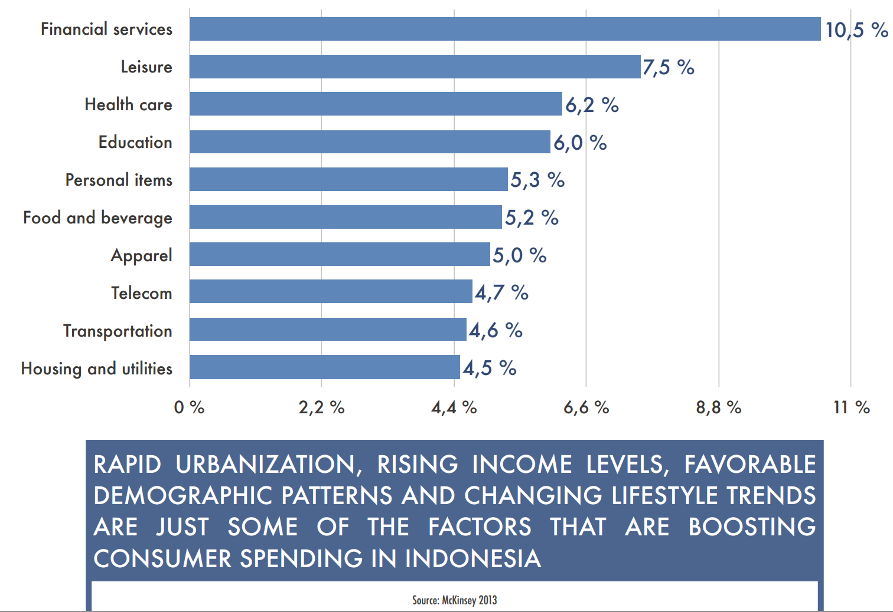
Consumer Spending

Slide 58
Indonesia Software Innovation Maps
eCommerce and Platform
Tokopedia
Bhinneka
Media
Kurio
Scoop
Education
Kelase
RuangGuru
BukaLapak
MatahariMall
Transportation
Gojek
Uber
Grab Car
Accomodation and Logistics
Traveloka
Tiket.Com
Qraved
Fabelio
BliBli
BerryBenka
Ralali
Bizzy
BerryKitchen
HappyFresh

Slide 59
Evolution of Sciences
Before 1600: Empirical science
1600-1950s: Theoretical science
  Each discipline has grown a theoretical component
  Theoretical models motivate experiments and generalize understanding
1950s-1990s: Computational science
  Most disciplines have grown a third, computational branch (e.g. empirical, theoretical, and computational ecology, or physics, or linguistics.)
  Computational Science traditionally meant simulation. It grew out of our inability to find closed-form solutions for complex mathematical models
1990-now: Data science
  The flood of data from new scientific instruments and simulations
  The ability to economically store and manage petabytes of data online
  The Internet makes all these archives universally accessible
  Data mining is a major new challenge!
Jim Gray and Alex Szalay, The World Wide Telescope:
An Archetype for Online Science, Comm. ACM, 45(11): 50-54, Nov. 2002

Slide 60
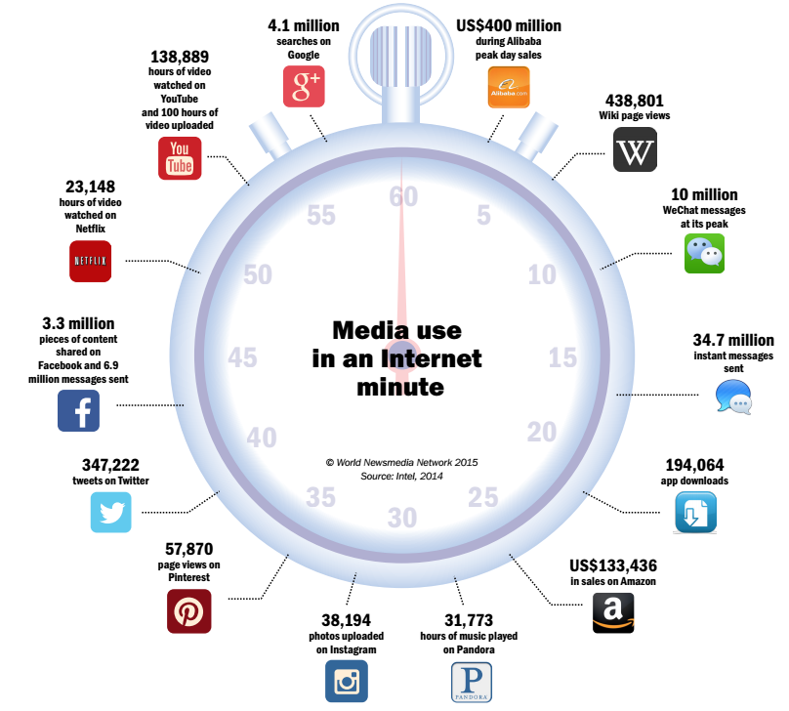
Perubahan Kultur dan Perilaku
(Insight, Big Data Trends
for Media, 2015)

Slide 61
Datangnya Tsunami Data
kilobyte (kB) | 10³
megabyte (MB) | 10⁶
gigabyte (GB) | 10⁹
terabyte (TB) | 10¹²
petabyte (PB) | 10¹⁵
exabyte (EB) | 10¹⁸
zettabyte (ZB) | 10²¹
yottabyte (YB) | 10²⁴
Mobile Electronics market
  5B mobile phones in use in 2010
  150M tablets was sold in 2012 (IDC)
  200M is global notebooks shipments in 2012 (Digitimes Research)
Web and Social Networks generates amount of data
  Google processes 100 PB per day, 3 million servers
  Facebook has 300 PB of user data per day
  Youtube has 1000PB video storage
  235 TBs data collected by the US Library of Congress
  15 out of 17 sectors in the US have more data stored per company than the US Library of Congress

Slide 62

Mining dari Data ke Pengetahuan

Slide 63
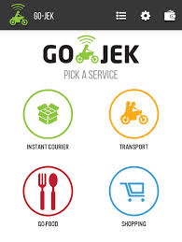
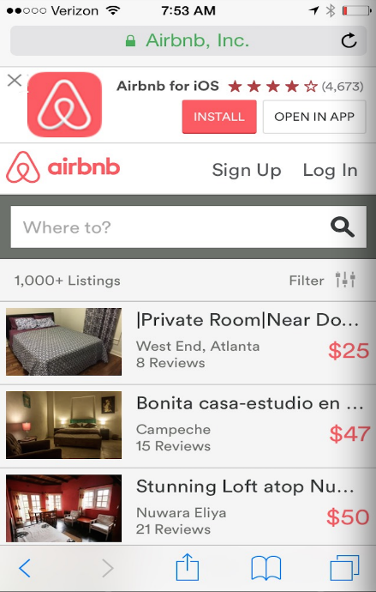
Aplikasi Berbasis Pengetahuan
Uber - the world’s largest taxi company, owns no vehicles
Google - world’s largest media/advertising company, creates no content
Alibaba - the most valuable retailer, has no inventory
Airbnb - the world’s largest accommodation provider, owns no real estate
Gojek - perusahaan angkutan umum, tanpa memiliki kendaraan
Groceria – perusahaan penjual sayur dan daging di pasar, tanpa punya toko dan barang dagangan

Slide 64
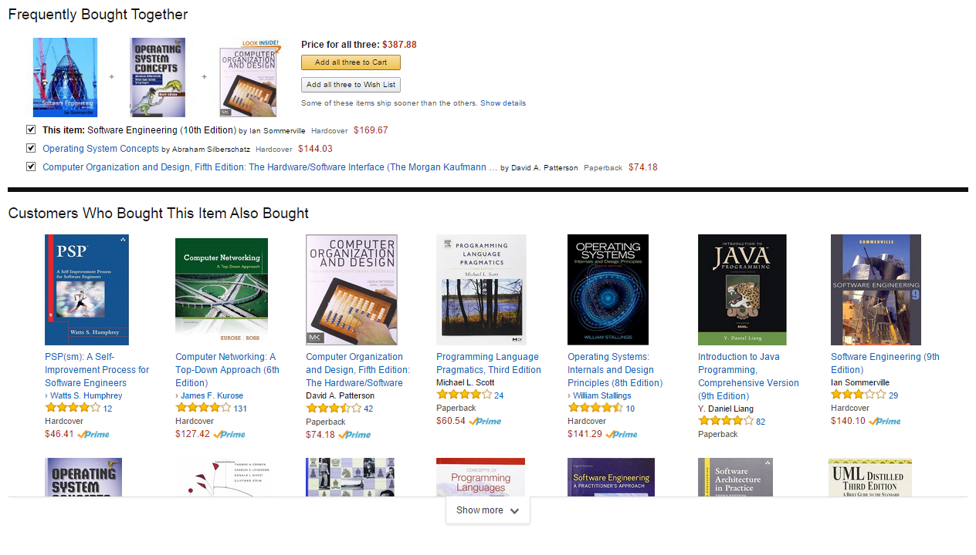
Aturan Asosiasi di Amazon.com

Slide 65
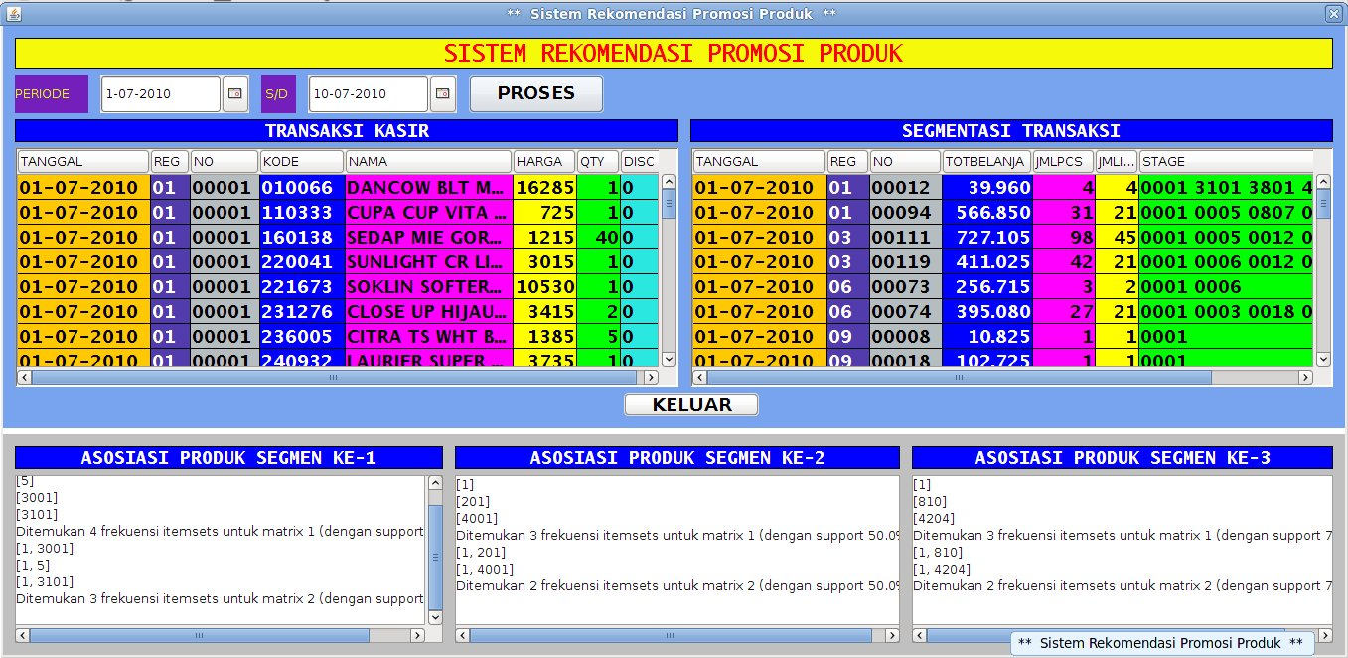
Product Recommender System
Cluster - 2
Cluster - 3
Cluster - 1

Slide 66
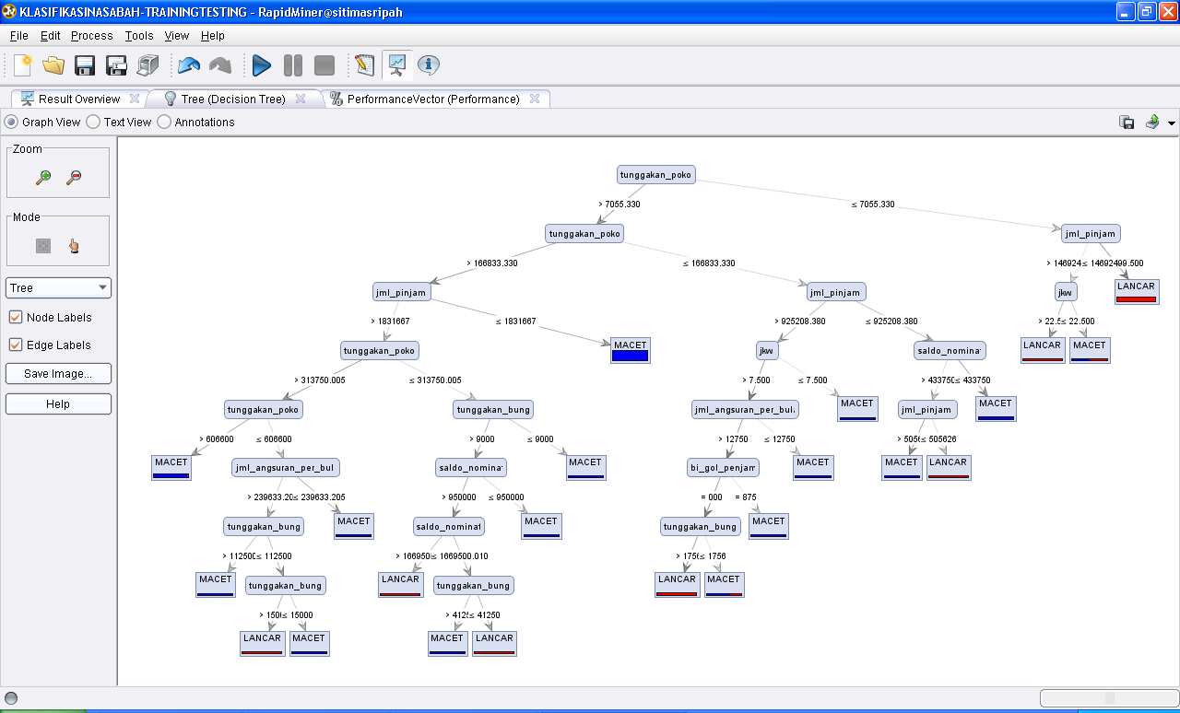
Sistem Penentuan Kelayakan Kredit

Slide 67
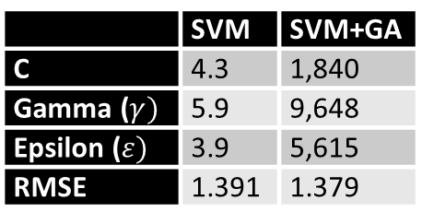
Sistem Prediksi Kebakaran Hutan
FFMC | DMC | DC | ISI | temp | RH | wind | rain | ln(area+1)
93.5 | 139.4 | 594.2 | 20.3 | 17.6 | 52 | 5.8 | 0 | 0
92.4 | 124.1 | 680.7 | 8.5 | 17.2 | 58 | 1.3 | 0 | 0
90.9 | 126.5 | 686.5 | 7 | 15.6 | 66 | 3.1 | 0 | 0
85.8 | 48.3 | 313.4 | 3.9 | 18 | 42 | 2.7 | 0 | 0.307485
91 | 129.5 | 692.6 | 7 | 21.7 | 38 | 2.2 | 0 | 0.357674
90.9 | 126.5 | 686.5 | 7 | 21.9 | 39 | 1.8 | 0 | 0.385262
95.5 | 99.9 | 513.3 | 13.2 | 23.3 | 31 | 4.5 | 0 | 0.438255
 | SVM | SVM+GA
C | 4.3 | 1,840
Gamma ($γ)$ | 5.9 | 9,648
Epsilon ($ε)$ | 3.9 | 5,615
RMSE | 1.391 | 1.379

Slide 68
Sistem Prediksi Koruptor
Aktivitas Penindakan
Aktivitas Intelijen
Prediksi dan klastering calon tersangka koruptor
Asosiasi atribut tersangka koruptor
Prediksi pencucian uang
Estimasi jenis dan jumlah tahun hukuman
DATA
Pengetahuan
DATA
DATA
DATA
Aktivitas Pendukung
Aktivitas Pencegahan

Slide 69

MITOS 5
Nggak Suka Dunia IT, Tapi Saya Yakin Bisa Sukses Menyelesaikan Urusan IT

Slide 70

Saya tidak keberatan dengan 5 tahun dan 5126 kegagalan saya dalam membuat penyedot debu dual cyclone tanpa kantung...
(James Dyson)

Slide 71
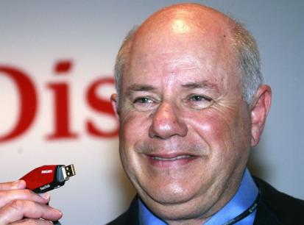
Kesalahan terbesar saya adalah mencoba membuat alat pancing, padahal saya tidak suka memancing dan tidak pernah pergi memancing...
(Eli Harari)

Slide 72

Satu hal yang membuat saya tetap bertahan adalah bahwa saya mencintai apa yang saya lakukan...
(Steve Jobs)

Slide 73
5 Mitos Kesalahan Penerapan Teknologi Informasi
Mitos 1: Cara Sekarang Manual, Perlu Diterapkan Teknologi Informasi
Mitos 2: Kualitas Software Dinilai dari Teknologi yang Digunakan
Mitos 3: Divisi IT Harus Memikirkan Semua Ide dan Kebutuhan Perusahaan
Mitos 5: Tidak Suka, Tapi Yakin Sukses di Dunia IT
Mitos 4: Saya Akan Membuat Aplikasi Seperti Yang Ada

Slide 74
2. Pengantar Tata Kelola Teknologi Informasi
2.1 Apa dan Mengapa Tata Kelola Teknologi Informasi
2.2 Apa dan Mengapa Framework Tata Kelola Teknologi Informasi

Slide 75
2.1 Apa dan Mengapa Tata Kelola Teknologi Informasi

Slide 76

Kondisi Rumah Saya
Luas 1000 m2
Total penghuni 13 orang
1 istri, 7 anak, 3 PRT, 1 supir
13 kamar tidur
1 ruang perpustakaan
2 ruang keluarga
13 kamar mandi
1 kolam renang
1 kolam ikan dengan puluhan jenis ikan
Taman dengan puluhan pohon dan hewan

Slide 77
Masalah di Rumah Saya
Berhubungan dengan Aset dan Layanan Pendukung
  Seluruh aset rumah, di mana posisinya, bagaimana mengontrol dan memperbaiki bila ada kerusakan
  Bagaimana memilih pembelian aset baru
  Apakah arsitektur rumah, besar kamar, cukup untuk mendukung kehidupan
  Dokumen yang diproduksi seluruh penghuni
Berhubungan dengan Kegiatan
  Kegiatan sehari-hari, kebiasaan masing-masing penghuni rumah, dan bagaimana tahapan penyelesaian masalah
  Bagaimana proses menguras kolam renang, membersihkan kamar tidur, kamar mandi, ruang tengah
Berhubungan dengan Pengontrolan dan Pengukuran Kinerja
  Bagaimana mengukur kinerja staf di rumah dan anak-anak
  Bagaimana aset dan kegiatan mendukung prestasi anak

Slide 78
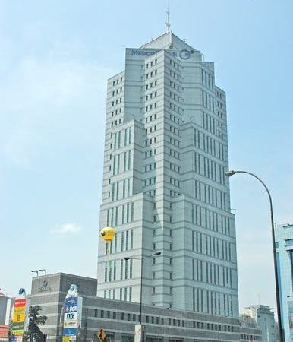
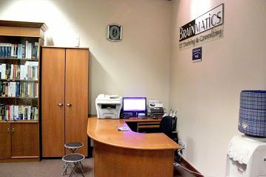
Kantor
Rumah
=

Slide 79
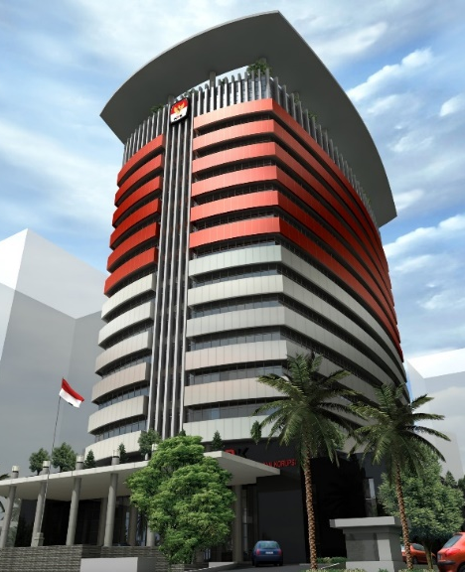








Kondisi di Organisasi
Ribuan pegawai dan puluhan unit kerja yang sering tidak termonitor dengan baik
Proses bisnis yang kompleks
Infrastruktur dan aset teknologi informasi tidak terkendali
Tingkat rotasi pegawai yang tinggi
Staff dan pimpinan baru perlu waktu untuk memahami kondisi organisasi
Pengelolaan layanan berbasis teknologi informasi yang tidak sistematis

Slide 80
Masalah di Organisasi
Berhubungan dengan Aset dan Layanan Pendukung
  Seluruh aset organisasi, di mana posisinya, bagaimana mengontrol dan memperbaiki bila ada kerusakan
  Bagaimana memilih pembelian aset baru
  Apakah arsitektur organisasi, pembagian divisi, cukup untuk mendukung proses bisnis organisasi
  Dokumen yang diproduksi seluruh staf
Berhubungan dengan Kegiatan
  Kegiatan sehari-hari, kebiasaan masing-masing staf, dan bagaimana tahapan penyelesaian masalah
  Bagaimana proses pengajuan cuti, pelaksanaan pekerjaan, pengunduran diri, dsb
Berhubungan dengan Pengontrolan dan Pengukuran Kinerja
  Bagaimana mengukur kinerja staf dan organisasi
  Bagaimana aset dan kegiatan mendukung layanan yang disediakan organisasi

Slide 81
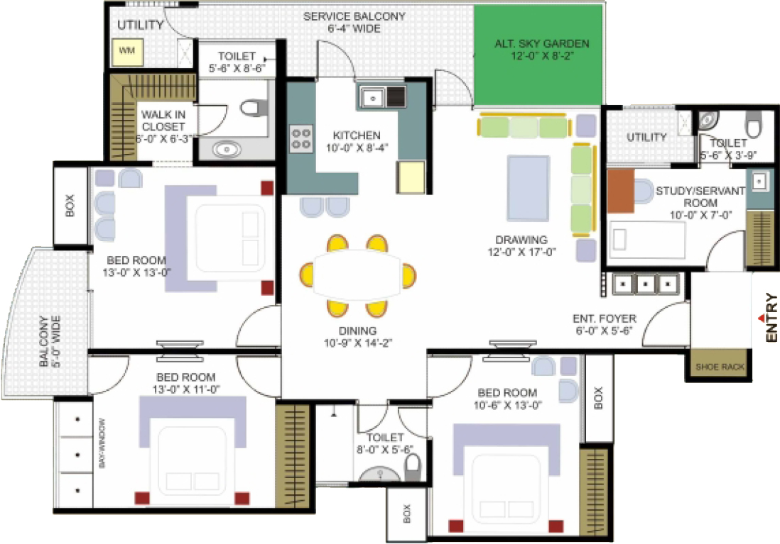
Kita Perlu Arsitektur Organisasi
Struktur Organisasi
Proses Bisnis
Struktur Data dan Informasi
Software dan Infrastruktur IT
Kebijakan Keamanan
Analisis Pola dari Data
dsb …
Enterprise
Architecture
1. Business Architecture
2. Data Architecture
3. Application Architecture
4. Technology Architecture

Slide 82

Kita Perlu Perencanaan Strategis
Penentuan stakeholder
Analisis kekuatan dan kelemahan organisasi
Penentuan visi, misi dan tujuan
Penentuan prioritas kegiatan
Penentuan roadmap untuk beberapa tahun ke depan
Penentuan pengukuran kinerja
dsb …
IT Strategic
Planning
1. Vision and Mission
2. SWOT Analysis
3. IT Roadmap and Strategies
4. IT Organization

Slide 83
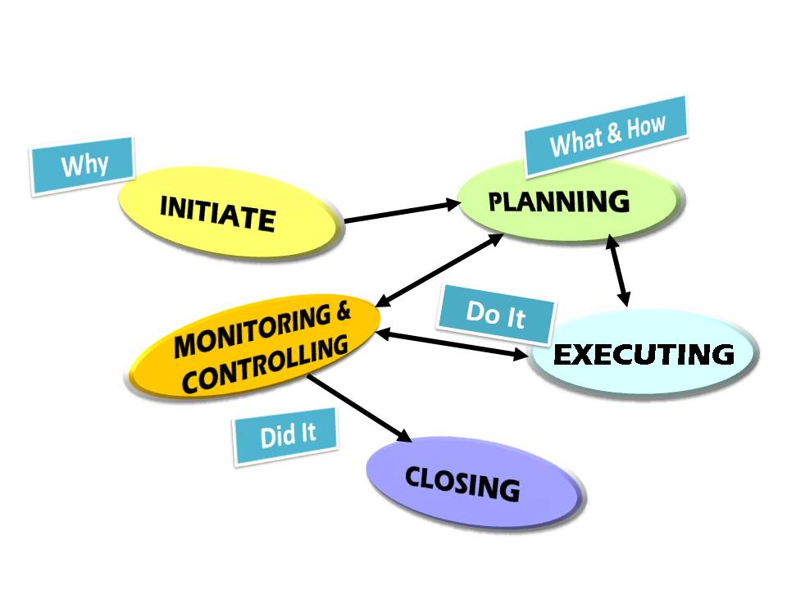
Kita Perlu Manajemen Kegiatan
Bagaimana tahapan melakukan proyek
Analisis dari suatu proyek
Dokumen apa saja yang dihasilkan
Bagaimana memonitor hasil pekerjaan
Bagaimana cara mengukur hasil pekerjaan
Software apa saja yang digunakan
dsb ...
Initiation
Planning
Executing
Monitoring and Controlling
Closing
IT Project
Management

Slide 84
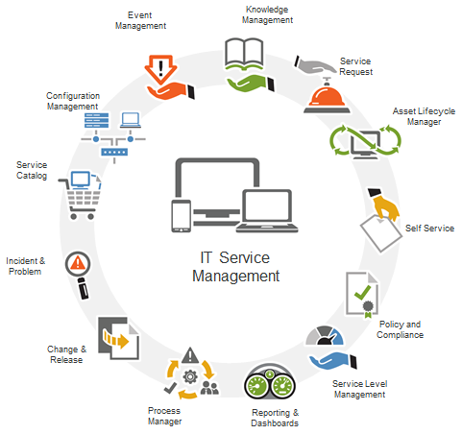
Kita Perlu Pengoperasian Layanan
Bagaimana membangun layanan IT yang baik
Bagaimana pengaturan service level agreement
Bagaimana bila ada masalah
Bagaimana mengelola pengetahuan
Bagaimana pengaturan pelaporan berkalanya
dsb …
IT Service
Management
1. Service Strategy
2. Service Design
3. Service Operation
4. Service Transition

Slide 85

Kita Perlu Pengukuran Kinerja
Kapan kinerja bisa diukur
Parameter apa saja untuk mengukur kinerja
Apa alat ukur yang bisa digunakan
Bagaimana menilai tingkat kematangan dari kinerja
Siapa yang berhak mengukur
Siapa yang berhak menjawab kuesioner pengukuran
1. Planning and Organization
2. Acquisition and Implementation
3. Delivery and Service
4. Monitoring
IT Monitoring
Evaluation

Slide 86
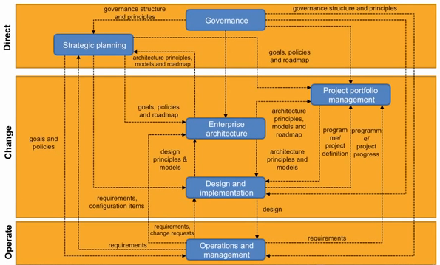
Kita Perlu Tata Kelola Teknologi Informasi

Slide 87

Enterprise Governance Drives Business and
IT Governance

Slide 88
Definisi Tata Kelola Teknologi Informasi
IT Governance is the responsibility of the Board of Directors and executive management, it is an integral part of enterprise governance and consist of the leadership and organizational structures and processes that ensure that the organization’s IT sustains and extends the organization’s strategy and objectives (IT Governance Institute, 2001)
Specifying the decision rights and accountability framework to encourage desirable behaviour in using IT (Weill & Ross, 2004)
The system by which the current and future use of ICT is directed and controlled. It involves evaluating and directing the plans for the use of ICT to support the organization and monitoring this use to achieve plans. It includes the strategy and policies for using ICT within an organization (Australian Standard on Corporate Governance of ICT, 2005)

Slide 89
Manfaat Tata Kelola Teknologi Informasi
Strengthens the relationship between the organization and IT
  Helps ensure limited IT resources are focused on the right strategic and tactical activities at the right time
Synergies with Enterprise Risk Management (ERM) and other risk management activities
  Helps ensure the appropriate IT risk management processes and activities are in place and operating effectively
Enhanced visibility into the IT Function’s ability to achieve its both strategic objectives and Key Performance Indicators (KPIs) for day-to-day activities and longer-term/strategic initiatives
Improved adaptability of the IT Function to organizational and IT environment changes
  Formality of Governance structure, processes and activities enables more efficient and effective response to change

Slide 90
Landasan Tata Kelola Teknologi Informasi
Permen Kominfo No 41 2007 tentang Tata Kelola Teknologi Informasi Nasinal
UU 30 tahun 2014 tentang Administrasi Pemerintahan
Perpres No 7 tahun 2015 tentang Organisasi Kementrian Negara
Permen Pan No 12 tahun 2011 tentang Penataan Tatalaksana Proses Bisnis
Permen Keuangan No 131 tentang Proses Bisnis
Permen Kominfo tentang Pedoman Teknis Audit Manajemen Keamanan Sistem Elektronik
Keputusan Mentri Keuangan No 330 tahun 2011 tentang Standard Manajemen Proyek Teknologi Informasi
Permen Pan RB no 11 Tahun 2015 tentang Road Map Reformasi Birokrasi 2015-2019

Slide 91
Kunci Kesuksesan Tata Kelola Teknologi Informasi
Dukungan dan komitmen penuh dari seluruh stakeholder dan pimpinan organisasi
Project pengembangan tata kelola IT bukan hanya kebutuhan divisi IT, tapi kebutuhan seluruh elemen organisasi
Tata kelola IT akan menggambarkan bisnis proses, aset, infrastruktur, analisis gap dan kebutuhan seluruh unit kerja, sehingga diperlukan koordinasi dan kolaborasi dari seluruh elemen organisasi
Perlu presentasi, diskusi dan interview secara intensif dengan pimpinan organisasi sehingga kebutuhan lebih akurat tertangkap

Slide 92
2.2 Apa dan Mengapa Framework Tata Kelola?

Slide 93


Slide 94


Slide 95


Slide 96


Slide 97


Slide 98


Slide 99


Slide 100
Bagaimana Tata Kelola Teknologi Informasi?
Harus mulai dari mana?
Siapa saja yang terlibat?
Apa yang harus dibuat?
Bagaimana tahapan pembuatannya?
Bagaimana standardisasi untuk alurnya?
☹
Pusing? Perlu contoh dan template?
☺
IT Governance Framework

Slide 101

Framework Tata Kelola Teknologi Informasi

Slide 102

Framework Tata Kelola Teknologi Informasi

Slide 103

Framework Tata Kelola Teknologi Informasi

Slide 104


Slide 105
3. Framework Tata Kelola Teknologi Informasi
3.1 TOGAF (Enterprise Architecture Framework)
3.2 PMBOK (Project Management Framework)
3.3 ITIL (Service Management Framework)
3.4 COBIT (IT Monitoring and Evaluation Framework)

Slide 106
Framework Tata Kelola Teknologi Informasi

Slide 107
3.1 TOGAF (Enterprise Architecture Framework)

Slide 108
What is TOGAF?
TOGAF is a framework (a detailed method and a set of supporting tools) for developing an enterprise architecture
TOGAF provides the methods and tools for assisting in the acceptance, production, use, and maintenance of an enterprise architecture
It is based on an iterative process model supported by best practices and a re-usable set of existing architecture assets
It may be used freely by any organization wishing to develop an enterprise architecture for use within that organization

Slide 109

TOGAF

Slide 110


TOGAF Methodology

Slide 111

TOGAF Methodology and Artifacts
TOGAF Methodology
TOGAF Artifacts

Slide 112


Modified TOGAF Framework (Wahono, 2015)
Modified TOGAF Methodology
Modified TOGAF Artifacts

Slide 113
EA - Architecture Vision

Slide 114

Brainmatics Vision and Mission
Vision
Mission
Menyediakan layanan jasa training dan sertifikasi di bidang teknologi informasi dengan kurikulum internasional yang berkarakter progressive, customizable dan berbasis experience
Menjadi perusahaan penyedia jasa training dan pengembang software dengan kualitas terbaik di Indonesia
Menyediakan layanan pengembangan software custom dan generic dengan metodologi standard internasional dan berbasis pengalaman industri

Slide 115




















Business Model Canvas
PT Brainmatics Cipta Informatika
Key Partners
Key Activities
Value
Propositions
Customer
Relationships
Customer
Segments
Pearson
Vue
Software
Development
Kurikulum Internasional dan Customizable dengan Kebutuhan
Offline: Kegiatan Workshop dan Training
Staff IT
Training
Center
Dosen
Kryterion Online
Pengajar dengan Kompetensi Terpadu Akademisi dan Industri
Online: Social Media Participation, Situs Brainmatics.Com
Certification
Examination
Mahasiswa
Prometrics
Key Resources
Peserta Ujian
Sertifikasi
Ruang Kelas Nyaman dan Posisi di Tengah Kota Jakarta
Channels
Percetakan
Kurikulum
Email
Pegawai
International Authorized Training and Testing Center
Telepon
Lembaga Pendidikan
Penerbit dan Distributor Buku
Brand Romi Satria Wahono
Brainmatics.Com
Lembaga
Pemerintahan
Online Market
Pengembangan Software dengan Metodologi Standard Internasional
Instant Messaging
(YM, WA, Line, BBM)
Food Court
Perusahaan Swasta
Brand IlmuKomputer.Com
Social Media
(Kaskus, Facebook, Twitter)
Cost Structure
Revenue Streams
Honor Pengajar
Biaya Operasional
Penjualan
Jasa Training
Penjualan
Produk Software
Gaji Pegawai
Biaya Infrastruktur
Biaya Marketing

Slide 116
Value Chain Diagram
Financial
Management
Human Resource
Management
Software Development Service
Training Service
Marketing Activities
SUPPORTING ACTIVITIES
PRIMARY ACTIVITIES

Slide 117
Organization Decomposition Diagram
Chief Executive Officer
General Manager
Finance Division
Marketing Division
Technology Course
Creative Course
Development Course
Human Resource Division
Development Division
Creative Product
Software Product
Training Division
Infrastructure
Training

Slide 118

Visi dan Misi DJPK
Visi
Misi
Mewujudkan perumusan kebijakan hubungan keuangan pusat dan daerah yang transparan dan akuntabel
Menjadi Pengelola Hubungan Fiskal Pusat dan Daerah Berkelas Dunia Yang Adil dan Transparan
Melaksanakan monitoring dan evaluasi pelaksanaan hubungan keuangan pusat dan daerah yang efektif
Menyelenggarakan sistem informasi keuangan daerah yang akurat, transparan, dan tepat waktu
Meningkatkan kualitas pengelolaan keuangan daerah

Slide 119

Organization Decomposition Diagram DJPK

Slide 120
MANAGEMENT FUNCTION
Kepatuhan
Internal
Pengelolaan
Risiko
Pengelolaan
Kinerja
PRIMARY FUNCTION
Perumusan Kebijakan dan Perencanaan HKPD
Pengelola Fiskal Pusat Daerah
Penganggaran dan Pengalokasian Dana Transfer ke Daerah, Dana
Desa, dan Hibah Daerah
Pelaksanaan dan Penatausahaan Transfer ke Daerah, Dana Desa, dan Hibah Daerah
Monitoring dan Evaluasi Pengelolaan HKPD
Peningkatan Kapasitas Keuangan Daerah
Penyelenggaraan Sistem Informasi Keuangan Daerah
Adil dan Transparan
SUPPORT FUNCTION
Pelayanan Perencanaan
dan Keuangan
Pelayanan Umum, Kehumasan dan Bantuan Hukum
Pelayanan
Sumber Daya Manusia
Pelayanan Organisasi dan Tata Laksana
Pelayanan Teknologi Informasi
120

Slide 121
Business Model Canvas
Direktorat Jenderal Perimbangan Keuangan
Key Partners
Key Activities
Value
Propositions
Customer
Relationships
Customer
Segments
Perumusan Kebijakan dan Perencanaan HKPD
Menjadi one
source data untuk keuangan daerah di level nasional
Offline: Sosialisasi, Korespondensi, Koordinasi, Supervisi, Workshop, Bimbingan Teknis, Ruang Pelayanan Terpadu, Kotak Saran, Site Visit
Kementerian/ Lembaga
Penganggaran dan Pengalokasian Dana Transfer ke Daerah, Dana
Desa, dan Hibah Daerah
Kementerian/ Lembaga
Pembina jabatan fungsional analis keuangan pusat dan daerah
DPR/DPD
Peningkatan Kapasitas Keuangan Daerah
Pelaksanaan dan Penatausahaan Transfer ke Daerah, Dana Desa, dan Hibah Daerah
Pemerintahan Daerah
Kewenangan sebagai penyedia layanan terpadu keuangan daerah (RPTKD)
Online: Situs djpk.depkeu.go.id, Call Center, Help Desk.
Masyarakat
Unit Eselon I Kementerian Keuangan
Penyelenggaraan SIKD
Monitoring dan Evaluasi Pengelolaan
HKPD
Menjadi model monitoring dan evaluasi hubungan keuangan pusat dan daerah
Akademisi
BPK
BPKP
Channels
Key Resources
Desa
BI
APH
Informasi dan Data
Kewenangan perumusan formulasi kebijakan desentralisasi fiskal
Email
Media Defis
Guru
SDM
SOP
SIKD
Pemerintahan Daerah
Kewenangan alokasi dan pelaksanaan transfer ke daerah dan dana desa
Sekolah
Rencana Strategis
Aset/ Infrastruktur
Telepon
Website
Media Masa
Kode Etik
Peraturan Perundang-undangan
Memegang teguh nilai-nilai kementerian keuangan (integritas, professionalme, pelayanan, sinergi, kesempurnaan)
Puskesmas
Universitas
Social Media
(Facebook, Twitter)
Anggaran
Cost Structure
Revenue Streams
Belanja Pegawai
Belanja Barang dan Jasa
Belanja Modal
APBN
Donor

Slide 122
FUNGSI ORGANISASI
Management
Perumusan Kebijakan dan Perencanaan HKPD
Penganggaran dan Pengalokasian Dana Transfer ke Daerah, Dana Desa dan Hibah Daerah
Pelaksanaan dan Penatausahaan Transfer ke Daerah, Dana Desa, dan Hibah Daerah
Monitoring dan Evaluasi Pengelolaan HKPD
Peningkatan Kapasitas Keuangan Daerah
Penyelenggaraan Sistem Informasi Keuangan Daerah
Supporting
PROSES BISNIS
Pengelolaan Kinerja
Kebijakan Dana Perimbangan
Penganggaran Dana Perimbangan
Pelaksanaan Transfer Dana Perimbangan
Monev Pelaksanaan Kebijakan dan Alokasi Dana Perimbangan
Perencanaan Bimbingan Teknis
Pembangunan dan Pengembangan Sistem
Pelayanan Umum
Kepatuhan Internal
Kebijakan Transfer Non Dana Perimbangan Dan Dana Desa
Pengalokasian Dana Perimbangan
Pelaksanaan Transfer Non Dana Perimbangan
Monev Pelaksanaan Kebijakan dan Alokasi Transfer Non Dana Perimbangan
Pelaksanaan Bimbingan Teknis
Tata Kelola Data
Pelayanan Humas dan Kerjasama Antar Lembaga
Pengelolaan Risiko
Kebijakan Hibah Daerah
Layanan SIKD
Fasilitasi Bantuan Hukum
Kebijakan Pembiayaan Daerah
Penganggaran Non Dana Perimbangan
Penyusunan DIPA TKDD, Dana Desa dan Hibah
Monev Pelaksanaan Kebijakan PDRD
Monev dan Pelaporan PKPKD
Kebijakan Pendapatan Asli Daerah
Pengalokasian Non Dana Perimbangan
Penatausahaan TKDD, Dana Desa dan Hibah
Monev Pelaksanaan Kebijakan Peningkatan Pendapatan dan Kapasitas Keuangan Daerah
Peningkatan Pemanfaatan SIKD
Pelayanan SDM
Kebijakan Peningkatan Kapasitas Keuangan Daerah
Perencanaan Keuangan
Kebijakan Pendanaan Perkotaan, Daerah Otonom Baru, Perdesaan, dan Kawasan
Monev Pengelolaan Keuangan Daerah
Pelayanan TI
Kebijakan Penyelenggaraan Sistem Informasi Keuangan Daerah
Monev Sistem Informasi Keuangan Daerah
Organisasi dan Tata Laksana
APLIKASI
SISTEM INFORMASI KEUANGAN DAERAH
OPERATIONAL INFORMATION SYSTEMS
Simulasi dan Alokasi DAK
e-Proposal DAK
Pelaksanaan Transfer I
MELINDA
BERBUDI
WBRS
IP Audit Network Report
Simulasi dan Alokasi DAU
SMS Broadcast Transfer ke Daerah
Repository DJPK
Monitoring Penyaluran Hibah Daerah
Simia
Cacti
Simulasi dan Alokasi Dana Desa
INOVASI DAK
Komandan
e-Learning
Aplikasi GPP
ADIK
Aplikasi Persediaan
SAIBA
SIPRIDA
DBH CHT
ID WEB
SIMDKD
SIMAK-BMN
DKD
Aplikasi Pustaka
LDT
INTAN INDIRA MASBRO SPIDI SIMPEG GUESTBOOK DJPK e-Office Simpatik SIKD Sinergi SIKD Core SIKD
STRATEGIC INFORMATION SYSTEMS
D a s h b o a r d E x e c u t i v e I n f o r m a t i o n S y s t e m s
PUBLIC INFORMATION SYSTEMS
W e b s i t e D J P K S I M T R A D A
Kebijakan Monev HKPD
SISTEM EKSTERNAL
Sistem Perbendaharaan dan Anggaran Negara
Government Finance Statistics
RKA-KL
INOVASI DAK
SAS
ID WEB
e-Proposal DAK
INDIKATOR KINERJA UTAMA
Perencanaan Kinerja dan Keuangan yang Komprehensif
Pengelolaan BMN yang Akuntabel
Pengelolaan BMN yang Akuntabel
Pengendalian Mutu Hubungan Keuangan Pusat dan Daerah (HKPD) yang Efektif
Kepuasan Pengguna Layanan yang Tinggi
Pemenuhan Layanan Publik
Organisasi Sekretariat yang Kondusif
Perumusan Kebijakan Hubungan Keuangan Pusat dan Daerah (HKPD) yang Berkualitas
Pengembangan Kapasitas Pengelola Keuangan yang Berkualitas
Sistem Informasi Manajemen yang Handal
Organisasi Sekretariat yang Kondusif
Pengembangan Pegawai yang Berkualitas dan SDM yang Kompetitif
Pelaksanaan Anggaran Sekretariat yang Optimal

Slide 123

Visi dan Misi
Visi
Fakultas Ilmu Komputer Unsri pada tahun 2020 menjadi program pendidikan bidang Teknologi Informasi dan Komunikasi yang bermutu, relevan dan memiliki daya saing yang tinggi dalam penyelenggaraan tridharma.
Misi
Menyelenggarakan akademik, manajemen dan keuangan secara efisien, efektif, berkualitas dan otonom.
Menciptakan organisasi yang sehat dan suasana akademik yang kondusif.
Memberikan kontribusi pada daya saing bangsa dan pengembangan masyarakat madani.

Slide 124
Business Model Canvas
Fakultas Ilmu Komputer UNSRI
Key Partners
Key Activities
Value
Propositions
Customer
Relationships
Customer
Segments
Pengajaran dan Pendidikan
Universitas dan Unit Kerja Dibawahnya
Promosi ke Stakeholders
Penelitian
Kurikulum Internasional Standar ACM
Penunjang
Tracer Study Alumni
Siswa SMA/SMK
Alumni
Pengabdian kepada Masyarakat
Integrasi Kurikulum dengan Sertifikasi Internasional
Seminar, Workshop dan Pelatihan
Industry
DIKTI
Key Resources
Mahasiswa Terseleksi dengan Ketat
Channels
Mahasiswa S1
Kurikulum
BAN-PT
Email
Guru Sekolah Menengah
ISP
Dosen
Pegawai
Memiliki Jurnal Internasional Terakreditasi DIKTI
Telepon
Mahasiswa
Laboratorium Riset dan Lab Praktikum
Website
Fax
Universitas Lainya
Prodi
Kerjasama Program dengan Universitas Luar Negeri
Surat Kabar
Pemda
Social Media
(Facebook, Twitter)
Sarana dan Prasarana
Cost Structure
Revenue Streams
Honor Pegawai kontrak
Honor Penelitian dan Pengabdian Dosen
Biaya Promosi
Hibah Penelitian dan Pengabdian
Proyek Kerjasama
BOPTN
Pembangunan Infrastruktur
Biaya Operasional
Biaya Pengembangan SDM
Pembiayaan Hibah Penelitian dan Pengabdian
Hibah (CSR)
SPP (PNBP)
APBN

Slide 125
Primary Activity
Pengabdian kepada Masyarakat
Pendidikan dan Pengajaran
Bermutu, Relevan
Penelitian
Supporting Activity
Pengelolaan Umum dan Perlengkapan
Pengelolaan
Tata Usaha
Pengembangan Kerjasama
Pengelolaan Keuangan dan Kepegawaian
Pengembangan dan Pengelolaan ICT
Pengelolaan Kemahasiswaan dan Alumni
dan Daya Saing Tinggi

Slide 126
Organization Decomposition Diagram
Wadek I Akademik
Wadek II Keuangan dan Kepegawaian
Wadek III Kemahasiswaan, Alumni dan Kerjasama
Dekan
UPPM
Jurusan
Laboratorium
Program Diploma
UPM
Program Pasca
Bagian Akademik
Bagian Keuangan dan Kepegawaian
ICT
Bagian Umum dan Perlengkapan
Unit Perencanaan dan Pengembangan
Unit Kerjasama
Bagian Kemahasiswaan dan Alumni
Senat Fakultas
Tata Usaha

Slide 127
Solution Concept Diagram (Target)
FUNGSI ORGANISASI
Pengelolaan Umum dan Perlengkapan
Pengelolaan Keuangan dan Kepegawaian
Pengelolaan
Tata Usaha
Pengembangan dan Pengelolaan ICT
Pengembangan Bisnis dan Kerjasama
Pengelolaan Kemahasiswaan dan Alumni
Pendidikan dan Pengajaran
Penelitian
Pengabdian kepada Masyarakat
PROSES BISNIS
Penyusunan RKAKL
Pengelolaan Keuangan
Pengendalian Dokumen Internal
Pengembangan Layanan
Pengelolaan Kerjasama
Pengelolaan Beasiswa
Penerimaan Mahasiswa Baru Fakultas
Pengajuan Proposal Penelitian
Pengajuan Proposal Pengabdian Masyarakat
Pelaksanaan Pengadaan
Pengelolaan Usulan Pegawai dan Dosen
Pengendalian Dokumen Eksternal
Pengelolaan Layanan
Evaluasi Kerjasama
Pengelolaan Mahasiswa
Pengisian KRS
Pelaksanaan Perkuliahan
Pelaksanaan Penelitian
Pelaksanaan Pengabdian Masyarakat
Pengelolaan Aset
Pengelolaan Usulan Pangkat dan Jabatan Dosen
Identifikasi dan Pemenuhan Sumber Daya
Monitoring Jaringan
Pengelolaan Pelatihan & Sertifikasi Dosen
Pengelolaan Alumni
Penyelesaian Kerja Praktik
PenyelesaiaanT ugas Akhir
Evaluasi Kinerja Pegawai
Pengelolaan Pelatihan, Sertifikasi Mahasiswa & Pihak Exkternal
Pendaftaran Yudisium
Monitoring dan Evaluasi Mutu Akademik
Pengelolaan Kurikulum
APLIKASI
ERP FASILKOM UNSRI
OPERATIONAL INFORMATION SYSTEMS
Modul Permintaan Barang
Modul E-Budgeting
Modul Pengelolaan Dokumen
Modul Monitoring
Modul Layanan Kerjasama
Modul Layanan Mahasiswa dan Alumni
Modul Elearning
Modul Monitoring PPM
Modul Pengelolaan Pegawai & Dosen
Modul Layanan Informasi Pelatihan dan Sertifikasi
Modul Manajemen Lab.
Modul Monitoring TA
Modul Monitoring dan Evaluasi Mutu Akademik
Modul E-Library
STRATEGIC INFORMATION SYSTEMS
M o d u l D a s h b o a r d K i n e r j a F a k u l t a s
PUBLIC INFORMATION SYSTEMS
Situs Blog Dosen dan Mahasiswa
E-Journal
SISTEM EKSTERNAL
LPSE
SIMKEU
SIMAK BMN
SIRENA
SIMAK
KEY PERFORMANCE INDICATOR
- Akurasi Jumlah Aset
- Kelancaran Pengadaan Barang
- Tingkat Serapan Anggaran
- Akuntabilitas Penggunaan Anggaran
- Kelancaran Pangkat dan Jabatan
- Tingkat Rasio Dosen Mahasiswa
- Jumlah Dosen Studi Lanjut
- Jumlah Insentif Dosen Tetap
- Akurasi Dokumen
- Peningkatan Paperless Dokumen
- Jumlah Tiket Masalah Terselesaikan
- Tingkat Kehandalan Layanan
- Jumlah Kerjasama
- Jumlah Realisasi Kerjasama
- Jumlah Pelatihan dan Sertifikasi (Nasional dan Internasional)
- Jumlah Penerima Beasiswa
- Jumlah Keterserapan Alumni
- Jumlah Kegiatan Mahasiswa (Prestasi)
- Rata-rata IPK
- Rata-rata Masa Studi
- Tingkat Kehadiran Dosen
- Tingkat Kehadiran Mahasiswa
- Akreditasi Program Studi
- Lama Penyusunan TA
- Kesesuaian Jenis Pekerjaan Alumni
- Tingkat DO
- Jumlah Proposal Masuk dan Diterima
- Jumlah Publikasi Per Dosen
- Jumlah Dana Penelitian
- Jumlah Sumber Dana Penelitian
- Jumlah Proposal Masuk dan Diterima
- Jumlah Dana Pengabdian
- Jumlah Sumber Dana Pengabdian

Slide 128
Hierarki Organisasi – Fungsi – Proses Bisnis
Visi dan Misi
Fungsi 1
Proses Bisnis Level 1
Proses Bisnis Level 1
Fungsi 2
Proses Bisnis Level 1
Organisasi
Fungsi
Proses Bisnis Level 1
Proses Bisnis Level 3
Proses Bisnis Level 2
Proses Bisnis Level 2
Proses Bisnis Level 3
Proses Bisnis Level 3
Proses Bisnis Level 3
Proses Bisnis Level 2
Proses Bisnis Level 2

Slide 129
EA - Business Architecture

Slide 130
Functional Decomposition Diagram
Finance
Division
Human Resource Division
Development Division
Training Division
Marketing Division
SUPPORTING ACTIVITIES
PRIMARY ACTIVITIES
Pengembalian Biaya Training
Penerimaan Magang
Pengembangan Software
Pelaksanaan Training
Pemasaran Training
Pinjaman Karyawan
Penerimaan Pegawai
Pengembangan Enterprise Architecture
Pelaksanaan Ujian
Monitoring Tender
Penggajian Karyawan
Pengajuan Cuti
Maintenance Software
Maintenance Infrastruktur
Belanja Bulanan
Pengunduran Diri
Maintenance Enterprise Architecture
Pembayaran Honor Instruktur
Monitoring Pendidikan
Penagihan Pembayaran

Slide 131
Business Interaction Matrix
 | Finance Division | Human Resource Division | Development Division | Training Division | Marketing Division
Finance Division |  | Request budget | Request budget | Request budget | Request budget
Human Resource Division | Apply for staffing issues |  | Apply for staffing issues | Apply for staffing issues | Apply for staffing issues
Development Division | Request systems and maintenance | Request systems and maintenance |  | Request systems and maintenance | Request systems and maintenance
Training Division | Request infrastructure maintenance | Request infrastructure maintenance | Request infrastructure maintenance |  | Request product knowledge
Marketing Division |  |  | Apply for software product marketing | Apply for training product marketing

Slide 132
Organization/Actor Catalog
Organization | Actor
Finance Division | Financial Manager
Human Resource Division | Human Resource Manager
 | Employee
 | Assistant
Development Division | Development Manager
 | Project Manager
 | Programmer
Training Division | Training Manager
 | Trainer
 | Participant
Marketing Division | Marketing Manager
 | Marketer
 | Customer

Slide 133

Business Process Model and Notation (BPMN)
Notasi standard untuk pemodelan proses bisnis
  Object Management Group (OMG))
  Permenpan No 12 Tahun 2011 tentang Pedoman Penataan Tata Laksana (Business Process)

Slide 134

General Business Process Diagram (Level 0)
Adhoc Version

Slide 135

Human Resource Division (Level 1):
Penerimaan Pegawai

Slide 136
Business Interaction Matrix
 | Pengabdian kepada Masyarakat | Pendidikan dan Pengajaran | Penelitian | Pengelolaan Umum dan Perlengkapan | Pengelolaan Kemahasiswaan dan Alumni | Pengembangan Bisnis dan Kerjasama | Pengelolaan Keuangan dan kepegawaian | Pengelolaan Tata Usaha | Pengembangan dan Pengelolaan ICT
Pengabdian kepada Masyarakat |  |  |  |  |  | Mempromosikan Inovasi dan teknologi yang dihasilkan | Meningkatkan pendapatan Fakultas
Pendidikan dan Pengajaran | Menerapkan Inovasi Pengajaran Sekolah |  |  |  |  | Mempromosikan Inovasi dan teknologi pengjaran
Penelitian | Menerapakan hasil penelitian kepada Masyarakat | Pembaharuan Bahan Ajar |  |  |  | Mempromosikan Inovasi dan teknologi yang dihasilkan Penelitian
Pengelolaan Umum dan Perlengkapan | Meminta Barang dan Peralatan | Meminta Barang dan Peralatan | Meminta Barang dan Peralatan |  | Meminta Barang dan Peralatan | Meminta Barang dan Peralatan | Permintaan Barang dan Peralatan | Permintaan Barang dan Peralatan | Permintaan Barang dan Peralatan
Pengelolaan Kemahasiswaan dan Alumni | Meminta Asistensi |  |  |  |  | Meminta Profile Mahasiswa dan Alumni
Pengembangan Kerjasama | Permintaan MoA | Permintaan MoA | Permintaan MoA
Pengelolaan Keuangan dan kepegawaian | Permintaan Pendanaan | Permintaan Pendanaan | Permintaan Pendanaan | Permintaan Pendanaan | Permintaan Pendanaan | Permintaan Pendanaan |  | Permintaan Pendanaan
Pengelolaan Tata Usaha | Permintaan surat Pengantar | Permintaan surat Pengantar | Permintaan surat Pengantar |  | Permintaan surat Pengantar | Permintaan surat Pengantar |  |  | Permintaan surat Pengantar
Pengembangan dan Pengelolaan ICT | Permintaan Aplikasi, Publikasi | Permintaan Aplikasi dan Perawatan | Permintaan Aplikasi, Publikasi | Permintaan Aplikasi | Permintaan Aplikasi, Peratawan Aplikasi dan Publikasi | Permintaan Aplikasi, Peratawan Aplikasi dan Publikasi | Permintaan Aplikasi, Peratawan Aplikasi dan Publikasi | Permintaan Aplikasi, Peratawan Aplikasi dan Publikasi

Slide 137
Function/Actor Catalog
Function | Actor
Pendidikan dan Penajaran | Bagian Akademik | Dosen | Ketua Jurusan | Subag Akademik | Tim Auditor | Wadek I
 | Calon Mahasiswa | Dosen PA | Mahasiswa | Subag Keahasiswaan | Unit Kerja | Wadek III
 | Dekan | Laboratorium | Stakeholder | Tata Usaha | UPM
Penelitian | Dekan | Dosen | Subag Keuangan | UPPM
Pengabdian Masyarakat | Dekan | Dosen | Subag Keuangan | UPPM
Pengelolaan Umum dan Perlengkapan | Bagian Umum dan Perlengkapan | Panitia Pengadaan | Pejabat Pengadaan | Subag Keuangan
 | Dekan | Wadek III | PD2 / PPK | Unit Kerja
Pengelolaan Kemahasiswaan dan Alumni | Mahasiswa | Dekan | Wakil Rektor III | Subag Kemahasiswaan | Tata Usaha
 | Alumni | Wadek II | Wadek III | Subag Keuangan
Pengembangan Kerjasama | Dekan | Wadek III | UnitKerja
Pengelolaan Keuangan dan Kepegawaian | Dekan | Jurusan | Senat Fakultas | Subag Kepegawaian | UPPM | Unit Kerja
 | Dosen dan Pegawai | PPK | Bendahara Pembantu | Subag Keuangan dan Kepegawaian | Tata Usaha
Pengelolaan Tata Usaha | Asesor | Dekan | Wakil Dekan | Dosen | Jurusan/Prodi | Diploma
 | Pegawai | Tata Usaha | Unit Pelaksana Teknis | Unit | Sub Bagian
 | Subag Kemahasiswaan | Subag Akademik | Subag Keuangan dan Kepegawaian | Subag Umum dan Perlengkapan | Jurusan
Pengembangan dan Pengelolaan ITC | Bagian ICT | Dosen | Laboran | Mahasiswa | Pegawai | Staf ITC
 | Unit Perlengkapan | Wadek II

Slide 138

Proses Bisnis Level 0
UNSRI

Slide 139

Proses Bisnis Pendidikan dan Pengajaran – Penerimaan Mahasiswa Baru (Level 1)

Slide 140

Bisnis Proses Level 1 DJPK

Slide 141

Bisnis Proses Level 2 DJPK

Slide 142

Bisnis Proses Level 3 DJPK

Slide 143
EA - Application Architecture

Slide 144
Application Portfolio Catalog
Organization | Application
Finance Division | Finance Module
Human Resource Division | Human Resource Module
Development Division | Project Management Module
Training Division | Training Management Module
Marketing Division | Customer Relationship Module

Slide 145
Application Portfolio Catalog
Organization | Application | Nilai Kelayakan | Komentar dan Saran
All Units | App 1 App 2 App 3 | 1 4 3 | Banyak bug dan ga dibutuhkan Ribet pakainya Sebaiknya ditambahi fitur abc
Unit A | App 4 App 5 App 6
Unit B | App 7
Unit C | App 8 App 9
Unit D | App 10

Slide 146
Application Portfolio Catalog
Function | Application |  | Nilai Kelayakan |  |  |  | Komentar
 |  |  | Kemanfaatan | Kemudahan | Kehandalan | Frekuensi Pemakaian
Layanan Publik | Website Fakultas & Jurusan |  | 3 | 3 | 3 | 3 | Belum Digunakan | Baseline
Pendidikan dan Pengajaran | Sistem Informasi Kinerja Fakultas | SIMAK (UNSRI) | 4 | 4 | 4 | 4 |  | Baseline
 |  | Blog Dosen | 2 | 4 | 3 | 2 |  | Baseline
 |  | E-Learning | 3 | 3 | 3 | 2 |  | Baseline
 |  | Facebook Page Fasilkom | 4 | 4 | 4 | 4 |  | Baseline
Penelitian |  | E-Journal | 4 | 4 | 4 | 4 |  | Baseline
Pengabdian Masyarakat
Pengelolaan Umum dan Perlengkapan |  | SIMAK Barang Milik Negara (Kemenkeu) LPSE (UNSRI) |  |  |  |  |  | Baseline Baseline
Pengelolaan Kemahasiswaan dan Alumni |  | Tracer Study Alumni | 4 | 3 | 3 | 4 |  | Baseline
Pengembangan Kerjasama
Pengelolaan Keuangan dan kepegawaian |  | SIMAK Keuangan (Kemenkeu) E-Budgeting | 4 | 3 | 3 | 4 |  | Baseline Target
Pengelolaan Tata Usaha
Pengembangan dan Pengelolaan ICT

Slide 147

Gap Analysis

Slide 148
Application Use Case Diagram:
Global Package

Slide 149
Application Use Case Diagram:
Customer Relationship Module

Slide 150
Application Use Case Diagram:
Customer Relationship Module - Pemasaran Training

Slide 151
Application Use Case Diagram:
Finance Module

Slide 152
Application Use Case Diagram:
Training Management Module

Slide 153
Application Use Case Diagram:
Project Management Module

Slide 154
Application Use Case Diagram:
Human Resources Module

Slide 155
EA - Data Architecture

Slide 156
Application/Data Matrix
Module DB - Entity | Finance Module | Human Resource Module | Project Management Module | Training Management Module | Customer Relationship Module
HRM - Karyawan | R | CRUD | R
PM - Project |  |  | CRUD
TM - Peserta | R |  |  | CRUD | R
TM – Instruktur | R | R |  | CRUD | R
...... | …… | …… | …… | …… | ……

Slide 157
Data Entity/Business Function Matrix
Module DB - Entity | Business Process | Organization
HR - Karyawan | Pengajuan Cuti | Human Resource Division
PM - Project | Maintenance Software Custom | Development Division
TM - Peserta | Pelaksanaan Training | Training Division
TM – Instruktur | Persiapan Training | Training DIvision
……. | ......... | ........

Slide 158

Logical Data Diagram

Slide 159

Arsitektur Data Mining

Slide 160
Data - Informasi - Pengetahuan
1. Estimasi
2. Prediksi
3. Klasifikasi
4. Klastering
5. Asosiasi
Prediksi dan klastering calon tersangka koruptor
Asosiasi atribut tersangka koruptor
Prediksi pencucian uang
Estimasi jenis dan jumlah tahun hukuman

Slide 161


Prediksi Calon Legislatif DKI Jakarta

Slide 162


Prediksi Kelulusan Mahasiswa

Slide 163
EA - Technology Architecture

Slide 164
Technology Standard Catalog
No | Technology
1 | RUP shall be used as the formal methodology for Brainmatics
2 | UML shall be used as the standard notation
3 | Sparx EA shall be used to facilitate the software engineering processes
4 | Java shall be the programming language
5 | Use JBoss 5.0 as the Application Server
6 | Browser: IE 4.0 +, Mozilla Firefox 1.0 HTML: 4.0 + Web 2.0
7 | Script Support: JavaScript 1.1
8 | Use IBM System x3850 M2 as the host server
9 | Symantec Network Security and Symantec AntiVirus for Security
10 | Oracle 10g for Database
11 | Hibernate Framework
12 | XML for Web Services
13 | Lightweight Directory Access Protocol (LDAP)
14 | SSL,PKI, Single Sign On

Slide 165
Application/Technology Matrix
Module Technology | Finance Module | Human Resource Module | Project Management Module | Training Module | Customer Relationship Module
JBOSS App Server | X
Oracle DBMS | X | X | X | X | X
Web Server |  | X |  |  | X
Javascript |  | X |  |  | X
OpenERP | X | X | X | X | X
…… | ........ | ........ | ........ | ........ | ........

Slide 166
Environment and Location Diagram

Slide 167
EA - Architecture Governance

Slide 168
Architecture Governance
CIO
Stewardship
Develop
Implement
Deploy
Chief Architect
Architecture Board
Program Management Offfice
Service Management
Guidance
Risk Management
Monitoring
Enterprise Architects
Alignment
Alignment
Domain Architects
Diffusion
Implementation Projects
Change
Operational Systems
Conformance
Enterprise Continuum
Architectures
Processes
Solutions
SLAs/OLAs
Regulatory Requirements
Authority Structures
Organizational Standarts

Slide 169
Architecture Governance
Dekan
Pengembangan
Pengelolaan
Penerapan
Chief Architect
Architecture Board
Program Management Offfice
Service Management
Guidance
Risk Management
Monitoring
Unit
Terkait
Enterprise Architects
Alignment
ICT
Alignment
Wakil
Dekan
Domain Architects
Diffusion
Implementation Projects
Change
Operational Systems
Conformance
Enterprise Continuum
Architectures
Processes
Solutions
SLAs/OLAs
Regulatory Requirements
Authority Structures
Organizational Standarts

Slide 170
3.2 PMBOK (Project Management Framework)

Slide 171
PMBOK
PMBOK (Project Management Body of Knowledge) adalah framework dan kumpulan pengetahuan khusus beserta best practice mengenai pengelolaan project
Dikeluarkan oleh Project Management Institute (PMI), dan diupdate setiap beberapa tahun sekali PMI
  Saat ini edisi yang terbaru adalah edisi kelima yang dirilis pada tahun 2013

Slide 172
PMBOK Process

Slide 173

PMBOK Process Group vs Knowledge Area

Slide 174


Slide 175


Slide 176


Project Charter

Slide 177

Project Management (Trello.Com Board)
Akan Dikerjakan
Sedang Dikerjakan
Sedang Direview
Selesai Dikerjakan

Slide 178

Project Management (Trello.Com Board)
Akan Dikerjakan
Sedang Dikerjakan
Sedang Direview
Selesai Dikerjakan

Slide 179
3.3 ITIL (Service Management Framework)

Slide 180
ITIL
ITIL atau Information Technology Infrastructure Library (Pustaka Infrastruktur Teknologi Informasi), adalah suatu rangka kerja dan teknik pengelolaan infrastruktur, pengembangan, serta operasional teknologi informasi
ITIL diterbitkan dalam suatu rangkaian buku yang masing-masing membahas suatu topik pengelolaan TI
Nama ITIL dan IT Infrastructure Library merupakan merek dagang terdaftar dari Office of Government Commerce (OGC) Britania Raya
ITIL memberikan deskripsi detail tentang beberapa praktik TI penting dengan daftar cek, tugas, serta prosedur yang menyeluruh yang dapat disesuaikan dengan segala jenis organisasi TI

Slide 181

ITIL

Slide 182

ITIL

Slide 183
3.4 COBIT (IT Monitoring and Evaluation Framework)

Slide 184
COBIT
Control Objective for Information and related Technology (COBIT) adalah panduan standar praktik manajemen teknologi informasi, yang bertujuan untuk menyediakan kebijakan yang jelas dan good practice untuk IT governance, mengukur penerapan IT, membantu manajemen mengelola resiko-resiko yang berhubungan dengan IT
Standar COBIT dikeluarkan oleh IT Governance Institute yang merupakan bagian dari ISACA. COBIT 5 merupakan versi terbaru, dengan cakupan domain:
  Align, Plan and Organise
  Build, Acquire and Implement
  Deliver, Service and Support
  Monitor, Evaluate and Asses
COBIT menyediakan kerangka IT governance dan petunjuk control objective yang detail untuk manajemen, pemilik proses bisnis, user dan auditor

Slide 185


Slide 186

COBIT 5 Reference Card

Slide 187

COBIT Maturity Model
Kondisi Sekarang
Kondisi rata-rata Perusahaan
Target yang akan dicapai

Slide 188
Non-existent
Tidak ada pengetahuan akan pentingnya penjajaran manajemen sumber daya manusia TI dengan proses perencanaan teknologi untuk organisasi
Tidak ada orang atau yang bertanggungjawab secara formal untuk manajemen sumber daya manusia TI

Slide 189
Initial
Manajemen mengenali kebutuhan akan manajemen sumber daya manusia TI, Tetapi tidak diformalisasikan pada suatu proses atau rencana
Proses Manajemen sumber daya manusia TI bersifat tidak formal dan sebuah pendekatan yang difokuskan secara reaktif dan operasional untuk penyewaan dan pengaturan personil TI
Pengetahuan merupakan pengembangan mengenai pengaruh yang kuat dimana perubahan-perubahan bisnis dan teknologi cepat dan solusi-solusi kompleks yang makin bertambah didapat dalam kebutuhan untuk kemahiran-kemahiran yang baru dan tingkatan yang kompeten

Slide 190
Repeatable
Terdapat pemahaman yang semestinya akan kebutuhan untuk manajemen sumber daya manusia TI
Ada suatu pendekatan taktis untuk penyewaan dan pengaturan dari personil TI, dikendalikan proyek-kebutuhan spesifik, dari pada oleh suatu arahan teknologi dan suatu keseimbangan pemahaman dari ketersediaan internal dan eksternal dari staf-staf yang memiliki skil
Pelatihan informal mengambil tempat untuk personil baru, yang menerima pelatihan dalam sebuah dasar yang dibutuhkan

Slide 191
Defined
Proses untuk pengaturan sumber daya manusia TI telah dikembangkan dan disana terdapat suatu rencana manajemen sumber saya manusia TI yang terdefenisi dan terdokumentasi
Terdapat suatu pendekatan strategi untuk penyewaan dan pengaturan dari personil TI
Ada suatu rencana pelatihan formal yang didisain untuk menemukan kebutuhan-kebutuhan bisnis dari sumber daya manusia TI
Suatu program yang rotasional, didisain untuk memperluas skil-skil manajemen teknikal dan bisnis, dibangun

Slide 192
Managed and Measurable
Tanggung jawab untuk pengembangan dan pemeliharaan dari suatu rencana manajemen sumber daya manusia TI telah diberikan pada individu yang khusus dengan keahlian dan kemahiran yang penting untuk mengembangkan dan memelihara rencana. Proses bersifat responsif untuk perubahan.
Organisasi telah memiliki ukuran yang distandarisasikan yang memperbolehkan organisasi tersebut untuk mengidentifikasi penyimpangan-penyimpangan dari rencana, dengan perhatian khusus dalam pengaturan pertumbuhan personil TI.
Analisa skala kompensasi dijalankan secara periodik untuk memastikan dimana gaji yang kompetitif dalam membandingkan organisasi-organisasi TI. Manajemen sumber daya manusia TI bersifat proaktif, pengambilan ke dalam pengembangan pencatatan jalur karir.

Slide 193
Optimised
Organisasi memiliki rencana manajemen sumber daya manusiaTI yang efektif dimana yang menemukan kebutuhan-kebutuhan bisnis untuk TI dan pendukung bisnis
Manajemen sumber daya manusia TI diintegrasikan dengan perencanaan teknologi, pemastian pengembangan optimum menggunakan skil skil TI yang tersedia. Komponen manajemen sumber daya manusia TI konsisten dengan praktek terbaik TI, seperti sebagai kompensasi, pelaksanaan pengkajian ulang, partisipasi dalam forum-forum industri, transfer pengetahuan,pelatihan dan mentoring
Program-program pelatihan dikembangkan bagi standar-standar teknologi yang baru secara keseluruhan dan produk-produk diprioritaskan untuk tenaga kerja mereka dalam organisasi. Teknologi digunakan dalam penyediaan skil, pelatihan dan kebutuhan kompeten informasi dalam kemudahan dapat mengakses database, untuk membantu proses manajemen sumber daya manusia TI
Program-program insentif didefenisikan dan dipastikan untuk manajemen TI, sama untuk ketersediaan untuk manajemen senior yang lain dari organisasi, untuk menghadiahi rapat sasaran pelaksanaan TI

Slide 194

Langkah 1. Menentukan Statement
The maturity level descriptions were split into separate statements, and all statements in the maturity level descriptions were separate in the questionnaire

Slide 195

Langkah 2. Menentukan Nilai Kepatuhan

Slide 196

Langkah 3. Membuat Kuesioner
When the questionnaire is complete, each maturity level will have a set of statements, each with its own compliance value of 0, 0.33, 0.66 or 1
The compliance value for the scenario can be computed as the average of the compliance level of the statements. In the case of maturity level 3, it is equal to 8.63/11 = 0.78

Slide 197

Langkah 4. Menghitung Nilai Kepatuhan
Working in the same way on the other maturity levels, one can compute a compliance value for all the maturity level form 0 to 5

Slide 198

Langkah 5. Normalisasi Nilai Kepatuhan
The ability to see the compliance values as a description of the "contribution" of each maturity level scenario to the overall maturity level of the organization

Slide 199

Langkah 6. Menghitung Total Maturity Level
Finally, the maturity level summary for the process was computed by combining the normalized compliance values for each maturity level as shown in figure 7

Slide 200
3 Dimension of Maturity
Tiga dimensi dalam kerangka kerja COBIT adalah:
  Kemampuan
  Kinerja
  Kontrol
Dapat digunakan untuk menilai suatu proses TI dalam situasi tertentu secara lebih akurat
Penerapan dimensi ini diserahkan kepada pengguna COBIT untuk memutuskan tergantung pada bagaimana detail dan tepat penilaian maturity diperlukan dan lingkup area target penilaian

Slide 201
3 Dimension of Maturity: Capability
Kemampuan adalah tingkat kematangan yang dibutuhkan dalam proses untuk memenuhi kebutuhan bisnis (idealnya didorong oleh usaha dan tujuan TI yang jelas)
COBIT berfokus pada kemampuan dan membantu perusahaan mengenali kemampuan yang paling sesuai dengan kebutuhan proses tertentu

Slide 202
3 Dimension of Maturity: Performance
Ukuran dari kinerja yaitu bagaimana dan di mana kemampuan perlu digunakan didasarkan pada kebutuhan bisnis, dan keputusan investasi berdasarkan pertimbangan biaya dan manfaat
Sebagai contoh: tingkat keamanan yang tinggi mungkin harus berfokus pada hanya untuk sistem perusahaan yang paling kritis

Slide 203
3 Dimension of Maturity: Control
Kontrol adalah ukuran kontrol aktual dan pelaksanaan proses, dalam mengelola risiko dan memberikan nilai yang diharapkan sesuai dengan kebutuhan bisnis
Sebuah proses mungkin tampak pada tingkat kemampuan yang tepat dengan karakteristik manajemen yang tepat, tapi masih gagal karena kurangnya pengendalian desain
Ini merupakan penilaian terhadap tujuan pengendalian COBIT dianggap perlu untuk proses itu
COBIT memberikan model maturity generik untuk pengendalian internal, dan proses PO6 dan ME2 membantu melembagakan kebutuhan untuk kontrol yang baik

Slide 204

Terima Kasih
Romi Satria Wahono
http://romisatriawahono.net
romi@romisatriawahono.net
081586220090

