Slide 1
BPMN Fundamentals
Romi Satria Wahono romi@romisatriawahono.net http://romisatriawahono.net/bpmn WA/SMS: +6281586220090

Slide 2
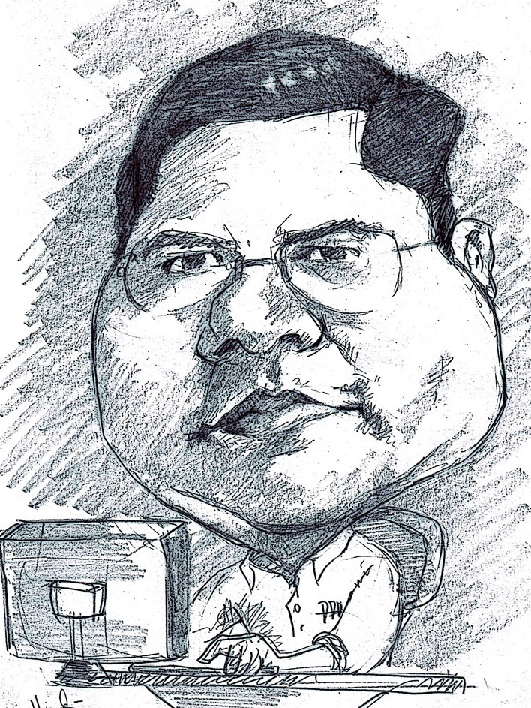
Romi Satria Wahono
SD Sompok Semarang (1987)
SMPN 8 Semarang (1990)
SMA Taruna Nusantara Magelang (1993)
B.Eng, M.Eng and Ph.D in Software Engineering from Saitama University Japan (1994-2004) Universiti Teknikal Malaysia Melaka (2014)
Research Interests: Software Engineering, Machine Learning
Founder dan Koordinator IlmuKomputer.Com
Peneliti LIPI (2004-2007)
Founder dan CEO PT Brainmatics Cipta Informatika

Slide 3
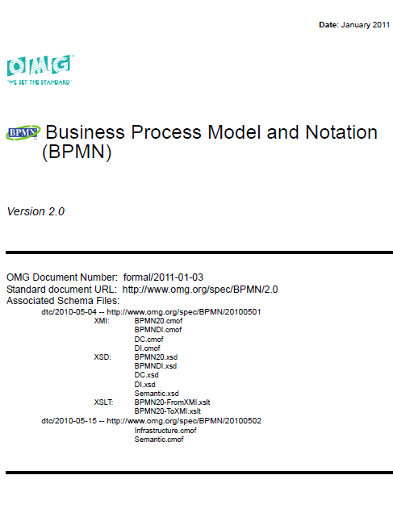
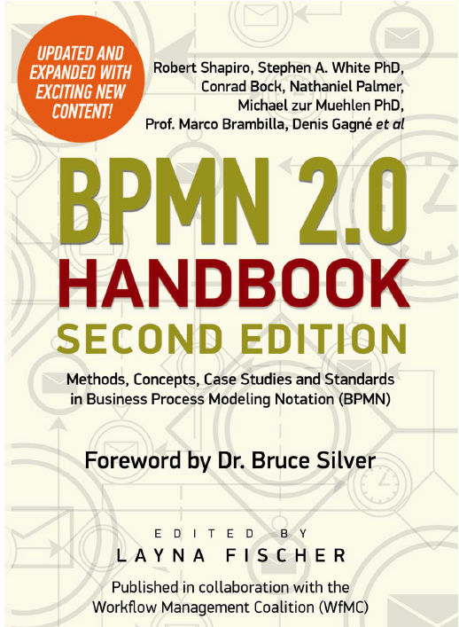
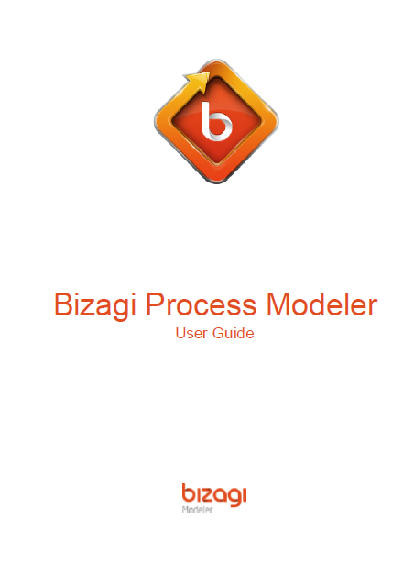
Textbooks

Slide 4
Course Outline
Introduction
BPMN Elements
3.1 Swimlane
3.2 Connecting Objects
3.3 Flow Objects
3.4 Artifacts
BPMN Simulation
BPMN Refactoring
BPMN Guide Examples

Slide 5
PreTest
Sebutkan nama unit kerja (divisi) tempat anda bekerja
Deskripsikan alur pekerjaan yang rutin anda kerjakan
Sebutkan diagram atau notasi apa saja yang dapat digunakan untuk memodelkan business process. Lingkari notasi atau diagram yang anda sangat familier menggunakannya
Dengan menggunakan diagram dan notasi yang anda kuasai, gambarkan business process model di bawah: alur penjualan pizza oleh penjual pizza dengan layanan delivery order

Slide 6
1. Introduction

Slide 7
Business Process
A business process is a collection of related, structured activities or tasks that produce a specific service or product for a particular customer or customers
There are three main types of business processes:
Management Processes, the processes that govern the operation of a system (corporate governance, strategic management)
Operational Processes, processes that constitute the core business and create the primary value stream (purchasing, manufacturing, marketing, sales)
Supporting Processes, which support the core processes (accounting, recruitment, technical support)

Slide 8
Business Process Analysis Strategies
Business Process Automation (BPA)
Business Process Improvement (BPI)
Business Process Reengineering (BPR)

Slide 9
Business Process Automation
Makes almost no changes to business processes, just makes them more efficient
Improves efficiency by automating the business processes
Least impact on users:
they do the same things, just more efficiently

Slide 10
Business Process Improvement
Goal is to improve the business processes
Change what the users do, not just how efficiently they do it
Changes to business process must be decided first
Decisions to change the business processes cannot be made by the analyst

Slide 11
Business Process Reengineering
“Fundamental rethinking and radical redesign of business processes to achieve dramatic improvements…”
Throw away everything
Start with a blank page
Appealing, but very expensive and risky

Slide 12
Strategy Comparison
Business Business Business
Process Process Process
Automation Improvement Reeingineering
Potential Business Low-Moderate Moderate High
Value
Project Cost Low Low-Moderate High
Breadth of
Analysis Narrow Narrow-Moderate Very Broad
Risk Low Low-Moderate Very High

Slide 13
Business Process Modeling
A business process model is:
a model of one or more business processes and defines the ways in which operations are carried out to accomplish the intended objectives of an organization
Typically performed by business analysts and managers who are seeking to improve process efficiency and quality
The process improvements identified by BPM may or may not require Information Technology involvement

Slide 14
Value Chain Diagram
Human Resource
Information Technology
Finance
Manufacturing
Sales
SUPPORTING ACTIVITIES
PRIMARY ACTIVITIES

Slide 15
Functional Decomposition Diagram
Human Resource
Information Technology
Finance
Manufacturing
Sales
SUPPORTING ACTIVITIES
PRIMARY ACTIVITIES
Onboarding
Systems Development
Loan Request
Procurement
Marketing
Offboarding
Help Desk
Manages Payable
Manufacturing
Sales
Promotion
Systems Maintenance
Manage Receivable
Inventory
Vacation Request
Manage Assets

Slide 16
Business Process Modeling Diagram
Diagram | Standard
Flowchart | No Standard
Use Case Diagram (UML) | OMG
Activity Diagram (UML) | OMG
Business Process Model and Notation (BPMN) | OMG

Slide 17
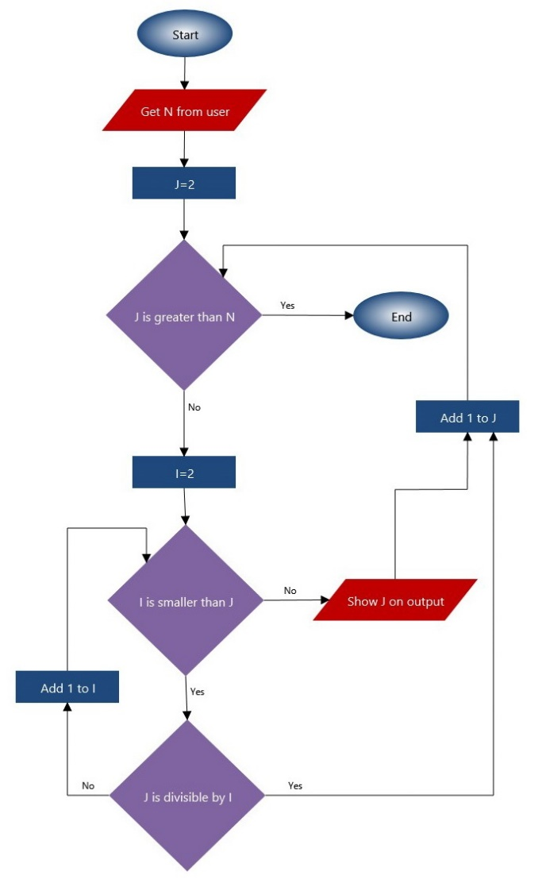
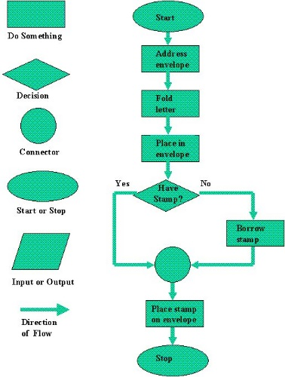
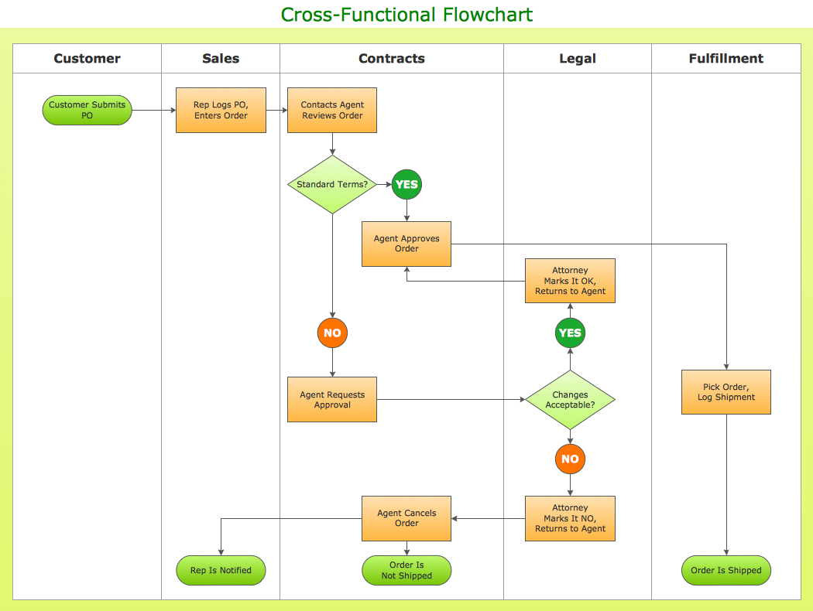
Flowchart

Slide 18
Use Case Diagram

Slide 19
Activity Diagram

Slide 20
Activity Diagram (Partition)

Slide 21
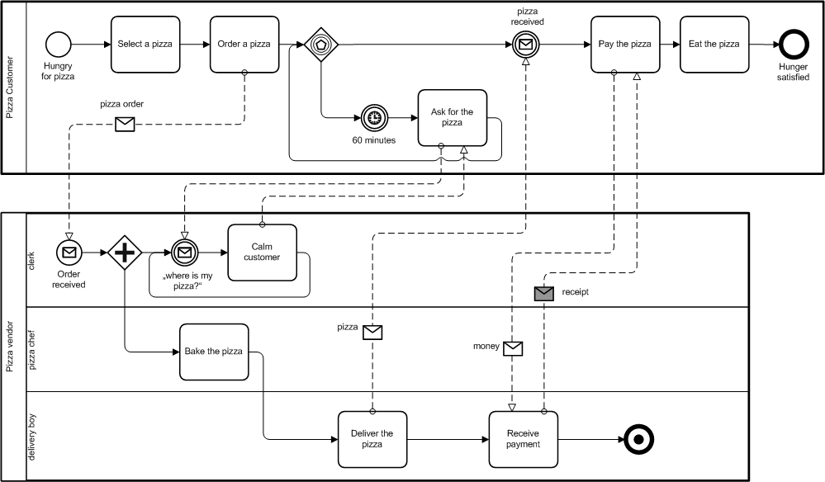
BPMN of Pizza Collaboration Process

Slide 22
Business Processes Standarization
In order to achieve a competitive advantage, organizations are focusing more on the management and optimization of their business processes
The business world has changed dramatically over the last few years, processes can now involve multiple participants and their coordination can be complex
There was no standard modeling technique

Slide 23
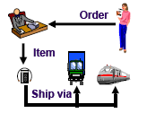
Why Standard Business Processes?

Slide 24
What is BPMN
Business Process Modeling Notation (BPMN) is a graphic notation that describes the logic of the steps in a Business Process
This notation has been especially designed to coordinate the sequence of processes and messages that flow between participants of different activities
It was developed by the organization BPM Initiative, made by the Object Management Goup (OMG)
This means great possibilities for BPMN to become the standard language regarding business processes, like UML which has become the standard for software modeling

Slide 25
Why BPMN?
Permenpan No 12 Tahun 2011 tentang Pedoman Penataan Tata Laksana (Business Process) yang merekomendasikan BPMN sebagai notasi untuk pemodelan business process

Slide 26
Why is BPMN Important?
BPMN provides a common notation so that the people related to the processes can express them graphically in a clear, standardized and complete manner
BPMN enables not only the standardization of the processes within the organization, but also expands the field of action for them to be shared and understood by different business partners
A goal for the development of BPMN is for the notation to be simple and adoptable by business analysts

Slide 27
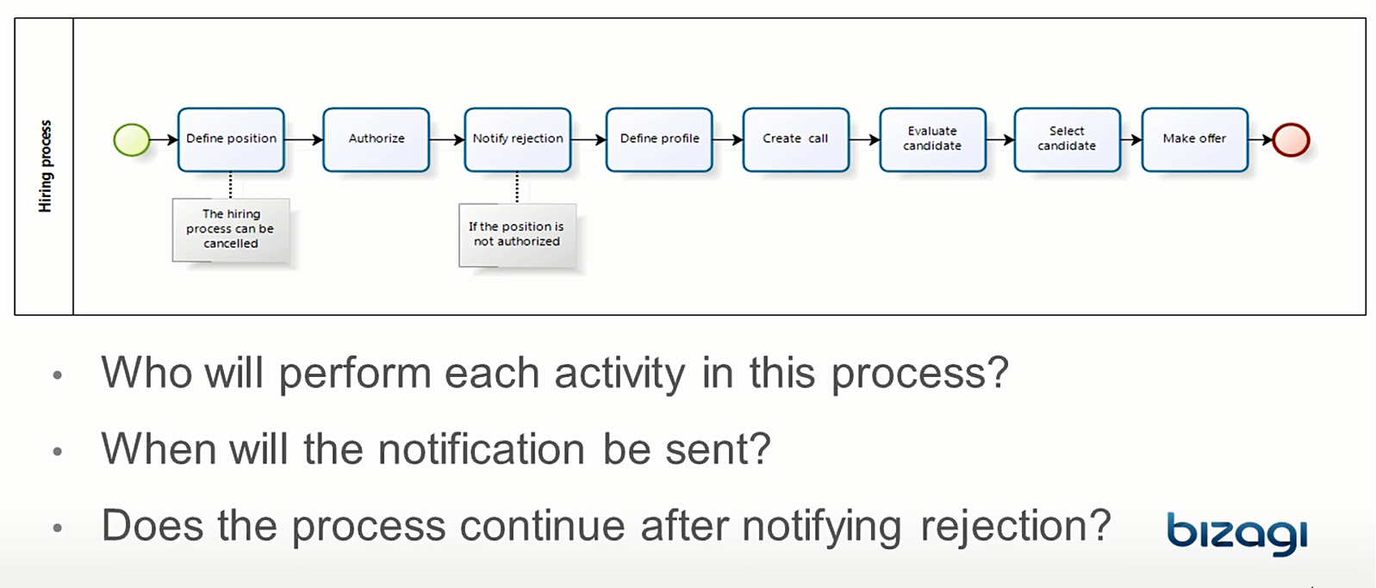
Why is BPMN Important?

Slide 28
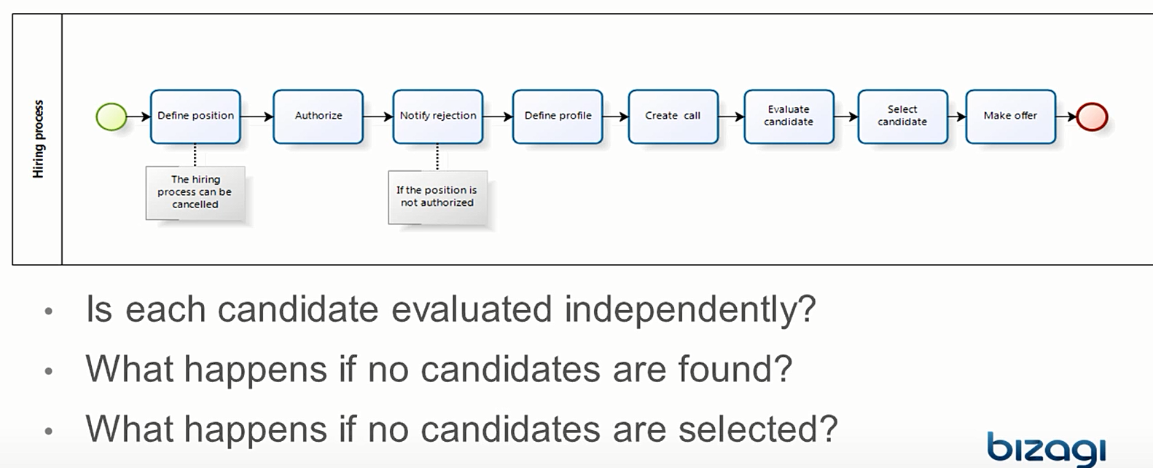
Why is BPMN Important?

Slide 29
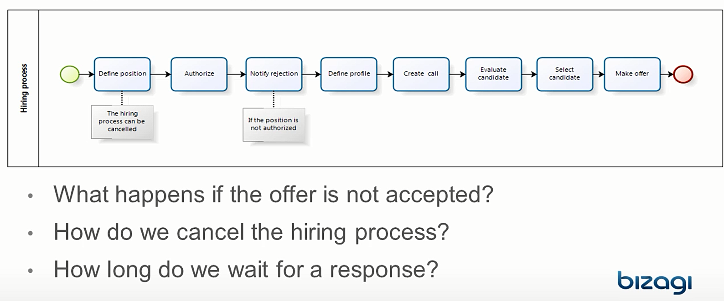
Why is BPMN Important?

Slide 30
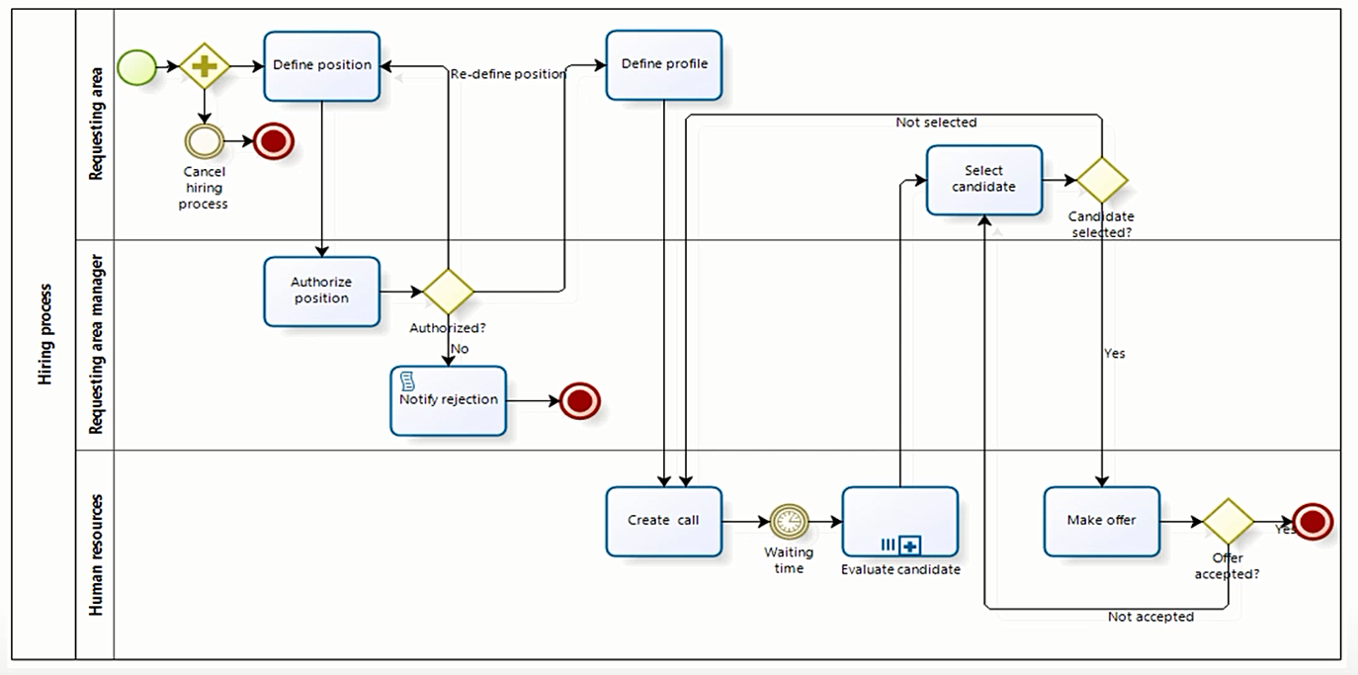
Why is BPMN Important?

Slide 31
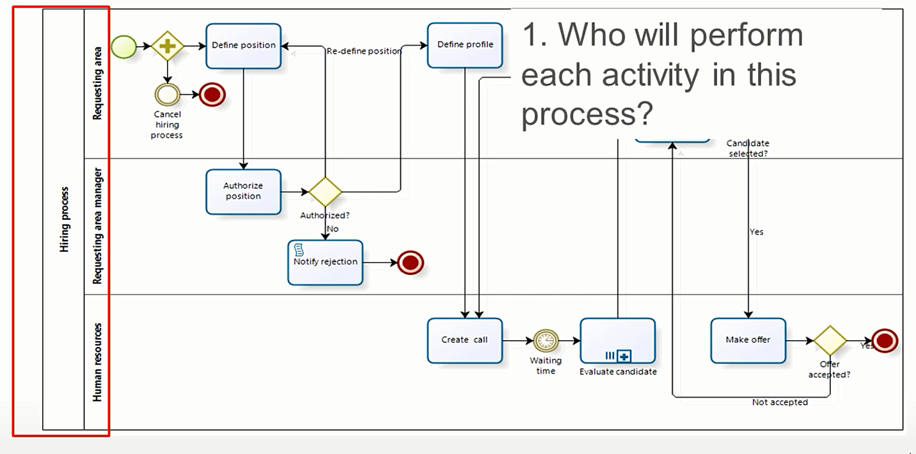
Why is BPMN Important?

Slide 32
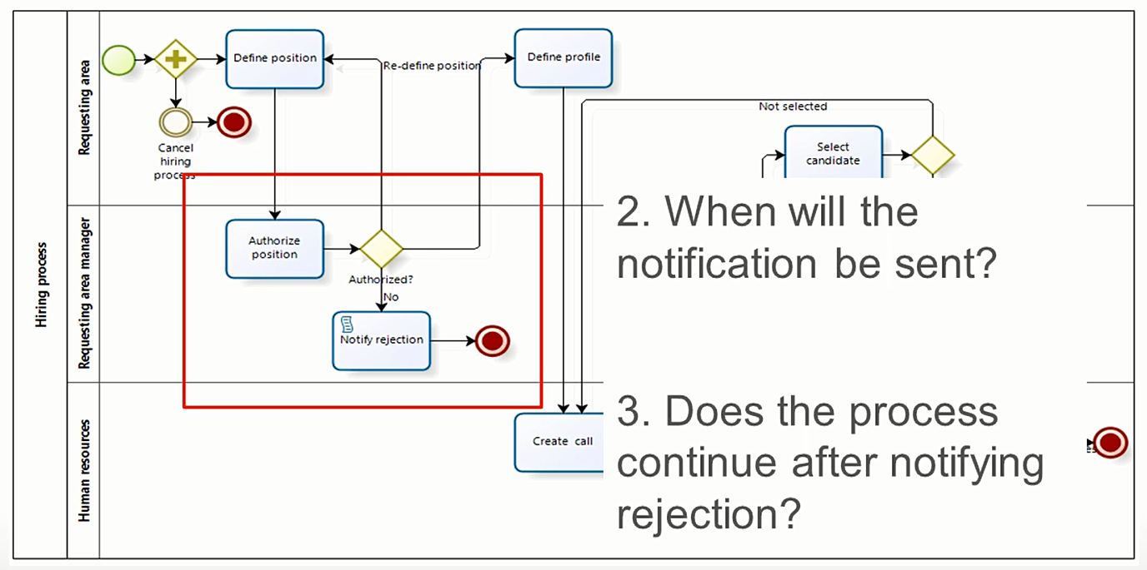
Why is BPMN Important?

Slide 33
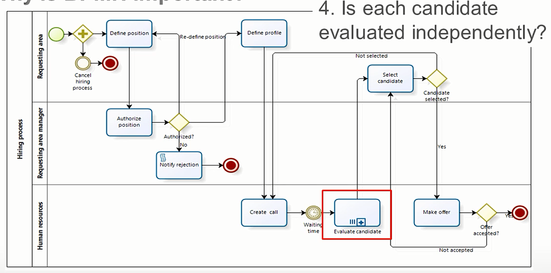
Why is BPMN Important?

Slide 34
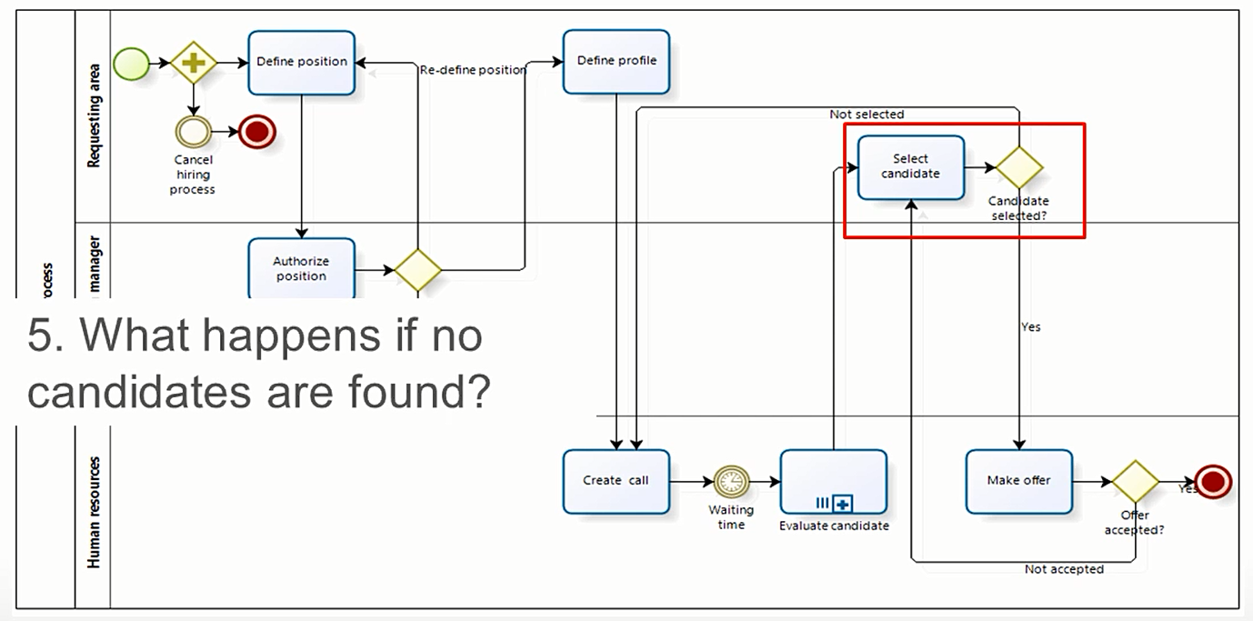
Why is BPMN Important?

Slide 35
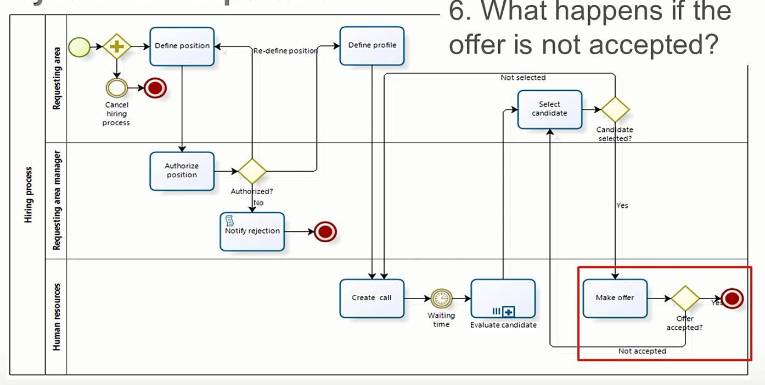
Why is BPMN Important?

Slide 36
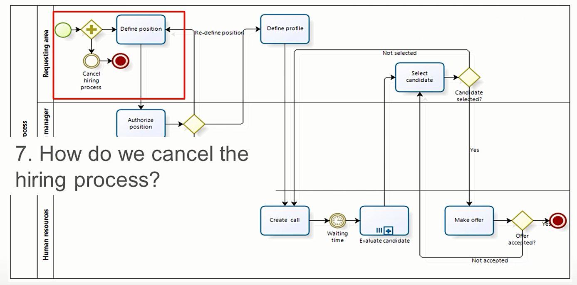
Why is BPMN Important?

Slide 37
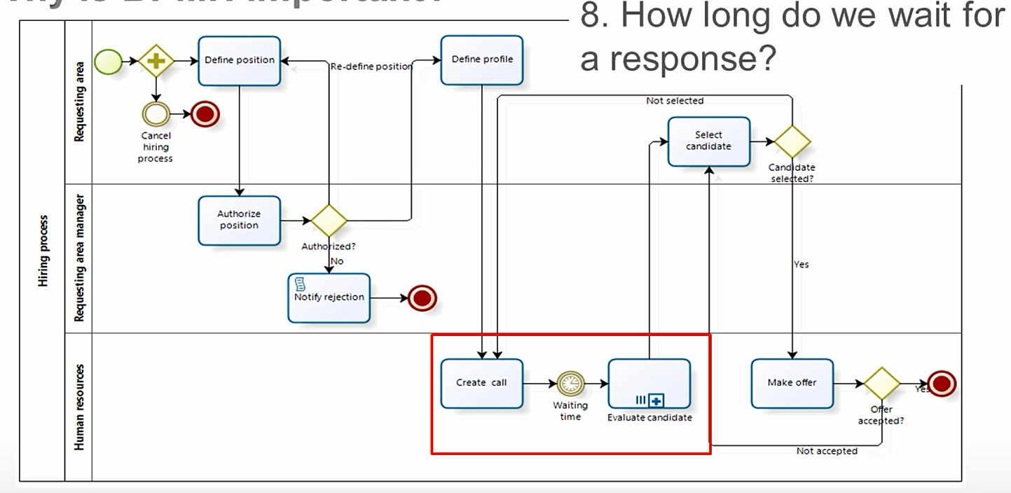
Why is BPMN Important?

Slide 38
Business Process Modeling Tools
Microsoft Visio
Visual Paradigm
Enterprise Architect
Bizagi Process Modeler
ARIS Express
Altova
Activiti

Slide 39
BPMN Modeling Elements
One of the guidelines for the development of BPMN is to create a simple mechanism to diagram process flows, which in turn can handle the complexity inherent to business processes
The approach taken to handle these two conflicting requirements was to organize the graphic aspects of the notation in specific categories
This provides a category system that helps the reader of a BPMN diagram to easily recognize the basic types of elements and understand the diagram

Slide 40
BPMN Modeling Elements
The four basic categories of these elements are:
Flow Objects
Connecting Objects
Swimlanes
Artifacts
Flow Objects
Connecting Objects
Swimlanes
Artifact

Slide 41
BPMN Modeling Elements
ELEMENT | DEFINITION | BPMN NAME
Flow Objects | Flow objects are the main graphic elements that define the behavior of the processes | Events
 |  | Activities
 |  | Gateways
Connecting Objects | Flow objects are connected to each other by means of connectors to create the basic framework of the business process structure | Sequence Flow
 |  | Message Flow
 |  | Association
Swimlane | Swimlanes are mechanisms to arrange activities in separate display categories to illustrate the different functional areas or persons in charge | Pools
 |  | Lanes
Artifacts | Artifacts are used to provide additional information about the process. They provide the notation with flexibility to express different contexts properly | Annotation
 |  | Group
 |  | Data Object
 |  | Data Store

Slide 42
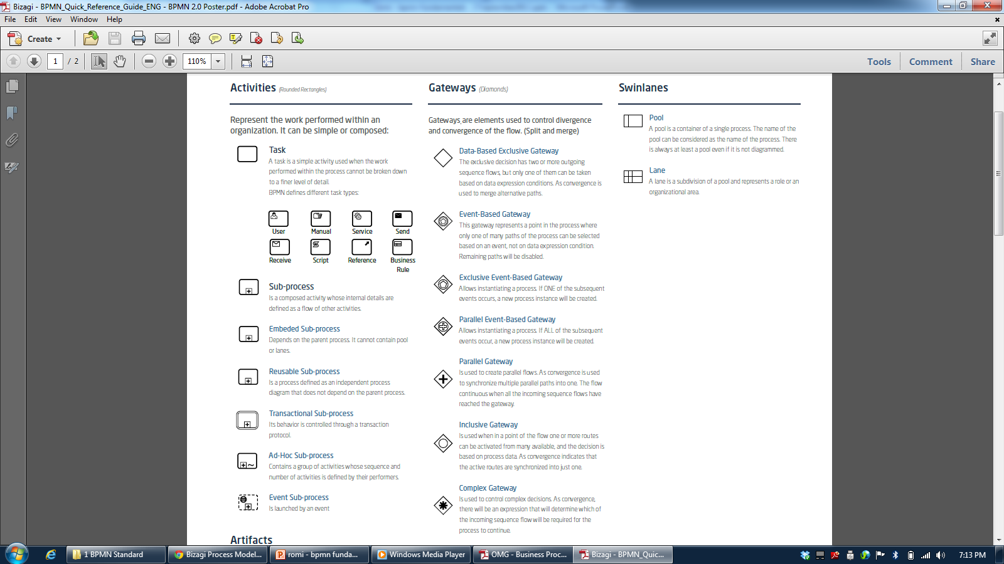
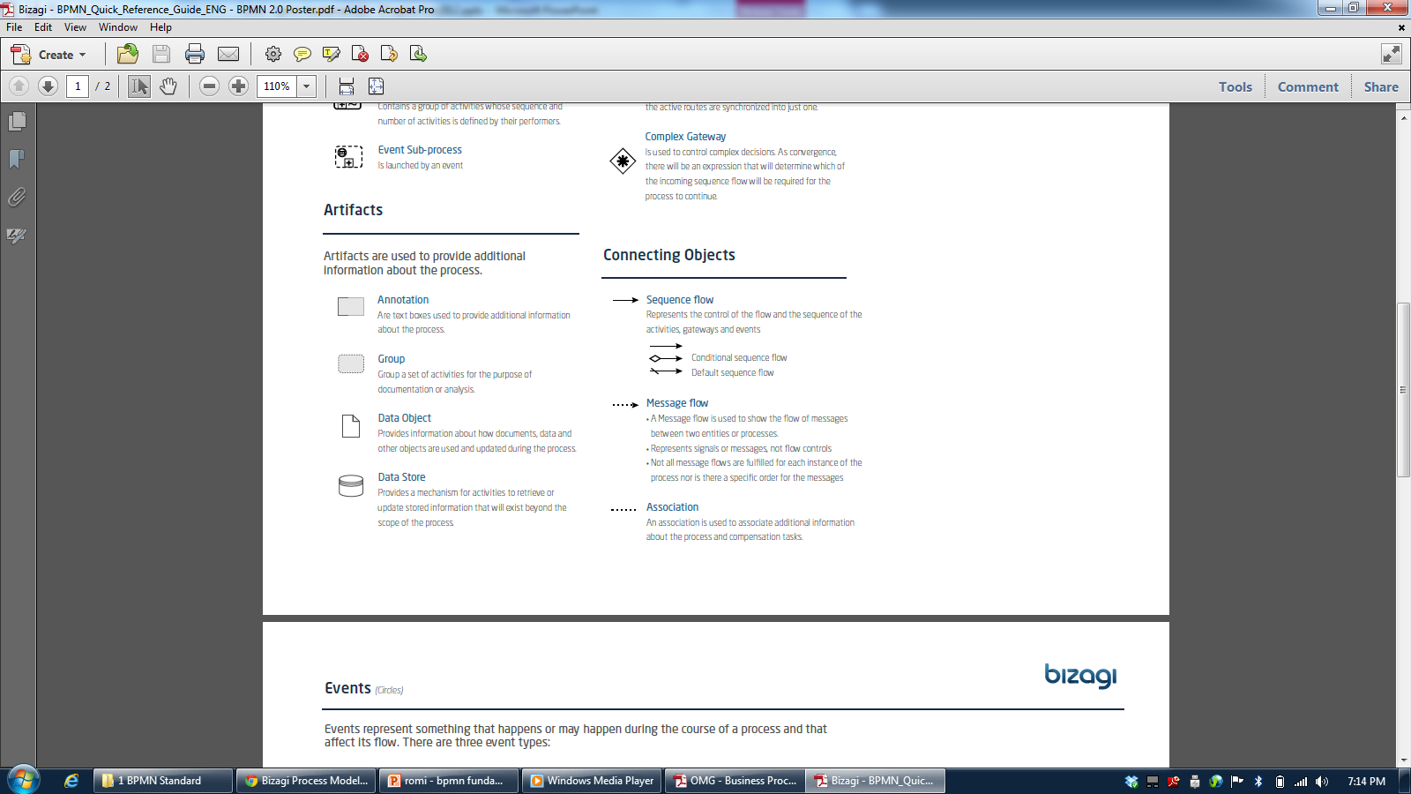

Slide 43
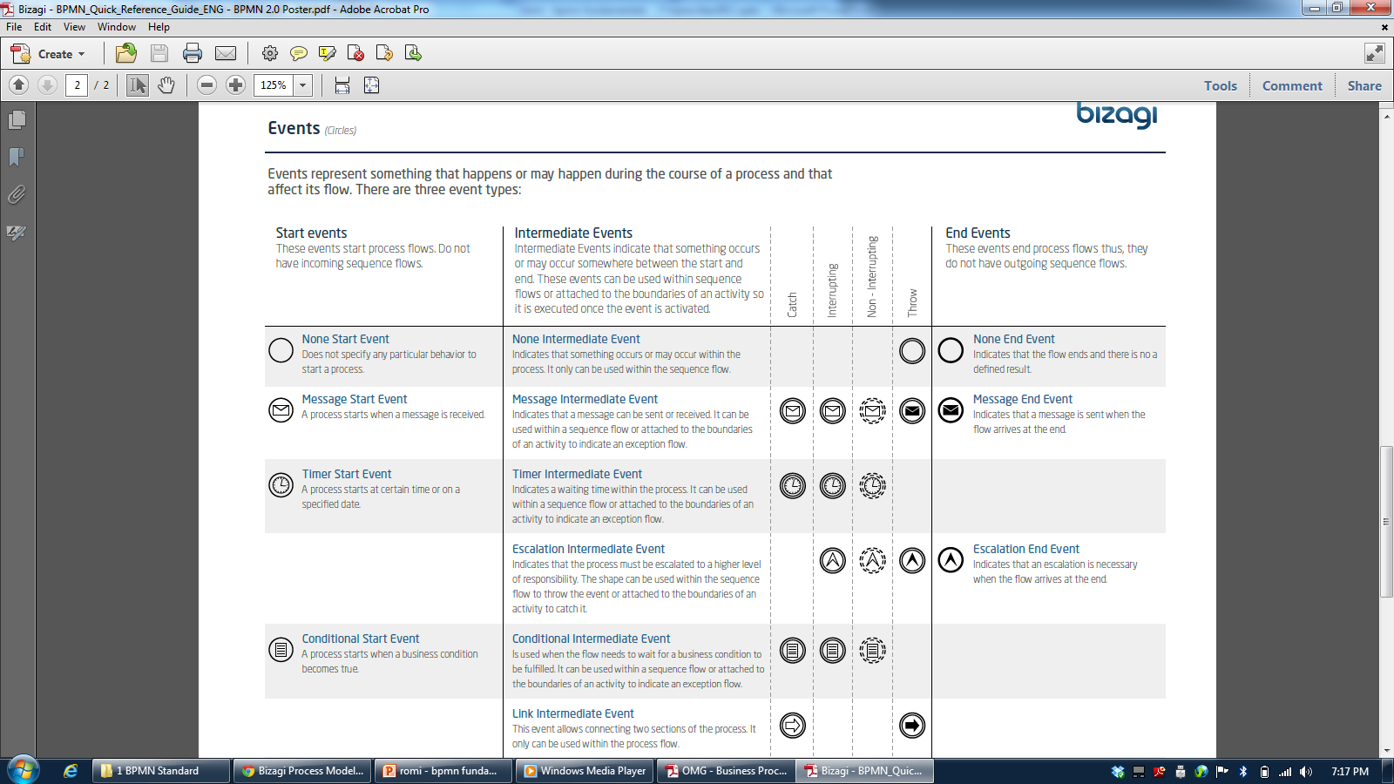

Slide 44
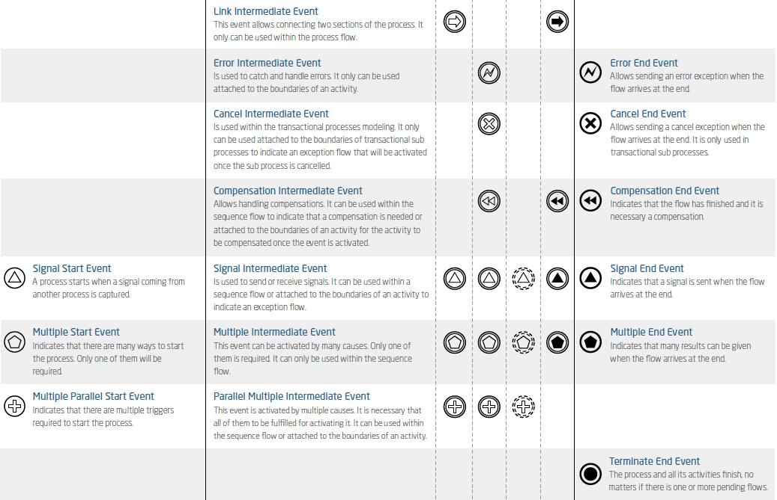

Slide 45
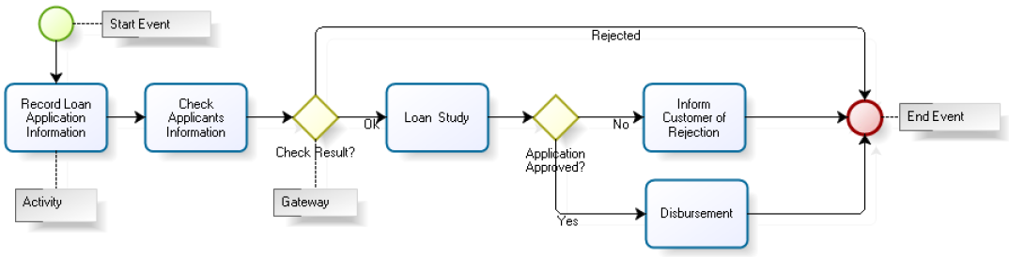
Example: Consumer Credit Application
Credit Application process begins with the recording of the application where the client expresses an interest in acquiring credit
This stage includes the presentation of the application, and the required documents to the organization for verification
This is followed by an analysis or study of the credit application and finally we find the activities needed to either disburse the credit or to notify the client in case of rejection

Slide 46
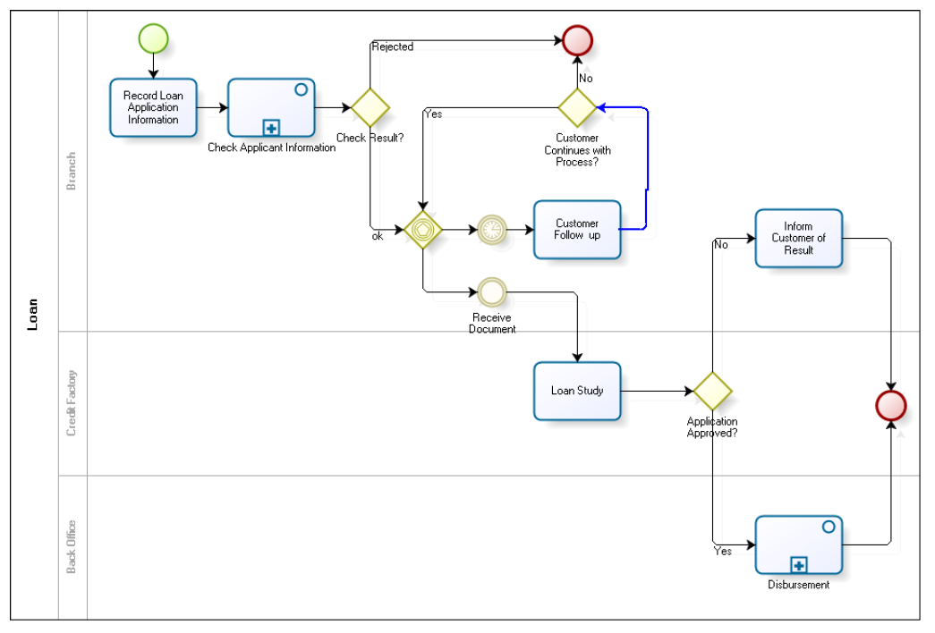
Example: Consumer Credit Application

Slide 47
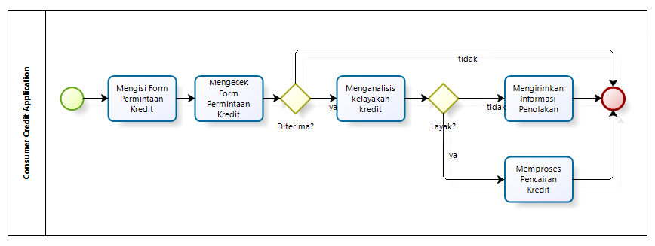
Example: Proses Pengajuan Kredit

Slide 48
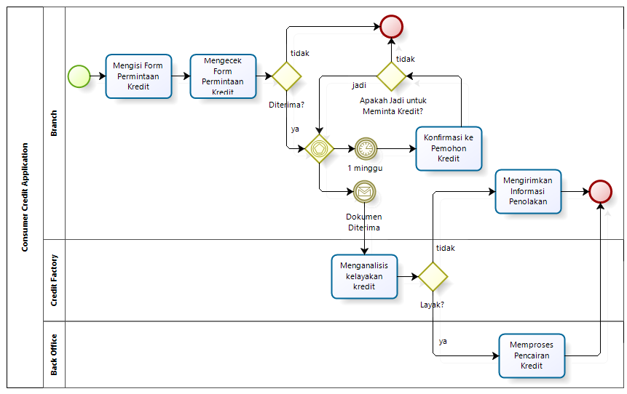
Proses Pengajuan Kredit dengan Lane

Slide 49
Reference
Object Management Group, Business Process Model and Notation (BPMN), OMG Document Number: formal/2011-01-04, 2011
Object Management Group, BPMN 2.0 by Example, OMG Document Number: dtc/2010-06-02, 2011
Bruce Silver, BPMN Method and Style Second Edition, Cody-Cassidy Press, 2011
Layna Fischer (edt.), BPMN 2.0 Handbook Second Edition, Future Strategies, 2012
Tom Debevoise, Rick Geneva, and Richard Welke, The Microguide to Process Modeling in BPMN 2.0 Second Edition, CreateSpace, 2011
Bizagi Proses Modeler User Guide, Bizagi, 2012
Bizagi BPM Suite User Guide, Bizagi, 2013
Thomas Allweyer, BPMN 2.0, BoD, 2010

