Slide 1
Enterprise Architecture
Romi Satria Wahono romi@romisatriawahono.net http://romisatriawahono.net

Slide 2
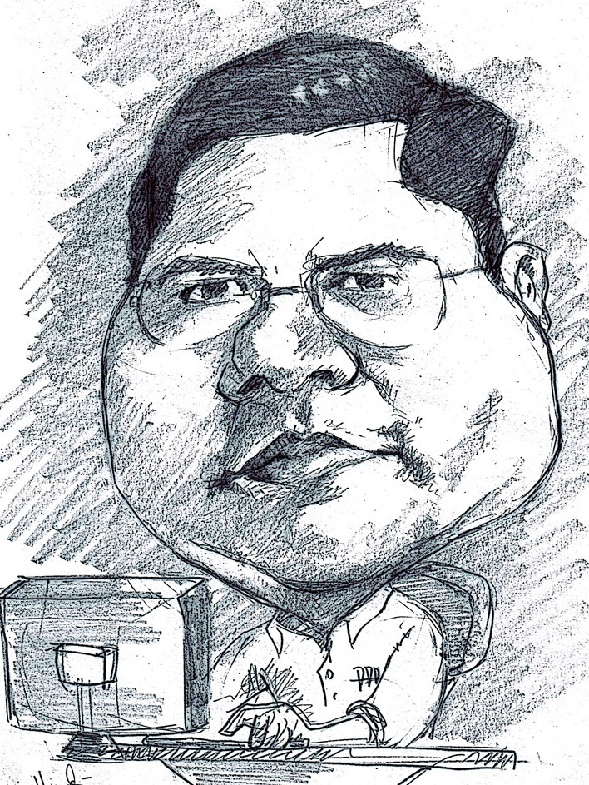
Romi Satria Wahono
SD Sompok Semarang (1987)
SMPN 8 Semarang (1990)
SMA Taruna Nusantara Magelang (1993)
B.Eng, M.Eng and Dr.Eng (on-leave) Department of Computer Science Saitama University, Japan (1994-2004)
Research Interests: Software Engineering and Intelligent Systems
Founder IlmuKomputer.Com
LIPI Researcher (2004-2007)
Founder and CEO PT Brainmatics Cipta Informatika

Slide 3
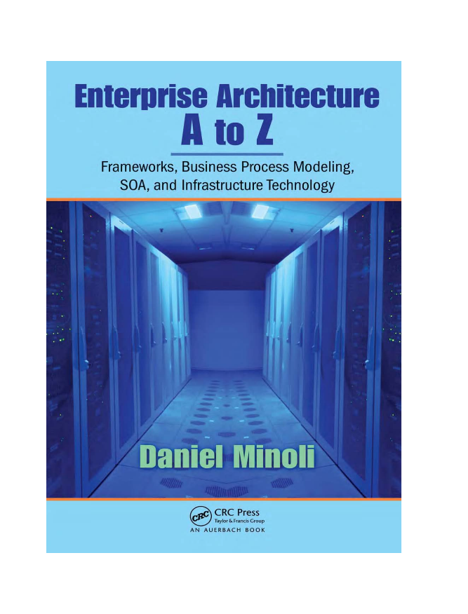
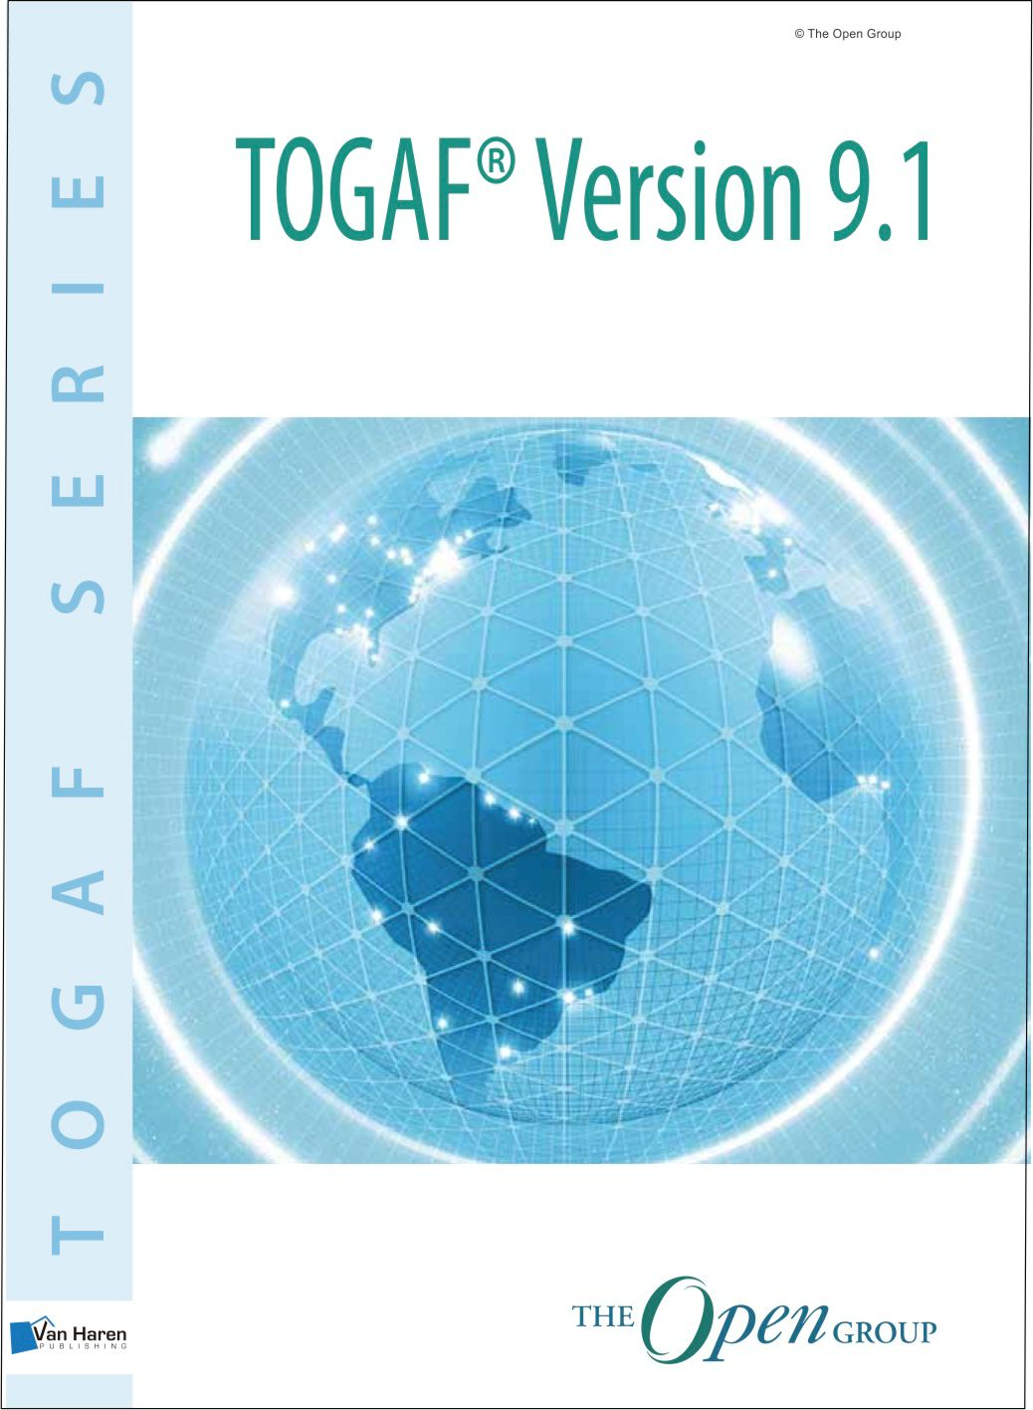
Textbooks

Slide 4
Course Outline
Enterprise Architecture
Enterprise Architecture Framework
Enterprise Architecture Tools
System Analysis and Design
TOGAF Enterprise Architecture Framework
TOGAF Reference Cards
TOGAF Case Study

Slide 5
PreTest
Apa tugas atau pekerjaan utama anda saat ini?
Apa itu enterprise architecture dan mengapa kita harus menggunakannya?
Apa itu enterprise architecture framework dan mengapa kita harus menggunakannya?
Modelkan business process dari requirement di bawah dengan use case diagram dan activity diagram/bpmn!
SISTEM ELIBRARY
Sistem elibrary memungkinkan pengguna untuk melakukan registrasi dan login
Setelah menjadi member, pengguna dapat memodifikasi profile, serta mencari dan mendownload koleksi buku elibrary
Admin sistem elibrary melakukan approval terhadap registrasi dan menampilkan laporan aktifitas pengguna secara individual maupun total

Slide 6
1. Enterprise Architecture

Slide 7
What and Why

Slide 8
What is an Enterprise?
Any collection of organizations that has a common set of goals
For example: a government agency, a whole corporation, a division of a corporation, a single department, or a chain of geographically distant organizations linked together by common ownership
The term "enterprise" in the context of enterprise architecture can be used to denote both:
an entire enterprise: encompassing all of its information and technology services, processes and infrastructure
a specific domain within the enterprise

Slide 9
What is an Enterprise?
Confusion often arises from the evolving nature of the term "enterprise". An extended enterprise nowadays frequently includes partners, suppliers, and customers
If the goal is to integrate an extended enterprise, then the enterprise comprises the partners, suppliers, and customers, as well as internal business units
Large corporations and government agencies may comprise multiple enterprises, and may develop and maintain a number of independent enterprise architectures to address each one

Slide 10
What is Architecture?
The art or science of building or constructing edifices of any kind for human use
The special method or style in accordance with which the details of the structure and ornamentation of a building are arranged

Slide 11
What is Architecture?
The organizational structure of a system or component (IEEE Standard 610, Standard Computer Dictionary: A Compilation of IEEE Standard Computer Glossaries)
The fundamental organization of a system embodied in its components, their relationships to each other, and to the environment, and the principles guiding its design and evolution (IEEE Standard 1471, IEEE Recommended Practice for Architectural Description of Software-Intensive Systems)

Slide 12
What is Architecture?
A formal description of a system, or a detailed plan of the system at a component level to guide its implementation
The structure of components, their inter-relationships, and the principles and guidelines governing their design and evolution over time

Slide 13
Four Types of Architecture
Architecture Type | Description
Business Architecture | The business strategy, governance, organization, and key business processes
Data Architecture | The structure of an organization's logical and physical data assets and data management resources
Application Architecture | A blueprint for the individual applications to be deployed, their interactions, and their relationships to the core business processes of the organization
Technology Architecture | The logical software and hardware capabilities that are required to support the deployment of business, data, and application services. This includes IT infrastructure, middleware, networks, communications, processing, and standards

Slide 14
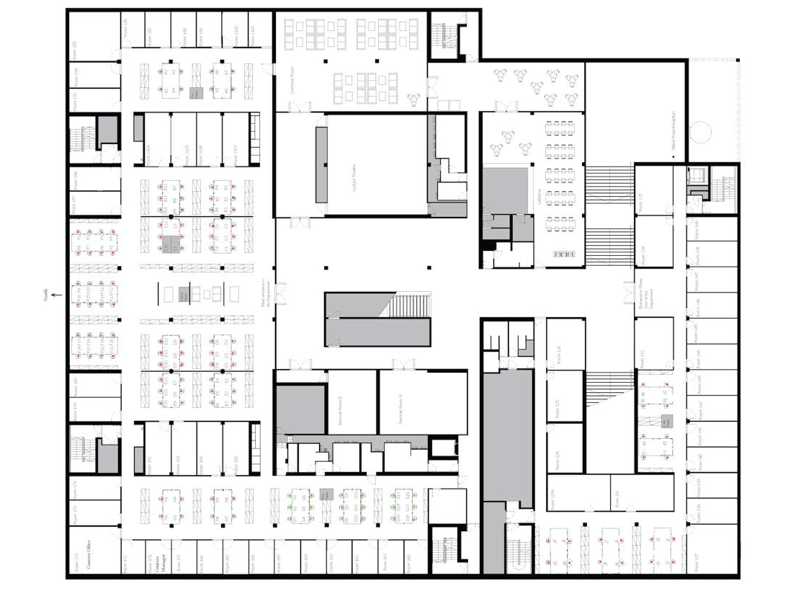
Why do I Need an Enterprise Architecture (EA)?

Slide 15
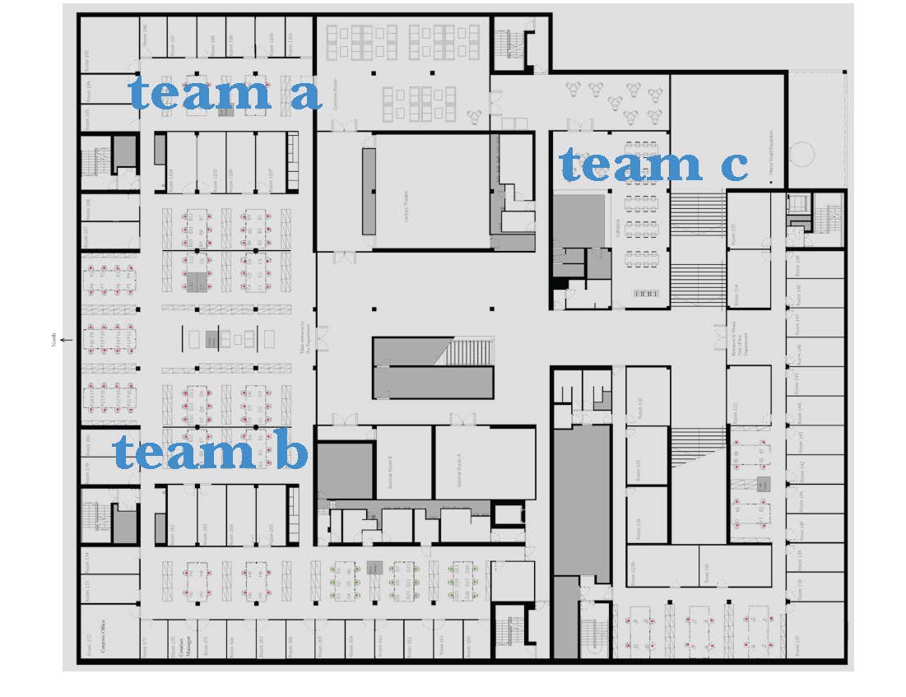
Why do I Need an Enterprise Architecture (EA)?

Slide 16
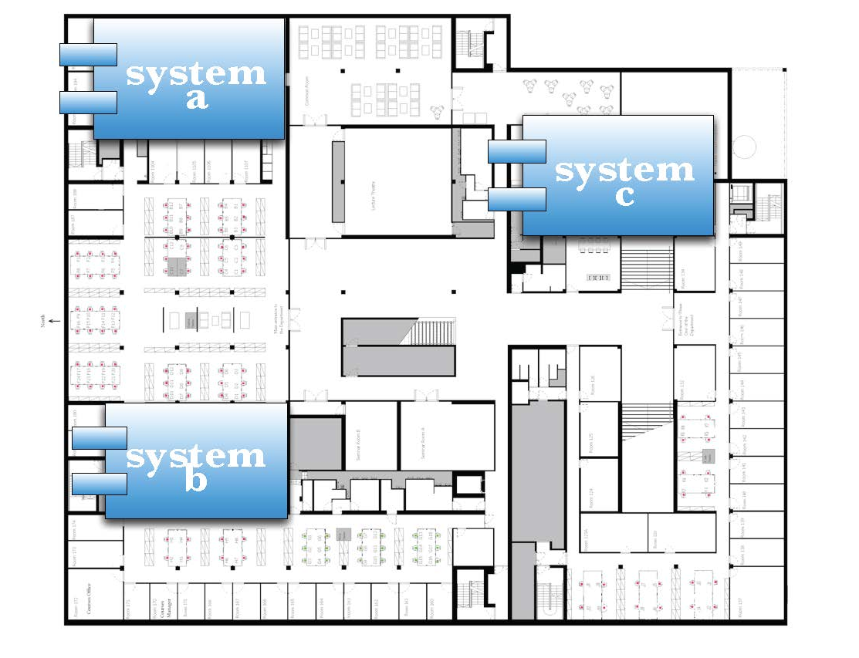
Why do I Need an Enterprise Architecture (EA)?

Slide 17
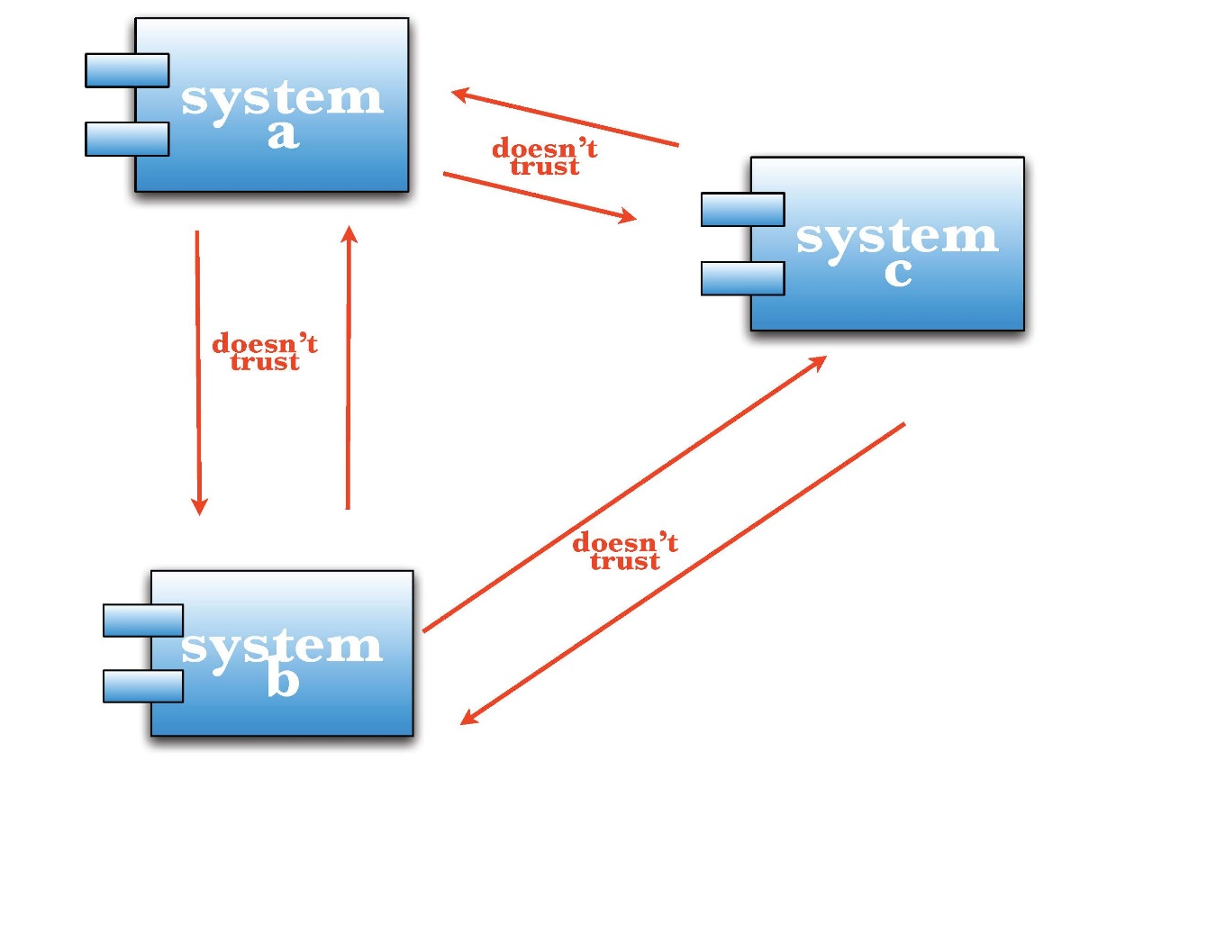
Why do I Need an Enterprise Architecture (EA)?

Slide 18
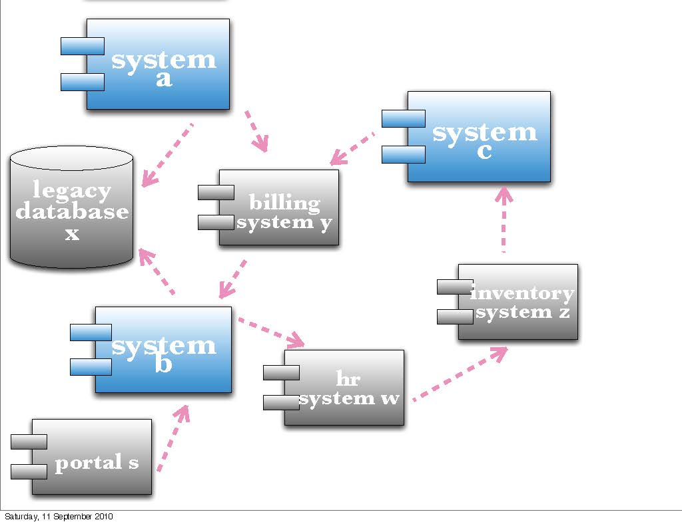
Why do I Need an Enterprise Architecture (EA)?

Slide 19
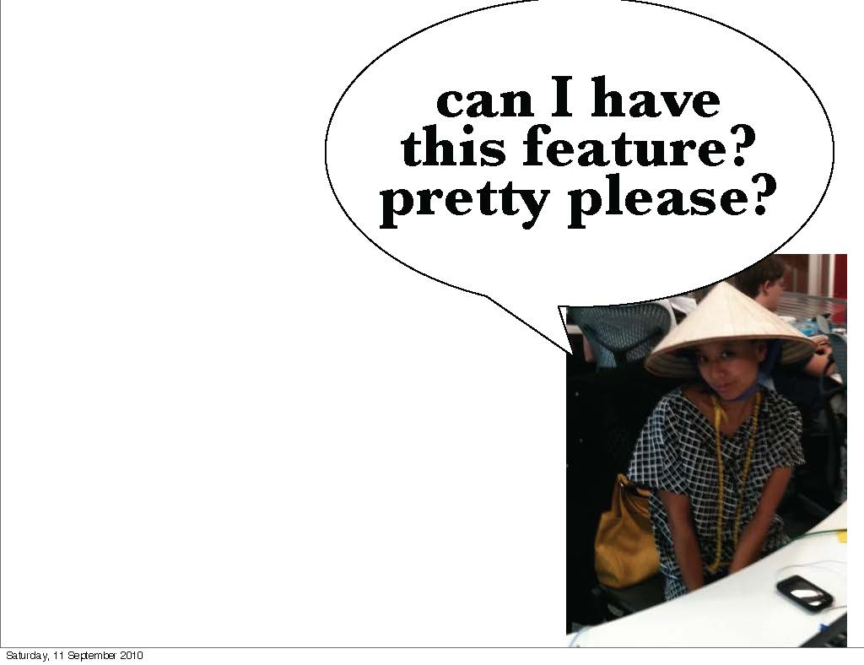
Why do I Need an Enterprise Architecture (EA)?

Slide 20
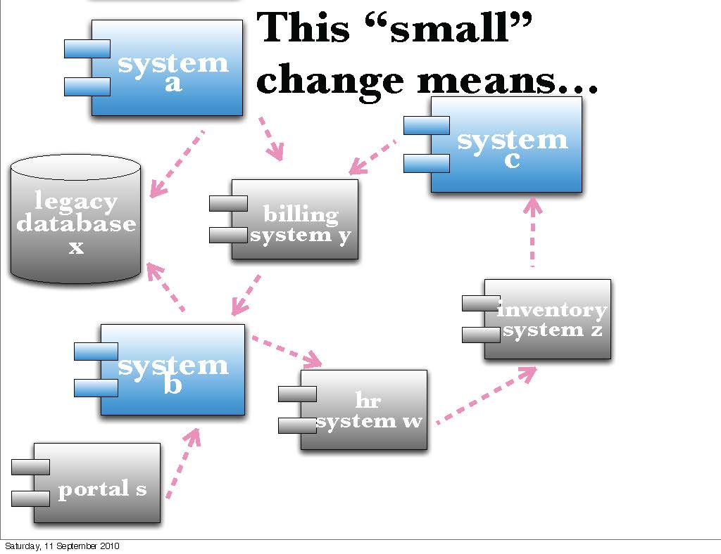
Why do I Need an Enterprise Architecture (EA)?

Slide 21
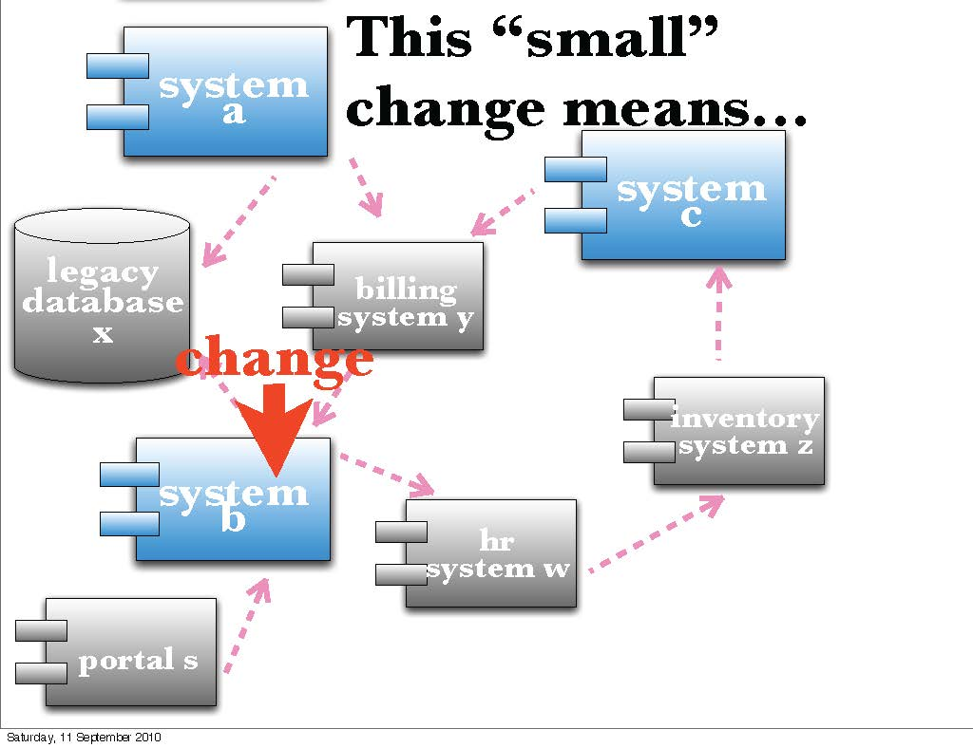
Why do I Need an Enterprise Architecture (EA)?

Slide 22
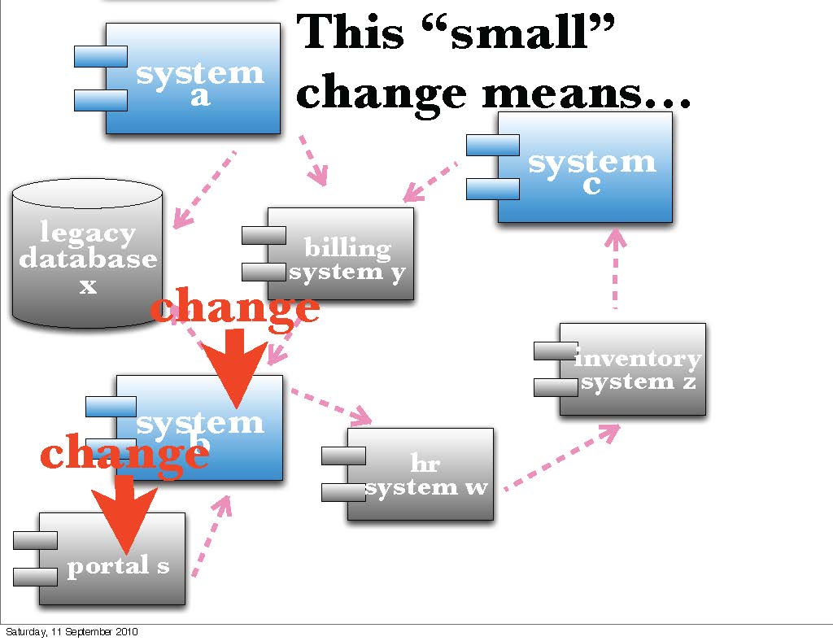
Why do I Need an Enterprise Architecture (EA)?

Slide 23
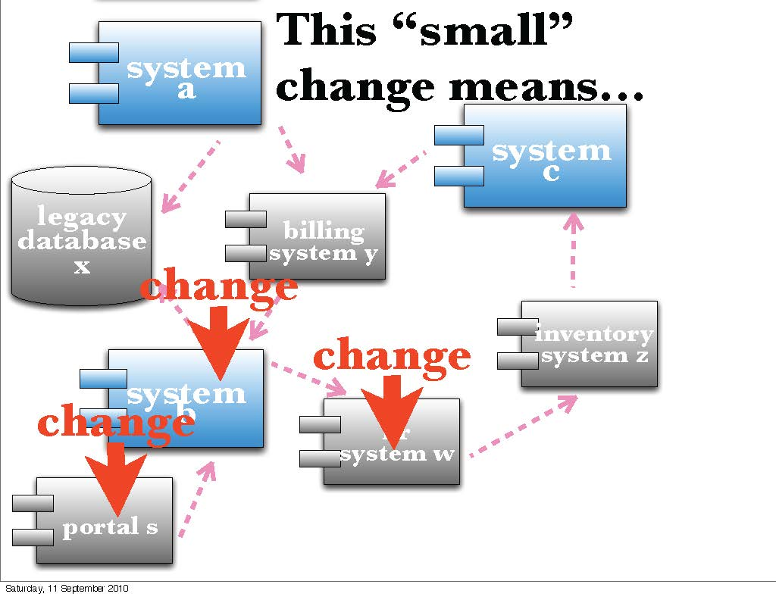
Why do I Need an Enterprise Architecture (EA)?

Slide 24
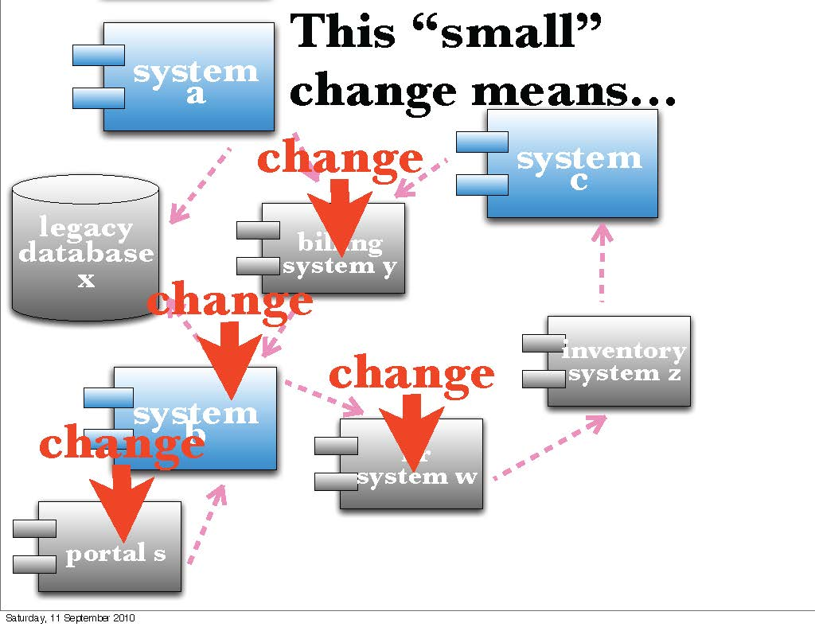
Why do I Need an Enterprise Architecture (EA)?

Slide 25
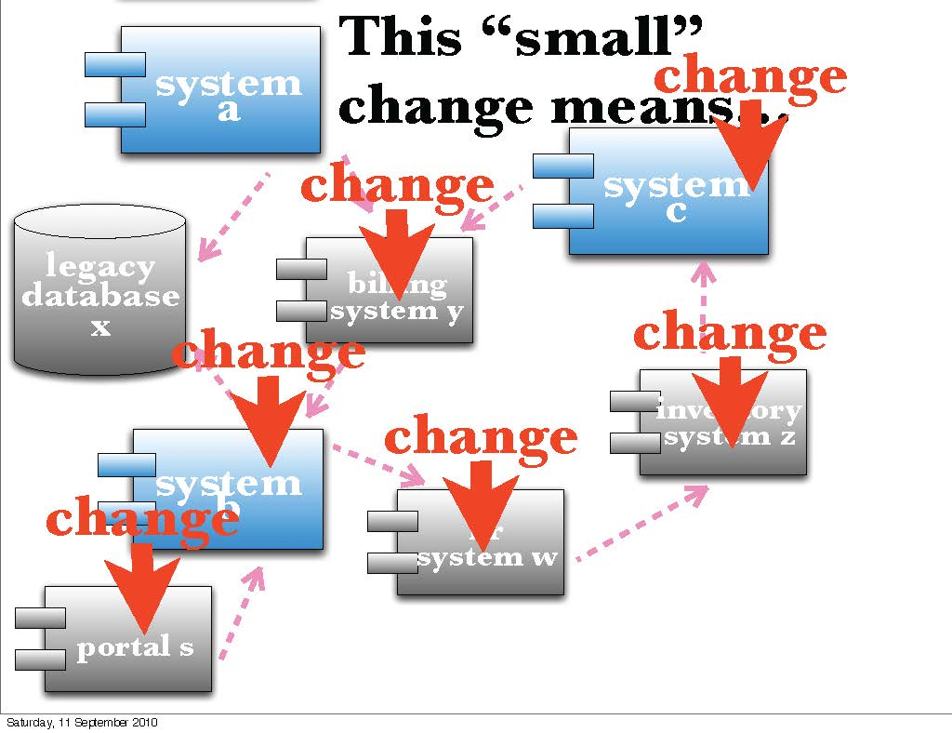
Why do I Need an Enterprise Architecture (EA)?

Slide 26
Why do I Need an Enterprise Architecture (EA)?
The purpose of enterprise architecture is to optimize across the enterprise:
the often fragmented legacy of processes (both manual and automated)
into an integrated environment that is responsive to change and supportive of the delivery of the business strategy
A good enterprise architecture enables you to:
Achieve the right balance between IT efficiency and business innovation
Allows individual business units to innovate safely in their pursuit of competitive advantage
Ensures the needs of the organization for an integrated IT strategy are met
Enables the synergy across the extended enterprise

Slide 27
The Advantages of Good EA
Advantages | Description
A more efficient business operation | Lower business operation costs More agile organization Business capabilities shared across the organization Lower change management costs More flexible workforce Improved business productivity
A more efficient IT operation | Lower software development, support, and maintenance costs Increased portability of applications Improved interoperability and easier system and network management Improved ability to address critical enterprise-wide issues like security Easier upgrade and exchange of system components

Slide 28
The Advantages of Good EA
Advantages | Description
Better return on existing investment, reduced risk for future investment | Reduced complexity in the business and IT Maximum return on investment in existing business and IT infrastructure The flexibility to make, buy, or out-source business and IT solutions Reduced risk overall in new investments and their cost of ownership
Faster, simpler, and cheaper procurement | Buying decisions are simpler, because the information governing procurement is readily available in a coherent plan The procurement process is faster - maximizing procurement speed and flexibility without sacrificing architectural coherence The ability to procure heterogeneous, multi-vendor open systems The ability to secure more economic capabilities

Slide 29
What Specifically Would Prompt Me to Develop an EA?
Typically, preparation for business transformation needs or for radical infrastructure changes initiates an enterprise architecture review or development. Often key people (stakeholders) identify areas of change required in order for new business goals to be met
The role of the architect is to address their concerns by:
Identifying and refining the requirements that the stakeholders have
Developing views of the architecture that show how the concerns and requirements are going to be addressed
Showing the trade-offs that are going to be made in reconciling the potentially conflicting concerns of different stakeholders
Without the enterprise architecture, it is highly unlikely that all the concerns and requirements will be considered and met

Slide 30
EA Layer

Slide 31
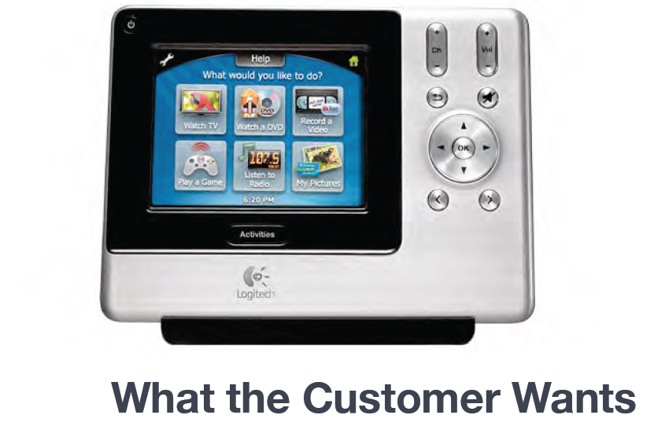

Slide 32
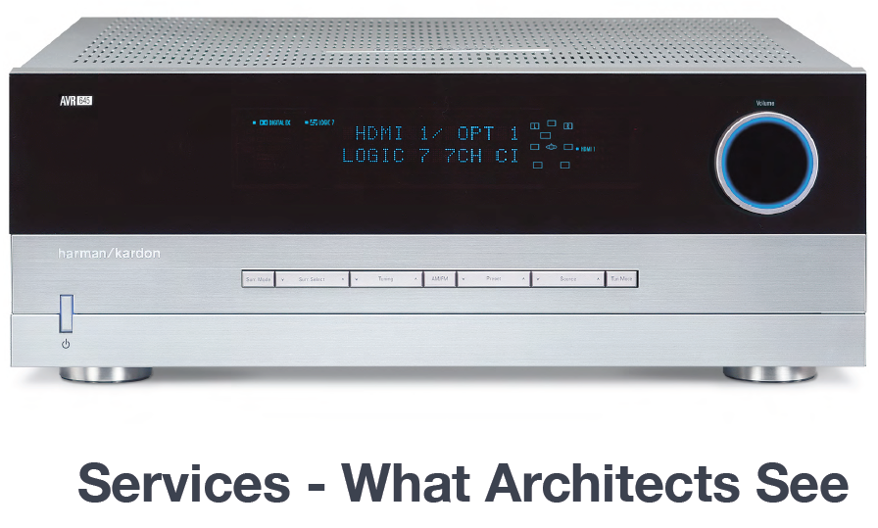

Slide 33
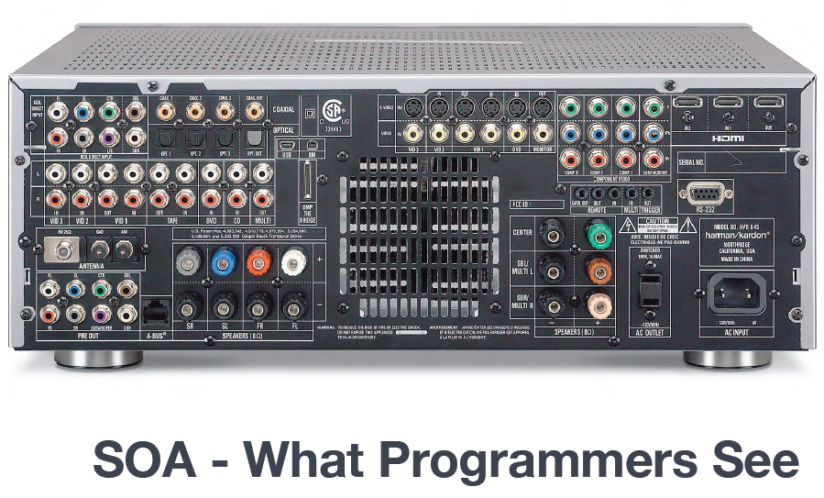

Slide 34
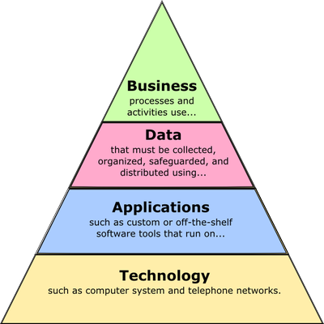

Slide 35
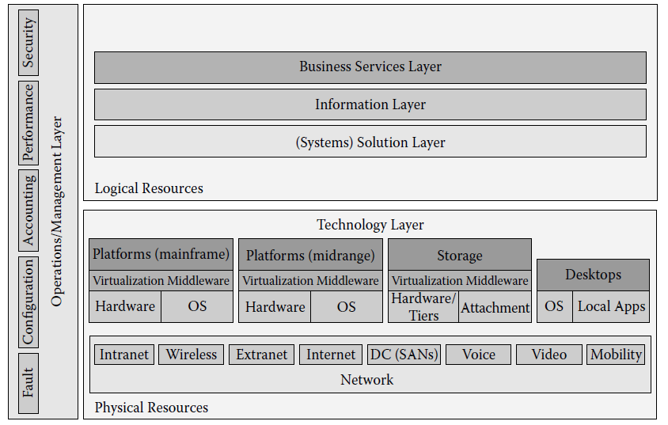
A Layered Model of the EA

Slide 36
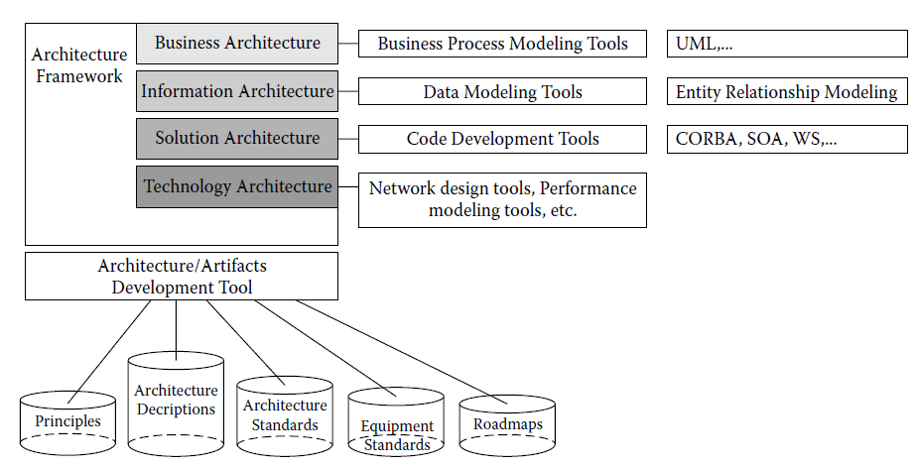
Key Components of an Architecture-Enabled Environment

Slide 37
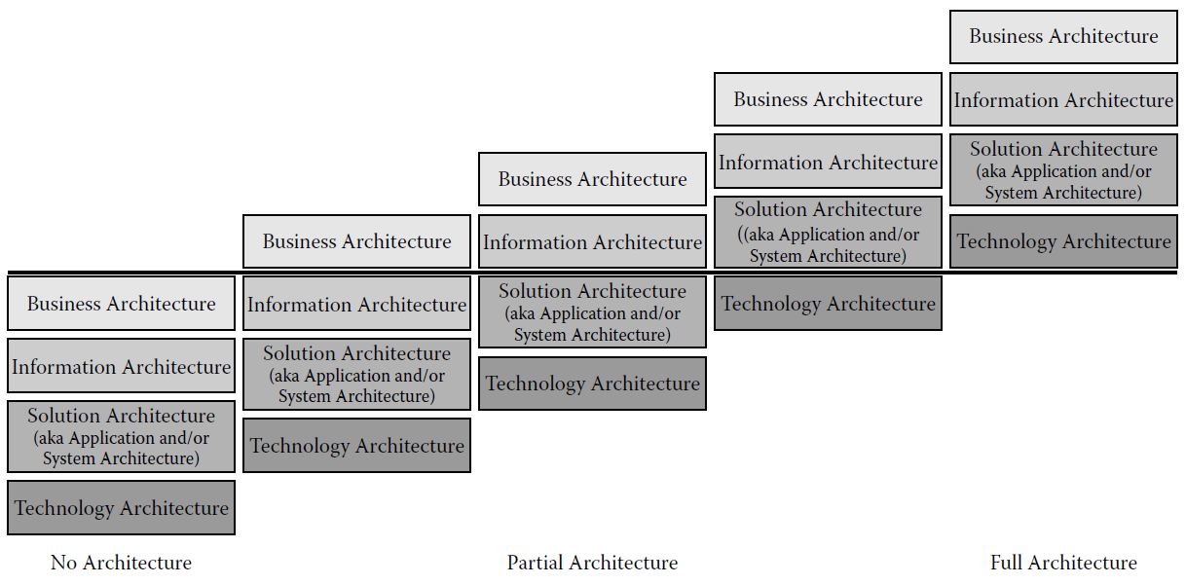
Maturity of EA Development at a Firm

Slide 38
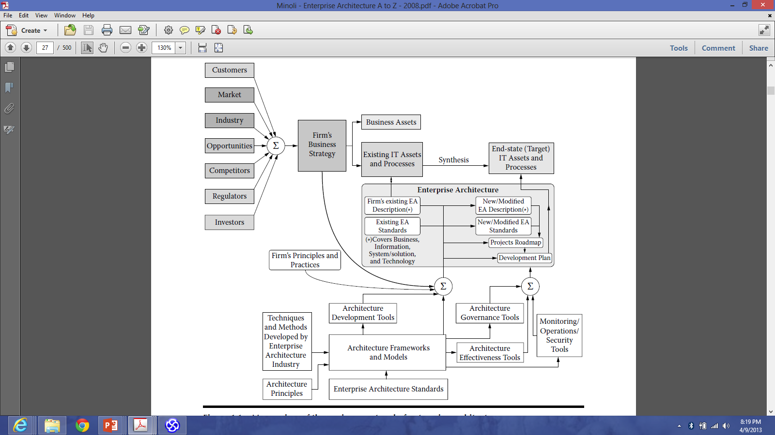
Macro View of the Environment and Enterprise Architecture

Slide 39
2. Enterprise Architecture(EA) Framework

Slide 40
What is an Architecture Framework?
A foundational structure, or set of structures, which can be used for developing a broad range of different architectures
It should describe a method for designing a target state of the enterprise in terms of a set of building blocks, and for showing how the building blocks fit together
It should contain a set of tools and provide a common vocabulary
It should also include a list of recommended standards and compliant products that can be used to implement the building blocks
A framework for an enterprise architecture which defines how to organize the structure and views associated with an enterprise architecture

Slide 41
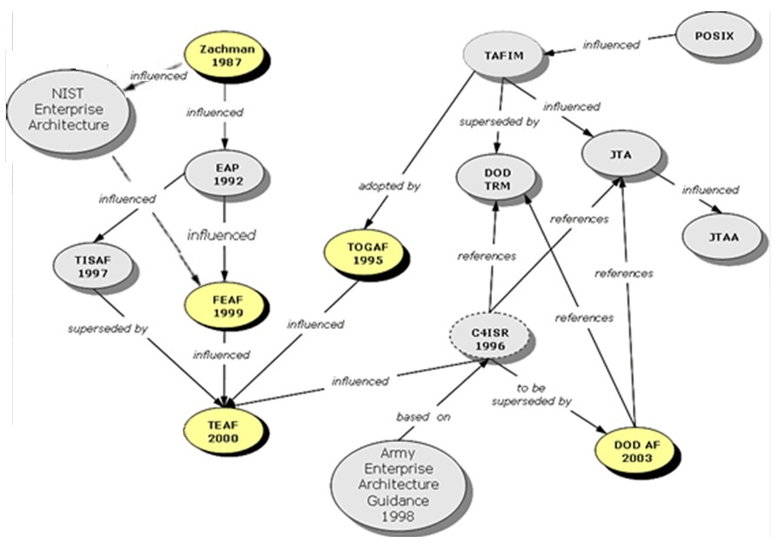
History of EA Framework

Slide 42
Major EA Framework
The Zachman Framework for Enterprise Architectures
Although self-described as a framework, is actually more accurately defined as a taxonomy
The Open Group Architectural Framework (TOGAF)
Although called a framework, is actually more accurately defined as a process
The Federal Enterprise Architecture(FEA)
Can be viewed as either an implemented enterprise architecture or a proscriptive methodology for creating an enterprise architecture
The Gartner Methodology
Can be best described as an enterprise architectural practice

Slide 43
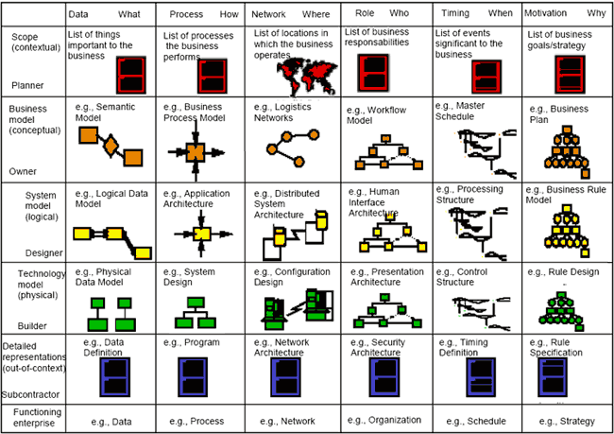
Zachman Framework

Slide 44
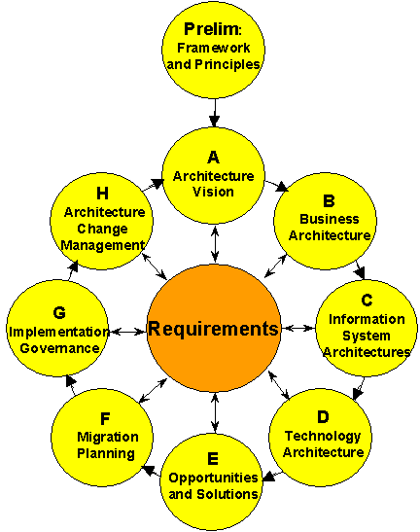
TOGAF

Slide 45
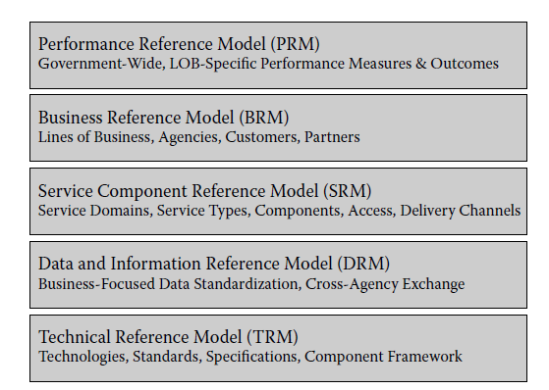
FEA

Slide 46
Comparison Parameters
Taxonomy completeness refers to how well you can use the methodology to classify the various architectural artifacts. This is almost the entire focus of Zachman
Process completeness refers to how fully the methodology guides you through a step-by-step process for creating an enterprise architecture. This is almost the entire focus of TOGAF
Reference-model guidance refers to how useful the methodology is in helping you build a relevant set of reference models. This is almost the entire focus of FEA
Practice guidance refers to how much the methodology helps you assimilate the mindset of enterprise architecture into your organization and develop a culture in which it is valued and used. This is a primary focus of Gartner's architectural practice
Maturity model refers to how much guidance the methodology gives you in assessing the effectiveness and maturity of different organizations within your enterprise in using enterprise architecture
Business focus refers to whether the methodology will focus on using technology to drive business value, in which business value is specifically defined as either reduced expenses and/or increased income

Slide 47
Comparison Parameters
Governance guidance refers to how much help the methodology will be in understanding and creating an effective governance model for enterprise architecture
Partitioning guidance refers to how well the methodology will guide you into effective autonomous partitions of the enterprise, which is an important approach to managing complexity
Prescriptive catalog refers to how well the methodology guides you in setting up a catalogue of architectural assets that can be reused in future activities
Vendor neutrality refers to how likely you are to get locked-in to a specific consulting organization by adopting this methodology. A high rating here indicates low vendor lock-in
Information availability refers to the amount and quality of free or inexpensive information about this methodology
Time to value refers to the length of time you will likely be using this methodology before you start using it to build solutions that deliver high business value

Slide 48
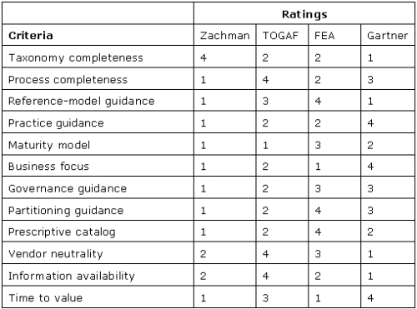
EA Comparison
(Roger Sessions, A Comparison of the Top Four EA Methodologies, 2007)

Slide 49
Key Competencies to Create an Enterprise Architecture
Enterprise Architecture Framework
Business Strategy and Organization Analysis
Business Process Model and Notation (BPMN)
Data Modeling (ER Diagram)
Unified Modeling Language (UML)
Infrastructure and Network Design

Slide 50
3. Enterprise Architecture Tools

Slide 51
EA Tools
planningIT (alphabet.com)
SAMU (altollgroup.eu)
Abacus (avolution.com.au)
Architect (bizzdesign.com)
Corporate Modeler (casewise.com)
Envision VIP (future-tech.com)
Rational System Architect (ibm.com)
Mega Suite (mega.com)
ProVision (metastorm.com)
MooD (tsorg.com)
ARIS (softwareag.com)
Enterprise Architect (sparxsystems.com)

Slide 52
Comparison Parameters
Repository or Metamodel
Modeling
Decision Analysis
Presentation
Administration
Configurability
Frameworks and Standards
Usability
(Julie Short and Chriss Wilson, Gartner Assessment of EA Tool Capabilities, Gartner Research, 2011)

Slide 53
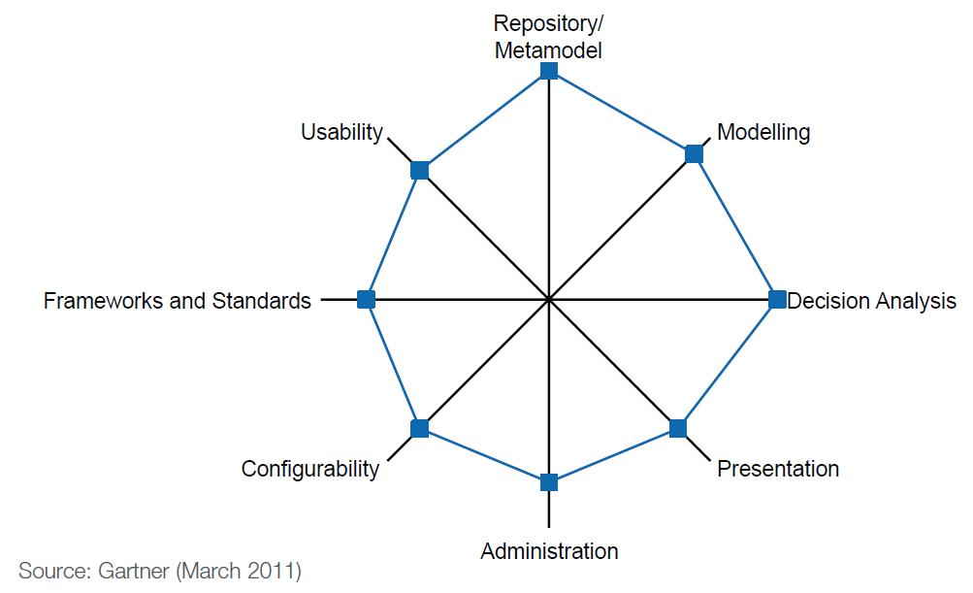
planningIT (alphabet.com)

Slide 54
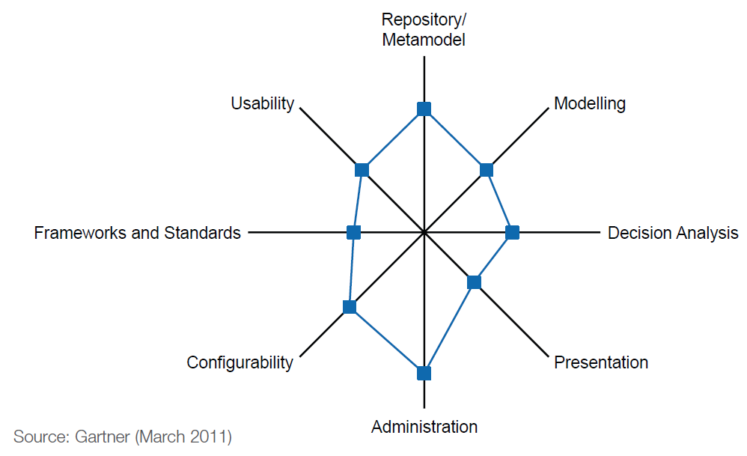
SAMU (altollgroup.eu)

Slide 55
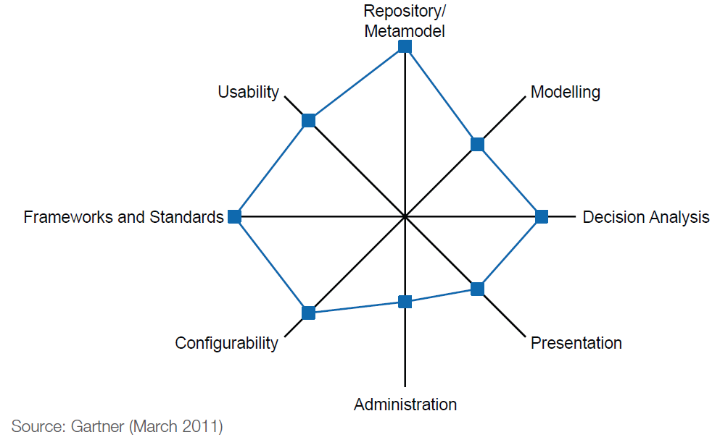
Abacus (avolution.com.au)

Slide 56
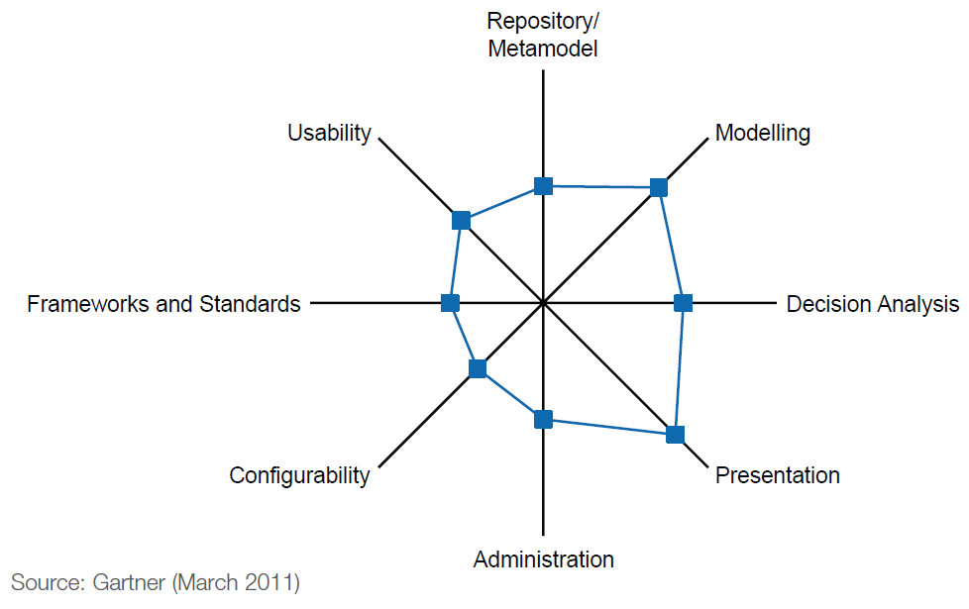
Architect (bizzdesign.com)

Slide 57
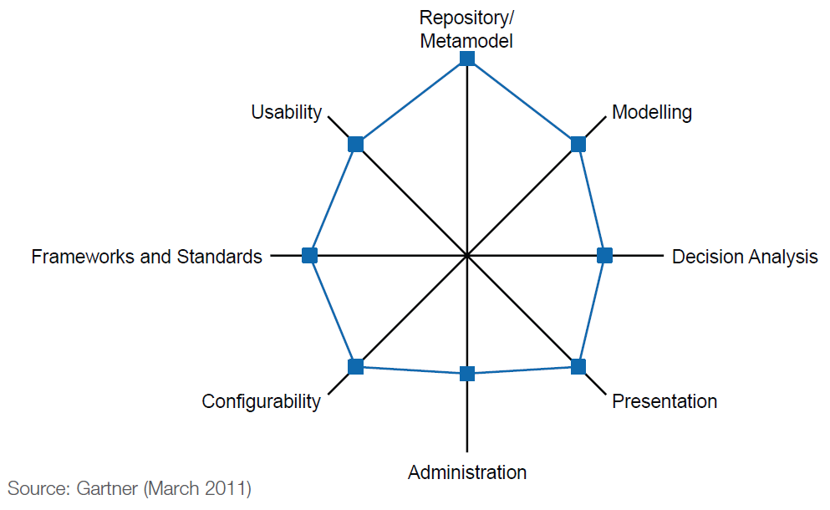
Corporate Modeler (casewise.com)

Slide 58

Envision VIP (future-tech.com)

Slide 59
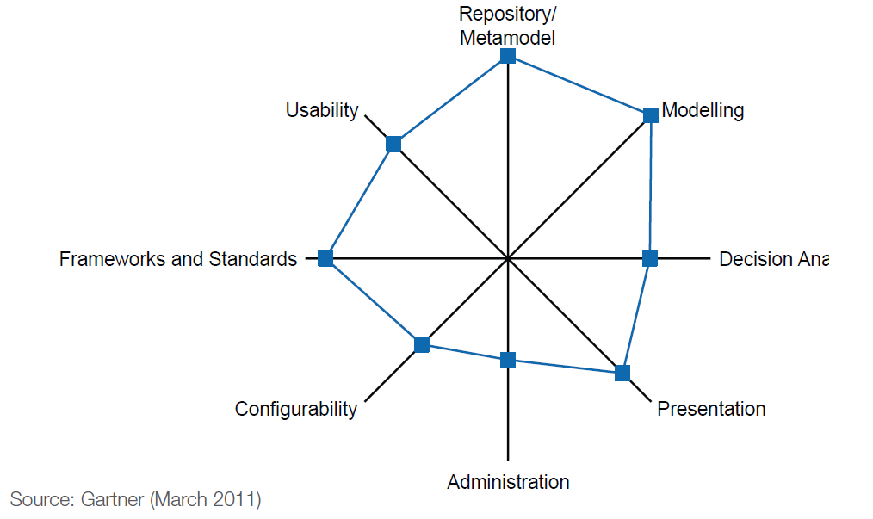
Rational System Architect (ibm.com)

Slide 60
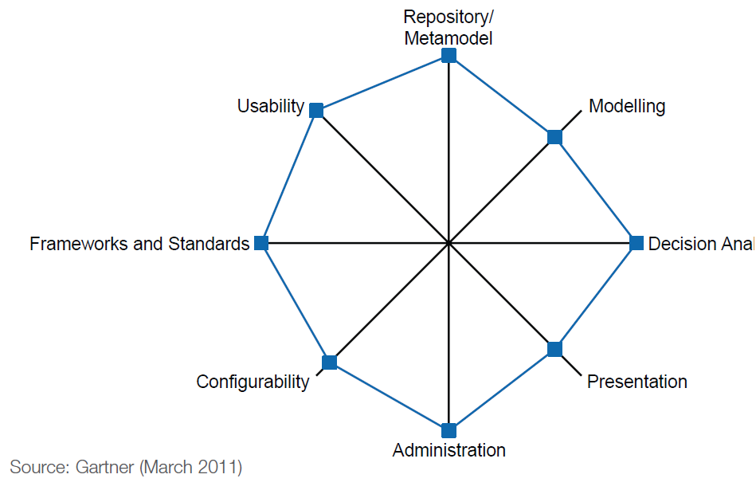
Mega Suite (mega.com)

Slide 61
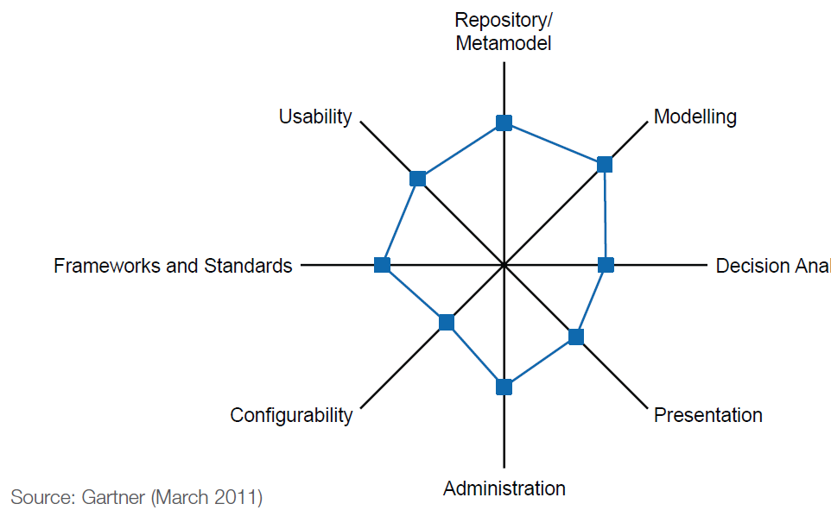
ProVision (metastorm.com)

Slide 62
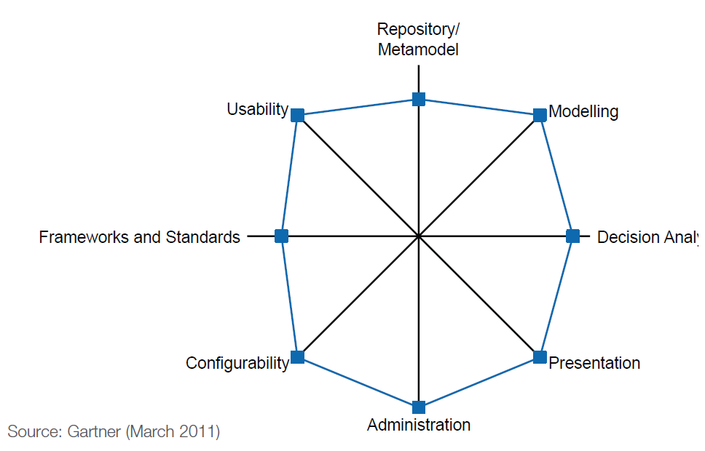
MooD (tsorg.com)

Slide 63
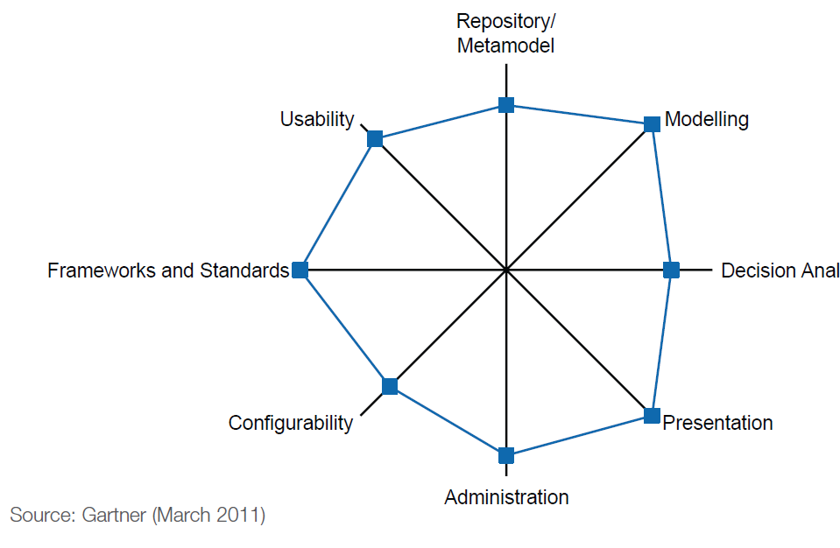
ARIS (softwareag.com)

Slide 64
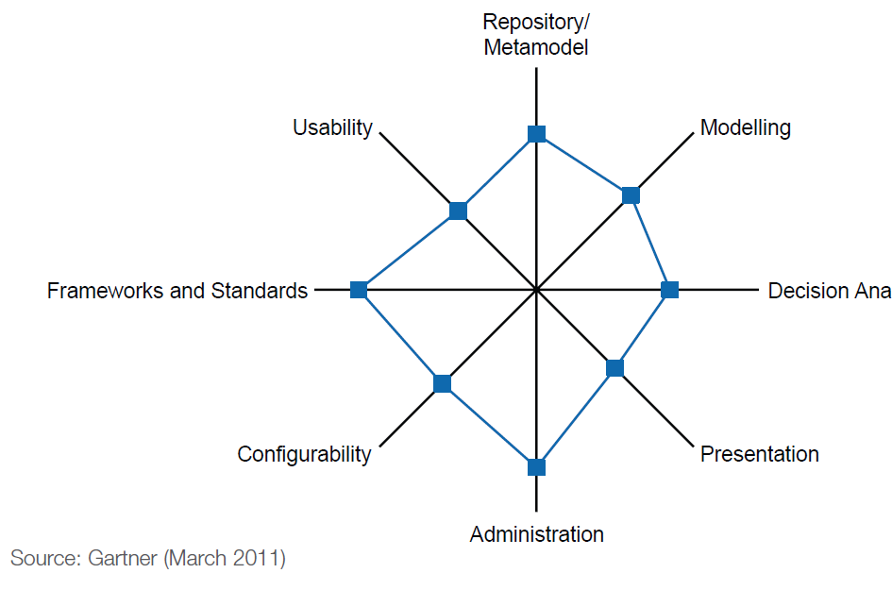
Enterprise Architect (sparxsystems.com)

Slide 65
4. System Analysis and Design

Slide 66
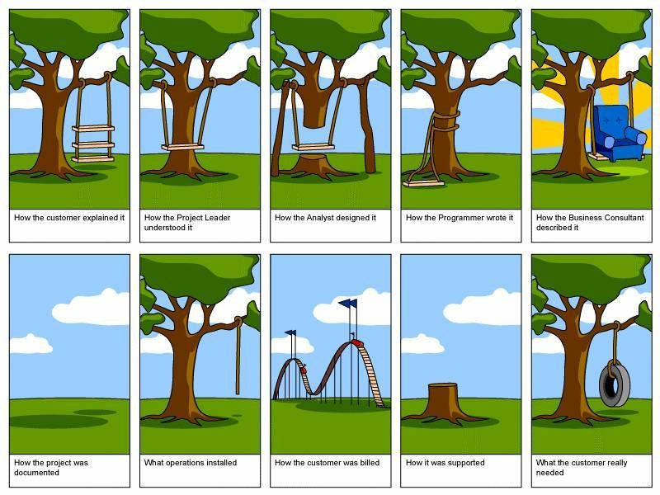

Slide 67
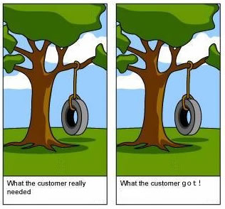
Is it Possible?

Slide 68
System Analysis and Design with UML
System Analysis
Business Process Identification
Use Case Diagram
Business Process Modeling
Activity Diagram or Business Process Model and Notation (BPMN)
Business Process Realization
Sequence Diagram (Buat untuk setiap use case dengan menggunakan pola Boundary-Control-Entity)
System Design
Program Design
Class Diagram (Gabungkan Boundary-Control-Entity Class dan susun story dari sistem yang dibangun)
Package Diagram (Gabungan class yang sesuai, boleh menggunakan pola B-C-E)
Deployment Diagram (arsitektur software dari sistem yang dibangun)
User Interface Design (Buat UI design dari Boundary Class)
Entity-Relationship Model (Buat ER diagram dari Entity Class)

Slide 69
Use Case Diagram

Slide 70
Use Case Diagrams
Summarized into a single picture
All of the use cases for the part of the system being modeled
A formal way of representing how a business interacts with its environment
The discrete activities performed by the user
Good for communicating with users

Slide 71
Use Case Diagram Syntax
Actor
person or system that derives benefit from and is external to the subject
Use Case
Represents a major piece of system functionality
Association Relationship
Include Relationship
Extend Relationship
Generalization Relationship
<<includes>>
<<extends>>

Slide 72
Use Case
A major piece of system functionality
Can extend other Use Cases
Placed inside system boundary
Labeled with descriptive verb - noun phrase
Use Case

Slide 73
System Boundary
Includes the name of the system inside or on top
Represents the scope of the system
Actors are outside the scope of the system
Boundary

Slide 74
Actor
A person or another system that interacts with the current system
A role, not a specific user
Provides input, receives output, or both
⟨⟨actor⟩⟩
Actor/Role

Slide 75
Extends Relationship
Extends Use Case to include Optional behavior
Arrow points from the extension Use Case to the base Use Case
⟨⟨extend⟩⟩
Make Pmt Arrangements
⟨⟨extend⟩⟩
Make Appointment

Slide 76
Include Relationship
Include one Use Case from within another
Arrow points from base Use Case to the included Use Case
⟨⟨include⟩⟩
Record Availability
⟨⟨include⟩⟩
Manage Schedule

Slide 77
Generalization Relationship
A specialized Use Case to a more generalized Use Case
Arrow points from specialized to general Use Case
Make Old Appointment
Make Appointment

Slide 78
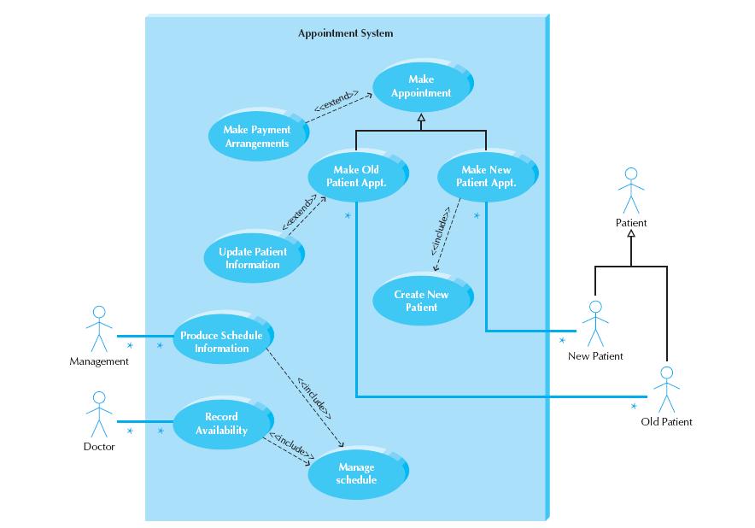
Sample Use Case

Slide 79
Extend and Include Relationships

Slide 80
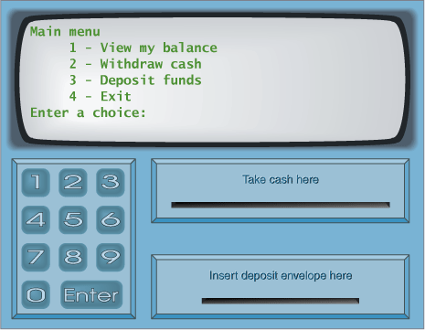
Case Study: ATM System

Slide 81
User Interface Design
Layar
Kotak Uang
Kotak Kartu
Kotak Kuitansi

Slide 82
Masukkan PIN:
Kotak Uang
Kotak Kartu
Kotak Kuitansi

Slide 83
Menu Utama
Melihat Saldo
Mengirim Uang
Mengambil Uang
Logout
Kotak Uang
Kotak Kartu
Kotak Kuitansi

Slide 84
Menu Melihat Saldo
Saldo anda adalah ….
Kotak Uang
Kotak Kartu
Kotak Kuitansi

Slide 85
Menu Mengirim Uang
No Account Penerima:
Kotak Uang
Kotak Kartu
Kotak Kuitansi

Slide 86
Menu Mengirim Uang
Jumlah uang yang dikirim:
Kotak Uang
Kotak Kartu
Kotak Kuitansi

Slide 87
Menu Mengirim Uang
Uang berhasil terkirim
Kotak Uang
Kotak Kartu
Kotak Kuitansi

Slide 88
Menu Mengambil Uang
Jumlah uang yang diambil:
Kotak Uang
Kotak Kartu
Kotak Kuitansi

Slide 89
Menu Mengambil Uang
Uang berhasil diambil
Kotak Uang
Kotak Kartu
Kotak Kuitansi

Slide 90
Use Case Diagram

Slide 91
Use Case Diagram (Multi Actors)

Slide 92
Activity Diagram

Slide 93
Actions and Activities
Performed for a specific business reason
Names begin with a verb and end with a noun
“Make Appointment”
Each activity diagram normally associated with a use case

Slide 94
Control & Object Flows
Control Flows (solid line)
Paths of execution through the business process
Can only be attached to actions or activities
Object Flows (dashed line)
Model the flow of objects through a business process
Show actual objects entering and exiting the system
An object is on one end, an action or activity is on the other end

Slide 95
Control Nodes
Initial – Only one, at top left
Final Activity – Stop the process
Final Flow – Stop this flow only
Decision – Guarded test conditions
Merge – Following decisions
Fork – Split parallel execution
Join – Join parallel execution

Slide 96
Swimlanes
The business process may be broken into persons of responsibility
Identify this with swimlanes

Slide 97
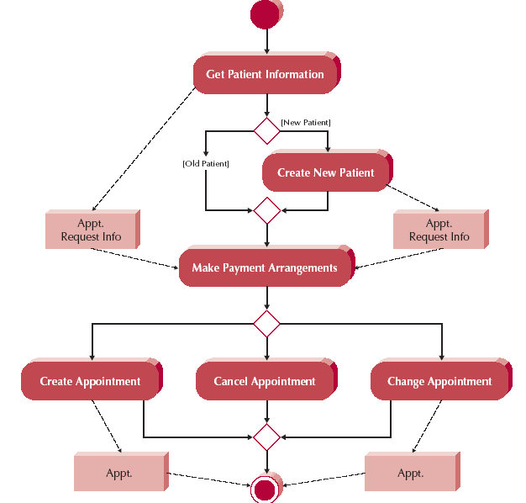
Activity Diagram Example

Slide 98
Business Process Model & Notation (BPMN)

Slide 99
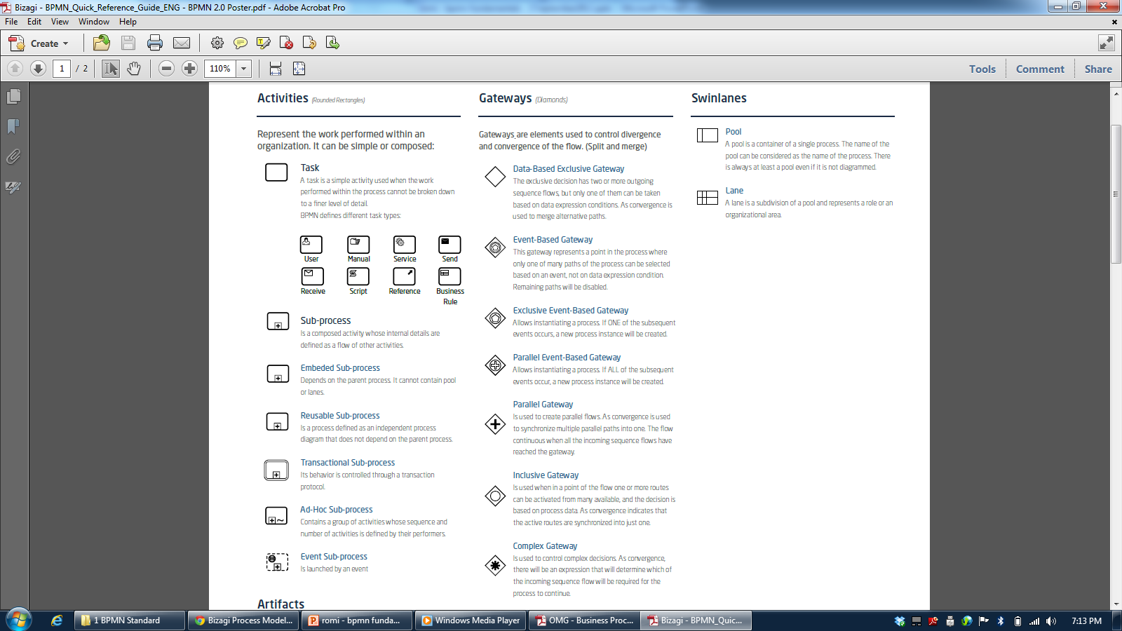
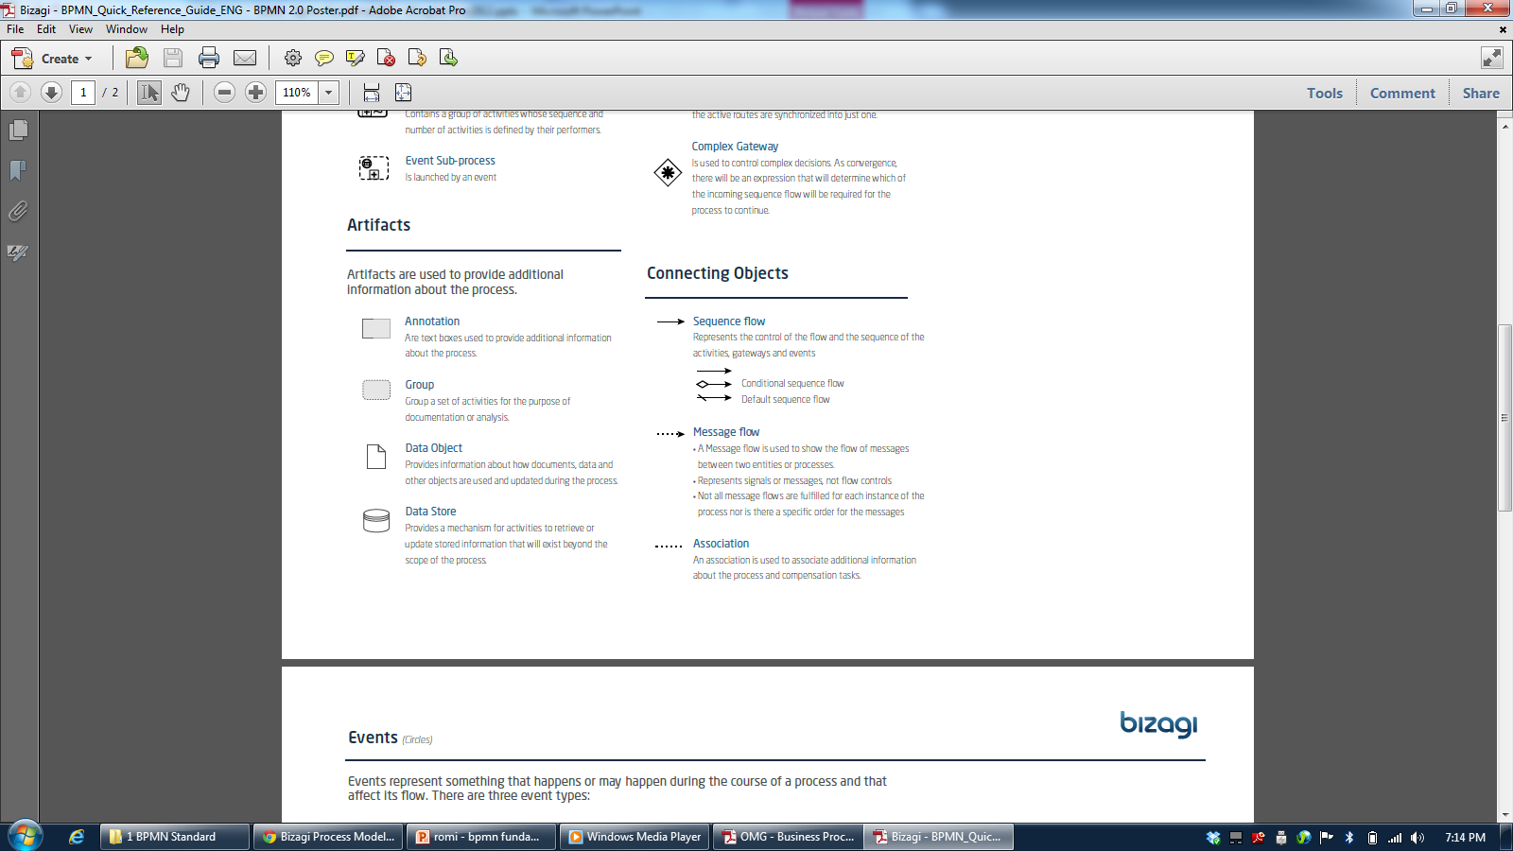

Slide 100
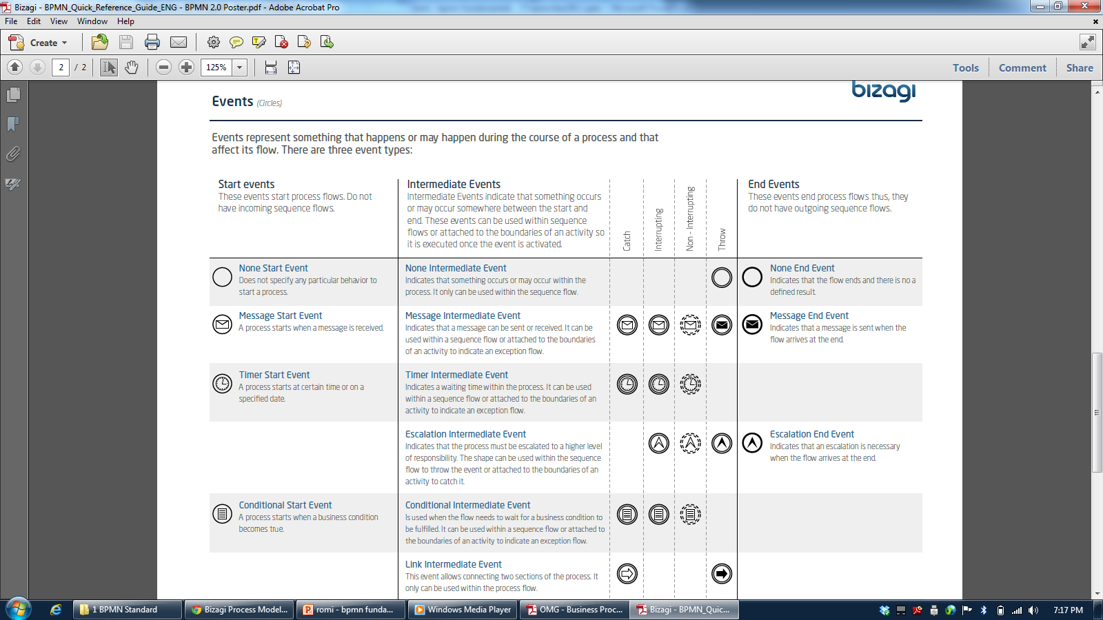

Slide 101
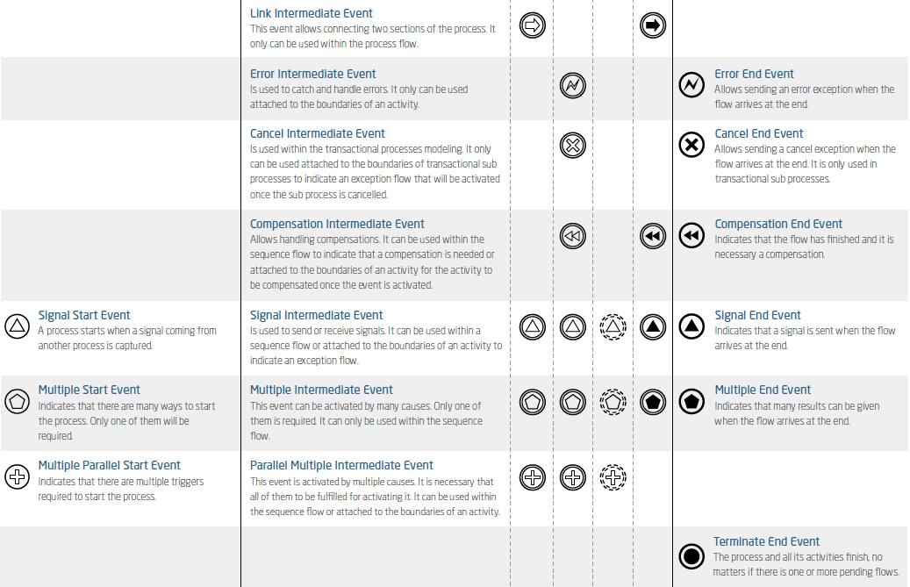

Slide 102
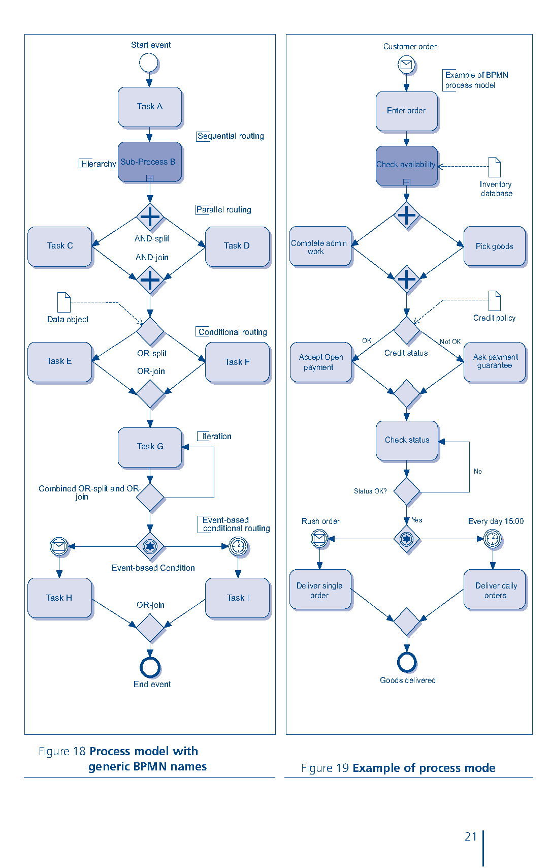

Slide 103
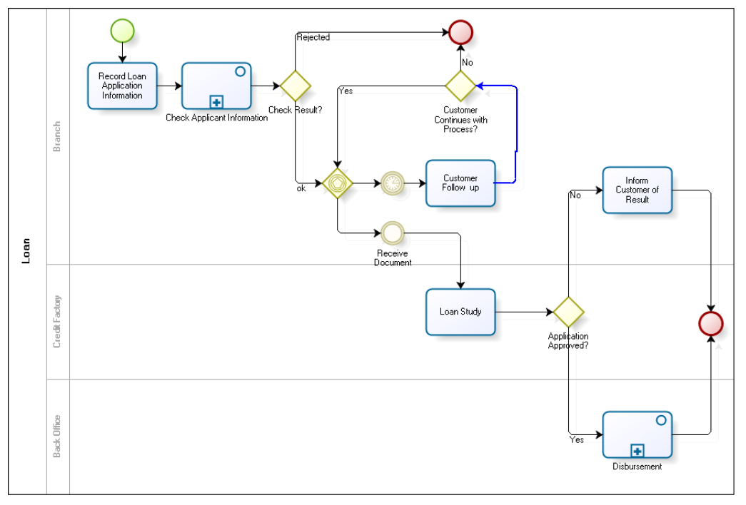
Credit Application

Slide 104

Purchase Request

Slide 105

Shipment Process of a Hardware Retailer

Slide 106

The Pizza Collaboration

Slide 107

Order Fulfillment and Procurement

Slide 108
Sequence Diagram

Slide 109
Sequence Diagram
Illustrate the objects that participate in a use case
Show the messages that pass between objects for a particular use-case over time

Slide 110
Sequence Diagram Syntax
AN ACTOR
AN OBJECT
A LIFELINE
A FOCUS OF CONTROL
A MESSAGE
OBJECT DESTRUCTION
anObject:aClass
aMessage()
x

Slide 111
Jenis Class (BCE Pattern)
Boundary Class:
Class yang berinteraksi dengan aktor langsung (user interface)
Form, input, UI ini masuk di sini
Control Class:
Class yang berhubungan dengan pemrosesan, penghitungan, kalkulasi, komputasi, query, dst
Entity Class:
Class yang berhubungan dengan data, penyimpanan data/file

Slide 112
Sequence Diagram: Memasukkan Kartu

Slide 113
Sequence Diagram: Memasukkan PIN

Slide 114
Sequence Diagram: Melihat Saldo

Slide 115
Sequence Diagram: Mengirim Uang

Slide 116
Sequence Diagram: Mengambil Uang

Slide 117
Sequence Diagram: Melakukan Logout

Slide 118
Class Diagram

Slide 119
Deployment Diagram (2 Tier)

Slide 120

Deployment Diagram (3 Tier)

Slide 121

Data Model

Slide 122
5. TOGAF Enterprise Architecture Framework

Slide 123
What is TOGAF?
TOGAF is a framework (a detailed method and a set of supporting tools) for developing an enterprise architecture
TOGAF provides the methods and tools for assisting in the acceptance, production, use, and maintenance of an enterprise architecture.
It is based on an iterative process model supported by best practices and a re-usable set of existing architecture assets
It may be used freely by any organization wishing to develop an enterprise architecture for use within that organization
TOGAF has been developed through the collaborative efforts of over 300 Architecture Forum member companies from some of the world's leading companies and organizations

Slide 124
What Kind of Architecture Does TOGAF Deal With?
Architecture Type | Description
Business Architecture | The business strategy, governance, organization, and key business processes
Data Architecture | The structure of an organization's logical and physical data assets and data management resources
Application Architecture | A blueprint for the individual applications to be deployed, their interactions, and their relationships to the core business processes of the organization
Technology Architecture | The logical software and hardware capabilities that are required to support the deployment of business, data, and application services. This includes IT infrastructure, middleware, networks, communications, processing, and standards

Slide 125
TOGAF Architecture Development Method (ADM)
The TOGAF ADM provides a tested and repeatable process for developing architectures. The ADM includes establishing an architecture framework, developing architecture content, transitioning, and governing the realization of architectures
All of these activities are carried out within an iterative cycle of continuous architecture definition and realization that allows organizations to transform their enterprises in a controlled manner in response to business goals and opportunities

Slide 126
TOGAF ADM

Slide 127
TOGAF ADM Phase
The Preliminary Phase describes the preparation and initiation activities required to create an Architecture Capability including customization of TOGAF and definition of Architecture Principles
Phase A: Architecture Vision describes the initial phase of an architecture development cycle. It includes information about defining the scope of the architecture development initiative, identifying the stakeholders, creating the Architecture Vision, and obtaining approval to proceed with the architecture development.
Phase B: Business Architecture describes the development of a Business Architecture to support the agreed Architecture Vision.
Phase C: Information Systems Architectures describes the development of Information Systems Architectures to support the agreed Architecture Vision.
Phase D: Technology Architecture describes the development of the Technology Architecture to support the agreed Architecture Vision

Slide 128
TOGAF ADM Phase
Phase E: Opportunities & Solutions conducts initial implementation planning and the identification of delivery vehicles for the architecture defined in the previous phases
Phase F: Migration Planning addresses how to move from the Baseline to the Target Architectures by finalizing a detailed Implementation and Migration Plan
Phase G: Implementation Governance provides an architectural oversight of the implementation
Phase H: Architecture Change Management establishes procedures for managing change to the new architecture
Requirements Management examines the process of managing architecture requirements throughout the ADM

Slide 129
6. TOGAF Reference Cards

Slide 130


Slide 131


Slide 132


Slide 133


Slide 134


Slide 135


Slide 136


Slide 137


Slide 138


Slide 139


Slide 140


Slide 141


Slide 142


Slide 143


Slide 144


Slide 145


Slide 146


Slide 147
7. TOGAF Case Study

Slide 148
References
Daniel Minoli, Enterprise Architecture A to Z: Frameworks, Business Process Modeling, SOA, and Infrastructure Technology, Taylor & Francis, 2008
Jon Holt and Simon Perry, Modelling Enterprise Architectures, The Institution of Engineering and Technology, 2010
Alan Dennis et al, Systems Analysis and Design with UML 4th Edition, John Wiley and Sons, 2013
Open Group Standard, TOGAF® Version 9.1 (G116), The Open Group, 2011
Open Group Standard, TOGAF® Version 9.1 – A Pocket Guide (G117), The Open Group, 2011

